Slide 1
Chapter4 Lists, Stacks, and Queues
1. Lists
2. Stacks
3. Queues

Slide 2
1. lists
1.1 Definition of lists
1.2 ADT of lists
1.3 Basic Implementation of Lists
  1.3.1 Array-based List
  1.3.2 Linked List
  1.3.3 Comparison
1.4 Free list
1.5 Double Linked List

Slide 3
Example of lists
Digital Library - List of books
001 | 高等数学 | 樊映川 | 机械工业出版社 | …
002 | 理论力学 | 罗远祥 | 电子工业出版社 | …
003 | 高等数学 | 华罗庚 | 高等教育出版社 | …
004 | 线性代数 | 栾汝书 | 高等教育出版社 | …
… | … | … | … | …
More example?
List of
students / airlines / songs / numbers / words...
Notes:
那么什么是List呢。我们先来看一些例子。这个例子中给出的是一个书目信息的列表。列表中的数据具有相同结构，都包括序号、名称、作者、出版社等信息。这些具有相同结构的数据排成一列，构成了一个list。
我们还可以举出更多的现实应用中的列表的例子。比如学生列表，航线列表，歌曲列表，数字列表，单词列表等。

Slide 4
Definition of lists (1)
A list is a finite, ordered sequence of data items called elements.
Notation of list: ( a₀, a₁, …,a_{n-1} )
Notes:
具体而言，一个list是由有限个数据项排列而成的序列。List中的每个数据项我们称为list中的一个元素。
List通常可以形式化的定义成如下形式，在一对圆括号内包含有一组元素的序列。

Slide 5
Definition of lists (2)
The empty list contains no elements.
The length of the list is the number of elements currently stored.
The beginning of the list is called the head, the end of the list is called the tail.
Sorted lists and unsorted lists
Notes:
关于List,有一些约定俗成的术语。
比如，如果一个列表中不包含有任何元素，我们称之为空列表。
一个列表的长度定义为列表中的元素的个数。
此外，列表的开始位置称为列表的头 - 也就是head，列表的末尾位置成为列表的尾 - 也就是tail。

Slide 6
Operation of List (1)
Operations on list:
  Add/delete element anywhere,
  search
  next
  previous
  ... ....
Notes:
当我们看待List这样一个数据结构的时候，比较重要的是关注在list上可以支持的操作。
在实际应用中，我们往往需要在列表的某个特定位置上插入或删除元素。
或者我们需要在列表中查找某个元素，
查找当前位置的下一个元素，
查找当前位置的上一个元素，等等

Slide 7
Operation of List (2)
The position of a list to execute operations is defined as a fence_{栅栏.}
For example:
<12, 22 | 32, 15,29>
fence
Notes:
我们可以看到，在列表中的访问的位置是一个很重要的概念。它决定了我们在列表中的哪个位置进行操作。在这里，我们用栅栏来形象的描述这个位置。
比如，在这个例子，我们用一个短竖线来表示一个栅栏，栅栏所在的位置就是我们进行数据操作的位置。栅栏可以位于任意两个相邻元素之间，也可以处于两端的位置。

Slide 8
Operation of List (3)
Ex: <12 | 32, 15>
insert (99)
Result: <12 | 99, 32, 15>
remove( )
Result: <12 | 32, 15>
read( )
Get 32.
Notes:
我们通过一些例子，来大家展示一下栅栏是如何体现当前操作的位置的。在这个例子中，list中有三个元素，栅栏处于第一个元素和第二元素之间。
当我们在当前位置插入元素99的时候，会变成这个样子。99添加到栅栏后面的位置。
当我们在当前位置删除一个元素时，会删除栅栏后面位置的元素。
当我们获取当前位置的元素的值的时候，会返回栅栏后面的元素的值。

Slide 9
1. lists
1.1 Definition of lists
1.2 ADT of lists
1.3 Basic Implementation of Lists
  1.3.1 Array-based List
  1.3.2 Linked List
  1.3.3 Comparison
1.4 Free list
1.5 Double Linked List

Slide 10
List ADT
template <class Elem> class List {
public:
virtual void clear() = 0;
virtual bool setPos(int pos) = 0;
virtual bool insert(const Elem&) = 0;
virtual bool append(const Elem&) = 0;
virtual bool remove(Elem&) = 0;
virtual bool getValue(Elem&) const = 0;
virtual void setStart() = 0;
virtual void setEnd() = 0;
virtual void prev() = 0;
virtual void next() = 0;
virtual int leftLength() const = 0;
virtual int rightLength() const = 0;
virtual void print() const = 0;
};
Notes:
How to get the total length by invoking the functions in the ADT

Slide 11
List ADT Examples （1）
Insert /remove/getvalue:
MyList: <12 | 32, 15>
MyList.insert(99);
Result: <12 | 99, 32, 15>
MyList.remove(element);
Result: <12 | 32, 15>
element = 99.
MyList.getvalue(element);
element = 32.

Slide 12
List ADT Examples （2）
setStart / setEnd/next / prev
MyList: <12 | 32, 15>
MyList.setStart();
Result: < | 12, 32, 15>
MyList.setEnd();
Result: < 12, 32, 15 | >
MyList.prev();
Result: < 12, 32 | 15 >
MyList.next();
Result: < 12, 32 ,15 | >
Notes:
注意栅栏移动的极端情况，当栅栏移动到末尾时，getvalue会返回false.

Slide 13
List ADT Examples （3）
Iterate through the whole list:
for (MyList.setStart();MyList.getValue(it);
MyList.next())
DoSomething(it);
< | 12, 32, 15>
it =12
< 12 | 32, 15>
it =32
< 12, 32 | 15>
it =15
< 12, 32, 15 | >
over

Slide 14
List ADT Examples (4)
Search for an element
// Return true iff K is in list
bool find(List<int>& L, int K) {
int it;
for (L.setStart(); L.getValue(it); L.next())
if (K == it) return true; // Found it
return false; // Not found
}

Slide 15
1. lists
1.1 Definition of lists
1.2 ADT of lists
1.3 Basic Implementation of Lists
  1.3.1 Array-based List
  1.3.2 Linked List
  1.3.3 Comparison
1.4 Free list
1.5 Double Linked List

Slide 16
Data Storage of a List
List : (e1, e2,e3, e4, e5)
e1
e2
e3
e4
e5
e1
e2
e3
e4
e5
array based list
linked list
Notes:
实现List的关键是，寻找合适的方式来存储List中的数据元素。
第一种常见的存储的方法，是建立一个数组来保存List。List中的数据元素在内存中一个紧接一个地顺序存放。这种基于数组的方法实施起来比较简单，进行数据的访问也比较高效。但这种方法需要预先分配一个连续的内存区间来存放数据。如果预先分配的空间太大，就会造成浪费，相反，如果分配的空间过小，则无法容纳新的数据。在空间的使用上不够灵活。
那么有没有一种方法，可以灵活的根据当前实际的数据元素的数量来分配内存空间呢。常用的方法是一种称为链表的方法。链表不要求数据连续存放，数据元素之间的先后的逻辑关系通过指针连接在一起。链表消耗的空间大小随着元素个数变化而进行动态调整。

Slide 17
1. lists
1.1 Definition of lists
1.2 ADT of lists
1.3 Basic Implementation of Lists
  1.3.1 Array-based List
  1.3.2 Linked List
  1.3.3 Comparison
1.4 Free list
1.5 Double Linked List

Slide 18
Array-Based List Class (1)
template <class Elem> // Array-based list
class AList : public List<Elem> {
private:
Elem* listArray; // Array holding list
int maxSize; // Maximum size of list
int listSize; // Actual elem count
int fence; // Position of fence
listArray
fence
listsize
maxsize

Slide 19
Array-Based List Class (2)
listArray
fence
listSize
public:
AList(int size=DefaultListSize) {
maxSize = size;
listSize = fence = 0;
listArray = new Elem[maxSize];
}
~AList() { delete [] listArray; }
void clear() {
delete [] listArray;
listSize = fence = 0;
listArray = new Elem[maxSize];
}
maxsize

Slide 20
Array-Based List Class (3)
void setStart() { fence = 0; }
void setEnd() { fence = listSize; }
void prev() { if (fence != 0) fence--; }
void next() { if (fence <= listSize-1)
fence++; }
int leftLength() const { return fence; }
int rightLength() const
{ return listSize - fence; }
Θ(1)
listArray
fence
listsize

Slide 21
Array-Based List Class (4)
//set the position of the fence
bool setPos(int pos) {
if ((pos >= 0) && (pos <= listSize))
fence = pos;
return (pos >= 0) && (pos <= listSize);
}
//get the first element after the fence
bool getValue(Elem& it) const {
if (rightLength() == 0) return false;
else {
it = listArray[fence];
return true;
}
}
Θ(1)
listArray
fence
listsize

Slide 22
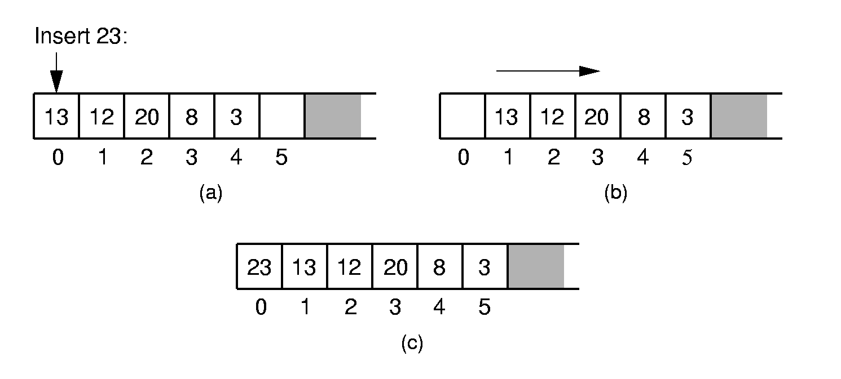
Array-Based List Class (5) - Insert
Notes:
Push items up/down. Cost: Θ(n).

Slide 23
Array-Based List Class (6) - Insert
// Insert at front of right partition
template <class Elem>
bool AList<Elem>::insert(const Elem& item) {
if (listSize == maxSize) return false;
// Shift Elems up to make room
for(int i=listSize; i>fence; i--)
listArray[i] = listArray[i-1];
}
Insert item
0
1
2
3
4
5
listArray
fence
listSize
maxsize

Slide 24
Array-Based List Class (6) - Insert
// Insert at front of right partition
template <class Elem>
bool AList<Elem>::insert(const Elem& item) {
if (listSize == maxSize) return false;
// Shift Elems up to make room
for(int i=listSize; i>fence; i--)
listArray[i] = listArray[i-1];
listArray[fence] = item;
listSize++; // Increment list size
return true;
}
Θ(n)
Insert item
0
1
item
2
3
4
5
listArray
fence
listSize
maxsize

Slide 25
Array-Based List Class (7) - append
// Append Elem to end of the list
template <class Elem>
bool AList<Elem>::append(const Elem& item) {
if (listSize == maxSize) return false;
listArray[listSize++] = item;
return true;
}
append item
listArray
listSize
fence
maxsize

Slide 26
Array-Based List Class (8) - remove
// Remove and return first Elem in right
// partition
template <class Elem>
bool AList<Elem>::remove(Elem& it) {
if (rightLength() == 0) return false;
it = listArray[fence]; // Copy Elem
for(int i=fence; i<listSize-1; i++)
listArray[i] = listArray[i+1];
}
remove
1
2
3
4
5
6
listArray
fence
listSize
maxsize

Slide 27
Array-Based List Class (8) - remove
// Remove and return first Elem in right
// partition
template <class Elem>
bool AList<Elem>::remove(Elem& it) {
if (rightLength() == 0) return false;
it = listArray[fence]; // Copy Elem
for(int i=fence; i<listSize-1; i++)
listArray[i] = listArray[i+1];
listSize--; // Decrement size
return true;
}
Θ(n)
remove
1
2
4
5
6
listArray
fence
listSize
maxsize

Slide 28
1. lists
1.1 Definition of lists
1.2 ADT of lists
1.3 Basic Implementation of Lists
  1.3.1 Array-based List
  1.3.2 Linked List
  1.3.3 Comparison
1.4 Free list
1.5 Double Linked List

Slide 29
Linked List Node
// Singly-linked list node
template <class Elem> class Link {
public:
Elem element; // Value for this node
Link *next; // Pointer to next node
Link(const Elem& elemval,
Link* nextval =NULL)
{ element = elemval; next = nextval; }
};
element next

Slide 30
Linked List Class (1)
// Linked list implementation
template <class Elem>
class LList:public List<Elem> {
private:
Link<Elem>* head; //Point to list header
Link<Elem>* tail; //Pointer to last Elem
Link<Elem>* fence;//Last element on left
int leftcnt; //Size of left
int rightcnt; //Size of right
tail
head
fence

Slide 31
Linked List Class (2)
LList(int size=DefaultListSize)
{ init(); }
void init() { //Initialization routine
fence = tail = head = new Link<Elem>;
leftcnt = rightcnt = 0;
}
tail
head
The head node is a special node to
indicate the beginning of the list.
fence

Slide 32
Linked List Class (3)
public:
~LList() { removeall(); } // Destructor
void clear() { removeall(); init(); }
void removeall() {
while(head != NULL) {
fence = head;
head = head->next;
delete fence;
}
}
tail
head
NULL
fence

Slide 33
Linked List Class (4)
void setStart() {
fence = head; rightcnt += leftcnt;
leftcnt = 0; }
tail
head
fence

Slide 34
Linked List Class (4)
void setStart() {
fence = head; rightcnt += leftcnt;
leftcnt = 0; }
void setEnd() {
fence = tail; leftcnt += rightcnt;
rightcnt = 0; }
tail
head
fence

Slide 35
Linked List Class (4)
void setStart() {
fence = head; rightcnt += leftcnt;
leftcnt = 0; }
void setEnd() {
fence = tail; leftcnt += rightcnt;
rightcnt = 0; }
void next() {
// Don't move fence if right empty
if (fence != tail) {
fence = fence->next; rightcnt--;
leftcnt++; }
}
tail
head
fence

Slide 36
Linked List Class (5) - Prev
// Move fence one step left;
// no change if left is empty
template <class Elem>
Void LList<Elem>::prev() {
Link<Elem>* temp = head;
if (fence == head) return; // No prev Elem
while (temp->next!=fence)
temp=temp->next;
fence = temp;
leftcnt--;
rightcnt++;
}
Θ(n)
tail
temp
head
fence

Slide 37
Linked List Class (6)
int leftLength() const { return leftcnt; }
int rightLength() const { return rightcnt; }
bool getValue (Elem& it) const {
if(rightLength() == 0) return false;
it = fence->next->element;
return true; }
tail
head
fence

Slide 38
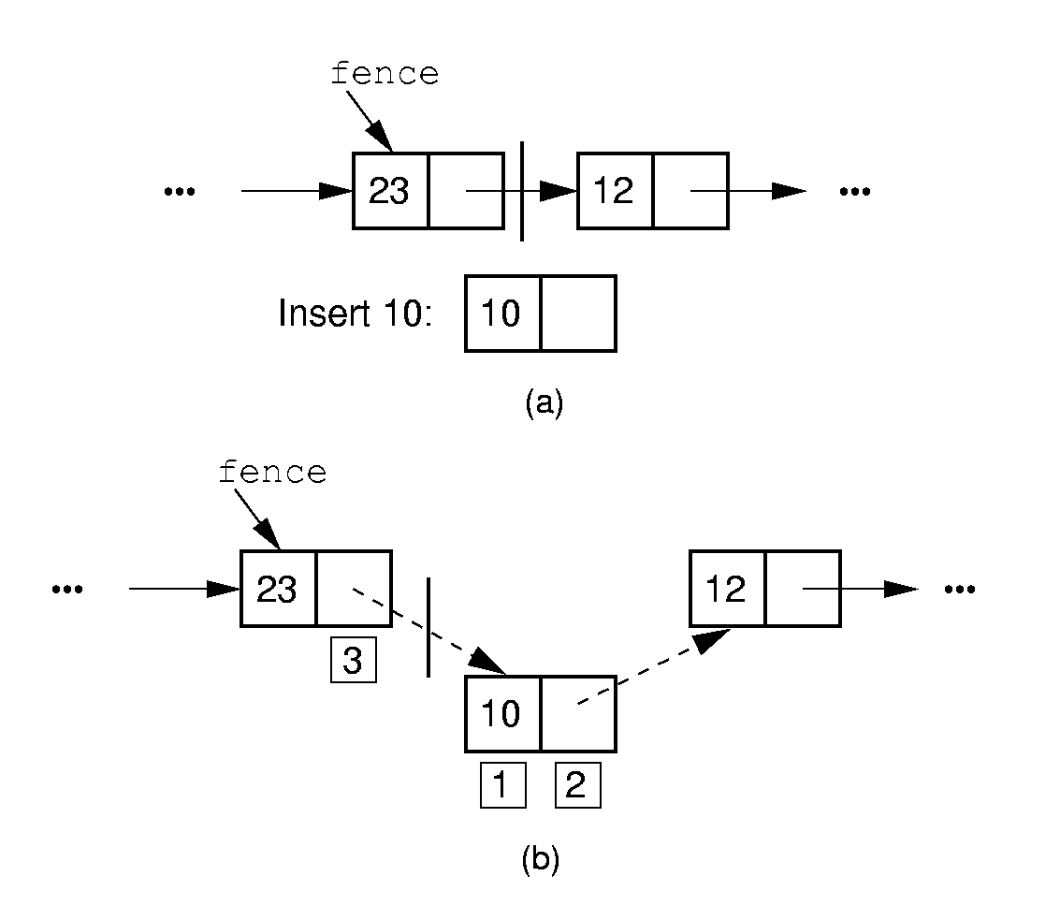
Insert

Slide 39
Insert
// Insert at front of right partition
template <class Elem>
bool LList<Elem>::insert(const Elem& item) {
fence->next =
new Link<Elem>(item, fence->next);
rightcnt++;
return true;}
tail
head
fence
item

Slide 40
Insert
// Insert at front of right partition
template <class Elem>
bool LList<Elem>::insert(const Elem& item) {
fence->next =
new Link<Elem>(item, fence->next);
if (tail == fence) tail = fence->next;
rightcnt++;
return true;}
Θ(1)
tail
head
item
fence

Slide 41
Append
// Append Elem to end of the list
template <class Elem>
bool LList<Elem>::append(const Elem& item) {
tail = tail->next =
new Link<Elem>(item, NULL);
rightcnt++;
return true;}
tail
head
item
fence

Slide 42
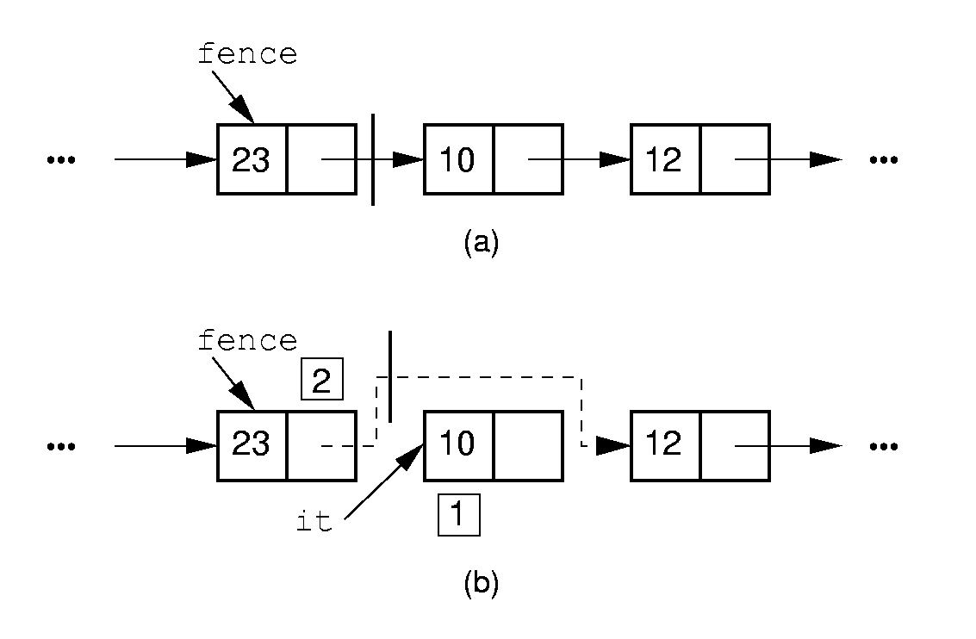
Remove

Slide 43
Remove
// Remove and return first Elem in right
// partition
template <class Elem>
bool LList<Elem>::remove(Elem& it) {
if (fence->next == NULL) return false;
it = fence->next->element; // Remember val
// Remember link node
Link<Elem>* ltemp = fence->next;
fence->next = ltemp->next; // Remove
delete ltemp; // Reclaim space
rightcnt--;
return true;
}
tail
fence
head
ltemp

Slide 44
Remove
// Remove and return first Elem in right
// partition
template <class Elem>
bool LList<Elem>::remove(Elem& it) {
if (fence->next == NULL) return false;
it = fence->next->element; // Remember val
// Remember link node
Link<Elem>* ltemp = fence->next;
fence->next = ltemp->next; // Remove
if (tail == ltemp) // Reset tail
tail = fence;
delete ltemp; // Reclaim space
rightcnt--;
return true;
}
Θ(1)
tail
fence
head
ltemp

Slide 45
Setpos
// Set the size of left partition to pos
template <class Elem>
bool LList<Elem>::setPos(int pos) {
if ((pos < 0) || (pos > rightcnt+leftcnt))
return false;
fence = head;
for(int i=0; i<pos; i++)
fence = fence->next;
rightcnt = rightcnt+leftcnt-pos;
leftcnt = pos;
return true;
}
Θ(n)
tail
head
fence
Notes:
从head开始移动了pos次，所以leftcnt = pos

Slide 46
1. lists
1.1 Definition of lists
1.2 ADT of lists
1.3 Basic Implementation of Lists
  1.3.1 Array-based List
  1.3.2 Linked List
  1.3.3 Comparison
1.4 Free list
1.5 Double Linked List

Slide 47
Comparison of Implementations
Array-Based Lists:
Insertion and deletion are Θ(n).
Prev and direct access are Θ(1).
Array must be allocated in advance.
No overhead if all array positions are full.
Linked Lists:
Insertion and deletion are Θ(1).
Prev and direct access are Θ(n).
Space grows with number of elements.
Every element requires overhead.
Notes:
Applies to both average and worst cases.
?如何解决array-based list的动态增长的问题

Slide 48
Space Comparison
Array-Based Lists Linked Lists
DE vs. n(P + E)
E: Space for data value.
P: Space for pointer.
D: Maximum Number of elements in array.
n: current number of elements
Notes:
谁大谁小，取决于具体情况

Slide 49
1. lists
1.1 Definition of lists
1.2 ADT of lists
1.3 Basic Implementation of Lists
  1.3.1 Array-based List
  1.3.2 Linked List
  1.3.3 Comparison
1.4 Free list
1.5 Double Linked List

Slide 50
Freelists (1)
System new and delete are slow.
Organize the freed nodes as a list call ‘freelist’
freelist
freelist
delete

Slide 51
Freelists (2)
System new and delete are slow.
Organize the freed nodes as a list call ‘freelist’
freelist
new

Slide 52
Freelists (3)
// Singly-linked list node with freelist
template <class Elem> class Link {
private:
static Link<Elem>* freelist; // Head
public:
Elem element; // Value for this node
Link* next; // Point to next node
… …
void* operator new(size_t); // Overload
void operator delete(void*); // Overload
};
element next
freelist
Notes:
修改new 和delete时所做的动作

Slide 53
Freelists (4)
template <class Elem>
Link<Elem>* Link<Elem>::freelist = NULL;
template <class Elem> // Overload for new
void* Link<Elem>::operator new(size_t) {
if (freelist == NULL) return ::new Link;
Link<Elem>* temp = freelist; // Reuse
freelist = freelist->next;
return temp; // Return the link
}
temp
freelist

Slide 54
Freelists (5)
template <class Elem> // Overload delete
void Link<Elem>::operator delete(void* ptr){
((Link<Elem>*)ptr)->next = freelist;
freelist = (Link<Elem>*)ptr;
}
ptr
freelist

Slide 55
1. lists
1.1 Definition of lists
1.2 ADT of lists
1.3 Basic Implementation of Lists
  1.3.1 Array-based List
  1.3.2 Linked List
  1.3.3 Comparison
1.4 Free list
1.5 Double Linked List

Slide 56
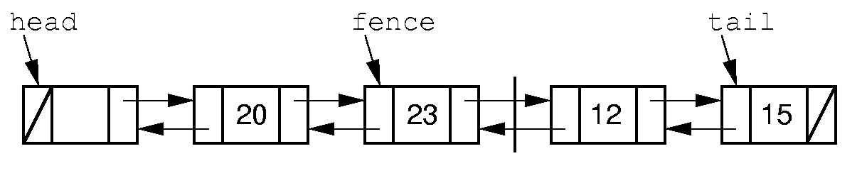
Doubly Linked Lists (1)
Simplify the prev() operation: Add a pointer pointing to
the previous node.

Slide 57
Doubly Linked Lists (2)
// Doubly-linked list link node
template <class Elem> class Link {
public:
Elem element; // Value for this node
Link *next; // Pointer to next node
Link *prev; // Pointer to previous node
Link(const Elem& e, Link* prevp =NULL,
Link* nextp =NULL)
{ element=e; prev=prevp; next=nextp; }
Link(Link* prevp =NULL, Link* nextp =NULL)
{ prev = prevp; next = nextp; }
};
prev element next

Slide 58
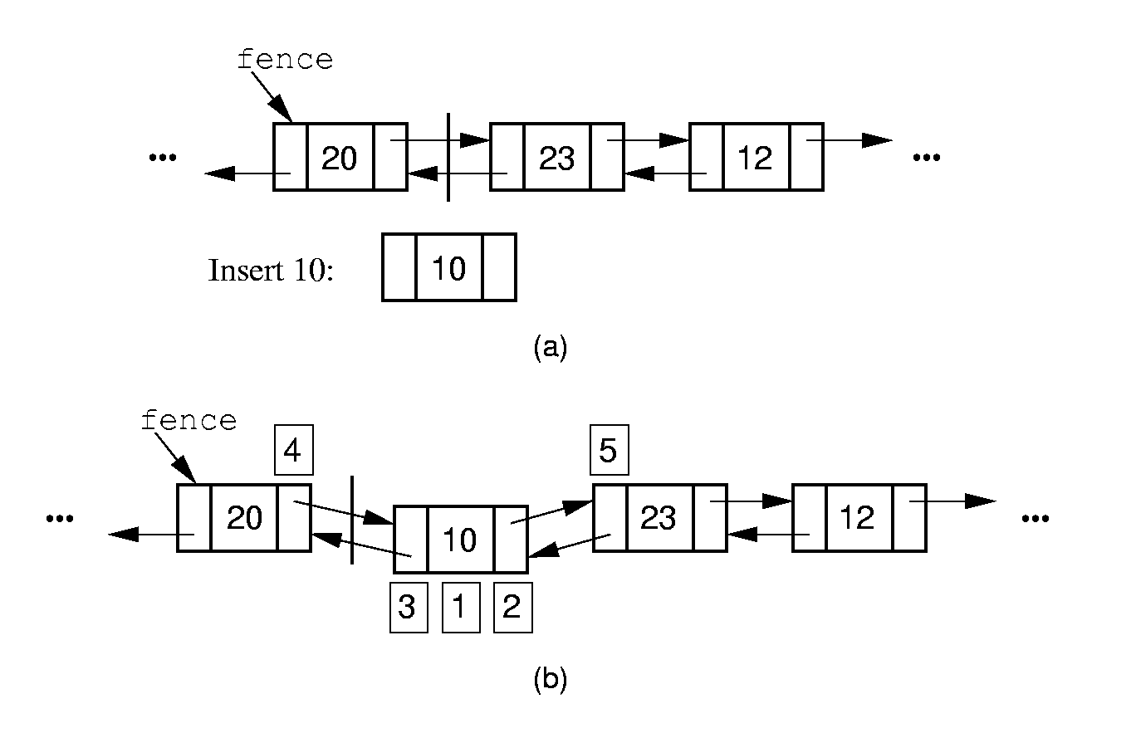
Doubly Linked List - Insert (3)

Slide 59
Doubly Linked List – Insert (4)
// Insert at front of right partition
template <class Elem>
bool LList<Elem>::insert(const Elem& item) {
fence->next =
new Link<Elem>(item, fence, fence->next);
if (fence->next->next != NULL)
fence->next->next->prev = fence->next;
if (tail == fence) // Appending new Elem
tail = fence->next; // so set tail
rightcnt++; // Added to right
return true;
}
tail
fence

Slide 60
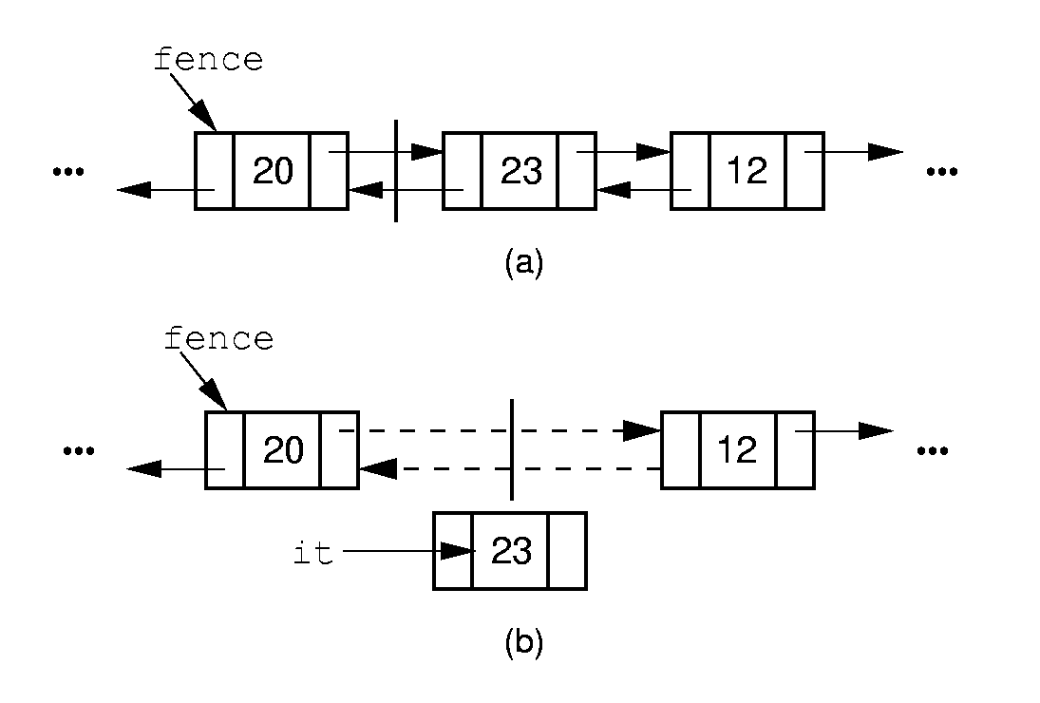
Doubly Linked List – Remove (5)

Slide 61
Doubly Linked List – Remove (6)
// Remove, return first Elem in right part
template <class Elem>
bool LList<Elem>::remove(Elem& it) {
if (fence->next == NULL) return false;
it = fence->next->element;
Link<Elem>* ltemp = fence->next;
if (ltemp->next != NULL)
ltemp->next->prev = fence;
else tail = fence; // Reset tail
fence->next = ltemp->next; // Remove
delete ltemp; // Reclaim space
rightcnt--; // Removed from right
return true;
}
tail
fence
ltemp

Slide 62
Chapter4 Lists, Stacks, and Queues
1. Lists
2. Stacks
3. Queues

Slide 63
2. Stacks
2.1 Definition of Stacks
2.2 ADT of Stacks
2.3 Basic Implementation of Stacks
  2.3.1 Array-based Stack
  2.3.2 Linked Stack
2.4 Application of stacks

Slide 64
Definition of Stacks
Stack: A restricted form of list: Insert and
remove only at front of list.
LIFO property: Last In, First Out.
Notation:
Insert: PUSH
Remove: POP
The accessible element is called the TOP element.
push
pop
TOP

Slide 65
2. Stacks
2.1 Definition of Stacks
2.2 ADT of Stacks
2.3 Basic Implementation of Stacks
  2.3.1 Array-based Stack
  2.3.2 Linked Stack
2.4 Application of stacks

Slide 66
Stack ADT
// Stack abtract class
template <class Elem> class Stack {
public:
// Reinitialize the stack
virtual void clear() = 0;
// Push an element onto the top of the stack.
virtual bool push(const Elem&) = 0;
// Remove the element at the top of the stack.
virtual bool pop(Elem&) = 0;
// Get a copy of the top element in the stack
virtual bool topValue(Elem&) const = 0;
// Return the number of elements in the stack.
virtual int length () const = 0;
};

Slide 67
2. Stacks
2.1 Definition of Stacks
2.2 ADT of Stacks
2.3 Basic Implementation of Stacks
  2.3.1 Array-based Stack
  2.3.2 Linked Stack
2.4 Application of stacks

Slide 68
Array-Based Stack (1)
// Array-based stack implementation
template <class Elem> class AStack: public Stack<Elem>
{
private:
Elem *listArray; //Array holding stack elements
int size; // Maximum size of stack
int top; // The position to insert the new element
push
listArray
pop
top
size
Notes:
注意top的取值范围

Slide 69
Array-Based Stack (2)
public:
AStack(int sz =DefaultListSize)
{ size = sz; top = 0;
listArray = new Elem[sz]; }
~AStack() { delete [] listArray;
void clear() { top = 0; }
listArray
top
size

Slide 70
Array-Based Stack (3)
bool push(const Elem& item) {
if (top == size) return false;//Stack is full
else { listArray[top++] = item; return true;}
}
item
listArray
top
size

Slide 71
Array-Based Stack (4)
// Pop top element
bool pop(Elem& it) {
if (top == 0)
return false;
else { it = listArray[--top]; return true; }
}
it
listArray
top
size

Slide 72
Array-Based Stack (5)
// Return top element
bool topValue(Elem& it) const {
if (top == 0) return false;
else { it = listArray[top-1]; return true; }
}
int length() const { return top; }
};
it
listArray
top
size

Slide 73
2. Stacks
2.1 Definition of Stacks
2.2 ADT of Stacks
2.3 Basic Implementation of Stacks
  2.3.1 Array-based Stack
  2.3.2 Linked Stack
2.4 Application of stacks

Slide 74
Linked Stack (1)
// Linked stack implementation
template <class Elem> class LStack: public Stack<Elem>
{
private:
Link<Elem>* top; // Pointer to first elem
int size; // Count number of elems
top

Slide 75
Linked Stack (2)
public:
LStack(int sz =DefaultListSize)
{ top = NULL; size = 0;}
top
NULL
size = 0
Stack is empty
top
size = 1
After push 1 element
top
size = 2
After push 2 elements

Slide 76
Linked Stack (3)
~LStack() {clear();}
void clear() {
while(top != NULL){
LINK<Elem>* temp = top;
top = top->next;
delete temp;
}
Size = 0;
}
top
NULL
temp

Slide 77
Linked Stack (4)
bool push(const Elem& item) {
top = new Link<Elem> (item, top);
size ++;
return true;
}
item
top

Slide 78
Linked Stack (5)
// Pop top element
bool pop(Elem& it) {
if(size == 0) return false;
it = top->element;
Link<Elem>* ltemp = top->next;
delete top;
top = ltemp;
size--;
return true;
}
top
ltemp

Slide 79
Linked Stack (6)
// Return top element
bool topValue(Elem& it) const {
if(size == 0) return false;
it = top->element;
return true;
}
int length() const {return size;}
};
top

Slide 80
2. Stacks
2.1 Definition of Stacks
2.2 ADT of Stacks
2.3 Basic Implementation of Stacks
  2.3.1 Array-based Stack
  2.3.2 Linked Stack
2.4 Application of stacks
  Make use of the LIFO property: Last In, First Out.

Slide 81
Example – Verify the Balance of Parentheses
Eg. The string “((())())” contains balanced parentheses. The string“(()” are not balanced.
Problem: Write a program to check if a string contains properly nested and balanced parentheses.
Stack
Last In First Out
( ( ( ) ) ( ) )
(
(
(
(
(
(
(
)
)
(
)
)
( ( )
(
(
(
(
)
Notes:
我们通过一个实例来解释栈的应用。这个例子是关于括号匹配的检测。一个括号字符串中，如果所有括号都能成组匹配，我们就称这个字符串是平衡的。否则，我们称该字符串不平衡的。
要解决的问题是，请写一段程序来检查输入的括号字符串的平衡性。
为了解决这个问题，我们先来看一个具体的例子。
我们可以从左往右，逐个检查字符串中的每一个括号。字符串中第一个字符是左括号，由于我们暂时无法确定后面哪个右括号和这个左括号匹配，所以我们先把这个左括号记录下来;
然后我们看到第二个也是左括号，同样，我们还是无法确认该括号的匹配情况，也将它记录下来。
第三个还是左括号，我们做同样的处理，这个时候，我们已经记录三个还没有匹配的左括号。
第四个出现的是右括号，和这个右括号匹配的应该是最后记录的左括号，所以我们从记录档案中取出最后添加进来的左括号进行匹配。在这里我们可以看到，这个记录档案具有类似栈的后进先出的性质，最后添加的最新取出来，完全可以采用一个栈来实现。往里面添加左括号就是一个push的过程，取出左括号进行匹配则是一个pop的过程。
明白了这个原理之后，我们继续处理剩下的括号。紧接下来的是一个右括号，我们会从栈中弹出一个左括号进行匹配。
然后我们又遇到一个左括号，将它压入栈中。
接着是右括号，从栈中弹出左括号。
最后也是一个右括号，继续从栈中弹出左括号。如果输入的是一个平衡的括号字符串，那么运行结束时，栈应该是空的，不存在未匹配成功的左括号; 同时字符串中的括号必须全部处理完毕，不存在未匹配的右括号。这两个条件的任意一个不满足，输入的就是不平衡的字符串。
下面我们来看一个不平衡的例子。类似前面的处理过程，我们逐个分析串中的括号。
首先是两个左括号，我们将它们依次压入栈中，
然后是一个右括号，将执行一次出栈操作。这个时候，字符串已经处理完毕，但是栈还不是空的，所以我们可以判断这个字符串是不平衡。通过这样一个例子，我们可以进一步体验到，栈的后进先出的显著特性。而栈的应用也要立足于这样一种特殊的性质。

Slide 82
Application of stack(2) – Subroutine Call
Subroutine call.
  Before calling a subroutine, the context (return address, parameters, local variables) is stored into the a stack.
4000
int a = 0;
int b =1;
Dosomething (a,b);
a = a + b;
Stack
4001
4003,0,1
4002
4003
Dosomthing(int x, int y)
{
… … }
context
context

Slide 83
Application of stack(2) – Subroutine Call (cont.)
Implementation of Recursion
// The recursion version to compute n!
long fact(int n)
{
if (n <= 1) return 1; // Base case: return base solution
return n * fact(n-1); // Recursive call for n > 1
}
300
301
fact(4)
fact(3)
fact(2)
fact(1)
fact(2)
fact(3)
fact(4)
return 1
return 2
301,4
301,3
301,2
return 6
return 24
Notes:
栈是保证嵌套调用现场保存的关键数据结构

Slide 84
1. Lists
2. Stacks
3. Queues

Slide 85
3. Queues
3.1 Definition of Queues
3.2 ADT of Queues
3.3 Basic Implementation of Queues
  3.3.1 Array-based Queues
  3.3.2 Linked Queues
3.4 Application of Queues

Slide 86

FIFO property: First In, First Out
Notes:
队列在我们的日常生活中非常常见。当我们要去排队去做某件事情的时候，我们就自然而然的形成了一个队列。比如我们排队去买车票，排在队头的人将优先接受服务，并优先离开队列; 而后面到来的人，只能排在队列的尾端，而不能随意插入到中间的位置。这种最常见的结构，蕴含着先到先服务，先服务先离开的公平性原则，
也就是所谓的FIFO性质：first in, first out.

Slide 87
Definition of Queues
Queue: A restricted form of list - Insert at one end, remove from the other.
FIFO property: First in, First Out
Notation:
Insert: enqueue （入队）
Delete: dequeue （出队）
First element: front
Last element: rear
enqueue
dequeue
front
rear
Notes:
特别强调，enqueue和dequeue的位置

Slide 88
3. Queues
3.1 Definition of Queues
3.2 ADT of Queues
3.3 Basic Implementation of Queues
  3.3.1 Array-based Queues
  3.3.2 Linked Queues
3.4 Application of Queues

Slide 89
ADT of Queues
template <class Elem> class Queue {
public:
virtual void clear() = 0;
virtual bool enqueue(const Elem&) = 0;
virtual bool dequeue(Elem&) = 0;
virtual bool frontValue(Elem&) const = 0;
virtual int length() const = 0;
};

Slide 90
3. Queues
3.1 Definition of Queues
3.2 ADT of Queues
3.3 Basic Implementation of Queues
  3.3.1 Array-based Queues
  3.3.2 Linked Queues
3.4 Application of Queues

Slide 91
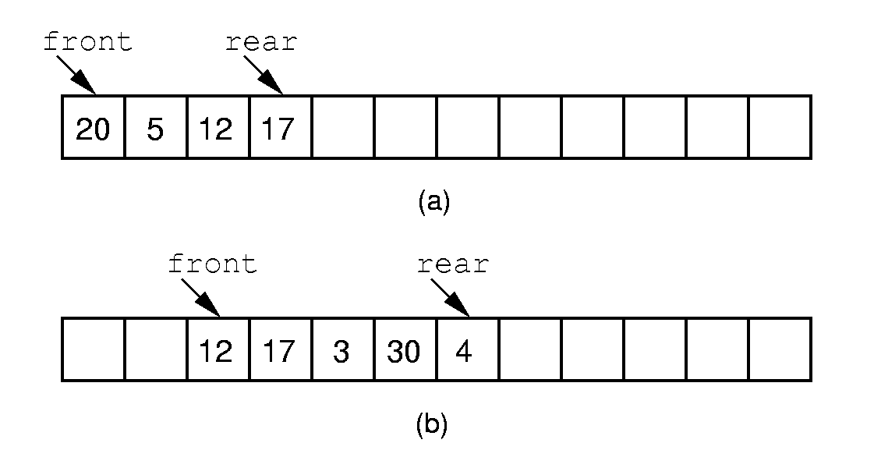
Array-based Queue Implementation (1)
Length of the queue
= rear – front + 1
front
rear
10
12
42
(c)
How to insert one more element?
Notes:
If we stick to the requirement that the queue elements be at the beginning n elements of the array, then either enqueue or dequeue must be θ(n).
Better is to let the elements “drift” within the array.
Unfortunately, as items are added and removed, the queue “drifts” toward the end. Eventually, there will be no space to the right of the queue, even though there is space in the array.

Slide 92
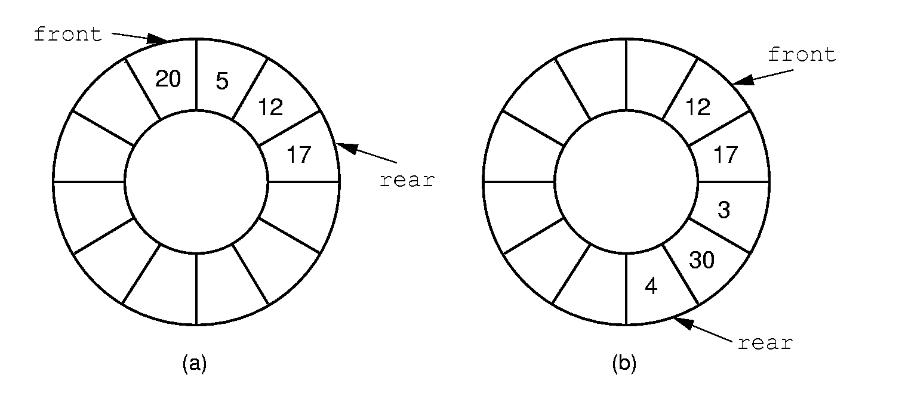
Array-based Queue Implementation (2)
Circular queue
Notes:
By using the mod function, we can easily achieve the effect of a “circular” queue.
This leaves one more issue. Where do the front and rear pointers go (point to the item? Or to the space before/after the item)? And, how do we distinguish a full from an empty queue?
Given a fixed position for the front element (and its pointer), there are n-1 possible states for the queue (0 through n elements in the queue for an array of size n), but only n possible positions for rear. To solve this dilemma, we must either leave an empty slot in the queue, or use and external variable to determine if the queue is empty or not.

Slide 93





Array-based Circular Queue
5
Array base
base
4
0
0
J6
1
J7
rear=1
2
3
1
3
J3
front=3
front
4
J4
2
5
J5
size =6
rear
The position of the element next
to the No. i element it is:
(i+1)% size
The length of the queue is:
Length = (rear - front + 1) ?
Length = (rear+size - front + 1) % size
Notes:
1.取模操作控制值域为[0,size-1]，且具有循环周期性。
2. If rear >= front length = rear – front + 1
If rear < front length = rear + size – front + 1
合并以上两种情况，为length = (rear + size – front + 1) % size

Slide 94


The state of a circular queue
rear
front
rear
rear
front
5
4
5
0
4
0
4
5
0
3
1
3
2
1
2
3
2
1
front
rear
5
front
4
0
3
2
1
5
4
0
front
3
2
1
rear
full
front = = (rear+1)%size
empty
How to distinguish?

Slide 95
Distinguish full and empty
4
5
0
4
5
0
3
1
3
1
2
2
front
front
rear
rear
(a) Empty
(b) Full
Only store n – 1 elements in a Circular queue with the length n.
Empty： front = = (rear+1)%size
Full： front = = (rear+2)%size

Slide 96
Implementation of the Array-Based Circular Queue(1)
template <class Elem> class AQueue: public Queue<Elem>
{
private:
int size; // Maximum size of queue
int front; // Index of front element
int rear; // Index of rear element
Elem *listArray; // Array holding queue elements
Size = 6
5
listArray
listArray
4
0
0
J6
1
J7
rear=1
2
3
1
3
J3
front=3
front
4
J4
2
5
J5
rear

Slide 97
Implementation of the Array-Based Circular Queue(2)
virtual int length() const
{ return (rear+size - front + 1) % size; }
bool frontValue(Elem& it) const {
if (length() == 0) return false; // Empty
it = listArray[front];
return true;
}
rear
4
5
0
3
2
1
front
it = J₃

Slide 98
Implementation of the Array-Based Circular Queue(3)
void clear() { front = (rear+1)%size; }
rear
4
5
0
5
3
2
1
4
0
3
2
1
front
clear
front
rear
Empty

Slide 99

Implementation of the Array-Based Circular Queue(4)
bool enqueue(const Elem& it) {
if (((rear+2) % size) == front) return false; // Full
rear = (rear+1) % size; // Circular increment
listArray[rear] = it;
return true;
}
rear
4
5
0
4
5
0
3
1
2
3
2
1
front
front
rear
Full
enqueue

Slide 100
Implementation of the Array-Based Circular Queue(5)
bool dequeue(Elem& it) {
if (length() == 0) return false; // Empty
it = listArray[front];
front = (front+1) % size; // Circular increment
return true;
}
rear
4
5
0
5
3
2
1
4
0
3
2
1
front
front
it = J₃
rear
Empty
dequeue

Slide 101
3. Queues
3.1 Definition of Queues
3.2 ADT of Queues
3.3 Basic Implementation of Queues
  3.3.1 Array-based Queues
  3.3.2 Linked Queues
3.4 Application of Queues

Slide 102
Linked Queues
tail
head
tail
head
dequeue
tail
head
enqueue

Slide 103
3. Queues
3.1 Definition of Queues
3.2 ADT of Queues
3.3 Basic Implementation of Queues
  3.3.1 Array-based Queues
  3.3.2 Linked Queues
3.4 Application of Queues

Slide 104
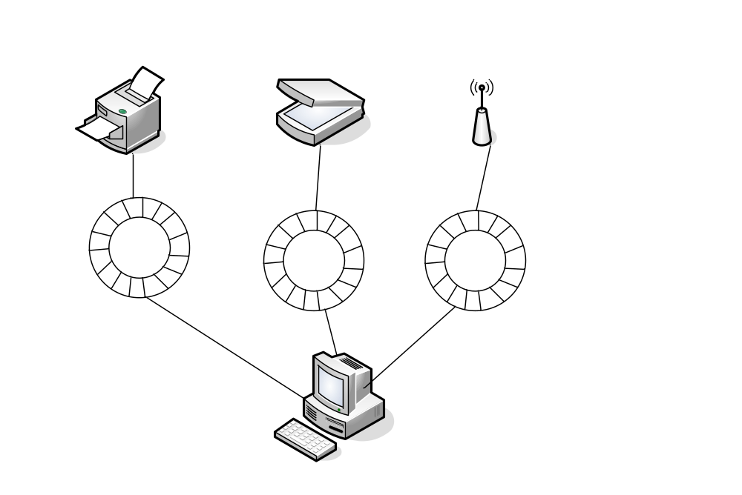
Application of Queue(1)- Buffer
Low speed devices
Queues for data buffer
High speed processor

Slide 105
Application of Queue(2)-Message Queue
Asynchronous collaboration between different
components.
Eg. Message Queue in Windows.
Message consumer
Message producer
dequeue
enqueue

Slide 106
Thanks!
Questions?

