Slide 1
Chapter5 Binary Trees
5.1 Definitions and Properties
5.2 Binary Tree ADT
5.3 Binary Tree Implementations
5.4 Traversal of Binary Tree
5.5 Binary Search Trees
5.6 Heaps and Priority Queues
5.7 Huffman Coding Trees

Slide 2

Tree
leaf
leaf
internal
node
root
root

Slide 3
Tree
root
leaf
internal
node
leaf
root

Slide 4
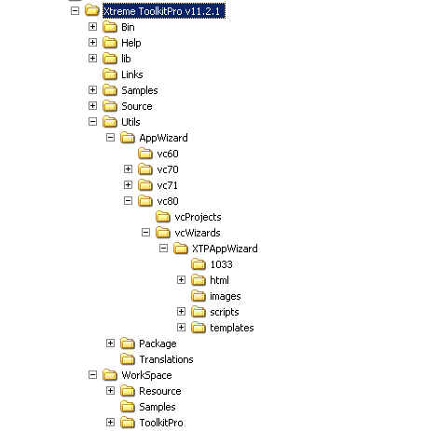
Example of Tree Structure (1)
Directory Tree

Slide 5
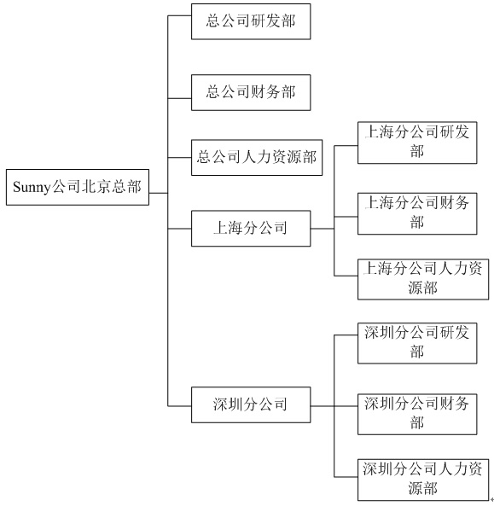
Example of Tree Structure (2)
Structure of
Organization

Slide 6
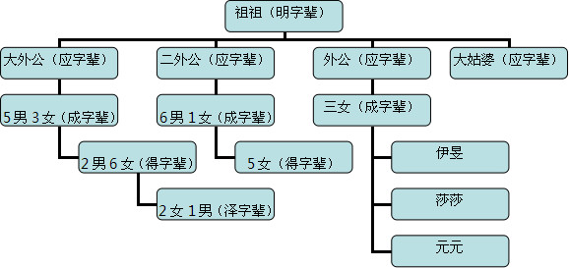
Example of Tree Structure (3)
Family Tree

Slide 7
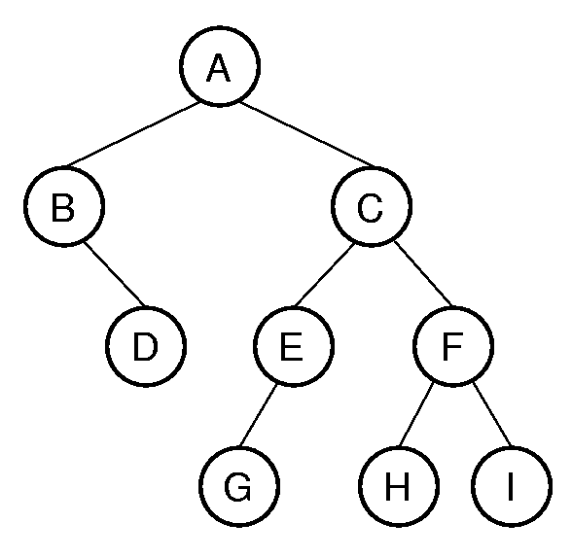
Binary Tree
A non-empty binary tree consists of a node called the root together with two disjoint binary trees, called the left and right subtrees.
root
left subtree
right subtree

Slide 8
Notation (1)
Notation:
children, parent
C's children : E,F
Leaf nodes has no children
C is the parent of E and F
The root A has no parent

Slide 9
Notation (2)
Notation:
ancestor, descendant
F's ancestor: A, C
C's descendant: E,F,G,H,I

Slide 10
Notation (3)
Notation:
path: A node sequence n₁,n₂,...,n_{k} is called a path from n₁ to n_{k}, if n_{i} is the parent of n_{i+1} for 1 ≤ i ≤ k. The length of the path is k -1.
e.g. A,C,E,G is a path from A to G

Slide 11
Notation (4)
Notation:
depth : The depth of a node is the length of the path from root to this node.
e.g. depth of G is 3.

Slide 12
Notation (5)
Notation:
level:
level 0
level 1
level 2
level 3

Slide 13
Notation (6)
Notation:
height: the height of a tree is one more than the depth of the deepest node in the tree
e.g. height = 4.

Slide 14
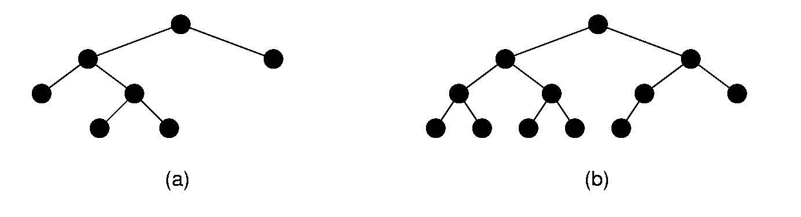
Full Binary Trees
Full binary tree: Each Internal node has exactly two non-empty children.

Slide 15
Full Binary Tree Theorem
Theorem1: The number of leaves in a non-empty full binary tree is one more than the number of internal nodes.
Proof: ?
4 leaves
3 internal nodes

Slide 16
Complete Binary Trees
Complete binary tree: has a restricted shape obtained by starting at the root and filling the tree by levels from left to right.
All levels except the bottom one are completely full. The bottom level has all nodes to the left side.

Slide 17
Chapter5 Binary Trees
5.1 Definitions and Properties
5.2 Binary Tree ADT
5.3 Binary Tree Implementations
5.4 Traversal of Binary Tree
5.5 Binary Search Trees
5.6 Heaps and Priority Queues
5.7 Huffman Coding Trees

Slide 18
Binary Tree Node ADT
Template <class Elem> class BinNode {
public:
virtual Elem& val( ) =0;
virtual void setVal( const Elem& ) = 0;
virtual BinNode* left( ) const = 0;
virtual void setLeft( BinNode* ) = 0;
virtual BinNode* right( ) const = 0;
virtual void setRight( BinNode* ) = 0;
virtual bool isLeaf( ) = 0;
}

Slide 19
Binary Tree ADT
Template <class Elem> class BinTree {
public:
//get the root of the tree
virtual BinNode<Elem>* getRoot() =0;
//preorder traversal of the subtree rooted at subroot
virtual void preorder(BinNode<Elem>* subroot);
//inorder traversal of the subtree rooted at subroot
virtual void inorder(BinNode<Elem>* subroot);
//postorder traversal of the subtree rooted at subroot
virtual void postorder(BinNode<Elem>* subroot);
}
Any process for visiting the nodes in a specific order is called a traversal of the tree.

Slide 20
Chapter5 Binary Trees
5.1 Definitions and Properties
5.2 Binary Tree ADT
5.3 Binary Tree Implementations
5.3.1 Link-based
5.3.2 Array-based
5.4 Traversal of Binary Tree
5.5 Binary Search Trees
5.6 Heaps and Priority Queues
5.7 Huffman Coding Trees

Slide 21
Structure of Binary Tree
root
? How to present a node
? How to present the edges among
nodes (relationship)
A
B
C
D
E
F
G
H
I

Slide 22
Chapter5 Binary Trees
5.1 Definitions and Properties
5.2 Binary Tree ADT
5.3 Binary Tree Implementations
5.3.1 Link-based
5.3.2 Array-based
5.4 Traversal of Binary Tree
5.5 Binary Search Trees
5.6 Heaps and Priority Queues
5.7 Huffman Coding Trees

Slide 23
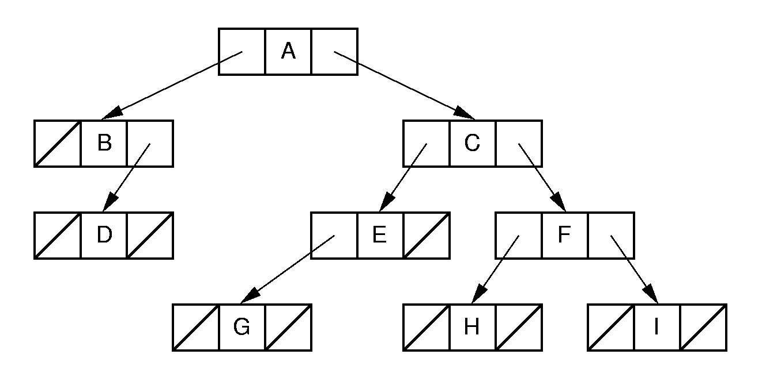
Link-based Binary Tree Implementation
root
root
A
B
C
D
E
F
G
H
I

Slide 24
Binary Tree Node Class (1)
// Binary tree node class
template <class Elem>
class BinNodePtr : public BinNode<Elem>{
public:
Elem val; // The node's value
BinNode* lc; // Pointer to left child
BinNode* rc; // Pointer to right child
BinNodePtr(Elem e, BinNode* l, BinNode* r)
{ val = e; lc = l; rc = r; }
lc
val
rc

Slide 25
Binary Tree Node Class (3)
inline BinNode<Elem>* left() const
{ return lc; }
inline BinNode<Elem>* right() const
{ return rc; }
void setLeft(BinNode<Elem>* b)
{ lc = (BinNodePtr*)b; }
void setRight(BinNode<Elem>* b)
{ rc = (BinNodePtr*)b; }
bool isLeaf()
{ return (lc == NULL) && (rc == NULL); }
};
lc
it
rc

Slide 26
Link-based Binary Tree class (1)
class LBinTree:public BinTree <Elem>
{
private:
BinNodePtr<Elem>* root;
public:
… …
root
lc
it
rc
lc
it
rc
lc
it
rc

Slide 27
Space Overhead of Linked–based Binary Tree (1)
Total space required is (2p + d)n,
(p is the size of a pointer and d is the size of the stored data）
Overhead: 2pn
  If p = d, this means (2pn)/((2p + d)n) = 2/3 overhead.
root
lc
it
rc
lc
it
rc
lc
it
rc

Slide 28
Space Overhead of Linked–based Binary Tree (2)
Theorem2: The number of null pointers in a non-empty binary tree is one more than the number of nodes in the tree.
Proof: 2n – (n-1) = n+1
root
lc
it
rc
lc
it
rc
lc
it
rc
NULL
NULL
NULL
NULL

Slide 29
Chapter5 Binary Trees
5.1 Definitions and Properties
5.2 Binary Tree ADT
5.3 Binary Tree Implementations
5.3.1 Link-based
5.3.2 Array-based
5.4 Traversal of Binary Tree
5.5 Binary Search Trees
5.6 Heaps and Priority Queues
5.7 Huffman Coding Trees

Slide 30
Array-based complete binary tree (1)
A
B
C
D
E
F
G
H
I
J
K
L
A
B
C
D
E
F
G
H
I
J
K
L
0 1 2 3 4 5 6 7 8 9 10 11 12 13 14
array

Slide 31
Array-based complete binary tree (2)
A
B
C
D
E
F
G
H
I
J
K
L
A
B
C
D
E
F
G
H
I
J
K
L
0 1 2 3 4 5 6 7 8 9 10 11 12 13 14
Parent (r) = (r - 1) / 2 if r > 0 and r < n.
Leftchild(r) = 2r + 1 if 2r+1 < n.
Rightchild(r) = 2r + 2 if 2r +2 < n.

Slide 32
Array-based Normal Binary Tree
A
Leftchild(r) = 2r + 1
Rightchild(r) = 2r + 2
B
C
D
E
A
B
C
D
E
0
1
2
3
4
5
6
7
8
9
10

Slide 33
Chapter5 Binary Trees
5.1 Definitions and Properties
5.2 Binary Tree ADT
5.3 Binary Tree Implementations
5.3.1 Link-based
5.3.2 Array-based
5.4 Traversal of Binary Tree
5.5 Binary Search Trees
5.6 Heaps and Priority Queues
5.7 Huffman Coding Trees

Slide 34
Traversal of Binary Tree
Traversal: any process for visiting the nodes of a tree in some order is called a traversal of the tree.
Possible traversal sequences:
  ABCDEFGHI
  ACEFGHIBD
  ABDCEFGHI
  ... ...

Slide 35
Preorder Traversals
Preorder traversal: (先序遍历)
  Visit the root
  Preorder traversal of the left subtree of the root
  Preorder traversal of right subtree of the root
Preorder traversal:
A
B
D
C
E
G
F
H
I

Slide 36
Postorder Traversals
Postorder traversal: (后序遍历)
  Postorder traversal of the left subtree of the root
  Postorder traversal of right subtree of the root
  Visit the root
Postorder traversal:
D
B
G
E
H
I
F
C
A

Slide 37
Inorder Traversals
Inorder traversal: (中序遍历)
  Inorder traversal of the left subtree of the root
  Visit the root
  Inorder traversal of right subtree of the root
Inorder traversal:
B
D
A
G
E
C
H
F
I

Slide 38
Exercise
Postorder traversal: D E C B H G F A
Inorder traversal: B D C E A F H G
What does the tree look like?

Slide 39
Implement Preorder Traversal
  Visit the root
  Preorder traversal of the left subtree of the root
  Preorder traversal of right subtree of the root
root
lc
val
rc
lc
val
rc
lc
val
rc
template <class Elem>
void preorder(BinNode<Elem>* root) {
if (root == NULL) return; // Empty
visit(root); // Perform some action
preorder(root->lc);
preorder(root->rc);
}

Slide 40
Implement Inorder Traversal
  Inorder traversal of the left subtree of the root
  Visit the root
  Inorder traversal of right subtree of the root
root
lc
val
rc
lc
val
rc
lc
val
rc
template <class Elem>
void inorder(BinNode<Elem>* root) {
if (root == NULL) return; // Empty
inorder(root->lc);
visit(root); // Perform some action
inorder(root->rc);
}

Slide 41
Implement Postorder Traversal
  Postorder traversal of the left subtree of the root
  Postorder traversal of right subtree of the root
  Visit the root
root
lc
val
rc
lc
val
rc
lc
val
rc
template <class Elem>
void posterorder(BinNode<Elem>* root) {
if (root == NULL) return; // Empty
postorder(root->lc);
postorder(root->rc);
visit(root); // Perform some action
}

Slide 42
Extension of Traversal (1)
Add 2 functions to the LBinTree class:
  // Return the number of nodes in the subtree
  int count(BinNode<Elem>* subroot)
  // Return the height of the subtree
  int height(BinNode<Elem>* subroot)
  How to implement them??

Slide 43
Extension of Traversal (2)
// Return the number of nodes in the subtree
template <class Elem>
int count(BinNode<Elem>* subroot) {
if (subroot == NULL)
return 0; // Nothing to count
return 1 + count(subroot->left())
+ count(subroot->right());
}
  How to implement height(BinNode<Elem>* subroot)?

Slide 44
Non-recursion Version of Traversal (1)
1
Preorder traversal
1
5
5
1
2
2
null
null
1
2
3
3
4
1
4
null
null
null
null
1
2
1
1

Slide 45
Non-recursion Version of Traversal (1)
1
Preorder traversal
1
5
5
1
2
2
null
null
1
2
3
3
4
1
4
null
null
null
null
1
2
1
1

Slide 46
Non-recursion Version of Tranversal (2)
template <class Elem>
void preorder ( BinNode<Elem>* subroot ) {
AStack<Elem> s;
BinNode<Elem> * p = subroot;
while (p | | s.length( ) ) {
if (p) {
//根指针进栈，访问根节点，遍历左子树
visit (p);
s.push (p);
p = p－>left( );
} // if
else { //根指针退栈，访问根结点，遍历右子树
s.Pop (p);
p = p－>right( );
} // else
} // while
return OK;
} // PreOrderTraverse

Slide 47
Chapter5 Binary Trees
5.1 Definitions and Properties
5.2 Binary Tree ADT
5.3 Binary Tree Implementations
5.3.1 Link-based
5.3.2 Array-based
5.4 Traversal of Binary Tree
5.5 Binary Search Trees
5.6 Heaps and Priority Queues
5.7 Huffman Coding Trees

Slide 48
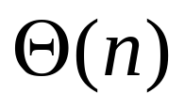
Search in a binary tree
How to Search the node H?
Traversal of the whole tree.
  Preorder, inorder, postorder
Any other faster data structure to support search?

Slide 49
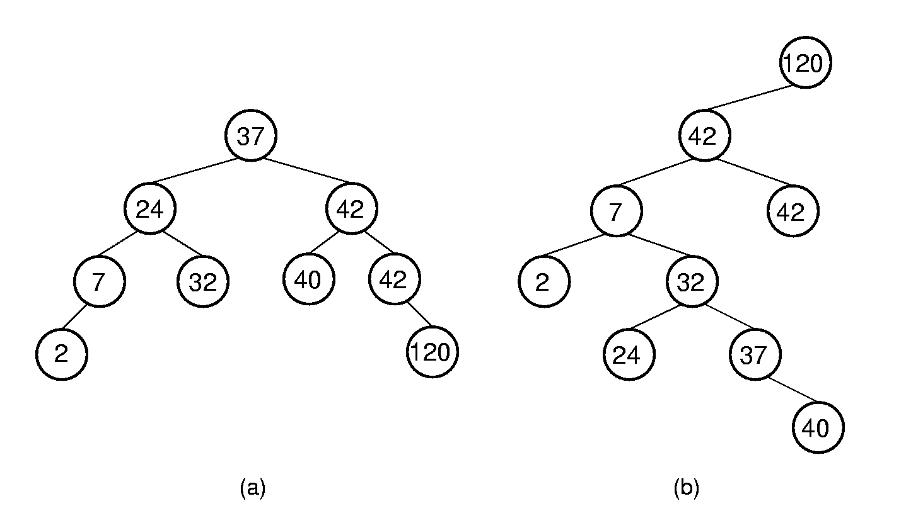
Binary Search Trees (BST)
BST Property: All elements stored in the left subtree of a node with value K have values < K. All elements stored in the right subtree of the node have values >= K.
? How to search in BST
? How many times of nodes comparison
Better than Θ(n)

Slide 50
BST class
// BST implementation for the Dictionary ADT
template <class Elem>
class BST {
private:
BinNode<Elem>* root; // Root of the BST
int nodecount; // Number of nodes
public:
BST() { root = NULL; nodecount = 0; }
root

Slide 51
BST Destruction
~BST() { clearhelp(root); }
clearhelp(BinNode<Elem>* subroot)
{
if(subroot == NULL) return;
clearhelp(subroot->left());
clearhelp(subroot->right());
delete subroot;
}
subroot

Slide 52
BST Search (1)
bool find(const Elem& e) const
{ return findhelp(root, e); }
bool findhelp(BinNode<Elem>* subroot, Elem& e)
{
if (subroot == NULL) return false;
else if (e < subroot->val())
return findhelp(subroot->left(), e);
else if (e > subroot->val()))
return findhelp(subroot->right(), e);
else { return true; }
}
subroot

Slide 53
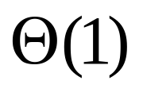

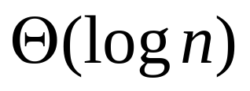
BST Search (2)
Best case:
40
find (40)
37
50
24
42
53
60
Worst case:
60
53
50
40
find (24)
42
40
h=
37
50
37
24
24
42
53
60
Average case in a balanced BST:

Slide 54
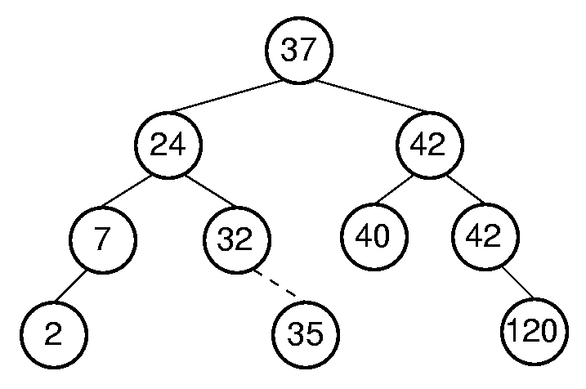
BST Insert (1)
root
Insert 35

Slide 55
BST Insert (2)
//return the root of the updated BST after insertion
BinNode<Elem>* inserthelp(BinNode<Elem>* subroot,
const Elem& val) {
if (subroot == NULL) // Empty: create node
return new BinNodePtr<Elem>(val,NULL,NULL);
if (val < subroot->val()))
subroot->setLeft(inserthelp(subroot->left(), val));
else
subroot->setRight(inserthelp(subroot->right(), val));
// Return subtree with node inserted
return subroot;
}
bool insert(const Elem& e) {
root = inserthelp(root, e);
nodecount++;
return true; }
subroot
val = 35

Slide 56
BST Remove (1)
Remove an element e from BST.
root
Remove e from
1. If e < root-> val()

Slide 57
BST Remove (2)
Remove an element e from BST.
root
Remove e from
2. If e > root->val()

Slide 58
BST Remove (3)
Remove an element e from BST.
root
3. If e == root->val()

Slide 59
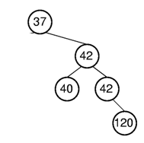
BST Remove (3)
Remove an element e from BST.
root
root
3. 1 If e == root->val() && root->left() == NULL

Slide 60
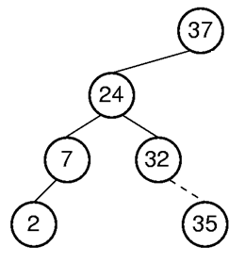
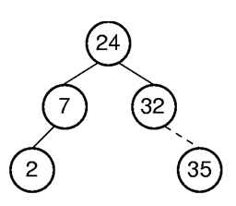
BST Remove (3)
Remove an element e from BST.
root
root
3. 2 If e == root->val() && root->right() == NULL

Slide 61
BST Remove (3)
Remove an element e from BST.
root
3.3 If e == root->val() && root->left() != NULL && root->right !=NULL

Slide 62
BST Remove (4)
//return the root of the updated tree after removal
//t point to the removed node
BinNode<Elem>* removehelp(BinNode<Elem>* subroot, const Elem& e, BinNode<Elem>*& t) {
if (subroot == NULL) return NULL;
else if (e < subroot->val())
subroot->setLeft(
removehelp(subroot->left(), e, t));
else if (e > subroot->val())
subroot->setRight(
removehelp(subroot->right(), e, t));
root

Slide 63
BST Remove (5)
else { // Found it: remove it
BinNode<Elem>* temp;
t = subroot;
if (subroot->left() == NULL)
subroot = subroot->right();
else if (subroot->right() == NULL)
subroot = subroot->left();
t
subroot
t
37
37
delete 37
subroot
42
42
39
50
39
50

Slide 64
BST Remove (6)
else { // Both children are non-empty
}
subroot
37
?
remove 37
30
42
21
32
39
50

Slide 65
BST Remove (6)
else { // Both children are non-empty
subroot->setRight(
deletemin(subroot->right(), temp));
Elem te = subroot->val();
subroot->setVal(temp->val());
temp->setVal(te);
t = temp;
} }
return subroot;
}
subroot
te =37
37
39
remove 37
30
42
21
32
39
37
50
t
temp

Slide 66
BST Remove (7)
//return the root of the tree after remove the node with the minimum value
BinNode<Elem>* deletemin(BinNode<Elem>* subroot,
BinNode<Elem>*& min) {
if (subroot->left() == NULL) {
min = subroot;
return subroot->right();
}
}
subroot
37
min
new subroot
42
39
50

Slide 67
BST Remove (7)
//return the root of the tree after remove the node with the minimum value
BinNode<Elem>* deletemin(BinNode<Elem>* subroot,
BinNode<Elem>*& min) {
if (subroot->left() == NULL) {
min = subroot;
return subroot->right();
}
else { // Continue left
subroot->setLeft(
deletemin(subroot->left(), min));
return subroot;
}
}
subroot
37
The subroot is unchanged
30
42
21
32
39
50

Slide 68
Cost of BST Operations
Find:
Insert:
Delete:
Worst case:
60
53
50
42
40
37
24
40
h=
37
50
24
42
53
60
Average case in a balanced BST:

Slide 69
Application of BST
Design a data structure to support efficient search/insert/remove operation on a set of data.
  Sorted List ?
    Search : Binary Search Ө (logn)
    Insert: Ө(n)
    Remove: Ө(n)
  BST ?
    Ө (logn). The tree should be kept balanced. (AVL Tree)

Slide 70
Chapter5 Binary Trees
5.1 Definitions and Properties
5.2 Binary Tree ADT
5.3 Binary Tree Node Implementations
5.4 Traversal of Binary Tree
5.5 Binary Search Trees
5.6 Heaps and Priority Queues
5.7 Huffman Coding Trees

Slide 71
Problem: Get Maxmum/Minimum element in a binary tree
Traversal of the whole tree.
  Preorder, inorder, postorder
Any other faster data structure to do this?

Slide 72
Heaps
Heap: Complete binary tree with the heap property
Every node stores a value that is less than or equal to the value of it children. // Min-heap(小顶堆):
or
Every node stores a value that is greater than or equal to the value of it children. //Max-heap(大顶堆):
12
96
36
24
83
27
85
47
30
53
38
11
09
91
Min-heap
Max-heap
partially ordered

Slide 73
Function of Heaps
?
96
Get the max = 96
83
27
83
27
38
11
09
38
11
09
reorganized into a max-heap
83
Get the max = 83
… …
38
27
09
11
Always keep the maximum/minimum node on the root

Slide 74
Implementation of Heaps
Heap representation: array-based complete binary tree representation.
12
36
24
85
47
30
53
91
Min-heap
12
36
24
85
47
30
53
91

Slide 75
Heap class (1)
template<class Elem> class maxheap{
private:
Elem* Heap; // Pointer to the heap array
int size; // Maximum size of the heap
int n; // Number of elems now in heap
96
83
27
38
11
9
96
83
27
38
11
9
Heap

Slide 76
Heap class (2)
int heapsize() const{return n;}
bool isLeaf(int pos) const
{return (pos >= n/2)&&(pos < n)};
int leftchild(int pos) const{return 2*pos+1};
int rightchild(int pos) const{return 2*pos+2};
int parent(int pos) const{return (pos-1)/2};
96
83
27
96
83
27
38
11
9
Heap
0 1 2 3 4 5 6 7 8
38
11
9

Slide 77
Heap Insertion (1)
Max-Heap
7
7
7
5
6
5
6
9
5
4
2
1
9
4
2
1
9
4
2
1
6
Insert 9
7
5
6
4
2
1
9
7
5
9
4
2
1
6
7
5
6
4
2
1
9
7
5
9
5
7
4
2
1
6
4
2
1
6

Slide 78
Heap Insertion(2)
bool insert(const Elem& val) {
if (n >= size) return false; // Heap is full
int curr = n++;
Heap[curr] = val; // Start at end of heap
// Now sift up until curr's parent > curr
while ((curr!=0) && (Heap[curr] >Heap[parent(curr)])) {
swap(Heap, curr, parent(curr)); //swap curr and its parent
curr = parent(curr);
}
}
}
7
cur
5
6
7
5
6
4
2
1
9
cur
Heap
0 1 2 3 4 5 6
4
2
1
9

Slide 79
Heap Insertion(2)
bool insert(const Elem& val) {
if (n >= size) return false; // Heap is full
int curr = n++;
Heap[curr] = val; // Start at end of heap
// Now sift up until curr's parent > curr
while ((curr!=0) && (Heap[curr] >Heap[parent(curr)])) {
swap(Heap, curr, parent(curr)); //swap curr and its parent
curr = parent(curr);
}
}
7
cur
5
9
7
5
9
4
2
1
6
cur
Heap
4
2
1
6

Slide 80
Heap Insertion(2)
bool insert(const Elem& val) {
if (n >= size) return false; // Heap is full
int curr = n++;
Heap[curr] = val; // Start at end of heap
// Now sift up until curr's parent > curr
while ((curr!=0) && (Heap[curr] >Heap[parent(curr)])) {
swap(Heap, curr, parent(curr)); //swap curr and its parent
curr = parent(curr);
}
return true;
}
9
Θ(log n)
cur
cur
5
7
9
5
7
4
2
1
6
Heap
4
2
1
6

Slide 81
Build a Heap
Problem: Given a set of elements, how to build a heap?
Method 1: call ‘insert’ to insert the element into the heap one by one.
  Θ (n logn)
Method 2: build a heap by exchanging elements
9
27
83
Heap
9
27
83
11
38
96
11
38
96
96
buildHeap()
83
27
96
83
27
38
11
9
Heap
38
11
9

Slide 82
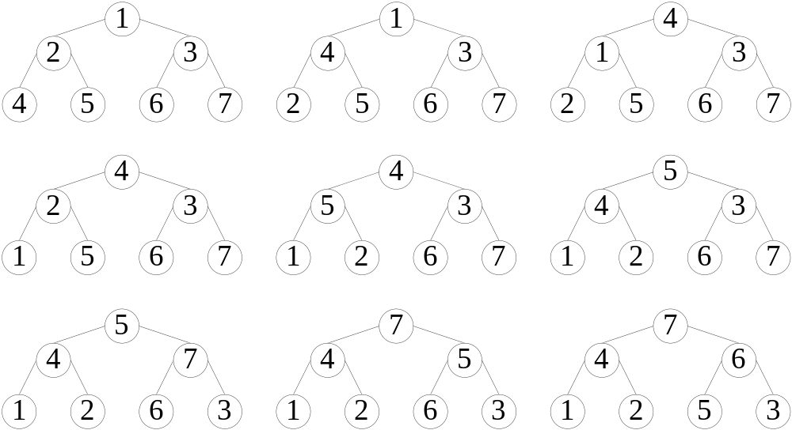
Building a Heap by Exchanging
(4-2)
(4-1)
(2-1)
(5-2)
(5-4)
(7-3)
(7-5)
(6-5)
8 exchanges
Max-heap

Slide 83
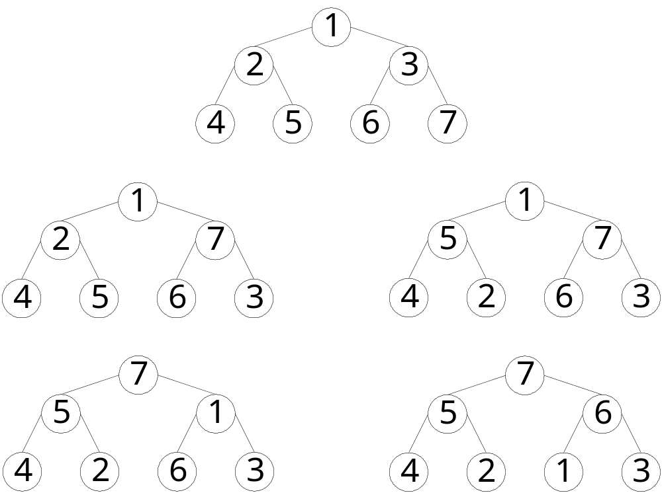
More Efficient Exchange (2)
(7-3)
(5-2)
(7-1)
(6-1)
4 exchanges

Slide 84
Bottom-up Building a Heap by Exchanging
Organize the left subtree of the root into a heap.
Organize the right subtree of the root into a heap.
Organize the whole tree into a heap
1
2
6
4
5
7
3
Max-Heap

Slide 85
Bottom-up Building a Heap by Exchanging
Organize the left subtree of the root into a heap.
Organize the right subtree of the root into a heap.
Organize the whole tree into a heap
1
5
6
4
2
7
3
Max-Heap

Slide 86
Bottom-up Building a Heap by Exchanging
Organize the left subtree of the root into a heap.
Organize the right subtree of the root into a heap.
Organize the whole tree into a heap
1
5
7
4
2
6
3
Max-Heap

Slide 87
Bottom-up Building a Heap by Exchanging
Organize the left subtree of the root into a heap.
Organize the right subtree of the root into a heap.
Organize the whole tree into a heap
7
7
1
1
5
6
5
7
5
3
4
2
1
3
4
2
6
3
4
2
6
Max-Heap
Sift (筛选) down

Slide 88
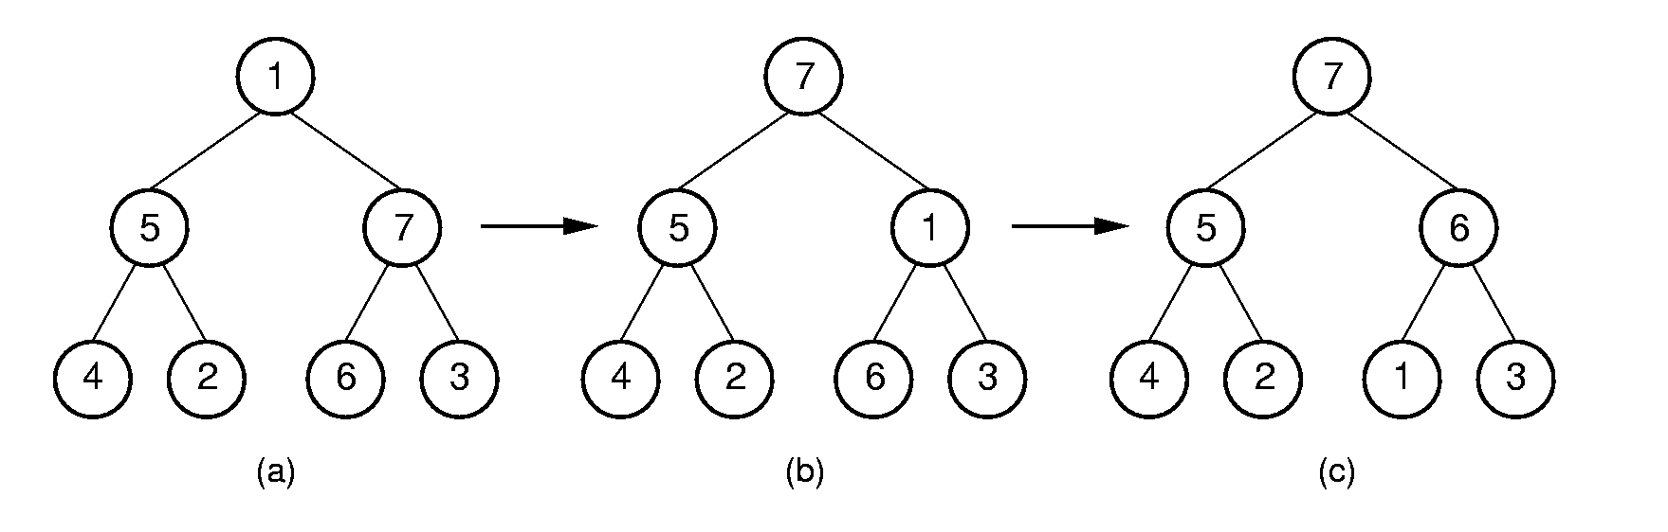
Siftdown
void siftdown(int pos) {
while (!isLeaf(pos)) {
int j = leftchild(pos);
int rc = rightchild(pos);
if ((rc<n) && Heap[j]< Heap[rc])
j = rc; // j -> the bigger child
if (Heap[pos] >= Heap[j]) return;
swap(Heap, pos, j);
pos = j;
}
}
Ө(logn)
pos
j
rc
pos
pos
j

Slide 89
Bottom-up Building a Heap with the siftdown function
3
5
6
Call siftdown for each internal node in a bottom-up way.
7
10
30
37
Heap
3
5
6
7
10
30
37
0 1 2 3 4 5 6 7
Siftdown (2)
3
5
37
7
10
30
6
Heap
3
5
37
7
10
30
6
0 1 2 3 4 5 6 7

Slide 90
Bottom-up Building a Heap with the siftdown function
3
5
37
Call siftdown for each internal node in a bottom-up way.
7
10
30
6
Heap
3
5
6
7
10
30
37
0 1 2 3 4 5 6 7
Siftdown (1)
3
10
37
7
5
30
6
Heap
3
10
37
7
5
30
6
0 1 2 3 4 5 6 7

Slide 91
Bottom-up Building a Heap with the siftdown function
3
10
37
Call siftdown for each internal node in a bottom-up way.
7
5
30
6
Heap
3
5
6
7
10
30
37
0 1 2 3 4 5 6 7
Siftdown (0)
37
37
10
30
10
3
7
5
3
6
7
5
30
6
Heap
37
10
30
7
5
3
6
0 1 2 3 4 5 6 7

Slide 92
Bottom-up Building a Heap with the siftdown function
heap construction:
Call siftdown for each internal node in a bottom-up way.
void void buildHeap()
{ for (int i=n/2-1; i>=0; i--) siftdown(i); }
The parent of the No. n - 1 node,
so its index is (n-1-1)/2 = n/2 -1
3
5
6
7
10
30
37
Heap
3
5
6
7
10
30
37
0 1 2 3 4 5 6 7

Slide 93
Heap Construction
maxheap(Elem* h, int num, int max)
{Heap = h; n = num; size = max; buildHeap();}
9
27
83
Heap
9
27
83
11
38
96
11
38
96
h
96
buildHeap()
83
27
96
83
27
38
11
9
Heap
38
11
9

Slide 94
Cost of Buildheap
Cost： log n
∑ (i - 1) n/2^{i} = Θ (n).
i=1
number of exchanges
i=4
3×n/16
= (i-1)n/2^{i}
i=3
2×n/8
= (i-1)n/2^{i}
i=2
1×n/4
= (i-1)n/2^{i}
i=1
0×n/2
=(i-1)n/2^{i}

Slide 95
Remove Max Value
Bool removemax(Elem& it) {
if (n == 0) return false; // Heap is empty
swap(Heap, 0, --n); // Swap max with end
if (n != 0) siftdown(0);
it = Heap[n]; // Return max value
return true;
}
Ө(logn)
Sift down
7
3
6
5
6
5
6
3
5
4
2
1
3
4
2
1
7
4
2
1
7
7
5
6
4
2
1
3
3
5
6
4
2
1
7
6
5
3
4
2
1
7
0 1 2 3 4 5 6
0 1 2 3 4 5 6
0 1 2 3 4 5 6

Slide 96
bool remove(int pos, Elem& it) {
if ((pos < 0) || (pos >= n)) return false;
swap(Heap, pos, --n);
while ((pos != 0) && (Heap[pos]>
Heap[parent(pos)]))
{ swap(Heap, pos, parent(pos));
pos = parent(pos); }
siftdown(pos);
it = Heap[n];
return true;
}
12
12
pos
11
7
11
7
pos
5
6
9
6
10
8
10
8
4
2
1
3
9
4
2
1
3
5

Slide 97
bool remove(int pos, Elem& it) {
if ((pos < 0) || (pos >= n)) return false;
swap(Heap, pos, --n);
while ((pos != 0) && (Heap[pos]>
Heap[parent(pos)])))
{ swap(Heap, pos, parent(pos));
pos = parent(pos); }
siftdown(pos);
it = Heap[n];
return true;
}
11
11
pos
pos
7
10
10
3
Sift down
5
6
9
8
5
6
9
8
4
2
1
3
4
2
1
7

Slide 98
Application of Heaps (1)
Design a data structure to support efficient Get_max/insert/remove operation on a set of data.
 | Sorted List (Array based) | Sorted List (Link based) | Heap
Construction | Ө (nlogn) | Ө (nlogn) | Ө (n)
Get_max | Ө (1) | Ө (1) | Ө (1)
Remove_max | Ө (1) | Ө (1) | Ө (logn)
Insert | Ө(n) | Ө(n) | Ө (logn)

Slide 99
Application of Heaps (2) –
Priority Queues
Example: Scheduling jobs in a multi-tasking operating system.
job
job
Get the job with
highest priority
to run
job
Priority queues

Slide 100
Application of Heaps (2) –
Priority Queues （cont.）
Implementation: Use a heap to store the priority queue of the jobs.
job
job
Get the job with
highest priority
to run
job
Organized into a heap by the priority of the jobs

Slide 101
Chapter5 Binary Trees
5.1 Definitions and Properties
5.2 Binary Tree ADT
5.3 Binary Tree Node Implementations
5.4 Traversal of Binary Tree
5.5 Binary Search Trees
5.6 Heaps and Priority Queues
5.7 Huffman Coding Trees

Slide 102
Coding
Coding: represent a set of items by assigning a unique code to each item.
Fixed-length coding: Each item is represented as a fixed length code.
    ASCII codes: 8 bits per character
  0100 0001 A
  0100 0010 B
  0100 0011 C
  0100 0100 D
  0100 0101 E
  0100 0110 F
  … …
Hello, I am Jimmy.
0100 1000 0110 0101 0110 1100 0110 1100 0110 1111 … …

Slide 103
Different Frequency of characters
Letter | Freq |  | Letter | Freq |  | Letter | Freq
A | 77 |  | J | 4 |  | S | 67
B | 17 |  | K | 7 |  | T | 85
C | 32 |  | L | 42 |  | U | 37
D | 42 |  | M | 24 |  | V | 12
E | 120 |  | N | 67 |  | W | 22
F | 24 |  | O | 67 |  | X | 4
G | 17 |  | P | 20 |  | Y | 22
H | 50 |  | Q | 5 |  | Z | 2
I | 76 |  | R | 59
Hello, I am Jimmy.
How to make the code short?
0100 1000 0110 0101 0110 1100 0110 1100 0110 1111 … …

Slide 104
Variable-length coding
Variable-length coding: The length of code depends on the frequency of the letters.
  Short code for frequently appeared letters.
Letter | Freq | Code
C | 32 | 1110
D | 42 | 101
E | 120 | 0
M | 24 | 11111
K | 7 | 111101
L | 42 | 110
U | 37 | 100
Z | 2 | 111100
Save space cost compared to fix-length coding

Slide 105
Huffman Codes
Huffman coding:
  A kind of Variable-length coding
  Short code for frequently appeared letters.
Huffman coding is derived from Huffman Tree – a kind of full binary tree

Slide 106
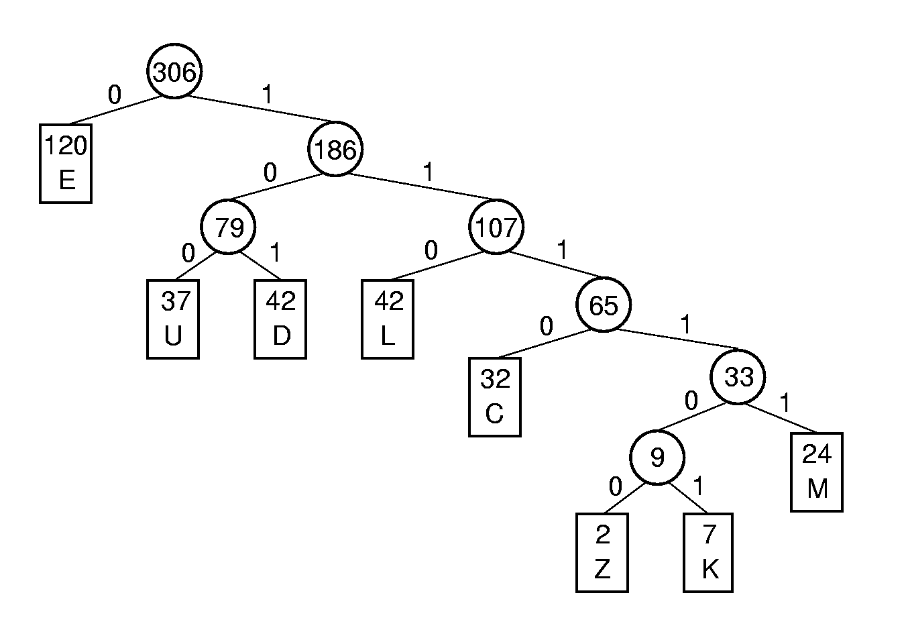
Huffman Tree
Letter | Freq | HuffmanCode
C | 32 | 1110
D | 42 | 101
E | 120 | 0
M | 24 | 11111
K | 7 | 111101
L | 42 | 110
U | 37 | 100
Z | 2 | 111100
Huffman tree: with all the letters as
Leaves and the frequency as
corresponding weight.
The leaves with small weight are arranged in the deep levels of the tree.

Slide 107
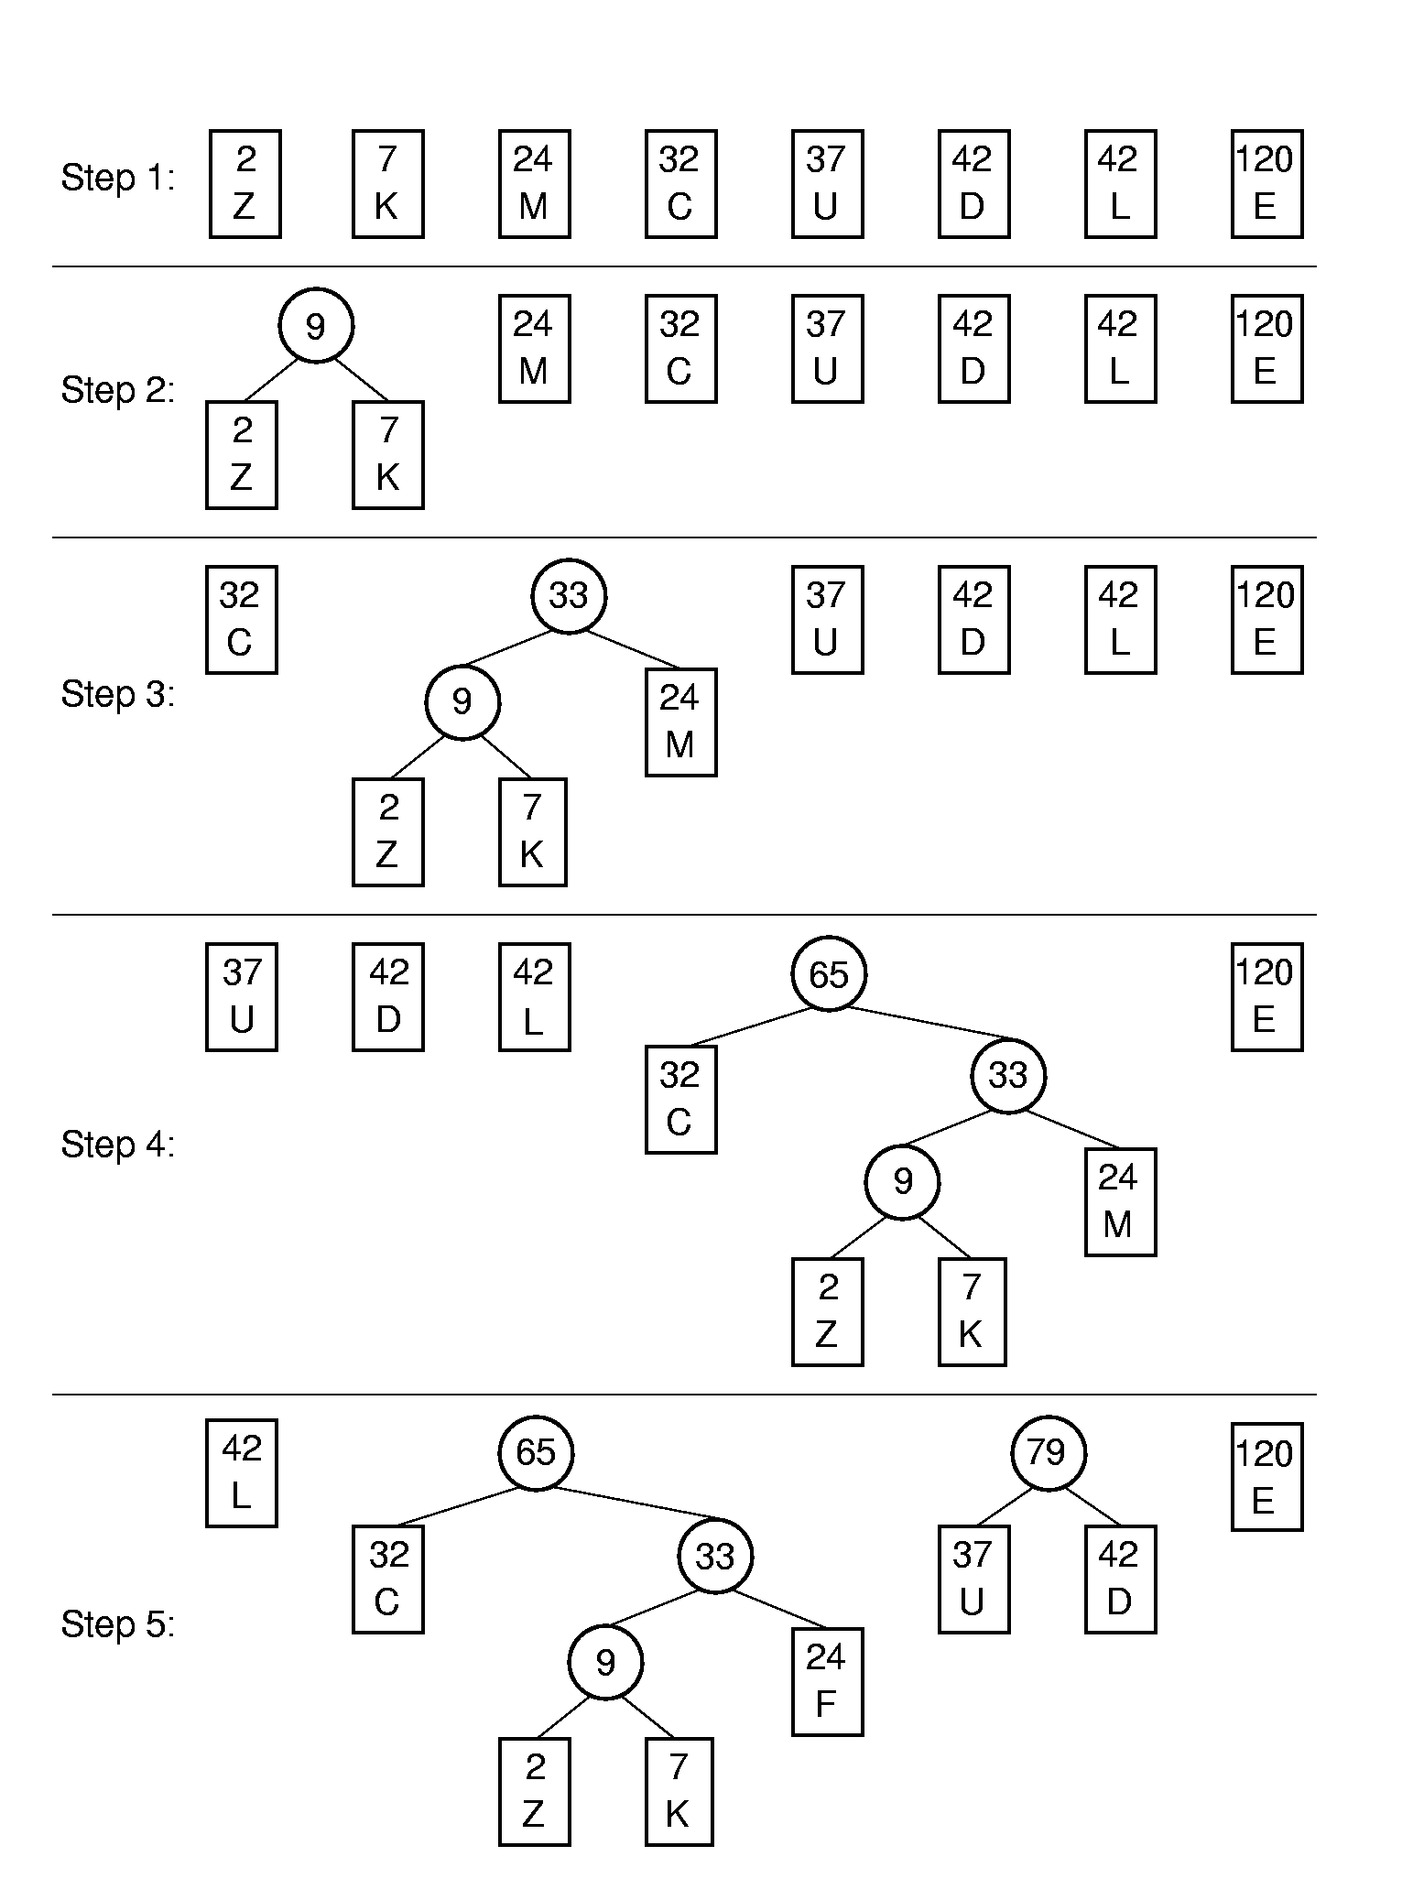
Huffman Tree Construction (1)
Greedy (贪心)

Slide 108
Huffman Tree Construction (2)

Slide 109
Assigning Codes
Letter | Freq | Code
C | 32 | 1110
D | 42 | 101
E | 120 | 0
M | 24 | 11111
K | 7 | 111101
L | 42 | 110
U | 37 | 100
Z | 2 | 111100

Slide 110
Cost
Letter | Freq | Code | Bits
C | 32 | 1110 | 4
D | 42 | 101 | 3
E | 120 | 0 | 1
M | 24 | 11111 | 5
K | 7 | 111101 | 6
L | 42 | 110 | 3
U | 37 | 100 | 3
Z | 2 | 111100 | 6
Expected cost per letter:
(4×32+3×42+1×120+5×24+6×7+
3×42+3×37+6×2) / 306 = 785/306 = 2.57
Compared with the fixed length coding:
log₂8 = 3.

Slide 111
Cost (2)
Letter | Freq | Code | Bits
C | 32 | 1110 | 4
D | 42 | 101 | 3
E | 120 | 0 | 1
M | 24 | 11111 | 5
K | 7 | 111101 | 6
L | 42 | 110 | 3
U | 37 | 100 | 3
Z | 2 | 111100 | 6
Expected cost per letter:
(4×32+3×42+1×120+5×24+6×7+
3×42+3×37+6×2) / 306
The cost is decided by the sum of weighted depth of all leaves.

Slide 112
Efficiency analysis
Theorem: For the given set of letters, the Huffman tree has the minimum sum of weighted depth
Huffman code is the optimal prefix-free coding.

Slide 113
Huffman Tree Node class (1)
template <class Elem>
class HuffNode { //Node abstract base class
public:
virtual int weight() = 0;
virtual bool isLeaf() = 0;
virtual HuffNode* left() const = 0;
virtual void setLeft(HuffNode*) = 0;
virtual HuffNode* right() const = 0;
virtual void setRight(HuffNode*) = 0;
};

Slide 114
Huffman Tree Node class (2)
template <class Elem> //leaf node subclass
class LeafNode: public HuffNode<Elem> {
private:
Freqpair<Elem>* it; //Frequency pair
public:
LeafNode(const Elem& val, int freq) //constructor
{ it = new Freqpair<Elem>(val,freq); }
int weight() { return it->weight(); } //Return frequency
Freqpair<Elem>* val() { return it; }
bool isLeaf() { return true; }

Slide 115
Huffman Tree Node class (3)
virtual HuffNode* left() const { return NULL; }
virtual void setLeft(HuffNode*) { }
virtual HuffNode* right() const { return NULL; }
virtual void setRight(HuffNode*) { }
};

Slide 116
Huffman Tree Node class (4)
template <class Elem>
class FreqPair { //An element / frequency pair
private:
Elem it; //An element of some sort
int freq;
public:
FreqPair(const Elem& e, int f) //Constructor
{ it = e; freq = f; }
~FreqPair() { } //Destructor
int weight() { return freq; } //Return the weight
Elem& val() { return it; } //Return the element
};

Slide 117
Huffman Tree Node class (5)
template <class Elem> //Internal node subclass
class IntlNode: public HuffNode<Elem> {
private:
HuffNode<Elem>* lc; //left child
HuffNode<Elem>* rc; //right child
int wgt; //Subtree weight
public:
IntlNode(HuffNode<Elem> * l, HuffNode<Elem> * r)
{ wgt = l->weight() + r->weight(); lc = l; rc = r; }
int weight() { return wgt; } //Return frequency

Slide 118
Huffman Tree Node class (6)
bool isLeaf() { return false; }
HuffNode<Elem>* left() const { return lc; }
void setLeft(HuffNode<Elem>* b)
{ lc = (HuffNode*)b; }
HuffNode<Elem>* right() const { return rc; }
void setRight(HuffNode<Elem>* b)
{ rc = (HuffNode*)b; }
};

Slide 119
Huffman Coding Trees class
template <class Elem>
class HuffTree {
private:
HuffNode<Elem>* theRoot;
public:
HuffTree(Elem& val, int freq)
{ theRoot = new LeafNode<Elem>(val,freq); }
HuffTree(HuffTree<Elem>* l, HuffTree<Elem>* r)
{ theRoot = new IntlNode<Elem>(l->root(), r->root()); }
~ HuffTree() { }
HuffNode<Elem>* root() { return theRoot; }
int weight() { return theRoot->weight(); }
};
theRoot

Slide 120
Build Huffman Tree
template <class Elem> HuffTree<Elem>*
buildHuff(SLList <HuffTree<Elem>*, HHCompare<Elem> >* f1) {
HuffTree<Elem>* temp1, *temp2, *temp3;
while(f1-> Length() > 1) { //While at least two items left
f1->setStart();
f1->remove(temp1); //Pull first two trees off the list
f1->remove(temp2);
temp3 = new HuffTree<Elem>(temp1, temp2);
f1->insert(temp3); //Put the new tree back on list
delete temp1; //Must delete the remnants
delete temp2; // of the trees we created
}
return temp3; }

Slide 121
Sorted Link List (1)
//sorted link list
template <class Elem, class Compare>
class SLList: protected LList<Elem> {
public:
SLList(int size=DefaultListSize) : LList<Elem>(size) {}
~SLList() {} // Destructor
bool insert(const Elem& item) { // Insert at right
Elem curr;
for (setStart(); getValue(curr); next())
if(!Compare::lt(curr, item)) break;
return LList<Elem>::insert(item);
}
… …

Slide 122
Sorted Link List(2)
//compare the weight of the roots of two Huffman Trees
template <class Elem>
class HHCompare {
public:
static bool lt(HuffTree<Elem>* x, HuffTree<Elem>* y)
{ return x->weight() < y->weight(); }
static bool eq(HuffTree<Elem>* x, HuffTree<Elem>* y)
{ return x->weight() = = y->weight(); }
static bool gt(HuffTree<Elem>* x, HuffTree<Elem>* y)
{ return x->weight() > y->weight(); }
};

Slide 123
Thanks!
Questions?

