Slide 1
Chapter7 Internal Sorting
7.1 Terminology and notation
7.2 Three Θ(n²) Sorting Algorithms
  Insertion Sort
  Bubble Sort
  Selection Sort
7.3 Shell Sort
7.4 Quick Sort
7.5 Merge Sort
7.6 Heap Sort
7.7 BinSort and Radix Sort
7.8 Empirical Comparison of Sorting Algorithms
7.9 Lower bounds for Sorting

Slide 2
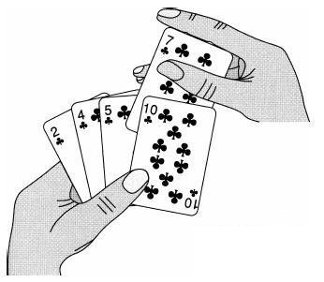
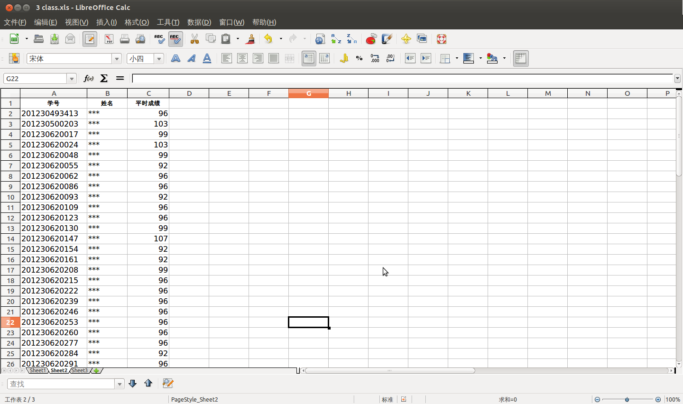

Example

Slide 3
Sorting Problem
Given a sequence of records R₁ , R₂ , … , R_{n} with key values k₁ , k₂ ,… , k_{n} , respectively, arrange the records into any orders such that records R_{s1},R_{s2},…,R_{sn} have keys obeying the property k_{s1} ≤ k_{s2} ≤ …≤ k_{sn}.
23
11
5
77
50
80
5
11
23
50
77
80

Slide 4
Stable vs unstable
A sort algorithm is said to be stable if it does not change the relative ordering of records with identical key values.
k5
k3
k4
k2
k6
k1
stable
k1
k2
k3
k4
k5
k6
k5
k3
k4
k6
k2
k1
unstable
k5<k3<k4<k2 = k6<k1

Slide 5
Sorting Terminology
Internal Sorting (内部排序)：Sort the data stored in the memory
External Sorting (外部排序)：Sort the data stored on the disk

Slide 6
Chapter7 Internal Sorting
7.1 Terminology and notation
7.2 Three Θ(n²) Sorting Algorithms
  Insertion Sort
  Bubble Sort
  Selection Sort
7.3 Shell Sort
7.4 Quick Sort
7.5 Merge Sort
7.6 Heap Sort
7.7 BinSort and Radix Sort
7.8 Empirical Comparison of Sorting Algorithms
7.9 Lower bounds for Sorting

Slide 7
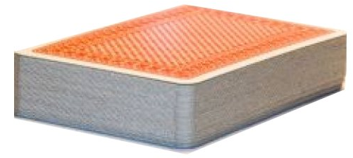
Insertion Sort (1)
Insert each card in a proper place

Slide 8
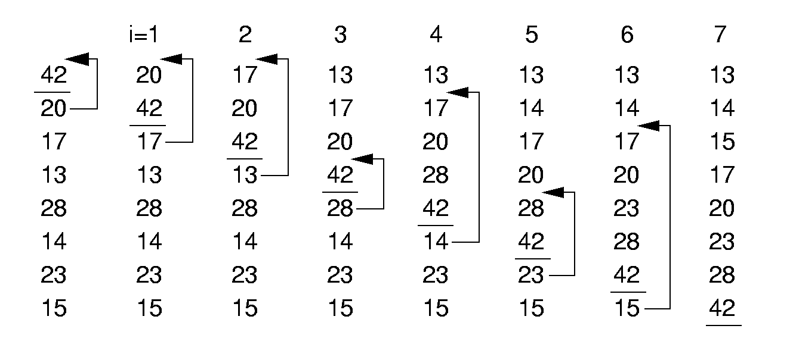

Insertion Sort
In the iteration i, insert the No. i record
(1 <= i <= n -1)

Slide 9
Insertion
13
17
20
28
42
14
23
15
13
17
20
28
42
14
23
15
13
17
20
28
14
42
23
15
13
17
20
14
28
42
23
15
13
17
14
20
28
42
23
15
13
14
17
20
28
42
23
15
13
14
17
20
28
42
23
15
Comparision and swapping

Slide 10
Insertion Sort (2)
template <class Elem>
void inssort(Elem A[], int n) {
for (int i=1; i<n; i++)
//insert the No. i record
for (int j=i; (j>0) &&
(A[j]< A[j-1])); j--)
swap(A, j, j-1);
}
i=2
20
17
42
18
i=2
17
20
42
18
i=3
17
20
42
18
i=3
17
20
18
42
i=3
17
18
20
42
i=1
i=1
20
42
17
18
i=2
20
42
17
18
42
20
17
18
j
j
j
j
j
j
j
j

Slide 11
Cost Analysis (1)
Best Case: 0 swaps, n - 1 comparisons Θ(n)
13
14
15
17
20
23
28
42
13
14
15
17
20
23
28
42
13
14
15
17
20
23
28
42
13
14
15
17
20
23
28
42
13
14
15
17
20
23
28
42
13
14
15
17
20
23
28
42
13
14
15
17
20
23
28
42
13
14
15
17
20
23
28
42

Slide 12
Cost Analysis (2)
Worst Case: n(n-1)/2 swaps and comparisons Θ(n²)
42
28
23
20
17
15
14
13
42
28
23
20
17
15
14
13
28
42
23
20
17
15
14
13
23
28
42
20
17
15
14
13
20
23
28
42
17
15
14
13
17
20
23
28
42
15
14
13
15
17
20
23
28
42
14
13
15
17
20
23
28
42
14
13

Slide 13
Cost Analysis (3)
Best Case: 0 swaps, n - 1 comparisons Θ(n)
Worst Case: n(n-1)/2 swaps and comparisons Θ(n²)
Average Case: Θ(n²)

Slide 14
Stable Sort
Insertion Sorting algorithm is Stable.
i=1
i=1
20
42
17
17
i=2
20
42
17
17
i=2
20
17
42
17
i=2
17
20
42
17
i=3
17
20
42
17
i=3
17
20
17
42
i=3
17
17
20
42
42
20
17
17
42
20
17
17

Slide 15
Chapter7 Internal Sorting
7.1 Terminology and notation
7.2 Three Θ(n²) Sorting Algorithms
  Insertion Sort
  Bubble Sort
  Selection Sort
7.3 Shell Sort
7.4 Quick Sort
7.5 Merge Sort
7.6 Heap Sort
7.7 BinSort and Radix Sort
7.8 Empirical Comparison of Sorting Algorithms
7.9 Lower bounds for Sorting

Slide 16
Bubble Sort(冒泡排序) (1)
One iteration of bubble sort：
42
20
17
13
28
14
23
15
42
20
17
13
28
14
15
23
42
20
17
13
14
28
15
23
42
20
13
17
14
28
15
23
42
13
20
17
14
28
15
23
13
42
20
17
14
28
15
23
The least element comes out
Compare each adjacent pair of elements.
Swap the elements in the pairs which are out of order.

Slide 17
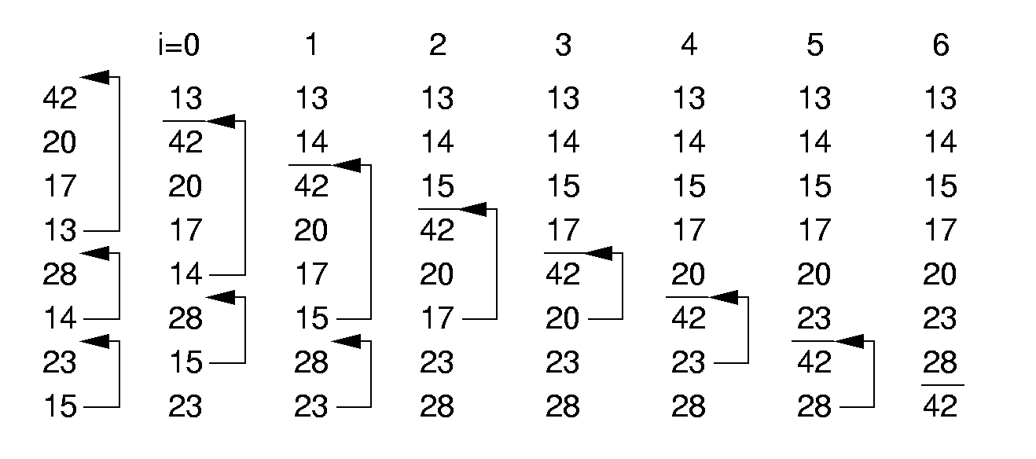
Bubble Sort(冒泡排序) (2)
The scope to exchange elements: [i, n-1]

Slide 18
Bubble Sort (3)
template <class Elem>
void bubsort(Elem A[], int n) {
for (int i=0; i<n-1; i++)
for (int j=n-1; j>i; j--)
if (A[j]< A[j-1])
swap(A, j, j-1);
}

Slide 19
Bubble Sort (4)
template <class Elem>
void bubsort(Elem A[], int n) {
for (int i=0; i<n-1; i++)
for (int j=n-1; j>i; j--)
if (A[j]< A[j-1])
swap(A, j, j-1);
}
Best Case: Θ(n²)
Worst Case: Θ(n²)
Average Case: Θ(n²)

Slide 20
Bubble Sort (5)
template <class Elem>
void bubsort(Elem A[], int n) {
for (int i=0; i<n-1; i++)
for (int j=n-1; j>i; j--)
if (A[j]< A[j-1])
swap(A, j, j-1);
}
Bubble Sorting algorithm is Stable.
42
20
17
13
28
13
23
15
42
20
17
13
28
13
15
23
42
20
17
13
13
28
15
23
42
20
13
17
13
28
15
23
42
13
20
17
13
28
15
23
13
42
20
17
13
28
15
23
13
13
42
20
17
15
28
23
… …

Slide 21
Chapter7 Internal Sorting
7.1 Terminology and notation
7.2 Three Θ(n²) Sorting Algorithms
  Insertion Sort
  Bubble Sort
  Selection Sort
7.3 Shell Sort
7.4 Quick Sort
7.5 Merge Sort
7.6 Heap Sort
7.7 BinSort and Radix Sort
7.8 Empirical Comparison of Sorting Algorithms
7.9 Lower bounds for Sorting

Slide 22
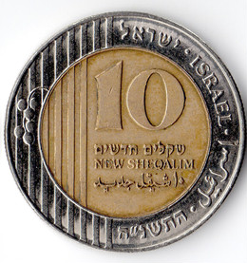
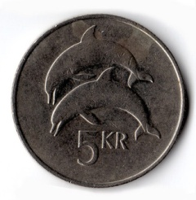





Selection Sort
select the smallest one
Sort the coins by their size

Slide 23

Selection Sort
select the smallest one
Sort the coins by their size

Slide 24
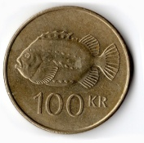
Selection Sort
select the smallest one
Sort the coins by their size

Slide 25
Selection Sort
select the smallest one
Sort the coins by their size

Slide 26
Selection Sort
select the smallest one
Sort the coins by their size

Slide 27
Selection Sort
select the smallest one
Sort the coins by their size

Slide 28

Selection Sort
select the smallest one
Sort the coins by their size

Slide 29
Selection Sort
select the smallest one
Sort the coins by their size

Slide 30
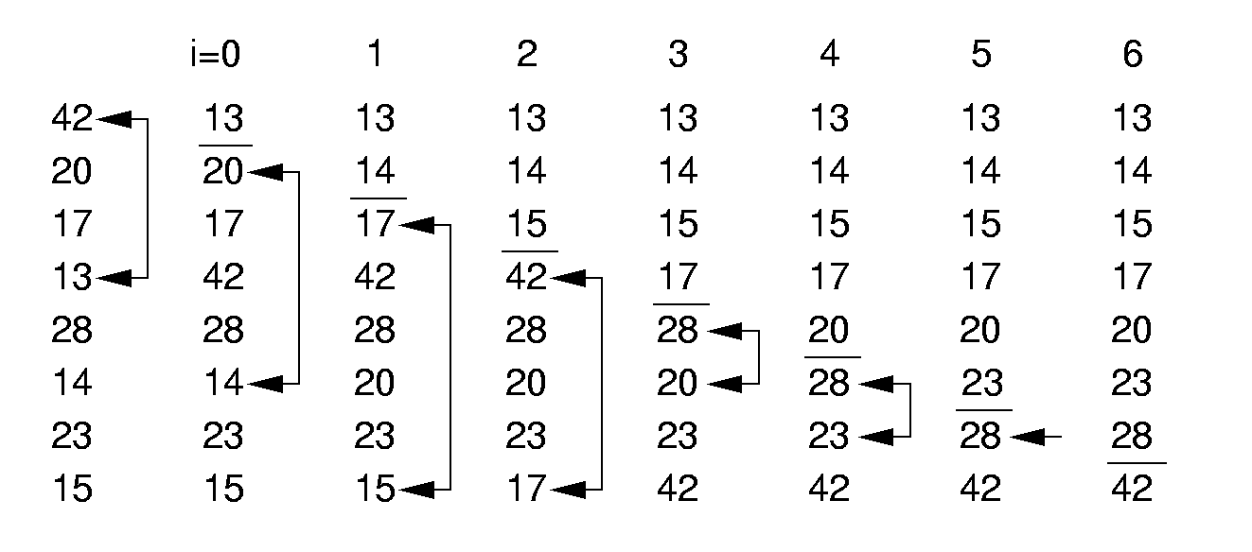
Selection Sort (1)
Totally n - 1 iterations.
In the No. i iteration:
  Select the minimum element from Array[i…n-1]
  exchange it with Array[i]

Slide 31
Selection Sort (2)
template <class Elem>
void selsort(Elem Array[], int n) {
for (int i=0; i<n-1; i++) {
// select the minimal values in Array[i...n-1]
int min = i;
for (int j = i+1; j <= n-1; j++) // Find least
if (A[j]< A[min])
min = j; // Put it in place
//exchange it with Array[i]
swap(A, i, min);
}
}
Totally n - 1 iterations.
In the No. i iteration:
  Select the minimum element from Array[i…n-1]
  exchange it with Array[i]

Slide 32
Cost Analysis
template <class Elem>
void selsort(Elem Array[], int n) {
for (int i=0; i<n-1; i++) {
// select the minimal values in Array[i...n-1]
int min = i;
for (int j = i+1; j <= n-1; j++) // Find least
if (A[j]< A[min])
min = j; // Put it in place
//exchange it with Array[i]
swap(A, i, min);
}
}
Best Case: Θ(n²)
Worst Case: Θ(n²)
Average Case: Θ(n²)

Slide 33
Unstable Sort
template <class Elem>
void selsort(Elem Array[], int n) {
for (int i=0; i<n-1; i++) {
// select the minimal values in Array[i...n-1]
int min = i;
for (int j = i+1; j <= n-1; j++) // Find least
if (A[j]< A[min])
min = j; // Put it in place
//exchange it with Array[i]
swap(A, i, min);
}
}
i=0
i=1
20
20
17
17
20
20
17
20
20

Slide 34
Summary
 | Insertion | Bubble | Selection
Best Case | Θ(n) | Θ(n²) | Θ(n²)
Average Case | Θ(n²) | Θ(n²) | Θ(n²)
Worst Case | Θ(n²) | Θ(n²) | Θ(n²)

Slide 35
Chapter7 Internal Sorting
7.1 Terminology and notation
7.2 Three Θ(n²) Sorting Algorithms
  Insertion Sort
  Bubble Sort
  Selection Sort
7.3 Shell Sort
7.4 Quick Sort
7.5 Merge Sort
7.6 Heap Sort
7.7 BinSort and Radix Sort
7.8 Empirical Comparison of Sorting Algorithms
7.9 Lower bounds for Sorting

Slide 36
Shellsort （希尔排序）
Insertion sort
Best Case | Θ(n)
Average Case | Θ(n²)
Worst Case | Θ(n²)
Shorter sequence → Faster
Sequence almost orderly → Faster

Slide 37
Shellsort （希尔排序）
Improvement：
Divide the sequence into shorter sub-sequences
Perform insertion sort on each sub-sequences
Perform insertion sort on the whole sequences
How to divide if we want to improve the performance?
Sort on sub-sequences can make the whole sequence more orderly!

Slide 38
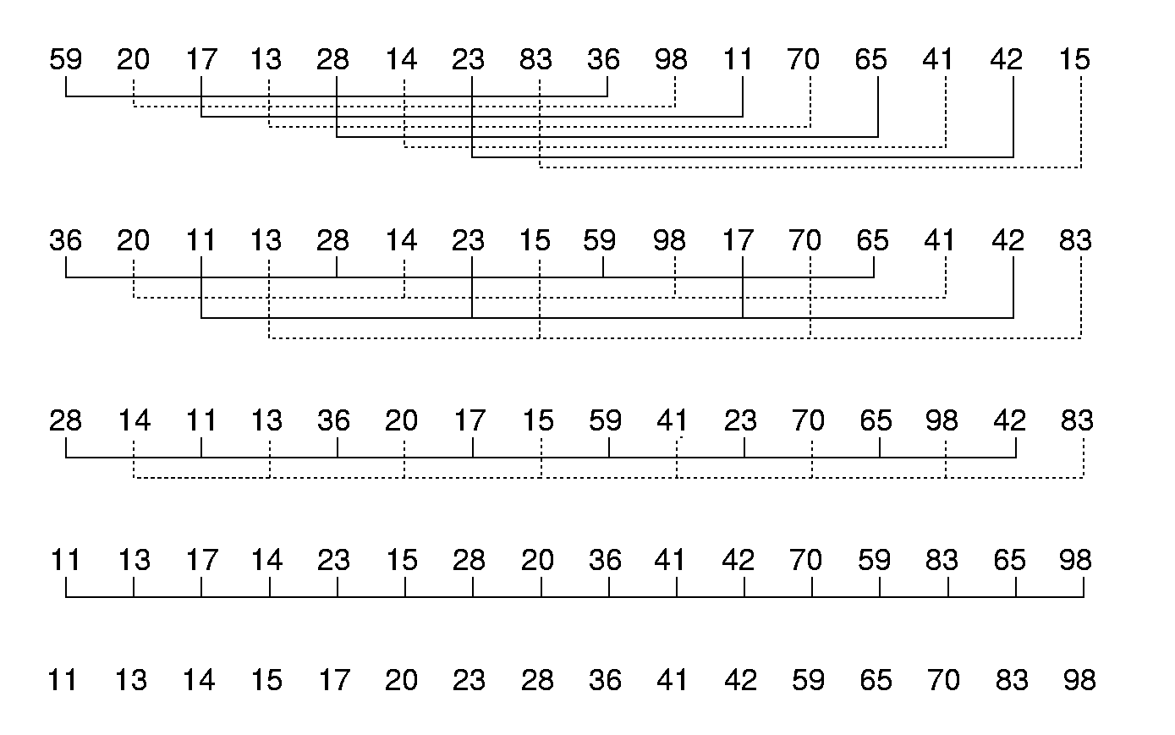
Shellsort (1)
8 subsequences
based on the increment 8
4 subsequences
based on the increment 4
2 subsequences
based on the increment 2
1 subsequence
based on the increment 1

Slide 39

Shellsort(2)
template <class Elem>
void shellsort(Elem A[], int n) { // Shellsort
for (int i=n/2; i>=1; i/=2) // For each incr
for (int j=0; j<i; j++) // Sort sublists
inssort2<Elem>(A, n, j, i);
}
// Modified version of Insertion Sort
template <class Elem>
void inssort2(Elem A[], int n, int from, int incr)
{
for (int i= from + incr; i<n; i+=incr)
for (int j=i; (j> from &&
A[j]< A[j-incr]); j-=incr)
swap(A, j, j-incr);
}
j
i = 4

Slide 40
Shellsort(2)
template <class Elem, class Comp>
void shellsort(Elem A[], int n) { // Shellsort
for (int i=n/2; i>=1; i/=2) // For each incr
for (int j=0; j<i; j++) // Sort sublists
inssort2<Elem,Comp>(A, n, j, i);
}
// Modified version of Insertion Sort
template <class Elem>
void inssort2(Elem A[], int n, int from, int incr)
{
for (int i= from + incr; i<n; i+=incr)
for (int j=i; (j> from &&
A[j]< A[j-incr]); j-=incr)
swap(A, j, j-incr);
}
from
j
i
incr= 4

Slide 41
Shellsort(2)
template <class Elem, class Comp>
void shellsort(Elem A[], int n) { // Shellsort
for (int i=n/2; i>=1; i/=2) // For each incr
for (int j=0; j<i; j++) // Sort sublists
inssort2<Elem,Comp>(A, n, j, i);
}
// Modified version of Insertion Sort
template <class Elem>
void inssort2(Elem A[], int n, int from, int incr)
{
for (int i= from + incr; i<n; i+=incr)
for (int j=i; (j> from &&
A[j]< A[j-incr]); j-=incr)
swap(A, j, j-incr);
}
28
36
from
j
i
incr= 4

Slide 42
Shellsort(2)
template <class Elem, class Comp>
void shellsort(Elem A[], int n) { // Shellsort
for (int i=n/2; i>=1; i/=2) // For each incr
for (int j=0; j<i; j++) // Sort sublists
inssort2<Elem,Comp>(A, n, j, i);
}
// Modified version of Insertion Sort
template <class Elem>
void inssort2(Elem A[], int n, int from, int incr)
{
for (int i= from + incr; i<n; i+=incr)
for (int j=i; (j> from &&
A[j]< A[j-incr]); j-=incr)
swap(A, j, j-incr);
}
28
36
from
j
i
incr= 4

Slide 43
Shellsort(3)
Not simple linear division
Divide a sequence based on some increment
Time complexity: related with the increments sequence.
While the increments sequence is ∆[k] = 2^{t-k+1} - 1，the time is O(n^{3/2}). Here t is the number of iterations, 1<=k<=t. Eg.（15，7，3，1）

Slide 44
Shell sort is unstable
Initial: 49 38 65 97 76 13 27 49 55 04
49 13
38 27
Increment = 5
65 49
97 55
76 04
Result 1 ： 13 27 49 55 04 49 38 65 97 76
13 55 38 76
Increment = 3
27 04 65
49 49 97
result 2： 13 04 49 38 27 49 55 65 97 76
result 3： 04 13 27 38 49 49 55 65 76 97

Slide 45
Chapter7 Internal Sorting
7.1 Terminology and notation
7.2 Three Θ(n²) Sorting Algorithms
  Insertion Sort
  Bubble Sort
  Selection Sort
7.3 Shell Sort
7.4 Quick Sort
7.5 Merge Sort
7.6 Heap Sort
7.7 BinSort and Radix Sort
7.8 Empirical Comparison of Sorting Algorithms
7.9 Lower bounds for Sorting

Slide 46
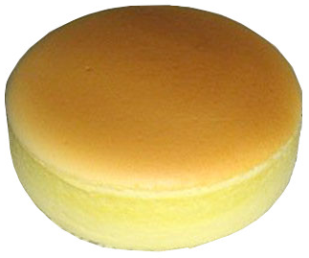


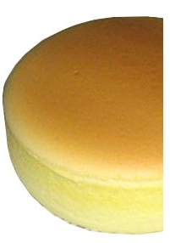
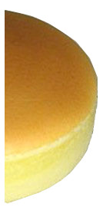
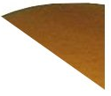
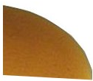

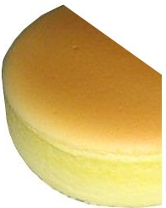

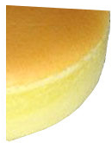
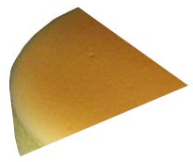

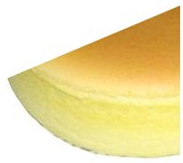
Divide and Conquer

Slide 47
Quicksort (1)
Quicksort is a kind of “Divide and Conquer” approach:
  Select a value called pivot(支点)
  Using the pivot to partition the array :
    arranging the records less than the pivot in the left of the pivot, and the records greater than of equal to the pivot in the right of the pivot.
72 6 57 88 60 42 83 73 48 85
48 6 57 42 60 88 83 73 72 85
< 60
≥ 60

Slide 48
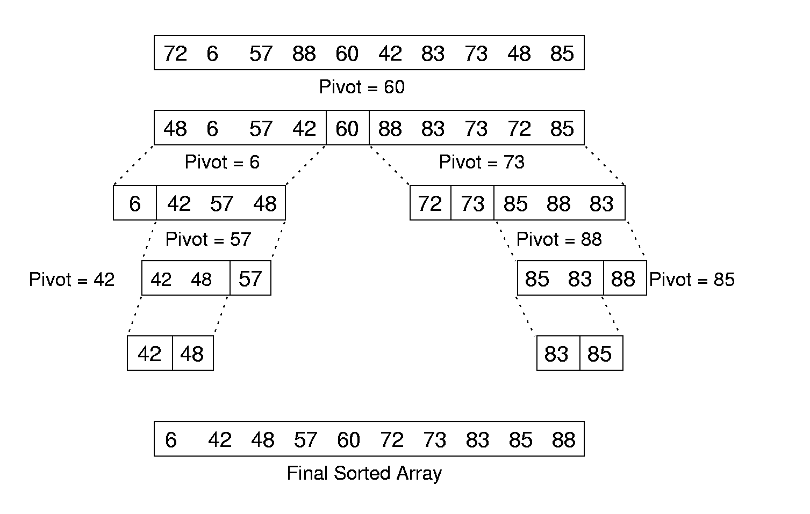
Quicksort (2)
Partition the left and right sub-array recursively, until each sub-array only contains one record.

Slide 49
Quicksort algorithm
template <class Elem>
void qsort(Elem A[], int i, int j) {
if (j <= i) return; // List too small
int pivot = findpivot(A, i, j);
swap(A, pivot, j); // Put pivot at end
int k = partition<Elem>(A, i, j, A[j]);
swap(A, k, j); // Put pivot in place
qsort<Elem>(A, i, k-1);
qsort<Elem>(A, k+1, j);
}
<
>=
k
i
j
pivot

Slide 50
findpivot
Select a key as pivot:
  Select the First element.
  Select the middle element.
  Others.
template <class Elem>
int findpivot(Elem A[], int i, int j)
{ return (i+j)/2; }

Slide 51
Partition
72
6
57
88
85
42
83
73
48
60
Pivot = 60
l
r

Slide 52
Partition
48
6
57
88
85
42
83
73
72
60
Pivot = 60
l
r

Slide 53
Partition
48
6
57
42
85
88
83
73
72
60
Pivot = 60
l
r

Slide 54
Partition
template <class Elem>
int partition(Elem A[], int l, int r,Elem& pivot)
{
do {
while (A[l] < pivot) l++;
while ((r > l) && A[r] >=pivot)
r--;
swap(A, l, r); // Swap out-of-place values
} while (l < r); // Stop when they cross
return l; // Return first pos on right
}
The elements before l are all less than pivot,
and the ones after r are all bigger than or equal to pivot.
72
6
57
88
85
42
83
73
48
60
Pivot = 60
l
r

Slide 55
Partition
template <class Elem>
int partition(Elem A[], int l, int r,Elem& pivot)
{
do {
while (A[l] < pivot) l++;
while ((r > l) && A[r] >=pivot)
r--;
swap(A, l, r); // Swap out-of-place values
} while (l < r); // Stop when they cross
return l; // Return first pos on right
}
The elements before l are all less than pivot,
and the ones after r are all bigger than or equal to pivot.
48
6
57
88
85
42
83
73
72
60
Pivot = 60
l
r

Slide 56
Partition
template <class Elem>
int partition(Elem A[], int l, int r,Elem& pivot) {
do {
while (A[l] < pivot) l++;
while ((r > l) && A[r] >=pivot)
r--;
swap(A, l, r); // Swap out-of-place values
} while (l < r); // Stop when they cross
return l; // Return first pos on right
}
The elements before l are all less than Pivot,
and the ones after r are all bigger than or equal to Pivot.
Θ(n)
48
6
57
42
85
88
83
73
72
60
Pivot = 60
l
r

Slide 57
Cost of Quicksort （1）
Θ(n)
Θ (n)
h
Θ (n)
Θ (hn)

Slide 58
Cost of Quicksort （2）
Best case: Balanced partition Θ (n log n)
Worst: Bad partition. Θ (n²)
Average case: Θ (n log n)
logn
n

Slide 59
Optimizations for Quicksort
Better Pivot
  Select the middle of three values : the first, middle, and last records of the array.
Better algorithm for small sub-arrays
  Quicksort is relatively slow when the sub-array size is small
  Use the insertion sort to sort the small sub-arrays
Eliminate recursion

Slide 60
Chapter7 Internal Sorting
7.1 Terminology and notation
7.2 Three Θ(n²) Sorting Algorithms
  Insertion Sort
  Bubble Sort
  Selection Sort
7.3 Shell Sort
7.4 Quick Sort
7.5 Merge Sort
7.6 Heap Sort
7.7 BinSort and Radix Sort
7.8 Empirical Comparison of Sorting Algorithms
7.9 Lower bounds for Sorting

Slide 61
Mergesort
Mergesort is a kind of “Divide and Conquer” approach:
  Split a list into two equal sub-lists and sort each sub-lists
  Recombine them into one sorted list.
Recursive procedure
Combine two sorted list into one
36 20 17 13 28 14 23 15
13 14 15 17 20 23 28 36
36 20 17 13
28 14 23 15
13 17 20 36
14 15 23 28

Slide 62
Mergesort algorithm (1)
List mergesort(List inlist) {
if (inlist.length() <= 1)return inlist;
List l1 = half of the items from inlist;
List l2 = other half of items from inlist;
return merge(mergesort(l1),
mergesort(l2));
}
36 20 17 13 28 14 23 15
36 20 17 13
28 14 23 15
36 20
17 13
36
20

Slide 63
Mergesort algorithm (2)
List mergesort(List inlist) {
if (inlist.length() <= 1)return inlist;
List l1 = half of the items from inlist;
List l2 = other half of items from inlist;
return merge(mergesort(l1),
mergesort(l2));
}
36 20 17 13 28 14 23 15
36 20 17 13
28 14 23 15
20 36
17 13
36
20
17
13

Slide 64
Mergesort algorithm (2)
List mergesort(List inlist) {
if (inlist.length() <= 1)return inlist;
List l1 = half of the items from inlist;
List l2 = other half of items from inlist;
return merge(mergesort(l1),
mergesort(l2));
}
36 20 17 13 28 14 23 15
36 20 17 13
28 14 23 15
20 36
13 17
36
20
17
13

Slide 65
Mergesort algorithm (2)
List mergesort(List inlist) {
if (inlist.length() <= 1)return inlist;
List l1 = half of the items from inlist;
List l2 = other half of items from inlist;
return merge(mergesort(l1),
mergesort(l2));
}
36 20 17 13 28 14 23 15
13 17 20 36
28 14 23 15
20 36
13 17
28 14
23 15
36
20
17
13
28
14

Slide 66
Mergesort algorithm (2)
List mergesort(List inlist) {
if (inlist.length() <= 1)return inlist;
List l1 = half of the items from inlist;
List l2 = other half of items from inlist;
return merge(mergesort(l1),
mergesort(l2));
}
36 20 17 13 28 14 23 15
13 17 20 36
28 14 23 15
20 36
13 17
14 28
23 15
36
20
17
13
28
14
23
15

Slide 67
Mergesort algorithm (2)
List mergesort(List inlist) {
if (inlist.length() <= 1)return inlist;
List l1 = half of the items from inlist;
List l2 = other half of items from inlist;
return merge(mergesort(l1),
mergesort(l2));
}
36 20 17 13 28 14 23 15
13 17 20 36
28 14 23 15
20 36
13 17
14 28
15 23
36
20
17
13
28
14
23
15

Slide 68
Mergesort algorithm (2)
List mergesort(List inlist) {
if (inlist.length() <= 1)return inlist;
List l1 = half of the items from inlist;
List l2 = other half of items from inlist;
return merge(mergesort(l1),
mergesort(l2));
}
36 20 17 13 28 14 23 15
13 17 20 36
14 15 23 28
20 36
13 17
14 28
15 23
36
20
17
13
28
14
23
15

Slide 69
Mergesort algorithm (2)
List mergesort(List inlist) {
if (inlist.length() <= 1)return inlist;
List l1 = half of the items from inlist;
List l2 = other half of items from inlist;
return merge(mergesort(l1),
mergesort(l2));
}
36 20 17 13 28 14 23 15
13 14 15 17 20 23 28 36
13 17 20 36
14 15 23 28
20 36
13 17
14 28
15 23
36
20
17
13
28
14
23
15

Slide 70
Mergesort Implementation
template <class Elem>
void mergesort(Elem A[], Elem temp[],
int left, int right) {
int mid = (left+right)/2;
if (left == right) return;
mergesort<Elem>(A, temp, left, mid);
mergesort<Elem>(A, temp, mid+1, right);
mid
left
right
A
36 20 17 13 28 14 23 15

Slide 71
Mergesort Implementation
template <class Elem>
void mergesort(Elem A[], Elem temp[],
int left, int right) {
int mid = (left+right)/2;
if (left == right) return;
mergesort<Elem>(A, temp, left, mid);
mergesort<Elem>(A, temp, mid+1, right);
mid
left
right
A
13 17 20 36 14 15 23 28

Slide 72
Mergesort Implementation
for (int i=left; i<=right; i++) // Copy
temp[i] = A[i];
int i1 = left; int i2 = mid + 1;
for (int curr=left; curr<=right; curr++) {
if (i1 > mid) // Left exhausted
A[curr] = temp[i2++];
else if (i2 > right) // Right exhausted
A[curr] = temp[i1++];
else if (temp[i1] < temp[i2])
A[curr] = temp[i1++];
else A[curr] = temp[i2++];
}}
curr
A
13 17 20 36 14 15 23 28
left
mid
right
temp
13 17 20 36 14 15 23 28
i1
i2

Slide 73
Mergesort Implementation
for (int i=left; i<=right; i++) // Copy
temp[i] = A[i];
int i1 = left; int i2 = mid + 1;
for (int curr=left; curr<=right; curr++) {
if (i1 > mid) // Left exhausted
A[curr] = temp[i2++];
else if (i2 > right) // Right exhausted
A[curr] = temp[i1++];
else if (temp[i1] < temp[i2])
A[curr] = temp[i1++];
else A[curr] = temp[i2++];
}}
curr
A
13 17 20 36 14 15 23 28
left
mid
right
temp
13 17 20 36 14 15 23 28
i1
i2

Slide 74
Mergesort Implementation
for (int i=left; i<=right; i++) // Copy
temp[i] = A[i];
int i1 = left; int i2 = mid + 1;
for (int curr=left; curr<=right; curr++) {
if (i1 > mid) // Left exhausted
A[curr] = temp[i2++];
else if (i2 > right) // Right exhausted
A[curr] = temp[i1++];
else if (temp[i1] < temp[i2])
A[curr] = temp[i1++];
else A[curr] = temp[i2++];
}}
curr
A
13 14 20 36 14 15 23 28
left
mid
right
temp
13 17 20 36 14 15 23 28
i1
i2

Slide 75
Mergesort Implementation
for (int i=left; i<=right; i++) // Copy
temp[i] = A[i];
int i1 = left; int i2 = mid + 1;
for (int curr=left; curr<=right; curr++) {
if (i1 > mid) // Left exhausted
A[curr] = temp[i2++];
else if (i2 > right) // Right exhausted
A[curr] = temp[i1++];
else if (temp[i1] < temp[i2])
A[curr] = temp[i1++];
else A[curr] = temp[i2++];
}}
curr
A
13 14 15 36 14 15 23 28
left
mid
right
temp
13 17 20 36 14 15 23 28
i1
i2

Slide 76
Mergesort Implementation
for (int i=left; i<=right; i++) // Copy
temp[i] = A[i];
int i1 = left; int i2 = mid + 1;
for (int curr=left; curr<=right; curr++) {
if (i1 > mid) // Left exhausted
A[curr] = temp[i2++];
else if (i2 > right) // Right exhausted
A[curr] = temp[i1++];
else if (temp[i1] < temp[i2])
A[curr] = temp[i1++];
else A[curr] = temp[i2++];
}}
curr
A
13 14 15 17 14 15 23 28
left
mid
right
temp
13 17 20 36 14 15 23 28
i1
i2

Slide 77
Mergesort Implementation
for (int i=left; i<=right; i++) // Copy
temp[i] = A[i];
int i1 = left; int i2 = mid + 1;
for (int curr=left; curr<=right; curr++) {
if (i1 > mid) // Left exhausted
A[curr] = temp[i2++];
else if (i2 > right) // Right exhausted
A[curr] = temp[i1++];
else if (temp[i1] < temp[i2])
A[curr] = temp[i1++];
else A[curr] = temp[i2++];
}}
curr
A
13 14 15 17 20 15 23 28
left
mid
right
temp
13 17 20 36 14 15 23 28
i1
i2

Slide 78
Mergesort Implementation
for (int i=left; i<=right; i++) // Copy
temp[i] = A[i];
int i1 = left; int i2 = mid + 1;
for (int curr=left; curr<=right; curr++) {
if (i1 > mid) // Left exhausted
A[curr] = temp[i2++];
else if (i2 > right) // Right exhausted
A[curr] = temp[i1++];
else if (temp[i1] < temp[i2])
A[curr] = temp[i1++];
else A[curr] = temp[i2++];
}}
curr
A
13 14 15 17 20 23 23 28
left
mid
right
temp
13 17 20 36 14 15 23 28
i1
i2

Slide 79
Mergesort Implementation
for (int i=left; i<=right; i++) // Copy
temp[i] = A[i];
int i1 = left; int i2 = mid + 1;
for (int curr=left; curr<=right; curr++) {
if (i1 > mid) // Left exhausted
A[curr] = temp[i2++];
else if (i2 > right) // Right exhausted
A[curr] = temp[i1++];
else if (temp[i1] < temp[i2])
A[curr] = temp[i1++];
else A[curr] = temp[i2++];
}}
curr
A
13 14 15 17 20 23 28 28
left
mid
right
temp
13 17 20 36 14 15 23 28
i1
i2

Slide 80
Mergesort Implementation
for (int i=left; i<=right; i++) // Copy
temp[i] = A[i];
int i1 = left; int i2 = mid + 1;
for (int curr=left; curr<=right; curr++) {
if (i1 > mid) // Left exhausted
A[curr] = temp[i2++];
else if (i2 > right) // Right exhausted
A[curr] = temp[i1++];
else if (temp[i1] < temp[i2])
A[curr] = temp[i1++];
else A[curr] = temp[i2++];
}}
curr
A
13 14 15 17 20 23 28 36
left
mid
right
temp
13 17 20 36 14 15 23 28
i1
i2

Slide 81
Optimized Mergesort (1)
template <class Elem>
void mergesort(Elem A[], Elem temp[],
int left, int right) {
int mid = (left+right)/2;
if (left == right) return;
mergesort<Elem>(A, temp, left, mid);
mergesort<Elem>(A, temp, mid+1, right);
for (int i=left; i<=right; i++) // Copy
temp[i] = A[i];
int i1 = left; int i2 = mid + 1;
for (int curr=left; curr<=right; curr++) {
if (i1 > mid) // Left exhausted
A[curr] = temp[i2++];
else if (i2 > right) // Right exhausted
A[curr] = temp[i1++];
else if (temp[i1] < temp[i2])
A[curr] = temp[i1++];
else A[curr] = temp[i2++];
}}

Slide 82
Optimized Mergesort (2)
for (i=mid; i>=left; i--) temp[i] = A[i];
for (j=1; j<=right-mid; j++)
temp[right-j+1] = A[j+mid];
for (i=left,j=right,k=left; k<=right; k++)
if (temp[i] < temp[j]) A[k] = temp[i++];
else A[k] = temp[j--];
}
k
A
13 17 20 36 14 15 23 28
left
mid
right
temp
13 17 20 36 28 23 15 14
i
j

Slide 83
Optimized Mergesort (2)
for (i=mid; i>=left; i--) temp[i] = A[i];
for (j=1; j<=right-mid; j++)
temp[right-j+1] = A[j+mid];
for (i=left,j=right,k=left; k<=right; k++)
if (temp[i] < temp[j]) A[k] = temp[i++];
else A[k] = temp[j--];
}
k
A
13 17 20 36 14 15 23 28
left
mid
right
temp
13 17 20 36 28 23 15 14
i
j

Slide 84
Optimized Mergesort (2)
for (i=mid; i>=left; i--) temp[i] = A[i];
for (j=1; j<=right-mid; j++)
temp[right-j+1] = A[j+mid];
for (i=left,j=right,k=left; k<=right; k++)
if (temp[i] < temp[j]) A[k] = temp[i++];
else A[k] = temp[j--];
}
k
A
13 14 20 36 14 15 23 28
left
mid
right
temp
13 17 20 36 28 23 15 14
i
j

Slide 85
Optimized Mergesort (2)
for (i=mid; i>=left; i--) temp[i] = A[i];
for (j=1; j<=right-mid; j++)
temp[right-j+1] = A[j+mid];
for (i=left,j=right,k=left; k<=right; k++)
if (temp[i] < temp[j]) A[k] = temp[i++];
else A[k] = temp[j--];
}
k
A
13 14 15 36 14 15 23 28
left
mid
right
temp
13 17 20 36 28 23 15 14
i
j

Slide 86
Optimized Mergesort (2)
for (i=mid; i>=left; i--) temp[i] = A[i];
for (j=1; j<=right-mid; j++)
temp[right-j+1] = A[j+mid];
for (i=left,j=right,k=left; k<=right; k++)
if (temp[i] < temp[j]) A[k] = temp[i++];
else A[k] = temp[j--];
}
k
A
13 14 15 17 14 15 23 28
left
mid
right
temp
13 17 20 36 28 23 15 14
i
j

Slide 87
Optimized Mergesort (2)
for (i=mid; i>=left; i--) temp[i] = A[i];
for (j=1; j<=right-mid; j++)
temp[right-j+1] = A[j+mid];
for (i=left,j=right,k=left; k<=right; k++)
if (temp[i] < temp[j]) A[k] = temp[i++];
else A[k] = temp[j--];
}
k
A
13 14 15 17 20 15 23 28
left
mid
right
temp
13 17 20 36 28 23 15 14
i
j

Slide 88
Optimized Mergesort (2)
for (i=mid; i>=left; i--) temp[i] = A[i];
for (j=1; j<=right-mid; j++)
temp[right-j+1] = A[j+mid];
for (i=left,j=right,k=left; k<=right; k++)
if (temp[i] < temp[j]) A[k] = temp[i++];
else A[k] = temp[j--];
}
k
A
13 14 15 17 20 23 23 28
left
mid
right
temp
13 17 20 36 28 23 15 14
i
j

Slide 89
Optimized Mergesort (2)
for (i=mid; i>=left; i--) temp[i] = A[i];
for (j=1; j<=right-mid; j++)
temp[right-j+1] = A[j+mid];
for (i=left,j=right,k=left; k<=right; k++)
if (temp[i] < temp[j]) A[k] = temp[i++];
else A[k] = temp[j--];
}
k
A
13 14 15 17 20 23 28 28
left
mid
right
temp
13 17 20 36 28 23 15 14
i
j

Slide 90
Optimized Mergesort (2)
for (i=mid; i>=left; i--) temp[i] = A[i];
for (j=1; j<=right-mid; j++)
temp[right-j+1] = A[j+mid];
for (i=left,j=right,k=left; k<=right; k++)
if (temp[i] < temp[j]) A[k] = temp[i++];
else A[k] = temp[j--];
}
k
A
13 14 15 17 20 23 28 36
mid
right
Θ(n).
left
temp
13 17 20 36 28 23 15 14
i
j

Slide 91
Mergesort Cost
Time :
  Θ(n log n) in the best, average, and worst cases.
Space :
  2n.
36 20 17 13 28 14 23 15
13 14 15 17 20 23 28 36
Θ(n)
13 17 20 36
14 15 23 28
Θ(n)
logn
20 36
13 17
14 28
15 23
Θ(n)
36
20
17
13
28
14
23
15
Θ(n)

Slide 92
Chapter7 Internal Sorting
7.1 Terminology and notation
7.2 Three Θ(n²) Sorting Algorithms
  Insertion Sort
  Bubble Sort
  Selection Sort
7.3 Shell Sort
7.4 Quick Sort
7.5 Merge Sort
7.6 Heap Sort
7.7 BinSort and Radix Sort
7.8 Empirical Comparison of Sorting Algorithms
7.9 Lower bounds for Sorting

Slide 93
Function of Heaps
?
96
Get the max = 96
83
27
83
27
38
11
09
38
11
09
Reorganized into a heap
83
Get the max = 83
… …
38
27
09
11

Slide 94
Heap class (1)
template<class Elem> class maxheap{
private:
Elem* Heap; // Pointer to the heap array
int size; // Maximum size of the heap
int n; // Number of elems now in heap
96
83
27
38
11
9
96
83
27
38
11
9
Heap

Slide 95
Heap class(2)
public:
maxheap(Elem* h, int num, int max)
{Heap = h; n = num; size = max; buildHeap();}
9
27
83
Heap
9
27
83
11
38
96
11
38
96
h
96
buildHeap()
38
83
96
83
27
38
11
9
Heap
11
27
9

Slide 96
RemoveMax
Bool removemax(Elem& it) {
if (n == 0) return false; // Heap is empty
swap(Heap, 0, --n); // Swap max with end
if (n != 0) siftdown(0);
it = Heap[n]; // Return max value
return true;
}
Θ(log n)
7
3
6
Sift down
5
6
5
6
3
5
4
2
1
3
4
2
1
7
4
2
1
7
7
5
6
4
2
1
3
6
5
3
4
2
1
7

Slide 97
HeapSort（1）
7
6
6
5
3
5
removemax
4
2
1
3
4
2
1
7
7
5
6
4
2
1
3
6
5
3
4
2
1
7
4
removemax
5
removemax
3
2
3
4
1
5
6
7
1
2
6
7
5
4
3
1
2
6
7
5
4
3
1
5
6
7

Slide 98
HeapSort （1）
3
2
2
1
1
3
removemax
4
5
6
7
4
5
6
7
3
2
1
4
5
6
7
2
1
3
4
5
6
7
4
removemax
1
2
3
2
3
1
5
6
7
4
5
6
7
5
4
3
1
5
6
7
1
2
3
4
5
6
7

Slide 99
HeapSort （2）
template <class Elem>
void heapsort(Elem A[], int n) { //Heapsort
Elem mval;
maxheap<Elem> H(A, n, n);
for (int i=0; i<n; i++) // Now sort
H.removemax(mval);
}
Cost:
build the heap ： Θ(n)
removemax: Θ(log n)
removemax n times: Θ(nlog n)
Θ(n log n)

Slide 100
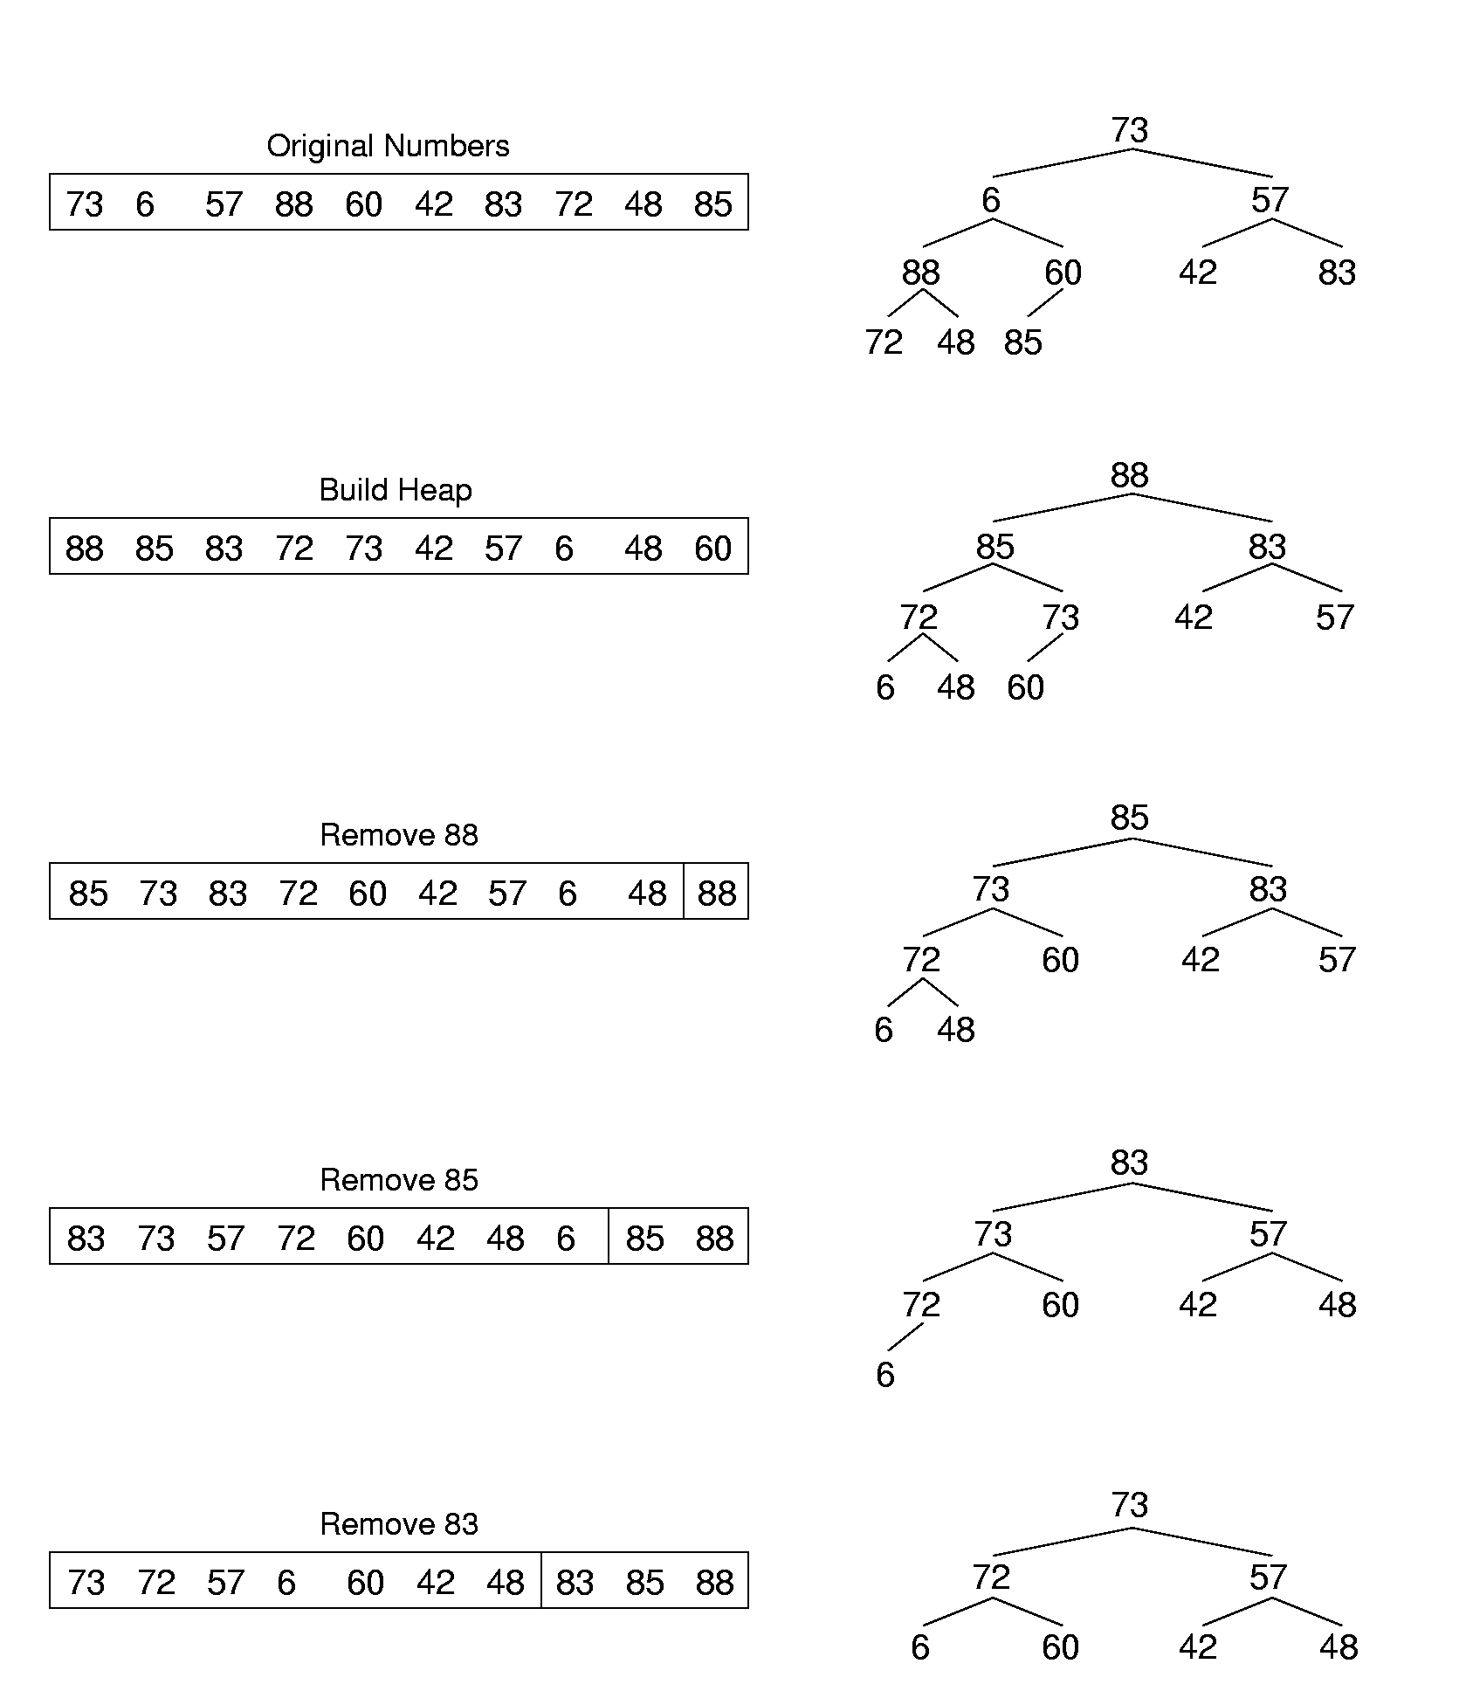
Heapsort Example (1)

Slide 101
Heapsort Example (2)

Slide 102
Chapter7 Internal Sorting
7.1 Terminology and notation
7.2 Three Θ(n²) Sorting Algorithms
  Insertion Sort
  Bubble Sort
  Selection Sort
7.3 Shell Sort
7.4 Quick Sort
7.5 Merge Sort
7.6 Heap Sort
7.7 BinSort and Radix Sort
7.8 Empirical Comparison of Sorting Algorithms
7.9 Lower bounds for Sorting

Slide 103
Binsort (箱排序 ) （1）
Two stages of Binsort:
Dispatch: Scan the sequence in order, and put the record with key k into the NO. k bin.
3
5
1
8
Records
Dispatch
Bins （箱子）
0 1 2 3 4 5 6 7 8 9

Slide 104
Binsort (箱排序 ) （2）
Two stages of Binsort:
Dispatch: Scan the sequence in order, and put the record with key k into the NO. k bin.
Collect: Collect the data from the bins in order.
Records
Collect
1
3
5
8
Bins （箱子）
0 1 2 3 4 5 6 7 8 9

Slide 105
Binsort (箱排序 ) （3）
How to extend the Binsort to support mutiple records with a same key
A
3
8
1
8
4
Records
B
Bins （箱子）
0 1 2 3 4 5 6 7 8 9

Slide 106
Binsort (箱排序 ) （4）
Extension of Binsort to support mutiple records with a same key
Cost: Θ(Number-of-Records + Number-of-Bins).
Records
8
1
3
4
8
B
Bins （箱子）
0 1 2 3 4 5 6 7 8 9

Slide 107
Binsort (箱排序 ) （5）
How to decide the number of bins we need?
  Related to the maximum key value (MaxKeyValue).
While MaxKeyValue is large, Binsort is costly.
3
5
1
8
Records
Bins （箱子）
0 1 2 3 4 5 6 7 8 9

Slide 108
Radix Sort （基排序) (1)
Radix Sort is an extension of BinSort to support efficient sort on large key values.
An integer key values K_{d-1}K_{d-2…}K₀ with the radix r can be considered as a sequence of d sub-keys K_{d-1},K_{d-2},…,K_{0.} (0<=K_{i}< r)
E.g. A decimal number 5432 =>
K₃=5 , K₂=4 , K₁=3 ,K₀=2, d = 4, r = 10.

Slide 109
Radix Sort （基排序) (2)
Radix Sort on the key K_{d-1}K_{d-2…}K₀ :
  Perform Binsort on K_{0.}
  Perform Binsort on K_{1.}
  … …
  Perform Binsort on K_{d-1.}
How many bins are needed?
The number is determined by the radix r

Slide 110
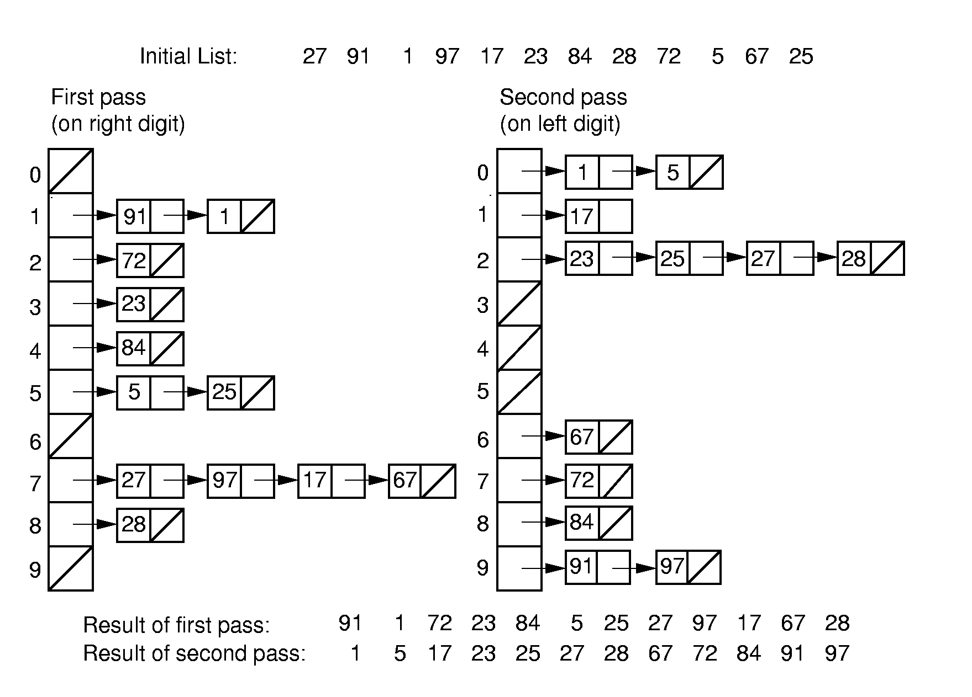
Radix Sort (1)
stable
Θ((n + r)d) (n is the number of the records. d is the digit count of a keyword. r is the radix )

Slide 111
Radix Sort Cost
Cost: Θ((n + r)d)
//n – number of the records
//d – digit count of a keyword
//r – radix
If there are n distinct keys, then d >= log_{r} n
  Thus, Radix Sort is Ω(n log n) in general case

Slide 112
Chapter7 Internal Sorting
7.1 Terminology and notation
7.2 Three Θ(n²) Sorting Algorithms
  Insertion Sort
  Bubble Sort
  Selection Sort
7.3 Shell Sort
7.4 Quick Sort
7.5 Merge Sort
7.6 Heap Sort
7.7 BinSort and Radix Sort
7.8 Empirical Comparison of Sorting Algorithms
7.9 Lower bounds for Sorting

Slide 113
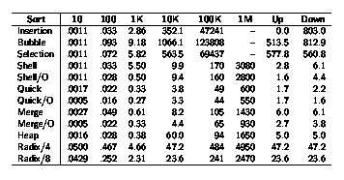
Empirical Comparison (1)

Slide 114
Chapter7 Internal Sorting
7.1 Terminology and notation
7.2 Three Θ(n²) Sorting Algorithms
  Insertion Sort
  Bubble Sort
  Selection Sort
7.3 Shell Sort
7.4 Quick Sort
7.5 Merge Sort
7.6 Heap Sort
7.7 BinSort and Radix Sort
7.8 Empirical Comparison of Sorting Algorithms
7.9 Lower bounds for Sorting

Slide 115
the Sorting Problem
What is the upper bound and lower bound of the sorting problem?
Sorting is O(n log n) , because we know of algorithms with this upper bound.
We would like to know a lower bound for all possible sorting algorithms.

Slide 116
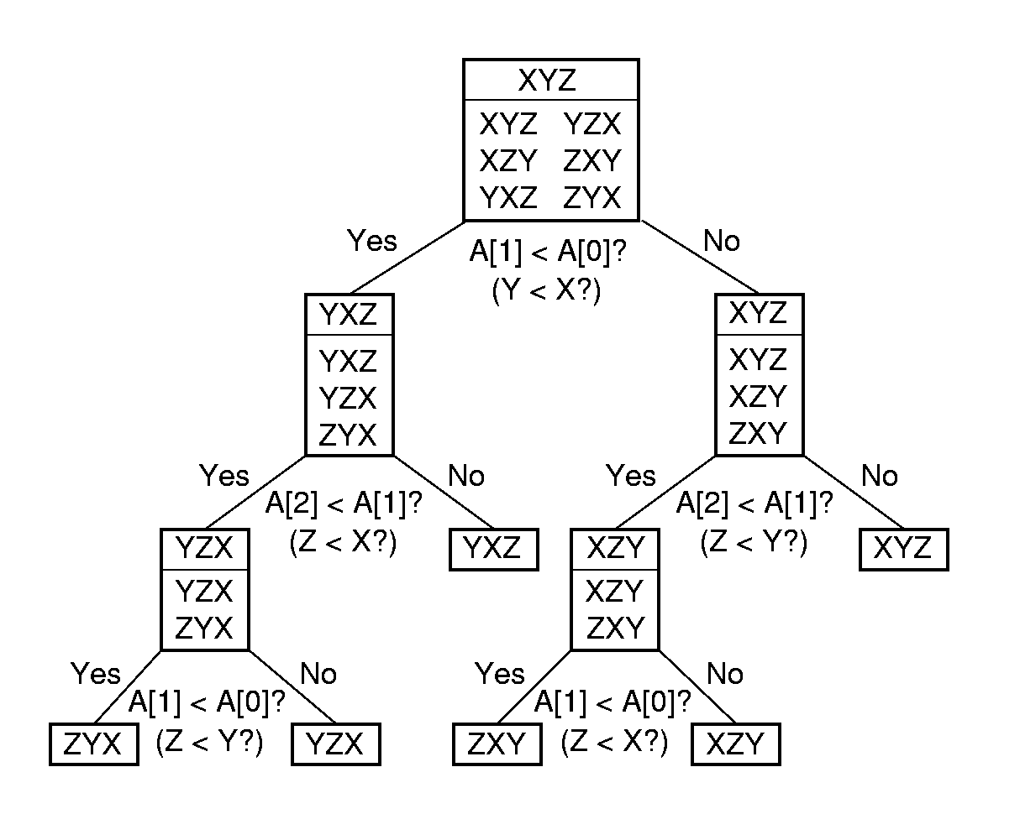
Sorting Procedure : a Decision Tree
Ω (log n!)
n !

Slide 117

Lower Bound Proof
There are n! permutations for n records.
A comparison based sorting algorithm can be viewed as going through the root to a leaf on a decision tree with n! leaves.
A tree with n leaves has Ω(log n) levels, so the tree with n! leaves has Ω (log n!) = Ω (n log n) levels
Sorting is Ω (n log n).
Stirling's approximation

Slide 118
Thanks!

