Slide 1
Data Structures and Algorithm Analysis
Chapter 1 Overview
Notes:
Überblick

Slide 2
冯玉翔
yxfeng@scut.edu.cn
教材：
  A Practical Introduction to Data Structures and Alogrithm Analysis, Second Edition
  数据结构与算法分析（第二版）

Slide 3
Overview
Data Structures
+
Algorithm
Notes:
Überblick

Slide 4
Data Structures and Algorithms
1.1 A Philosophy of Data Structures
1.2 Abstract Data Types and Data Structures
1.3 Problems, Algorithms, and Programs

Slide 5
The Need for Data Structures
Data structures organize data
⇒ more efficient programs.
More powerful computers
⇒ more complex applications.
More complex applications demand more calculations.
Complex computing tasks are unlike our everyday experience.

Slide 6
Organizing Data
Any organization for a collection of records can be searched, processed in any order, or modified.
The choice of data structure and algorithm can make the difference between a program running in a few seconds or many days.

Slide 7
Efficiency
A solution is said to be efficient if it solves the problem within its resource constraints.
  Space
  Time
The cost of a solution is the amount of resources that the solution consumes.

Slide 8
Selecting a Data Structure
Select a data structure as follows:
Analyze the problem to determine the resource constraints a solution must meet.
Determine the basic operations that must be supported. Quantify the resource constraints for each operation.
Select the data structure that best meets these requirements.

Slide 9
Some Questions to Ask
Are all data inserted into the data structure at the beginning, or are insertions interspersed with other operations?
Can data be deleted?
Are all data processed in some well-defined order, or is random access allowed?

Slide 10
Data Structure Philosophy
Each data structure has costs and benefits.
Rarely is one data structure better than another in all situations.
A data structure requires:
  space for each data item it stores
  time to perform each basic operation
  programming effort
Data + Overhead

Slide 11
Data Structure Philosophy
Each problem has constraints on available space and time.
Only after a careful analysis of problem characteristics can we know the best data structure for the task.
Bank example:
  Start account: a few minutes
  Transactions: a few seconds
  Close account: overnight

Slide 12
Goals of this Course
Reinforce the concept that costs and benefits exist for every data structure.
Learn the commonly used data structures.
  These form a programmer's basic data structure.
Understand how to measure the cost of a data structure or program.
  These techniques also allow you to judge the merits of new data structures that you or others might invent.

Slide 13
Data Structures and Algorithms
1.1 A Philosophy of Data Structures
1.2 Abstract Data Types and Data Structures
1.3 Problems, Algorithms, and Programs

Slide 14
Definitions
A type is a set of values.
A data type is a type and a collection of operations that manipulate the type.
A data item or element is a piece of information or a record.
A data item is said to be a member of a data type.
A simple data item contains no subparts.
An aggregate data item may contain several pieces of information.

Slide 15
Abstract Data Types
Abstract Data Type (ADT):
a definition for a data type solely in terms of a set of values and a set of operations on that data type.
Each ADT operation is defined by its inputs and outputs.
Encapsulation:
Hide implementation details.

Slide 16
Data Structure
A data structure is the physical implementation of an ADT.
  Each operation associated with the ADT is implemented by one or more subroutines in the implementation.
Data structure usually refers to an organization for data in main memory.
File structure is an organization for data on peripheral storage, such as a disk drive.

Slide 17
Logical vs. Physical Form
Data items have both a logical and a physical form.
Logical form:
definition of the data item within an ADT.
  Ex: Integers in mathematical sense: +, -
Physical form:
implementation of the data item within a data structure.
Ex: 16/32 bit integers：overflow.

Slide 18
Data Type
ADT:
  Type
  Operations
Data Items:
Logical Form
Data Structure:
  Storage Space
  Subroutines
Data Items:
Physical Form

Slide 19
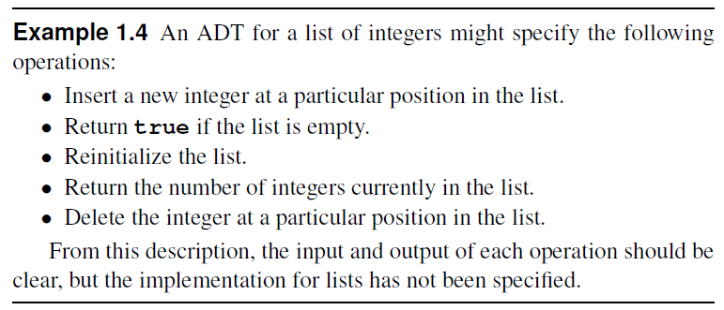
Example for ADT

Slide 20
Data Structures and Algorithms
1.1 A Philosophy of Data Structures
1.2 Abstract Data Types and Data Structures
1.3 Problems, Algorithms, and Programs

Slide 21
Problems
Problem:
a task to be performed.
  Best thought of as inputs and matching outputs.
  Problem definition should include constraints on the resources that may be consumed by any acceptable solution.

Slide 22
Problems
Problems ⇔ mathematical functions
  A function is a matching between inputs (the domain) and outputs (the range).
  An input to a function may be single number, or a collection of information.
  The values making up an input are called the parameters of the function.
  A particular input must always result in the same output every time the function is computed.

Slide 23
Algorithms and Programs
Algorithm: a method or a process followed to solve a problem.
  A recipe.
An algorithm takes the input to a problem (function) and transforms it to the output.
  A mapping of input to output.
A problem can have many algorithms.

Slide 24
Algorithm Properties
An algorithm possesses the following properties:
  It must be correct.
  It must be composed of a series of concrete steps.
  There can be no ambiguity as to which step will be performed next.
  It must be composed of a finite number of steps.
  It must terminate.
A computer program is an instance, or concrete representation, for an algorithm in some programming language.

Slide 25
Supplementary ex
P17
1.3, 1.4, 1.6, 1.7, 1.8

