Slide 1
Chapter10 Indexing
10.1 Linear Indexing
10.2 ISAM
10.3 Tree-based Indexing
10.4 2-3 Trees
10.5 B-Trees

Slide 2
Indexing
Goals:
  Store large files
  Support multiple search keys
  Support efficient insert, delete, and range queries

Slide 3
Files and Indexing
Entry sequenced file: Order records by time of insertion.
  Search with sequential search
Index file: Organized, stores pointers to actual records.
  Could be organized with a tree or other data structure.
Entry sequenced files are not practical as an organization for large databases

Slide 4
Keys and Indexing
Primary Key: A unique identifier for records. May be inconvenient for search.
Secondary Key: An alternate search key, often not unique for each record. Often used for search key.

Slide 5
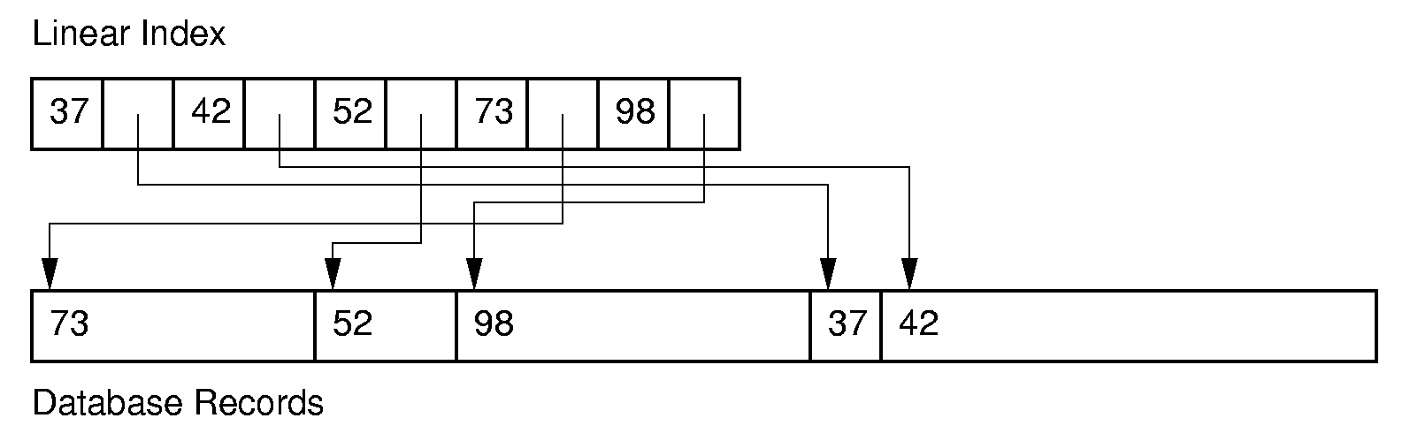
Linear Indexing (1)
Linear index: Index file organized as a simple sequence of key/record pointer pairs with key values are in sorted order.
Linear indexing is good for searching variable-length records.

Slide 6
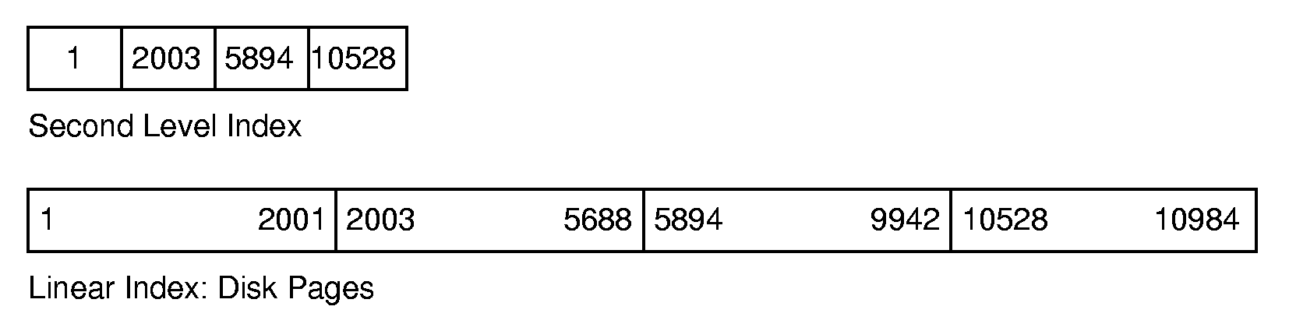
Linear Indexing (2)
If the index is too large to fit in main memory, a second-level index might be used.

Slide 7
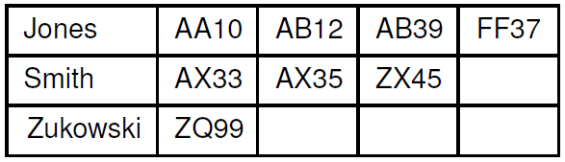
Inverted List (1)
  Inverted list is another term for a secondary index.
  A secondary key is associated with a primary key, which in turn locates the record.

Slide 8
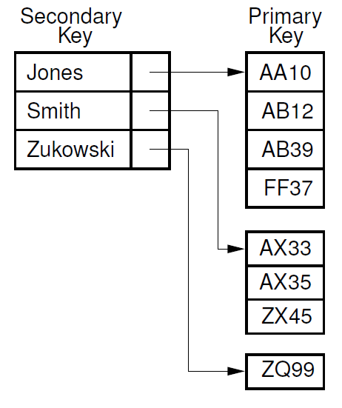
Inverted List (2)

Slide 9
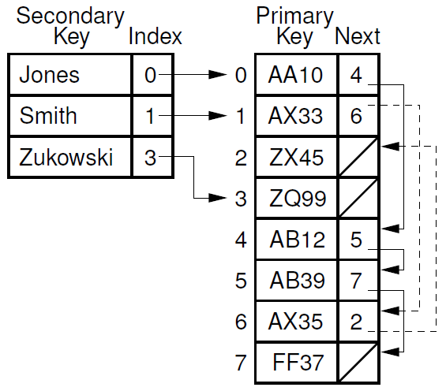
Inverted List (3)

Slide 10
Chapter10 Indexing
10.1 Linear Indexing
10.2 ISAM
10.3 Tree-based Indexing
10.4 2-3 Trees
10.5 B-Trees

Slide 11
Tree Indexing (1)
Linear index is poor for insertion/deletion.
Tree index can efficiently support all desired operations:
  Insert/delete
  Multiple search keys (multiple indices)
  Key range search

Slide 12
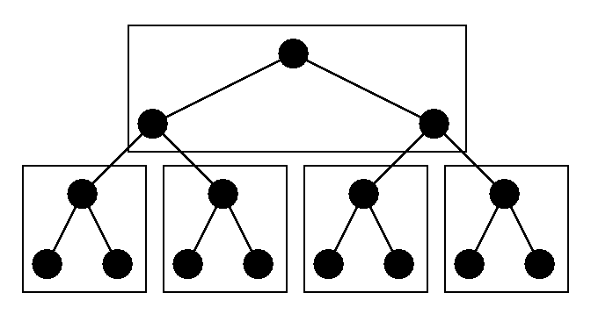
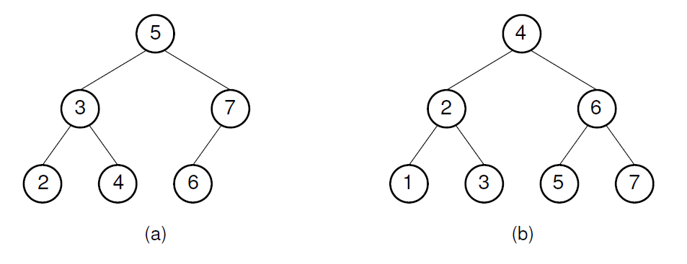
Tree Indexing (2)
Difficulties when storing tree index on disk:
  Tree must be balanced.
  Each path from root to leaf should cover few disk pages.

Slide 13
Chapter10 Indexing
10.1 Linear Indexing
10.2 ISAM
10.3 Tree-based Indexing
10.4 2-3 Trees
10.5 B-Trees

Slide 14
2-3 Tree (1)
A 2-3 Tree has the following properties:
  A node contains one or two keys
  Every internal node has either two children (if it contains one key) or three children (if it contains two keys).
  All leaves are at the same level in the tree, so the tree is always height balanced.
The 2-3 Tree has a search tree property analogous to the BST.

Slide 15
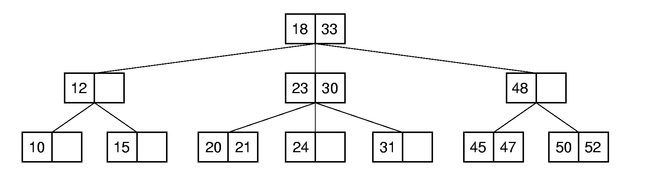
2-3 Tree (2)
The advantage of the 2-3 Tree over the BST is that it can be updated at low cost.

Slide 16
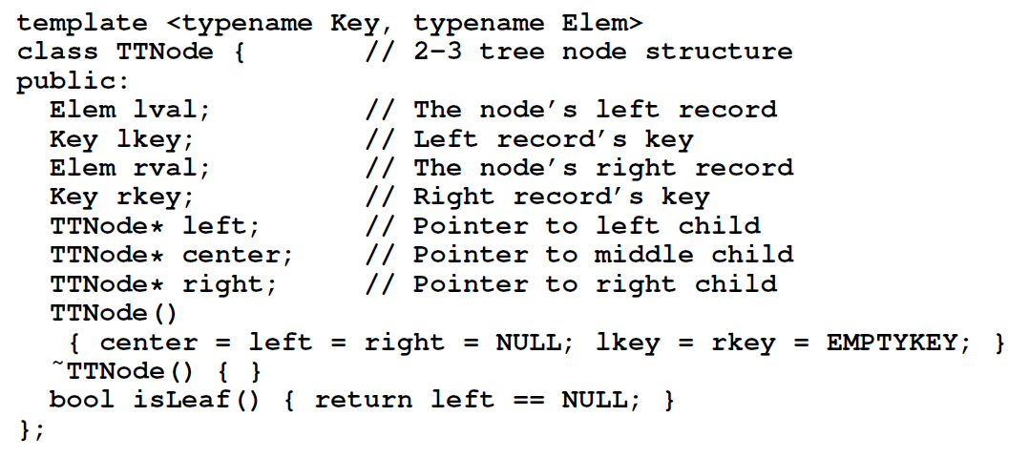
2-3 Tree (3)

Slide 17
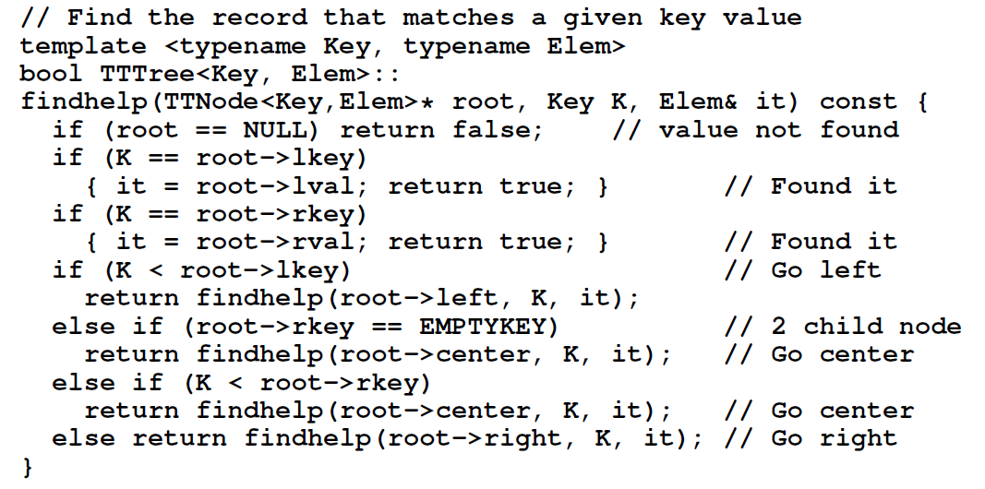

2-3 Tree Find

Slide 18
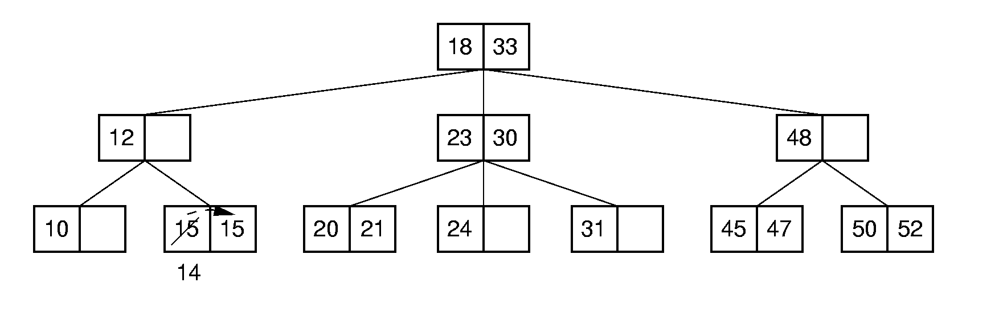
2-3 Tree Insertion (1)
Insert 14

Slide 19
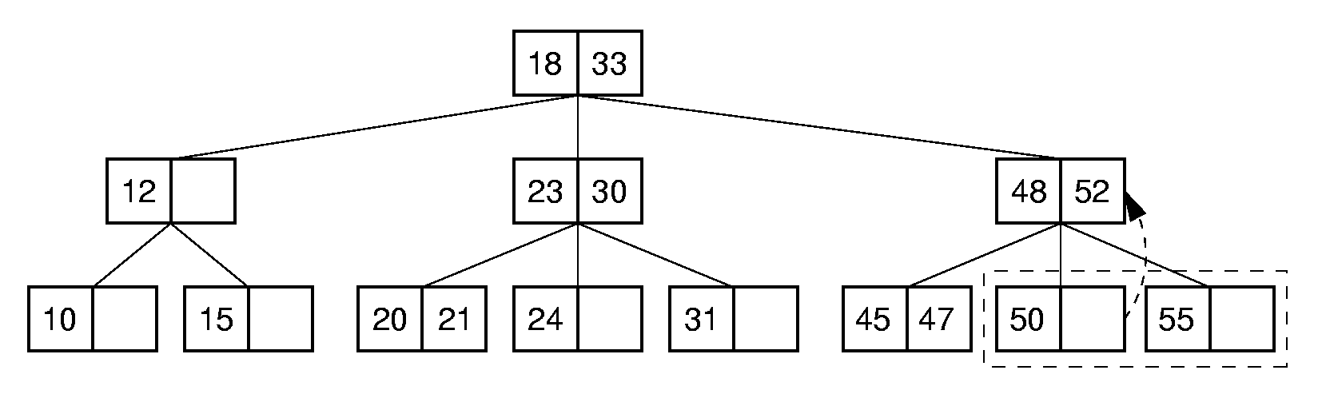
2-3 Tree Insertion (2)
Insert 55

Slide 20
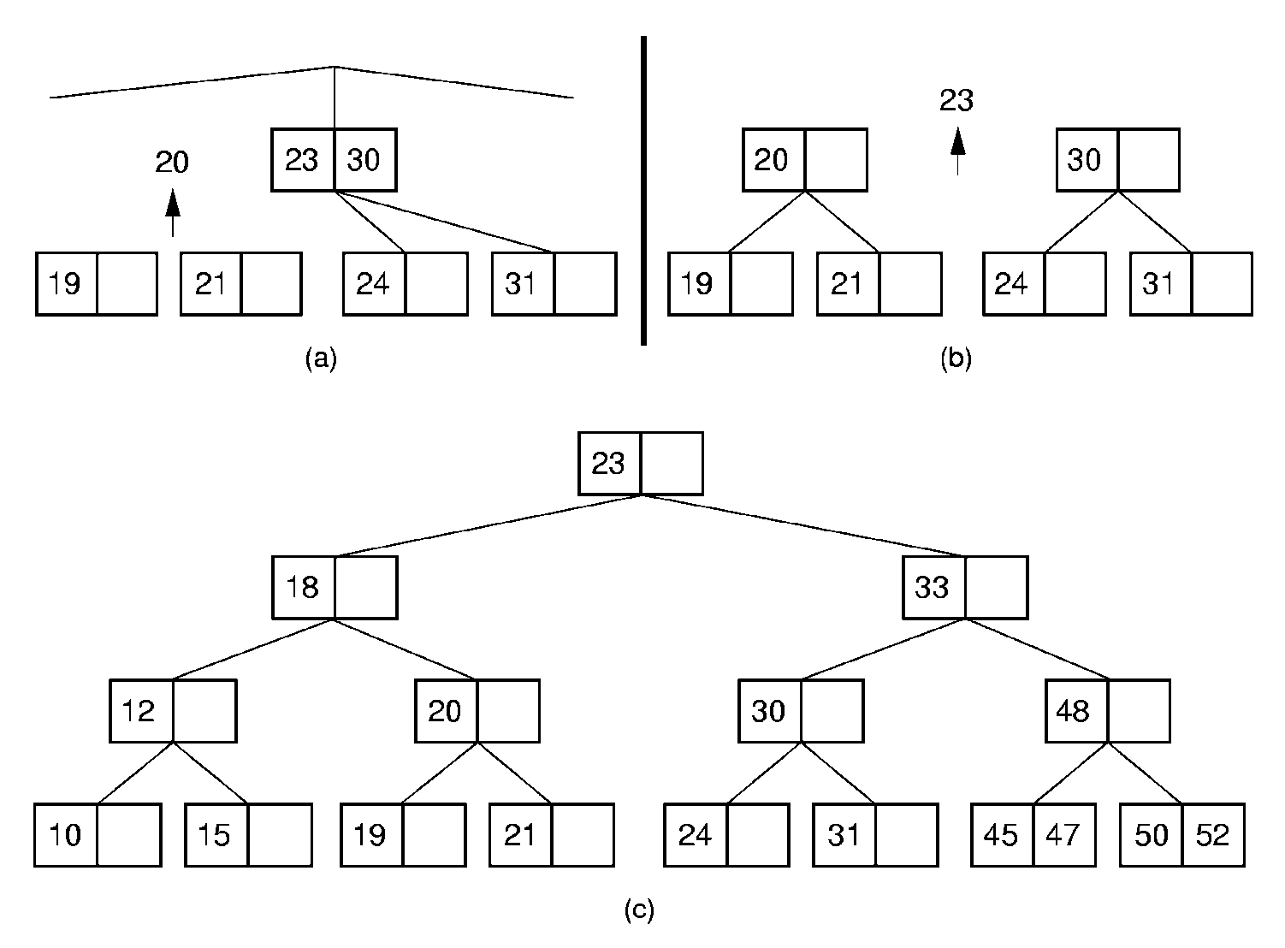
2-3 Tree Insertion (3)
Insert 19

Slide 21
Chapter10 Indexing
10.1 Linear Indexing
10.2 ISAM
10.3 Tree-based Indexing
10.4 2-3 Trees
10.5 B-Trees

Slide 22
B-Trees (1)
The B-Tree is an extension of the 2-3 Tree.
The B-Tree is now the standard file organization for applications requiring insertion, deletion, and key range searches.

Slide 23
B-Trees (2)
B-Trees are always balanced.
B-Trees keep similar-valued records together on a disk page, which takes advantage of locality of reference.
B-Trees guarantee that every node in the tree will be full at least to a certain minimum percentage. This improves space efficiency while reducing the typical number of disk fetches necessary during a search or update operation.

Slide 24
B-Tree Definition
A B-Tree of order m has these properties:
  The root is either a leaf or has at least two children.
  Each node, except for the root and the leaves, has between ⎡m/2⎤ and m children.
  All leaves are at the same level in the tree, so the tree is always height balanced.
A B-Tree node is usually selected to match the size of a disk block.
  A B-Tree node could have hundreds of children.

Slide 25
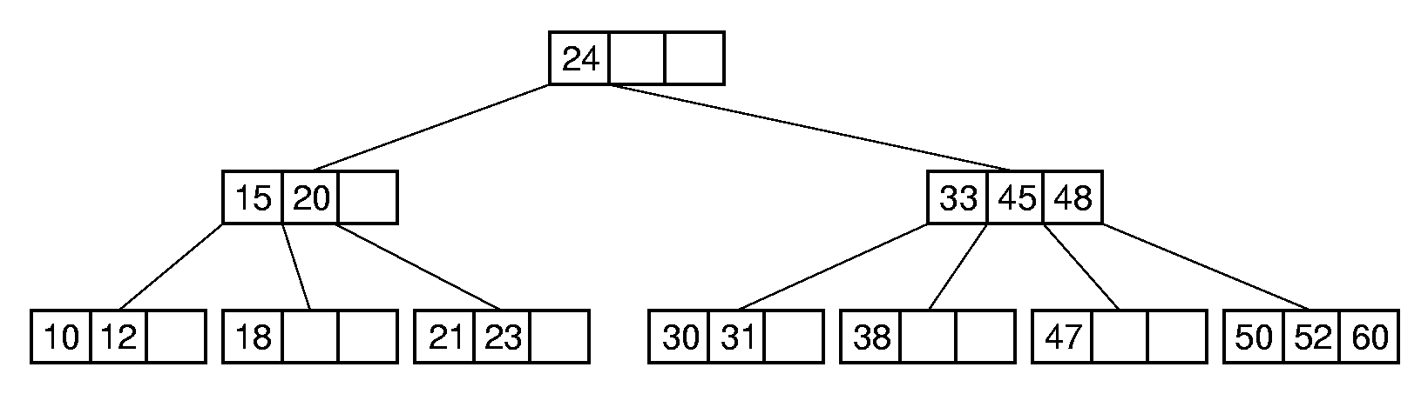
B-Tree Search
Search in a B-Tree is a generalization of search in a 2-3 Tree.
  Do binary search on keys in current node. If search key is found, then return record. If current node is a leaf node and key is not found, then report an unsuccessful search.
  Otherwise, follow the proper branch and repeat the process.

Slide 26
B⁺-Trees
The most commonly implemented form of the B-Tree is the B⁺-Tree.
Internal nodes of the B⁺-Tree do not store record -- only key values to guild the search.
Leaf nodes store records or pointers to records.
A leaf node may store more or less records than an internal node stores keys.

Slide 27
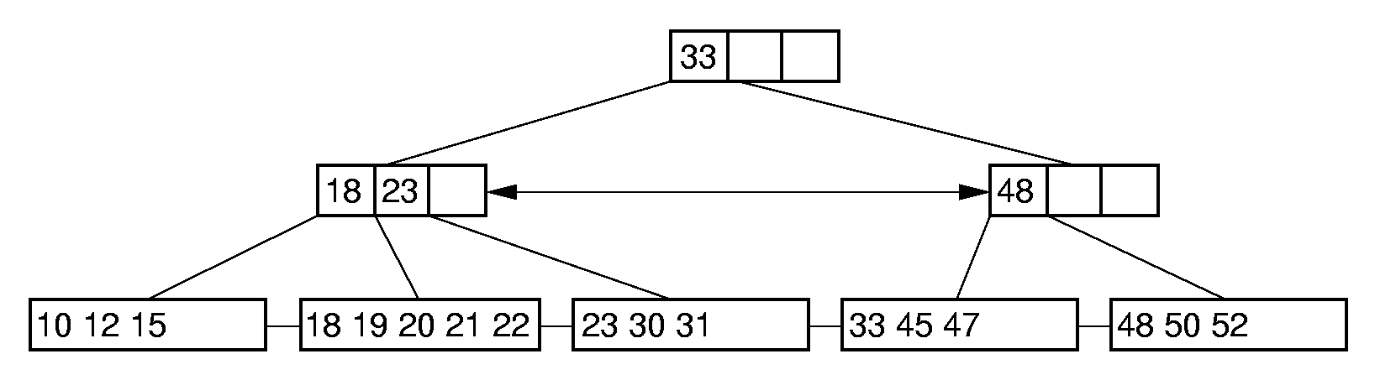
B⁺-Tree Example

Slide 28
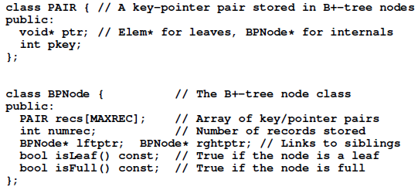
B⁺-Trees Node

Slide 29
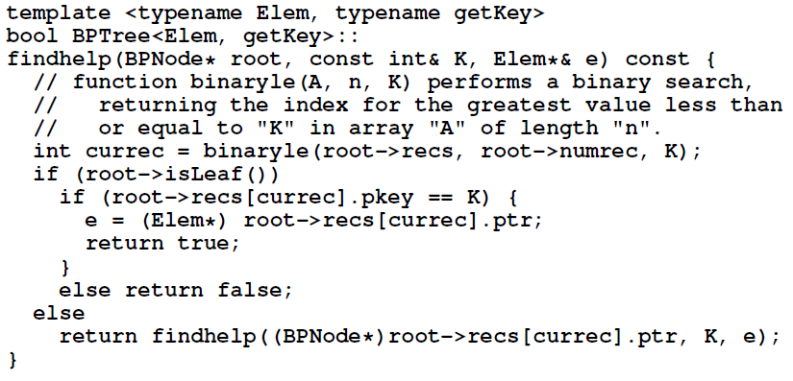
B⁺-Tree find

Slide 30
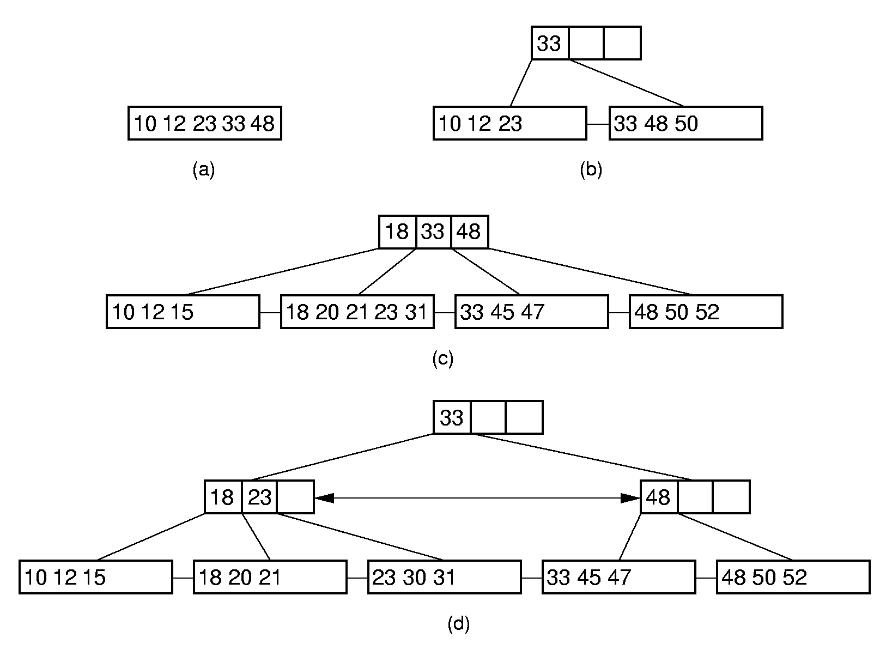
B⁺-Tree Insertion

Slide 31
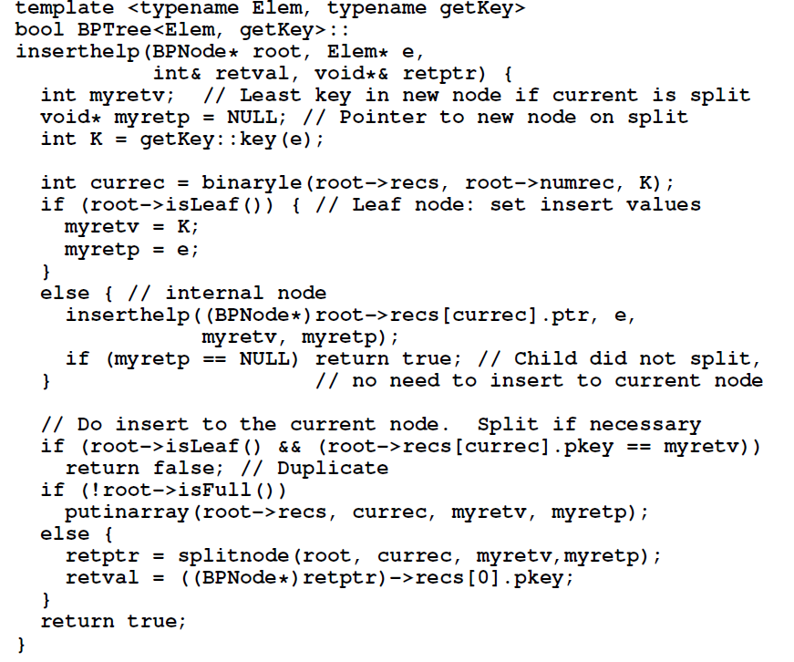

Slide 32
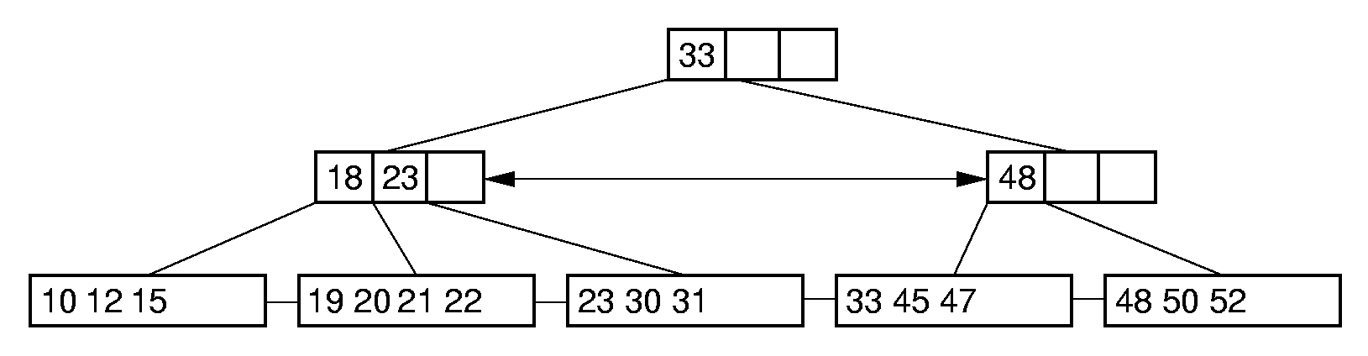
B⁺-Tree Deletion (1)

Slide 33
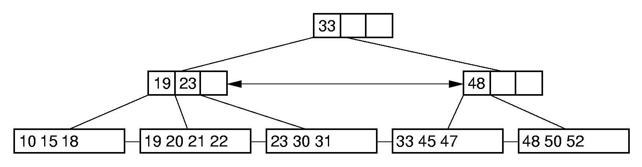
B⁺-Tree Deletion (2)

Slide 34
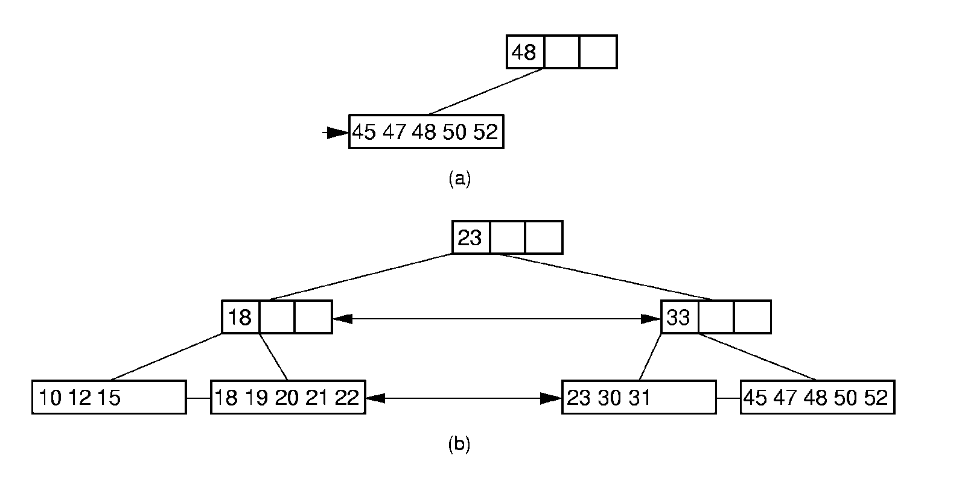
B⁺-Tree Deletion (3)

Slide 35
B-Tree Space Analysis (1)
B⁺-Trees nodes are always at least half full.
The B*-Tree splits two pages for three, and combines three pages into two. In this way, nodes are always 2/3 full.
Asymptotic cost of search, insertion, and deletion of nodes from B-Trees is Θ(log n).
  Base of the log is the (average) branching factor of the tree.

Slide 36
B-Tree Space Analysis (2)
Example: Consider a B⁺-Tree of order 100 with leaf nodes containing 100 records.
1 level B⁺-tree:
Min 0, Max 100
2 level B⁺-tree:
Min: 2 leaves of 50 for 100 records.
Max: 100 leaves with 100 for 10,000 records.
3 level B⁺-tree:
Min: 2 x 50 nodes of leaves, for 5000 records.
Max: 100³ = 1,000,000 records.
4 level B⁺-tree:
Min: 250,000 records (2 * 50 * 50 * 50).
Max: 100⁴ = 100 million records.

Slide 37
B-Tree Space Analysis (3)
Ways to reduce the number of disk fetches:
  Keep the upper levels in memory.
  Manage B⁺-Tree pages with a buffer pool.

Slide 38
Exercises
10.9, 10.12, 10.13

