Slide 1
Chapter11 Graphs
11.1 Terminology and Representations
11.2 Graph Implementations
11.3 Graph Traversals
11.4 Shortest-Paths Problems
11.5 Minimum-Cost Spanning Trees

Slide 2
Graph Applications
Modeling connectivity in computer networks
Representing maps
Modeling flow capacities in networks
Finding paths from start to goal
Modeling transitions in algorithms
Ordering tasks
Modeling relationships (families, organizations)

Slide 3
Graphs (1)
A graph G = (V, E) consists of a set of vertices V, and a set of edges E, such that each edge in E is a connection between a pair of vertices in V.
The number of vertices is written |V|, and the number edges is written |E|.

Slide 4
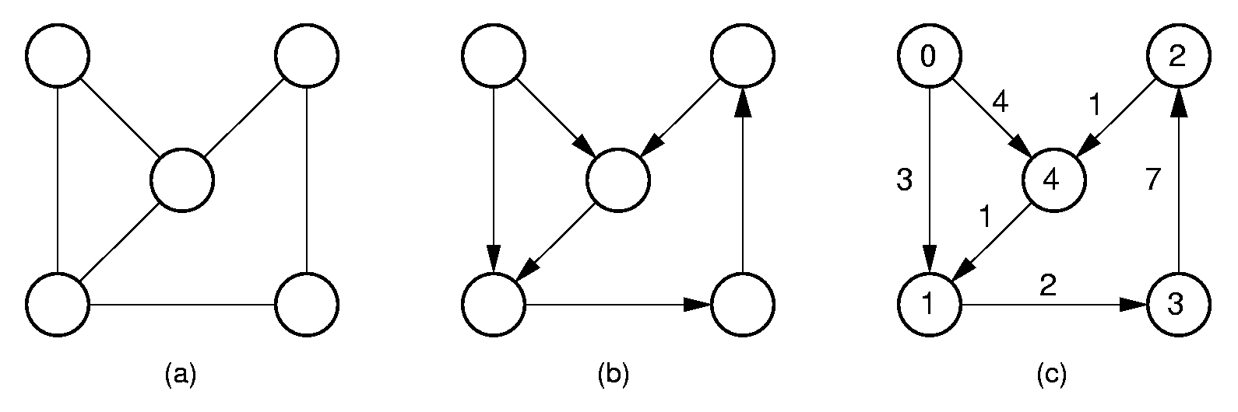
Graphs (2)
undirected graph directed graph labeled graph

Slide 5
Paths and Cycles
Path: A sequence of vertices v₁, v₂, …, v_{n} of length n-1 with an edge from v_{i} to v_{i+1} for 1 <= i < n.
A path is simple if all vertices on the path are distinct.
A cycle is a path of length 3 or more that connects v_{i} to itself.
A cycle is simple if the path is simple, except the first and last vertices are the same.

Slide 6
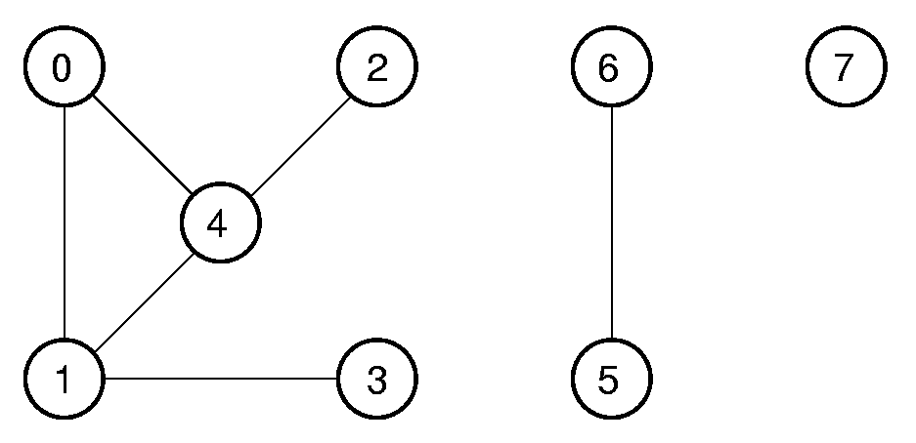
Connected Components
An undirected graph is connected if there is at least one path from any vertex to any other.
The maximum connected sub-graphs of an undirected graph are called connected components.

Slide 7
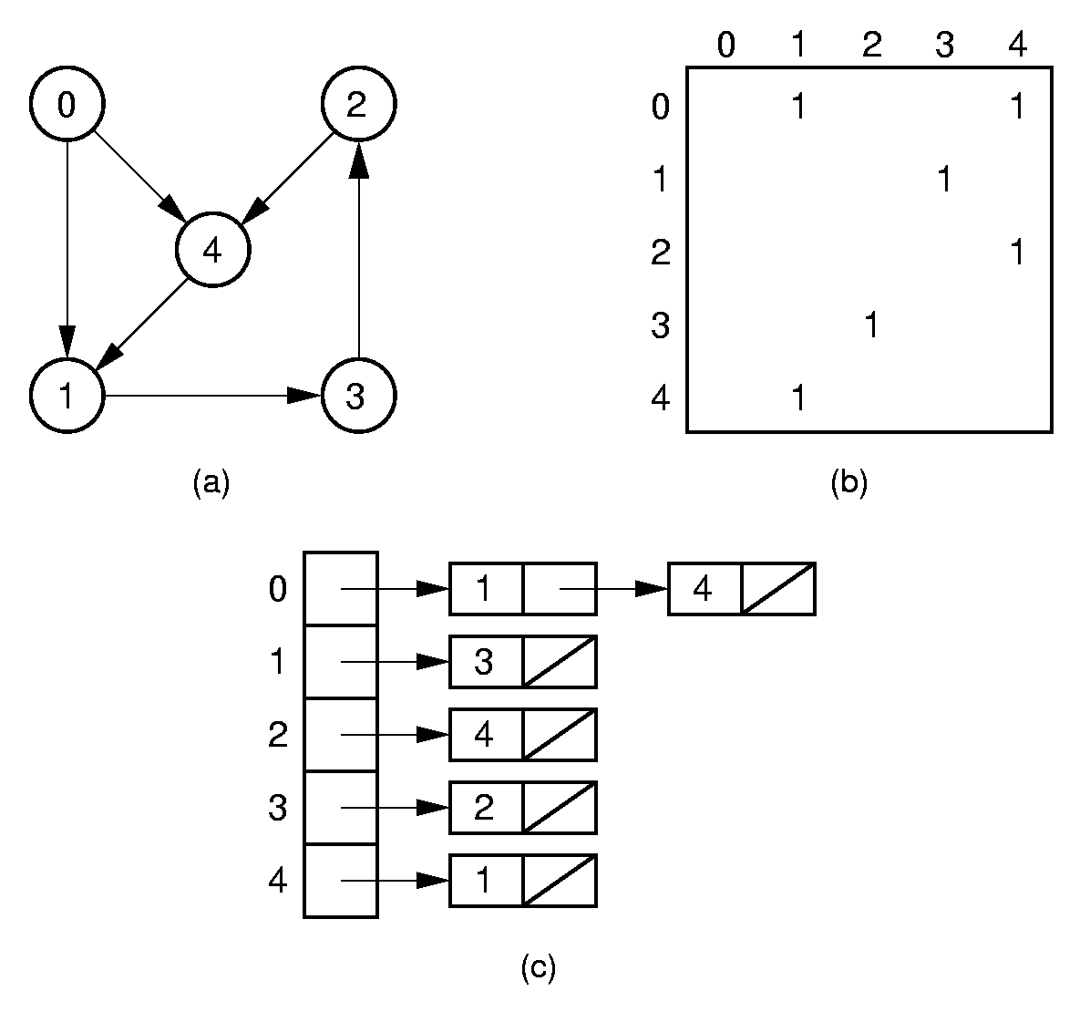
Directed Representation

Slide 8
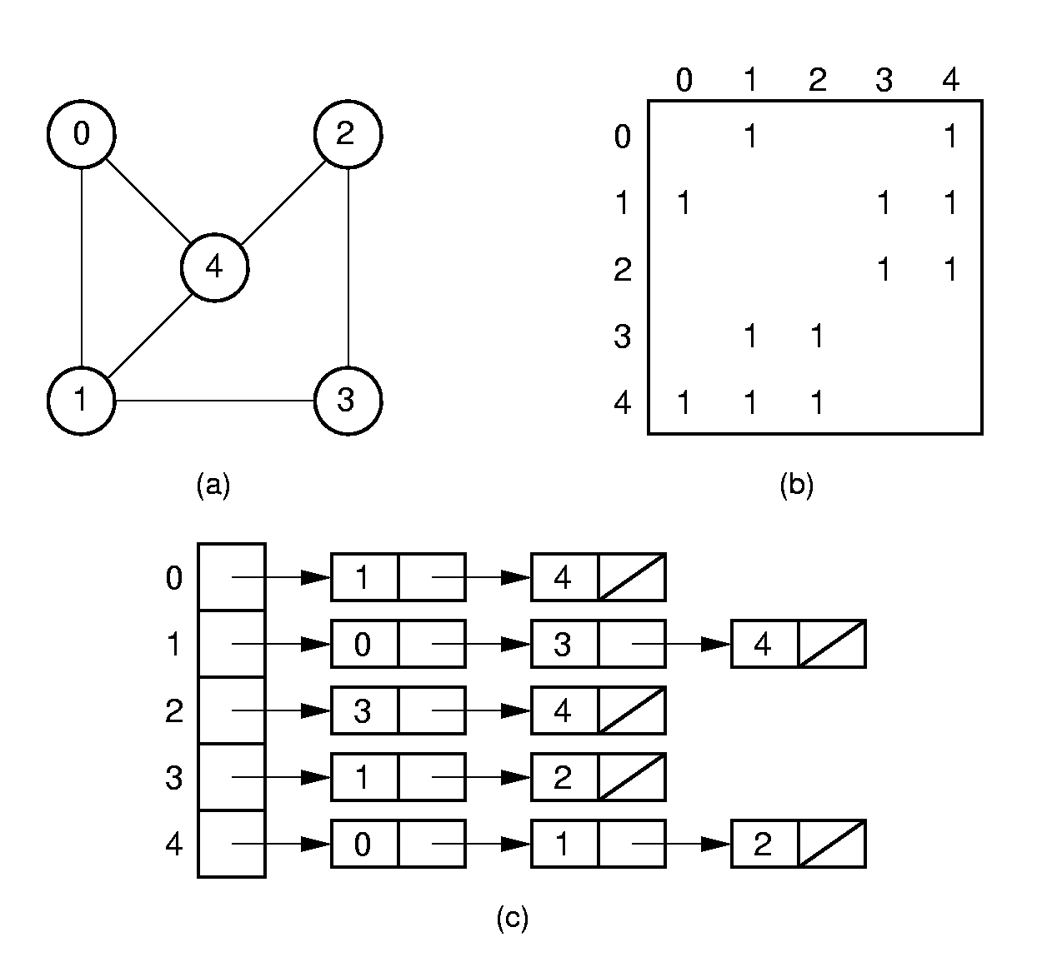
Undirected Representation

Slide 9
Representation Costs
Adjacency Matrix:
Θ(|V|²) space
Adjacency List:
Θ(|V| + |E|) space

Slide 10
Chapter11 Graphs
11.1 Terminology and Representations
11.2 Graph Implementations
11.3 Graph Traversals
11.4 Shortest-Paths Problems
11.5 Minimum-Cost Spanning Trees

Slide 11
Graph ADT
class Graph { // Graph abstract class
public:
virtual int n() =0; // # of vertices
virtual int e() =0; // # of edges
// Return index of first, next neighbor
virtual int first(int) =0;
virtual int next(int, int) =0;
// Store new edge
virtual void setEdge(int, int, int) =0;
// Delete edge defined by two vertices
virtual void delEdge(int, int) =0;
// Weight of edge connecting two vertices
virtual int weight(int, int) =0;
virtual int getMark(int) =0;
virtual void setMark(int, int) =0;
};

Slide 12
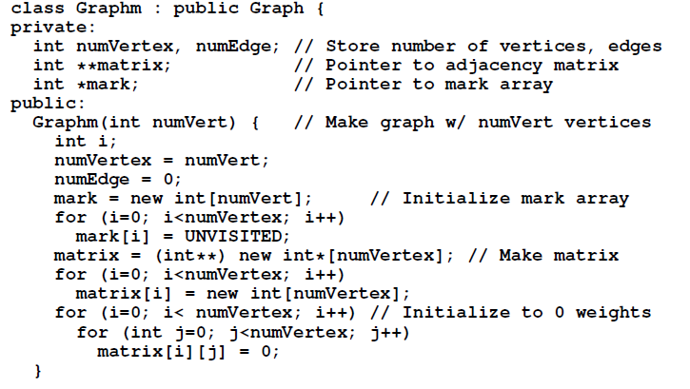

The Adjacency Matrix（1）

Slide 13
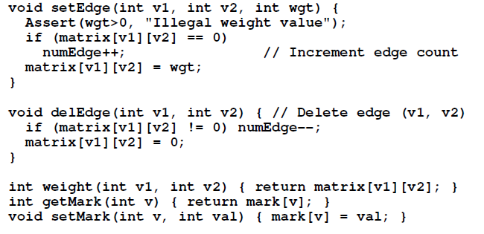
The Adjacency Matrix（2）

Slide 14
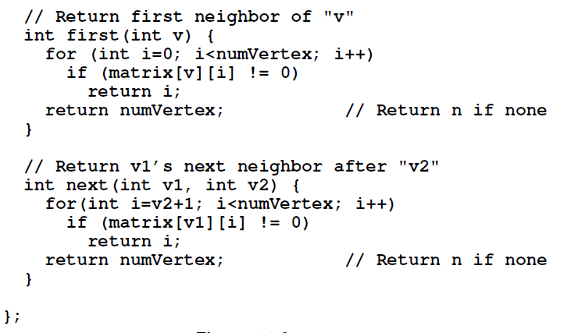
The Adjacency Matrix（3）

Slide 15
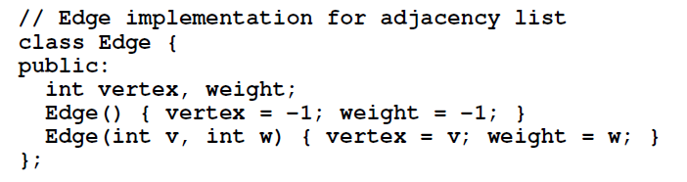
The Adjacency List（1）

Slide 16
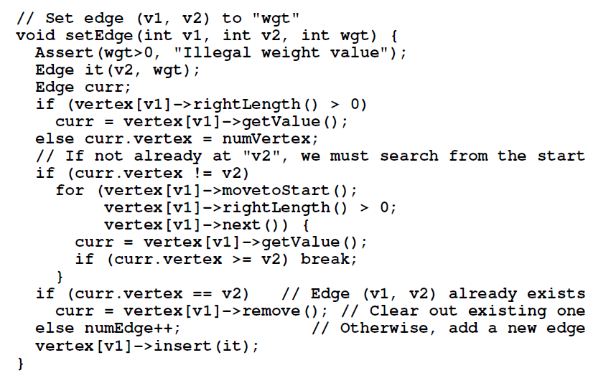
The Adjacency List（2）

Slide 17
Chapter11 Graphs
11.1 Terminology and Representations
11.2 Graph Implementations
11.3 Graph Traversals
11.4 Shortest-Paths Problems
11.5 Minimum-Cost Spanning Trees

Slide 18
Graph Traversals (1)
Some applications require visiting every vertex in the graph exactly once.
The application may require that vertices be visited in some special order based on graph topology.
Examples:
  Artificial Intelligence Search
  Shortest paths problems

Slide 19
Graph Traversals (2)
To insure visiting all vertices:
void graphTraverse(const Graph* G) {
for (v=0; v<G->n(); v++)
G->setMark(v, UNVISITED); // Initialize
for (v=0; v<G->n(); v++)
if (G->getMark(v) == UNVISITED)
doTraverse(G, v);
}

Slide 20
Depth First Search (1)
// Depth first search
void DFS(Graph* G, int v) {
PreVisit(G, v); // Take action
G->setMark(v, VISITED);
for (int w=G->first(v); w<G->n();
w = G->next(v,w))
if (G->getMark(w) == UNVISITED)
DFS(G, w);
PostVisit(G, v); // Take action
}

Slide 21
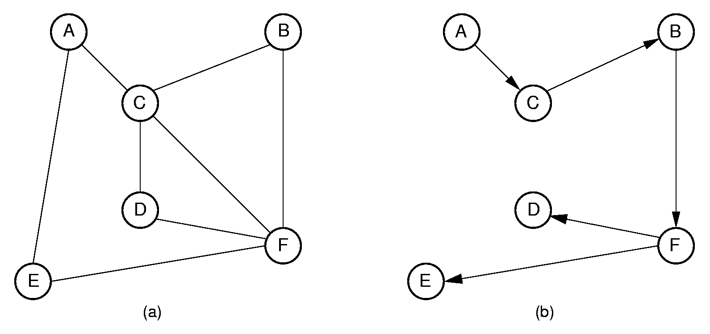
Depth First Search (2)
Order that nodes are processed: ACBFDE

Slide 22
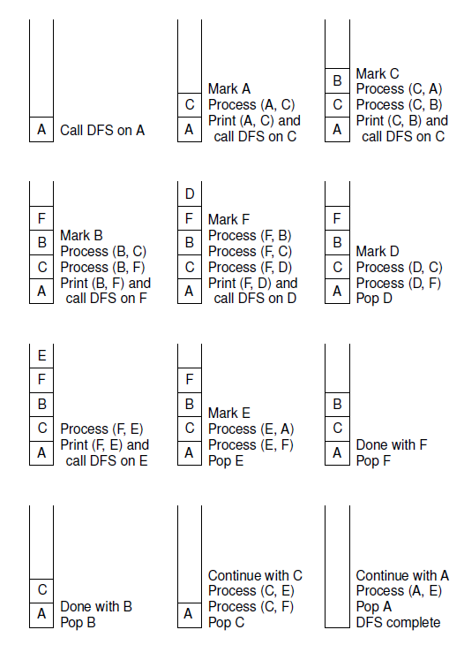


Slide 23
Breadth First Search (1)
void BFS(Graph* G, int start,Queue<int>*Q) {
int v, w;
Q->enqueue(start); // Initialize Q
G->setMark(start, VISITED);
while (Q->length() != 0) { // Process Q
Q->dequeue(v);
PreVisit(G, v); // Take action
for(w=G->first(v);w<G->n();w=G->next(v,w))
if (G->getMark(w) == UNVISITED) {
G->setMark(w, VISITED);
Q->enqueue(w);
}
}
}

Slide 24
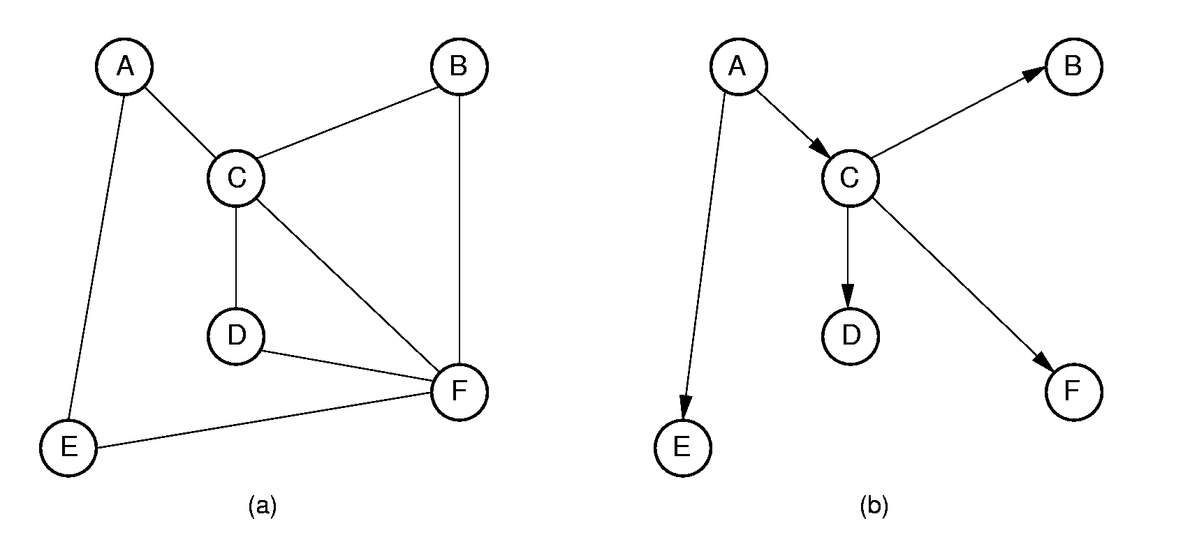
Breadth First Search (2)
Order that nodes are processed: ACEBDF

Slide 25
Topological Sort (1)
Problem: Given a set of jobs, courses, etc., with prerequisite constraints, output the jobs in an order that does not violate any of the prerequisites.

Slide 26
Topological Sort (2)
void topsort(Graph* G) { // Topological sort
int i;
for (i=0; i<G->n(); i++) // Initialize
G->setMark(i, UNVISITED);
for (i=0; i<G->n(); i++) // Do vertices
if (G->getMark(i) == UNVISITED)
tophelp(G, i); // Call helper
}
void tophelp(Graph* G, int v) { // Process v
G->setMark(v, VISITED);
for (int w=G->first(v); w<G->n();
w = G->next(v,w))
if (G->getMark(w) == UNVISITED)
tophelp(G, w);
printout(v); // PostVisit for Vertex v
}

Slide 27
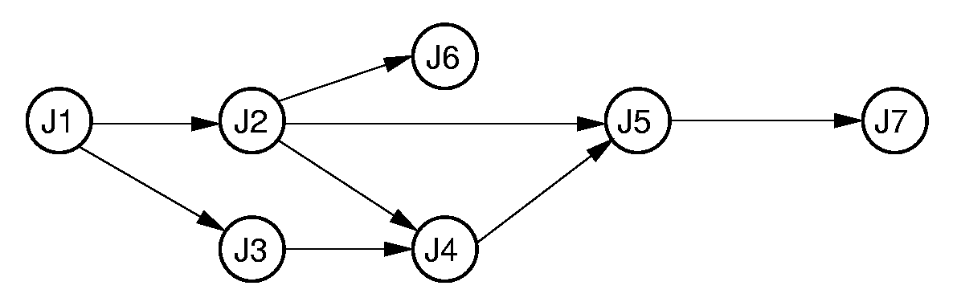
Topological Sort (3)
Prints in reverse order:
J7,J5,J4,J6,J2,J3,J1

Slide 28
Queue-Based Topsort
void topsort(Graph* G, Queue<int>* Q) {
int Count[G->n()];
int v, w;
for (v=0; v<G->n(); v++) Count[v] = 0;
for (v=0; v<G->n(); v++) // Process edges
for (w=G->first(v); w<G->n();
w = G->next(v,w))
Count[w]++; // Add to v2's count
for (v=0; v<G->n(); v++) // Initialize Q
if (Count[v] == 0) // No prerequisites
Q->enqueue(v);
while (Q->length() != 0) {
Q->dequeue(v);
printout(v); // PreVisit for V
for (w=G->first(v); w<G->n();
w = G->next(v,w)) {
Count[w]--; // One less prereq
if (Count[w] == 0) // Now free
Q->enqueue(w);
}}}

Slide 29
Chapter11 Graphs
11.1 Terminology and Representations
11.2 Graph Implementations
11.3 Graph Traversals
11.4 Shortest-Paths Problems
11.5 Minimum-Cost Spanning Trees

Slide 30
Shortest Paths Problems
Input: A graph with weights or costs associated with each edge.
Output: The list of edges forming the shortest path.
Sample problems:
  Find shortest path between two specified vertices
  Find shortest path from S to all other vertices
  Find shortest path between all pairs of vertices
Our algorithms will actually calculate only distances.

Slide 31
Shortest Paths Definitions
d(A, B) is the shortest distance from vertex A to B.
w(A, B) is the weight of the edge connecting A to B.
  If there is no such edge, then w(A, B) = ∞.

Slide 32
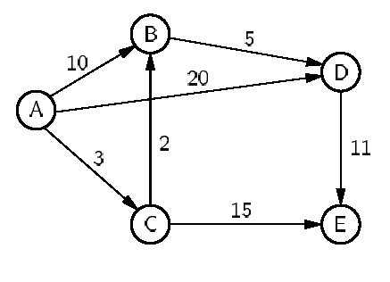


Shortest Paths Example
w(A, D) = 20; d(A, D) = 10 (through ACBD).

Slide 33
Single-Source Shortest Paths
Given start vertex s, find the shortest path from s to all other vertices.
Try 1: Visit vertices in some order, compute shortest paths for all vertices seen so far, then add shortest path to next vertex x.
Problem: Shortest path to a vertex already processed might go through x.
Solution: Process vertices in order of distance from s.

Slide 34

Single-Source Shortest Paths
Problem:
Shortest path to a vertex already processed
might go through x.
Example:
d(v₀,v_{i})=d(v₀,v_{j})+w(v_{j},v_{i}) j>i
Solution:
Process vertices in order of distance from s.

Slide 35
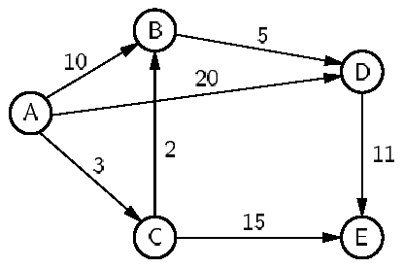
Dijkstra’s Algorithm Example
 | A | B | C | D | E
Initial | 0 | ∞ | ∞ | ∞ | ∞
Process A | 0 | 10 | 3 | 20 | ∞
Process C | 0 | 5 | 3 | 20 | 18
Process B | 0 | 5 | 3 | 10 | 18
Process D | 0 | 5 | 3 | 10 | 18
Process E | 0 | 5 | 3 | 10 | 18

Slide 36
Dijkstra’s Implementation
// Compute shortest path distances from s,
// return them in D
void Dijkstra(Graph* G, int* D, int s) {
int i, v, w;
for (i=0; i<G->n(); i++) { // Do vertices
v = minVertex(G, D);
if (D[v] == INFINITY) return;
G->setMark(v, VISITED);
for (w=G->first(v); w<G->n();
w = G->next(v,w))
if (D[w] > (D[v] + G->weight(v, w)))
D[w] = D[v] + G->weight(v, w);
}
}

Slide 37
Implementing minVertex
Issue: How to determine the next-closest vertex? (I.e., implement minVertex)
Approach 1: Scan through the table of current distances.
  Total Cost: Θ(|V|² + |E|) = Θ(|V|²).
Approach 2: Store unprocessed vertices using a min-heap to implement a priority queue ordered by D value. Must update priority queue for each edge.
  Total Cost: Θ((|V| + |E|)log|E|)

Slide 38
Approach 1
// Find min cost vertex
int minVertex(Graph* G, int* D) {
int i, v;
// Set v to an unvisited vertex
for (i=0; i<G->n(); i++)
if (G->getMark(i) == UNVISITED)
{ v = i; break; }
// Now find smallest D value
for (i++; i<G->n(); i++)
if ((G->getMark(i) == UNVISITED) &&
(D[i] < D[v]))
v = i;
return v;
}

Slide 39
Approach 2
void Dijkstra(Graph* G, int* D, int s) {
int i, v, w; // v is current vertex
DijkElem temp;
DijkElem E[G->e()]; // Heap array
temp.distance = 0; temp.vertex = s;
E[0] = temp; // Initialize heap array
minheap<DijkElem, DDComp> H(E, 1, G->e());
for (i=0; i<G->n(); i++) {// Get distances
do { if(!H.removemin(temp)) return;
v = temp.vertex;
} while (G->getMark(v) == VISITED);
G->setMark(v, VISITED);
if (D[v] == INFINITY) return;
for(w=G->first(v); w<G->n(); w=G->next(v,w))
if (D[w] > (D[v] + G->weight(v, w))) {
D[w] = D[v] + G->weight(v, w);
temp.distance = D[w]; temp.vertex = w;
H.insert(temp); // Insert in heap
}}}

Slide 40
Chapter11 Graphs
11.1 Terminology and Representations
11.2 Graph Implementations
11.3 Graph Traversals
11.4 Shortest-Paths Problems
11.5 Minimum-Cost Spanning Trees

Slide 41
Minimal Cost Spanning Trees
Minimal Cost Spanning Tree (MST) Problem:
  Input: An undirected, connected graph G.
  Output: The sub-graph of G that
  1) has minimum total cost as measured by summing the values of all the edges in the subset
  2) keeps the vertices connected.

Slide 42
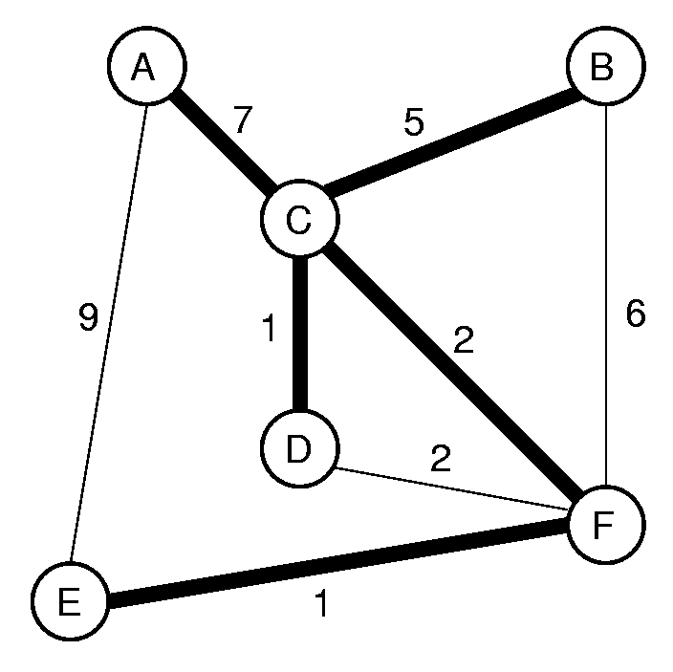
Prim

Slide 43
Prim’s MST Algorithm
void Prim(Graph* G, int* D, int s) {
int V[G->n()]; // Who's closest
int i, w;
for (i=0; i<G->n(); i++) {// Do vertices
int v = minVertex(G, D);
G->setMark(v, VISITED);
if (v != s) AddEdgetoMST(V[v], v);
if (D[v] == INFINITY) return;
for (w=G->first(v); w<G->n();
w = G->next(v,w))
if (D[w] > G->weight(v,w)) {
D[w] = G->weight(v,w);// Update dist
V[w] = v; // Update who it came from
}
}
}

Slide 44
Alternate Implementation
As with Dijkstra’s algorithm, the key issue is determining which vertex is next closest.
As with Dijkstra’s algorithm, the alternative is to use a priority queue.
Running times for the two implementations are identical to the corresponding Dijkstra’s algorithm implementations.

Slide 45
Kruskal’s MST Algorithm (1)
Initially, each vertex is in its own MST.
Merge two MST’s that have the shortest edge between them.
  Use a priority queue to order the unprocessed edges. Grab next one at each step.
How to tell if an edge connects two vertices already in the same MST?
  Use the UNION/FIND algorithm with parent-pointer representation.

Slide 46
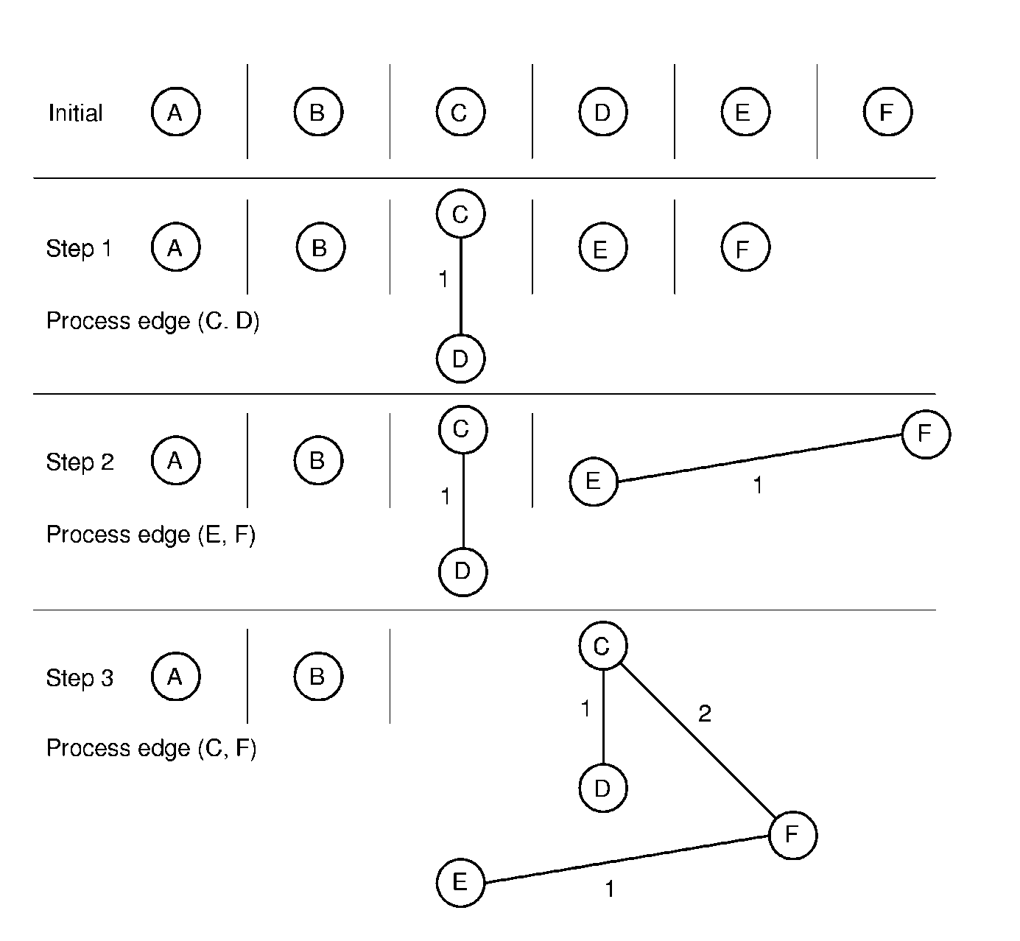
Kruskal’s MST Algorithm (2)

Slide 47
Kruskal’s MST Algorithm (3)
Class KruskElem {
public:
int from, to, distance;
KruskElem( ) { from=-1; to=-1; distance=-1; }
KruskElem(int f, int t, int d)
{ from=f; to=t; distance=d; }
};
Kruskal(Graph& G) { // Kruskal's MST algorithm
Gentree A[G->n( )]; // Equivalence class array
KruskElem E[G->e( )]; // Array of edges for min-heap
int edgecnt = 0;

Slide 48
Kruskal’s MST Algorithm (4)
for (int i=0; i<G->n( ); i++) // Put edges on array
for (int w = G->first(i); w<G->n( ); w = G->next(i,w)) {
E[edgecnt].distance = G->weight(i,w);
E[edgecnt].from = i; E[edgecnt++].to = w;
}
Minheap<KruskElem,KKComp> H(E, edgecnt, edgecnt);
int numMST = G->n( ); // Init n equiv classes
for (i=0; numMST>1; i++) { // Combine equiv classes
KruskElem temp;
H.removemin(temp); // Get next cheap edge
int v = temp.from; int u = temp.to;
if (A.differ(v, u)) { // If different equiv classes
A.UNION(v, u); // Combine equiv classes
AddEdgetoMST(v,u); // Add to MST
numMST--; // One less MST
}}}

Slide 49
Kruskal’s MST Algorithm (3)
Cost is dominated by the time to remove edges from the heap.
  Can stop processing edges once all vertices are in the same MST
Total cost:
worst case: Θ(|E| log |E|).
average case: Θ(|V| log |E|).

Slide 50
Exercises
11.4, 11.6,11.17,11.18
Coding: 11.11

