Slide 1
Data Structures and Algorithm Analysis
Chapter 4 Lists, Stacks, and Queues
Notes:
Überblick

Slide 2
Chapter4 Lists, Stacks, and Queues
4.1 Lists
4.2 Stacks
4.3 Queues
4.4 The Dictionary

Slide 3
Lists
A list is a finite, ordered sequence of data items called elements.
Each list element has a data type.
The empty list contains no elements.
The length of the list is the number of elements currently stored.
The beginning of the list is called the head, the end of the list is called the tail.

Slide 4
Lists
Sorted lists have their elements positioned in ascending order of value, while unsorted lists have no necessary relationship between element values and positions.
Notation: ( a₀, a₁, …,a_{n-1} )
What operations should we implement?
Add/delete element anywhere, find, next, previous, test for empty

Slide 5
List ADT
template <class Elem> class List {
public:
virtual void clear() = 0;
virtual bool insert(const Elem&) = 0;
virtual bool append(const Elem&) = 0;
virtual bool remove(Elem&) = 0;
virtual void setStart() = 0;
virtual void setEnd() = 0;
virtual void prev() = 0;
virtual void next() = 0;

Slide 6
List ADT
virtual int leftLength() const = 0;
virtual int rightLength() const = 0;
virtual bool setPos(int pos) = 0;
virtual bool getValue(Elem&) const = 0;
virtual void print() const = 0;
};

Slide 7
List ADT Examples
List: <12 | 32, 15>
MyList.insert(99);
Result: <12 | 99, 32, 15>
Iterate through the whole list:
for (MyList.setStart(); MyList.getValue(it); MyList.next())
DoSomething(it);

Slide 8
List Find Function
// Return true iff K is in list
bool find(List<int>& L, int K) {
int it;
for (
L.setStart();
L.getValue(it); L.next())
if (K == it) return true; // Found it
return false; // Not found
}

Slide 9
Array-Based List

Slide 10
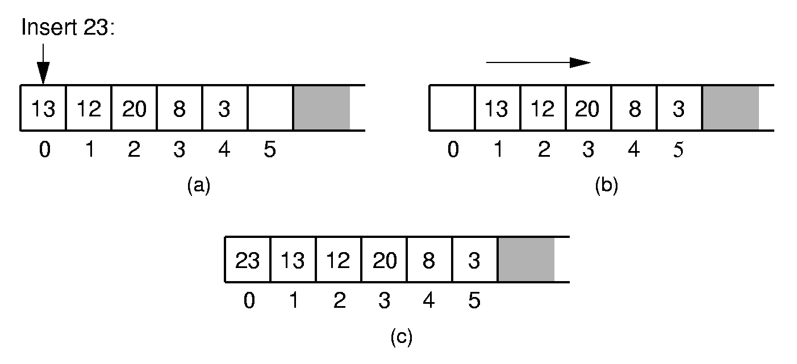
Array-Based List Insert

Slide 11
Array-Based List Class (1)
template <class Elem> // Array-based list
class AList : public List<Elem> {
private:
int maxSize; // Maximum size of list
int listSize; // Actual elem count
int fence; // Position of fence
Elem* listArray; // Array holding list
public:
AList(int size=DefaultListSize) {
maxSize = size;
listSize = fence = 0;
listArray = new Elem[maxSize];
}

Slide 12
Array-Based List Class (2)
~AList() { delete [] listArray; }
void clear() {
delete [] listArray;
listSize = fence = 0;
listArray = new Elem[maxSize];
}
void setStart() { fence = 0; }
void setEnd() { fence = listSize; }
void prev() { if (fence != 0) fence--; }
void next() { if (fence <= listSize-1)
fence++; }
int leftLength() const { return fence; }
int rightLength() const
{ return listSize - fence; }

Slide 13
Array-Based List Class (3)
bool setPos(int pos) {
if ((pos >= 0) && (pos <= listSize))
fence = pos;
return (pos >= 0) && (pos <= listSize);
}
bool getValue(Elem& it) const {
if (rightLength() == 0) return false;
else {
it = listArray[fence];
return true;
}
}

Slide 14
Insert
// Insert at front of right partition
template <class Elem>
bool AList<Elem>::insert(const Elem& item) {
if (listSize == maxSize) return false; for(int i=listSize; i>fence; i--)
// Shift Elems up to make room
listArray[i] = listArray[i-1]; listArray[fence] = item;
listSize++; // Increment list size
return true;
}

Slide 15
Append
// Append Elem to end of the list
template <class Elem>
bool AList<Elem>::append(const Elem& item) {
if (listSize == maxSize) return false;
listArray[listSize++] = item;
return true;
}

Slide 16
Remove
// Remove and return first Elem in right
// partition
template <class Elem> bool AList<Elem>::remove(Elem& it) {
if (rightLength() == 0) return false;
it = listArray[fence]; // Copy Elem
for(int i=fence; i<listSize-1; i++)
// Shift them down
listArray[i] = listArray[i+1];
listSize--; // Decrement size
return true;
}

Slide 17
Linked List

Slide 18
Link Class
Dynamic allocation of new list elements.
// Singly-linked list node
template <class Elem> class Link {
public:
Elem element; // Value for this node
Link *next; // Pointer to next node
Link(const Elem& elemval,
Link* nextval =NULL)
{ element = elemval; next = nextval; }
Link(Link* nextval =NULL)
{ next = nextval; }
};

Slide 19
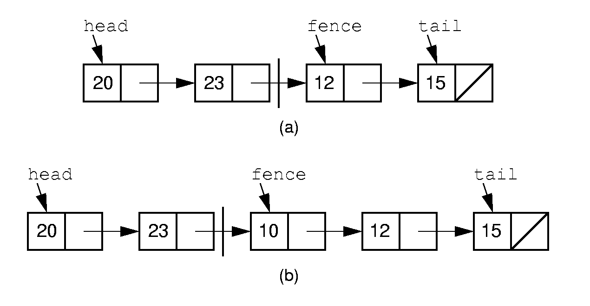
Linked List Position (1)

Slide 20
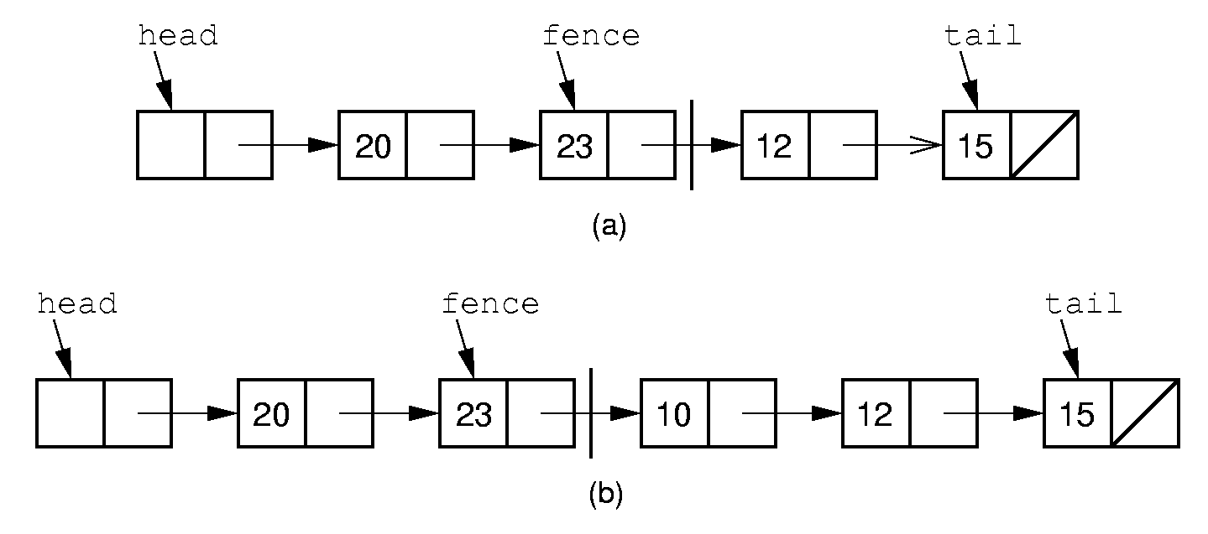
Linked List Position (2)

Slide 21
Linked List Class (1)
// Linked list implementation
template <class Elem> class LList:
public List<Elem> {
private:
Link<Elem>* head;//Point to list header
Link<Elem>* tail;//Pointer to last Elem Link<Elem>* fence;//Last element on left
int leftcnt; //Size of left
int rightcnt; //Size of right
void init() { //Initialization routine
fence = tail = head = new Link<Elem>;
leftcnt = rightcnt = 0;
}

Slide 22
Linked List Class (2)
void removeall() {
//Return link nodes to free store
while(head != NULL) {
fence = head;
head = head->next;
delete fence;
}
}
public:
LList(int size=DefaultListSize)
{ init(); }
~LList() { removeall(); } // Destructor
void clear() { removeall(); init(); }

Slide 23
Linked List Class (3)
void setStart() {
fence = head; rightcnt += leftcnt;
leftcnt = 0; }
void setEnd() {
fence = tail; leftcnt += rightcnt;
rightcnt = 0; }
void next() {
// Don't move fence if right empty
if (fence != tail) {
fence = fence->next; rightcnt--;
leftcnt++; }
}
int leftLength() const { return leftcnt; }
int rightLength() const { return rightcnt;}
bool getValue(Elem& it) const {
if(rightLength() == 0) return false;
it = fence->next->element;
return true; }

Slide 24
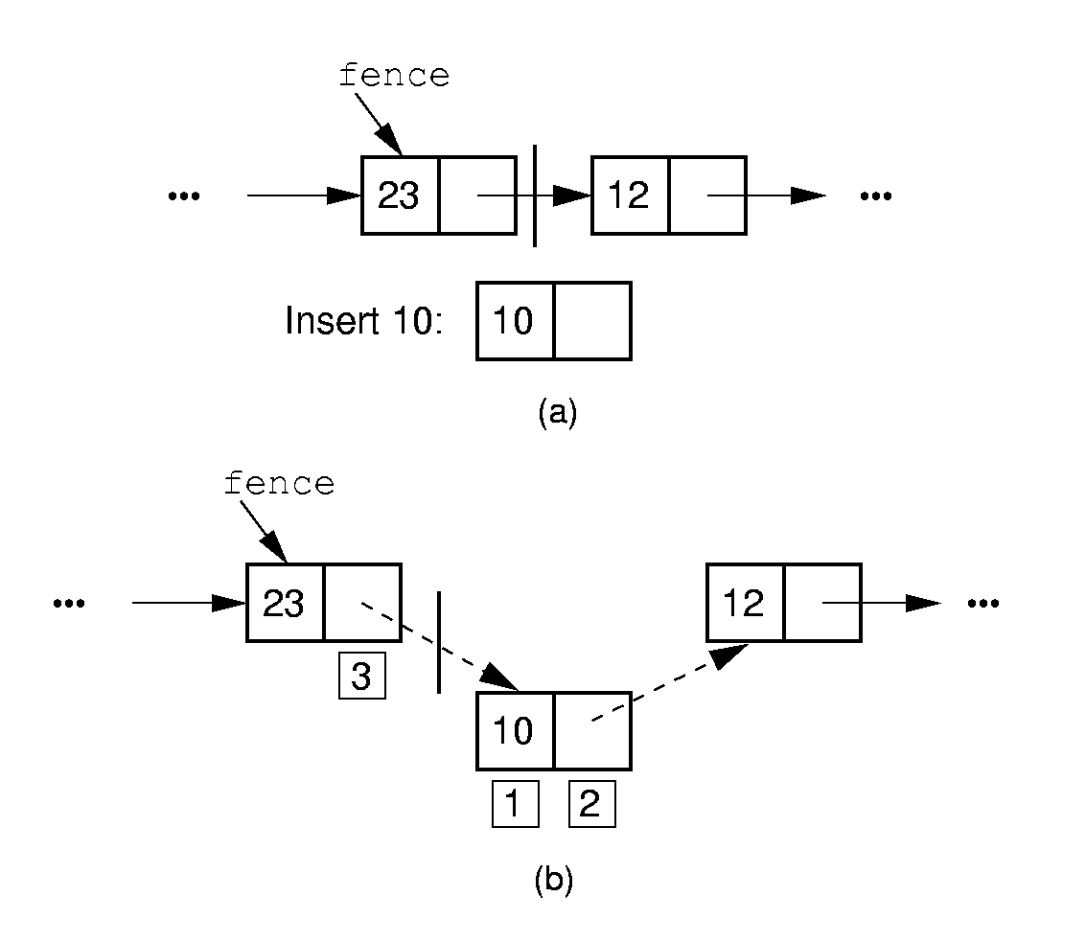
Linked List Insertion

Slide 25
Insert/Append
// Insert at front of right partition
template <class Elem>
bool LList<Elem>::insert(const Elem& item) {fence->next =
new Link<Elem>(item, fence->next);
if (tail == fence) tail = fence->next; rightcnt++;
return true;}
// Append Elem to end of the list
template <class Elem>
bool LList<Elem>::append(const Elem& item) {tail = tail->next =
new Link<Elem>(item, NULL);
rightcnt++;
return true;}

Slide 26
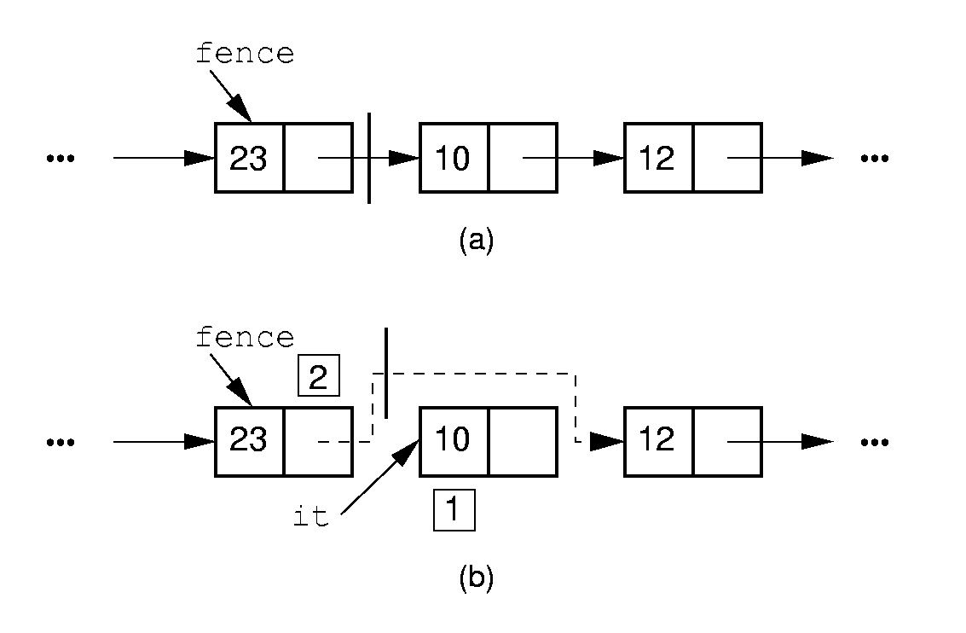
Removal

Slide 27
Remove
// Remove and return first Elem in right
// partition
template <class Elem> bool LList<Elem>::remove(Elem& it) {
if (fence->next == NULL) return false;
it = fence->next->element; //Remember val
// Remember link node
Link<Elem>* ltemp = fence->next;
fence->next = ltemp->next; // Remove
if (tail == ltemp) // Reset tail
tail = fence;
delete ltemp; // Reclaim space
rightcnt--;
return true;
}

Slide 28
Prev
// Move fence one step left;
// no change if left is empty
template <class Elem> void
LList<Elem>::prev() {
Link<Elem>* temp = head;
if (fence == head) return;//No prev Elem
while (temp->next!=fence)
temp=temp->next;
fence = temp;
leftcnt--;
rightcnt++;
}

Slide 29
Setpos
// Set the size of left partition to pos
template <class Elem>
bool LList<Elem>::setPos(int pos) {
if ((pos < 0) || (pos > rightcnt+leftcnt))
return false;
fence = head;
for(int i=0; i<pos; i++)
fence = fence->next;
return true;
}

Slide 30
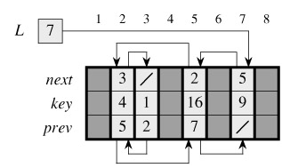
Implementing pointers and objects
How to implement pointers and objects in languages that do not provide them
  represent a collection of objects that have the same fields by using an array for each field

Slide 31
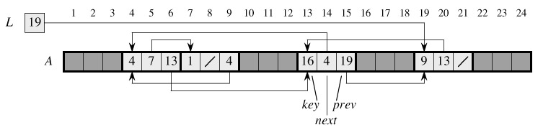
Implementing pointers and objects
  A single-array representation of objects

Slide 32
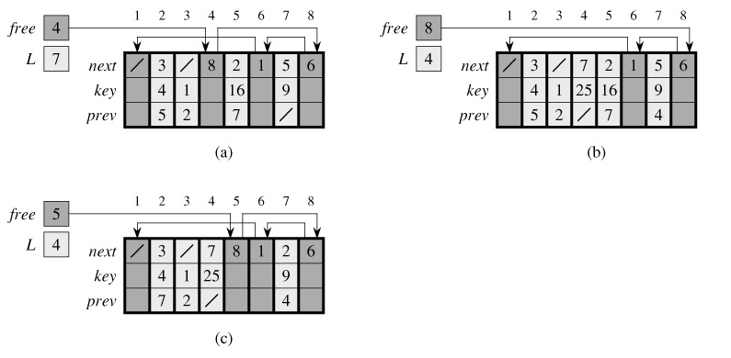
Allocating and freeing objects
System new and delete are slow.
In some systems, a garbage collector is responsible for determining which objects are unused.
List stack and queue

Slide 33
Freelists
// Singly-linked list node with freelist
template <class Elem> class Link {
private:
static Link<Elem>* freelist; // Head
public:
Elem element; // Value for this node
Link* next; // Point to next node Link(const Elem& elemval,
Link* nextval =NULL)
{ element = elemval; next = nextval; }
Link(Link* nextval =NULL) {next=nextval;}
void* operator new(size_t); // Overload
void operator delete(void*); // Overload
};

Slide 34
Freelists (2)
template <class Elem>
Link<Elem>* Link<Elem>::freelist = NULL;
template <class Elem> // Overload for new
void* Link<Elem>::operator new(size_t) {
if (freelist == NULL) return ::new Link;
Link<Elem>* temp = freelist; // Reuse
freelist = freelist->next;
return temp; // Return the link
}
template <class Elem> // Overload delete
void Link<Elem>::operator delete(void* ptr){
((Link<Elem>*)ptr)->next = freelist;
freelist = (Link<Elem>*)ptr;
}

Slide 35
Space Comparison
DE vs. n(P + E);
E: Space for data value.
P: Space for pointer.
D: Number of elements in array.
n: Current number of elements.

Slide 36
Comparison of Implementations
Array-Based Lists:
Insertion and deletion are Θ(n).
Prev and direct access are Θ(1).
Array must be allocated in advance.
No overhead if all array positions are full.
Linked Lists:
Insertion and deletion are Θ(1).
Prev and direct access are Θ(n).
Space grows with number of elements.
Every element requires overhead.

Slide 37
Element Implementations
Usage of pointers—advantages vs disad
Homogeneity—void*pointer
Objects memory management—leakage

Slide 38
Doubly Linked List

Slide 39
Doubly Linked Lists
Simplify insertion and deletion: Add a prev pointer.
// Doubly-linked list link node
template <class Elem> class Link {
public:
Elem element; // Value for this node
Link *next; // Pointer to next node
Link *prev; // Pointer to previous node
Link(const Elem& e, Link* prevp =NULL,
Link* nextp =NULL)
{ element=e; prev=prevp; next=nextp;}
Link(Link* prevp =NULL, Link* nextp =NULL)
{ prev = prevp; next = nextp; }
};

Slide 40
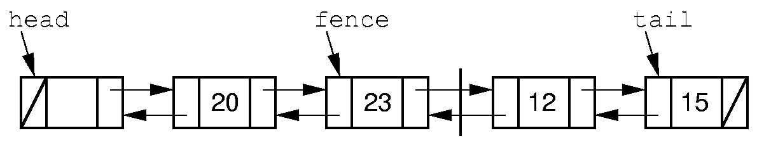
Doubly Linked Lists

Slide 41
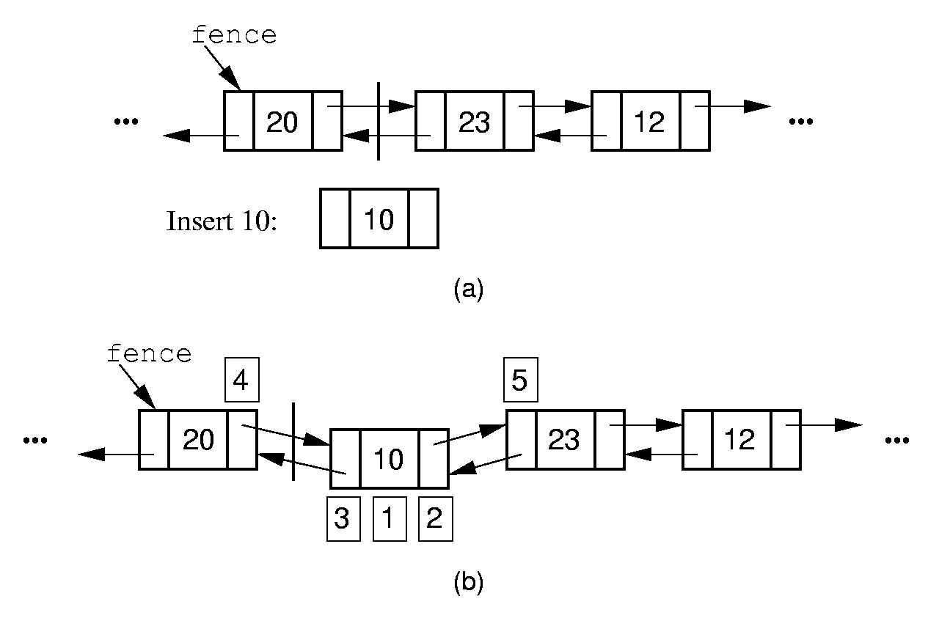
Doubly Linked Insert

Slide 42
Doubly Linked Insert
// Insert at front of right partition
template <class Elem>
bool LList<Elem>::insert(const Elem& item) {
fence->next =
new Link<Elem>(item, fence, fence->next);
if (fence->next->next != NULL)
fence->next->next->prev = fence->next;
if (tail == fence) // Appending new Elem
tail = fence->next; // so set tail
rightcnt++; // Added to right
return true;
}

Slide 43
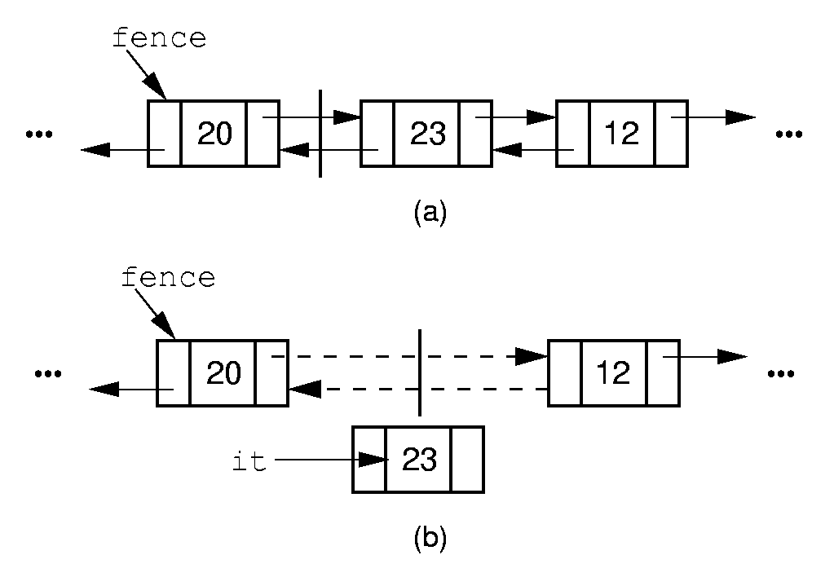
Doubly Linked Remove

Slide 44
Doubly Linked Remove
// Remove, return first Elem in right part
template <class Elem>
bool LList<Elem>::remove(Elem& it) {
if (fence->next == NULL) return false;
it = fence->next->element;
Link<Elem>* ltemp = fence->next;
if (ltemp->next != NULL)
ltemp->next->prev = fence;
else tail = fence; // Reset tail
fence->next = ltemp->next; // Remove delete ltemp; // Reclaim space
rightcnt--; // Removed from right
return true;
}

Slide 45
Chapter4 Lists, Stacks, and Queues
4.1 Lists
4.2 Stacks
4.3 Queues
4.4 The Dictionary

Slide 46
Stacks
LIFO: Last In, First Out.
Restricted form of list: Insert and remove only at front of list.
Notation:
  Insert: PUSH
  Remove: POP
  The accessible element is called TOP.

Slide 47
Stack ADT
// Stack abtract class
template <class Elem> class Stack {
public:
// Reinitialize the stack
virtual void clear() = 0;
// Push an element onto the top of the stack.
virtual bool push(const Elem&) = 0;
// Remove the element at the top of the stack.
virtual bool pop(Elem&) = 0;
// Get a copy of the top element in the stack
virtual bool topValue(Elem&) const = 0;
// Return the number of elements in the stack.
virtual int length() const = 0;
};

Slide 48
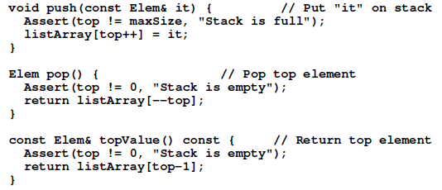
Array-Based Stack
// Array-based stack implementation
private:
int maxsize; // Maximum size of stack
int top; // Index for top element
Elem *listArray; // Array holding elements

Slide 49
Array-Based Stack
Issues:
Which end is the top?
What is the cost of the operations?

Slide 50
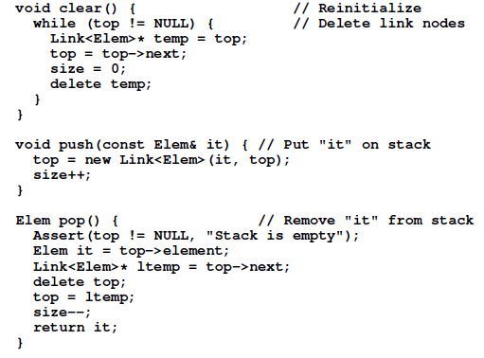
Linked Stack

Slide 51

Linked Stack
Issues:
What is the cost of the operations?
How do space requirements compare to the array-based stack implementation?

Slide 52
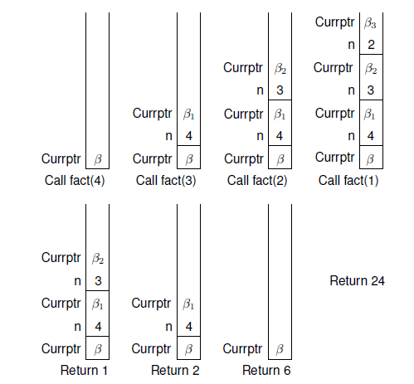
Implementing Recursion

Slide 53
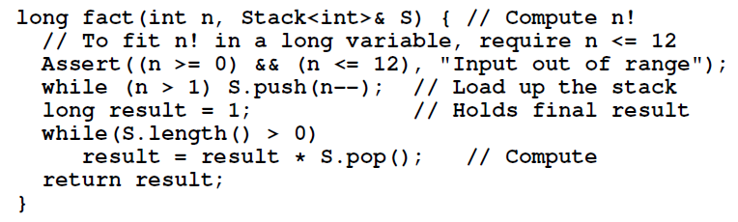
Implementing Recursion

Slide 54
Chapter4 Lists, Stacks, and Queues
4.1 Lists
4.2 Stacks
4.3 Queues
4.4 The Dictionary

Slide 55
Queues
FIFO: First in, First Out
Restricted form of list: Insert at one end, remove from the other.
Notation:
  Insert: Enqueue
  Delete: Dequeue
  First element: Front
  Last element: Rear

Slide 56
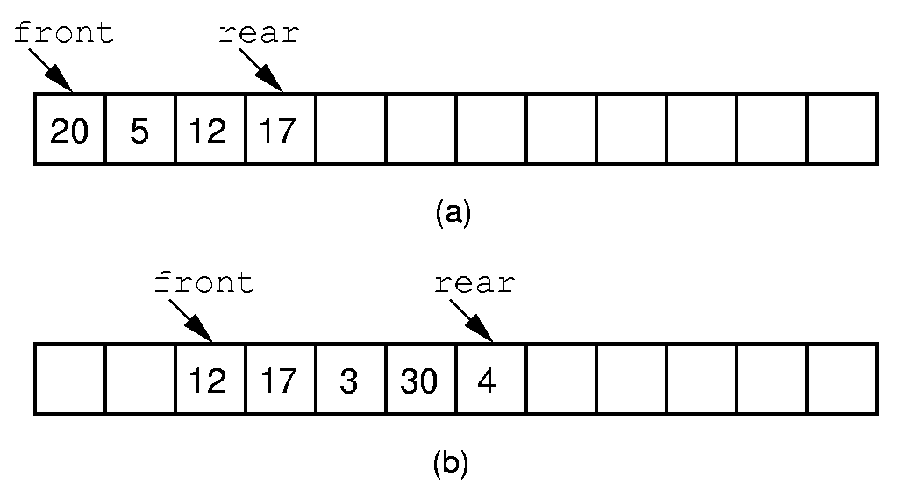
Queue Implementation (1)

Slide 57
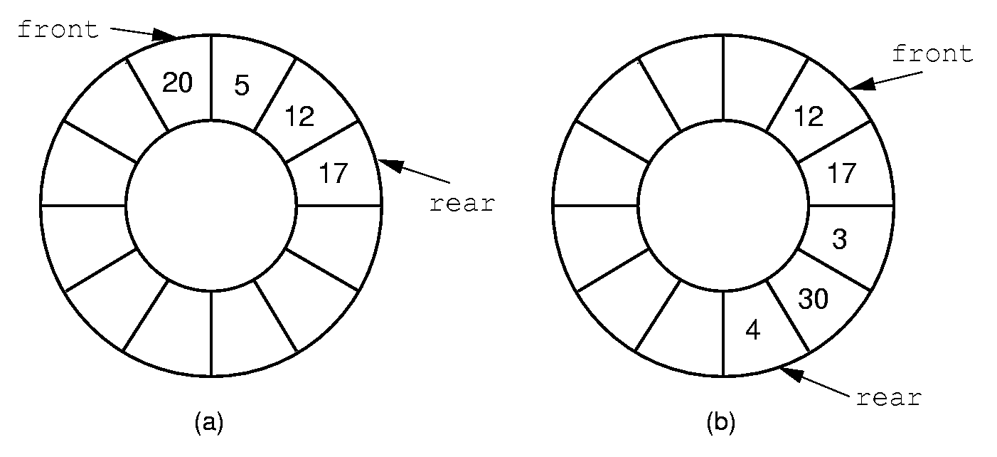
Queue Implementation (2)

Slide 58
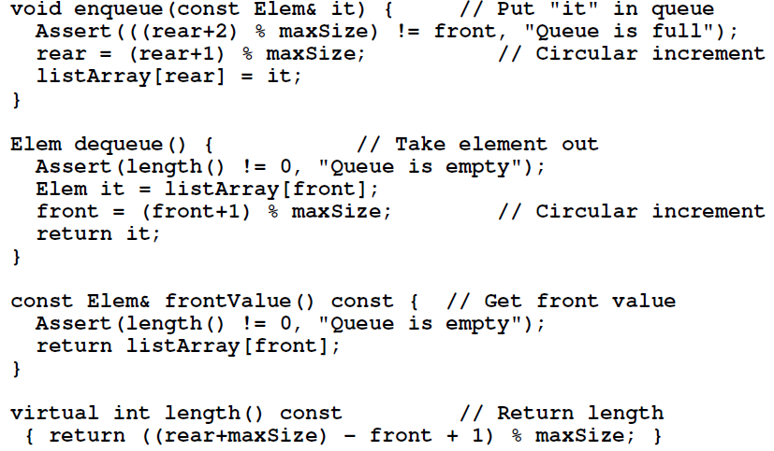
Array-based queue implementation

Slide 59
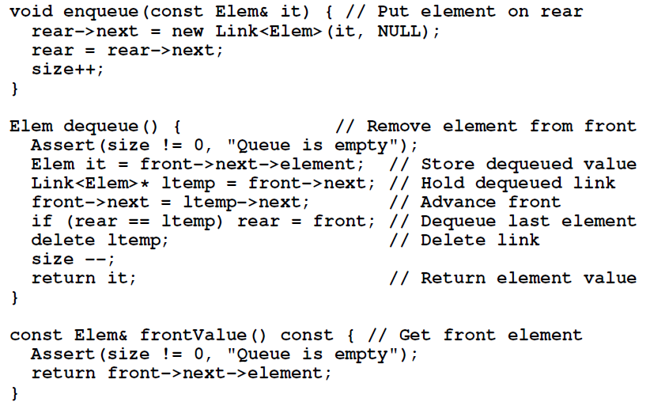
Linked queue implementation

Slide 60
Chapter4 Lists, Stacks, and Queues
4.1 Lists
4.2 Stacks
4.3 Queues
4.4 The Dictionary

Slide 61
Dictionary
Often want to insert records, delete records, search for records.
Required concepts:
  Search key: Describe what we are looking for
  Key comparison
    Equality: sequential search
    Relative order: sorting
  Record comparison

Slide 62
Comparator Class
How do we generalize comparison?
  Use ==, <=, >=: Disastrous
  Overload ==, <=, >=: Disastrous
  Define a function with a standard name
    Implied obligation
    Breaks down with multiple key fields/indices for same object
  Pass in a function
    Explicit obligation
    Function parameter
    Template parameter

Slide 63
Comparator Example
class intintCompare {
public:
static bool lt(int x, int y)
{ return x < y; }
static bool eq(int x, int y)
{ return x == y; }
static bool gt(int x, int y)
{ return x > y; }
};

Slide 64
Comparator Example (2)
class PayRoll {
public:
int ID;
char* name;
};
class IDCompare {
public:
static bool lt(Payroll& x, Payroll& y)
{ return x.ID < y.ID; }
};
class NameCompare {
public:
static bool lt(Payroll& x, Payroll& y)
{ return strcmp(x.name, y.name) < 0; }
};

Slide 65
Dictionary ADT
// The Dictionary abstract class.
template <class Key, class Elem,
class KEComp, class EEComp>
class Dictionary {
public:
virtual void clear() = 0;
virtual bool insert(const Elem&) = 0;
virtual bool remove(const Key&, Elem&) = 0;
virtual bool removeAny(Elem&) = 0;
virtual bool find(const Key&, Elem&)
const = 0;
virtual int size() = 0;
};

Slide 66
Unsorted List Dictionary
template <class Key, class Elem,
class KEComp, class EEComp>
class UALdict : public
Dictionary<Key,Elem,KEComp,EEComp> {
private: AList<Elem>* list;
public:
bool remove(const Key& K, Elem& e) {
for(list->setStart(); list->getValue(e);
list->next())
if (KEComp::eq(K, e)) {
list->remove(e);
return true;
}
return false;
}
};

Slide 67
Sorted List Dictionary
Sorted array-based list
Find： Θ（logn）
Insert： Θ（n）
Remove： Θ（n）

Slide 68
Exercise
P153
4.4 , 4.6, 4.13, 4.14, 4.15, 4.19

