Slide 1
Chapter6 General Trees
6.1 Definitions and Terminology
6.2 Parent Pointer Implementation
6.3 General Tree Implementations
6.4 K-ary Trees
6.5 Sequential Tree Implementations

Slide 2
General Trees
A tree T is a finite set of one or more nodes such that there is one designated node r called the root of T, and the remaining nodes in (T –{r}) are partitioned into n≥0 disjoint subsets T1, T2, ..., Tk, each of which is a tree, and whose roots r1, r2, ..., rk, respectively, are children of r.

Slide 3
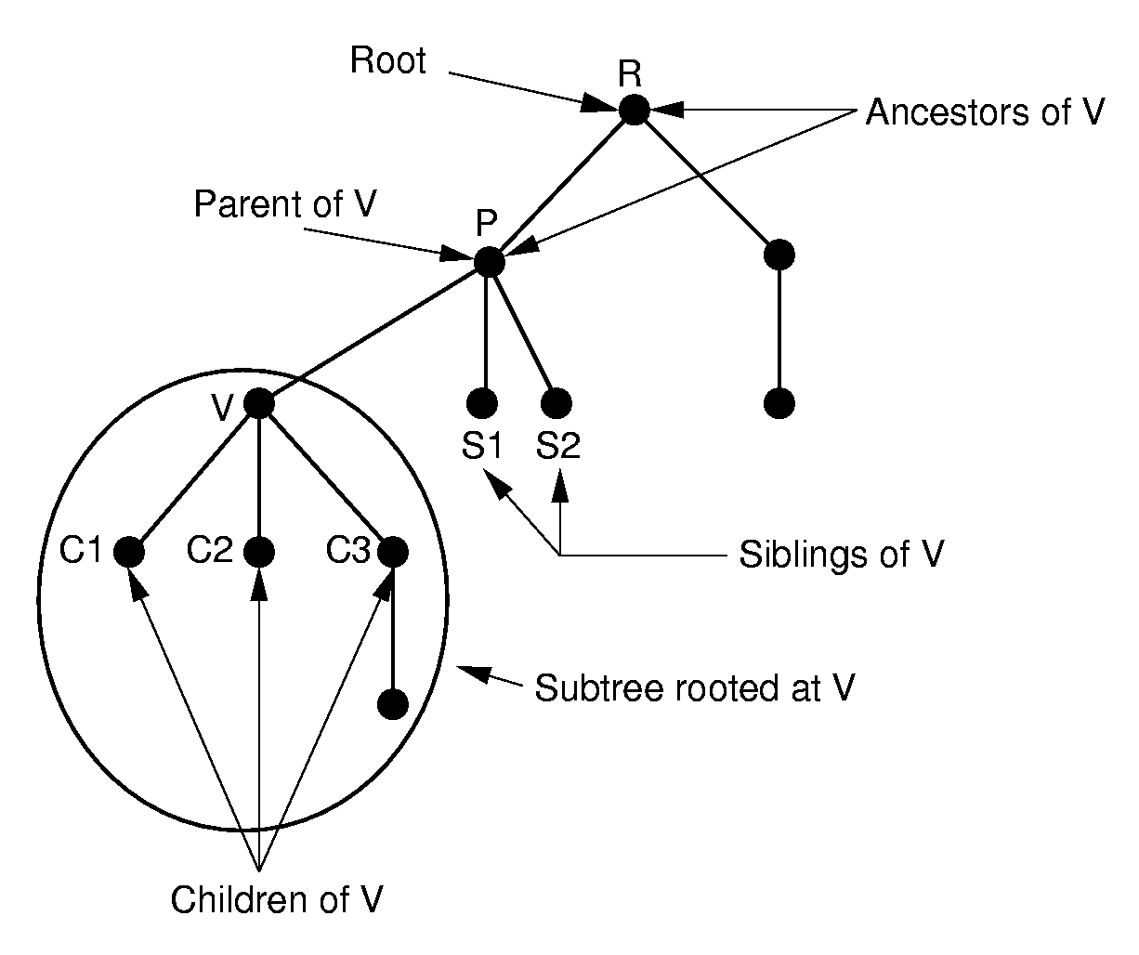
General Trees

Slide 4
General Tree Node
// General tree node ADT
template <class Elem> class GTNode {
public:
GTNode(const Elem&); // Constructor
~GTNode(); // Destructor
Elem value(); // Return value
bool isLeaf(); // TRUE if is a leaf
GTNode* parent(); // Return parent
GTNode* leftmost_child(); // First child
GTNode* right_sibling(); // Right sibling
void setValue(Elem&); // Set value
void insert_first(GTNode<Elem>* n);
void insert_next(GTNode<Elem>* n);
void remove_first(); // Remove first child
void remove_next(); // Remove sibling
};

Slide 5
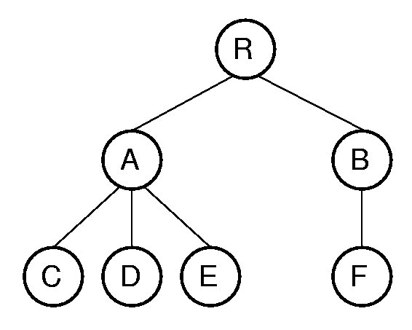
General Tree Traversal
template <class Elem>
void GenTree<Elem>::
printhelp(GTNode<Elem>* subroot) {
if (subroot->isLeaf()) cout << "Leaf: ";
else cout << "Internal: ";
cout << subroot->value() << "\n";
for (GTNode<Elem>* temp =
subroot->leftmost_child();
temp != NULL;
temp = temp->right_sibling())
printhelp(temp);
}

Slide 6
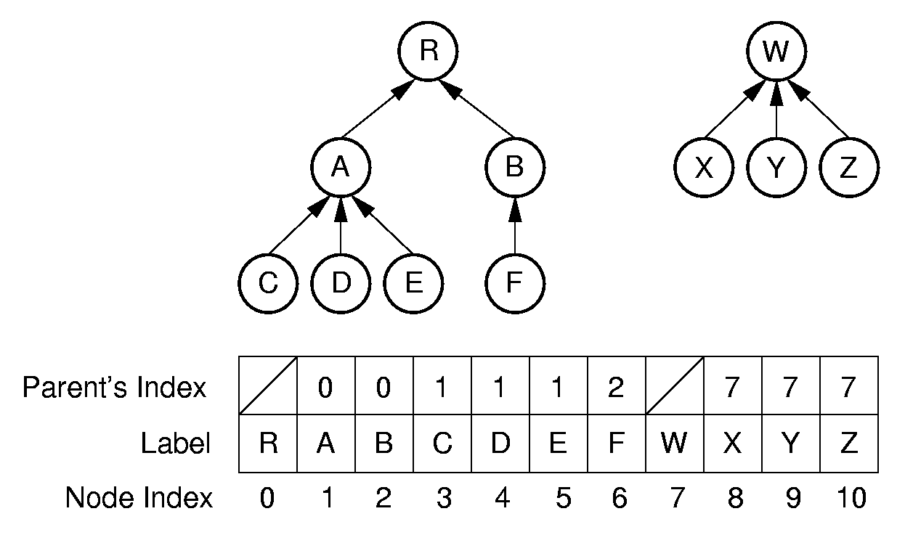
Parent Pointer Implementation(1)

Slide 7
Parent Pointer Implementation(2)
The parent pointer representation is good for answering:
  Are two elements in the same tree?
// Return TRUE if nodes in different trees
bool Gentree::differ(int a, int b) {
int root1 = FIND(a); // Find root for a
int root2 = FIND(b); // Find root for b
return root1 != root2; // Compare roots
}

Slide 8
Union/Find
void Gentree::UNION(int a, int b) {
int root1 = FIND(a); // Find root for a
int root2 = FIND(b); // Find root for b
if (root1 != root2) array[root2] = root1;
}
int Gentree::FIND(int curr) const {
while (array[curr]!=ROOT) curr = array[curr];
return curr; // At root
}

Slide 9

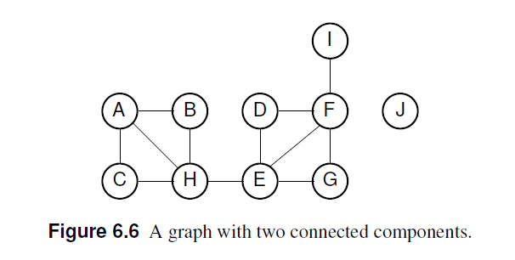
Equiv Class

Slide 10
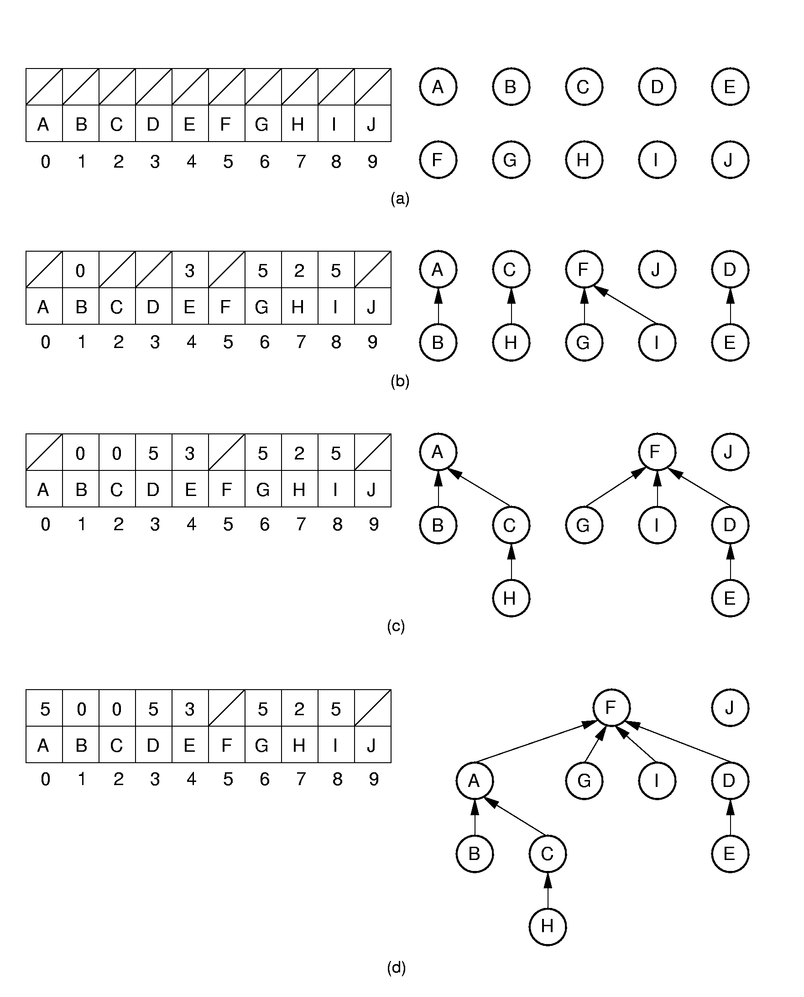
Equiv Class Processing (1)
(A,B) (C,H) (G,F) (D,E) (I,F)

Slide 11
Equiv Class Processing (2)
(H,A) (E,G) (H,E)

Slide 12
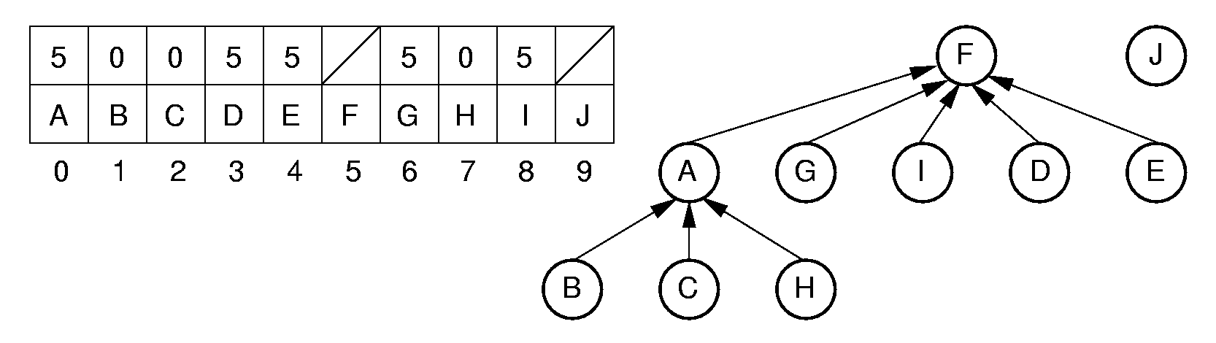
Path Compression
int Gentree::FIND(int curr) const {
if (array[curr] == ROOT) return curr;
return array[curr] = FIND(array[curr]);
}

Slide 13
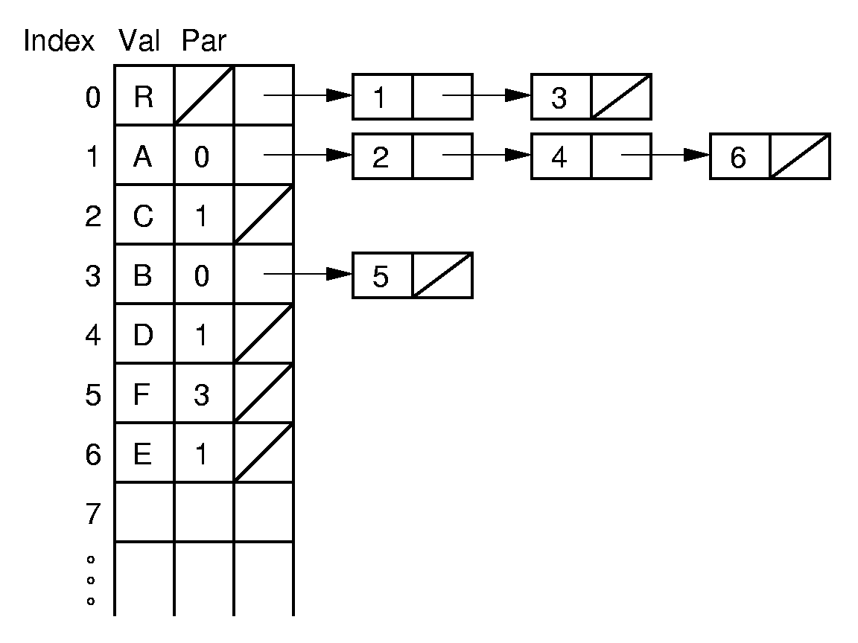
Lists of Children

Slide 14
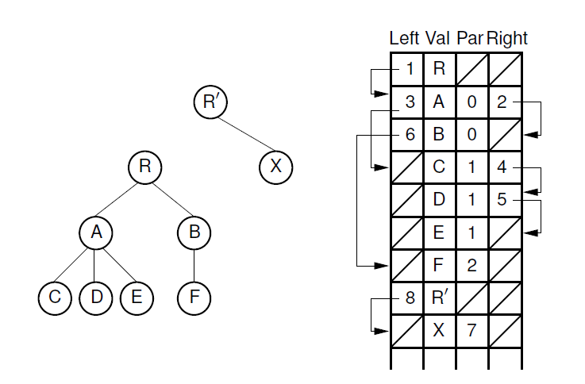
Leftmost Child/Right Sibling (1)

Slide 15
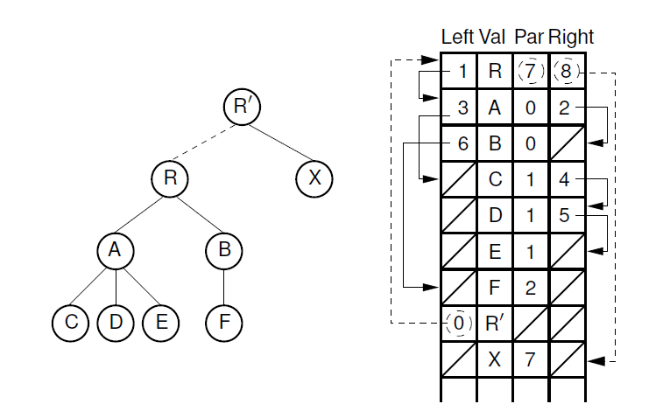
Leftmost Child/Right Sibling (2)

Slide 16
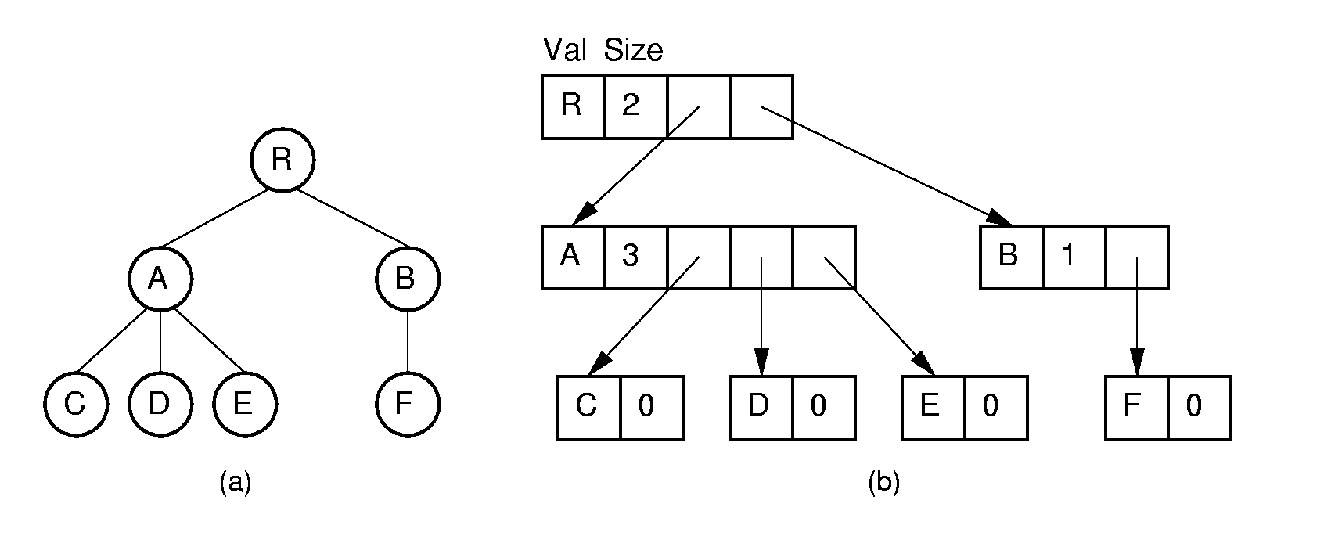
Linked Implementations (1)

Slide 17
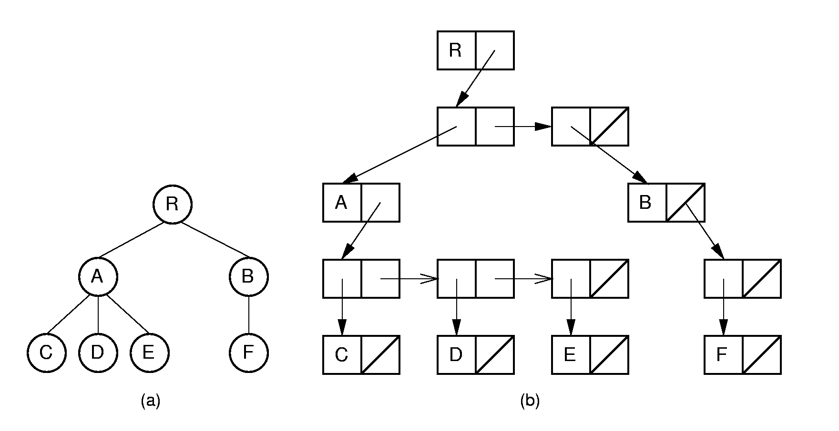
Linked Implementations (2)

Slide 18
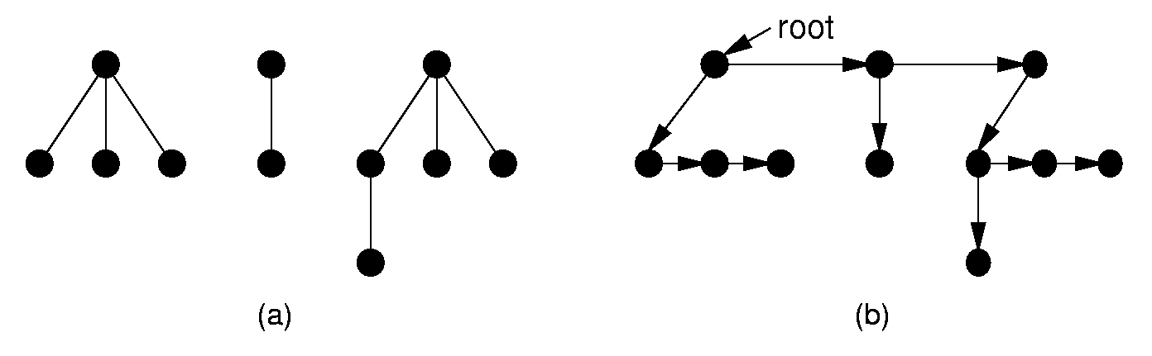
Converting to a Binary Tree (1)
Left child/right sibling representation essentially stores a binary tree.
Use this process to convert any general tree to a binary tree.
A forest is a collection of one or more general trees.

Slide 19
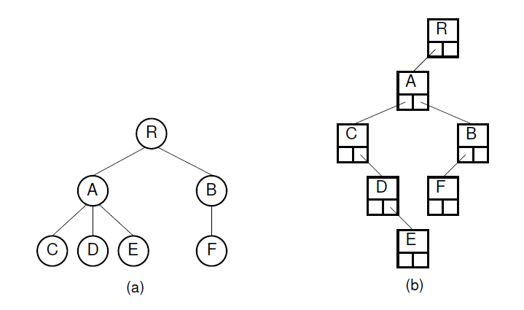
Converting to a Binary Tree (2)

Slide 20
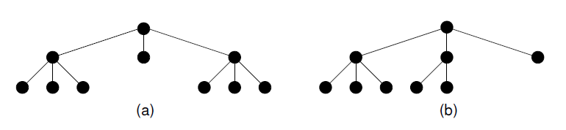
K-ary Trees

Slide 21
Sequential Implementations (1)
List node values in the order they would be visited by a preorder traversal.
Saves space, but allows only sequential access.
Need to retain tree structure for reconstruction.

Slide 22
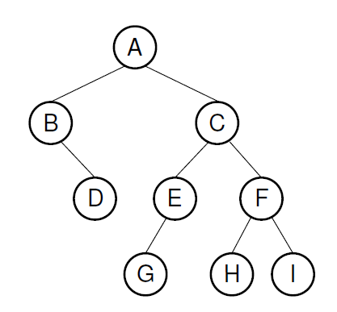
Sequential Implementations (2)
Example1:
For binary trees, us a symbol to mark null links.
AB/D//CEG///FH//I//
Example2:
For full binary trees, mark nodes as leaf or internal.
A’B’/DC’E’G/F’HI

Slide 23
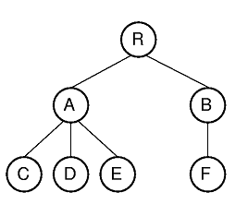
Sequential Implementations (3)
Example: For general trees, mark the end of each subtree.
RAC)D)E))BF)))

Slide 24
exercises
6.4 , 6.12

