Slide 1
Chapter7 Internal Sorting
7.1 Sorting Terminology and Notation
7.2 Three Sorting Algorithms
7.3 Shellsort
7.4 Mergesort
7.5 Quicksort
7.6 Heapsort
7.7 Binsort and Radix Sort
7.8 An Empirical Comparison of Sorting Algorithms
7.9 Lower Bounds for Sorting

Slide 2
Sorting
Given a sequence of records R₁ , R₂ , … , R_{n} with
key values k₁ , k₂ ,… , k_{n} , respectively, arrange the
records into any orders such that records
R_{s1},R_{s2},…,R_{sn} have keys obeying the property
k_{s1} ≤ k_{s2} ≤ …≤ k_{sn}.
Each record contains a field called the key.
Linear order: comparison.
Measures of cost:
Comparisons
Swaps

Slide 3
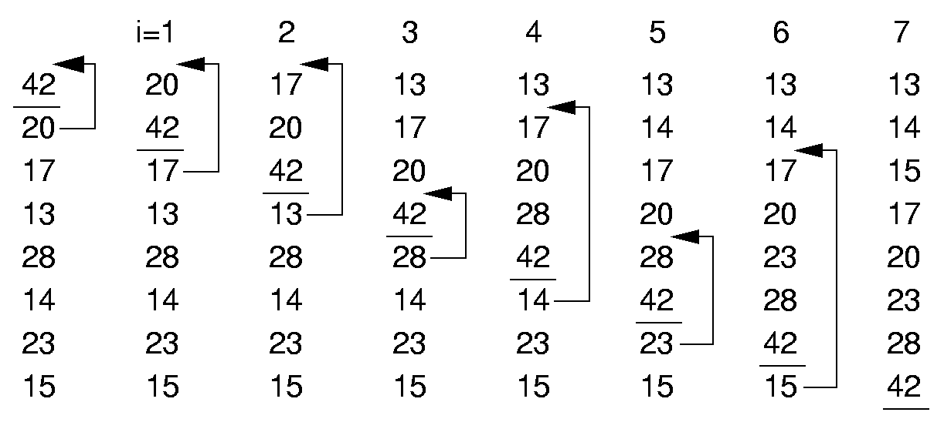
Insertion Sort (1)

Slide 4
Insertion Sort (2)
template <class Elem, class Comp>
void inssort(Elem A[], int n) {
for (int i=1; i<n; i++)
for (int j=i; (j>0) &&
(Comp::lt(A[j], A[j-1])); j--)
swap(A, j, j-1);
}
Best Case: 0 swaps, n - 1 comparisons
Worst Case: n(n-1)/2 swaps and comparisons
Average Case: n (n-1)/4 swaps and comparisons
Optimizing?

Slide 5
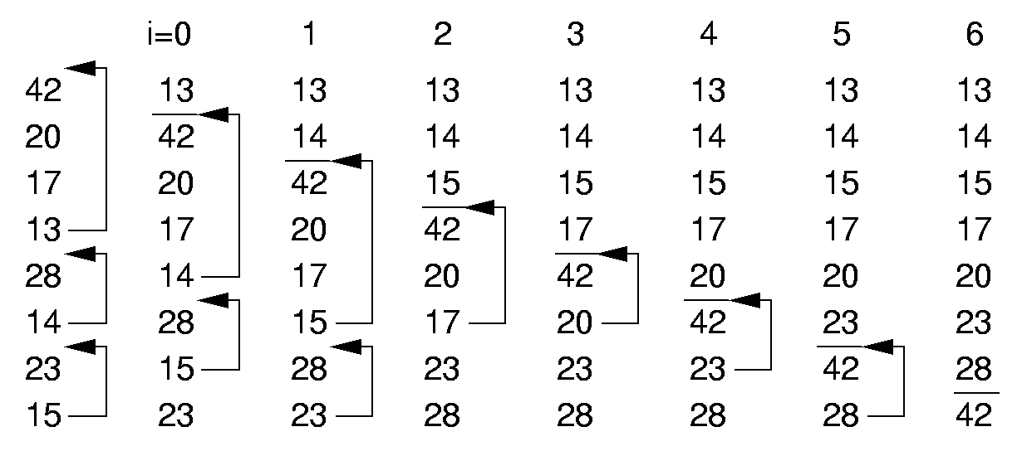
Bubble Sort (1)

Slide 6
Bubble Sort (2)
template <class Elem, class Comp>
void bubsort(Elem A[], int n) {
for (int i=0; i<n-1; i++)
for (int j=n-1; j>i; j--)
if (Comp::lt(A[j], A[j-1]))
swap(A, j, j-1);
}
Best Case: 0 swaps, n(n-1)/2 comparisons
Worst Case:
n(n-1)/2 swaps and comparisons
Average Case:
n(n-1) /4 swaps and n(n-1) /2 comparisons.

Slide 7
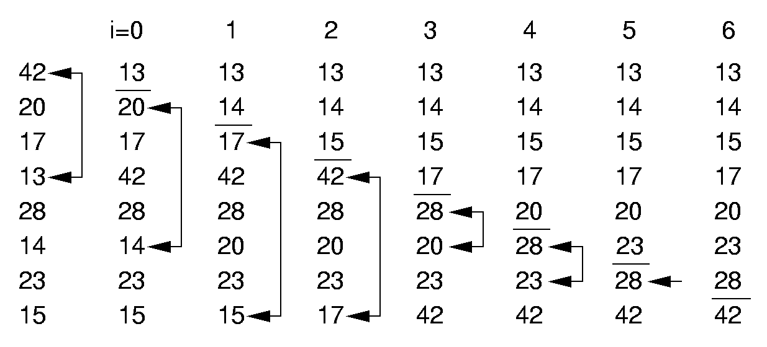
Selection Sort (1)

Slide 8
Selection Sort (2)
template <class Elem, class Comp>
void selsort(Elem A[], int n) {
for (int i=0; i<n-1; i++) {
int lowindex = i; // Remember its index
for (int j=n-1; j>i; j--) // Find least
if (Comp::lt(A[j], A[lowindex]))
lowindex = j; // Put it in place
swap(A, i, lowindex);
}
}
Best Case: 0 swaps (n-1 as written), n(n-1)/2 comparisons.
Worst Case: n - 1 swaps and n(n-1)/2 comparisons
Average Case: O(n) swaps and n(n-1)/2 comparisons

Slide 9
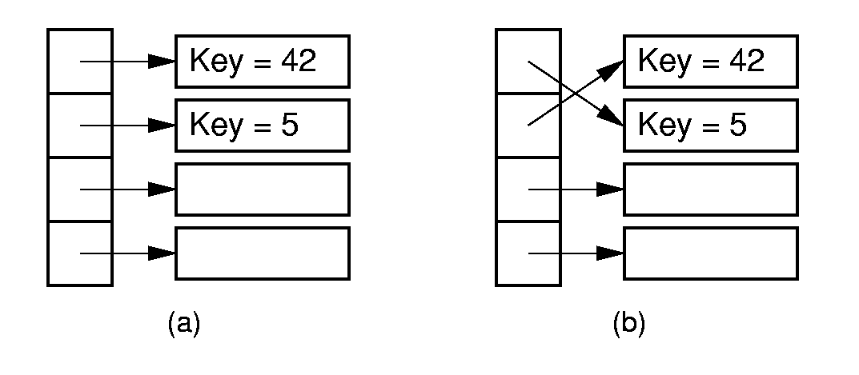
Pointer Swapping

Slide 10

Summary
 | Insertion | Bubble | Selection
Comparisons:
Best Case | Θ(n) | Θ(n²) | Θ(n²)
Average Case | Θ(n²) | Θ(n²) | Θ(n²)
Worst Case | Θ(n²) | Θ(n²) | Θ(n²)
Swaps
Best Case | 0 | 0 | Θ(n)
Average Case | Θ(n²) | Θ(n²) | Θ(n)
Worst Case | Θ(n²) | Θ(n²) | Θ(n)

Slide 11
Exchange Sorting
All of the sorts so far rely on exchanges of adjacent records.
What is the average number of exchanges required?
  There are n! permutations
  Consider permuation X and its reverse, X’
  Together, every pair requires n(n-1)/2 exchanges.
Brain storm! What’s your sorting algorithm?

Slide 12
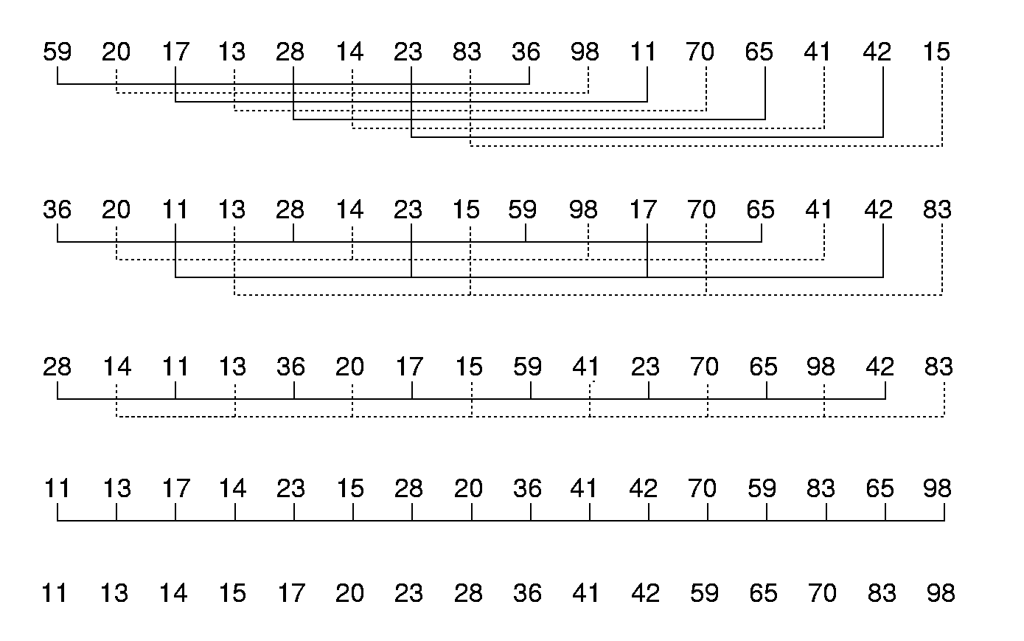
Shellsort

Slide 13
Shellsort
// Modified version of Insertion Sort
template <class Elem, class Comp>
void inssort2(Elem A[], int n, int incr) {
for (int i=incr; i<n; i+=incr)
for (int j=i;
(j>=incr) &&
(Comp::lt(A[j], A[j-incr])); j-=incr)
swap(A, j, j-incr);
}
template <class Elem, class Comp>
void shellsort(Elem A[], int n) { // Shellsort
for (int i=n/2; i>2; i/=2) // For each incr
for (int j=0; j<i; j++) // Sort sublists
inssort2<Elem,Comp>(&A[j], n-j, i);
inssort2<Elem,Comp>(A, n, 1);
}

Slide 14
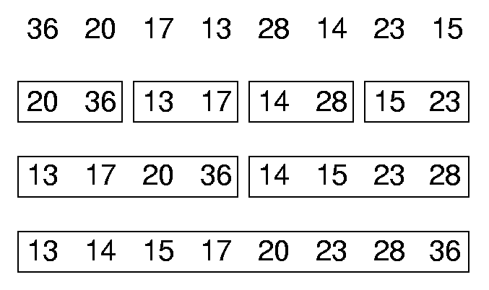
Mergesort
List mergesort(List inlist) {
if (inlist.length() <= 1)return inlist;
List l1 = half of the items from inlist;
List l2 = other half of items from inlist;
return merge(mergesort(l1),
mergesort(l2));
}

Slide 15
Mergesort Implementation
template <class Elem, class Comp>
void mergesort(Elem A[], Elem temp[],
int left, int right) {
int mid = (left+right)/2;
if (left == right) return;
mergesort<Elem,Comp>(A, temp, left, mid);
mergesort<Elem,Comp>(A, temp, mid+1, right);
for (int i=left; i<=right; i++) // Copy
temp[i] = A[i];
int i1 = left; int i2 = mid + 1;
for (int curr=left; curr<=right; curr++) {
if (i1 == mid+1) // Left exhausted
A[curr] = temp[i2++];
else if (i2 > right) // Right exhausted
A[curr] = temp[i1++];
else if (Comp::lt(temp[i1], temp[i2]))
A[curr] = temp[i1++];
else A[curr] = temp[i2++];
}}

Slide 16
Optimized Mergesort
template <class Elem, class Comp>
void mergesort(Elem A[], Elem temp[],
int left, int right) {
if ((right-left) <= THRESHOLD) {
inssort<Elem,Comp>(&A[left],right-left+1);
return;
}
int i, j, k, mid = (left+right)/2;
if (left == right) return;
mergesort<Elem,Comp>(A, temp, left, mid);
mergesort<Elem,Comp>(A, temp, mid+1, right);
for (i=mid; i>=left; i--) temp[i] = A[i];
for (j=1; j<=right-mid; j++)
temp[right-j+1] = A[j+mid];
for (i=left,j=right,k=left; k<=right; k++)
if (temp[i] < temp[j]) A[k] = temp[i++];
else A[k] = temp[j--];
}

Slide 17
Mergesort Cost
Mergesort cost:
  Θ(n log n) in the best, average, and worst cases.
Mergsort is also good for sorting linked lists.
Mergesort requires twice the space.

Slide 18
Quicksort
Divide and Conquer:
divide list into values less than pivot and values greater than pivot.
Initial call: qsort(array, 0, n-1);
template <class Elem, class Comp>
void qsort(Elem A[], int i, int j) {
if (j <= i) return; // List too small
int pivotindex = findpivot(A, i, j);
swap(A, pivotindex, j); // Put pivot at end
// k will be first position on right side
int k =
partition<Elem,Comp>(A, i-1, j, A[j]);
swap(A, k, j); // Put pivot in place
qsort<Elem,Comp>(A, i, k-1);
qsort<Elem,Comp>(A, k+1, j);
}

Slide 19
Quicksort Partition
template <class Elem>
int findpivot(Elem A[], int i, int j)
{ return (i+j)/2; }
template <class Elem, class Comp>
int partition(Elem A[], int l, int r,
Elem& pivot) {
do { // Move the bounds in until they meet
while (Comp::lt(A[++l], pivot));
while ((r != 0) && Comp::gt(A[--r],
pivot));
swap(A, l, r); // Swap out-of-place values
} while (l < r); // Stop when they cross
swap(A, l, r); // Reverse last swap
return l; // Return first pos on right
}
The cost for partition is Θ(n).

Slide 20
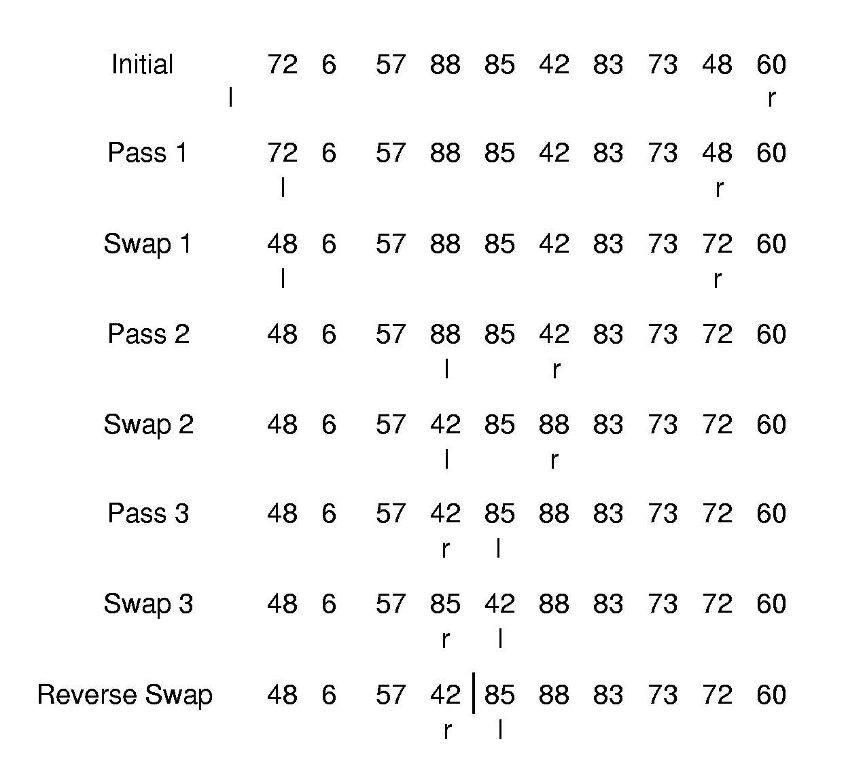
Partition Example

Slide 21
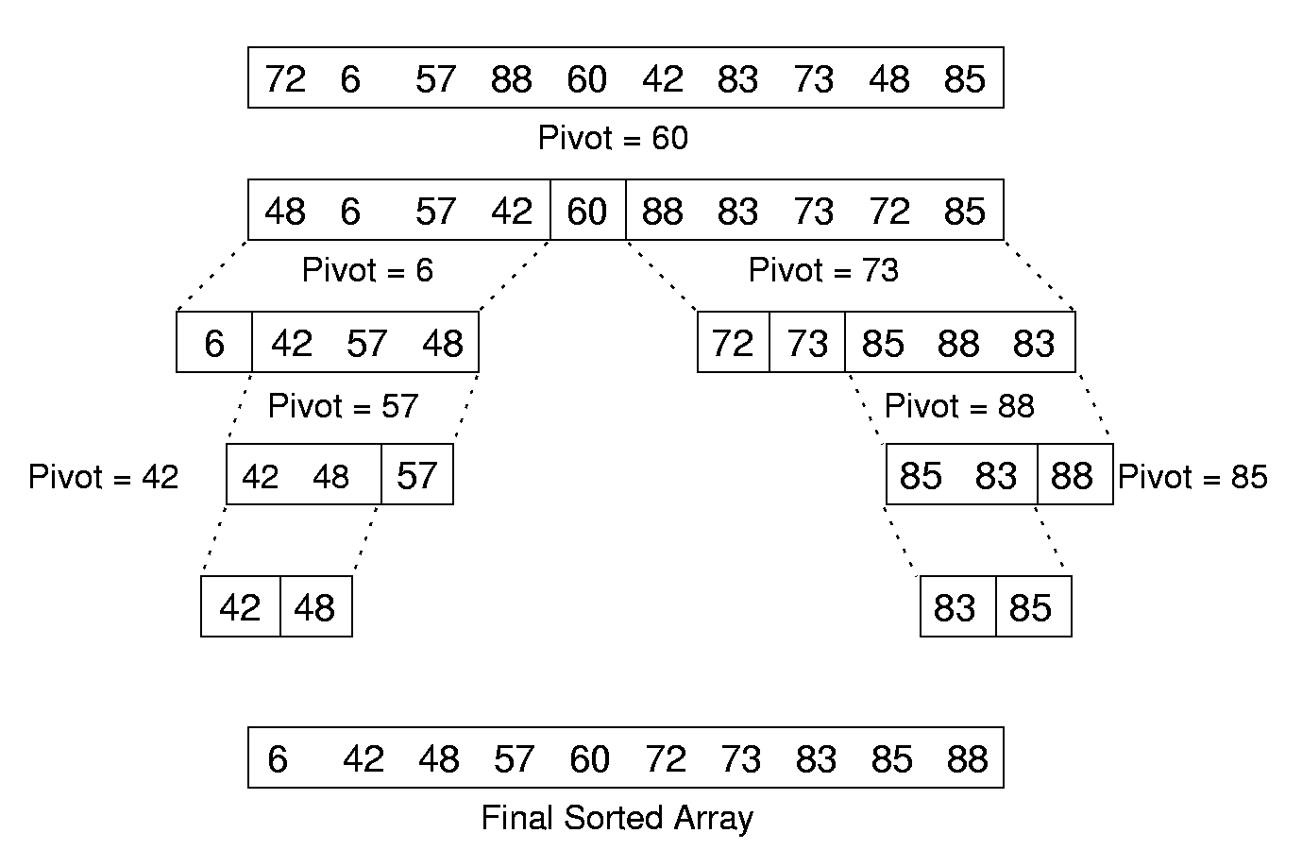
Quicksort Example

Slide 22
Cost of Quicksort
Best case: Always partition in half. Θ(n log n)
Worst case: Bad partition. Θ(n²)
Average case:
T(n) = cn + 1/n Σ(T(k) + T(n-1-k))= Θ(n log n)
Optimizations for Quicksort:
  Better Pivot
  Better algorithm for small sublists
  Eliminate recursion
n-1
k=0

Slide 23
Heapsort
template <class Elem, class Comp>
void heapsort(Elem A[], int n) { // Heapsort
Elem mval;
maxheap<Elem,Comp> H(A, n, n);
for (int i=0; i<n; i++) // Now sort
H.removemax(mval); // Put max at end
}
Use a max-heap, so that elements end up sorted within the array.
Cost of heapsort:
build the heap is Θ(n)
remove the n elements is Θ(n log n)
Cost of finding K largest elements:
Θ(n + k log n)

Slide 24
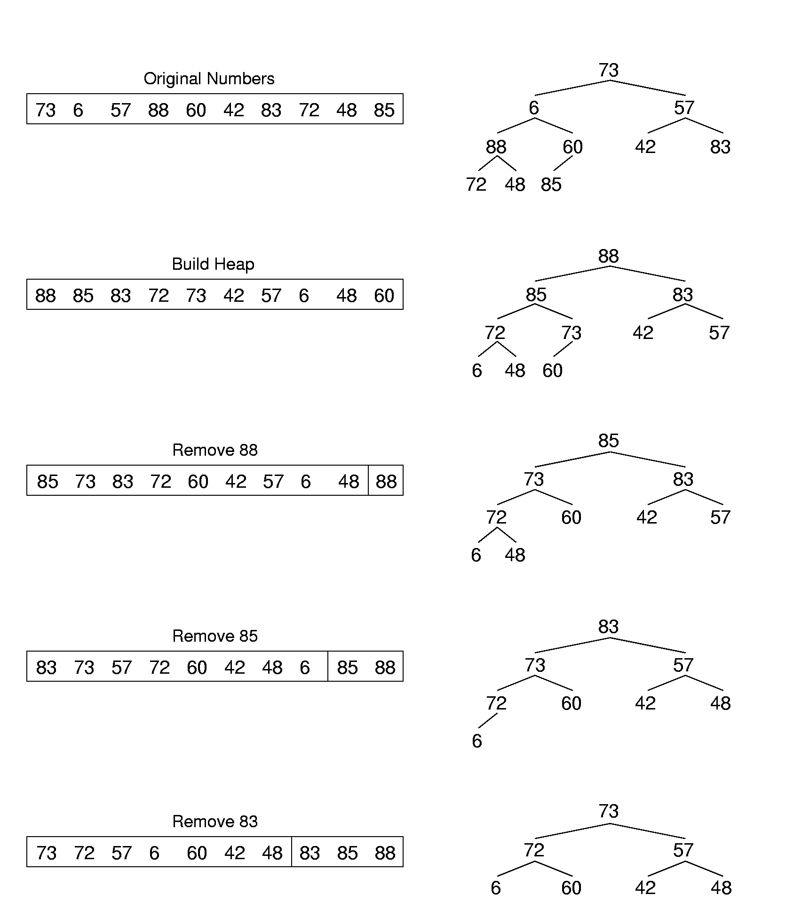
Heapsort Example (1)

Slide 25
Heapsort Example (2)

Slide 26
Binsort (1)
A simple, efficient sort:
for (i=0; i<n; i++)
B[A[i]] = A[i];
Ways to generalize:
  Make each bin the head of a list.
  Allow more keys than records.

Slide 27
Binsort (2)
template <class Elem>
void binsort(Elem A[], int n) {
List<Elem> B[MaxKeyValue];
Elem item;
for (i=0; i<n; i++) B[A[i]].append(A[i]);
for (i=0; i<MaxKeyValue; i++)
for (B[i].setStart();
B[i].getValue(item); B[i].next())
output(item);
}
Cost: Θ(n + MaxKeyValue).
Density of distribution?

Slide 28
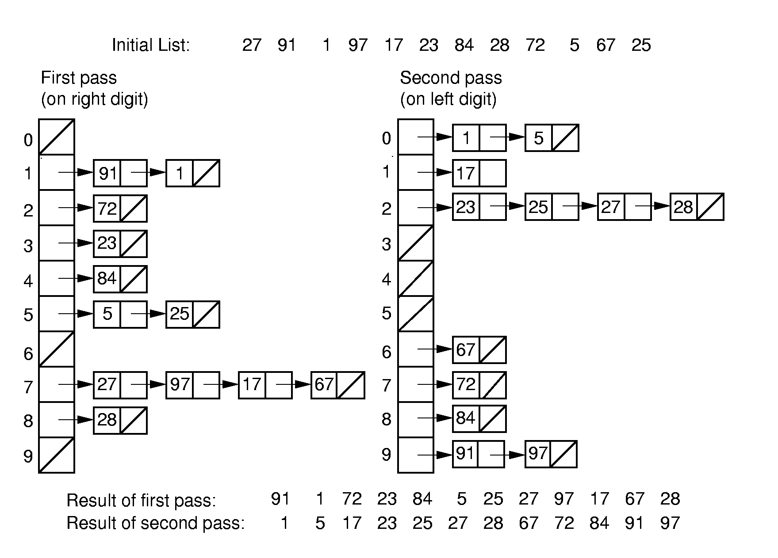
Radix Sort (1)

Slide 29
Radix Sort (2)
template <class Elem, class Comp>
void radix(Elem A[], Elem B[],
int n, int k, int r, int cnt[]) {
// cnt[i] stores # of records in bin[i]
int j;
for (int i=0, rtok=1; i<k; i++, rtok*=r) {
for (j=0; j<r; j++) cnt[j] = 0;
// Count # of records for each bin
for(j=0; j<n; j++) cnt[(A[j]/rtok)%r]++;
// cnt[j] will be last slot of bin j.
for (j=1; j<r; j++)
cnt[j] = cnt[j-1] + cnt[j];
for (j=n-1; j>=0; j--)\
B[--cnt[(A[j]/rtok)%r]] = A[j];
for (j=0; j<n; j++) A[j] = B[j];
}}

Slide 30
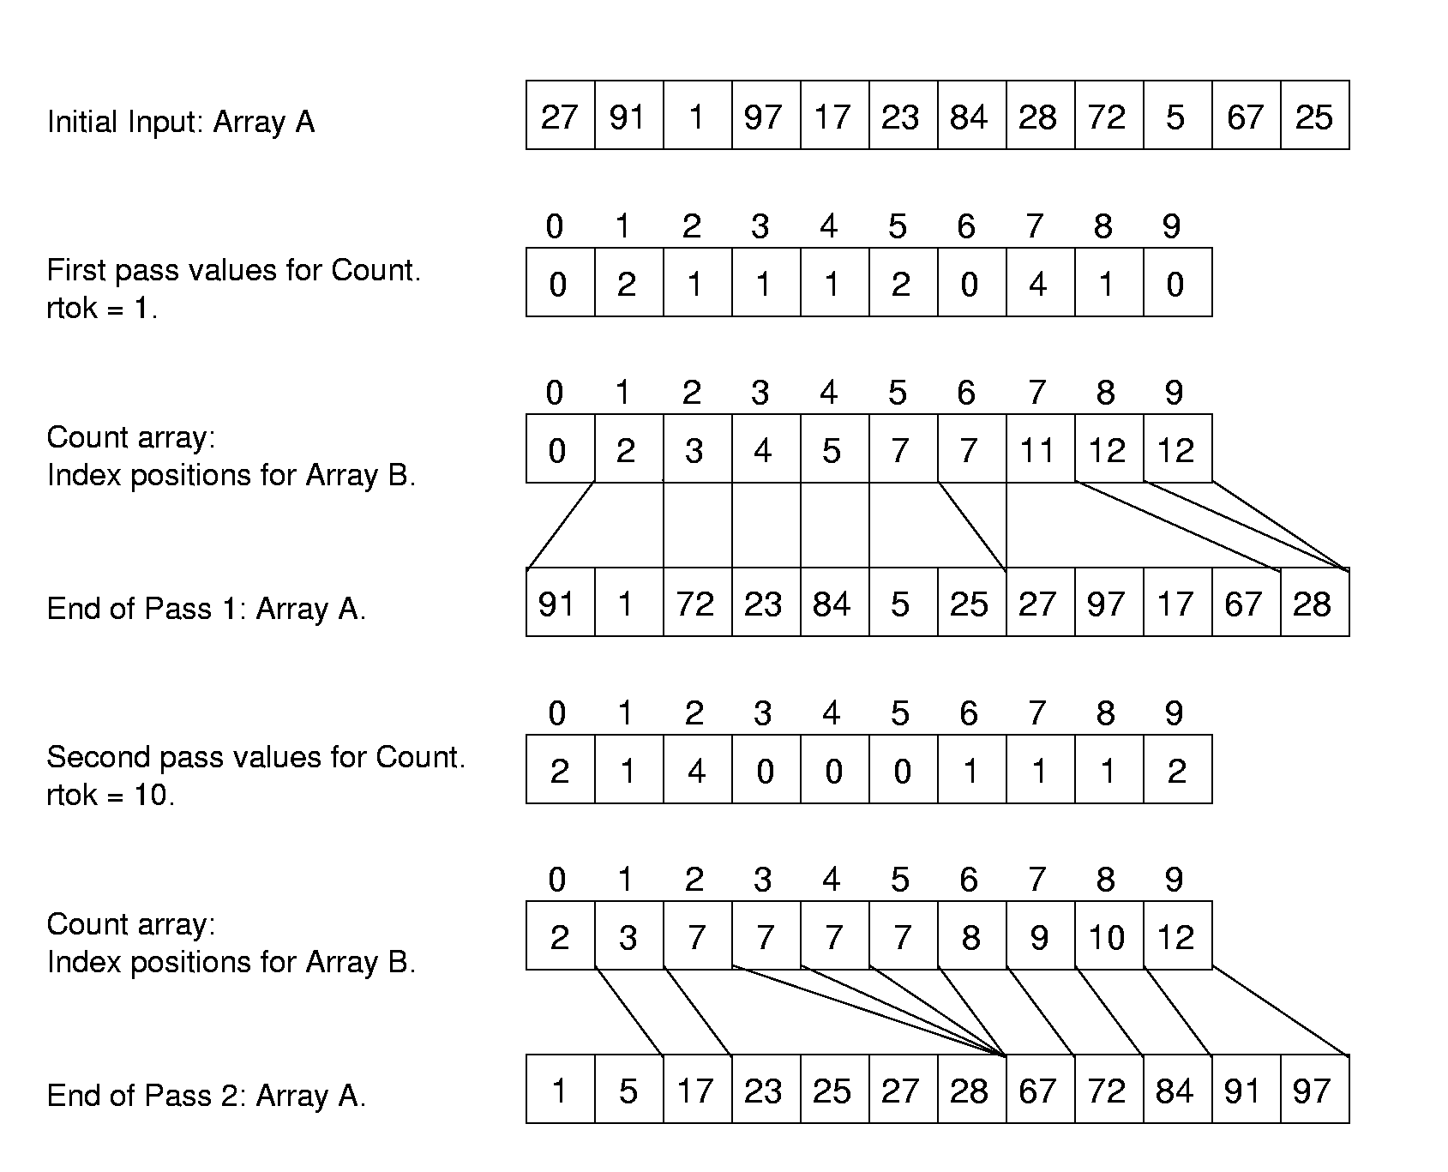
Radix Sort Example

Slide 31
Radix Sort Cost
Cost: Θ(nk + rk)
How do n, k, and r relate?
  If key range is small, then this can be Θ(n).
If there are n distinct keys, then the length of a key must be at least log n.
  Thus, Radix Sort is Θ(n log n) in general case

Slide 32
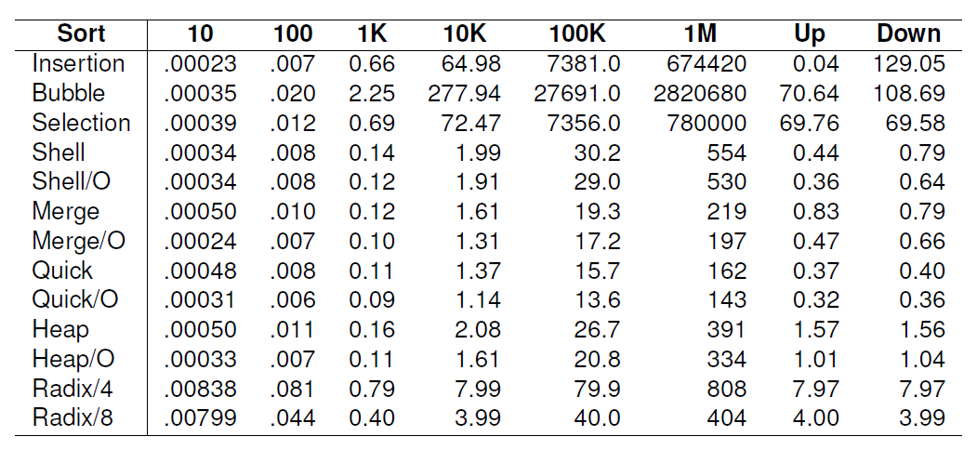
Empirical Comparison

Slide 33
Sorting Lower Bound
We would like to know a lower bound for all possible sorting algorithms.
Sorting is O(n log n) (average, worst cases) because we know of algorithms with this upper bound.
Sorting I/O takes Ω(n) time.
We will now prove Ω(n log n) lower bound for sorting.

Slide 34
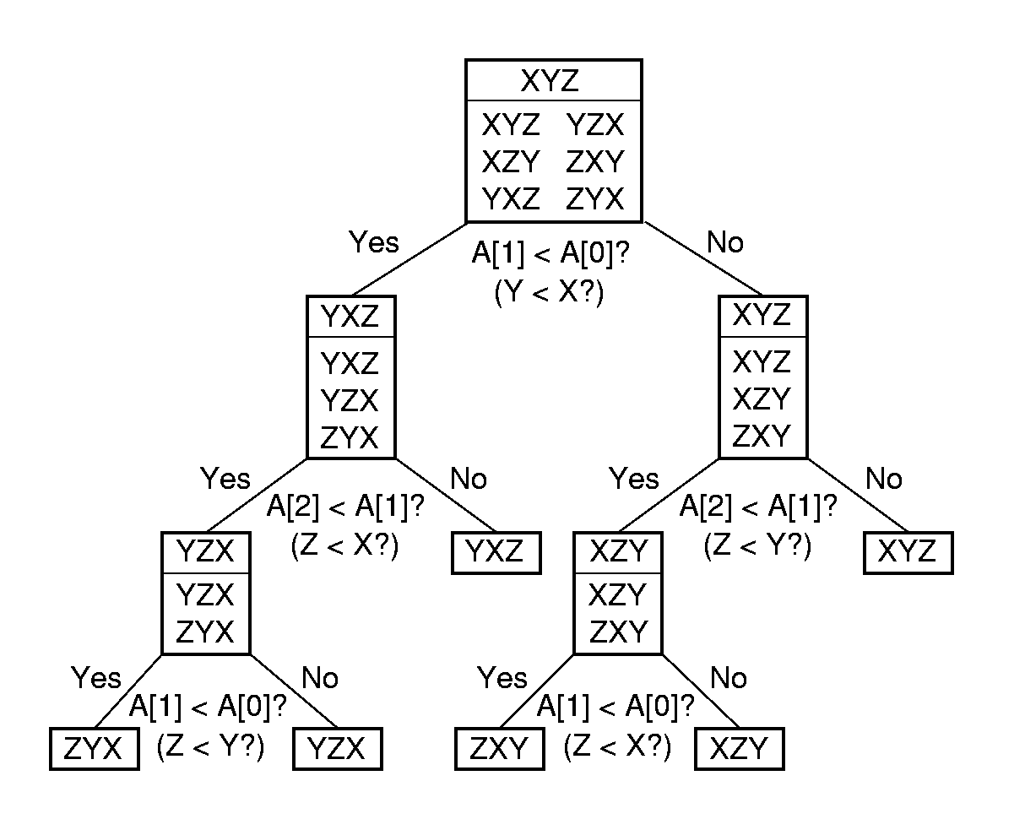
Decision Trees

Slide 35
Lower Bound Proof
There are n! permutations.
A sorting algorithm can be viewed as determining which permutation has been input.
Each leaf node of the decision tree corresponds to one permutation.
A tree with n nodes has Ω(log n) levels, so the tree with n! leaves has Ω(log n!) = Ω(n log n) levels.

Slide 36
Exercises
Exercise：
7.2, 7.12, 7.20
Project：
7.8
作业邮件名及附件文件名格式：
姓名+班级+章节名

