Slide 1
Chapter8 File Processing and External Sorting
8.1 Primary versus Secondary Storage
8.2 Disk Drives
8.3 Buffers and Buffer Pools
8.4 The Programmer's View of Files
8.5 External Sorting

Slide 2
Primary vs. Secondary Storage
Primary storage: Main memory (RAM)
Secondary Storage: Peripheral devices
  Disk drives
  Tape drives

Slide 3
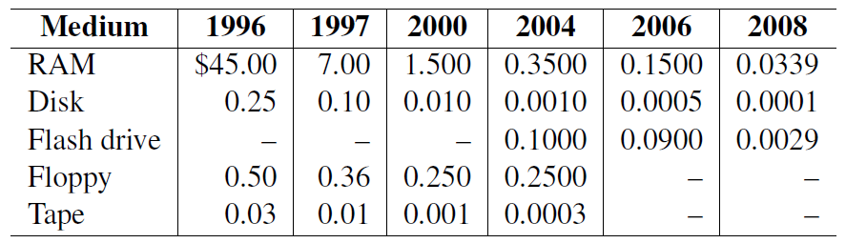
Comparisons
RAM is usually volatile.
RAM is about 1/4 million times faster than disk.

Slide 4
Golden Rule of File Processing
Minimize the number of disk accesses!
  1. Arrange information so that you get what you want with few disk accesses.
  2. Arrange information to minimize future disk accesses.
An organization for data on disk is often called a file structure.
Disk-based space/time tradeoff: Compress information to save processing time by reducing disk accesses.

Slide 5
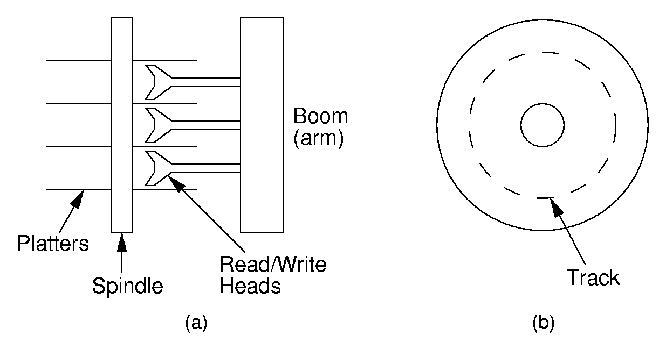
Disk Drives

Slide 6
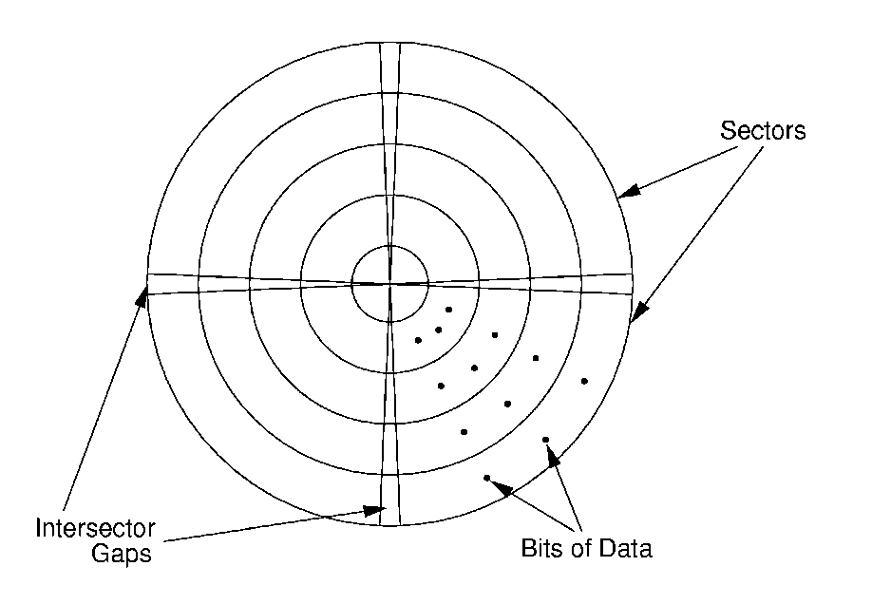
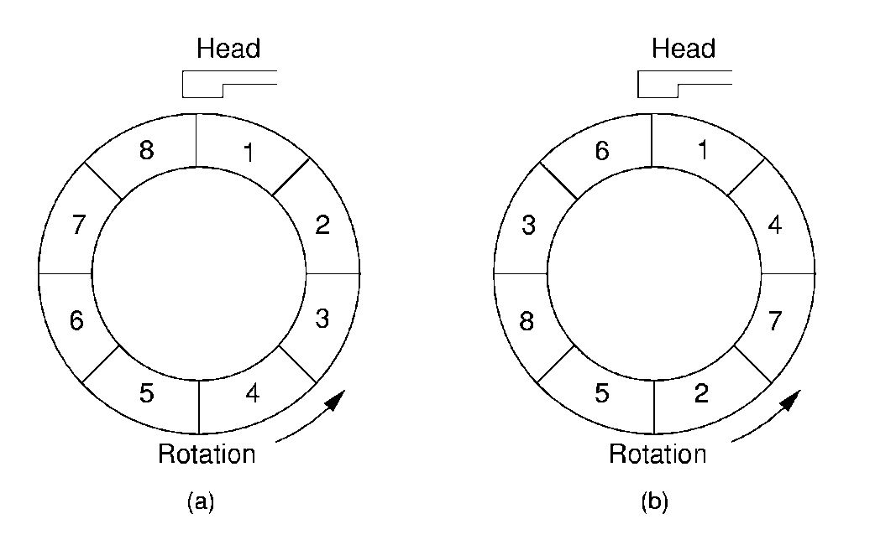
Sectors
A sector is the basic unit of I/O.
Interleaving factor: Physical distance between logically adjacent sectors on a track.

Slide 7
Seek Time
Seek time: Time for I/O head to reach desired track. Largely determined by distance between I/O head and desired track.
Track-to-track time: Minimum time to move from one track to an adjacent track.
Average Seek time: Average time to reach a track for random access.

Slide 8
Terms
Locality of Reference: When record is read from disk, next request is likely to come from near the same place in the file.
Cluster: Smallest unit of file allocation, usually several sectors.
Extent: A group of physically contiguous clusters.
Internal fragmentation: Wasted space within sector if record size does not match sector size; wasted space within cluster if file size is not a multiple of cluster size.

Slide 9
Other Factors
Rotational Delay or Latency: Time for data to rotate under I/O head.
  One half of a rotation on average.
  At 7200 rpm, this is 8.3/2 = 4.2ms.
Transfer time: Time for data to move under the I/O head.
  At 7200 rpm:
  Number of sectors read/Number of sectors per track * 8.3ms.

Slide 10
Disk Spec Example
16.8 GB disk on 10 platters = 1.68GB/platter
13,085 tracks/platter
256 sectors/track
512 bytes/sector, 8 sectors/cluster
4KB/cluster, 32 clusters/track.
Track-to-track seek time: 2.2 ms
Average seek time: 9.5ms
Interleaving factor of 3.
5400RPM

Slide 11
Disk Access Cost Example (1)
Read a 1MB file divided into 2048 records of 512 bytes (1 sector) each.
Assume all records are on 8 contiguous tracks.
First track: 9.5 + 11.1/2 + 11.1 = 26.2 ms
Remaining 7 tracks: 2.2 + 11.1/2 + 11.1 = 18.9 ms.
Total: 26.2 + 7 * 18.9 = 158.5ms （335.7ms）

Slide 12
Disk Access Cost Example (2)
Read a 1MB file divided into 2048 records of 512 bytes (1 sector) each.
Assume all file clusters are randomly spread across the disk.
256 clusters. Cluster read time is
(3 x 8)/256 of a rotation for about 1 ms.
256(9.5 + 11.1/2 + 11.1 x ( 8/256 )) is about 3942 ms.

Slide 13
How Much to Read?
Read time for one track:
  9.5 + 11.1/2 + 11.1 = 26.2ms.
Read time for one sector:
  9.5 + 11.1/2 + (1/256)11.1 = 15.1ms.
Read time for one byte:
  9.5 + 11.1/2 = 15.05 ms.
Nearly all disk drives read/write one sector at every I/O access.
  Also referred to as a page.

Slide 14
Buffers
The information in a sector is stored in a buffer or cache.
If the next I/O access is to the same buffer, then no need to go to disk.
There are usually one or more input buffers and one or more output buffers.

Slide 15
Buffer Pools
A series of buffers used by an application to cache disk data is called a buffer pool.
Virtual memory uses a buffer pool to imitate greater RAM memory by actually storing information on disk and “swapping” between disk and RAM.

Slide 16
Organizing Buffer Pools
Which buffer should be replaced when new data must be read?
First-in, First-out: Use the first one on the queue.
Least Frequently Used (LFU): Count buffer accesses, reuse the least used.
Least Recently used (LRU): Keep buffers on a linked list. When buffer is accessed, bring it to front. Reuse the one at end.

Slide 17

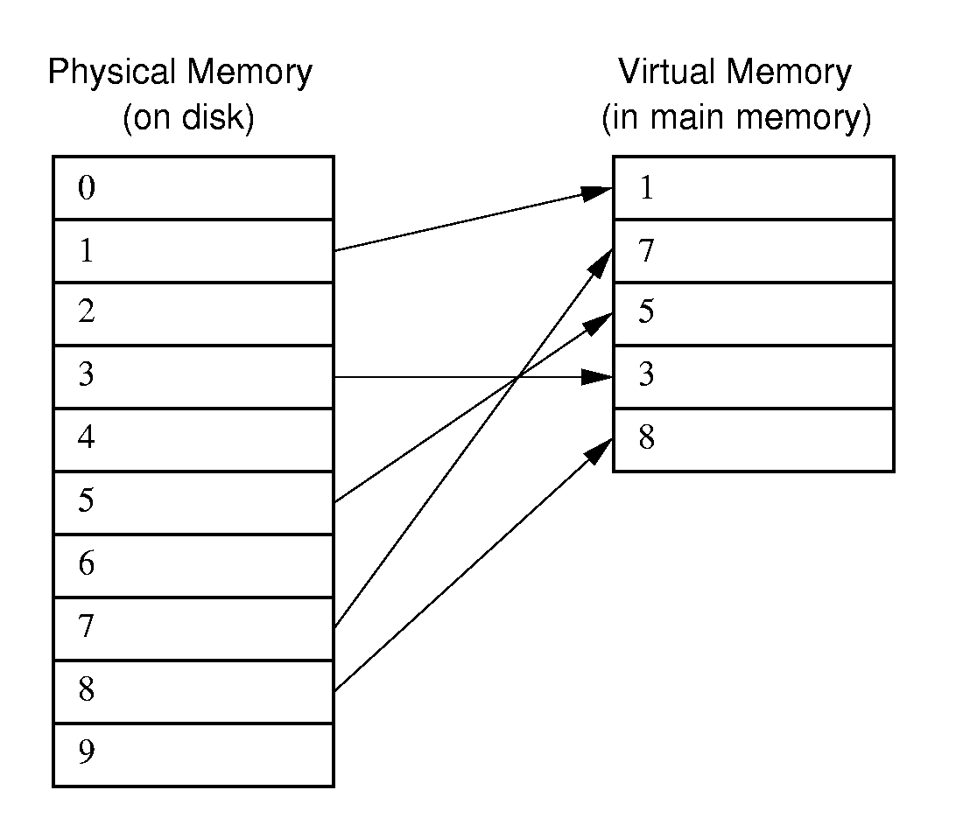
Buffer Pools

Slide 18
Bufferpool ADT (1)
class BufferPool { // (1) Message Passing
public:
virtual void insert(void* space,
int sz, int pos) = 0;
virtual void getbytes(void* space,
int sz, int pos) = 0;
};
class BufferPool { // (2) Buffer Passing
public:
virtual void* getblock(int block) = 0;
virtual void dirtyblock(int block) = 0;
virtual int blocksize() = 0;
};

Slide 19
Design Issues
Disadvantage of message passing:
  Messages are copied and passed back and forth.
Disadvantages of buffer passing:
  The user is given access to system memory (the buffer itself)
  The user must explicitly tell the buffer pool when buffer contents have been modified, so that modified data can be rewritten to disk when the buffer is flushed.
  The pointer might become stale when the buffer pool replaces the contents of a buffer.

Slide 20
Programmer’s View of Files
Logical view of files:
  An array of bytes.
  A file pointer marks the current position.
Three fundamental operations:
  Read bytes from current position (move file pointer)
  Write bytes to current position (move file pointer)
  Set file pointer to specified byte position.

Slide 21
C++ File Functions
#include <fstream.h>
void fstream::open(char* name, openmode mode);
  Example: ios::in | ios::binary
void fstream::close();
fstream::read(char* ptr, int numbytes);
fstream::write(char* ptr, int numbtyes);
fstream::seekg(int pos);
fstream::seekg(int pos, ios::curr);
fstream::seekp(int pos);
fstream::seekp(int pos, ios::end);

Slide 22
External Sorting
Problem: Sorting data sets too large to fit into main memory.
  Assume data are stored on disk drive.
To sort, portions of the data must be brought into main memory, processed, and returned to disk.
An external sort should minimize disk accesses.

Slide 23
Model of External Computation
Secondary memory is divided into equal-sized blocks (512, 1024, etc…)
A basic I/O operation transfers the contents of one disk block to/from main memory.
Under certain circumstances, reading blocks of a file in sequential order is more efficient. (When?)
Primary goal is to minimize I/O operations.
Assume only one disk drive is available.

Slide 24
Key Sorting
Often, records are large, keys are small.
  Ex: Payroll entries keyed on ID number
Approach 1: Read in entire records, sort them, then write them out again.
Approach 2: Read only the key values, store with each key the location on disk of its associated record.
After keys are sorted the records can be read and rewritten in sorted order.

Slide 25
Simple External Mergesort (1)
Quicksort requires random access to the entire set of records.
Better: Modified Merge-sort algorithm.
  Process n elements in Θ(log n) passes.
A group of sorted records is called
a run 顺串.

Slide 26
Simple External Mergesort (2)
Split the file into two files.
Read in a block from each file.
Take first record from each block, output them in sorted order.
Take next record from each block, output them to a second file in sorted order.
Repeat until finished, alternating between output files. Read new input blocks as needed.
Repeat steps 2-5, except this time input files have runs of two sorted records that are merged together.
Each pass through the files provides larger runs.

Slide 27
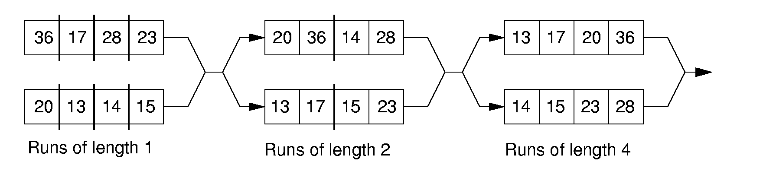
Simple External Mergesort (3)

Slide 28
Problems with Simple Mergesort
Is each pass through input and output files sequential?
What happens if all work is done on a single disk drive?
How can we reduce the number of Merge-sort passes?
In general, external sorting consists of two phases:
  Break the files into initial runs
  Merge the runs together into a single run.

Slide 29
Breaking a File into Runs
General approach:
  Read as much of the file into memory as possible.
  Perform an in-memory sort.
  Output this group of records as a single run.

Slide 30
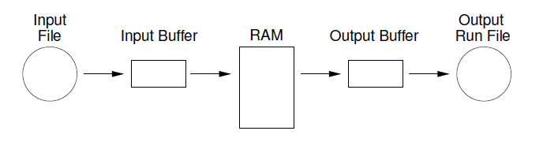
Replacement Selection (1)
Break available memory into an array for the heap, an input buffer, and an output buffer. Fill the array from disk.

Slide 31
Replacement Selection (2)
Make a min-heap.
Send the smallest value (root) to the output buffer.
If the next key in the file is greater than the last value output, then
  Replace the root with this key
  else
  Replace the root with the last key in the array
  Add the next record in the file to a new heap (actually, stick it at the end of the array).

Slide 32
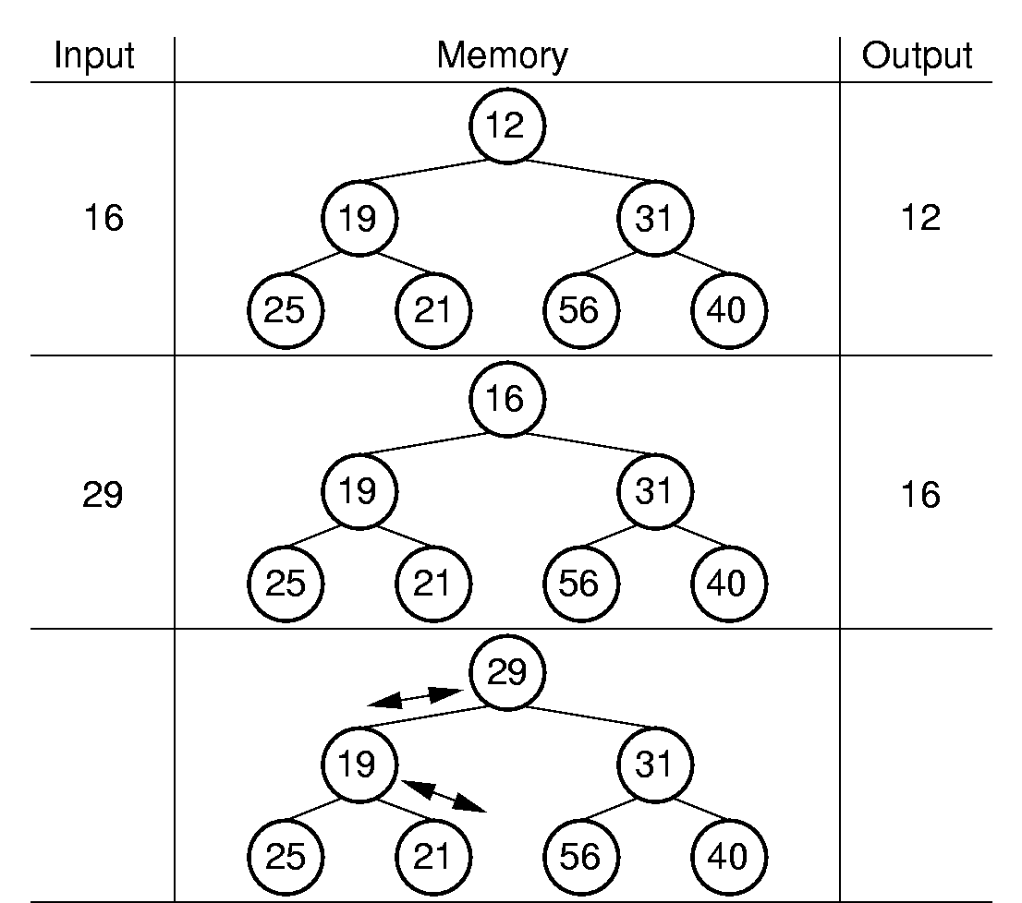
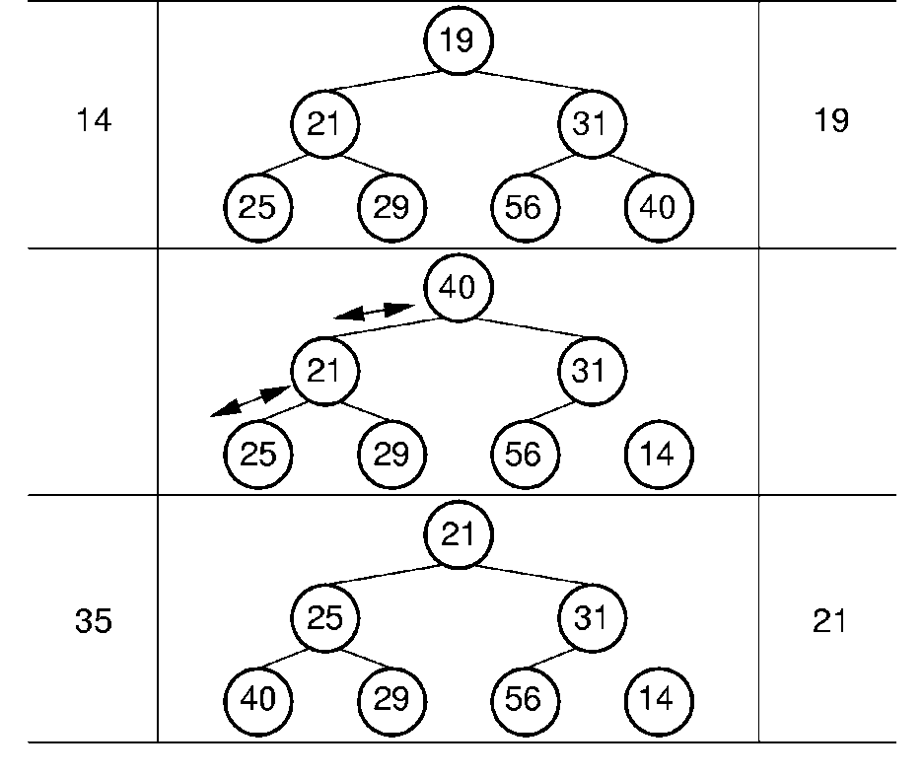
RS Example

Slide 33
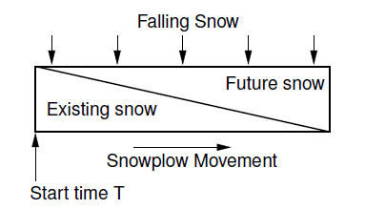
snowplow argument
Size of the run:
  Best case: the entire file
  Worst case: M
  Average case: 2M

Slide 34
Problems with Simple Merge
Simple merge-sort: Place runs into two files.
  Merge the first two runs to output file, then next two runs, etc.
Repeat process until only one run remains.
  How many passes for r initial runs?
Is there benefit from sequential reading?
Is working memory well used?
Need a way to reduce the number of passes.

Slide 35
Multi-way Merge (1)
With replacement selection, each initial run is several blocks long.
Assume each run is placed in separate file.
Read the first block from each file into memory and perform an r-way merge.
When a buffer becomes empty, read a block from the appropriate run file.
Each record is read only once from disk during the merge process.

Slide 36
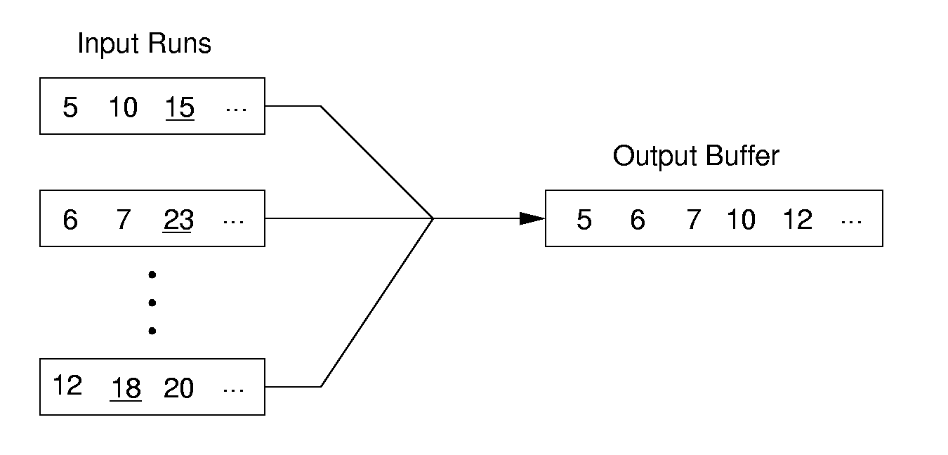
Multi-way Merge (2)
In practice, use only one file and seek to appropriate block.

Slide 37
Limits to Multi-way Merge (1)
Assume working memory is b blocks in size.
How many runs can be processed at one time?
The runs are 2b blocks long (on average).
How big a file can be merged in one pass?

Slide 38
Limits to Multi-way Merge (2)
Larger files will need more passes -- but the run size grows quickly!
In k merge passes, we process 2b^{(k+1)} blocks.
Example: 0.5MB working memory, 4KB blocks, yield 128 blocks for working memory. Average run size is 1MB, so 128MB can be sorted in one pass on average. 16GB in two merge passes.

Slide 39
General Principles
A good external sorting algorithm will seek to do the following:
  Make the initial runs as long as possible.
  At all stages, overlap input, processing and output as much as possible.
  Use as much working memory as possible. Applying more memory usually speeds processing.
  If possible, use additional disk drives for more overlapping of processing with I/O, and allow for more sequential file processing.

Slide 40
Exercise
8.2, 8.3, 8.11,8.16

