Slide 1
Chapter9 Searching
9.1 Searching Unsorted and Sorted Arrays
9.2 Self-Organizing Lists
9.3 Bit Vectors for Representing Sets
9.4 Hashing

Slide 2
Search
Given: Distinct keys k₁, k₂, …, k_{n} and collection T of n records of the form
(k₁, I₁), (k₂, I₂), …, (k_{n}, I_{n})
where I_{j} is the information associated with key k_{j} for 1 <= j <= n.
Search Problem: For key value K, locate the record (k_{j}, I_{j}) in T such that k_{j} = K.
Searching is a systematic method for locating the record(s) with key value k_{j} = K.

Slide 3
Successful vs. Unsuccessful
A successful search is one in which a record with key k_{j} = K is found.
An unsuccessful search is one in which no record with k_{j} = K is found (and presumably no such record exists).
Brain storms: how to search what you want in a set/file??

Slide 4
Approaches to Search
1. Sequential and list methods (lists, tables, arrays).
2. Direct access by key value (hashing)
3. Tree indexing methods.

Slide 5
Average Cost for Sequential Search
How many comparisons does sequential search do on average?
We must know the probability of occurrence for each possible input.
Must K be in L?
For analysis, ignore everything except the position of K in L. Why?
What are the n + 1 events?

Slide 6
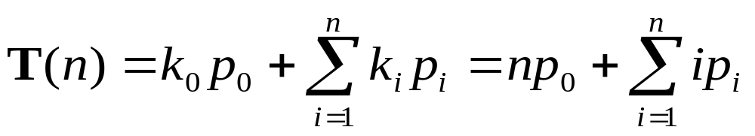
Average Cost (cont)
Let k_{i} = I+1 be the number of comparisons when X = L[i].
Let k_{n} = n be the number of comparisons when X is not in L.
Let p_{i} be the probability that X = L[i].
Let p_{n} be the probability that X is not in L[i] for any I.

Slide 7
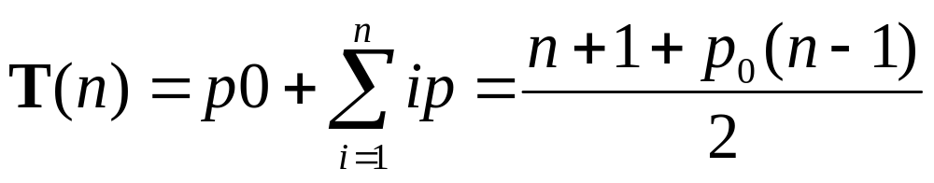
Generalizing Average Cost
What happens to the equation if we assume all p_{i}'s are equal (except p₀)?
Depending on the value of p₀,
(n+1)/2 < T(n) < n.

Slide 8
Searching Ordered Arrays
Sequential Search
Binary Search
Dictionary Search

Slide 9
Searching Ordered Arrays
Change the model: Assume that the elements are in ascending order.
Is linear search still optimal? Why not?
Optimization: Use linear search, but test if the element is greater than K. Why?
Observation: If we look at L[5] and find that K is bigger, then we rule out L[1] to L[4] as well.
More is Better: If K > L[n], then we know in one test that K is not in L.
  What is wrong here?

Slide 10
Jump Search
What is the right amount to jump?
Algorithm:
  Check every k'th element (L[k], L[2k], ...).
  If K is greater, then go on.
  If K is less, then use linear search on the k elements.
This is called Jump Search.

Slide 11
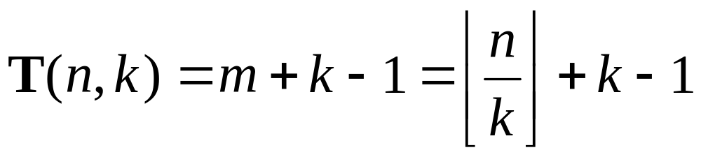
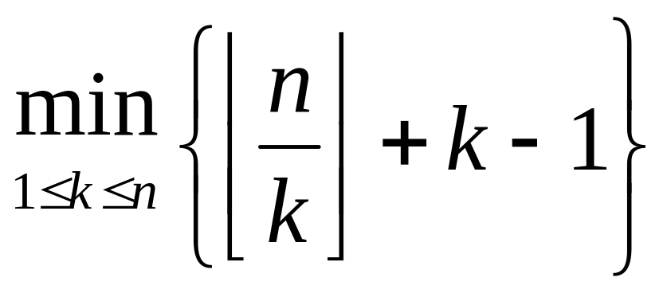
Analysis of Jump Search
If mk <= n < (m+1)k, then the total cost is at most m + k – 1 3-way comparisons.
What should k be?

Slide 12
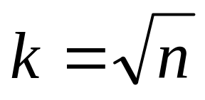
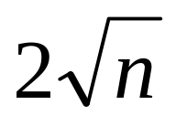
Jump Search Analysis (cont)
Take the derivative and solve for T'(x) = 0 to find the minimum.
This is a minimum when
What is the worst case cost?
Roughly

Slide 13
Lessons
We want to balance the work done while selecting a sublist with the work done while searching a sublist.
In general, make sub-problems of equal effort.
This is an example of divide and conquer.
What if we extend this to three levels?

Slide 14
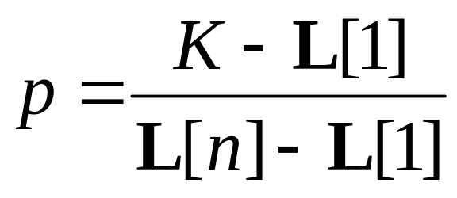
Interpolation Search
(Also known as Dictionary Search)
Search L at a position that is appropriate to the value K.
Repeat as necessary to recalculate p for future searches.

Slide 15
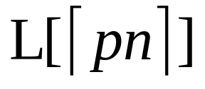
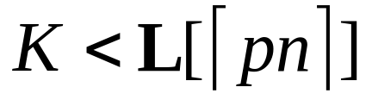
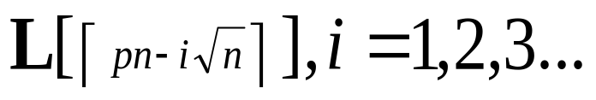
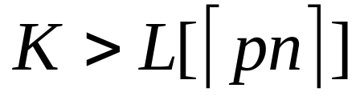
Quadratic Binary Search
(This is easier to analyze.)
Compute p and examine
If then sequentially probe
Until we reach a value less than or equal to K.
Similar for

Slide 16
QBS Probe Count
QBS cost is Θ(log log n) if the number of probes on jump search is constant.
From Cebysev’s inequality, we can show that on uniformly distributed data, the average number of probes required will be about 2.4.
Is this better than binary search? Theoretically, yes (in the average case).

Slide 17
Chapter9 Searching
9.1 Searching Unsorted and Sorted Arrays
9.2 Self-Organizing Lists
9.3 Bit Vectors for Representing Sets
9.4 Hashing

Slide 18
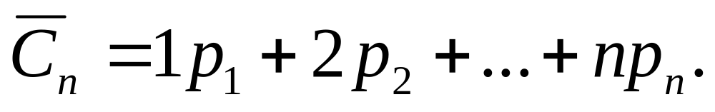
Lists Ordered by Frequency
Order lists by (expected) frequency of occurrence.
  Perform sequential search
Cost to access first record: 1
Cost to access second record: 2
Expected search cost:

Slide 19
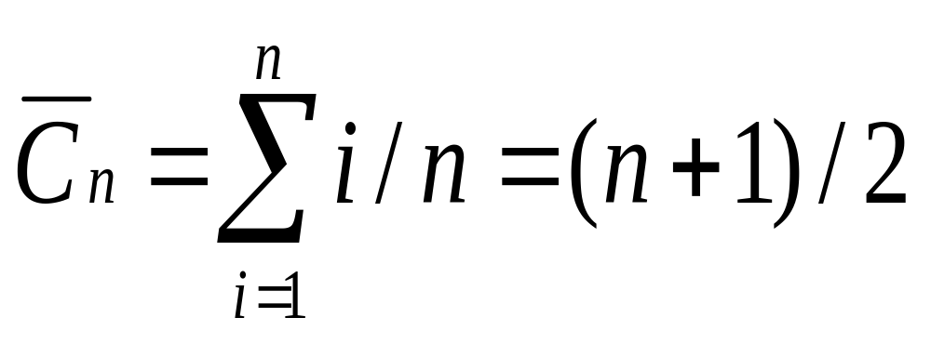
Examples(1)
All records have equal frequency.

Slide 20
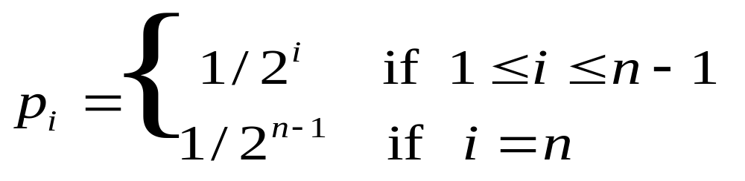
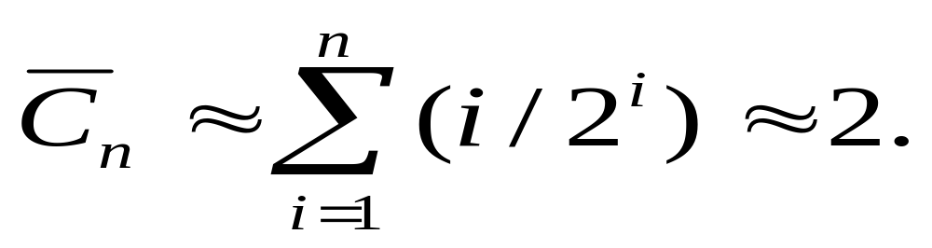
Examples(2)
(2) Exponential Frequency

Slide 21
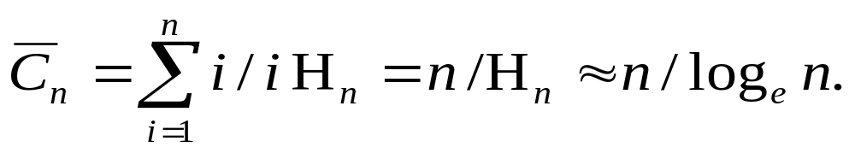
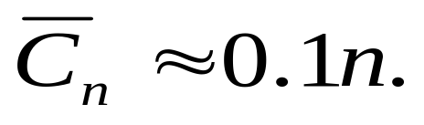
Zipf Distributions
Applications
  Distribution for frequency of word usage in natural languages.
  Distribution for populations of cities, etc.
80/20 rule:
  80% of accesses are to 20% of the records.
  For distributions following 80/20 rule,

Slide 22
Self-Organizing Lists
Self-organizing lists modify the order of records within the list based on the actual pattern of record accesses.
Self-organizing lists use a heuristic for deciding how to reorder the list. These heuristics are similar to the rules for managing buffer pools.

Slide 23
Heuristics
Order by actual historical frequency of access. (Similar to LFU buffer pool replacement strategy.)
Move-to-Front: When a record is found, move it to the front of the list. (Similar to LRU buffer pool replacement strategy.)
not worse than twice “best arrangement”
3. Transpose 转置: When a record is found, swap it with the record ahead of it.
bad example: Keep swapping the last two elements
Exercise: Given the series of access: F D F G E G F A D F G E,
how to organize your list?

Slide 24
Order by actual historical frequency of access (count heuristic):
F G D E A B C H
2. Move-to-Front:
E G F D A B C H
Transpose:
A B F D G E C H

Slide 25
Text Compression Example
Application: Text Compression.
Keep a table of words already seen, organized via Move-to-Front heuristic.
  If a word not yet seen, send the word.
  Otherwise, send (current) index in the table.
The car on the left hit the car I left.
The car on 3 left hit 3 5 I 5.
This is similar in spirit to Ziv-Lempel coding.

Slide 26
Chapter9 Searching
9.1 Searching Unsorted and Sorted Arrays
9.2 Self-Organizing Lists
9.3 Bit Vectors for Representing Sets
9.4 Hashing

Slide 27

Searching in Sets
For dense sets (small range, high percentage of elements in set).
Can use logical bit operators.1 if element in set, 0 otherwise.
Example: To find all primes that are odd numbers, compute:
0011010100010100 & 0101010101010101

Slide 28
Chapter9 Searching
9.1 Searching Unsorted and Sorted Arrays
9.2 Self-Organizing Lists
9.3 Bit Vectors for Representing Sets
9.4 Hashing

Slide 29
Hashing
Hashing: The process of mapping a key value to a position in a table.
A hash function maps key values to positions. It is denoted by h.
A hash table is an array that holds the records. It is denoted by HT.
HT has M slots, indexed form 0 to M-1.

Slide 30
Hashing (2)
For any value K in the key range and some hash function h, h(K) = i, 0 <= i < M, such that key (HT[i]) = K.
Hashing is appropriate only for sets (no duplicates).
Good for both in-memory and disk-based applications.
Hashing is not good for range queries.

Slide 31
Simple Examples
(1) Store the n records with keys in range 0 to n-1.
  Store the record with key i in slot i.
  Use hash function h(K) = K.
(2) More reasonable example:
  Store about 1000 records with keys in range 0 to 16,383.
  Impractical to keep a hash table with 16,384 slots.
  We must devise a hash function to map the key range to a smaller table.

Slide 32
Collisions (1)
Given: hash function h with keys k₁ and k₂. β is a slot in the hash table.
If h(k₁) = β = h(k₂), then k₁ and k₂ have a collision at β under h.
Search for the record with key K:
  Compute the table location h(K).
  Starting with slot h(K), locate the record containing key K using (if necessary) a collision resolution policy.

Slide 33
Collisions (2)
Collisions are inevitable in most applications.
  Example: 23 people are likely to share a birthday.
  Perfect hashing: no collision

Slide 34
Hash Functions (1)
A hash function MUST return a value within the hash table range.
To be practical, a hash function SHOULD evenly distribute the records stored among the hash table slots.
Ideally, the hash function should distribute records with equal probability to all hash table slots. In practice, success depends on distribution of actual records stored.

Slide 35
Hash Functions (2)
If we know nothing about the incoming key distribution, evenly distribute the key range over the hash table slots while avoiding obvious opportunities for clustering.
If we have knowledge of the incoming distribution, use a distribution-dependent hash function.

Slide 36
Examples (1)
int h(int x) {
return(x % 16);
}
This function is entirely dependent on the lower 4 bits of the key.
Mid-square method: Square the key value, take the middle r bits from the result for a hash table of 2^{r} slots.
3 0000 0011 3²=9 0000 1001
19 0001 0011 19²=361 10110 1001

Slide 37
Examples (2)
For strings: Sum the ASCII values of the letters and take results modulo M.
int h(char* x) {
int i, sum;
for (sum=0, i=0; x[i] != '\0'; i++)
sum += (int) x[i];
return(sum % M);
}
This is only good if the sum is large compared to M.

Slide 38
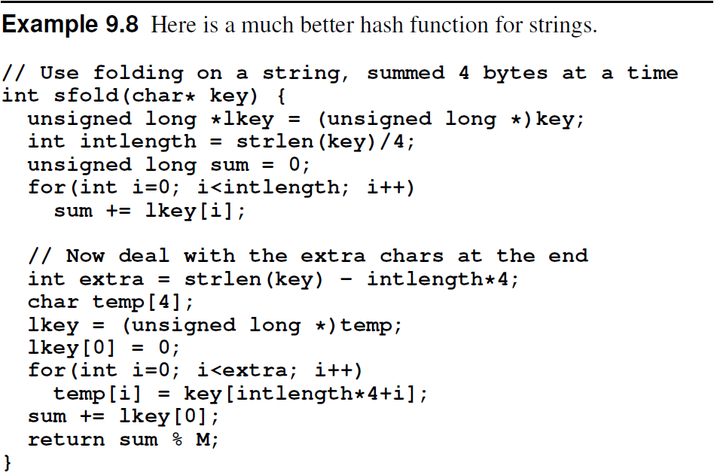

Examples (3)

Slide 39
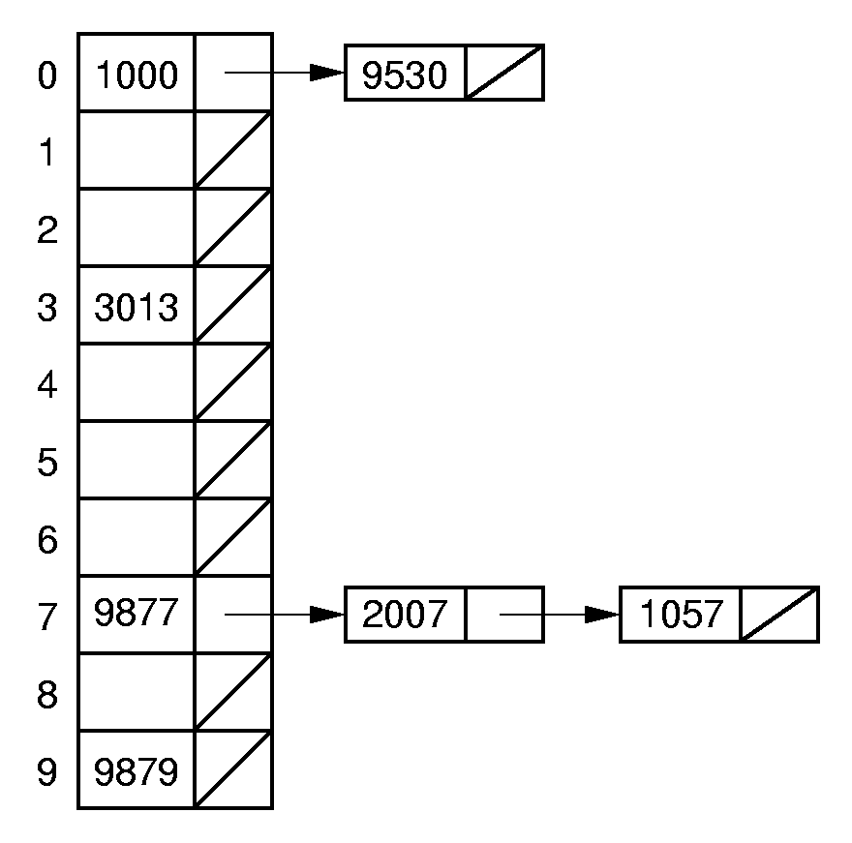
Open Hashing
What to do when collisions occur?
Open hashing treats each hash table slot as a bin.

Slide 40
Closed Hashing
Closed hashing stores all records directly in the hash table.
Each record i has a home position h(k_{i}).
If another record occupies i’s home position, then another slot must be found to store i.
The new slot is found by a collision resolution policy.
Search must follow the same policy to find records not in their home slots.

Slide 41
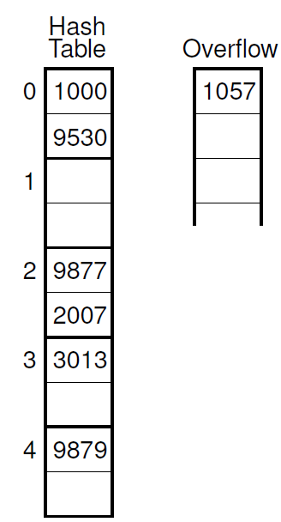
Bucket Hashing
Divide the hash table slots into buckets.
  Example: 8 slots/bucket.
Include an overflow bucket.
Records hash to the first slot of the bucket, and fill bucket. Go to overflow if necessary.
When searching, first check the proper bucket. Then check the overflow.

Slide 42
Collision Resolution
During insertion, the goal of collision resolution is to find a free slot in the table.
Probe sequence: The series of slots visited during insert/search by following a collision resolution policy.
Let β₀ = h(K). Let (β₀, β₁, …) be the series of slots making up the probe sequence.

Slide 43
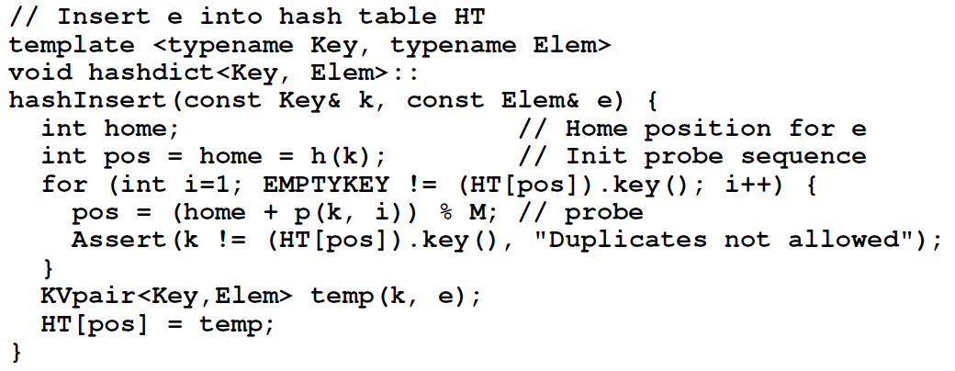
Insertion

Slide 44
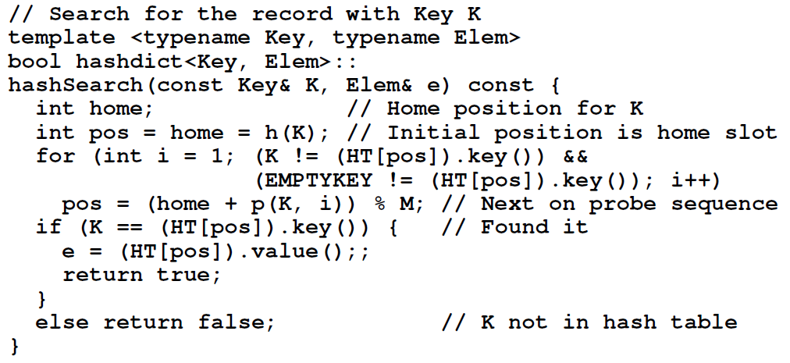
Search

Slide 45
Probe Function
Look carefully at the probe function p().
pos = (home + p(getkey(e), i)) % M;
Each time p() is called, it generates a value to be added to the home position to generate the new slot to be examined.
p() is a function both of the element’s key value, and of the number of steps taken along the probe sequence.
  Not all probe functions use both parameters.

Slide 46
Linear Probing
Use the following probe function:
p(K, i) = i;
Linear probing simply goes to the next slot in the table.
  Past bottom, wrap around to the top.
To avoid infinite loop, one slot in the table must always be empty.

Slide 47
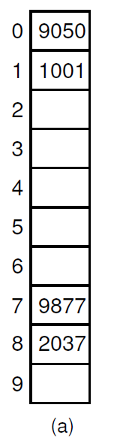
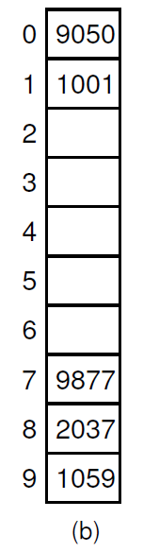
Linear Probing Example
Primary Clustering: Records tend to cluster in the table under linear probing since the probabilities for which slot to use next are not the same for all slots.

Slide 48
Improved Linear Probing
Instead of going to the next slot, skip by some constant c.
  Warning: Pick M and c carefully.
The probe sequence SHOULD cycle through all slots of the table.
  Pick c to be relatively prime to M.
There is still some clustering聚集
  Ex: c=2, h(k₁) = 3; h(k₂) = 5.
  Probe sequences for k₁ and k₂ are linked together.

Slide 49
Pseudo-Random Probing(1)
The ideal probe function would select the next slot on the probe sequence at random.
An actual probe function cannot operate randomly. (Why?)

Slide 50
Pseudo-Random Probing(2)
Select a (random) permutation of the numbers from 1 to M-1:
r₁, r₂, …, r_{M-1}
All insertions and searches use the same permutation.
Example: Hash table size of M = 101
  r₁=2, r₂=5, r₃=32.
  h(k₁)=30, h(k₂)=28.
  Probe sequence for k₁:30，32，35，62
  Probe sequence for k₂:28，30，33，60

Slide 51
Quadratic Probing
Set the i’th value in the probe sequence as
p(K, i) = i²;
Example: M=101
  h(k₁)=30, h(k₂) = 29.
  Probe sequence for k₁ :30，31，34，39
  Probe sequence for k₂ :29，30，33，38

Slide 52
Secondary Clustering
Pseudo-random probing eliminates primary clustering.
If two keys hash to the same slot, they follow the same probe sequence. This is called secondary clustering.
To avoid secondary clustering, need probe sequence to be a function of the original key value, not just the home position.

Slide 53
Double Hashing
p(K, i) = i * h₂(K)
Be sure that all probe sequence constants (h₂(K)) are relatively prime to M.
  This will be true if M is prime, or if M=2^{m} and the constants are odd.
Example: Hash table of size M=101
  h(k₁)=30, h(k₂)=28, h(k₃)=30.
  h₂(k₁)=2, h₂(k₂)=5, h₂(k₃)=5.
  Probe sequence for k₁ is: 30, 32, 34, 36.
  Probe sequence for k₂ is: 28, 33, 38, 43.
  Probe sequence for k₃ is: 30, 35, 40, 45.

Slide 54
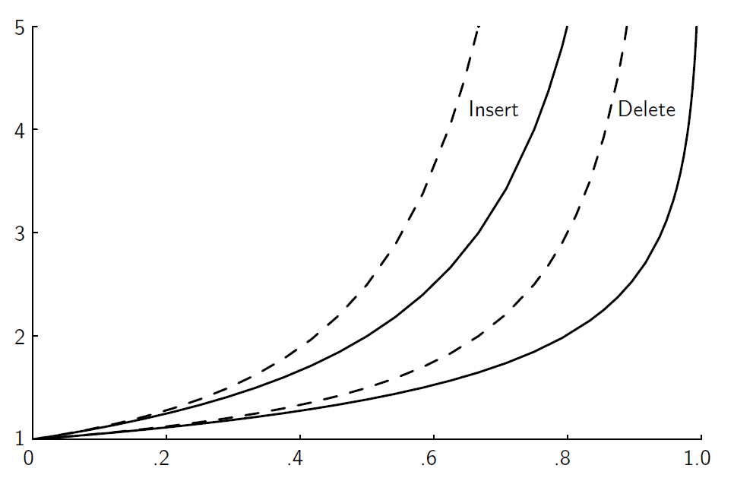
Analysis of Closed Hashing
The load factor is α = N/M where N is the number of records currently in the table.

Slide 55
Deletion
Deleting a record must not hinder later searches.
We do not want to make positions in the hash table unusable because of deletion.

Slide 56
Tombstones (1)
Both of these problems can be resolved by placing a special mark in place of the deleted record, called a tombstone.
A tombstone will not stop a search, but that slot can be used for future insertions.

Slide 57
Tombstones (2)
Unfortunately, tombstones add to the average path length.
Solutions:
Local reorganizations to try to shorten the average path length.
Periodically rehash the table (by order of most frequently accessed record).

Slide 58
Exercises
9.19
Further thinking 9.18

