Slide 1

2010最新目 录
1
Oracle ERP系统结构
2
Oracle ERP系统开发工具及开发过程
3
如何在系统中注册表单
4
如何在系统中注册报表
5
开放式接口 / 应用编程接口(API)
6
其它

Slide 2











1. 三层逻辑体系结构
客户端
应用服务器
数据库服务器
User Interface
Application logic
Database logic

Slide 3


客户端
Use a web browser
  Netscape
  Internet Explorer
On
  Windows
  Macintosh
To display
  Java
  HTML

Slide 4

应用服务器层
Servlet Engine
Application Server
9i 1.0.2.2.2
JSP
BC4J
Login Server
Portal
Web Listener
Discoverer
Reports
Forms
Integration
Mobile

Slide 5
数据库服务器层:
8i
9i
9iR2

Slide 6
PL/SQL 运行原理
客户端
应用服务器
数据库服务器
Listener
Stored
Procedures
Browser
Web
Applications
Dictionary
PL/SQL
Gateway
Workflow
Data

Slide 7
Forms Network Traffic
Java code downloaded as needed
Applet cached on client
Forms
Server
Browser running Forms
java applet
Data
Server
LAN
WAN
Dial-up

Slide 8
系统灵活性
历史记录和诊断、检查
  用户可以看到当前记录来源于哪个表(视图)、哪个字段和最后一查询的SQL语句等其它的信息。这对客户化开发有极大的帮助。
Custom.pll
  开发人员只需客户化此文件，而不需要修改Oracle 的标准程序来达到客户化的目的。用户自已在FORM中定义字段，来保存其它的附加信息。
弹性域
  用户自已在FORM中定义字段，来保存其它的附加信息。

Slide 9
附件
  对每一记录能附上文件、文本信息或Web Page的大容量信息.
修改Forms 界面的文件功能或Show隐藏字段
  用户能显示自已想要显示的字段，并能调整顺序
Export
  用户能用export功能从Form 中export数据到文件中。
  通常用来转换到Excel文件中。

Slide 10
2. Oracle 开发工具及开发过程
-Form (See AVI File)
- Report (See AVI File)
- Discoverer (See AVI File)
- Workflow (See Following)
- PL/SQL
- FSG (Financial Statement Generator)

Slide 11
Oracle 开发工具及开发过程
-Form (See AVI File)
- Report (See AVI File)
- Discoverer (See AVI File)
- Workflow
- PL/SQL
- FSG (Financial Statement Generator)

Slide 12
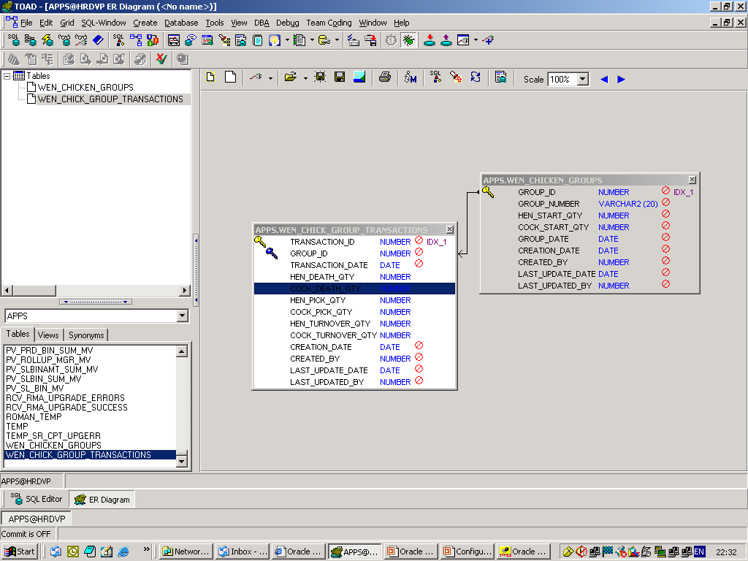
实例：

Slide 13
3. 如何在系统中注册表单
      编译表单
      登记表单
      注册功能
      挂上菜单(子菜单 ->菜单)
      分配菜单到职责
      分配职责到用户

Slide 14
Compiler Forms
.fmb文件上传到Server
Telnet 连接到Server，Login In
切换到 $AU_TOP/forms/US

Slide 15
Compiler Form
4.Compiler Form
f60gen <Form Name> apps/<apps password>
f60gen Module=BD_TEST.fmb userid=apps/apps output_file=/u21/oracle/visappl/po/11.5.0/forms/US/BD_TEST.fmx

Slide 16
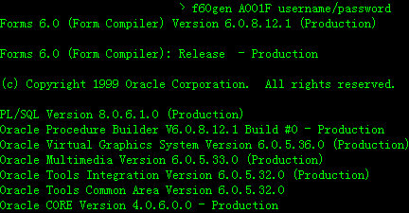
Compiler Form
4.Compiler Form
f60gen <Form Name> apps/<apps password>

Slide 17
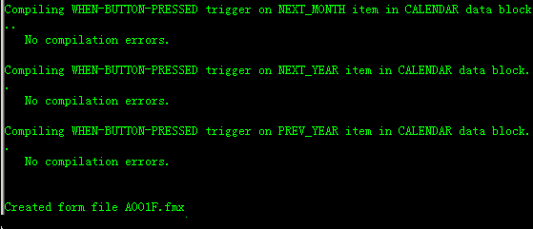
Compiler Form
5.Compiler 成功 ,Create .fmx 文件

Slide 18
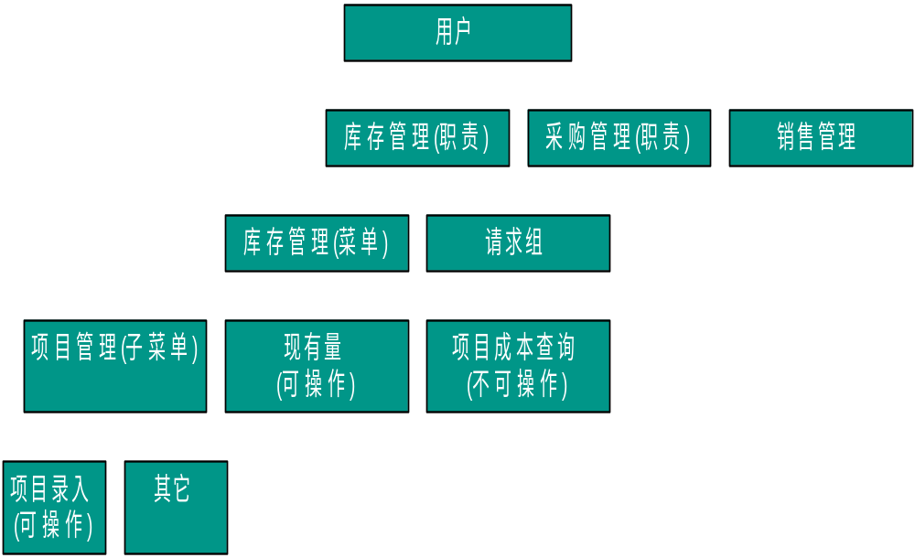
用户权限控制结构
5
4
3
1,2

Slide 19
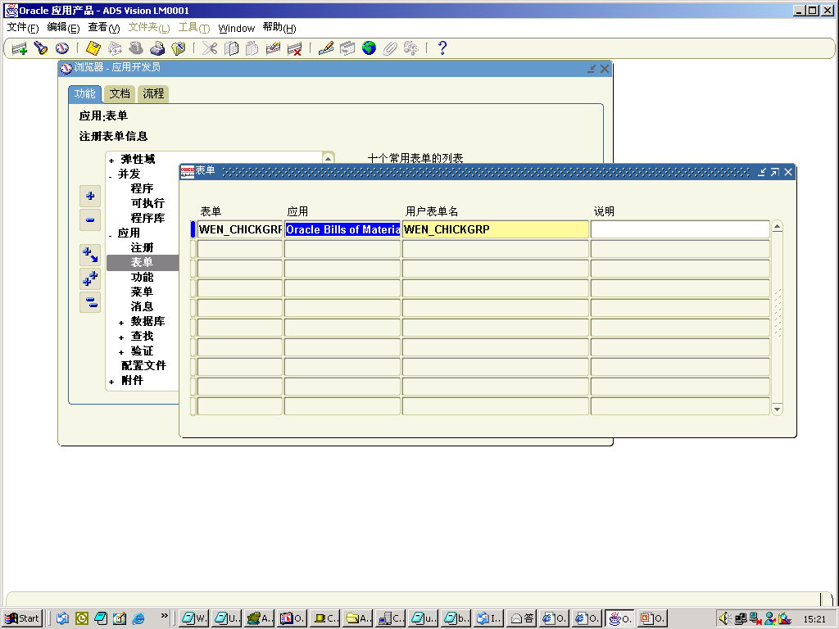
2、登记表单

Slide 20
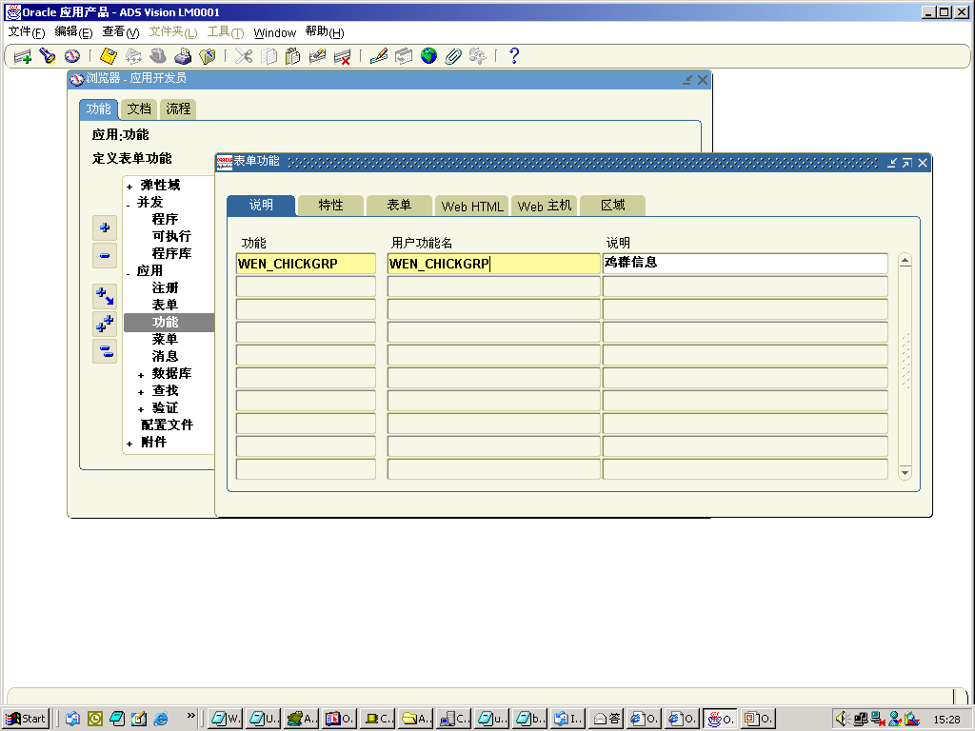
3、注册功能

Slide 21
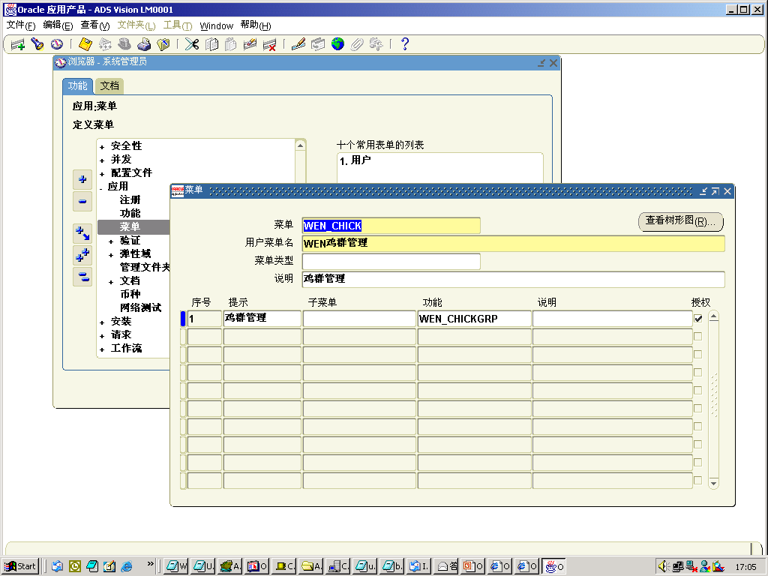
4.1、挂上菜单(子菜单)

Slide 22
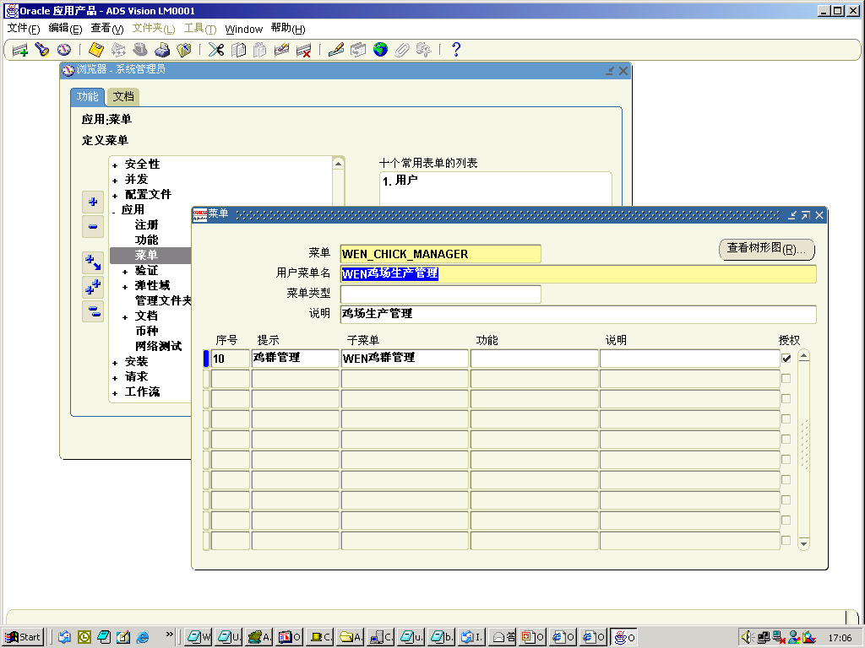
4.2、挂上菜单(子系统菜单)

Slide 23
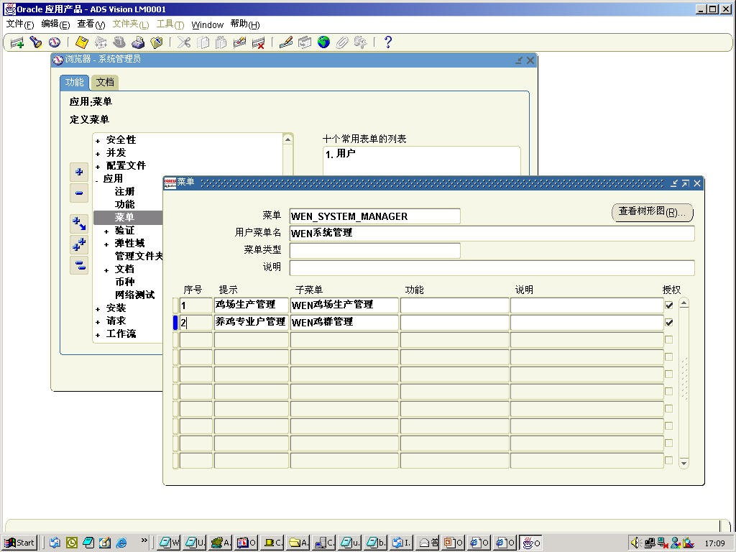
4.3、挂上菜单(系统菜单)

Slide 24
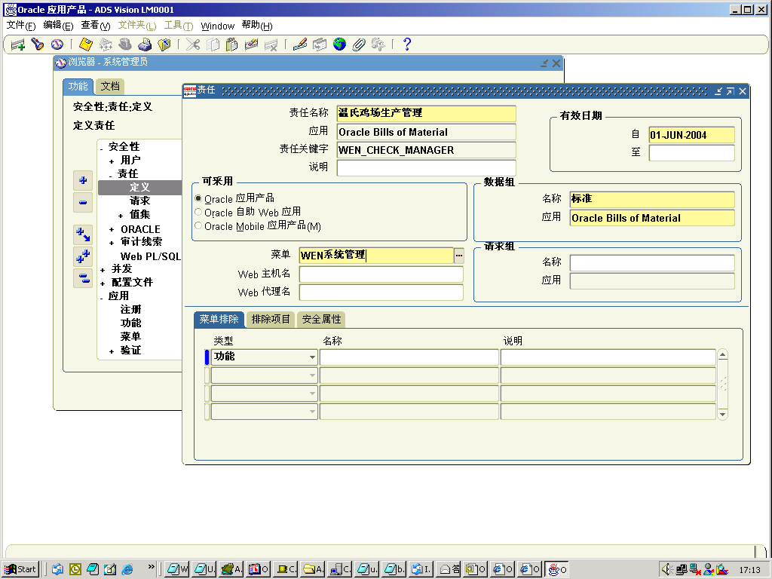
5、分配菜单到职责

Slide 25
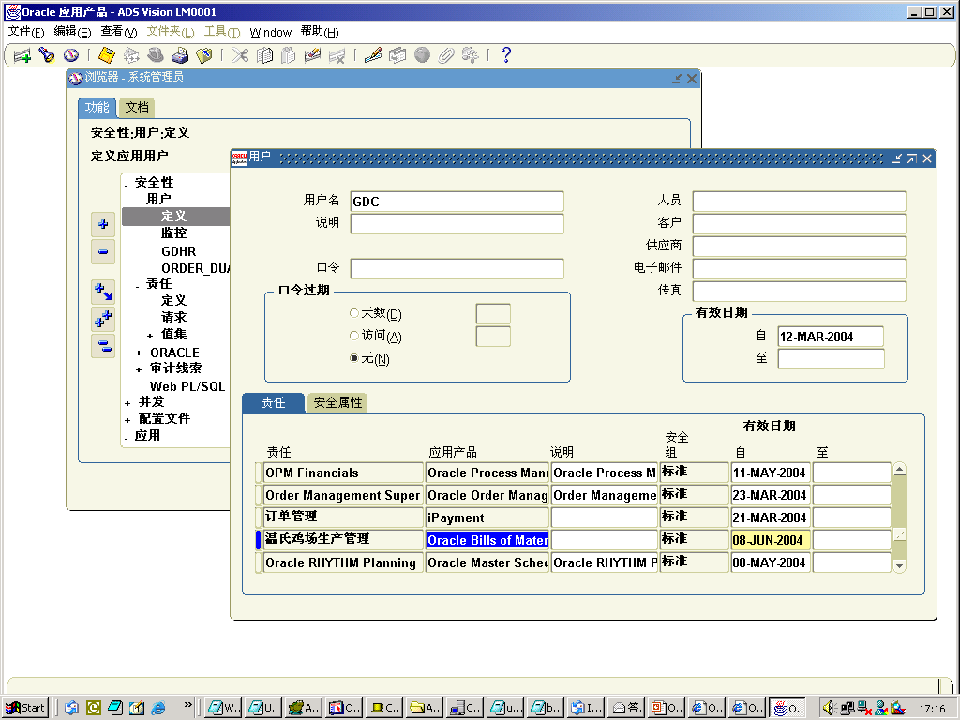
6、分配职责到用户

Slide 26
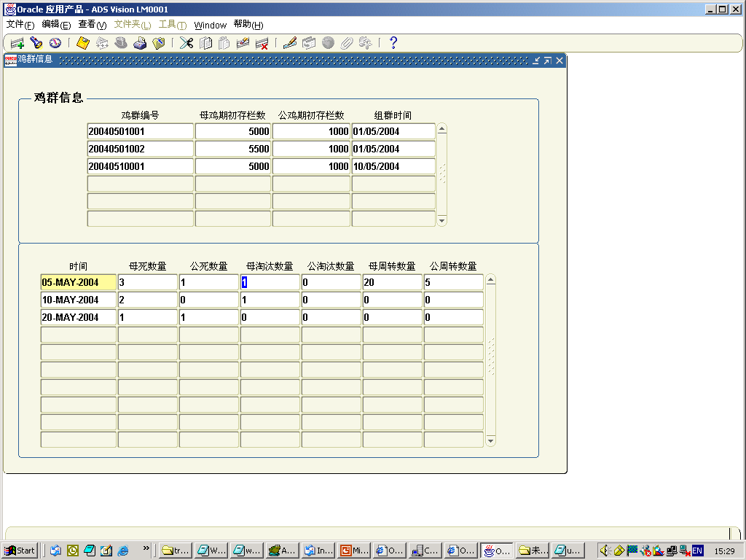
客户化表单的界面

Slide 27
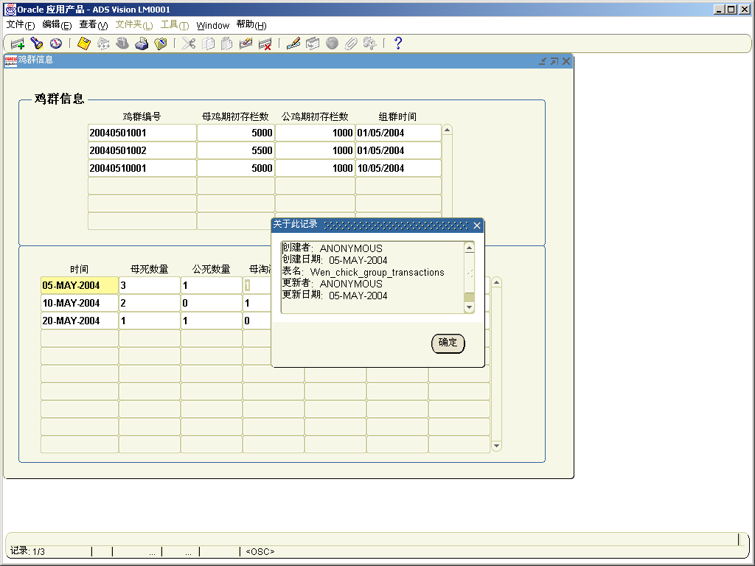
表单的数据来源(数据表)

Slide 28
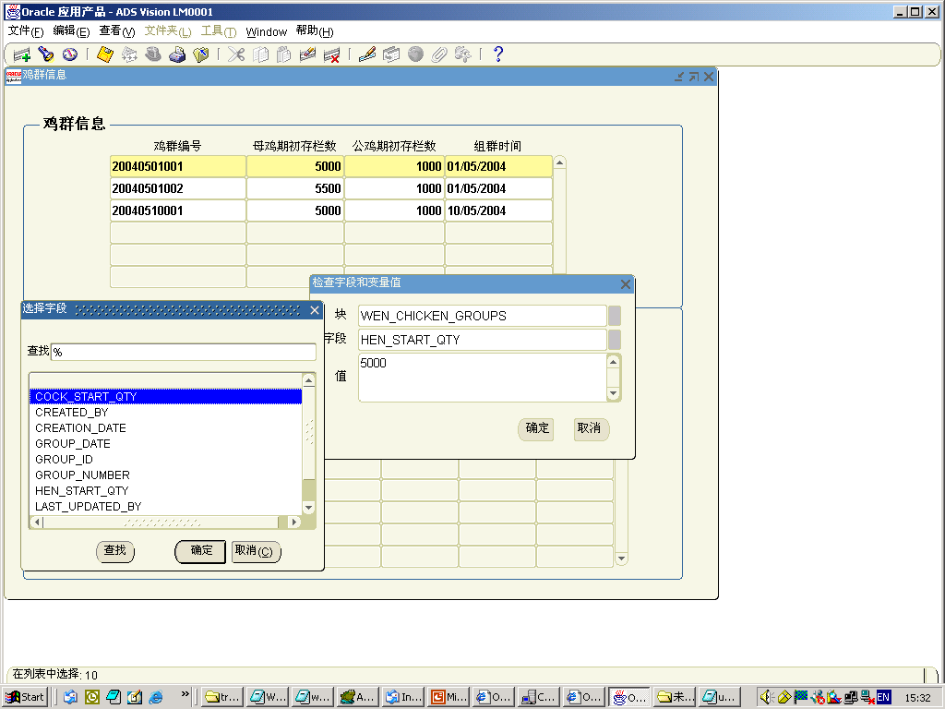
表单的数据来源(字段)

Slide 29
Oracle 开发工具及开发过程
-Form (See AVI File)
- Report (See AVI File)
- Discoverer (See AVI File)
- Workflow
- PL/SQL
- FSG (Financial Statement Generator)

Slide 30
4. 如何在系统中注册报表
      注册可执行并发程序
      注册并发程序
      挂上请求组

Slide 31
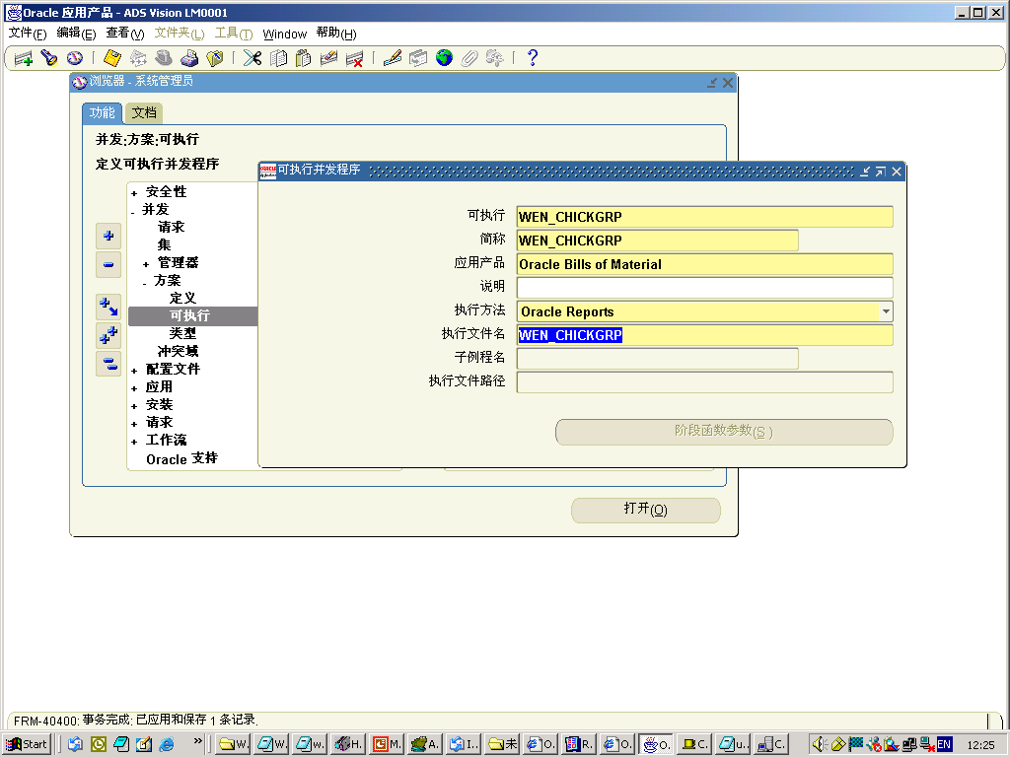
1、注册可执行并发程序

Slide 32
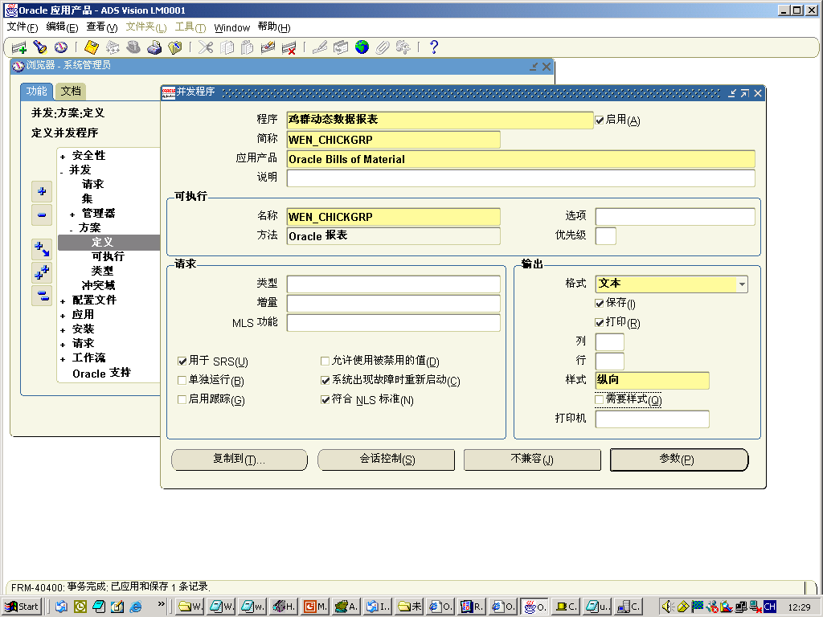
2、注册并发程序

Slide 33
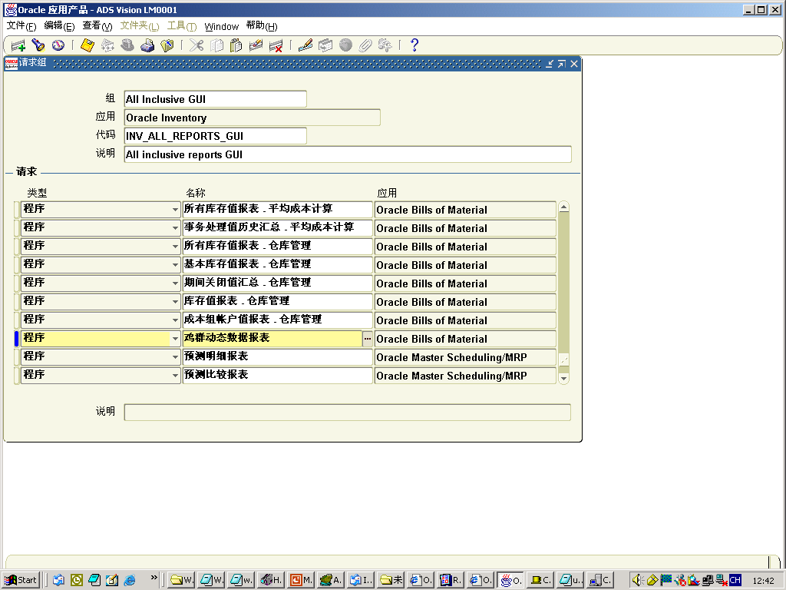
3、挂上请求组

Slide 34
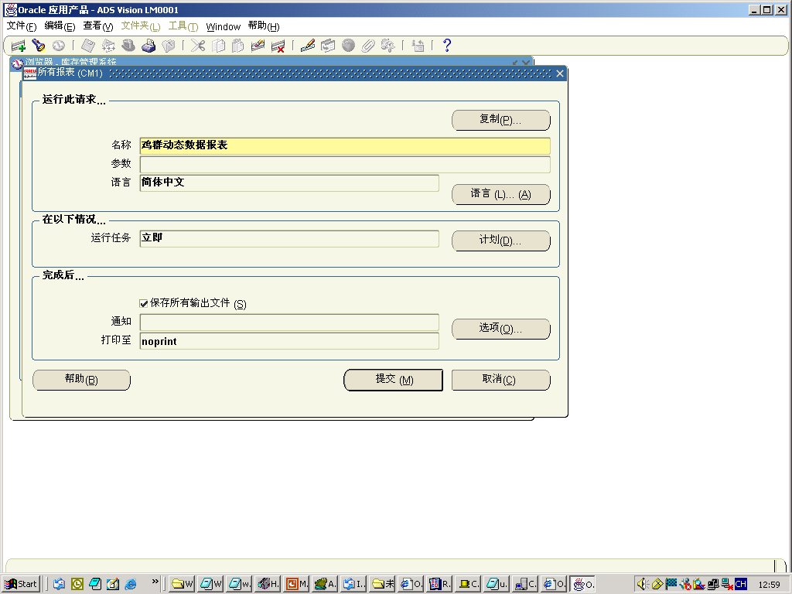
运行报表

Slide 35
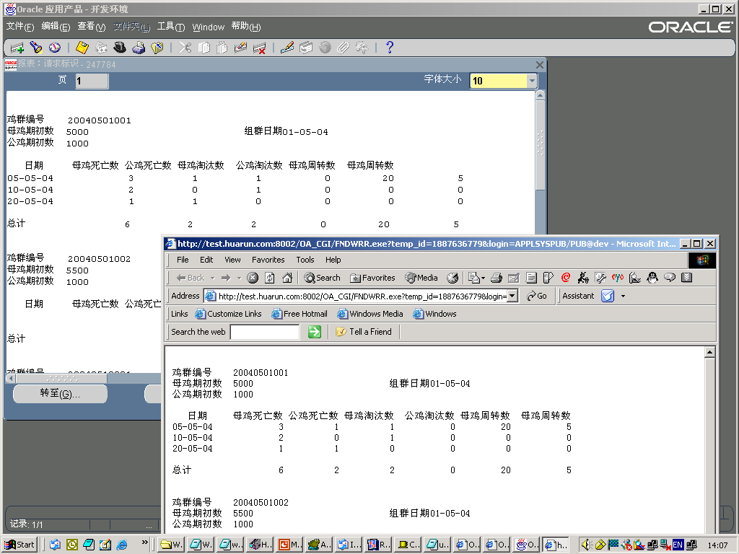
报表结果

Slide 36
Oracle 开发工具及开发过程
-Form (See AVI File)
- Report (See AVI File)
- Discoverer (See AVI File)
- Workflow
- PL/SQL
- FSG (Financial Statement Generator)

Slide 37
Oracle 开发工具及开发过程
-Form (See AVI File)
- Report (See AVI File)
- Discoverer (See AVI File)
- Workflow (See Following)
- PL/SQL
- FSG (Financial Statement Generator)

Slide 38
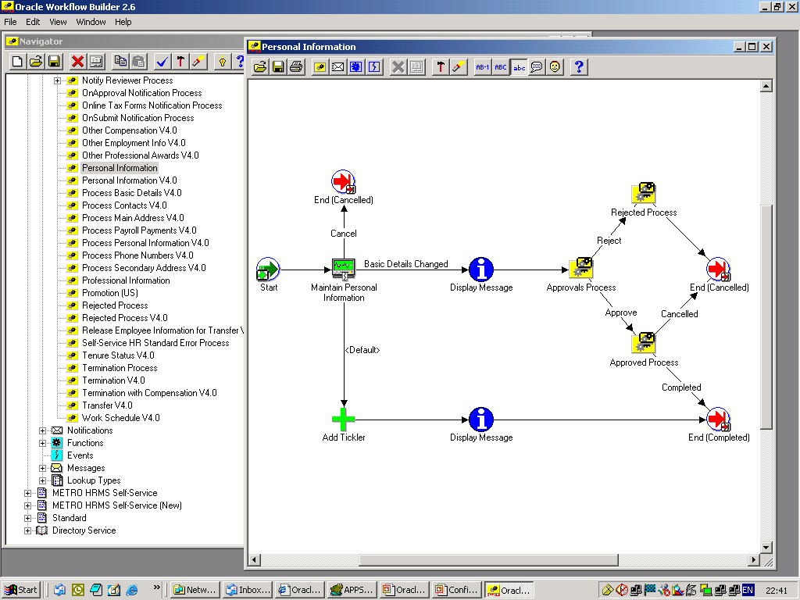
Workflow:

Slide 39
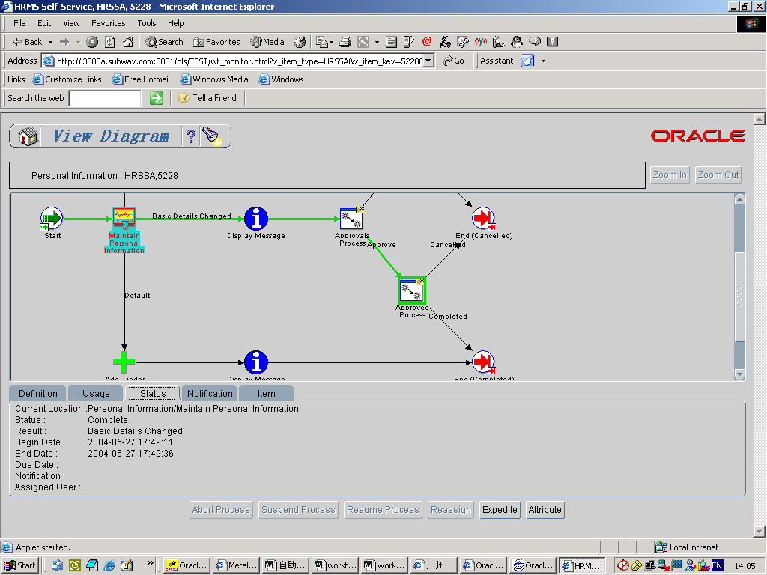
系统中的Workflow:

Slide 40
Oracle 开发工具及开发过程
-Form (See AVI File)
- Report (See AVI File)
- Discoverer (See AVI File)
- Workflow (See Following)
- PL/SQL
- FSG (Financial Statement Generator)

Slide 41
5. Oracle 开放式接口/
应用编程接口(API)

Slide 42
开放式接口、应用编程接口(API)原理
Oracle ERP系统
Excel
File
Open Interface
Table
Oracle
ERP
Build in
Process
Table
Package
API

Slide 43
系统接口数据表和应用编程接口(API)程序
Module Function | Interface Table/API | Comments
AP Suppliers | PO_VENDORS PO_VENDOR_SITES_ALL PO_VEDNRO_CONTACTS | No Interface /API
AR Customers | RA_CUSTOMERS_INTERFACE_ALL RA_CUSTOMER_PROFILES_INT_ALL RA_CUSTOMER_BANKS_INT_ALL | Open interface table
AR Receipts | AR_RECEIPT_API_PUB ARP_PROCESS_MISC_RECEIPTS.INSERT_MISC_RECEIPT | API packages
GL Journals | GL_INTERFACE | Open interface table

Slide 44
6. Oracle使用的其它相关工具
-ADI (Application Desktop Integrator)
- Dataload (www.quest.com)
- Sql loader
- Fndload
- Toad
- SQL Developer
- etc…

Slide 45
Oracle 数据字典
全部数据字典在如下三个组
- DBA_OBJECTS - DBA_TABLES -DBA_VIEWS
- ALL_OBJECTS - ALL_TABLES -ALL_VIEWS
- USER_OBJECTS -USER_TABLES -USER_VIEWS
系统登录用户
由系统来定义、分配和控制
数据库用户
只用 APPS

Slide 46
Oracle 系统命名的标准规则
Type | Rules | Example
Table | English Plural, start with module name | AP_INVOICES
View | <table name>_V | AP_INVOICES_V
Unique Index | <table name>_U <n> | AP_INVOICES_U1
Non-Unique Index | <table name>_N<n> | AP_INVOICES_N1
Sequence generator | <table name>_S | AP_INVOICES_S
Trigger | <table_name>_<event> | AR_CUSTOMER_PROFILES_BRU

Slide 47
Oracle 系统 － 数据库触发器
CREATE OR REPLACE TRIGGER ar_customer_profiles_bru
/* $Header: arplt26.sql 70.4 96/10/29 15:04:58 porting ship $ */
BEFORE UPDATE ON "AR"."AR_CUSTOMER_PROFILES"
FOR EACH ROW
DECLARE
CreditHold varchar2(1) := null;
RiskCode varchar2(30) := null;
CreditRating varchar2(30) := null;
ChangesMade varchar2(1) := 'N';
BEGIN
IF (( :new.credit_hold != :old.credit_hold ) OR
( :new.credit_hold is null and :old.credit_hold is not null ) OR
( :new.credit_hold is not null and :old.credit_hold is null )) THEN
CreditHold := :old.credit_hold;
/* IF FIELD VALUE OF credit_hold IS CHANGED THEN SET */
/* THE VALUE OF THIS VARIABLE TO Y */
ChangesMade := 'Y';
END IF;
IF (( :new.risk_code != :old.risk_code ) OR
( :new.risk_code is null and :old.risk_code is not null ) OR
( :new.risk_code is not null and :old.risk_code is null )) THEN
RiskCode := :old.risk_code;
ChangesMade := 'Y';
END IF;
IF (( :new.credit_rating != :old.credit_rating ) OR
( :new.credit_rating is null and :old.credit_rating is not null ) OR
( :new.credit_rating is not null and :old.credit_rating is null )) THEN
CreditRating := :old.credit_rating;
ChangesMade := 'Y';
END IF;
IF ChangesMade = 'Y' THEN
INSERT INTO ar_credit_histories
(credit_history_id, last_updated_by, last_update_date, created_by, creation_date,
customer_id, on_hold, hold_date, credit_rating, risk_code, site_use_id)
VALUES
(ar_credit_histories_s.nextval, :old.last_updated_by, :old.last_update_date, :old.last_updated_by,
:old.last_update_date,:old.customer_id, CreditHold, decode(CreditHold, 'Y', :old.last_update_date, null ), CreditRating, RiskCode,:old.site_use_id);
END IF;
END;

Slide 48
Oracle Application – Stored Procedure
Client
Server
Oracle
S1
S2
S3
S4
S1
S2
S3
S4
Oracle
Abc
Abc(S1, S2, S3, S4)

Slide 49

Q & A

