Slide 1
智能算法及应用
詹志辉 教授

Slide 2
课程目标
[1]理解智能算法的原理和应用方法
[2]学会使用智能算法求解实际问题
[3]掌握高水平学术论文的研读方法
[4]锻炼学生学术论文写作能力
[5]培养学生present成果的能力

Slide 3
课程对象
适合想深造、攻读博士学位的学生提前进行科研训练
不适合纯粹为了修学分的学生（本课程的作业非常多，要求很严格）
兴趣驱动、自由选课
需要付出一定时间，适合有毅力、学有余力的学生选修

Slide 4
课程形式
[1]老师讲解智能算法理论、应用及其最新进展以及典型的智能算法（GA/PSO/ACO)
[2]智能算法领域的研究经验、最新研究成果讲座分享
[3]学生进行课程作业实践、高水平论文研读和实验室实习研讨
[4]学生present 论文或成果

Slide 5
课程要求
1、所有学生期末的时候，必须提交一篇满足投稿要求的中文核心期刊论文或者英文EI会议论文（期末论文）
2、所有学生必须单独上讲台或线上进行作业、心得或者论文成果的展示
3、所有学生必须独立完成并提交所有的作业（1次综述写作+1次GA参数调研+1次PSO参数/拓扑结构调研+1次高水平学术论文研读+1次期末论文）
Notes:
1、所有学生期末的时候，必须提交一篇满足投稿要求的中文核心期刊论文或者英文EI会议论文
2、所有学生必须单独上讲台进行作业或者论文成果的展示
3、所有学生必须提交所有的作业（1次综述写作+1次GA参数调研+1次PSO拓扑结构调研+1次高水平学术论文研读+1次期末论文）
4、以上3项不满足的学生，成绩在59分以下
5、没有小组作业！
6、每次课都点名，无故旷课2次以上，成绩在59分以下
7、这是一门选修课，欢迎有兴趣、有毅力、学有余力的学生选修，不建议其他学生选修（避免毕业成绩单上的不及格分数）

Slide 6
个人作业1
作业1：选择一种智能算法为主题（如遗传算法、蚁群算法、粒子群算法、差分进化算法等）写一份算法综述（包括算法起源、流程结构、算法改进、实践应用等方面），了解智能算法的前世今生，以及未来发展趋势

Slide 7
综述写作要求
正文使用小四(12)号字体，双倍行距
中文使用宋体，英文和数字使用Times New Roman
排版工整，不少于50页
需要有不少于30篇参考文献，其中英文参考文献不少于10篇
提交文档为doc或docx格式，同时转为pdf格式。共两个文件
文档命名“智能算法作业1+学号+姓名+综述名称”（邮件主题同文档名）
提交时间：2020年3月10日之前，发送到zhanapollo@163.com
注意1：不按时提交者当自动放弃选课处理
注意2：邮件主题不按要求写的无法收到邮件(按注意1处理)

Slide 8
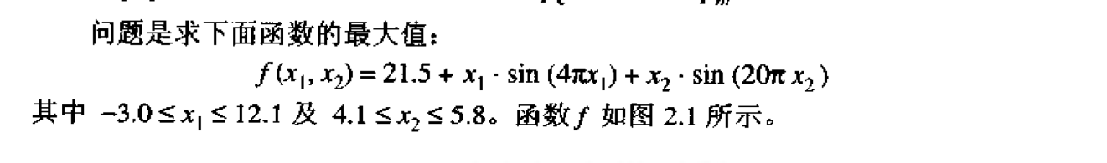
个人作业2
实现遗传算法程序，求解连续函数问题，并对算法参数进行调查，写成报告。
求解问题：
参数设定：N=100, pc=0.7, pm=0.07, Gmax=2000
对参数pc和pm进行调查，分别设pc=0.1,0.2,0.3….,0.9；pm=0.01,0.02，0.03，…0.09，对每一组参数组合在函数上运行30次，基于30次的平均结果进行报告的撰写。
注意：报告中需要画出函数图像
2周时间，提交形式与作业1类似

Slide 9


个人作业3
实现粒子群程序，求解连续函数问题，并对算法参数进行调查，写成报告。
求解问题：
维数n=30
参数设定：N=20, w=0.9~0.4, c1=c2=2.0, Gmax=2000
对参数w和c1/c2进行调查，分别设w=0.1,0.2,0.3….,0.9；c1=c2=0.5,1.0，1.5，…3.5，对每一组参数组合在函数上运行30次，基于30次的平均结果进行报告的撰写。
2周时间，提交形式与作业1类似
-100<= xi <=100
-5.12<= xi <=5.12

Slide 10
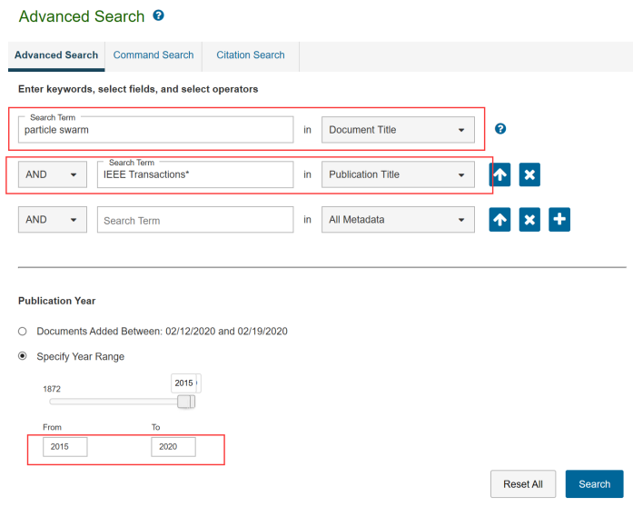
个人作业4
选择一篇IEEE Transactions论文进行学习
写一份学习心得体会，重点在于介绍论文的主要思想、相关内容、实验结论，以及个人学习体验
2周时间，提交形式与作业1类似
搜索论文：https://ieeexplore.ieee.org/search/advanced
  关键词：genetic algorithm, particle swarm optimization, differential evolution, ant colony, 等等
  注意publication title
  填写 IEEE Transactions*
  最好是近五年的论文
  最好是TEVC和TCYB的论文
或者选择实验室以下的与智能算法相关的论文

Slide 11
参考论文列表
求解复杂环境下大规模优化问题的智能算法：
Z. J. Wang(Student), Zhi-Hui Zhan(Corresponding Author), W. J. Yu, Y. Lin, J. Zhang, T. L. Gu, and J. Zhang, “Dynamic group learning distributed particle swarm optimization for large-scale optimization and its application in cloud workflow scheduling,” IEEE Transactions on Cybernetics, DOI: 10.1109/TCYB.2019.2933499, Aug. 2019.
X. Zhang(Student), K. J. Du, Zhi-Hui Zhan(Corresponding Author), S. Kwong, T. L. Gu, and J. Zhang, “Cooperative co-evolutionary bare-bones particle swarm optimization with function independent decomposition for large-scale supply chain network design with uncertainties,” IEEE Transactions on Cybernetics, DOI: 10.1109/TCYB.2019.2937565, Aug. 2019.
Y. F. Ge(Student), Zhi-Hui Zhan (詹志辉), et al., “Distributed differential evolution based on adaptive mergence and split for large-scale optimization,” IEEE Transactions on Cybernetics, vol. 48, no. 7, pp. 2166-2180, Jul. 2018.
J. R. Jian(Student), Zhi-Hui Zhan(Corresponding Author), and J. Zhang, “Large-scale evolutionary optimization: a survey and experimental comparative study,” International Journal of Machine Learning and Cybernetics, DOI: 10.1007/s13042-019-01030-4, Nov. 2019.
求解复杂环境下动态优化问题的智能算法：
X. F. Liu(Student), Zhi-Hui Zhan(詹志辉)(Corresponding Author), et al., “Neural network based information transfer for dynamic optimization,” IEEE Transactions on Neural Networks and Learning Systems, DOI:10.1109/TNNLS.2019.2920887. Jun. 2019.
Xiao-Fang Liu(Student), Zhi-Hui Zhan (詹志辉)(Corresponding Author), et al., “Neural Network for Change Direction Prediction in Dynamic Optimization,” IEEE Access, vol. 6, pp. 72649-72662, Dec. 2018.
求解复杂环境下多峰值优化问题的智能算法：
Z. G. Chen(Student), Zhi-Hui Zhan(Corresponding Author), H. Wang, and J. Zhang, “Distributed individuals for multiple peaks: A novel differential evolution for multimodal optimization problems,” IEEE Transactions on Evolutionary Computation, DOI: 10.1109/TEVC.2019.2944180, Oct. 2019.
Zi-Jia Wang (Student), Zhi-Hui Zhan (詹志辉)(Corresponding Author), et al., “Automatic niching differential evolution with contour prediction approach for multimodal optimization problems,” IEEE Transactions on Evolutionary Computation, DOI: 10.1109/TEVC.2019.2910721, April 2019.
Z. J. Wang(Student), Zhi-Hui Zhan(詹志辉)(Corresponding Author), et al., “Dual-strategy differential evolution with affinity propagation clustering for multimodal optimization problems,” IEEE Transactions on Evolutionary Computation, vol. 22, no. 6, pp. 894-908, Dec. 2018.
H. Zhao(Student), Zhi-Hui Zhan(Corresponding Author), Y. Lin, X. Chen, X. N. Luo, Jie Zhang, S. Kwong, and J. Zhang, “Local binary pattern based adaptive differential evolution for multimodal optimization problems,” IEEE Transactions on Cybernetics, DOI: 10.1109/TCYB.2019.2927780, Aug. 2019.

Slide 12
参考论文列表
求解复杂环境下多目标/超多目标优化问题的智能算法：
Xiao-Fang Liu (Student), Zhi-Hui Zhan(詹志辉)(Corresponding Author), et al., “Coevolutionary particle swarm optimization with bottleneck objective learning strategy for many-objective optimization,” IEEE Transactions on Evolutionary Computation, vol. 23, no. 4, pp. 587-602, Aug. 2019.
Z. G. Chen(Student), Zhi-Hui Zhan(詹志辉)(Corresponding Author), et al., “Multiobjective cloud workflow scheduling: A multiple populations ant colony system approach,” IEEE Transactions on Cybernetics, vol. 49, no. 8, pp. 2912-2926, Aug. 2019.
Zhi-Hui Zhan (詹志辉), et al., “Multiple populations for multiple objectives: A coevolutionary technique for solving multiobjective optimization problems,” IEEE Transactions on Cybernetics, vol. 43, no. 2, pp. 445-463, April. 2013.
数据辅助的自适应与分布式智能算法：
Zhi-Hui Zhan, Z. J. Wang, H. Jin, and J. Zhang, “Adaptive distributed differential evolution,” IEEE Transactions on Cybernetics, DOI: 10.1109/TCYB.2019.2944873, Oct. 2019.
X. F. Liu(Student), Zhi-Hui Zhan(Corresponding Author), Y. Lin, W. N. Chen, Y. J. Gong, T. L. Gu, H. Q. Yuan, and J. Zhang, “Historical and heuristic-based adaptive differential evolution,” IEEE Transactions on Systems, Man, and Cybernetics: Systems, vol. 49, no. 12, pp. 2623-2635, Dec. 2019.
Zhi-Hui Zhan(詹志辉), et al., “Cloudde: A heterogeneous differential evolution algorithm and its distributed cloud version,” IEEE Transactions on Parallel and Distributed Systems, vol. 28, no. 3, pp. 704-716, March. 2017.
Y. L. Li, Zhi-Hui Zhan(Corresponding Author), Y. J. Gong, W. N. Chen, J. Zhang, and Y. Li, “Differential evolution with an evolution path: A DEEP evolutionary algorithm,” IEEE Transactions on Cybernetics, vol. 45, no. 9, pp. 1798-1810, Sept. 2015.
Zhi-Hui Zhan, J. Zhang, Y. Li, and Y. H. Shi, “Orthogonal learning particle swarm optimization,” IEEE Transactions on Evolutionary Computation, vol. 15, no. 6, pp. 832-847, Dec. 2011.
Zhi-Hui Zhan, J. Zhang, Y. Li, and H. Chung, “Adaptive particle swarm optimization,” IEEE Transactions on Systems, Man, and Cybernetics--Part B, vol. 39, no. 6, pp. 1362-1381, Dec. 2009.
智能算法的典型应用：
Xiao-Fang Liu (Student), Zhi-Hui Zhan (詹志辉)(Corresponding Author), et al., “An energy efficient ant colony system for virtual machine placement in cloud computing,” IEEE Transactions on Evolutionary Computation, vol. 22, no. 1, pp. 113-128, Feb. 2018.
D. Liang(Student), Zhi-Hui Zhan(Corresponding Author), Y. Zhang, and J. Zhang, “An efficient ant colony system approach for new energy vehicle dispatch problem,” IEEE Transactions on Intelligent Transportation Systems, DOI: 10.1109/TITS.2019.2946711, Oct. 2019.

Slide 13
期末作业（论文）
主题：智能算法的改进或应用研究
  可以从附件题目中选取（另附）
按照另附的模板进行论文写作
中英文均可
最终提交一份 “学号-姓名-智能算法期末论文-题目.doc”或者docx。同时提供对应的PDF文件，并做一份“学号-姓名-智能算法期末论文-题目.ppt”或者pptx
一共3个文件
作业/论文提交时间：待定

Slide 14
Thank You !

Slide 15
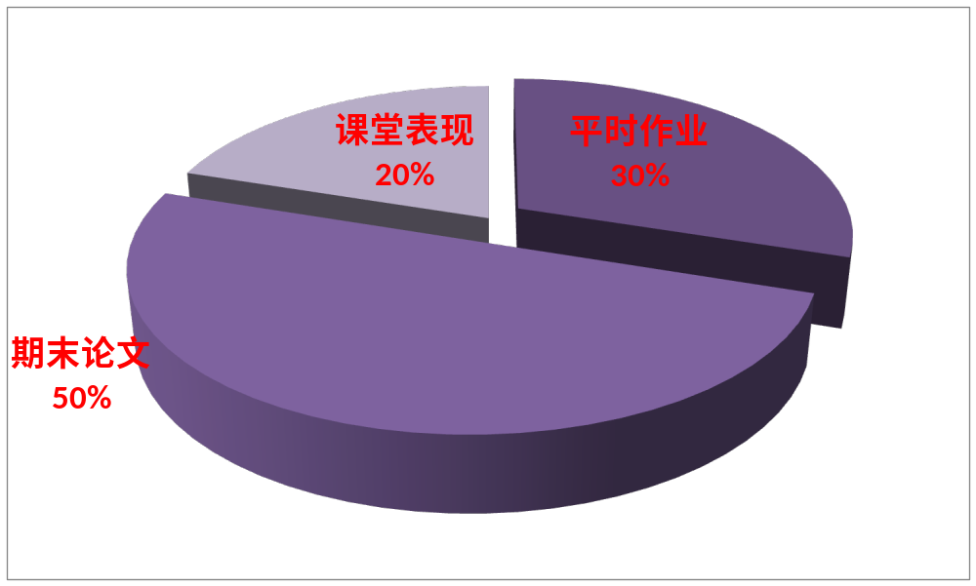
课程考核
有与本课程的智能算法相关论文发表（录用）的同学，分数在95分以上
已经投稿的分数在90分以上
考勤+展示
Notes:
有与本课程的智能算法相关论文发表（录用）的同学，分数在95分以上

