Slide 1
Sunday Class

Slide 2
Not continuing Unit 1

Slide 3
Group Presentation: Assignment 4
Starting from week 7, ending on week 16
At the beginning of class
Each class should have 10 groups (Group size of roughly 5)
Everyone must speak
Your team gets one grade, all teammates get the same grade.
Each group conducts research, designs PPT, and present a well-organized group presentation with sufficient information and using various formats.
Time limit for each group presentation 15-20 minutes.
Create your own purpose i.e for food science unit, you could research and find out the most healthy methods of cooking

Slide 4
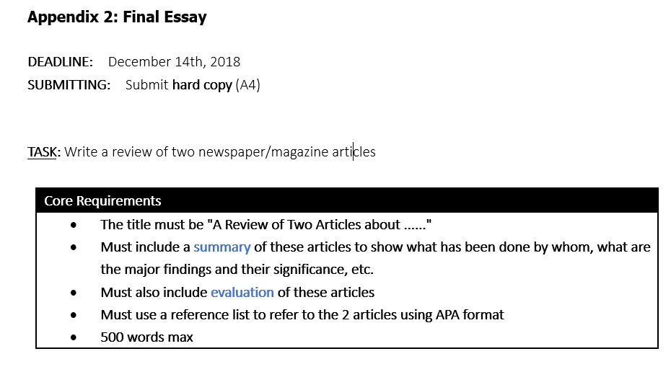

Slide 5
How to write an essay?
Introduction
Main Body
Conclusion

Slide 6
Introduction
Give a description or explanation of the situation or problem (general)
Why this situation or problem (or more specific aspect of it) is important
Say what your aim for your essay is
Notes:
Write your introduction after you have done your research. Your introduction may change based on new research. Usually an introduction length is around 10% of the total length of the essay.

Slide 7
Main body
Consists of a number of paragraphs
The paragraphs develop new ideas
For your essay, you will need to summarise and evaluate the ideas of two articles in your main body.

Slide 8
Conclusion
Normally consists of:
A summary of the main ideas (related to the importance of the topic)
A summary of your evidence (with your evaluation of it).
Your overall conclusion / answer to the question
Make sure the points are connected!
Notes:
Does not contain any new ideas or points, these go into your main points. Your conclusion should be around 10% the length of your entire essay.

Slide 9
Written Assignments
Assignment 1, Introduction,
Assignment 2, Main body
Assignment 3, Main body
Assignment 5, Conclusion
Combining all of these could produce your final essay

Slide 11
Referencing
http://www.bibme.org/citation-guide/apa/

Slide 12
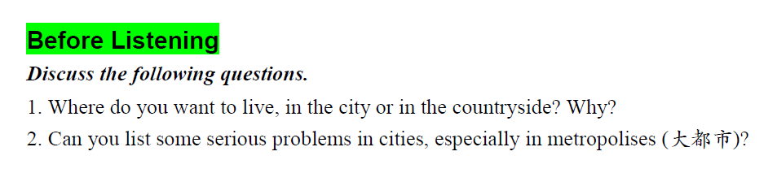
Unit 8

Slide 13
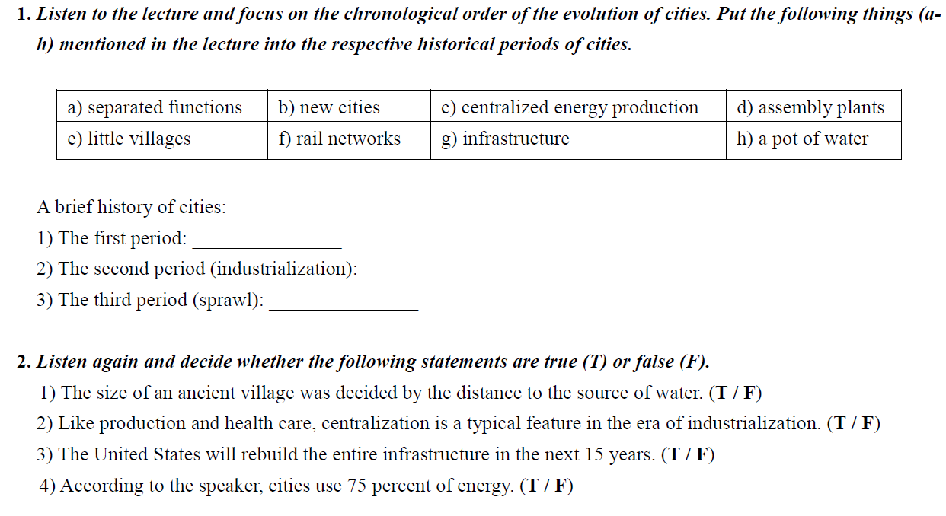
Listening Activity

Slide 14
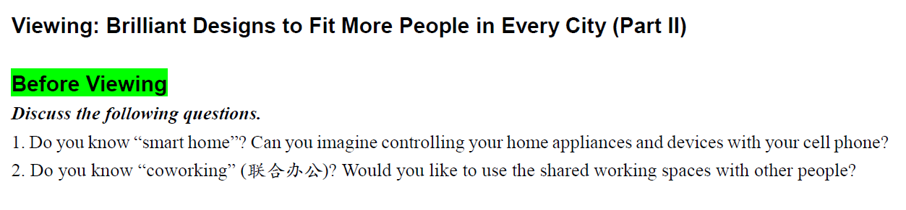
Viewing

Slide 15
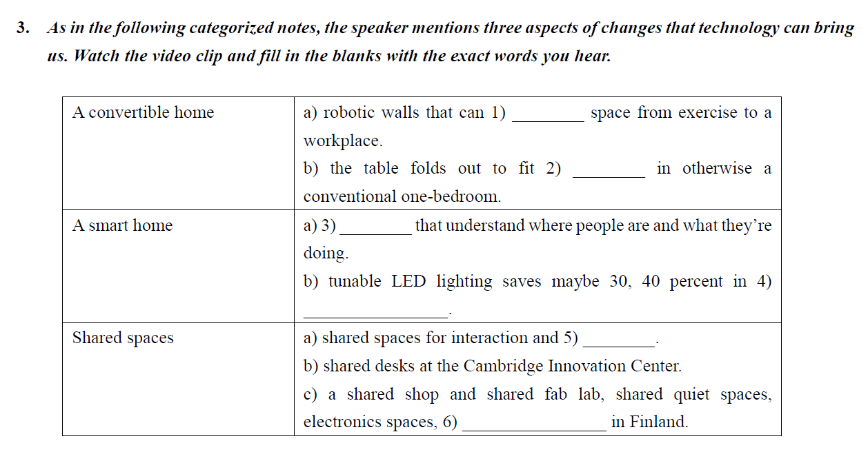
Viewing activities

Slide 16
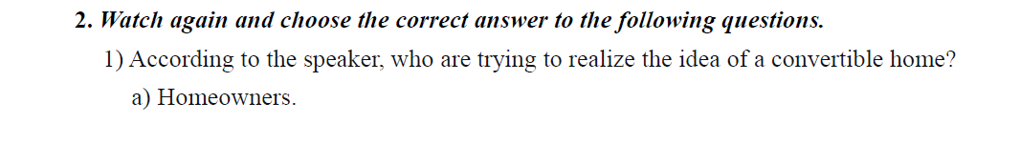
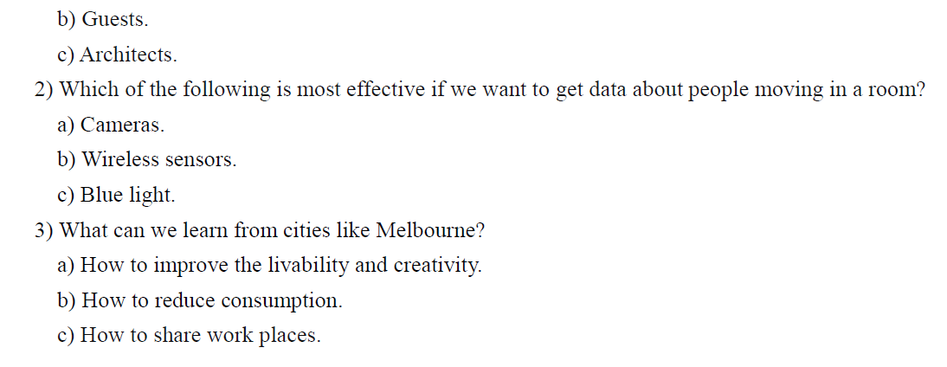
Viewing activities

Slide 17
