Slide 1
第4章 位运算
内容提要
算术运算
整数补码加减，浮点数加减
逻辑运算
逻辑非，逻辑与、或、异或
逻辑运算的应用
移位运算

Slide 2
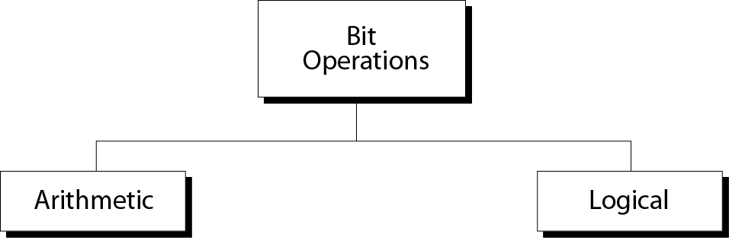
计算机的基本功能是对数据进行运算和加工处理，包含对数值信息的算术运算和逻辑数据的逻辑运算。

Slide 3
4.1算术运算 Arithmetic Operations
1.整数（定点数）
整数补码加减法及溢出判断和处理
2.浮点数
浮点加减法

Slide 4
整数加法运算
二进位计数制数学运算规则
0+0=0 0+1=1+0=1 1+1=0（进位）
0-0=0 1-0=1 0-1=1(借位）
0*0=0 0*1=1*0=0 1*1=1
0/1=0 1/1=1 0不得为除数
现代计算机内部整数采用补码存储，所以也采用补码进行运算。

Slide 5
整数位加运算
Number of 1s ------------
None
One
Two
Three
Result ------------
0
1
0
1
Carry ------------
1
1

Slide 6

注意:
补码加法规则
从低位开始，位权相同的位相加，采用二进制运算规则，逢2进1，往高位（左边）进位；符号位（最左边）的进位丢弃。

Slide 7
Example 1
Add two numbers in two’s complement representation: (+17) + (+22) ➔ (+39)
Solution
Carry 1
0 0 0 1 0 0 0 1 + 0 0 0 1 0 1 1 0
---------------------------------- Result 0 0 1 0 0 1 1 1 ➔ 39

Slide 8
Example 2
Add two numbers in two’s complement representation: (+24) + (-17) ➔ (+7)
Solution
Carry 1 1 1 1 1
0 0 0 1 1 0 0 0 + 1 1 1 0 1 1 1 1
---------------------------------- Result 0 0 0 0 0 1 1 1 ➔ +7

Slide 9
Example 3
Add two numbers in two’s complement representation: (-35) + (+20) ➔ (-15)
Solution
Carry 1 1 1
1 1 0 1 1 1 0 1 + 0 0 0 1 0 1 0 0
---------------------------------- Result 1 1 1 1 0 0 0 1 ➔ -15

Slide 10
Example 4
Add two numbers in two’s complement representation: (+127) + (+3) ➔ (+130)
Solution
Carry 1 1 1 1 1 1 1
0 1 1 1 1 1 1 1 + 0 0 0 0 0 0 1 1
---------------------------------- Result 1 0 0 0 0 0 1 0 ➔ -126 (Error) An overflow has occurred.

Slide 11
原因：产生溢出
补码的表数范围
- (2^{N-1}) ----- 0 ------ +(2^{N-1} –1)
溢出：当一个整数存在到超过分配的存储空间的表数范围的出错现象。

Slide 12
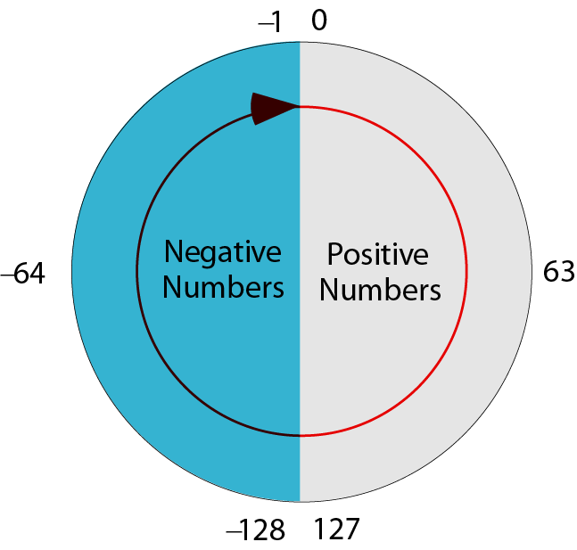
补码表数示意图

Slide 13
注意:
算术运算时，记得操作数和结果都应该在位模式的表数范围（定义域）内

Slide 14
注意:
补码减法统一成加法运算
（X – Y）补 = (X+ (-Y))补 =
X补 + (-Y)补

Slide 15
Example 5
Subtract 62 from 101 in two’s complement: (+101) - (+62) ⬅➔ (+101) + (-62)
Solution
Carry 1 1
0 1 1 0 0 1 0 1 + 1 1 0 0 0 0 1 0
---------------------------------- Result 0 0 1 0 0 1 1 1 ➔ 39 The leftmost carry is discarded.

Slide 16
补码定点加减运算
补码加法
规则
[X]补+[Y]补=[X+Y]补 Mod 2^n
每位加法形式
Xi+Yi+Ci=Si + Ci+1
补码减法
规则
[X-Y]补=[X+(-Y)]补=[X]补+[-Y]补 Mod 2^n

Slide 17
浮点加减运算
处理步骤
检验符号：
符号相同，加法运算，结果符号和加数相同
符号不同，绝对值大的减去绝对值小的，符号取绝对值大的
对阶，对齐小数点，小阶看齐大阶
尾数相加减
结果规格化
判断溢出

Slide 18
Example 6
Add two floats: 0 10000100 10110000000000000000000 0 10000010 01100000000000000000000
Solution
The exponents are 5 and 3. The numbers are: +2⁵ x 1.1011 and +2³ x 1.011 Make the exponents the same. (+2⁵ x 1.1011)+ (+2⁵ x 0.01011) ➔ +2⁵ x 10.00001 After normalization +2⁶ x 1.000001, which is stored as: 0 10000101 000001000000000000000000

Slide 20
逻辑运算Logic operations
逻辑代数
1854年法国数学家George Boole 布尔代数,现代逻辑代数经过香农改良
广泛应用于开关电路研究
逻辑变量
逻辑运算中的变量仅能取两个值：真或假，通常用1 和 0 表示，这些变量称为逻辑变量或布尔变量

Slide 21
逻辑运算 Logic operations
逻辑运算符
一元运算符 非运算
二元运算符 与、或、异或运算等
逻辑表达式
用逻辑运算符连接逻辑变量的式子。
逻辑表达式也是逻辑变量

Slide 22
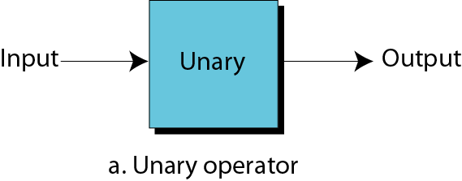
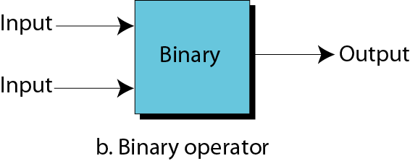
Figure 4-3
Unary and binary operations

Slide 23
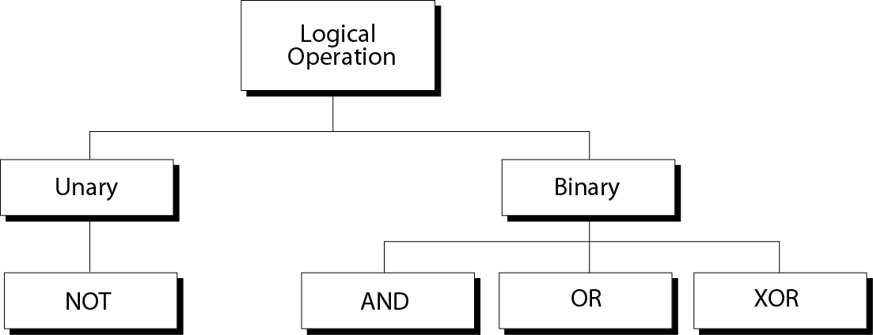
Figure 4-4
Logical operations

Slide 24
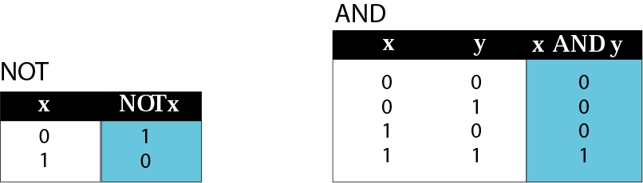
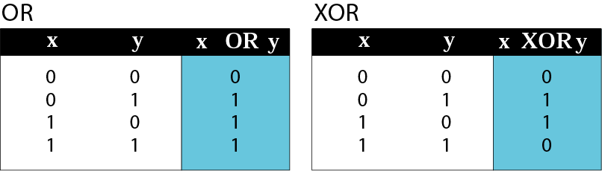
Figure 4-5
真值表 Truth tables

Slide 25
逻辑运算
逻辑非运算规则
非运算， 对变量A记为
或者 not A, ┓A
规则：not 0 = 1
not 1 = 0

Slide 26
逻辑运算
逻辑运算规则
与运算， 对变量A，B, 与运算记为
A and B, A*B, A∧B
规则：0 and 0 = 0
1and0 = 0and1 = 0
1 and 1 = 1
性质：0 ∧ A = 0

Slide 27
逻辑运算
逻辑运算规则
或运算， 对变量A，B, 或运算记为 A or B, A+B, A∨B
规则：0 or 0 = 0
1or0 = 0 or1 = 1
1 or 1 = 1
性质：1 ∨ A = 1

Slide 28
逻辑运算
逻辑运算规则
异或运算， 对变量A，B, 与运算记为 A ⊕ B
规则：0 ⊕ 0 = 0
1⊕0 = 0⊕1 = 1
1 ⊕ 1 = 0
性质：1⊕A = not A
0⊕A = A

Slide 29
逻辑运算
逻辑数（位模式）的运算规则
对于两个多位二进制逻辑数之间的逻辑运算，只在对应的位上分别进行，不进行借位，不同位之间不进行运算。

Slide 30
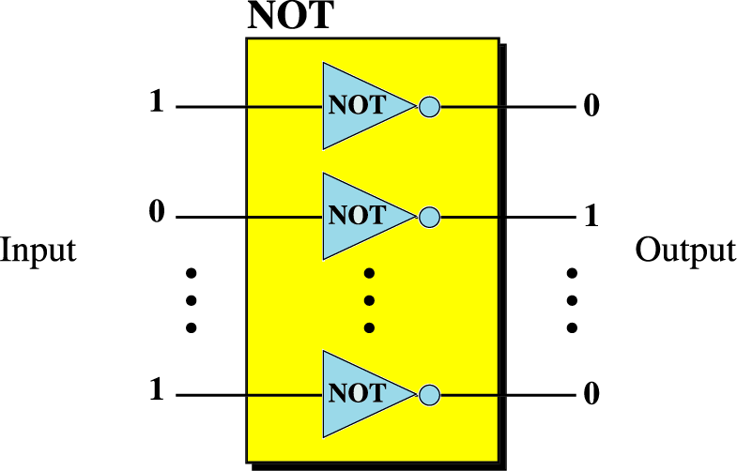
Figure 4-6
非运算符 NOT operator

Slide 31
Example 7
Use the NOT operator on the bit pattern 10011000
Solution
Target 1 0 0 1 1 0 0 0 NOT -------------------- Result 0 1 1 0 0 1 1 1

Slide 32
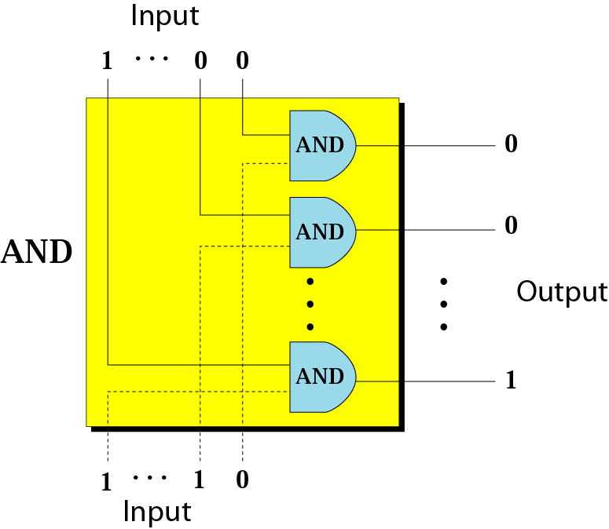
Figure 4-7
与运算符 AND operator

Slide 33
Example 8
Use the AND operator on bit patterns 10011000 and 00110101.
Solution
Target 1 0 0 1 1 0 0 0 AND 0 0 1 1 0 1 0 1 --------------------- Result 0 0 0 1 0 0 0 0

Slide 34
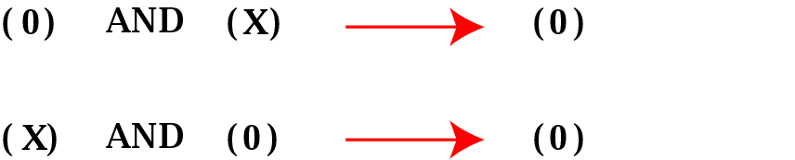
Figure 4-8
Inherent rule of the AND operator

Slide 35
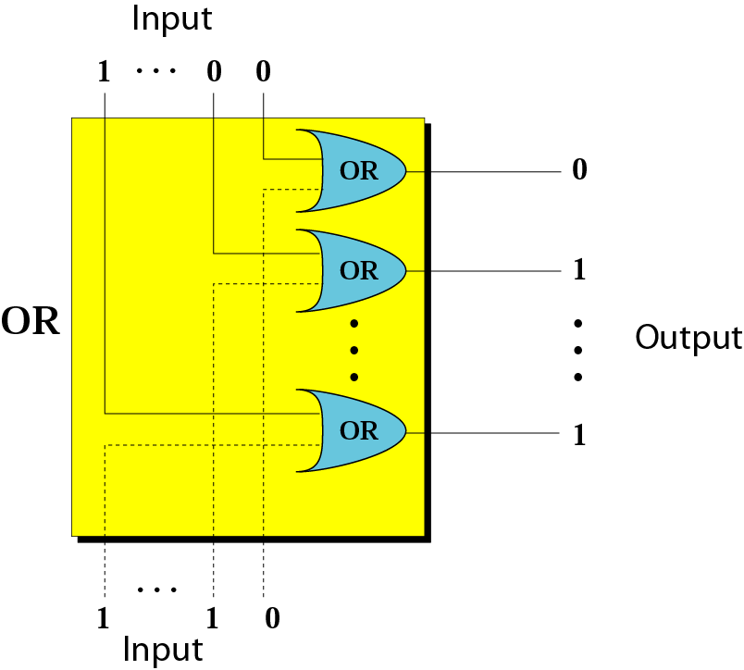
Figure 4-9
或运算符 OR operator

Slide 36
Example 9
Use the OR operator on bit patterns 10011000 and 00110101
Solution
Target 1 0 0 1 1 0 0 0 OR 0 0 1 1 0 1 0 1 --------------------- Result 1 0 1 1 1 1 0 1

Slide 37
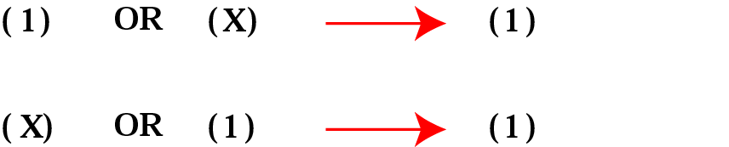
Figure 4-10
Inherent rule of the OR operator

Slide 38
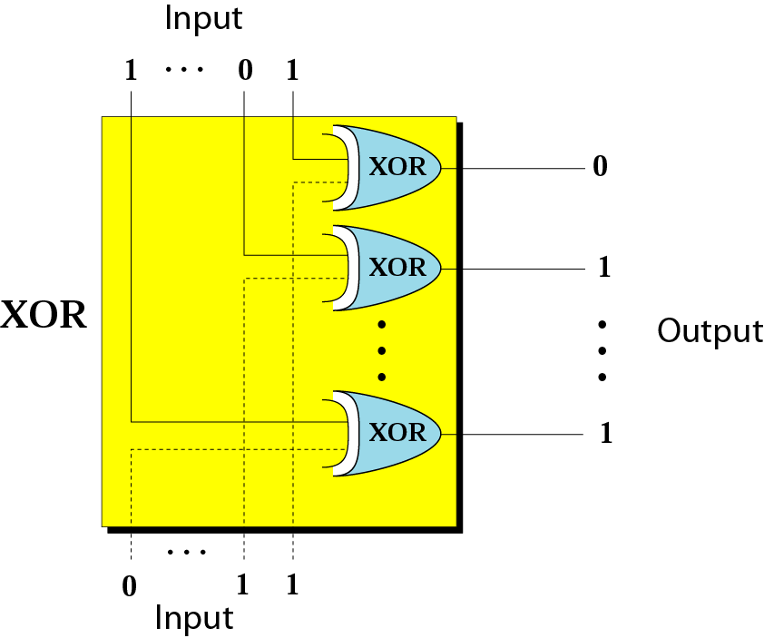
Figure 4-11
异或运算符 XOR operator

Slide 39
Example 10
Use the XOR operator on bit patterns 10011000 and 00110101.
Solution
Target 1 0 0 1 1 0 0 0 XOR 0 0 1 1 0 1 0 1 ---------------------- Result 1 0 1 0 1 1 0 1

Slide 40
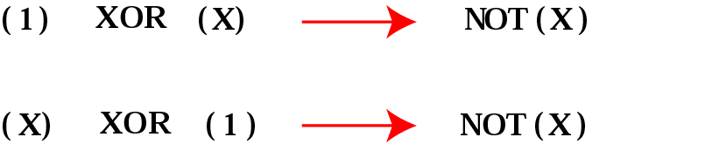
Figure 4-12
Inherent rule of the XOR operator

Slide 41
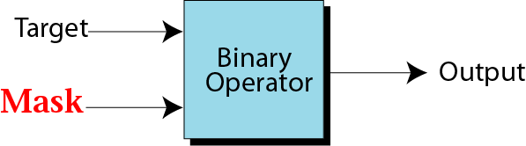
逻辑运算的应用
逻辑运算的应用
通过设置特殊掩码可以使用逻辑与、或、异或运算修改目标位模式。
掩码：
为修改目标位模式而引入的特殊位模式

Slide 42
逻辑运算
复位（置0）
原则：设置与目标位模式同位数的掩码进行与运算
掩码设置方法
对应目标位模式中需要复位的相应掩码位设为0；保持不变的相应位设为1
例子 目标：10100110
掩码：00000111
结果：00000110

Slide 43
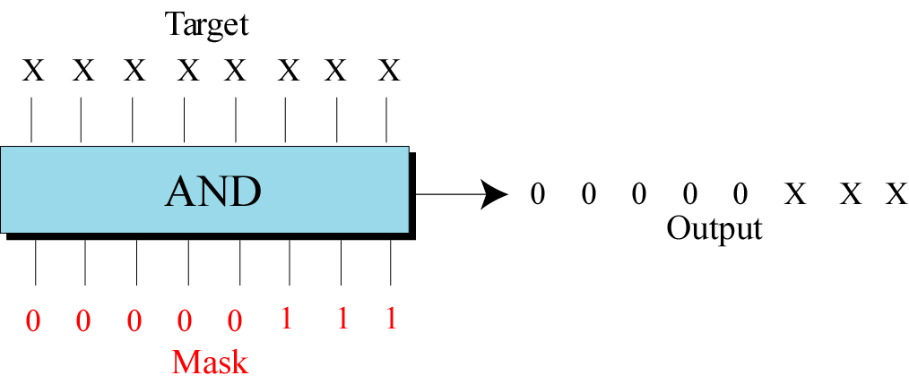
Figure 4-14
Example of unsetting specific bits

Slide 44
Example 11
Use a mask to unset (clear) the 5 leftmost bits of a pattern. Test the mask with the pattern 10100110.
Solution
The mask is 00000111.
Target 1 0 1 0 0 1 1 0 AND Mask 0 0 0 0 0 1 1 1 ---------------------- Result 0 0 0 0 0 1 1 0

Slide 45
Example 12
Imagine a power plant that pumps water to a city using eight pumps. The state of the pumps (on or off) can be represented by an 8-bit pattern. For example, the pattern 11000111 shows that pumps 1 to 3 (from the right), 7 and 8 are on while pumps 4, 5, and 6 are off. Now assume pump 7 shuts down. How can a mask show this situation?
Solution on the next slide.

Slide 46
Solution
Use the mask 10111111 to AND with the target pattern. The only 0 bit (bit 7) in the mask turns off the seventh bit in the target.
Target 1 1 0 0 0 1 1 1 AND Mask 1 0 1 1 1 1 1 1 --------------------- Result 1 0 0 0 0 1 1 1

Slide 47
逻辑运算
置位（置1）
原则：设置与目标位模式同位数的掩码进行或运算
掩码设置方法
对应目标位模式中需要置位的相应掩码位设为1；保持不变的相应位设为0
例子 目标：10100110
掩码：11111000
结果：11111110

Slide 48
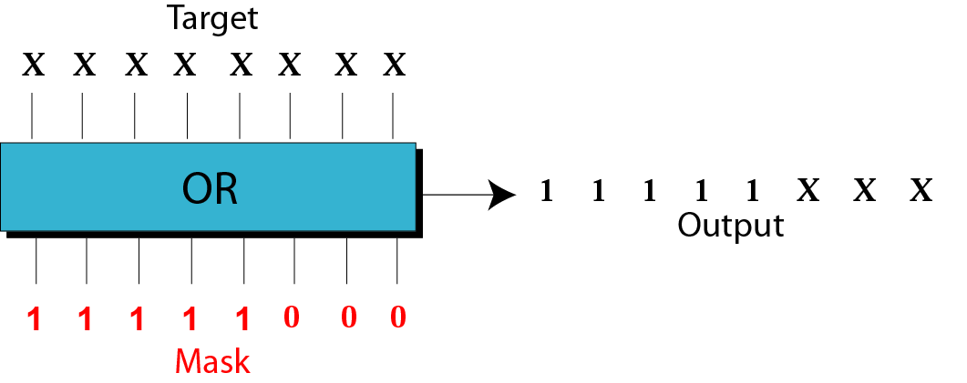
Figure 4-15
Example of setting specific bits

Slide 49
Example 13
Use a mask to set the 5 leftmost bits of a pattern. Test the mask with the pattern 10100110.
Solution
The mask is 11111000.
Target 1 0 1 0 0 1 1 0 OR Mask 1 1 1 1 1 0 0 0 ------------------ Result 1 1 1 1 1 1 1 0

Slide 50
Example 14
Using the power plant example, how can you use a mask to to show that pump 6 is now turned on?
Solution
Use the mask 00100000.
Target 1 0 0 0 0 1 1 1 OR Mask 0 0 1 0 0 0 0 0 --------------------- Result 1 0 1 0 0 1 1 1

Slide 51
逻辑运算
反转（0变1，1变0）
原则：设置与目标位模式同位数的掩码进行异或运算
掩码设置方法
对应目标位模式中需要反转的相应掩码位设为1；保持不变的相应位设为0
例子 目标：10100110
掩码：11111000
结果：01011110

Slide 52
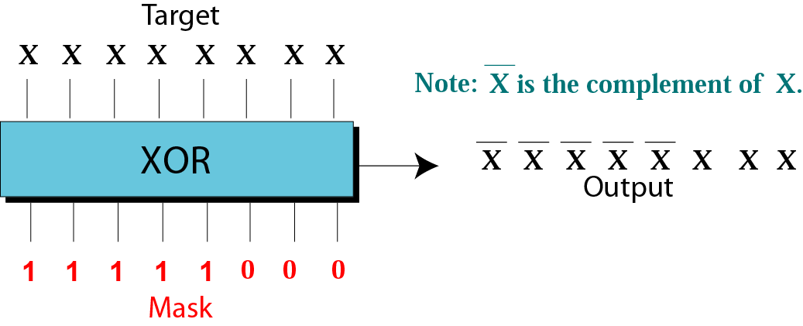
Figure 4-16
Example of flipping specific bits

Slide 53
Example 15
Use a mask to flip the 5 leftmost bits of a pattern. Test the mask with the pattern 10100110.
Solution
Target 1 0 1 0 0 1 1 0 XOR Mask 1 1 1 1 1 0 0 0 ---------------------- Result 0 1 0 1 1 1 1 0

Slide 54
移位运算 Shift operations
移位
逻辑左移，逻辑右移
不考虑符号位
算术左移，算术右移
考虑符号位
左移相当于乘2，右移相当于整除2

Slide 55
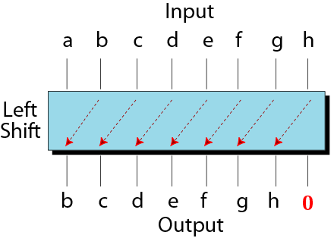
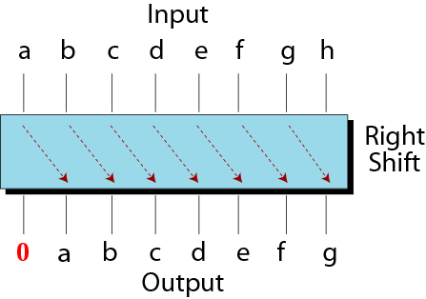
Figure 4-17
Shift operations

Slide 56
Example 16
Show how you can divide or multiply a number by 2 using shift operations.
Solution
If a bit pattern represents an unsigned number, a right-shift operation divides the number by two. The pattern 00111011 represents 59. When you shift the number to the right, you get 00011101, which is 29. If you shift the original number to the left, you get 01110110, which is 118.

Slide 57
Example 17
Use a combination of logical and shift operations to find the value (0 or 1) of the fourth bit (from the right).
Solution
Use the mask 00001000 to AND with the target to keep the fourth bit and clear the rest of the bits.
Continued on the next slide

Slide 58
Solution (continued)
Target a b c d e f g h AND Mask 0 0 0 0 1 0 0 0 ---------------------- Result 0 0 0 0 e 0 0 0
Shift the new pattern three times to the right 0000e000 ➔ 00000e00 ➔ 000000e0 ➔ 0000000e Now it is easy to test the value of the new pattern as an unsigned integer. If the value is 1, the original bit was 1; otherwise the original bit was 0.

