Slide 1
Backpropagation
Dept. of Astronomy, Space Science
Chungnam National University
Yeji Jo

Slide 2
Data
- Mnist
784
10
Number of data per image
Number of class
Number of images
300

Slide 3
Layers
L = 1
L = 2
L = 3
W1 ,b1
W2 ,b2
W3 ,b3
10
64
128
784

Slide 4
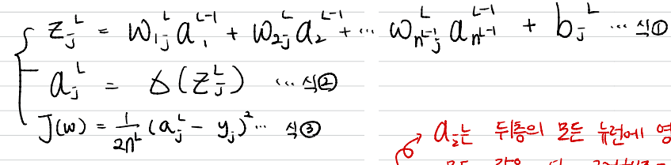
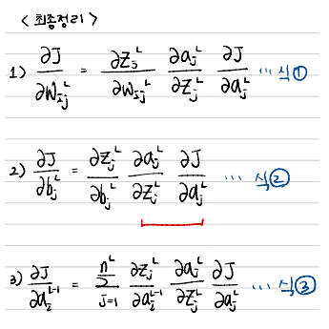
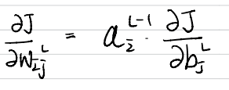
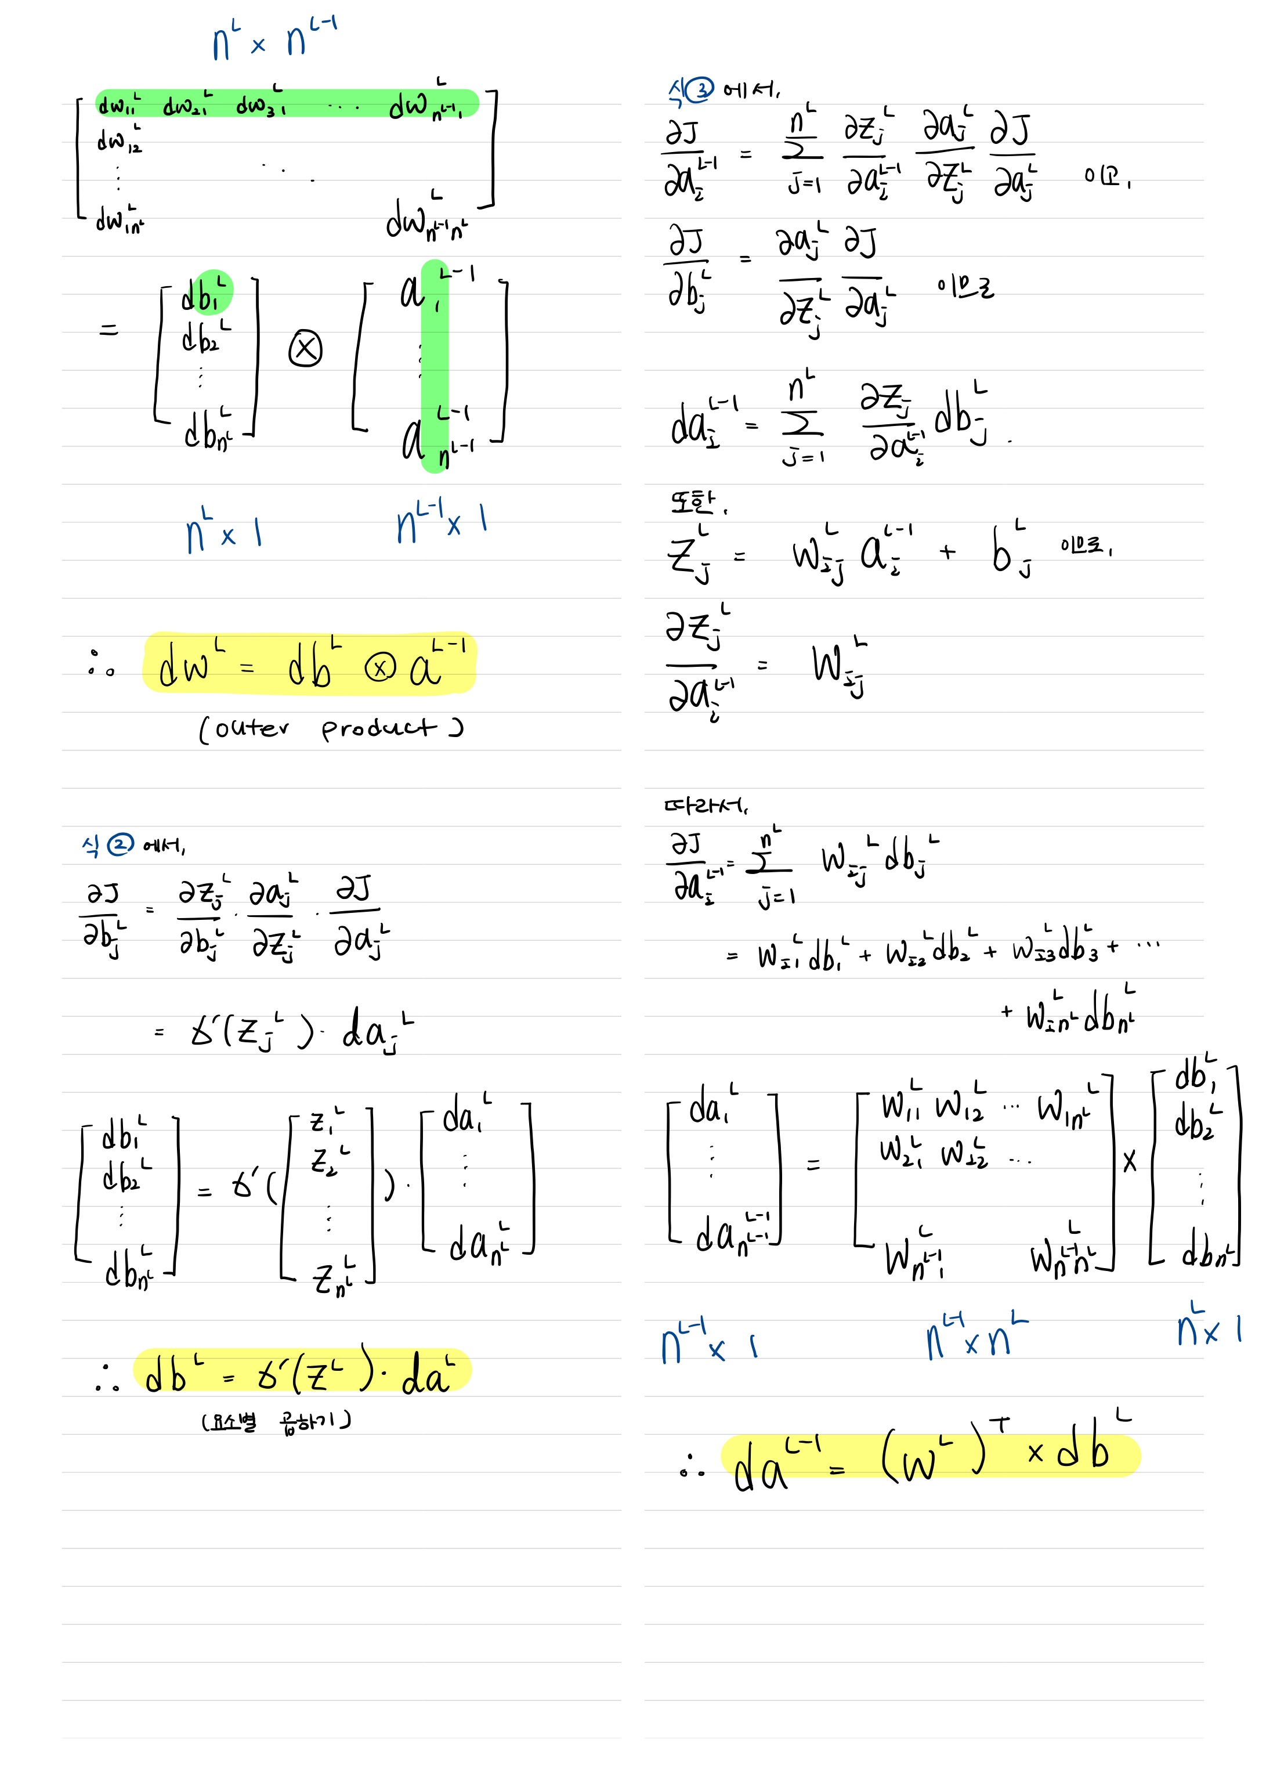

Backpropagation

Slide 5
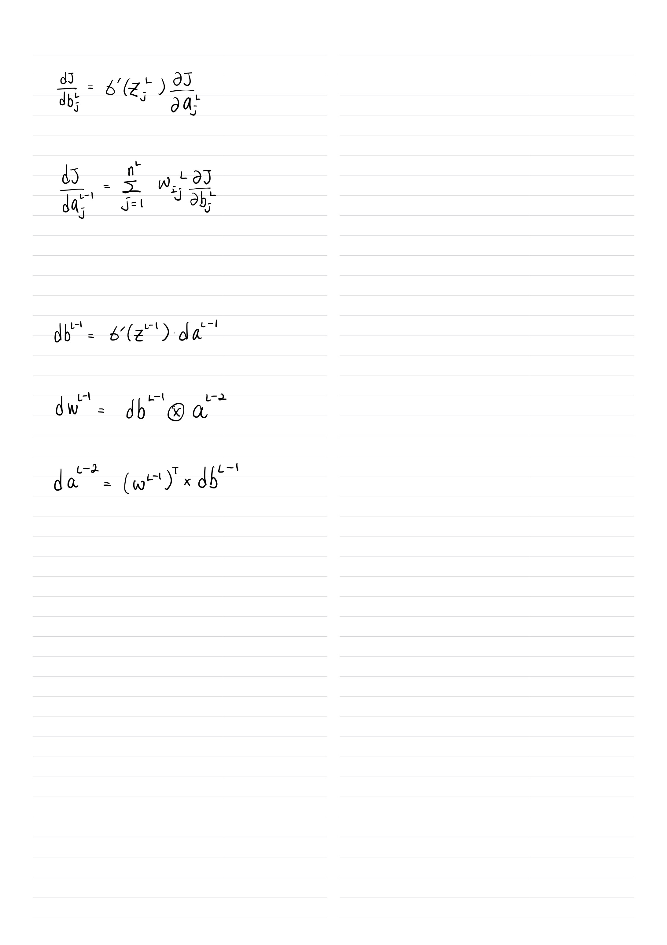
Backpropagation
6
3
……
5
4
2
1
7
4

Slide 6
Algorithm
Finding Predictions with Random Parameters
Activation Function : Sigmoid
Save values per layer in “cache” as a dictionary
Finding da, dW, db
Save gradient values per layer in “gradients” as a dictionary
Update Parameters
Use the mean of dW, db for all data
Save updated parameters per epoch
Save accuracy and MSE
Output :
Accuracy of test set,
MSE of training set,
Parameters

Slide 7
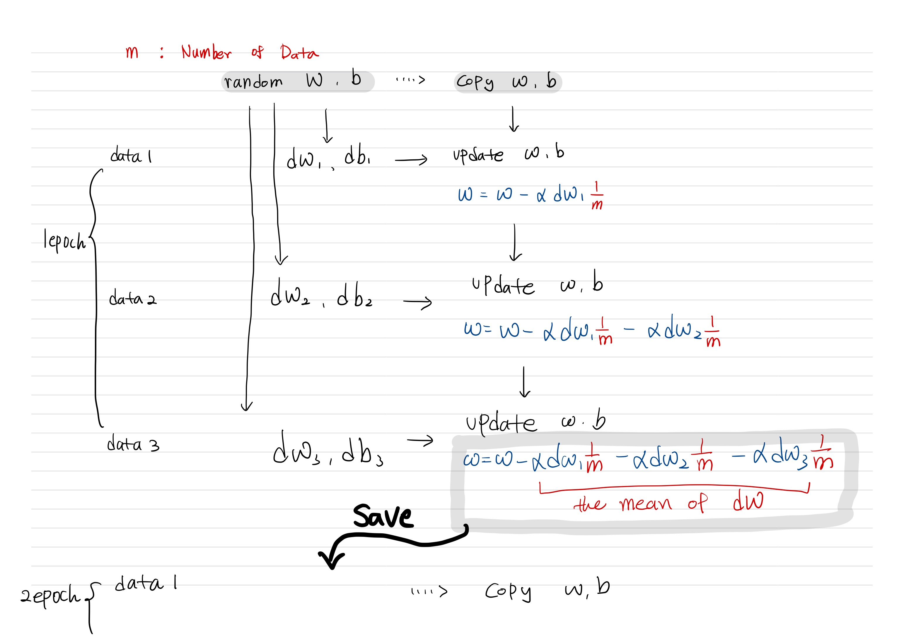
Algorithm

Slide 8
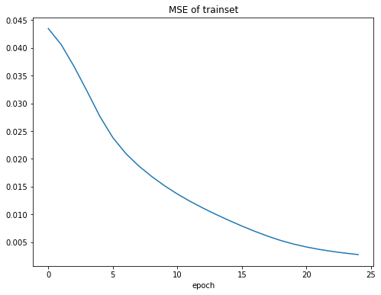
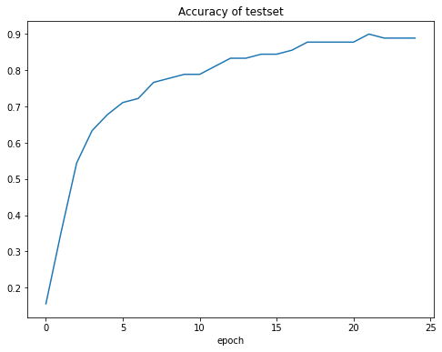
Result

