Slide 1
Convolutional Neural Networks
Dept. of Astronomy, Space Science
Chungnam National University
Yeji Jo

Slide 2
Project
Song Perception
Data Processing
Determining whether there is a song in the noise
If there is a song, denoise and extract the song
Finding a song
Creating a destructive interference wave
Noise canceling for songs

Slide 3
CNN (Convolutional Neural Networks)
Convolution Operation
Pooling Operation

Slide 4
CNN (Convolutional Neural Networks)
Convolution Operation
8
3
8
3
Data
Filter/Kernel
Stride = 1

Slide 5
CNN (Convolutional Neural Networks)
Convolution Operation
8
3
8
3
Data
Filter/Kernel
Stride = 1

Slide 6
CNN (Convolutional Neural Networks)
Convolution Operation
8
3
8
3
Data
Filter/Kernel
Stride = 1

Slide 7
CNN (Convolutional Neural Networks)
Convolution Operation
8
3
8
3
Data
Filter/Kernel
Stride = 1

Slide 8
CNN (Convolutional Neural Networks)
Convolution Operation
8 – 3 + 1 = 6
8
3
8
3
Data
Filter/Kernel
Out Layer

Slide 9
CNN (Convolutional Neural Networks)
2. Pooling Operation
8
2
8
2
Data
Filter/Kernel
Stride = 1

Slide 10
CNN (Convolutional Neural Networks)
2. Pooling Operation
8
2
8
2
Data
Filter/Kernel
Stride = 2

Slide 11
CNN (Convolutional Neural Networks)
2. Pooling Operation
8
2
8
2
Data
Filter/Kernel
Stride = 2

Slide 12
CNN (Convolutional Neural Networks)
2. Pooling Operation
8/2 = 4
8
2
8
2
Data
Filter/Kernel
Out Layer

Slide 13
CNN (Convolutional Neural Networks)
Convolution
Max Pooling
…
Data
Filter/Kernel
First Layer
Filter/Kernel
Second Layer
N Layer

Slide 14
CNN (Convolutional Neural Networks)
N Layer

Slide 15
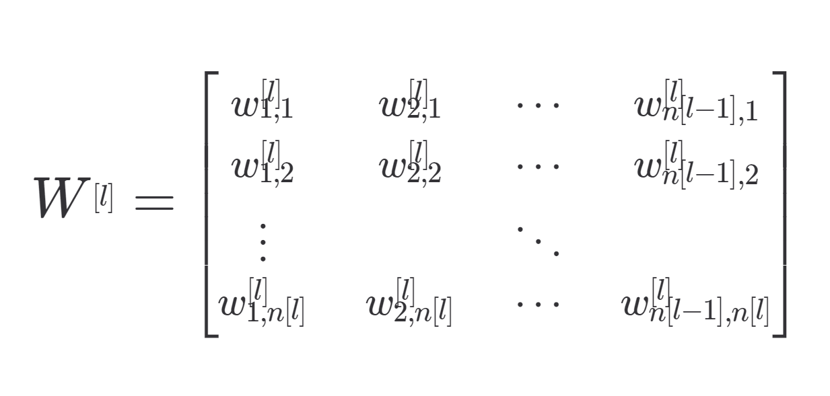
CNN (Convolutional Neural Networks)
N_data
1 | 0
0 | 1
0 | 1
0 | 1
1 | 0
0 | 1
*
( N_data, N_value)
N Layer
N Layer
N Layer
( N_value, N_class)
( N_data, N_class)
N_value

Slide 16
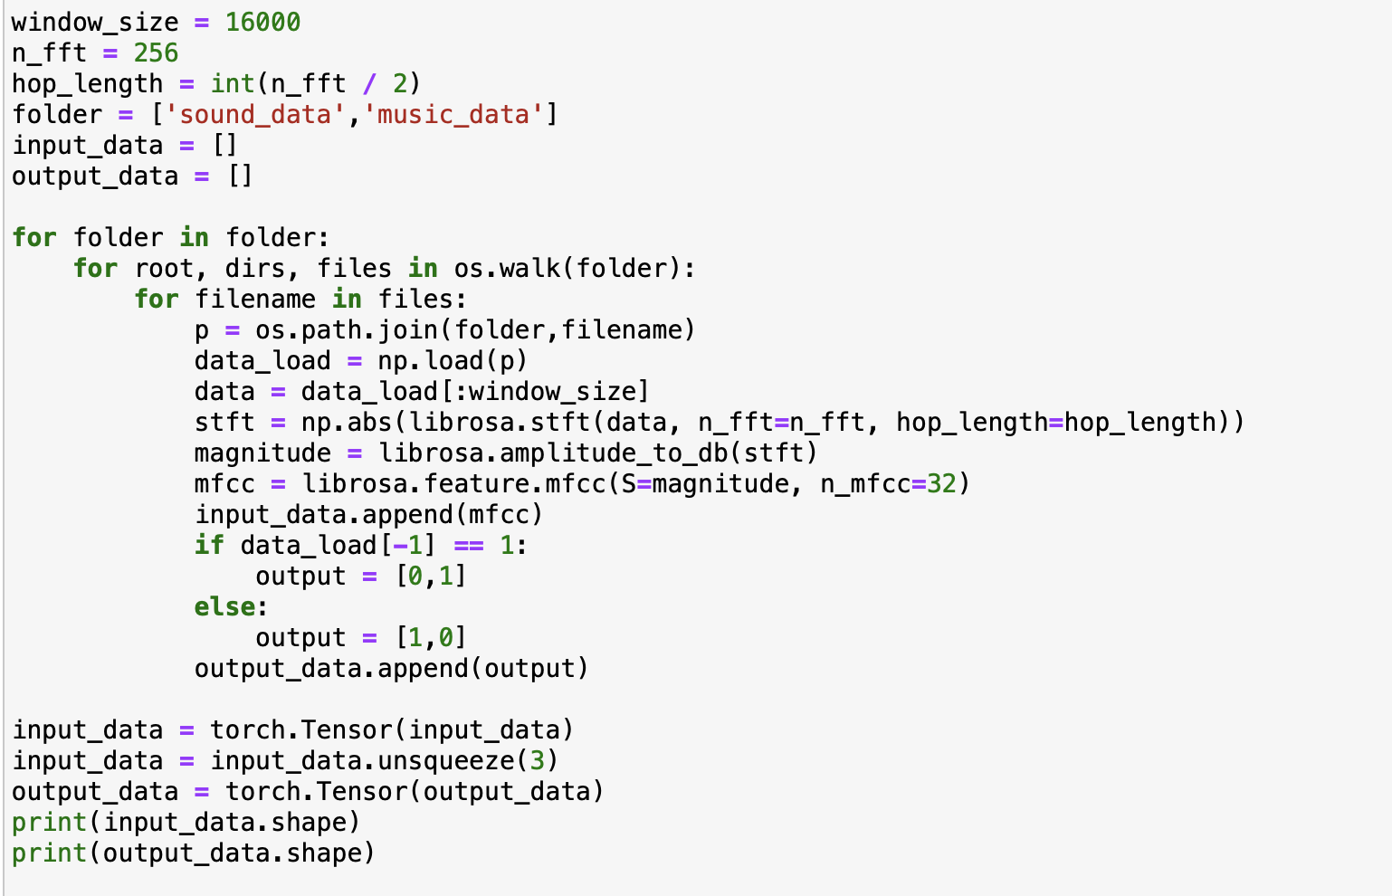
Project - Data preprocessing

Slide 17
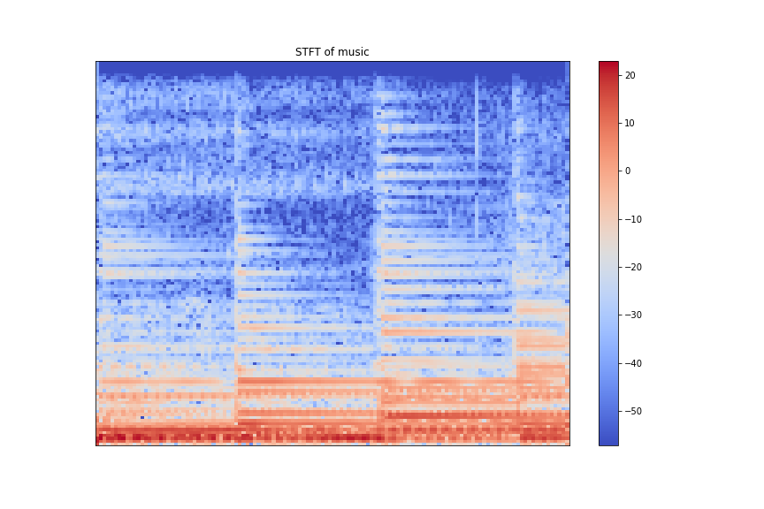
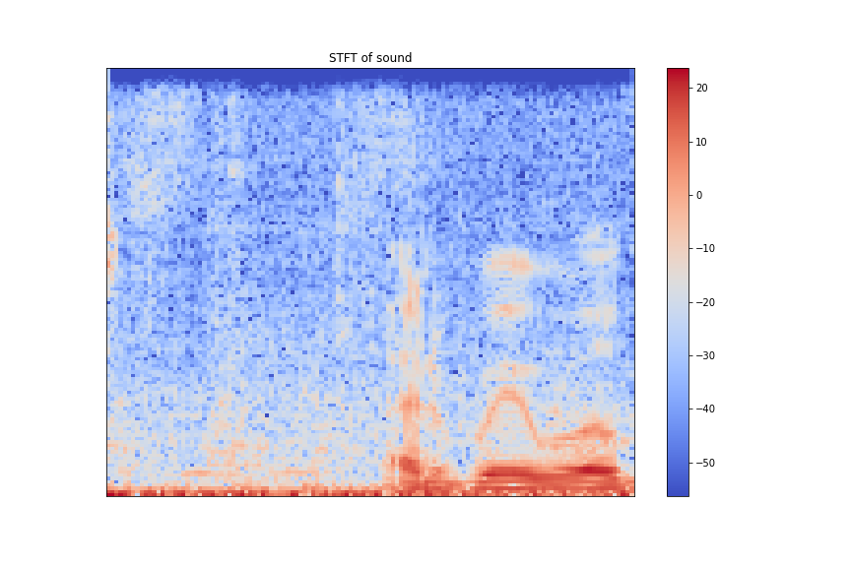
Project - Data preprocessing
STFT
n_fft = 256
Hop_length = 128
n_data = 16000
(n_fft / 2) +1
= 129
n_data / hop_length + 1
= 126
(129, 126)

Slide 18
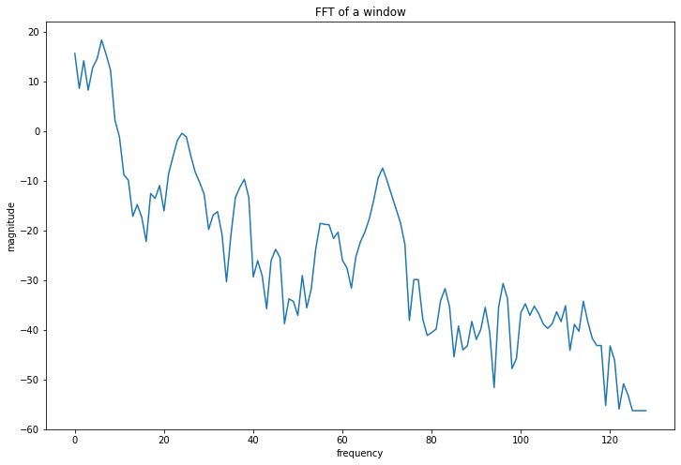
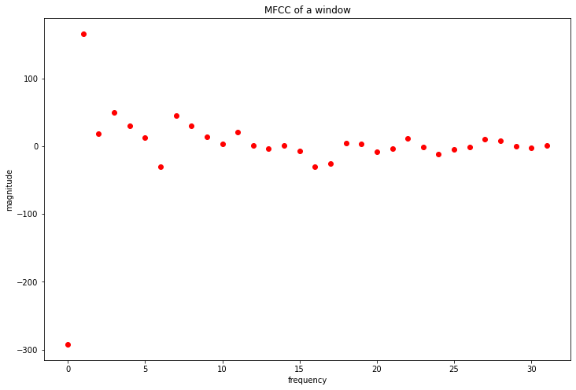
Project - Data preprocessing
MFCC (Mel-Frequency Cepstral Coefficient)

Slide 19
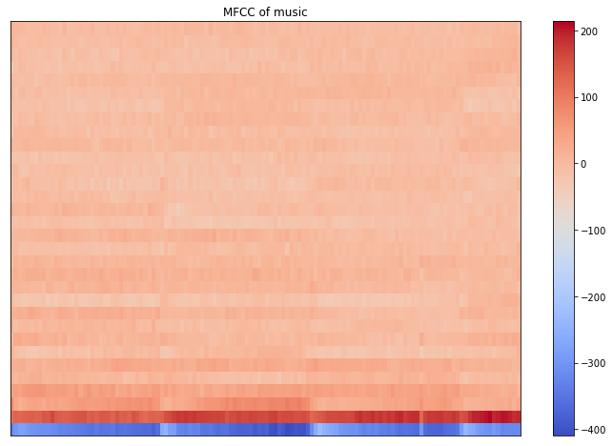
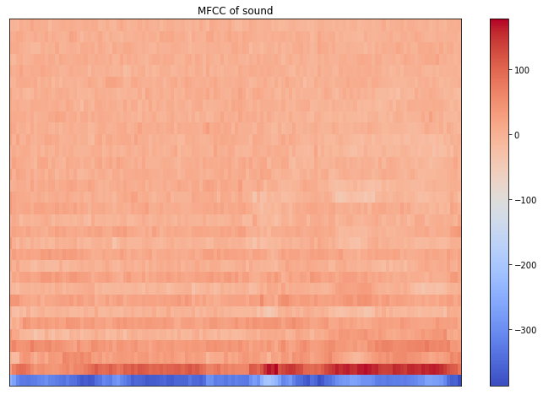
Project - Data preprocessing
MFCC (Mel-Frequency Cepstral Coefficient)
(32, 126)

Slide 20
Project - CNN
Convolution 1
(Zero Padding)
Max Pooling 1
(Stride = 1)
ReLU
Kernel
First Layer
Kernel
Second Layer
Data
(3,3,1,3)
(?, 32, 126, 1)
(1, 2, 2, 1)
(?, 16, 63, 3)
(?, 32, 126, 1)
Convolution 2
(Zero Padding)
ReLU
Max Pooling 2
(Stride = 1)
Reshape
Fifth Layer
Kernel
Third Layer
Kernel
Fourth Layer
(?, 8 *32 * 6)
(3,3,1,6)
(?, 16, 63, 6)
(1, 2, 2, 1)
(?, 8, 32, 6)

Slide 21
Project - CNN
1 | 0
0 | 1
0 | 1
0 | 1
1 | 0
0 | 1
Matrix product
*
Fifth Layer
(1536, 2)
(?, 1536)
Output Layer
(?, 2)

Slide 22
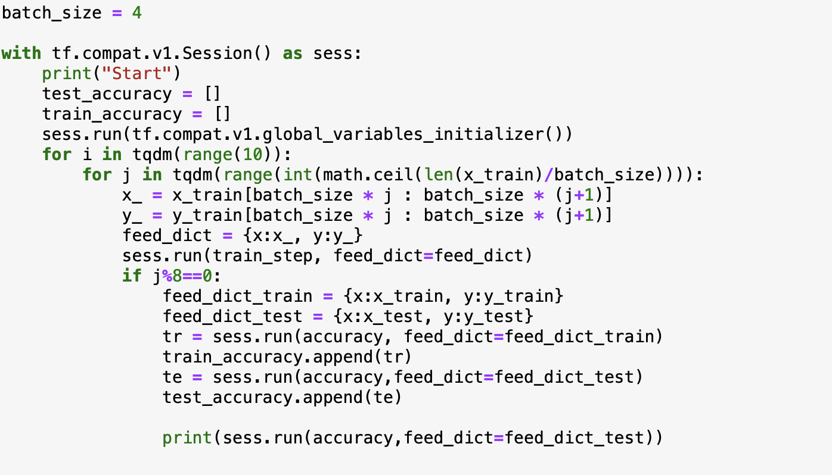
Project - CNN

Slide 23
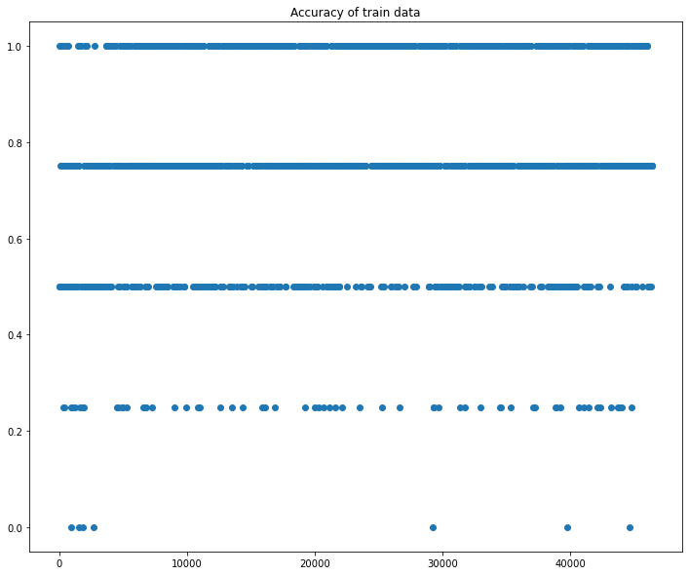
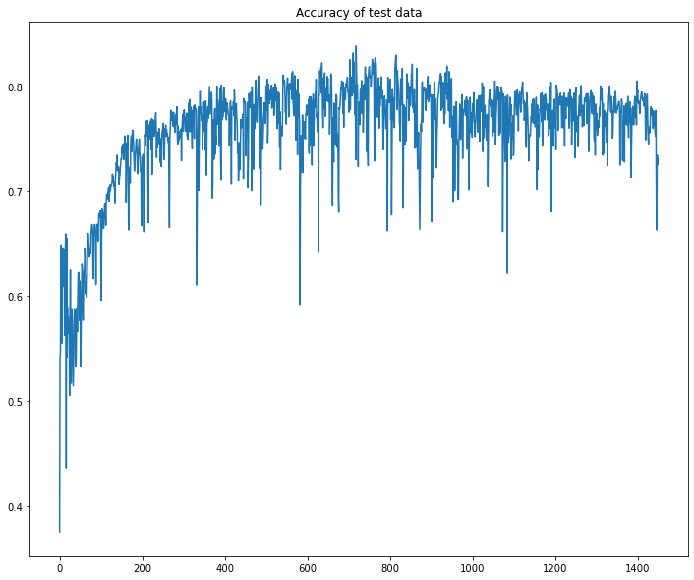
Project - CNN

