Slide 1
Griffin Lim Algorithm
Dept. of Astronomy, Space Science
Chungnam National University
Yeji Jo

Slide 2
Zero padding
Front :
window_length - (shift+1)
Back :
math.ceil(len(sig)/shift)*shift - (len(sig)-1)
255
Sig : 36843
22
Window_length : 512
Shift : 256

Slide 3
STFT
Number of Window :
144
m = 1
3
144
Sig : 37,120
0
36,608
256
512
Window Length :
512

Slide 4
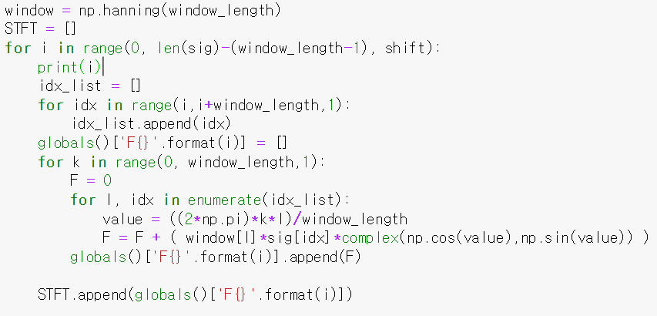
STFT
512
144

Slide 5
MSTFT
512
144
*
Mask
= complex(np.cos(10),np.sin(10))

Slide 6
MSTFT
512
144

Slide 7
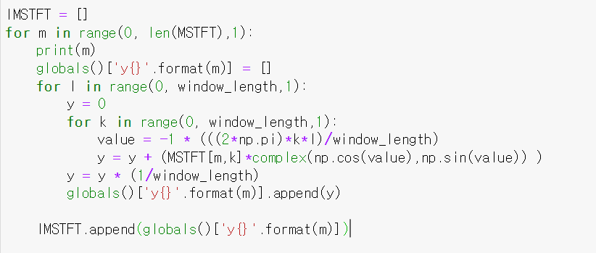
IMSTFT
512
144

Slide 8
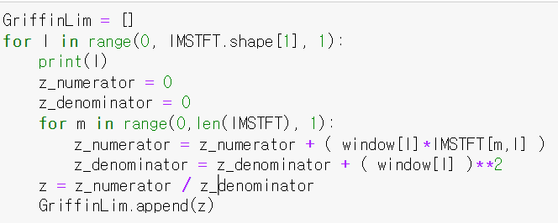
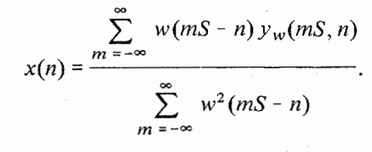
Griffin – Lim Algorithm
IMSTFT
512 ?

