Slide 1
Griffin Lim Algorithm
Dept. of Astronomy, Space Science
Chungnam National University
Yeji Jo

Slide 2
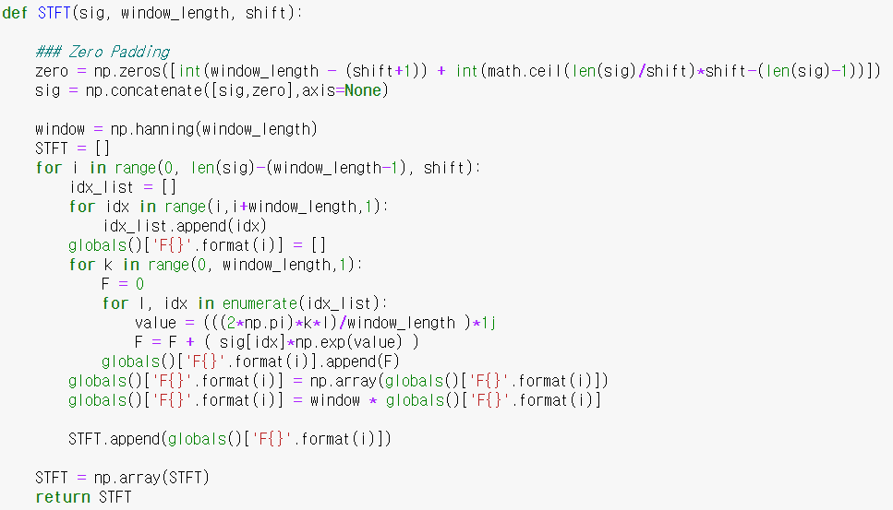
STFT
512
*
*
…
…
144

Slide 3
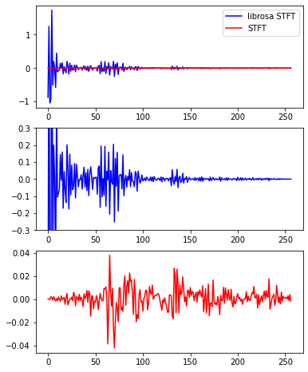
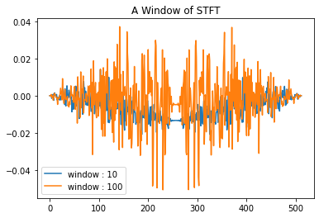
STFT

Slide 4
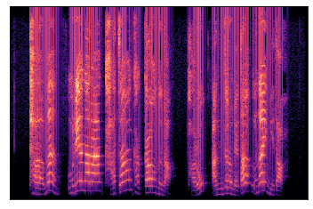
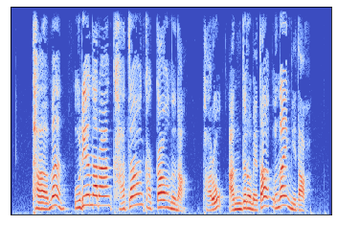
STFT
STFT Algorithm
Librosa STFT

Slide 5
MSTFT
512
144
*
Mask
= exp((2pi+7)j)

Slide 6
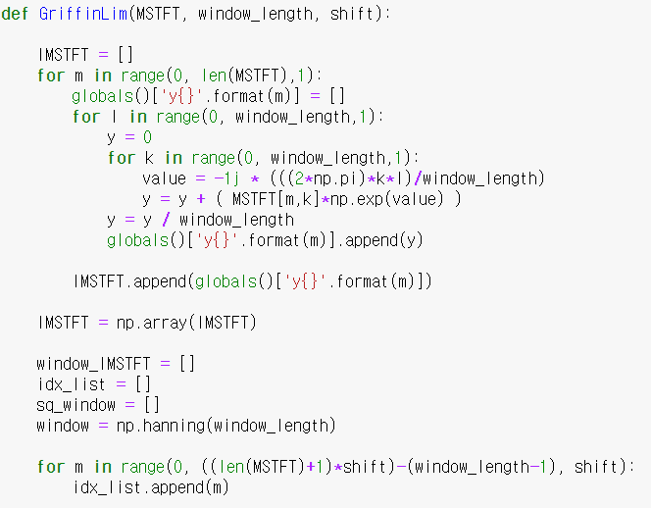
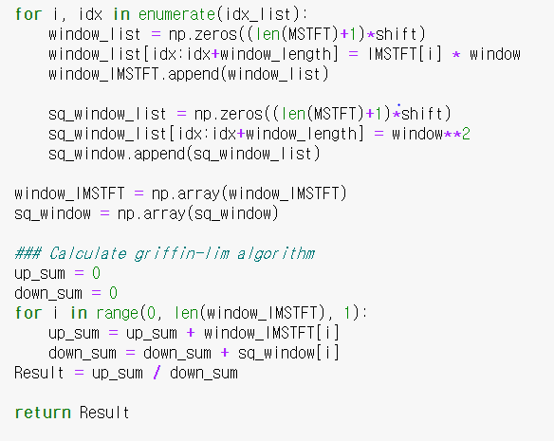
Griffin-Lim Algorithm

Slide 7
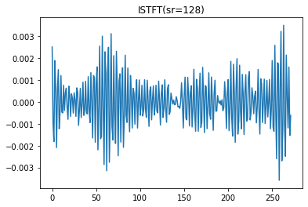
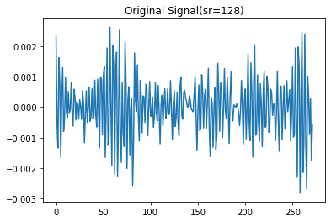
ISTFT

Slide 8
Griffin-Lim Algorithm
2
IMSTFT 1
000000000000000000
000000000000000000
+
+
2
000
IMSTFT 2
000000000000000
000
000000000000000
+
+
2
000000
IMSTFT 3
00000000000
000000
00000000000
+
+
…
…
up_sum
down_sum

Slide 9
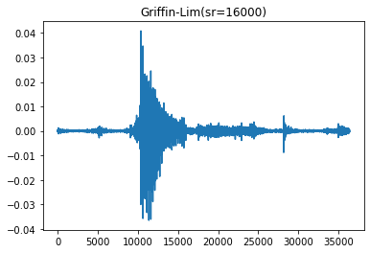
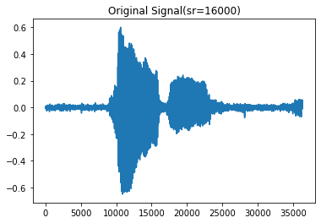
Griffin-Lim Algorithm
Test 1

Slide 10
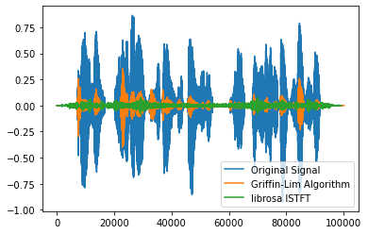
Griffin-Lim Algorithm
Librosa ISTFT doesn’t convert.
Test 2

