Slide 1
- Python 설치
https://www.sharedit.co.kr/posts/8407?fbclid=IwAR2NOSpIizw-emH4VMPeZFCidI-Nut026EFiWAgDPwVg_2LIXBmG6TOcVqU
sudo apt-get update
sudo apt-get upgrade
https://steemit.com/kr/@codingart/4-3-adafruit-dht11-3?fbclid=IwAR2BXuwqsvKGY1Jf143EAmSzNv_D6-Ctj1VI11Q9wuvayzJekd4RL2eTpco
sudo apt-get install python3-pip
sudo python3 -m pip install --upgrade pip setuptools wheel
sudo pip3 install Adafruit_DHT
git clone https://github.com/adafruit/Adafruit_Python_DHT.git
cd Adafruit_Python_DHT
sudo apt-get update
sudo apt-get install build-essential python-dev python-openssl
sudo python setup.py install

Slide 2
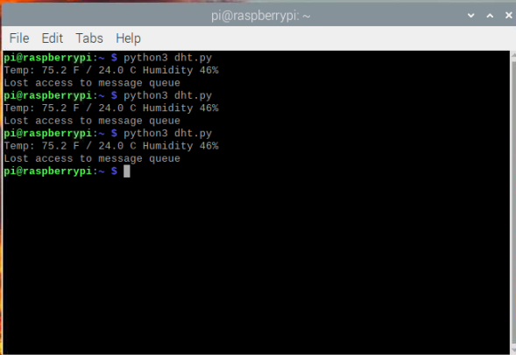
- 파일 생성 후 작동
sudo nano dht.py
-> 코드 작성
-> Ctrl+s -> ctrl+x
-> python dht.py로 실행
import time
import board
import adafruit_dht
dhtDevice = adafruit_dht.DHT11(board.D4)
t = dhtDevice.temperature
f = t * (9/5)+32
h = dhtDevice.humidity
print("Temp: {:.1f} F / {:.1f} C Humidity {}%".format(f,t,h))

Slide 3
- 2번째 예제
import datetime
import adafruit_dht
import requests
import board
dhtDevice = adafruit_dht.DHT11(board.D4)
temp = dhtDevice.temperature
hum = dhtDevice.humidity
print("Time : {0:%Y-%m-%d %H:%M:%S} Temperature = {1:0.1f}*C Humidity = {2:0.1f}%".format(datetime.datetime.now(), temp, hum))
if hum is not None and temp is not None :
params = {'dev':1, 't':temp, 'h':hum}
r = requests.get(url='http://xxx.co.kr/raspberyPI/setDevInfo.php', params=params)
print(r.status_code)

Slide 4
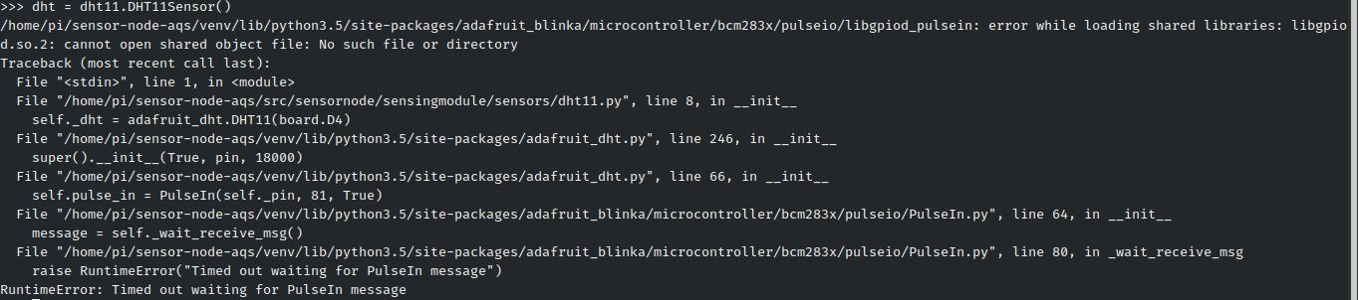
https://github.com/adafruit/Adafruit_CircuitPython_DHT/issues/28
오류 1 : py파일 작동 시 아래와 같은 오류
해결방안 : sudo apt-get install libgpiod2

Slide 5
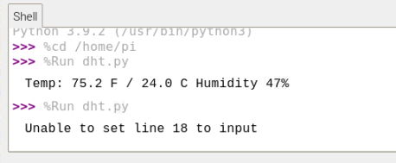
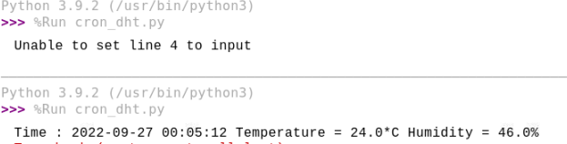
오류 2 : py파일 작동 후 재동작 시 unable 오류
해결방안 : pgrep libgpiod_pulsein -> killall libgpiod_pulsein
https://forums.adafruit.com/viewtopic.php?t=169472

Slide 6
파이썬 오류 시 참고 자료
https://bradheo.tistory.com/entry/%EB%9D%BC%EC%A6%88%EB%B2%A0%EB%A6%AC%ED%8C%8C%EC%9D%B4-%EC%98%A8%EC%8A%B5%EB%8F%84-%EC%84%BC%EC%84%9Cdht11
https://stackoverflow.com/questions/64093805/adafruit-python-dht-raspberry-pi-in-get-platform-runtimeerror-unknown-platf
https://gorakgarak.tistory.com/686
https://forums.adafruit.com/viewtopic.php?p=688382&sid=2e3352f4d9928c57fd3fdeacd07bff6b#p688382
https://m.blog.naver.com/PostView.naver?isHttpsRedirect=true&blogId=top60331&logNo=221282025014

