Slide 1
Week6
김예진

Slide 2
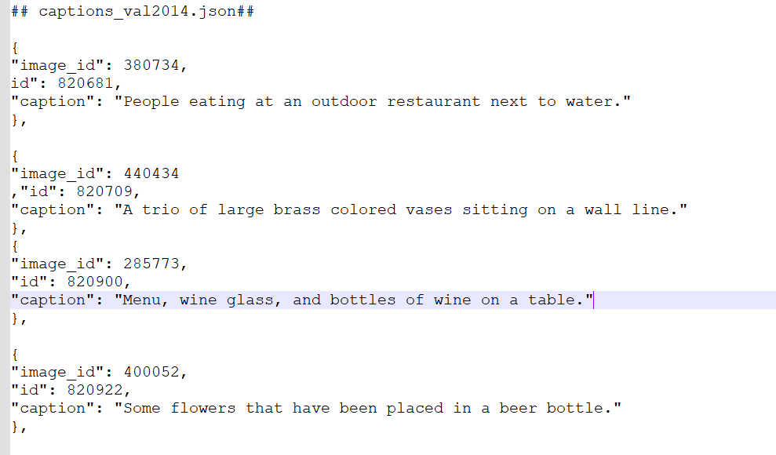
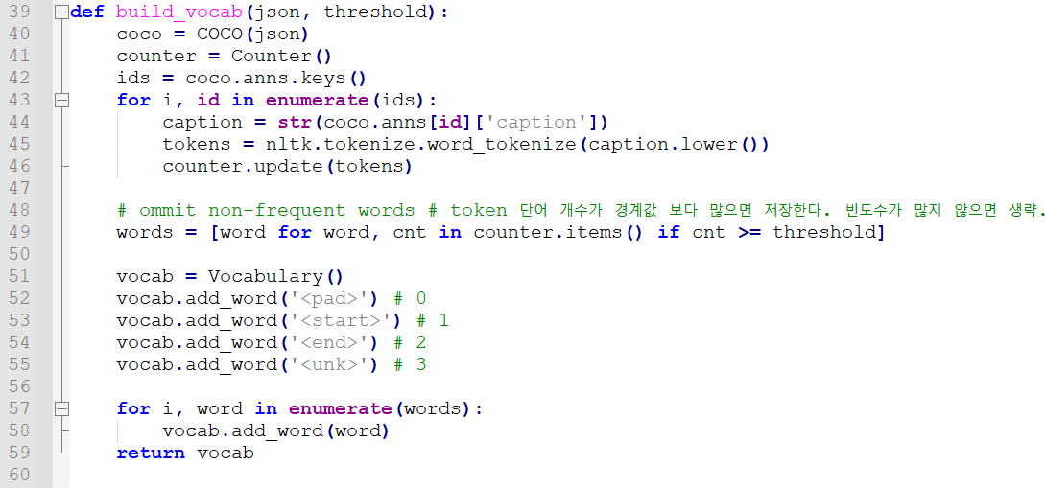
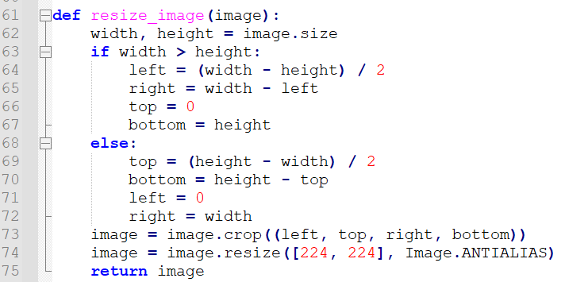
코드 분석 - processData.py
Build Vocabulary
Resize image
Notes:
https://mobicon.tistory.com/537 -> 사진 참조

Slide 3
Vocab.pkl
word2idx
ced': 8689, 'shoeless': 8690, 'carafe': 8691, 'contemplates': 8692, 'sprinkle': 8693, 't-ball': 8694, 'receipt': 8695, 'hot-dog': 8696, 'windsurfer': 8697, 'newlywed': 8698, 'windsurfing': 8699, 'sugared': 8700, 'unbaked': 8701, 'app': 8702, 'condiment': 8703, 'crusts': 8704, 'corned': 8705, 'mayonnaise': 8706, 'sideboard': 8707, 'bratwurst': 8708, 'slathered': 8709, 'partaking': 8710, 'waxing': 8711, 'grease': 8712, 'wakeboarder': 8713, 'untouched': 8714, 'parasailer': 8715, 'chocolate-covered': 8716, 'creamer': 8717, 'liquids': 8718, 'cheer': 8719, 'nerf': 8720, 'fritter': 8721, 'surfboarder': 8722, 'dribbles': 8723, 'parasails': 8724, 'martini': 8725, 'dribbling': 8726, 'soccerball': 8727, 'boad': 8728, 'sloppy': 8729, 'cresting': 8730, 'calzones': 8731, 'dunk': 8732, 'chees': 8733, 'tonight': 8734, 'cappuccino': 8735, 'oreo': 8736, 'glazing': 8737, 'poppy': 8738, 'crusty': 8739, 'windsurfers': 8740, 'kitesurfing': 8741, 'arugula': 8742, 'grandmother': 8743, 'gauze': 8744, 'tweezers': 8745, 'wrenches': 8746, 'bubbly': 8747, 'tomatoe': 8748, 'gyro': 8749, 'dougnuts': 8750, 'barbecued': 8751, 'simulator': 8752, 'slam': 8753, 'anchovies': 8754, 'reacts': 8755, 'surfboarders': 8756, 'expertly': 8757, 'para-sail': 8758, 'calories': 8759, 'windsurfs': 8760, 'para-surfing': 8761, 'mosquito': 8762, 'attempted': 8763, 'baseline': 8764, 'shelve': 8765, '1971': 8766, 'made-up': 8767, 'margherita': 8768, 'sibling': 8769, 'sparklers': 8770, 'pepperonis': 8771, 'returned': 8772, 'misshapen': 8773, 'raquet': 8774, 'mario': 8775, 'teresa': 8776, 'programming': 8777, 'daybed': 8778, 'blast': 8779, 'fiving': 8780, 'whites': 8781, 'technological': 8782, 'partners': 8783, 'prosciutto': 8784, 'jointly': 8785, 'tastefully': 8786, 'bodyboarding': 8787, 'bassinet': 8788, 'supreme': 8789, 'grimacing': 8790, 'swaddled': 8791, 'approval': 8792, 'ipads': 8793, 'rackett': 8794, 'clams': 8795, 'lapt': 8796, 'mantel': 8797, 'motes': 8798, 'peripheral': 8799, 'textbook': 8800, 'mote': 8801, 'wiimote': 8802, 'boxing': 8803, 'wii-mote': 8804, 'nunchuck': 8805, 'playstation': 8806, 'valentines': 8807, 'curio': 8808, 'thames': 8809, 'interactive': 8810, 'ergonomic': 8811, 'bristles': 8812, 'cordless': 8813, 'colgate': 8814, 'pendulum': 8815, 'alien': 8816, 'videogame': 8817, 'nokia': 8818, 'wi': 8819, 'icons': 8820, 'answering': 8821, 'workings': 8822, 'combs': 8823, 'coo': 8824, 'calculators': 8825, 'ottomans': 8826, 'floss': 8827, 'clipboard': 8828, 'talkie': 8829, 'mini-fridge': 8830, 'motorola': 8831, 'refrigeration': 8832, 'graduate': 8833, 'charms': 8834, 'daisy': 8835, 'application': 8836, 'sleeved': 8837, 'vein': 8838, 'carnation': 8839, 'mixers': 8840, 'dial': 8841, 'spools': 8842, 'wilting': 8843, 'cutters': 8844, 'pinking': 8845, 'rulers': 8846, 'puncher': 8847, 'bouquets': 8848, 'seniors': 8849, 'dandelion': 8850, 'coupons': 8851, 'cheerleader': 8852}
idx2word
8757: 'expertly', 8758: 'para-sail', 8759: 'calories', 8760: 'windsurfs', 8761: 'para-surfing', 8762: 'mosquito', 8763: 'attempted', 8764: 'baseline', 8765: 'shelve', 8766: '1971', 8767: 'made-up', 8768: 'margherita', 8769: 'sibling', 8770: 'sparklers', 8771: 'pepperonis', 8772: 'returned', 8773: 'misshapen', 8774: 'raquet', 8775: 'mario', 8776: 'teresa', 8777: 'programming', 8778: 'daybed', 8779: 'blast', 8780: 'fiving', 8781: 'whites', 8782: 'technological', 8783: 'partners', 8784: 'prosciutto', 8785: 'jointly', 8786: 'tastefully', 8787: 'bodyboarding', 8788: 'bassinet', 8789: 'supreme', 8790: 'grimacing', 8791: 'swaddled', 8792: 'approval', 8793: 'ipads', 8794: 'rackett', 8795: 'clams', 8796: 'lapt', 8797: 'mantel', 8798: 'motes', 8799: 'peripheral', 8800: 'textbook', 8801: 'mote', 8802: 'wiimote', 8803: 'boxing', 8804: 'wii-mote', 8805: 'nunchuck', 8806: 'playstation', 8807: 'valentines', 8808: 'curio', 8809: 'thames', 8810: 'interactive', 8811: 'ergonomic', 8812: 'bristles', 8813: 'cordless', 8814: 'colgate', 8815: 'pendulum', 8816: 'alien', 8817: 'videogame',
8818: 'nokia', 8819: 'wi', 8820: 'icons', 8821: 'answering', 8822: 'workings', 8823: 'combs', 8824: 'coo', 8825: 'calculators', 8826: 'ottomans', 8827: 'floss', 8828: 'clipboard', 8829: 'talkie', 8830: 'mini-fridge', 8831: 'motorola', 8832: 'refrigeration', 8833: 'graduate', 8834: 'charms', 8835: 'daisy', 8836: 'application', 8837: 'sleeved', 8838: 'vein', 8839: 'carnation', 8840: 'mixers', 8841: 'dial', 8842: 'spools', 8843: 'wilting', 8844: 'cutters', 8845: 'pinking', 8846: 'rulers', 8847: 'puncher', 8848: 'bouquets', 8849: 'seniors', 8850: 'dandelion', 8851: 'coupons', 8852: 'cheerleader’}
idx
8853
Notes:
https://wikidocs.net/31695 -> blue 설명

Slide 4
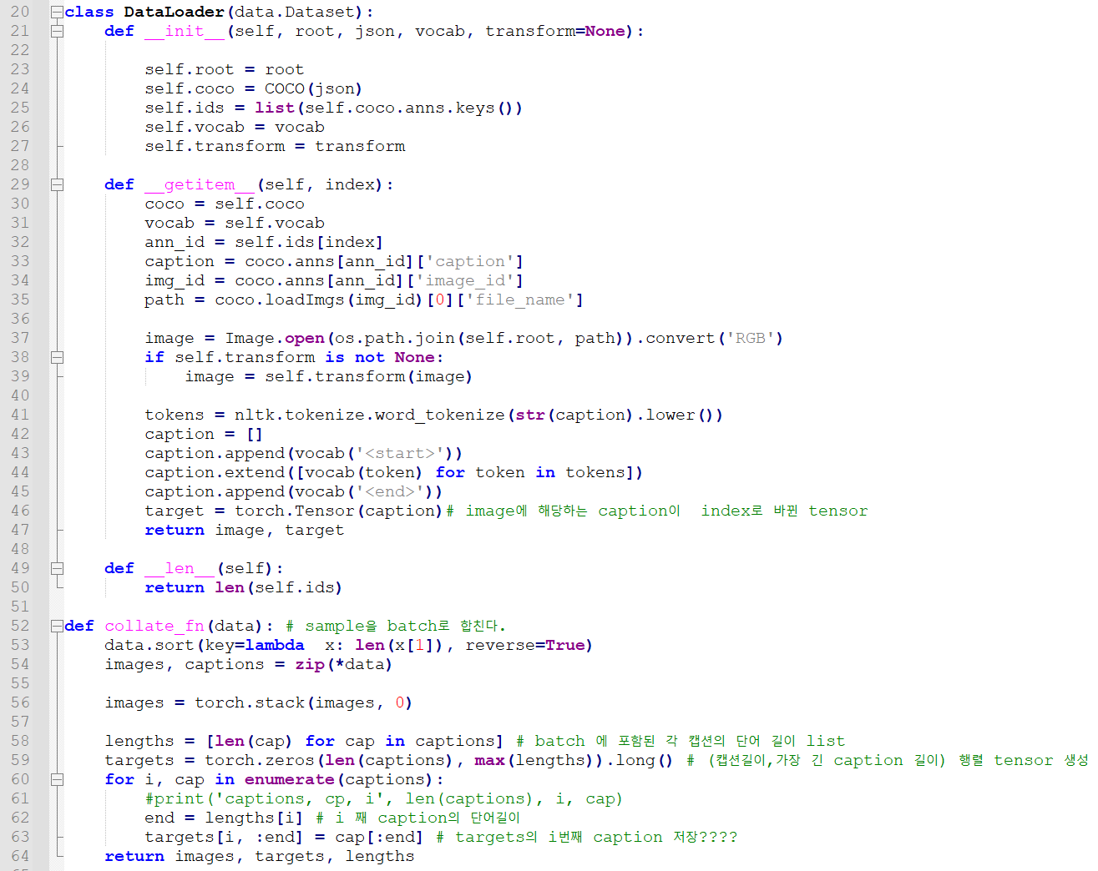
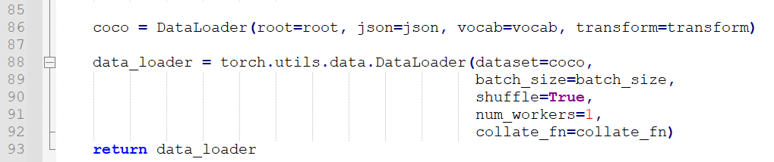
코드 분석 – DataLoader.py
이미지와 이미지에 해당하는 caption을 caption 단어를 vocabulary 를 사용하여 단어에 해당하는 index로 변환.
Sample을 Batch 단위로 합친다.
Lengths = batch단위로 묶인 caption들의 길이 list
caption0
Caption(batch_size=32)
max(caption lengths)
<Targets>

Slide 5
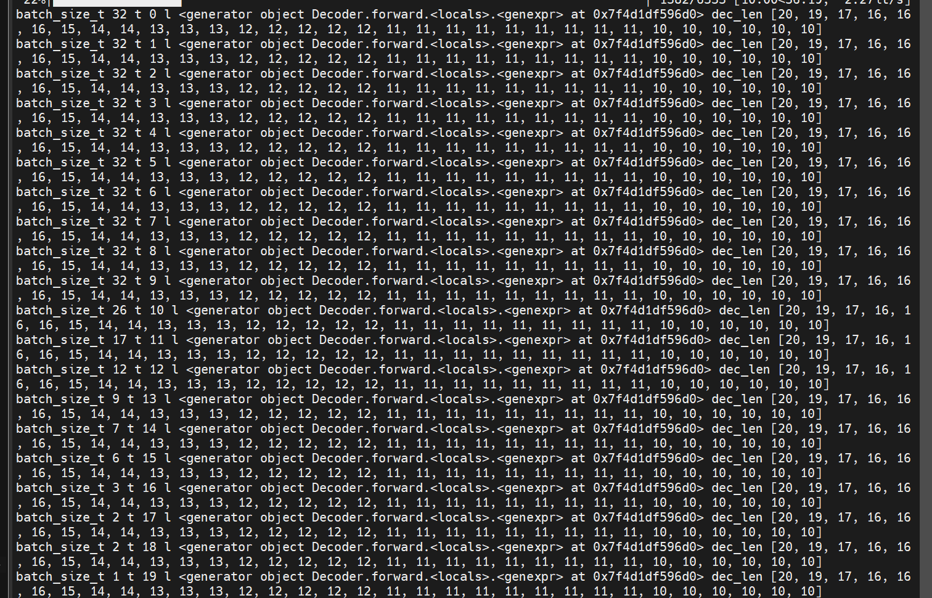
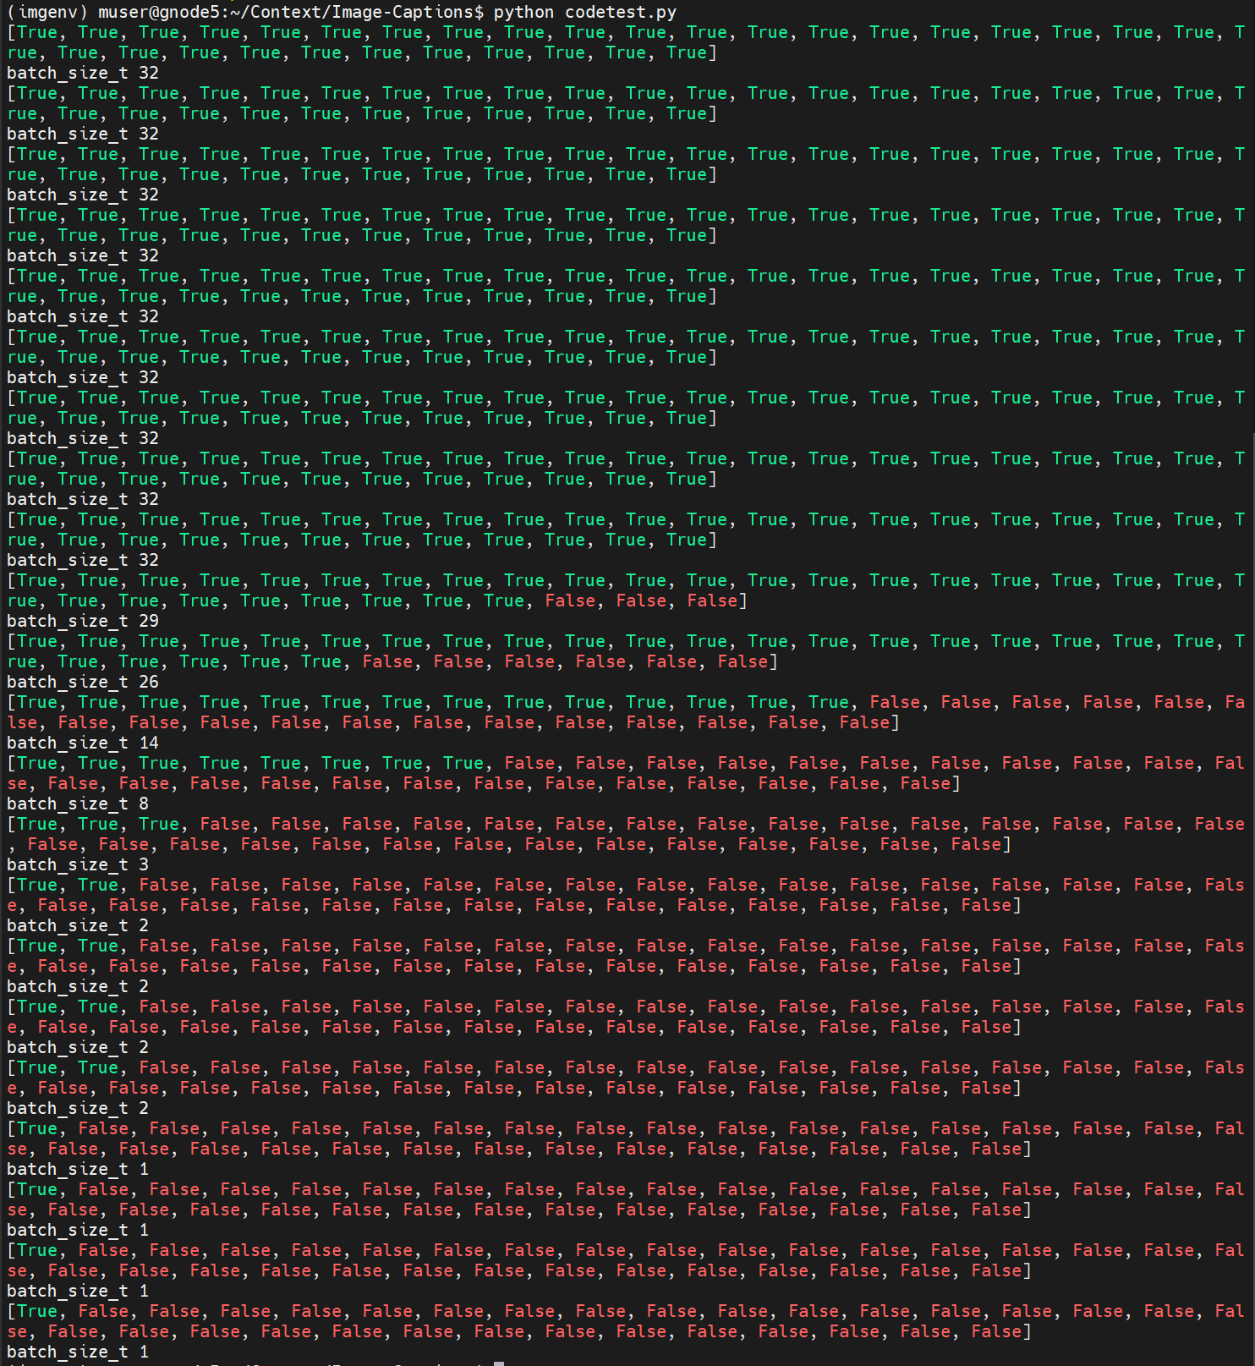
코드 분석
dec_len = [22, 18, 14, 13, 13, 13, 13, 13, 12, 12, 12, 12, 12, 12, 11, 11, 11, 11, 11, 11, 11, 11, 11, 11, 11, 11, 10, 10, 10, 9, 9, 9] ( batch 한 개)
Dec_len : batch안에 있는 caption들의 길이 list
Batch_size_t : ->captions
Notes:
https://mobicon.tistory.com/537 -> 사진 참조

Slide 6
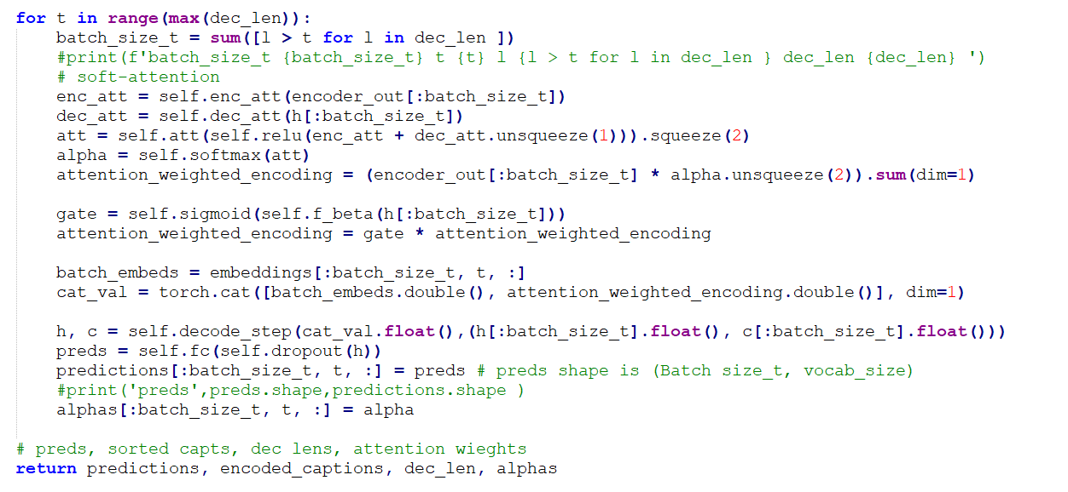
코드 분석 – Main.py

Slide 7
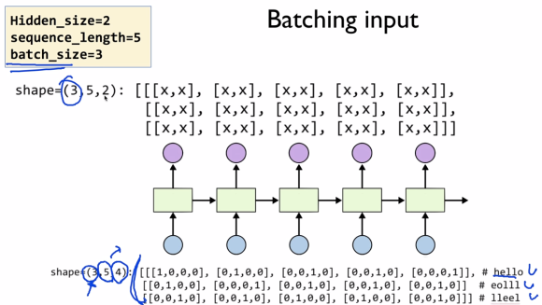
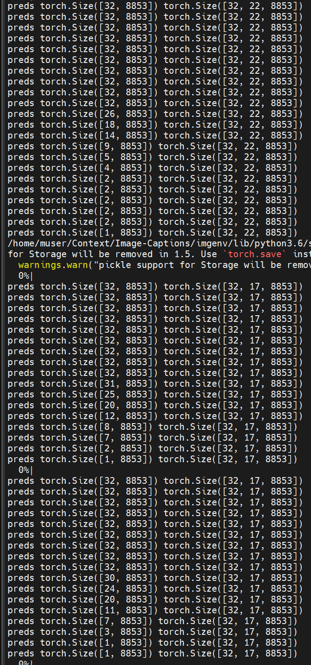
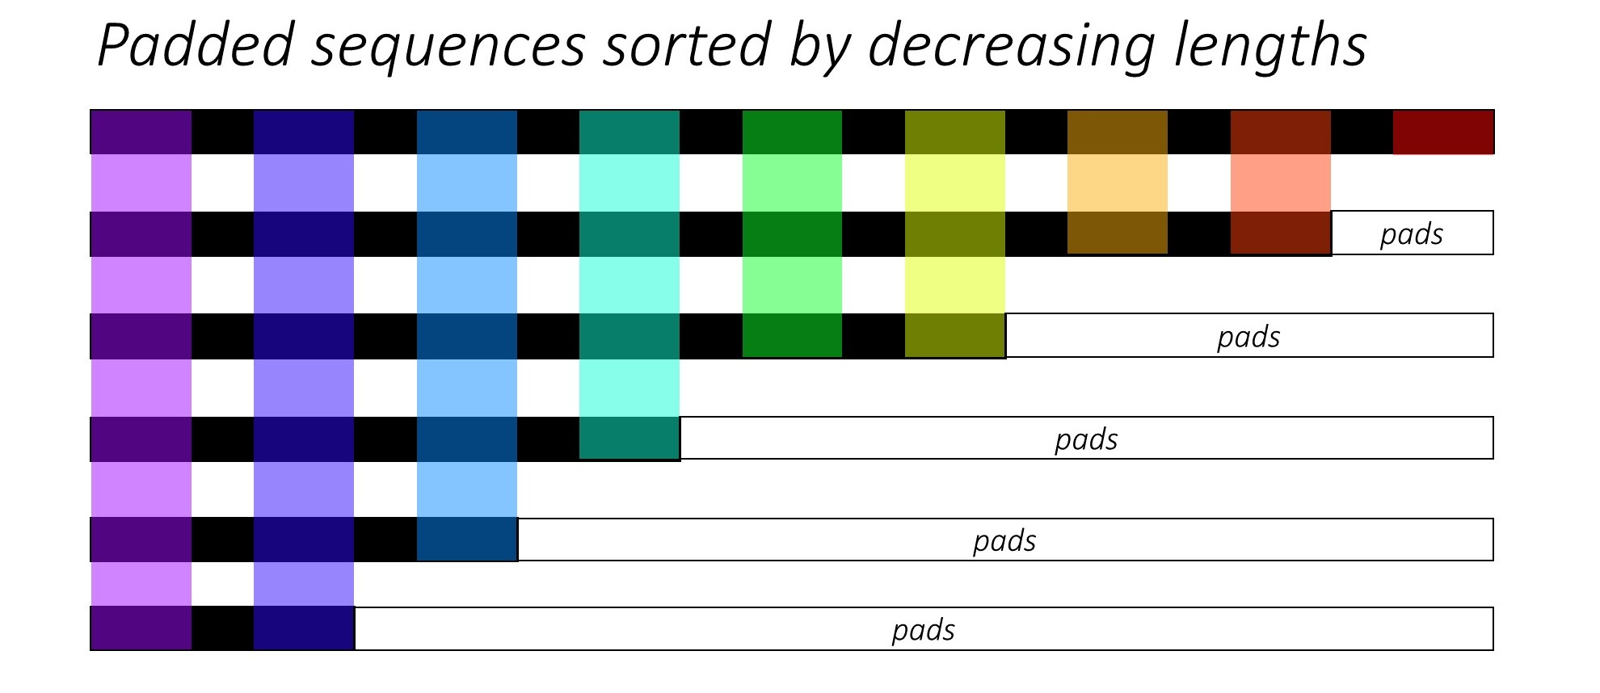
코드 분석
Shape( batch_size, caption len, vocab_size)
Preds / Prediction
Word embedding size=512
Shape( batch_size, caption
len,word embedding size)
Batch size
caplen

Slide 8
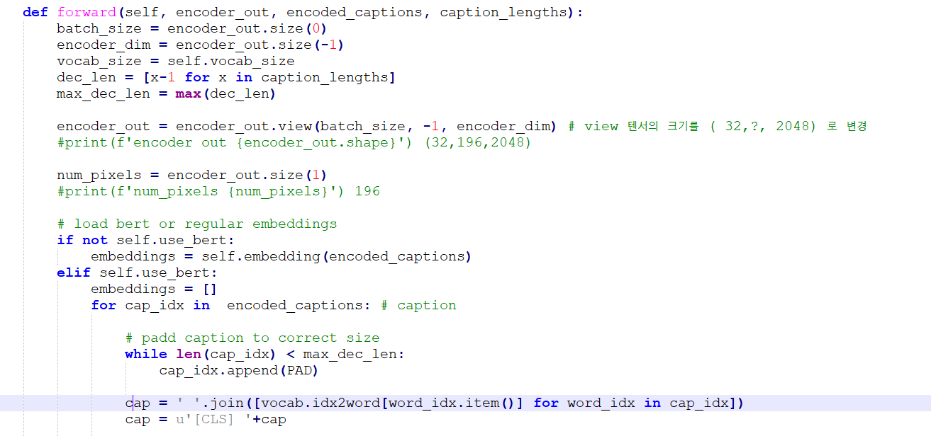
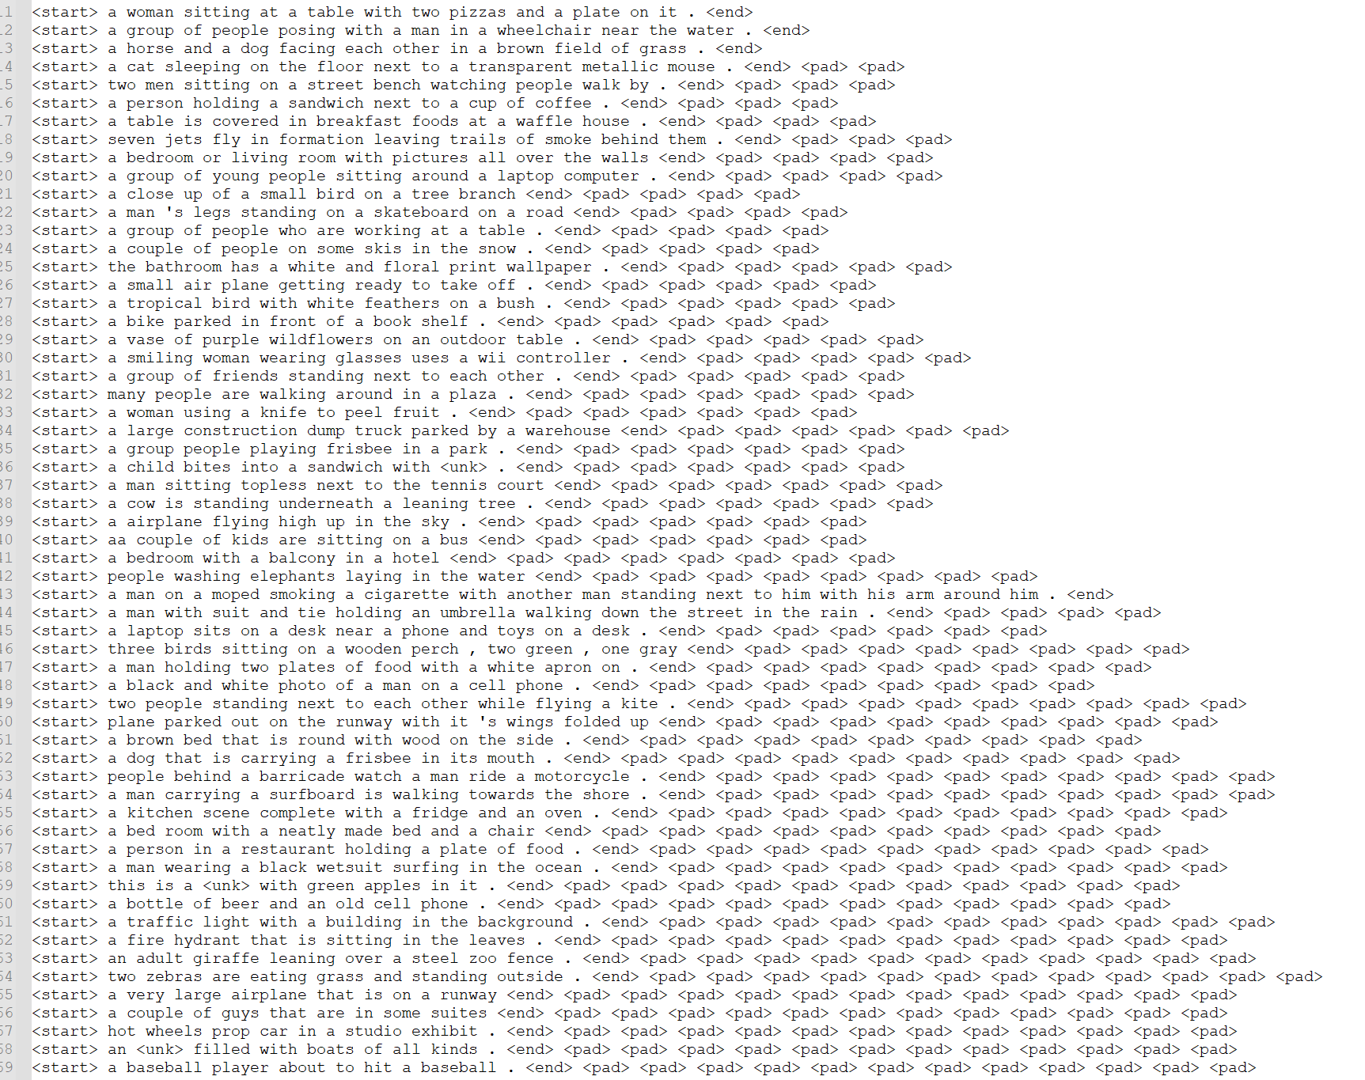
코드 분석
Bert embedding 하기 위해
1. Encoded caption -> word 로 변환.
최대 길이에 맞춰 padding

Slide 9
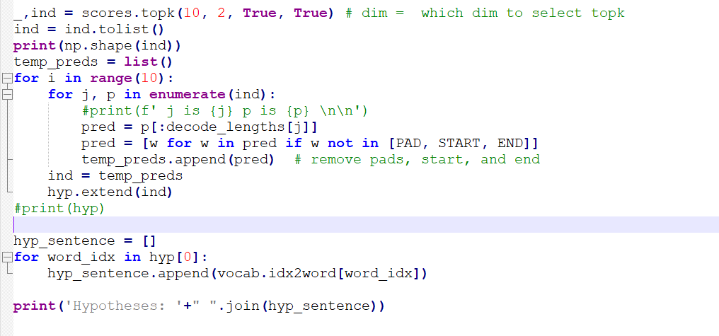
코드 분석
j is 32 p is [[146, 33, 251, 2860, 4, 3848, 47, 1666, 1663, 3],
[131, 53, 409, 106, 31, 40, 7, 65, 1412, 111],
[4, 48, 33, 30, 31, 212, 111, 146, 373, 106],
[30, 31, 34, 210, 3016, 115, 793, 36, 1256, 857],
[31, 115, 30, 7, 857, 1003, 87, 34, 2876, 936],
[7, 87, 65, 31, 938, 19, 785, 115, 30, 40],
[30, 7, 34, 31, 3384, 65, 115, 131, 3, 3016],
[30, 34, 31, 115, 65, 36, 61, 373, 770, 229],
[65, 31, 862, 192, 30, 409, 857, 120, 1038, 115],
[65, 1038, 862, 507, 131, 40, 2358, 1665, 112, 409],
[131, 65, 715, 106, 409, 1412, 3384, 53, 327, 1038],
[40, 78, 146, 131, 365, 65, 112, 53, 16, 1412],
[146, 33, 4, 111, 48, 47, 36, 648, 40, 242],
[34, 229, 4715, 6639, 7, 3828, 1123, 1296, 2715, 3945]]
j is 29 p is
[[251, 33, 252, 146, 52, 4, 3848, 194, 2860, 51],
[53, 131, 52, 106, 282, 970, 1412, 94, 1256, 280],
[52, 54, 280, 1352, 1633, 94, 1383, 4, 292, 1042],
[54, 40, 78, 52, 94, 7, 53, 171, 140, 105],
[78, 40, 54, 55, 185, 112, 193, 94, 33, 418],
[33, 4, 78, 146, 34, 40, 103, 48, 161, 47],
[34, 41, 2715, 230, 229, 186, 210, 705, 768, 827],
[2, 19, 40, 3, 78, 7, 34, 112, 805, 14],
[7, 6, 4, 5, 1, 0, 2, 3, 8, 9]]
j is 28 p is
[[4, 146, 33, 252, 251, 48, 3, 3848, 2479, 111],
[4244, 21, 2716, 1846, 1393, 3575, 61, 2723, 110, 195],
[131, 629, 4244, 352, 327, 322, 4490, 757, 4796, 1529],
[131, 2530, 322, 629, 327, 4244, 611, 4490, 352, 40],
[40, 249, 322, 611, 277, 627, 295, 288, 2530, 59],
[40, 249, 288, 78, 461, 4, 35, 627, 399, 59],
[4, 33, 40, 48, 258, 702, 2135, 2430, 288, 146],
[113, 64, 1453, 1402, 199, 820, 133, 29, 1040, 63],
[2, 113, 762, 490, 258, 19, 1402, 59, 847, 3],
[7, 6, 4, 5, 1, 0, 2, 3, 8, 9]]
(32, 17) torch.Size([32, 17, 8853])
J번 째 captio에서 나온 각 t시점에서 나온
Vocab size 크기의 prediction score top10 추출 ?

Slide 10
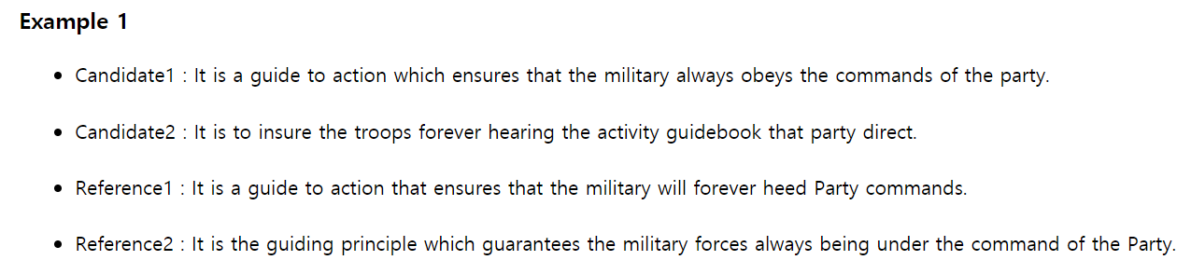
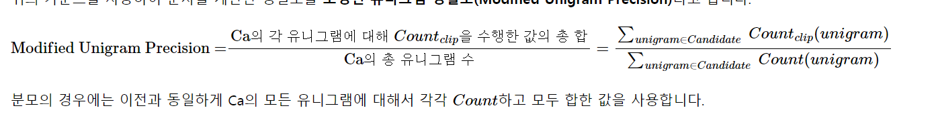

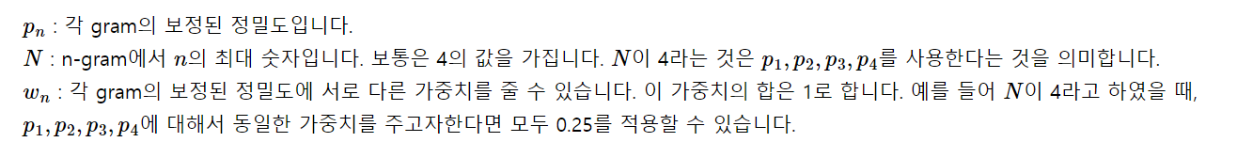
Metrics - BLEU
여기서는 나머지 gram의 weight는 0이어서 sigma계산 없는 것과 같음.
편의상 Candidate를 Ca로, Reference를 Ref로 축약하여 부르겠습니다.
이제 Ca 1, 2를 Ref 1, 2, 3과 비교하여 성능을 측정하고자 합니다.
가장 직관적인 성능 평가 방법은 Ref 1, 2, 3 중 어느 한 문장이라도 등장한 단어의 개수를 Ca에서 세는 것입니다. 그리고 그 후에 Ca의 모든 단어의 카운트의 합. 즉, Ca에서의 총 단어의 수으로 나눠줍니다.
이러한 측정 방법을 유니그램 정밀도(Unigram Precision)라고 합니다. 이를 식으로 표현하면 다음과 같습니다.
Notes:
https://wikidocs.net/31695 -> blue 설명

Slide 11
Metrics - BLEU
Ca 1, 2를 Ref 1, 2, 3과 비교하여 성능을 측정하고자 합니다.
가장 직관적인 성능 평가 방법은 Ref 1, 2, 3 중 어느 한 문장이라도 등장한 단어의 개수를 Ca에서 세는 것입니다. 그리고 그 후에 Ca의 모든 단어의 카운트의 합. 즉, Ca에서의 총 단어의 수으로 나눠줍니다.
이러한 측정 방법을 유니그램 정밀도(Unigram Precision)라고 합니다. 이를 식으로 표현하면 다음과 같습니다.
Notes:
https://wikidocs.net/31695 -> blue 설명

Slide 12
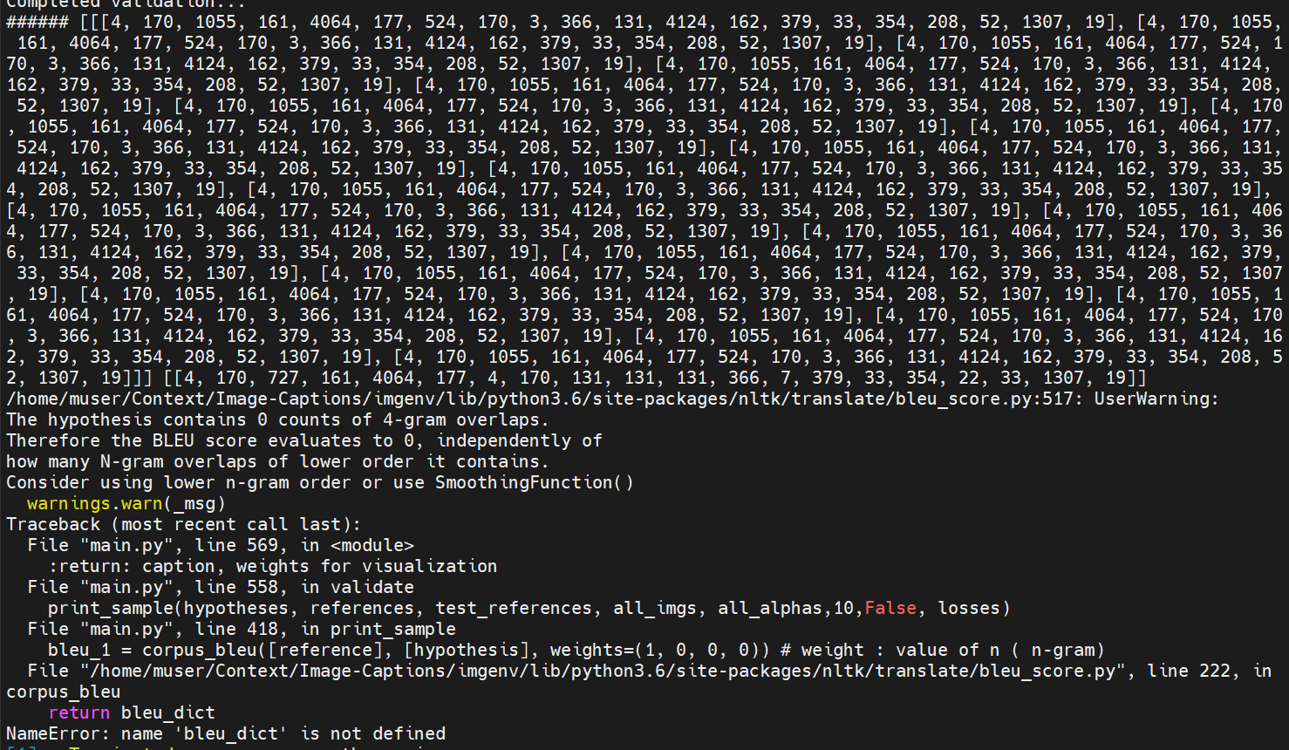
###### [[
[4, 170, 1055, 161, 4064, 177, 524, 170, 3, 366, 131, 4124, 162, 379, 33, 354, 208, 52, 1307, 19],
[4, 170, 1055, 161, 4064, 177, 524, 170, 3, 366, 131, 4124, 162, 379, 33, 354, 208, 52, 1307, 19],
[4, 170, 1055, 161, 4064, 177, 524, 170, 3, 366, 131, 4124, 162, 379, 33, 354, 208, 52, 1307, 19],
[4, 170, 1055, 161, 4064, 177, 524, 170, 3, 366, 131, 4124, 162, 379, 33, 354, 208, 52, 1307, 19],
[4, 170, 1055, 161, 4064, 177, 524, 170, 3, 366, 131, 4124, 162, 379, 33, 354, 208, 52, 1307, 19],
[4, 170, 1055, 161, 4064, 177, 524, 170, 3, 366, 131, 4124, 162, 379, 33, 354, 208, 52, 1307, 19],
[4, 170, 1055, 161, 4064, 177, 524, 170, 3, 366, 131, 4124, 162, 379, 33, 354, 208, 52, 1307, 19],
[4, 170, 1055, 161, 4064, 177, 524, 170, 3, 366, 131, 4124, 162, 379, 33, 354, 208, 52, 1307, 19],
[4, 170, 1055, 161, 4064, 177, 524, 170, 3, 366, 131, 4124, 162, 379, 33, 354, 208, 52, 1307, 19],
[4, 170, 1055, 161, 4064, 177, 524, 170, 3, 366, 131, 4124, 162, 379, 33, 354, 208, 52, 1307, 19],
[4, 170, 1055, 161, 4064, 177, 524, 170, 3, 366, 131, 4124, 162, 379, 33, 354, 208, 52, 1307, 19],
[4, 170, 1055, 161, 4064, 177, 524, 170, 3, 366, 131, 4124, 162, 379, 33, 354, 208, 52, 1307, 19],
[4, 170, 1055, 161, 4064, 177, 524, 170, 3, 366, 131, 4124, 162, 379, 33, 354, 208, 52, 1307, 19],
[4, 170, 1055, 161, 4064, 177, 524, 170, 3, 366, 131, 4124, 162, 379, 33, 354, 208, 52, 1307, 19],
[4, 170, 1055, 161, 4064, 177, 524, 170, 3, 366, 131, 4124, 162, 379, 33, 354, 208, 52, 1307, 19],
[4, 170, 1055, 161, 4064, 177, 524, 170, 3, 366, 131, 4124, 162, 379, 33, 354, 208, 52, 1307, 19],
[4, 170, 1055, 161, 4064, 177, 524, 170, 3, 366, 131, 4124, 162, 379, 33, 354, 208, 52, 1307, 19],
[4, 170, 1055, 161, 4064, 177, 524, 170, 3, 366, 131, 4124, 162, 379, 33, 354, 208, 52, 1307, 19],
[4, 170, 1055, 161, 4064, 177, 524, 170, 3, 366, 131, 4124, 162, 379, 33, 354, 208, 52, 1307, 19],
[4, 170, 1055, 161, 4064, 177, 524, 170, 3, 366, 131, 4124, 162, 379, 33, 354, 208, 52, 1307, 19],
[4, 170, 1055, 161, 4064, 177, 524, 170, 3, 366, 131, 4124, 162, 379, 33, 354, 208, 52, 1307, 19]
]]
[[4, 170, 727, 161, 4064, 177, 4, 170, 131, 131, 131, 366, 7, 379, 33, 354, 22, 33, 1307, 19]]

Slide 13
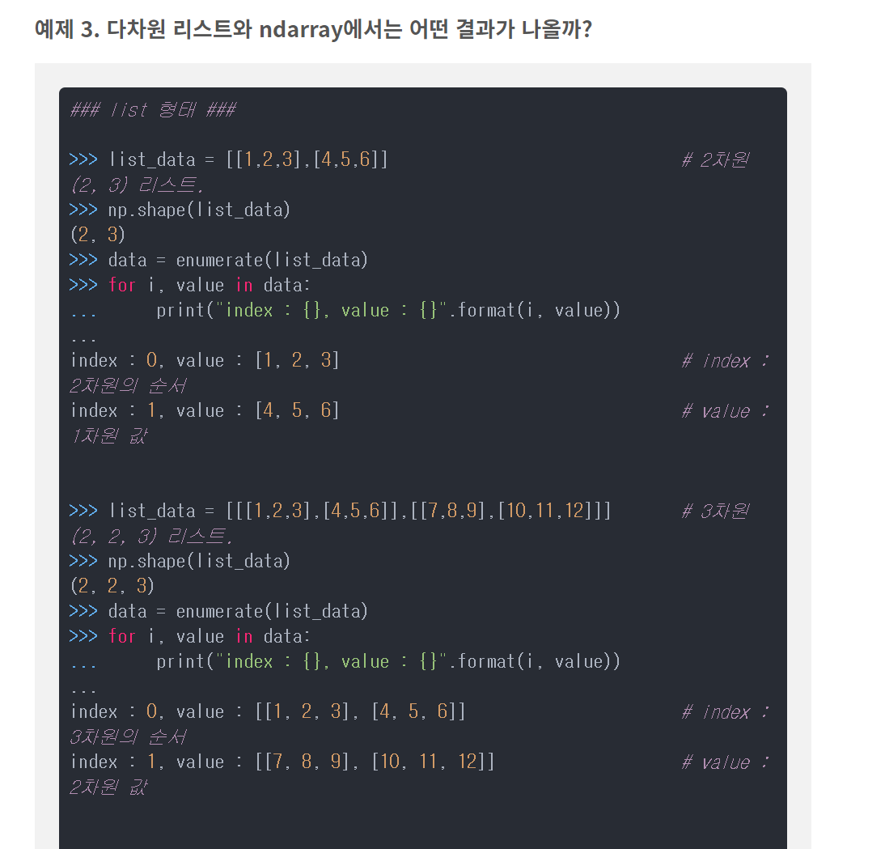
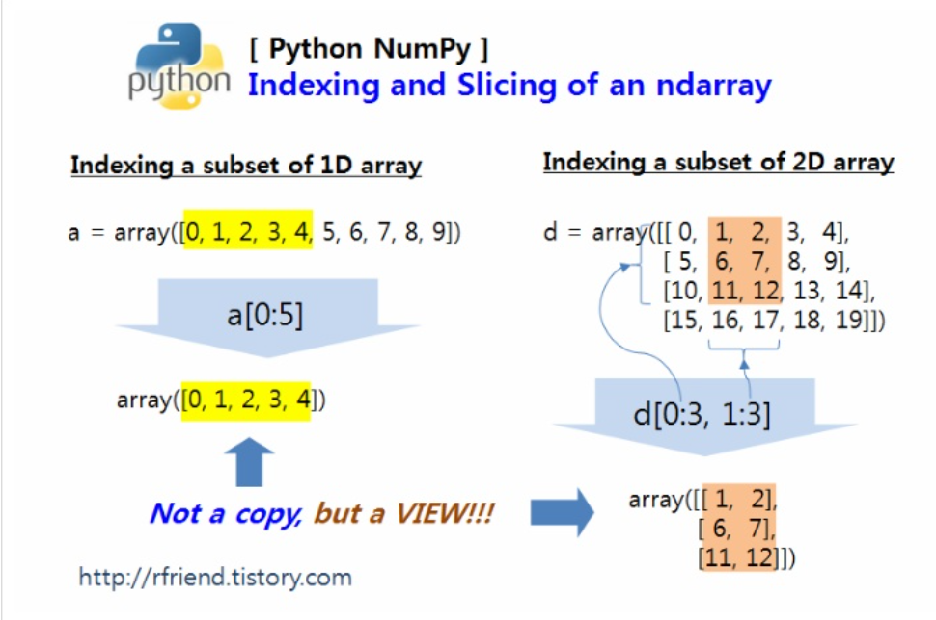

Slide 14
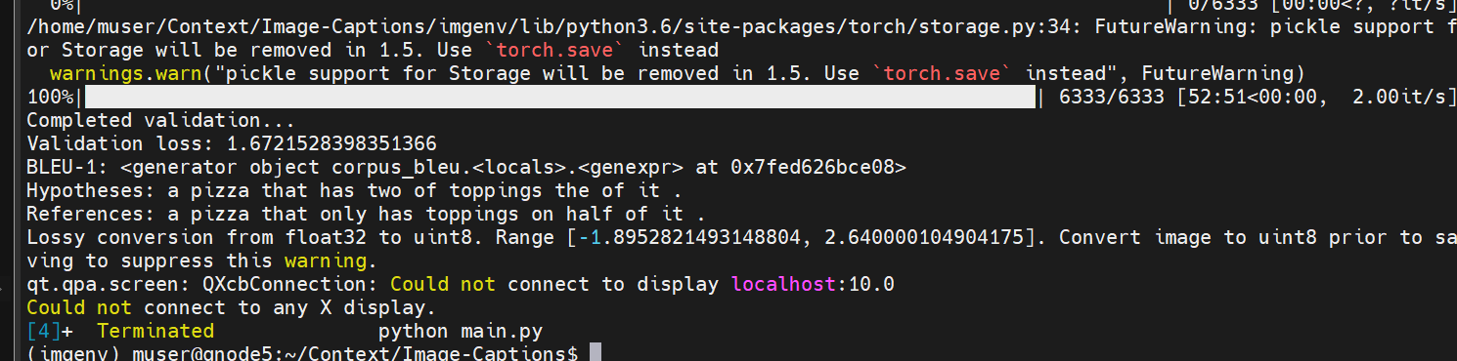

Slide 15
ref m hypo
[[4, 583, 323, 408, 7, 252, 3, 3293],
[4, 583, 323, 408, 7, 252, 3, 3293],
[4, 583, 323, 408, 7, 252, 3, 3293],
[4, 583, 323, 408, 7, 252, 3, 3293],
[4, 583, 323, 408, 7, 252, 3, 3293],
[4, 583, 323, 408, 7, 252, 3, 3293],
[4, 583, 323, 408, 7, 252, 3, 3293],
[4, 583, 323, 408, 7, 252, 3, 3293],
[4, 583, 323, 408, 7, 252, 3, 3293],
[4, 583, 323, 408,7, 252, 3, 3293],
[4, 583, 323, 408, 7, 252, 3, 3293],
[4, 583, 323, 408, 7, 252, 3, 3293],
[4, 583, 323, 408, 7, 252, 3,3293],
[4, 583, 323, 408, 7, 252, 3, 3293],
[4, 583, 323, 408, 7, 252, 3, 3293]]
[4, 323, 323, 408, 7, 252, 3]
######
[[[4, 583, 323, 408, 7, 252, 3, 3293], [4, 583, 323, 408, 7, 252, 3, 3293], [4, 583, 323, 408, 7, 252, 3, 3293], [4, 583, 323, 408, 7, 252, 3, 3293], [4, 583, 323, 408, 7, 252, 3, 3293], [4, 583, 323, 408, 7, 252, 3, 3293], [4, 583, 323, 408, 7, 252, 3, 3293], [4, 583, 323, 408, 7, 252, 3, 3293], [4, 583, 323, 408, 7, 252, 3, 3293], [4, 583, 323, 408, 7, 252, 3, 3293], [4, 583, 323, 408, 7, 252, 3, 3293], [4, 583, 323, 408, 7, 252, 3, 3293], [4, 583, 323, 408, 7, 252, 3, 3293], [4, 583, 323, 408, 7, 252, 3, 3293], [4, 583, 323, 408, 7, 252, 3, 3293]]]
[[4, 323, 323, 408, 7, 252, 3]]
BLEU-1: 0.7430381997858699

Slide 16
