Slide 1


Slide 2
Tap to continue

Slide 3

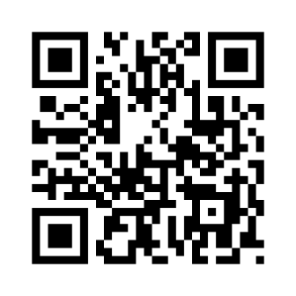

Place QR Code
within square

Slide 4
This correct?
Insert location here
No
Yes

Slide 5

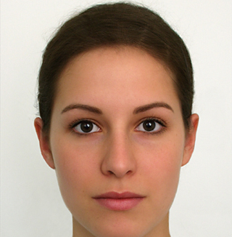


You
Tap your face

Slide 6
You
John smith
Is this you?
Not me
Login

Slide 7
You
John smith
Logging in
18th February
Is this you?
Not me
Login

Slide 8


John smith
Attendance
Fire escape

Slide 9
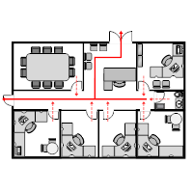

Evacuation Plan

Slide 10
Attendance
Mon | Tue | Wed | Thu | Fri
1 | 2 | 3 | 4 | 5
8 | 9 | 10 | 11 | 12
15 | 16 | 17 | 18 | 19
22 | 23 | 24 | 25 | 26
Present
Absent

