Slide 1

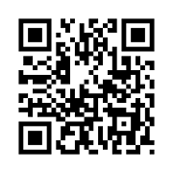

Log in with QR Code
OR

Slide 2
Log in with QR Code

Slide 3
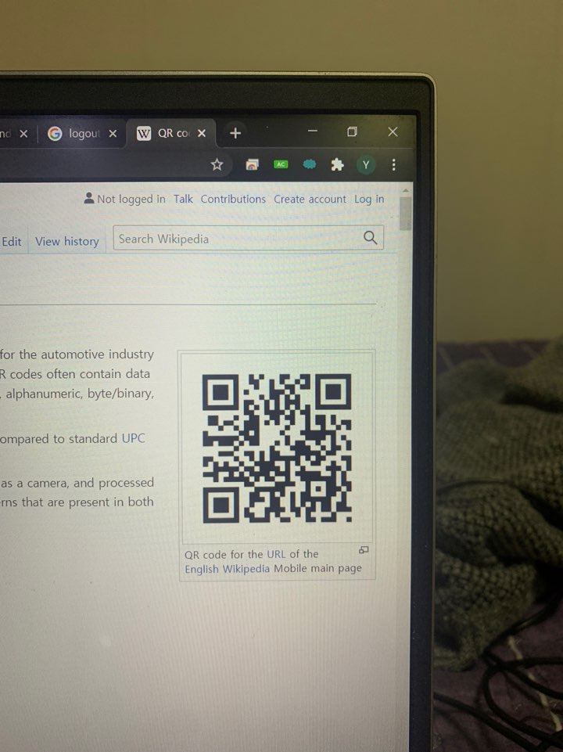


Saint John Of God
Sign In
Place QR Code
within square

Slide 4


Tap your face

Slide 5

Tap your face

Slide 6



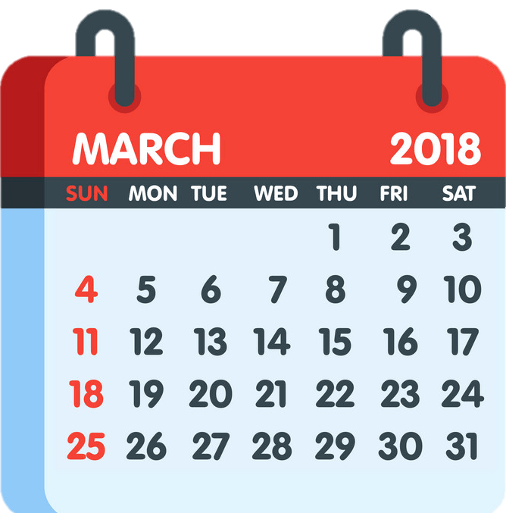

IN
2021
Attendance
Log Out

Slide 7


OUT
2021
Attendance
Fire Escape
Log Out

Slide 8
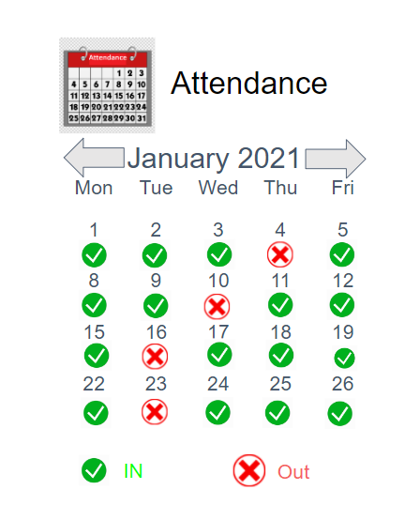
2021

Slide 9
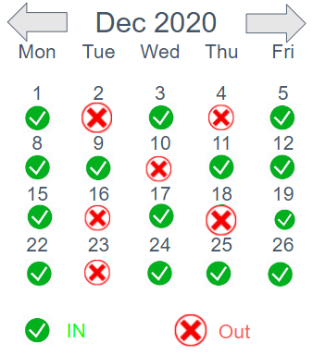
2021

Slide 10
