Slide 1

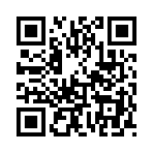

Log in with QR Code
OR

Slide 2
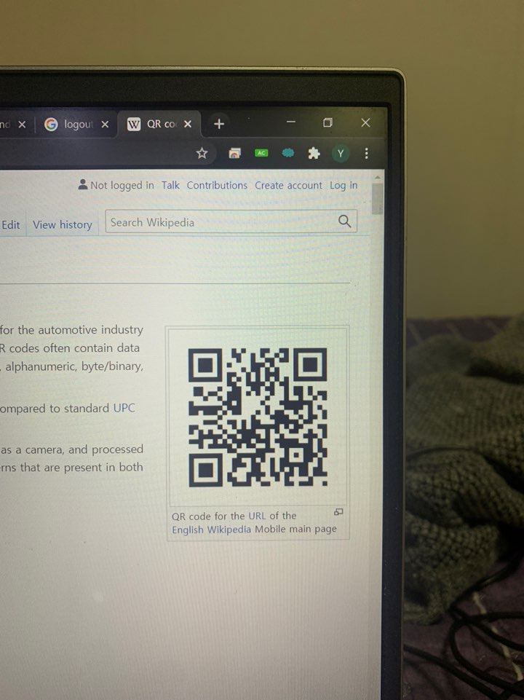


Saint John Of God
Sign In
Place QR Code
within square

Slide 3


Tap your face

Slide 4

Tap your face

Slide 5



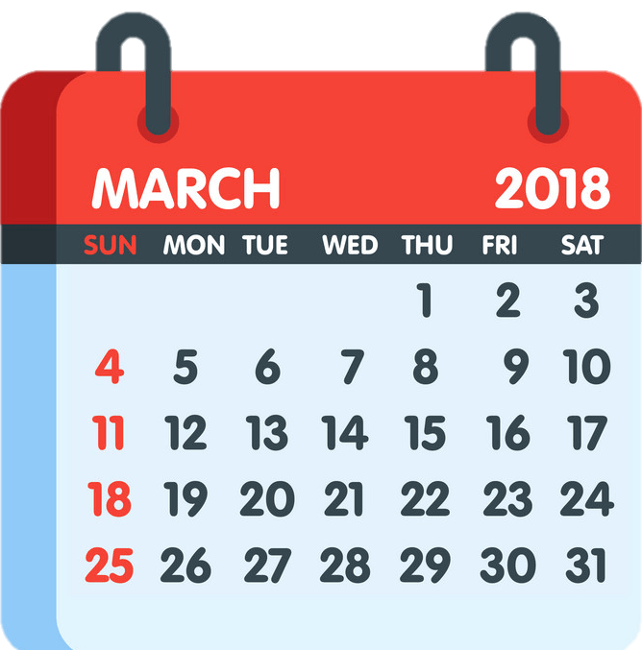

IN
2021
Attendance
Log Out

Slide 6


OUT
2021
Attendance
Fire Escape
Log Out

Slide 7
Log in with QR Code

Slide 8
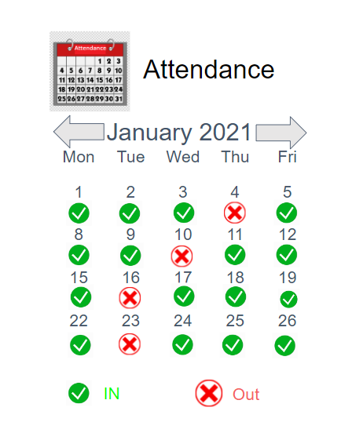
2021

Slide 9
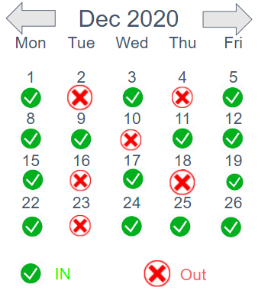
2021

Slide 10
