Slide 1


Collaborative Filtering for Recommendation System using
Yahoo! Music User Ratings
JUN 13, 2021
20181353 김예진
20161200 이영호
CONTACT
Industrial Engineering
5th Engineering Building Room 302-4
Web. http://sdm.unist.ac.kr

Slide 2
CONTENTS
1. Introduction
2. Preprocessing
3. Experiment
4. Conclusion

Slide 3
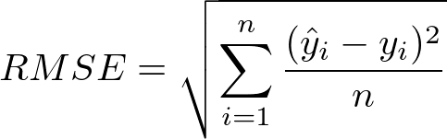
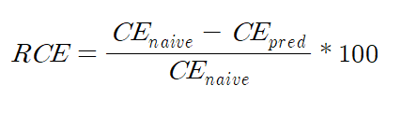
Introduction – Objective
Problem Definition
1. Predict Rating of user’s unrated music
2. Reducing computation time
Metric
Root Mean Square Error(RMSE) - Accuracy
Relative Cross Entropy(RCE)[1] – Fairness
Running Time - Efficiency
$$Running Time=End Time−Start Time$$
Notes:
# 여기다가 top100곡 뽑아서 비교한다는 말도 적어주면 좋을 것 같아요
# 다양성을 높이는 것은…?

Slide 4
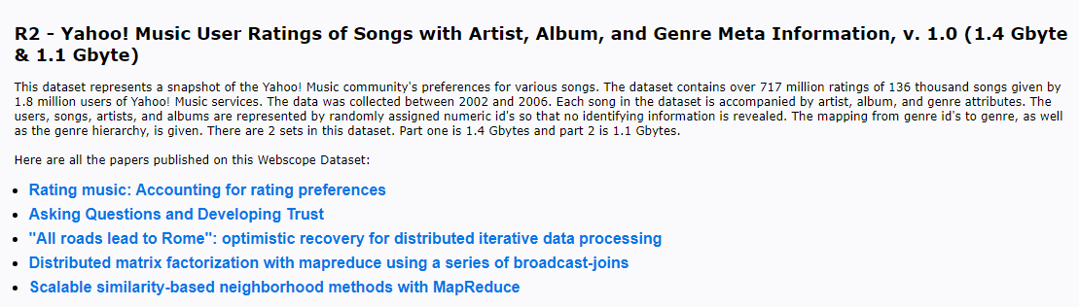

Introduction – Data Set
Dataset
3 txt files, have 76,344,627 rows(1GB) rating data file, 136,736 rows song attributes file, and genre file
200,000 user, 136,736 song
File Name | Columns
user-song-ratings | “user id”, “song id”, “rating”
song-attributes | “song id”, “album id”, “artist id”, “genre id”
genre-hierarchy | “genre id”, “parent genre id”, “level”, “genre name”

Slide 5
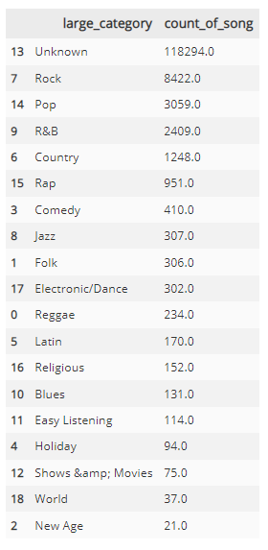
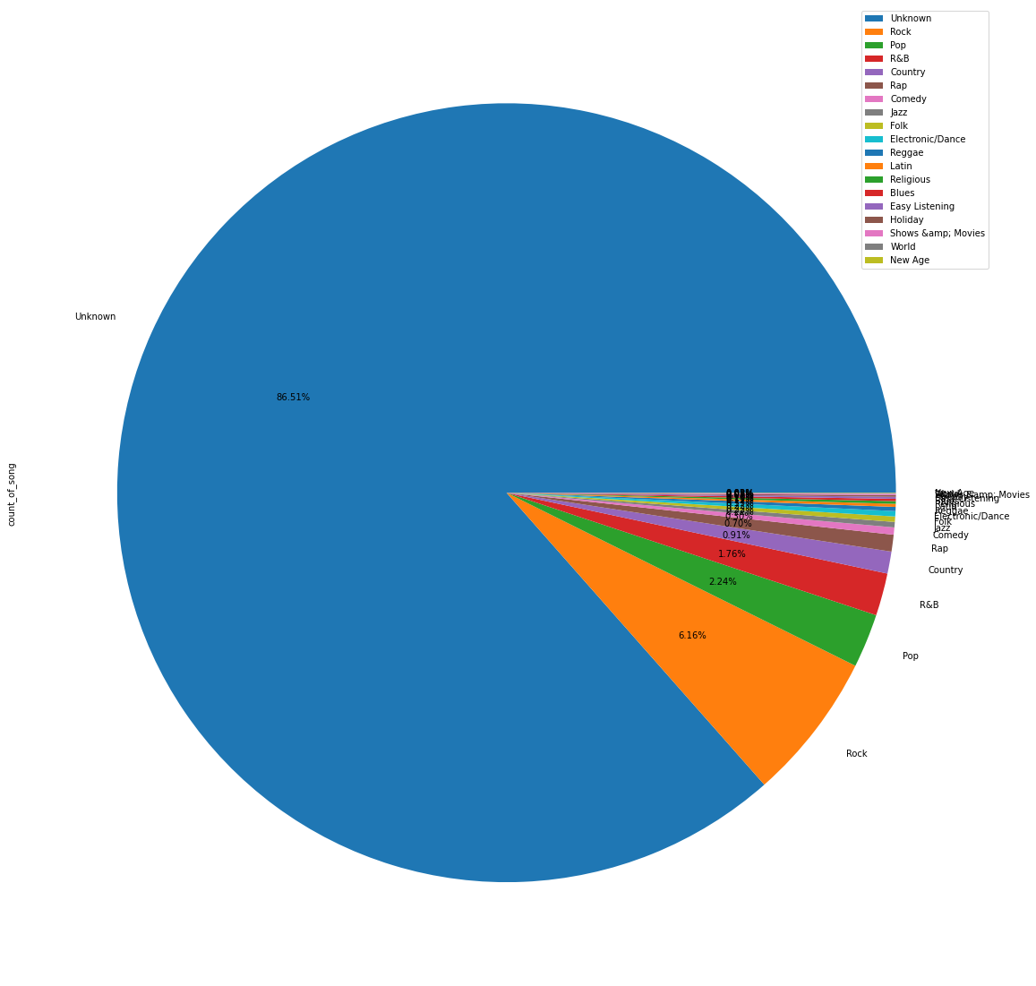
Introduction: Restrictions
Imbalance Genres
Genre of song have severe imbalance
Most of the songs belong to the unknown genre(85%)

Slide 6
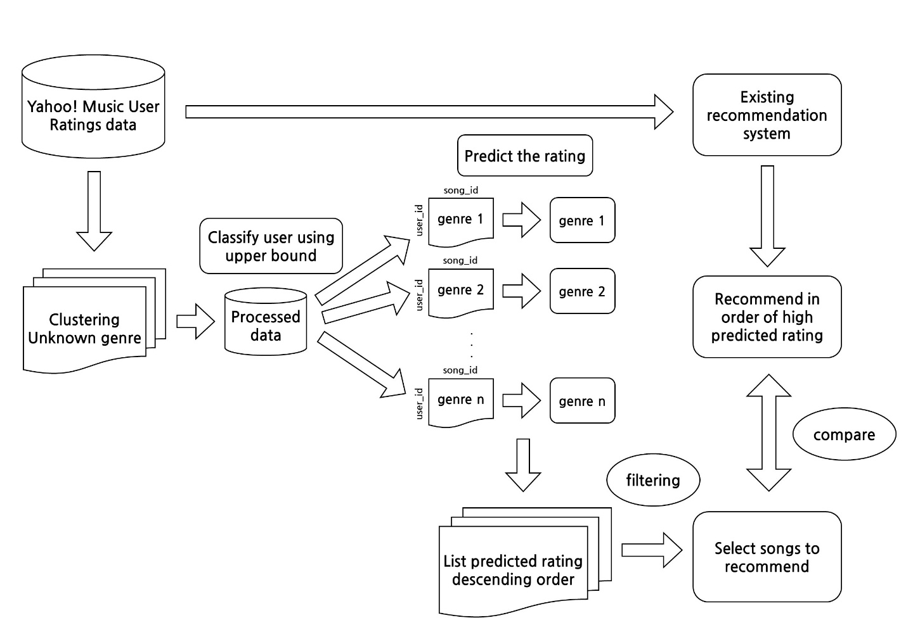
Model Architecture

Slide 7
Pre-Processing : Merge Data
Song rating
Song attribute
Genre -Hierarchy
76,344,627 * 3
136,736 * 4
216 * 4
Rating with metadata
76,344,627 * 11

Slide 8
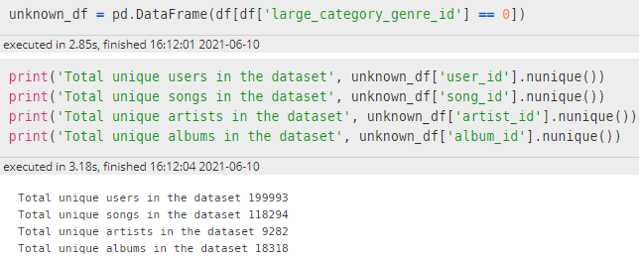
Pre-Processing : Unknown Music
85% of the songs belong to the unknown genre
99.9965% of users rated the unknown song
Unknown genre should be divided into small genre
-> Clustering
Clustering Methods
Cosine Similarity of Album [2]
UMAP [3]
HDBSCAN [4]

Slide 9
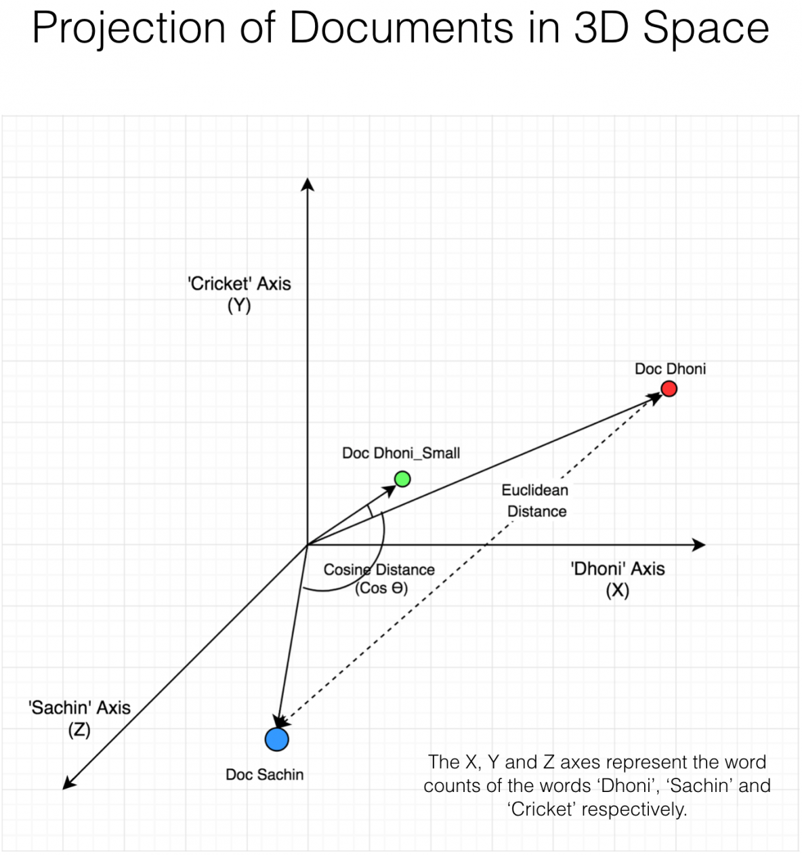
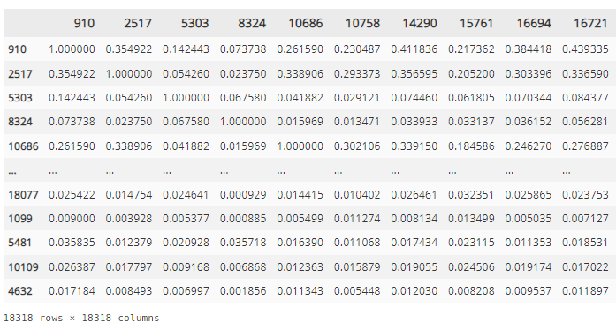
Pre-Processing : Cosine Similarity
$$Score=rating mean+0.5 ∗ \sqrt{rating count}$$
Notes:
https://www.machinelearningplus.com/nlp/cosine-similarity/

Slide 10
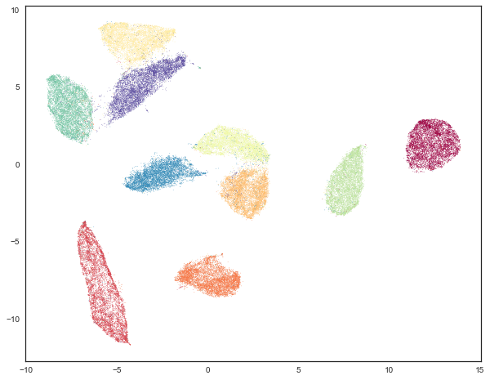

Pre-Processing : UMAP
UMAP: Uniform Manifold Approximation and Projection for Dimension Reduction
Notes:
https://umap-learn.readthedocs.io/en/latest/clustering.html
https://data-newbie.tistory.com/169

Slide 11
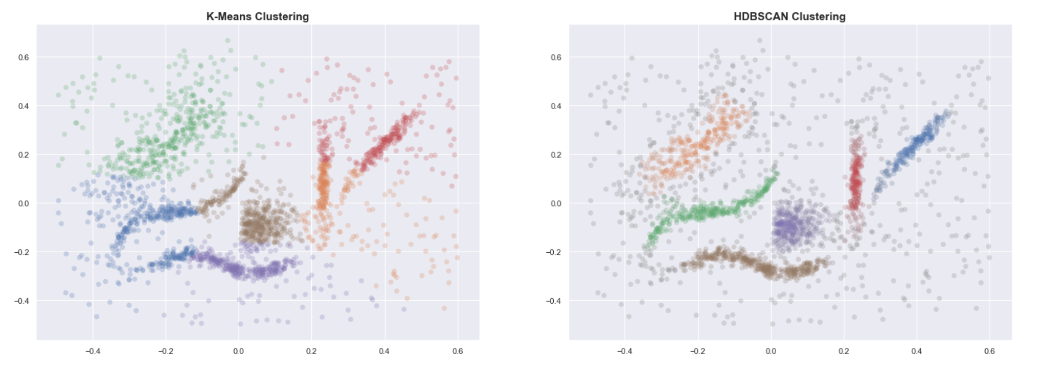
Pre-Processing : H-DBSCAN
HDBSCAN: Hierarchical Density-based Spatial Clustering of Applications with Noise
Notes:
https://hdbscan.readthedocs.io/en/latest/index.html#
https://towardsdatascience.com/a-gentle-introduction-to-hdbscan-and-density-based-clustering-5fd79329c1e8

Slide 12
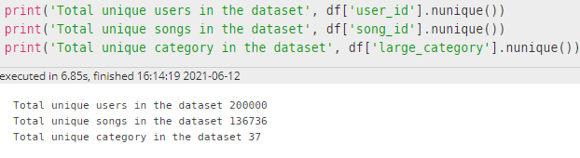
Pre-Processing : Rebuild Dataset
$$Score=rating mean+0.5 ∗ \sqrt{rating count}$$

Slide 13
Experiment

Slide 14
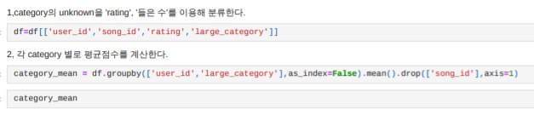
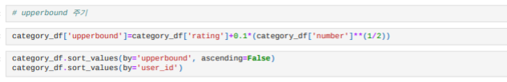
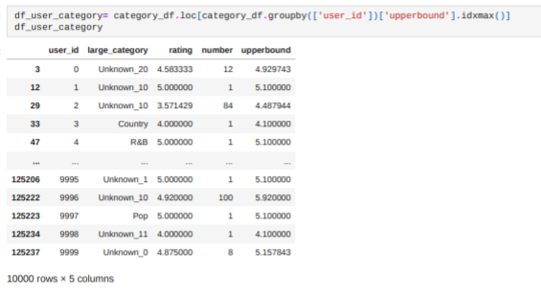
Experiment
1, make the dataframe with ‘user_id’, ‘song_id’, ‘rating’, ‘category’
2, calculate the average score of each category by each user
3, we also find out how many times each user has listened to each category
4, merge that two dataframes
5, finally, for each category, apply this data to upperbound expression to give the user the best song category

Slide 15
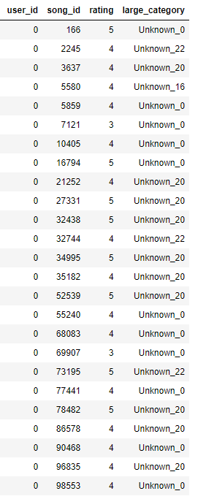
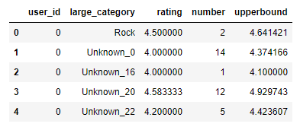
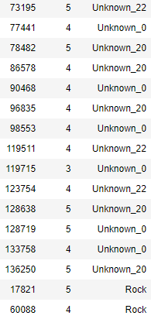
Experiment
For example,,, user_id = 0
$$Score=rating mean+0.5 ∗ \sqrt{rating count}$$
So, user_id = 0 → category = ‘Unknown_20’

Slide 16


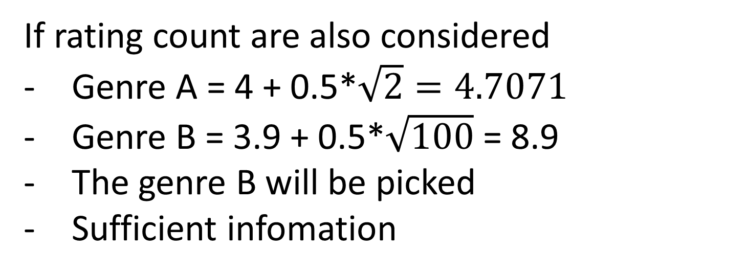
Experiment
Why we use this upperbound expression?
…. To give weight to rating count !!
$$Score=rating mean+0.5 ∗ \sqrt{rating count}$$
If only rating mean are considered
The genre A will be picked
But he only listen 2 times
→ not enough information
genre | Rating mean | Rating count
A | 4 | 2
B | 3.9 | 100
If rating count are also considered
Genre A = 4 + 0.5*$\sqrt{2}=4.7071$
Genre B = 3.9 + 0.5*$\sqrt{100}$ = 8.9
The genre B will be picked
Sufficient infomation

Slide 17
Experiment

Slide 18
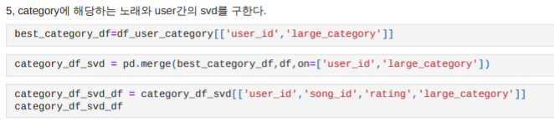
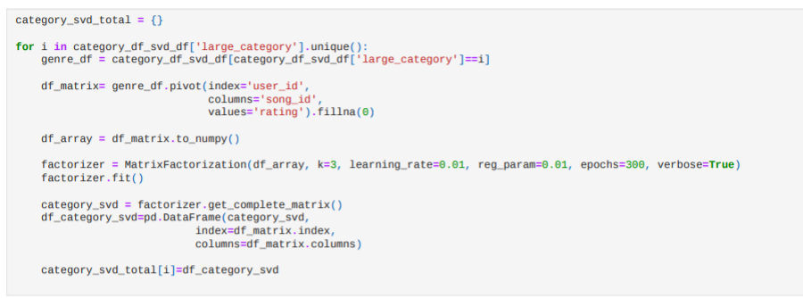
Experiment

Slide 19
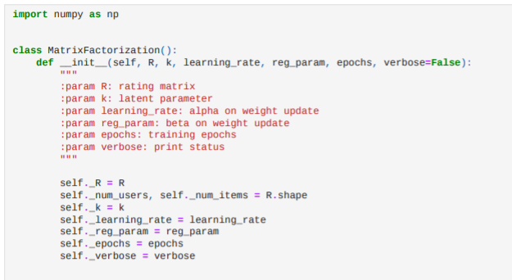
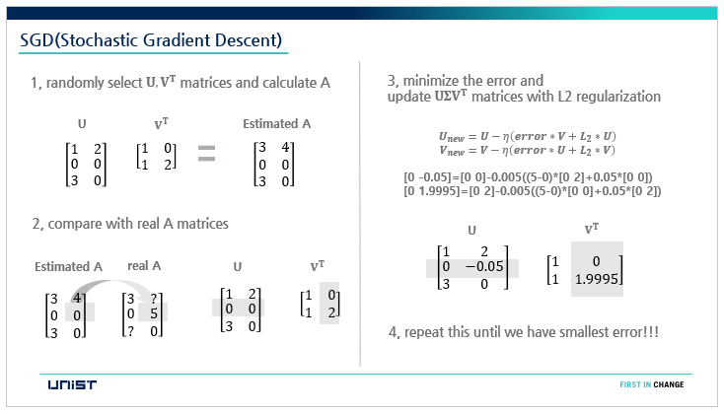
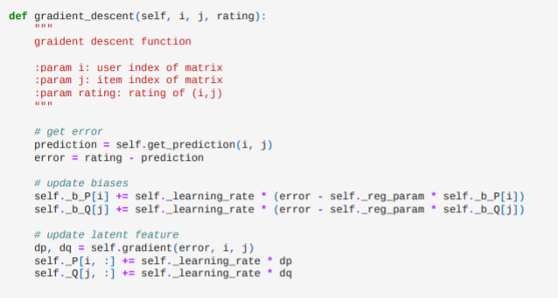
Experiment
Previous…

Slide 20
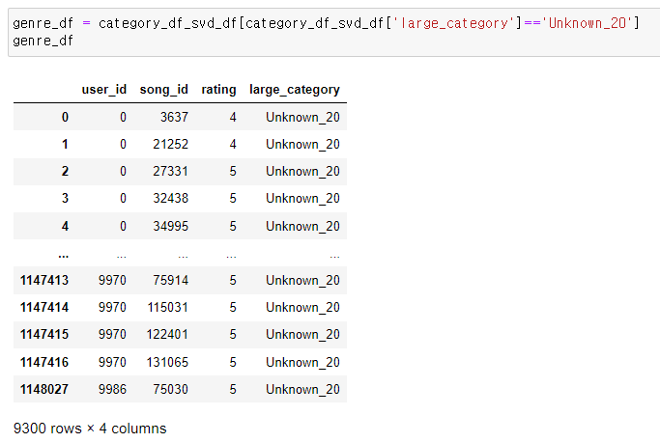
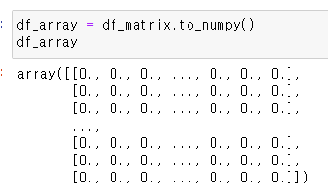
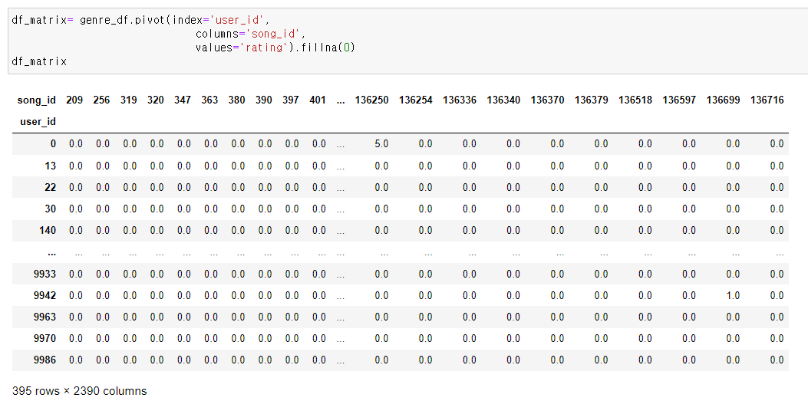
Experiment
For Unknown_20 category…
Dataframe[user_id, song_id, rating, category]
Change dataframe into array
Index = user_id
Columns = song_id
Values = rating

Slide 21
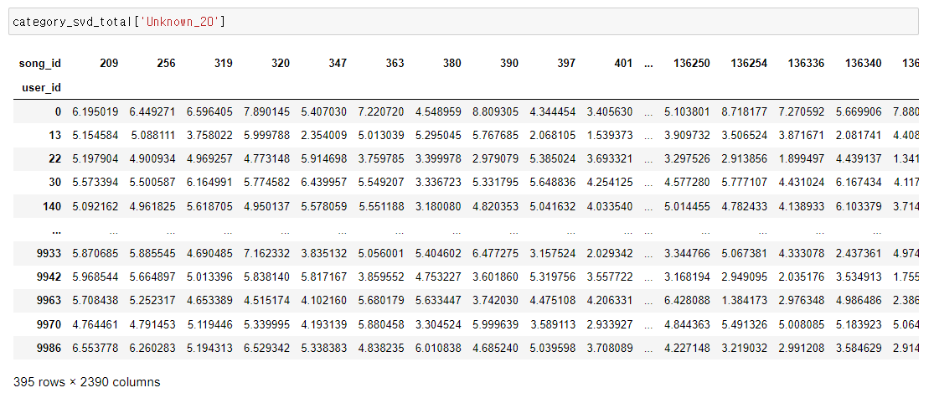
Experiment
Finally we got predicted rating dataframe!

Slide 22
Experiment

Slide 23
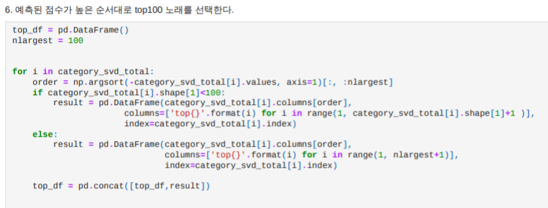
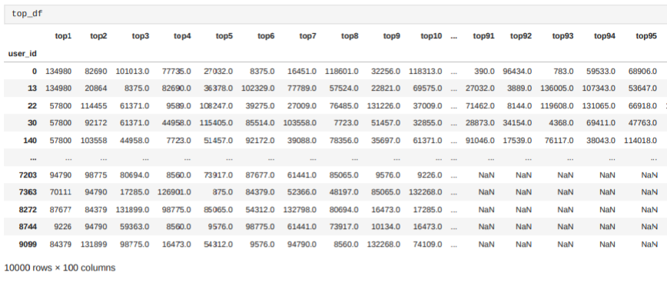
Experiment

Slide 24
Experiment
 | RMSE | RCE | Computing Time
KNN
SVD
SGD
Our Model

Slide 25
Conclusion
1. RMSE :
2. RCE :
3. Computing Time:

Slide 26
Reference
[1] Belli, Luca, et al. "Privacy-Aware Recommender Systems Challenge on Twitter's Home Timeline." arXiv e-prints (2020): arXiv-2004.
[2] Asanov, Daniar. "Algorithms and methods in recommender systems." Berlin Institute of Technology, Berlin, Germany (2011).
[3] McInnes, Leland, John Healy, and James Melville. "Umap: Uniform manifold approximation and projection for dimension reduction." arXiv preprint arXiv:1802.03426 (2018).
[4] McInnes, Leland, John Healy, and Steve Astels. "hdbscan: Hierarchical density based clustering." Journal of Open Source Software 2.11 (2017): 205.

Slide 27
THANK YOU

