Slide 1
NAT and NAT Traversal
SEng490 Directed Study
Haoran Song
Supervised by Dr. Jianping Pan

Slide 2
Outline
Problems of NAT in the real world
NAT Traversal in our research
Conclusion

Slide 3
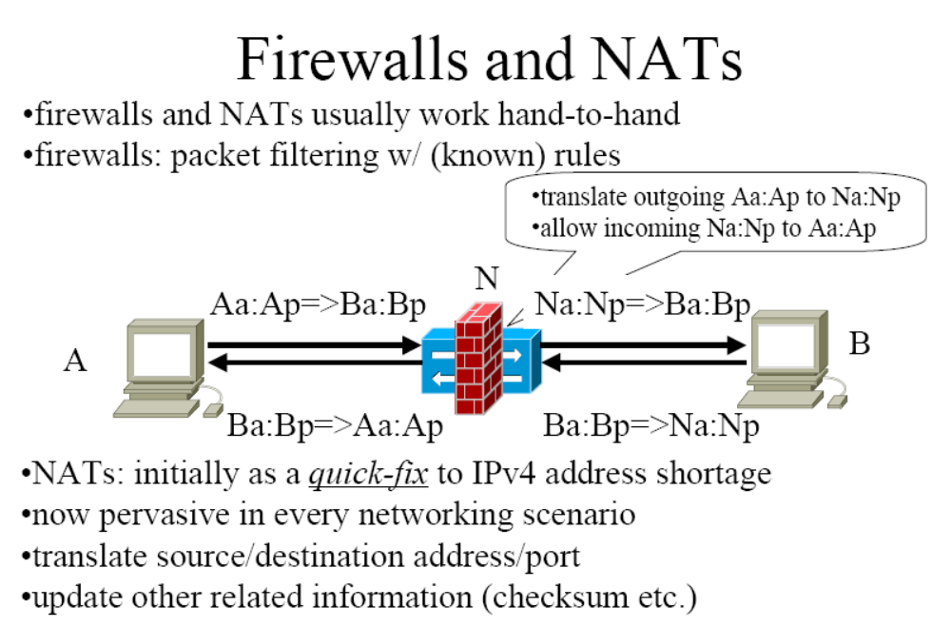
Firewalls and NAT

Slide 4
Four Types of NAT
Full Cone NAT
IP Restricted NAT
Port Restricted NAT
Symmetric NAT
Then let us see how these four NATs work?

Slide 5
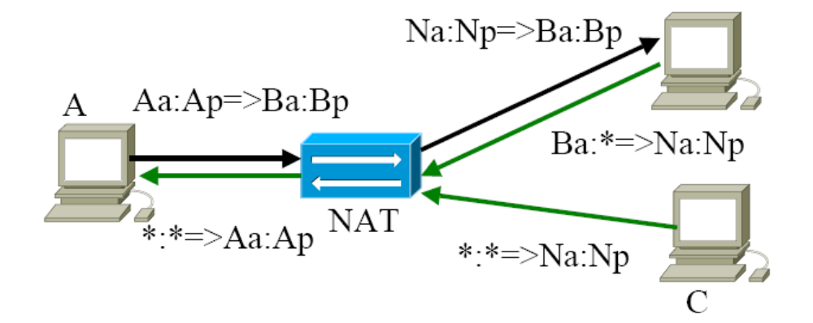
Full Cone: not very restricted
B

Slide 6
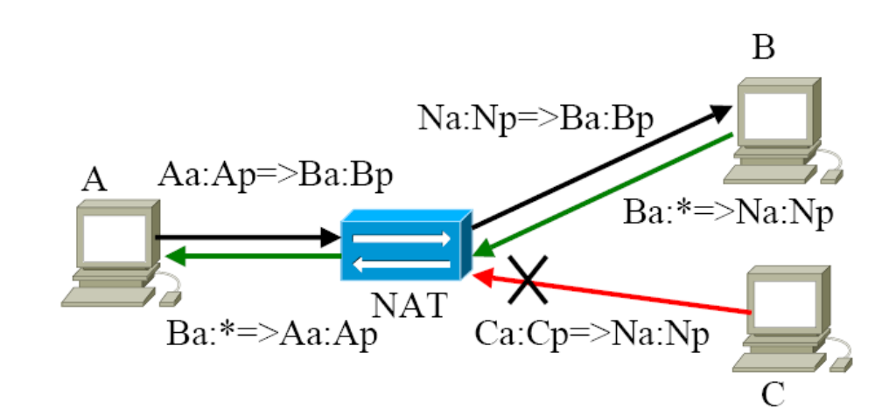
IP Restricted NAT
Has restrictions on incoming IP

Slide 7
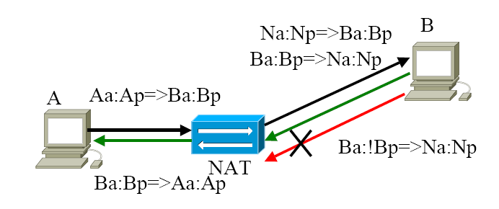
Port Restricted NAT
Not only has restrictions on IP, but also on Port

Slide 8
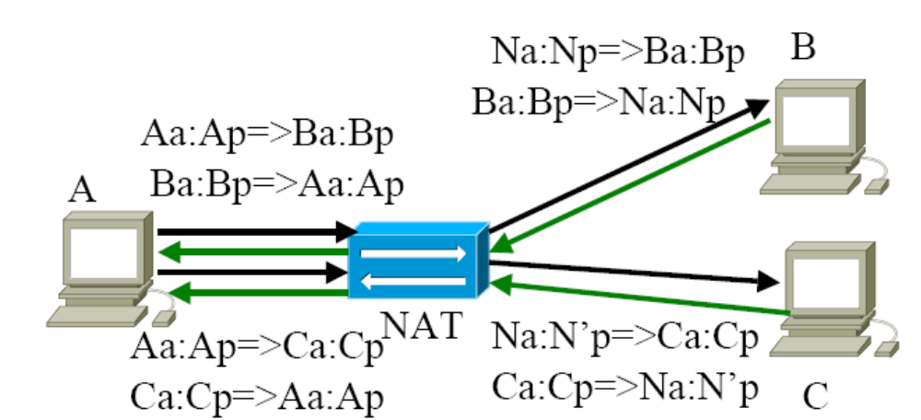
Symmetric NAT
Very restricted. New mapping for each different connection.

Slide 9
Problems caused by NAT
So, When we do communication with NAT, outside packets can not come in until inside packets go out first.
We need to find a way to overcome this problem and this technique is called NAT Traversal.

Slide 10
NAT Traversal
Our plan
We need to know what NAT we are behind
Do NAT traversal according to the identified NAT
Therefore, two main parts in our research
NAT Detection
NAT Traversal

Slide 11
NAT Detection
We get the PolyNAT from Dr. Hoffman. It can emulates four different NATs.
Thanks to Dr. Hoffman and his students.

Slide 12
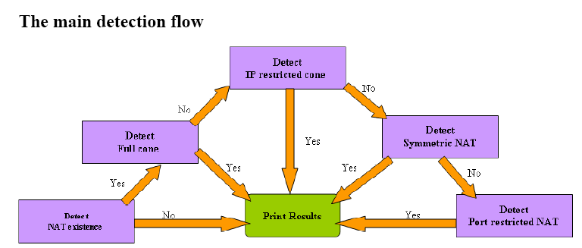
NAT Detection Flow

Slide 13
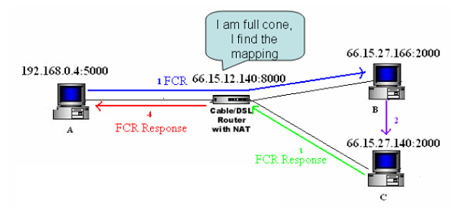
Example: Full Cone Detection

Slide 14
NAT Traversal
NAT Traversal
A
B
cone
IP restricted
port restricted
symmetric
cone
√
√
√
√
IP restricted
√
√
√
port restricted
√
?
symmetric
?

Slide 15
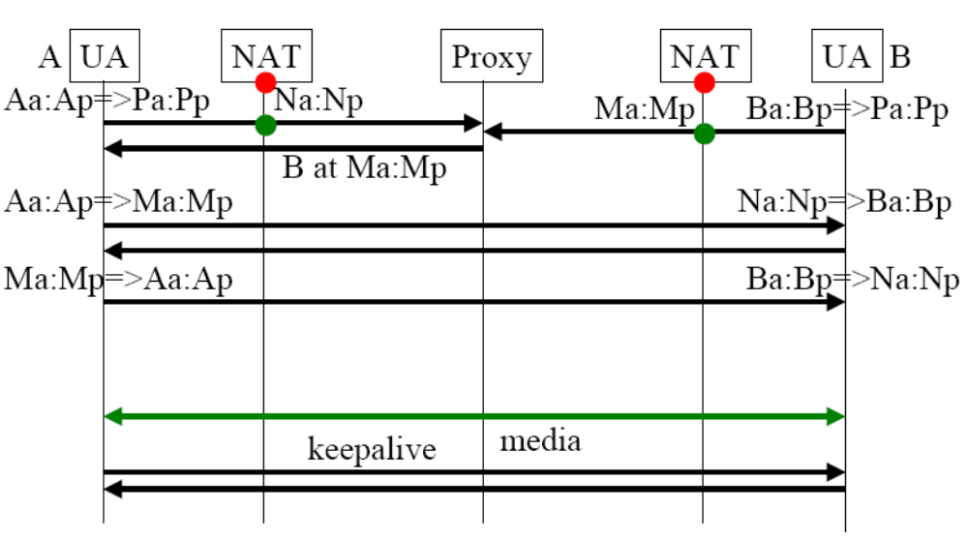
Full Cone-Full Cone

Slide 16
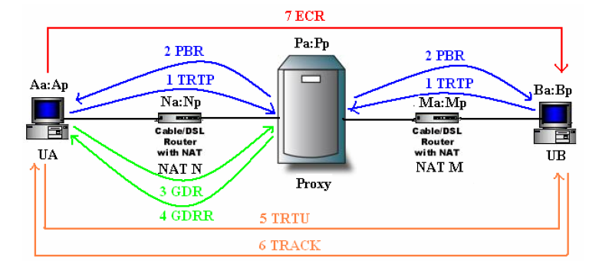
Full Cone-Full Cone: Scenario

Slide 17
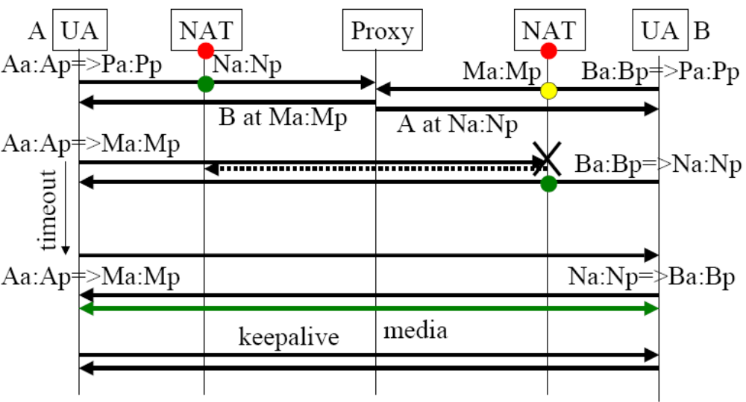
Full cone/restricted-restricted

Slide 18
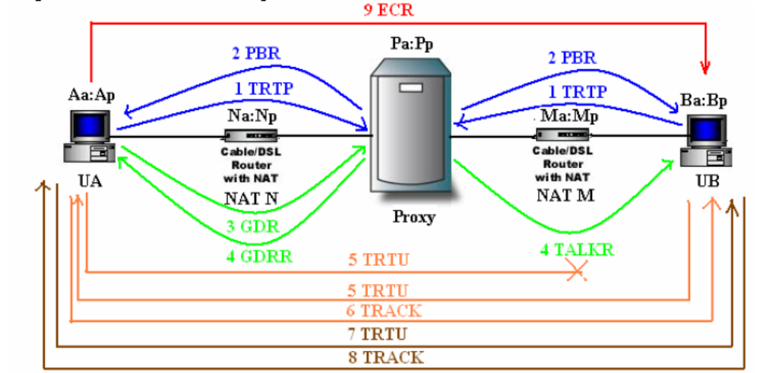
Full cone/restricted-restricted Scenario

Slide 19
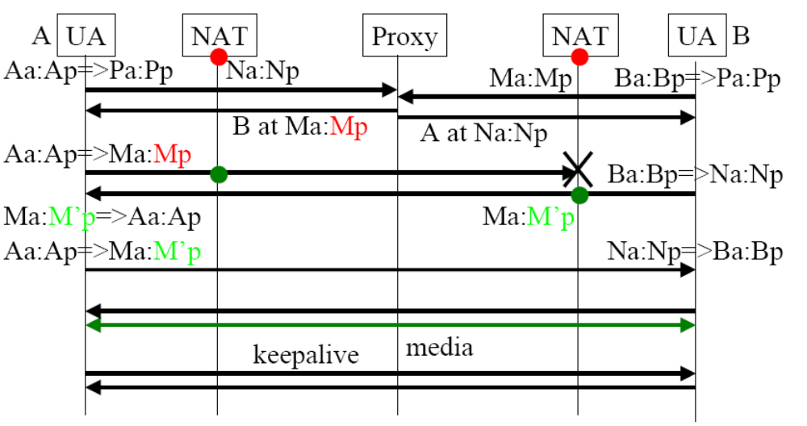
Full cone/IP restricted-symmetric

Slide 20
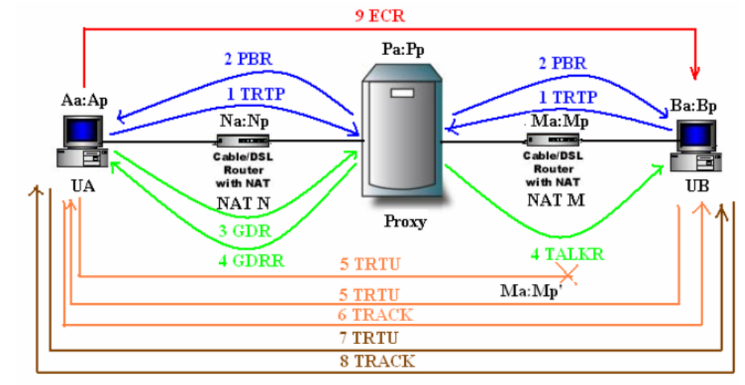
Full cone/IP restricted-symmetric Scenario

Slide 21
How does clients describe who they are
We build our own traversal commands
We use XML to describe necessary information and embed these descriptions in our traversal commands.
So, other clients get specified information about their peers by learning these XML contents.

Slide 22
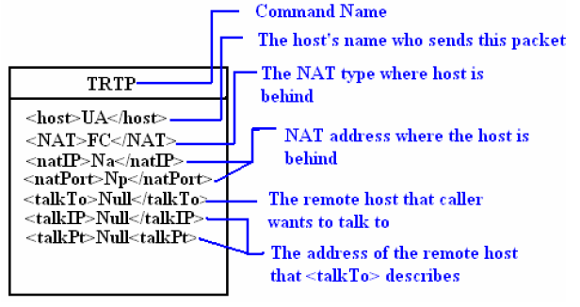
An example of a traversal command

Slide 23
Conclusion
We have implemented
Full Cone – Full Cone
Full/Restricted Cone – Restricted Cone
Full/IP Restricted Cone – Symmetric
The things we will do in the future
Port Restricted Cone – Symmetric
Symmetric – Symmetric

Slide 24
NAT and NAT Traversal
Questions?

