Slide 1
HW 2-3 and Midterm Exam
HW assignments posted on public web site and D2L
(for public web site, scroll to bottom of home page)
HW#2: Due Thursday Sep 11 (Lectures 3-4)
HW#3: Due Tuesday Sep 16 (Lectures 5-6)
First Midterm Quiz: Thursday Sep 18 at class time
Review session: Monday Sep 15 , 7-8:50 PM, ECCR 200
Exam coverage given in HW assignment documents

Slide 2
Reading Quiz #2 on Plane Stress
When: Tuesday September 10, 2013
Read: Lecture 6 posted on public web site
Also announced on HW#2 assignment

Slide 3
First Experimental Lab
First experimental lab: Torsion, starts Friday Sep 19,
the day after midterm exam
Demos at 1PM and 3PM by the Torsion Module,
located at level 2B of ITLL
Group Experiments the following week
Logistic details in Lab Description Document,
to be distributed by Tuesday Sep 16

Slide 4
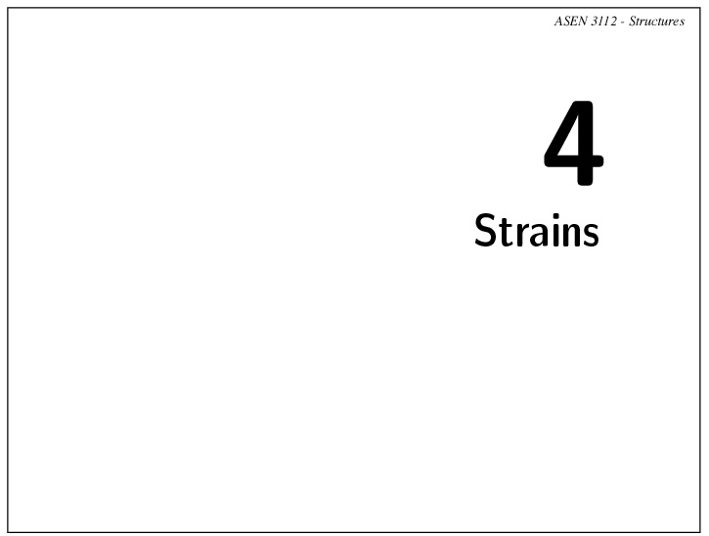

Slide 5
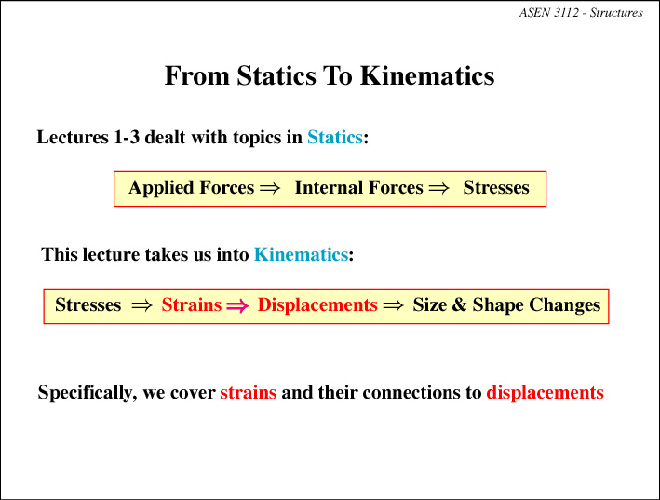

Slide 6
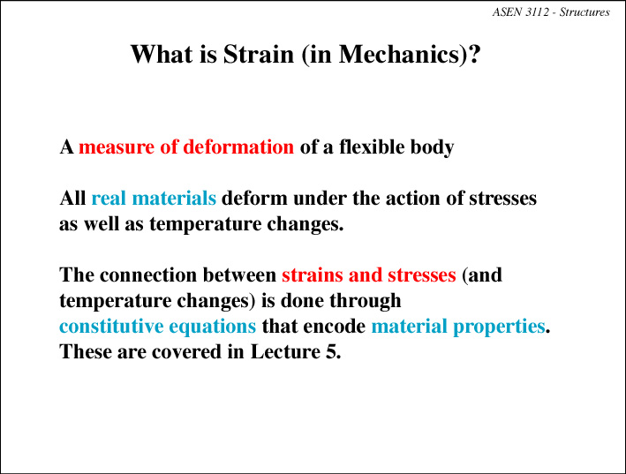

Slide 7
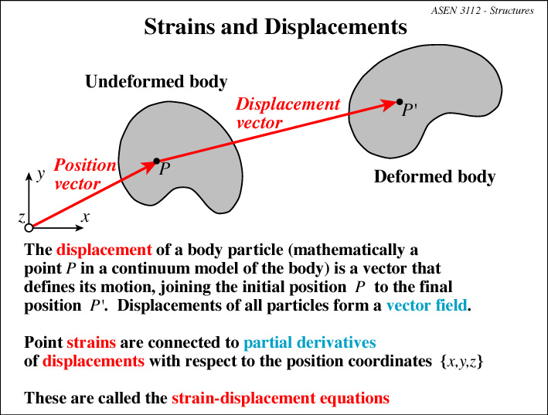

Slide 8
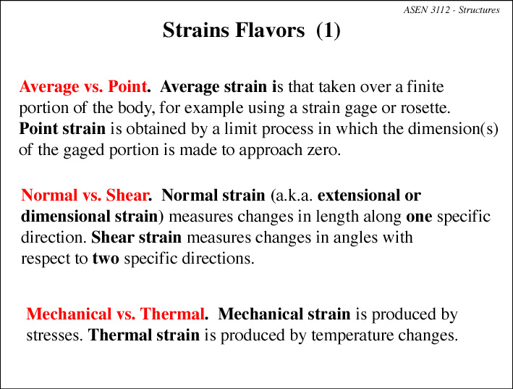

Slide 9
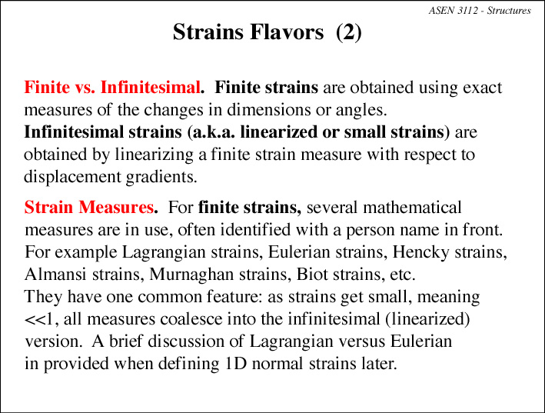

Slide 10
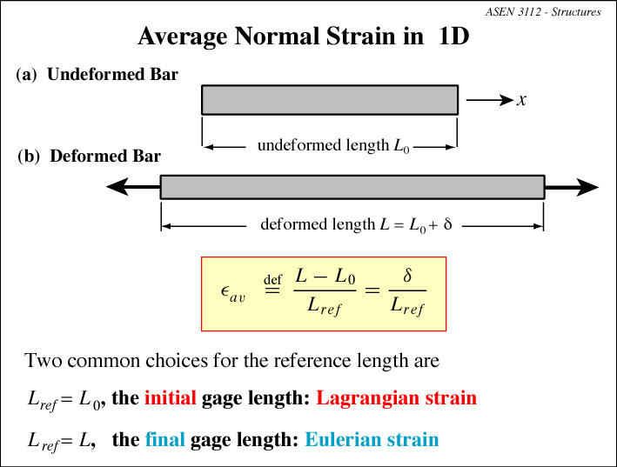

Slide 11
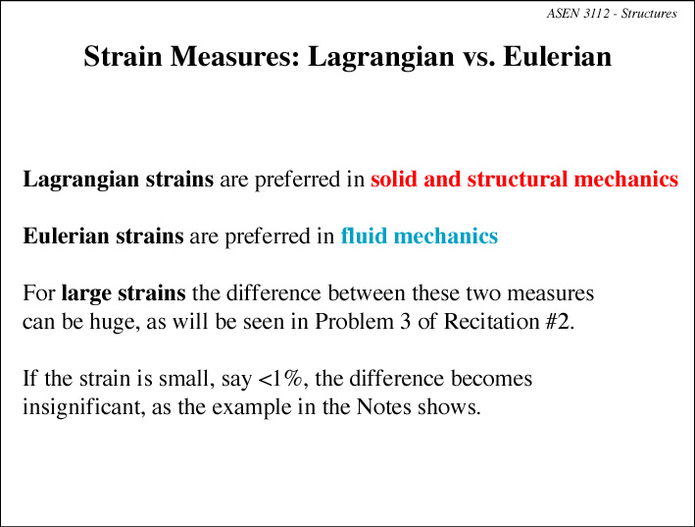

Slide 12
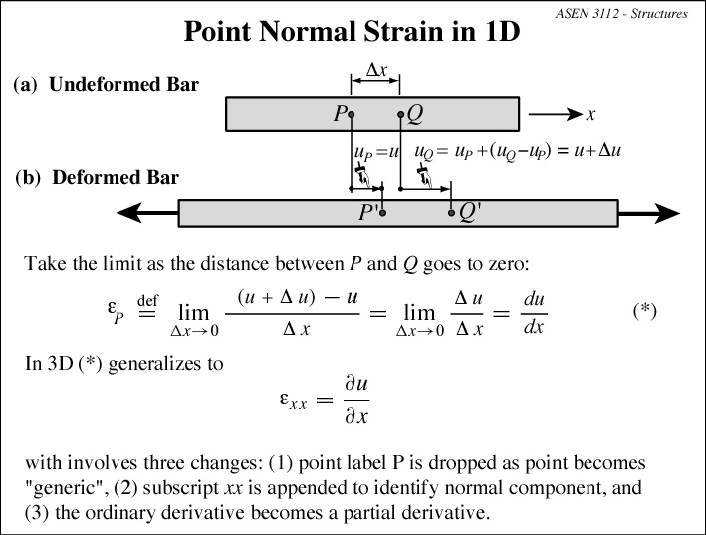

Slide 13
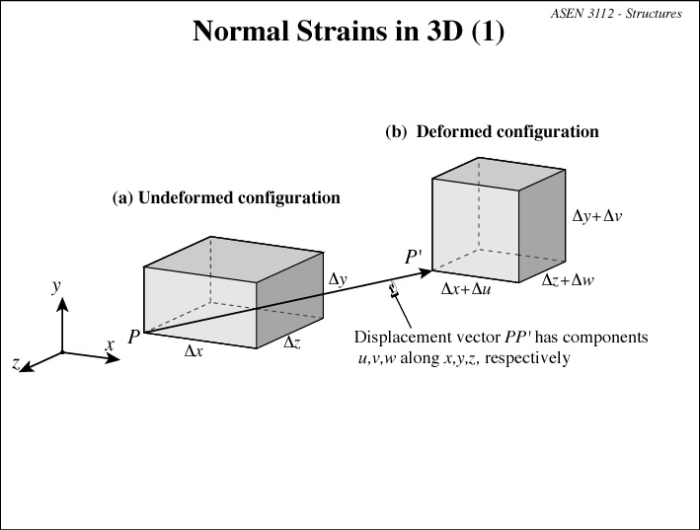

Slide 14
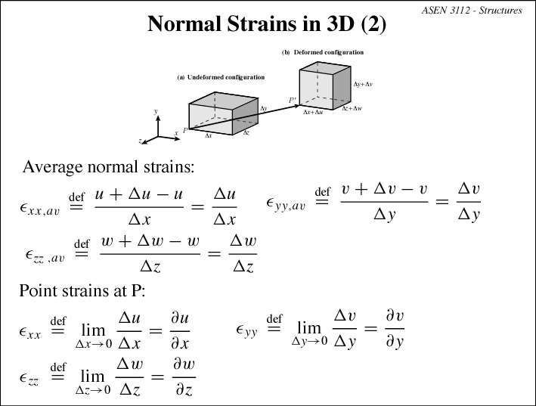

Slide 15
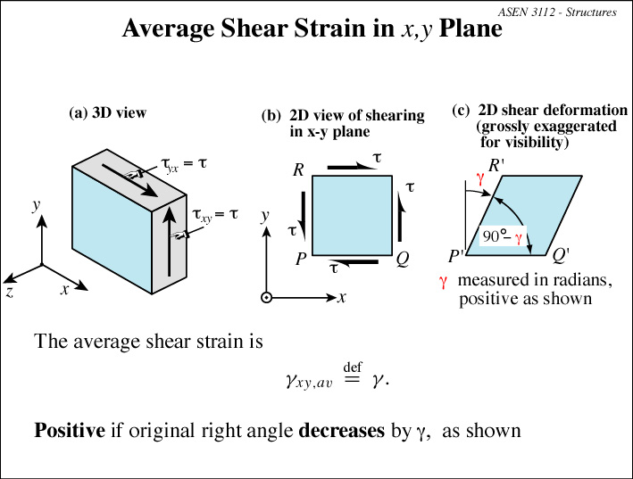

Slide 16
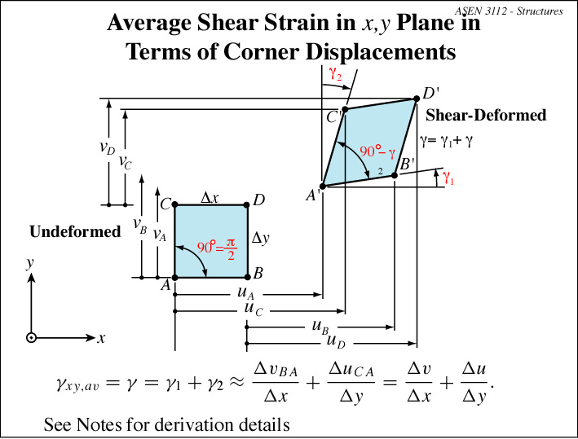

Slide 17
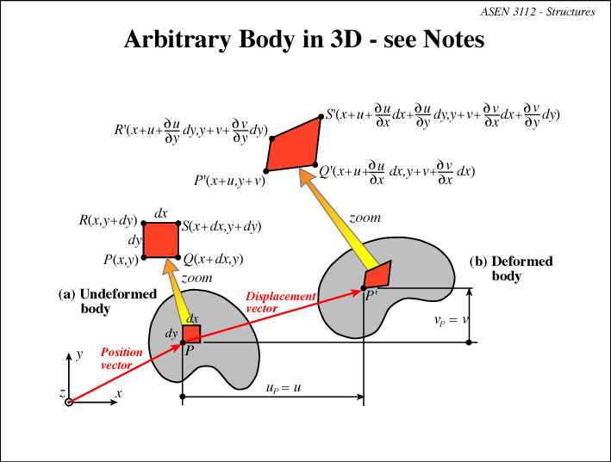

Slide 18
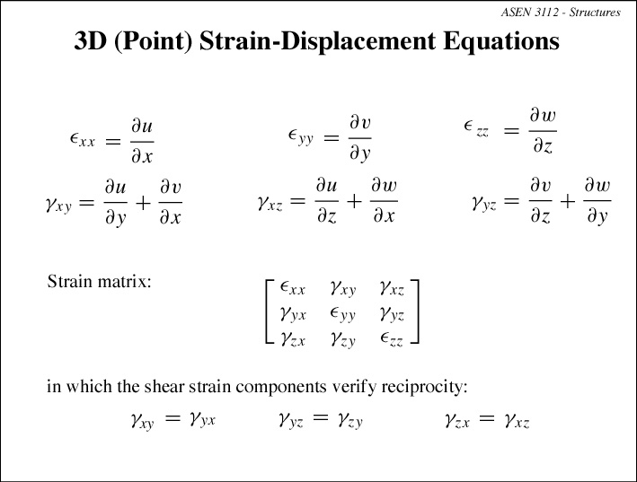

Slide 19
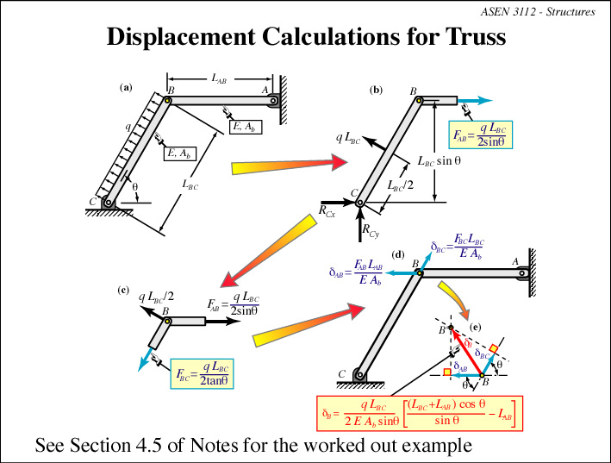

Slide 20
