Slide 1
This is ASEN 3112: Structures
Department of Aerospace Engineering Sciences
University of Colorado at Boulder
Fall 2014

Slide 2
Teaching Staff
Instructor: Carlos Felippa
TAs: Clemence Bacquet
Joseph (Joe) Hughes
CA: Martin Heaney
Lab supervisor: Trudy Schwartz

Slide 3
Two Course Online Sites
Public course web site:
http://www.colorado.edu/engineering/CAS/courses.d/Structures.d/Home.html
Contains lectures, slides, general material, lab documents
No access constraints
D2L web site - under construction
Will hold protected course material (e.g., scores) as well
as mirror images of public web site files (e.g. HWs).
Accessible by IdentiKey & password

Slide 4
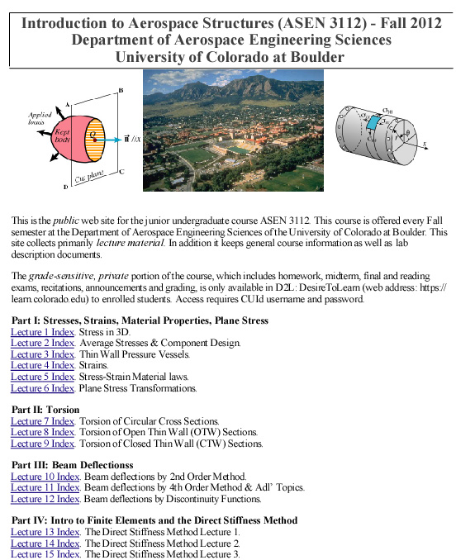
Public Web Site Homepage Image

Slide 5
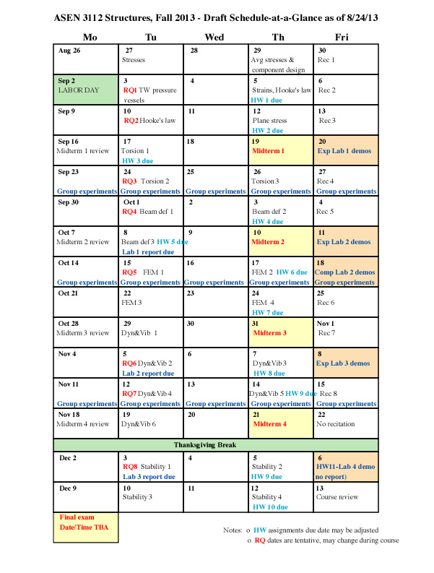
Schedule-At-A-Glance Sheet
In your handout,
but in B&W

Slide 6
Ongoing Events
Lectures: TuTh 2:00-3:15pm @ ECCR 1B40
Labs: F 1-2:50pm & 3-4:50pm @ ITLL
8 recitations at 1B50 (smart room)
3 formal exp labs (1 w/computer), Plaza or 1B50
1 demo-only lab (no report), 1B50
RQs 8 Tuesdays, M/C, first 10’ of lecture
Midterms 4 Thursdays, reviews previous Mo eve
Final exam Date/time TBA
HWs Usually due Th except midterm weeks
Office Hrs See Handout
See Schedule-at-a-Glance sheet (handout) for more details

Slide 7
Coursework Weights
Individual Work: 60 %
Midterms (4) 7.5% each 30 %
Final exam 15 %
Reading quizzes (up to 8) 10 %
Course participation grade 5 %
Group Work: 40 % *
Lab reports: 5% + 10% + 5% 20 %
Homework (10 or 11, lowest score dropped) 20 %
* Only counted if individual work score is C or better
See Coursework handout for further details

Slide 8
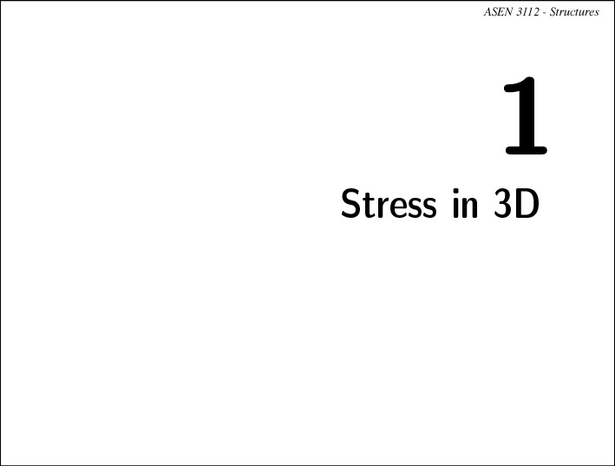

Slide 9
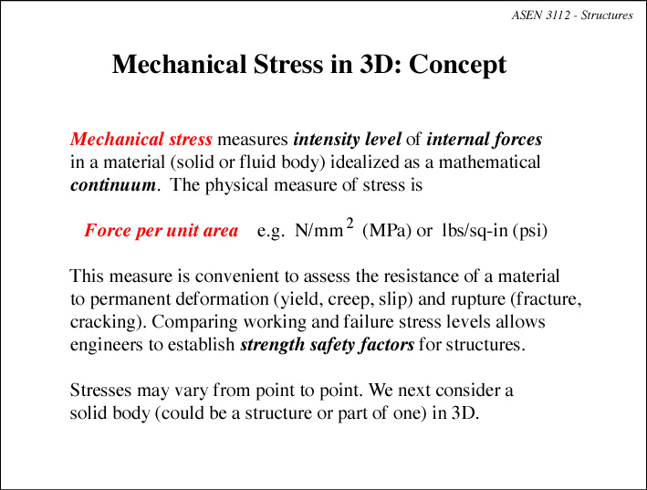

Slide 10
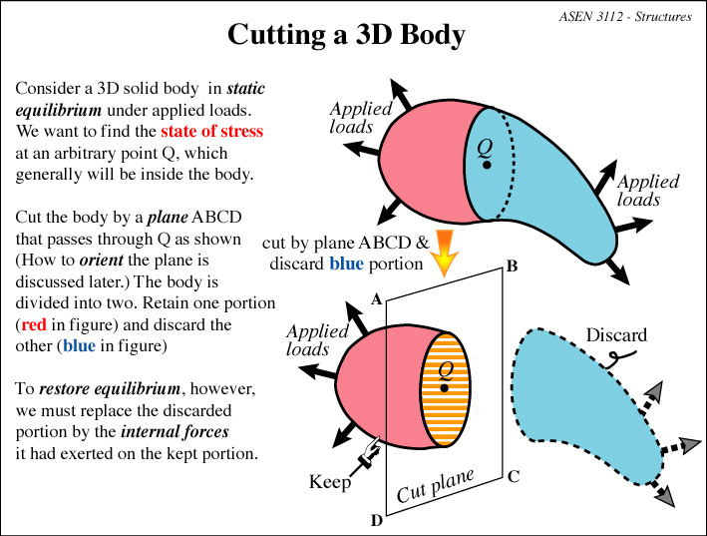

Slide 11
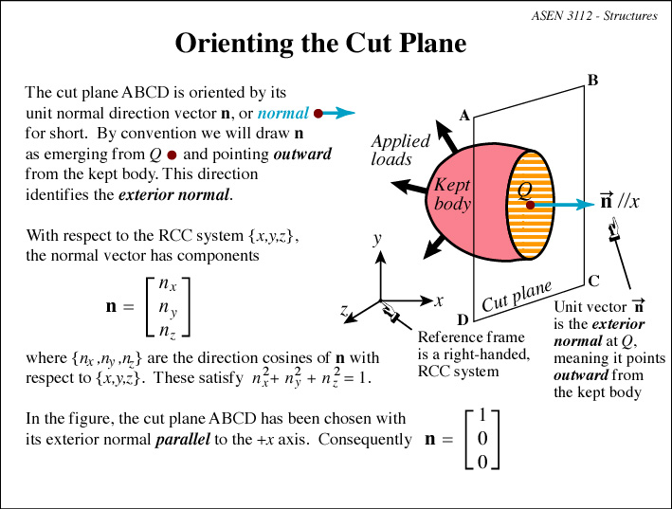

Slide 12
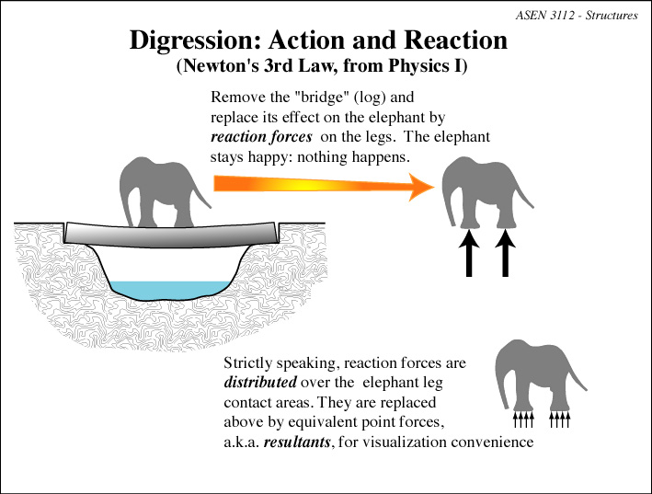

Slide 13
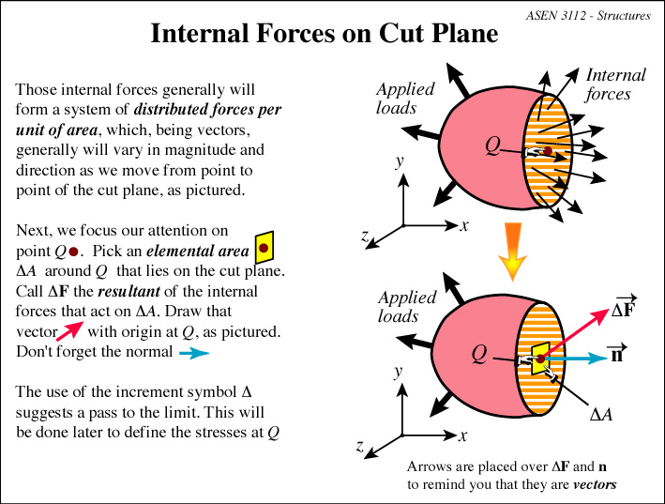

Slide 14
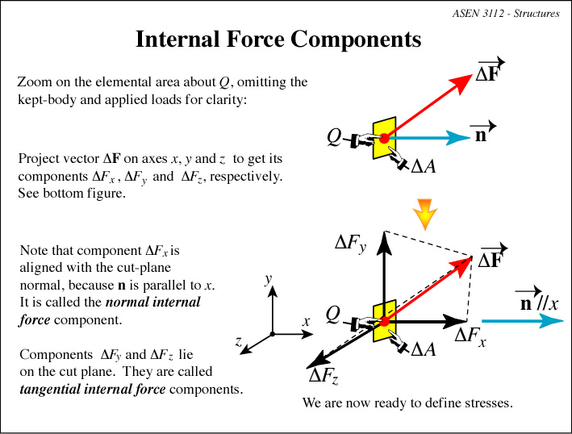

Slide 15
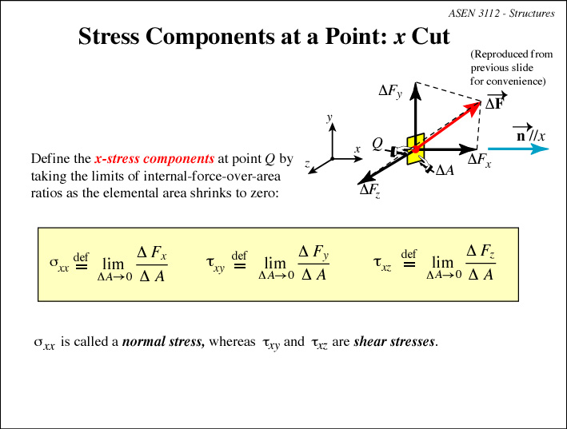

Slide 16
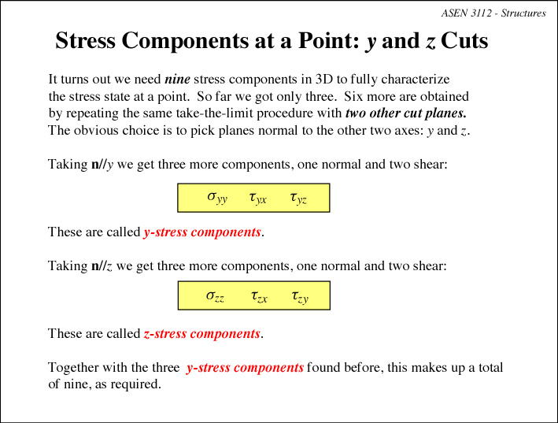

Slide 17
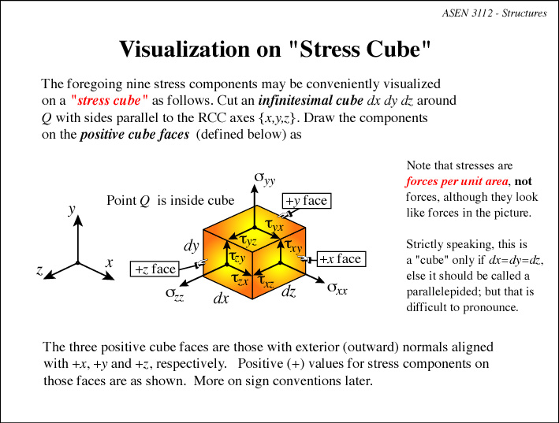

Slide 18
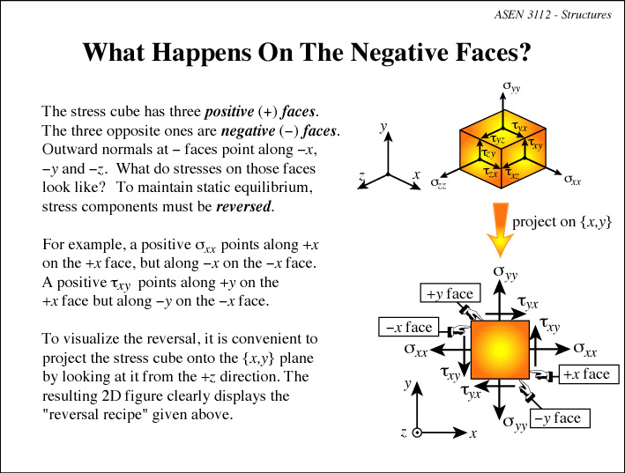

Slide 19
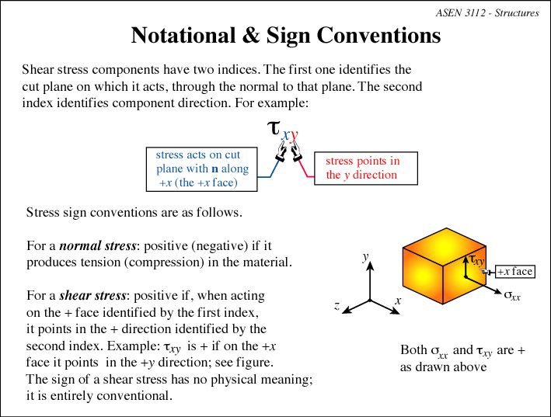

Slide 20
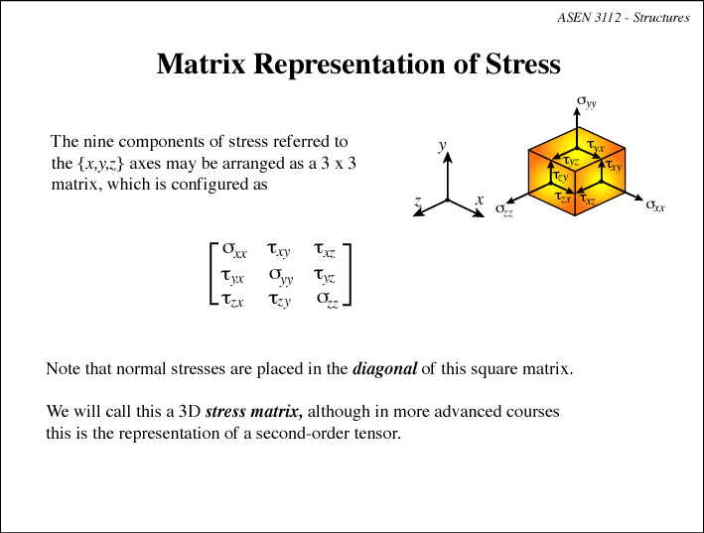

Slide 21
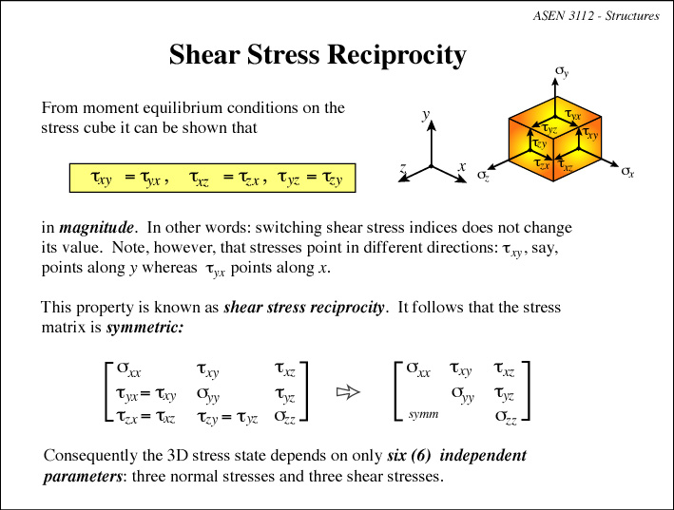

Slide 22
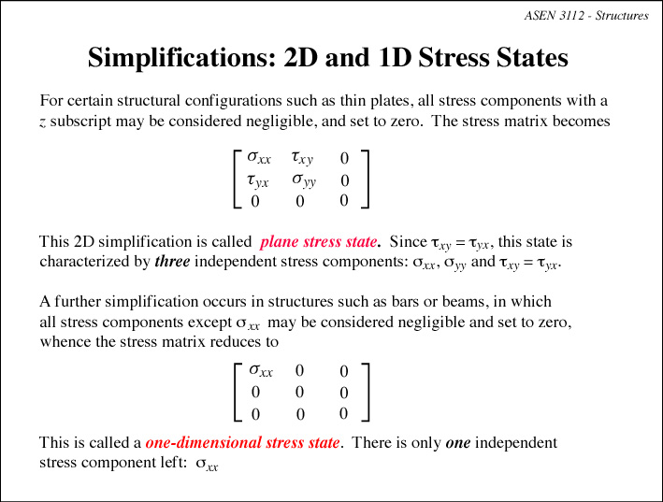

Slide 23
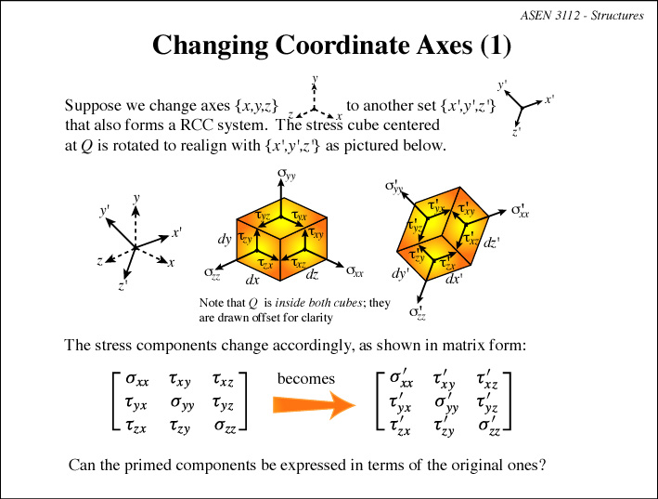

Slide 24
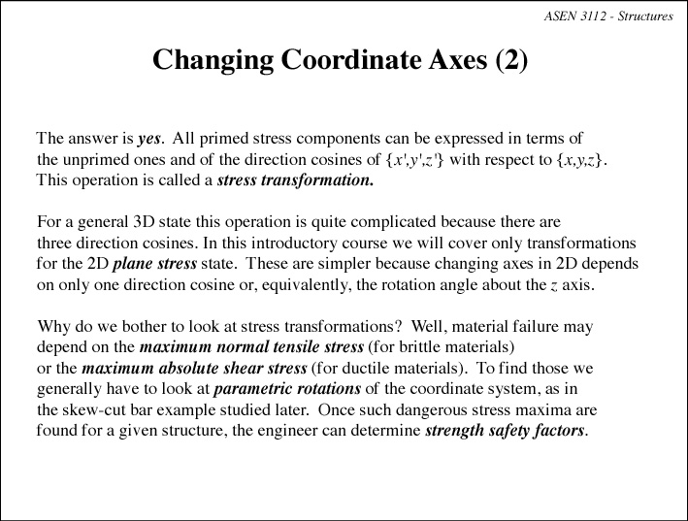

Slide 25
