Slide 1
Midterm Exam 1
The first midterm exam, on material covered during
the first six lectures will be given at class time on
Th Sep 19. Does not cover Lecture 7 on Tu Sep 17,
which starts a new topic (torsion).
Exam is closed book and closed notes but
one two-sided crib sheet is allowed.
Bring calculator and engineering paper.

Slide 2
Midterm Exam 1 Review Session
Review session to be held Monday Sep 16,
7-8:50 PM at ECCR 150.
We will go over an old Midterm Exam 1,
which is also to be posted on the public web site

Slide 3
Homework #3
Posted on Web site and D2L
Has more details on midterm exam
Due Tuesday Sep 17 so solutions can be
posted that afternoon anticipating exam

Slide 4
Experimental Lab 1 Schedule
The first experimental lab, on torsion of TW sections,
starts Fri Sep 20. Copies of Lab description document will
be distributed Tu Dep 17, also posted on the web.
Has a short term timetable on page 1.
One hour demos given at ITLL on Fri Sep 20 at 10 am & 1 pm.
Attendance required. Module located at ITLL 2B07.
No recitations that day. After demos, groups listed on page 12
of Lab description should sign up for a one-hour test the
following week, as described on page 11 of that document.
Sign up sheet on ITL board across entrance to 1B50.
After running the test (with TA supervision) each group
prepares a report, due on Tu Oct 8 at class time.

Slide 5
Circulated Sheet
Has first-cut configuration of Lab 1 groups
Please check that your name appears in a group
and only one. Report any errors or omissions
Circulate and return to instructor

Slide 6


Slide 7
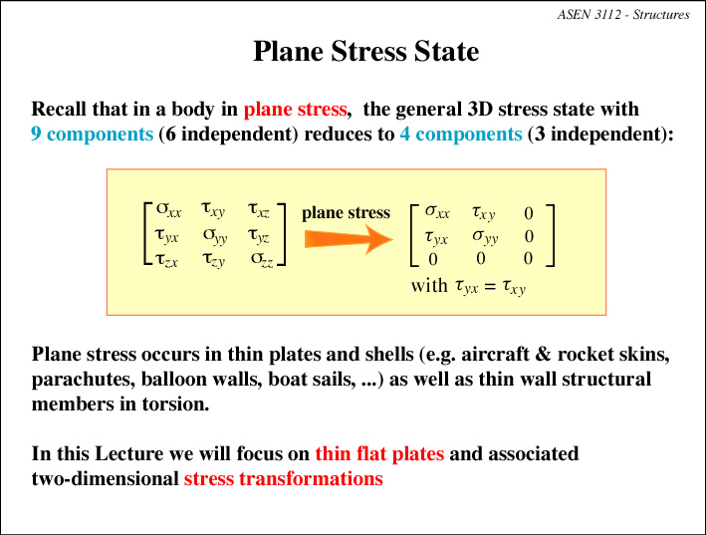

Slide 8
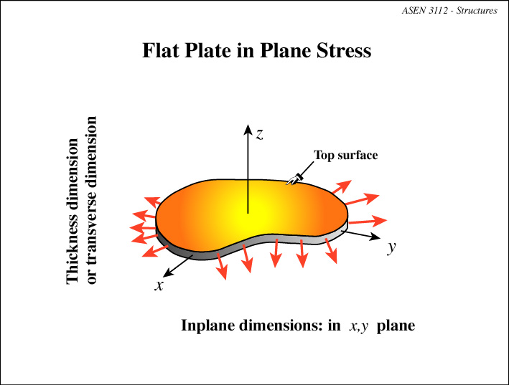

Slide 9
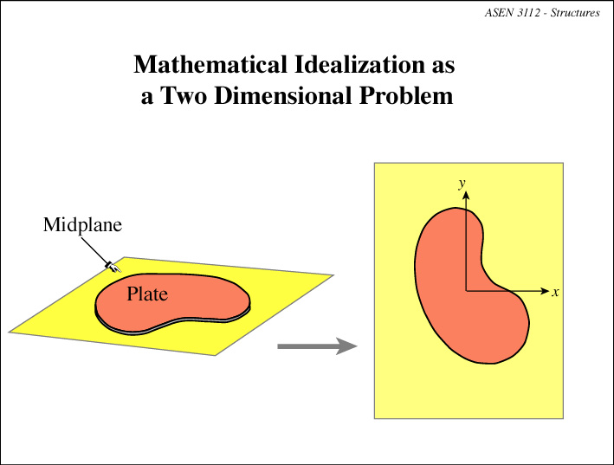

Slide 10
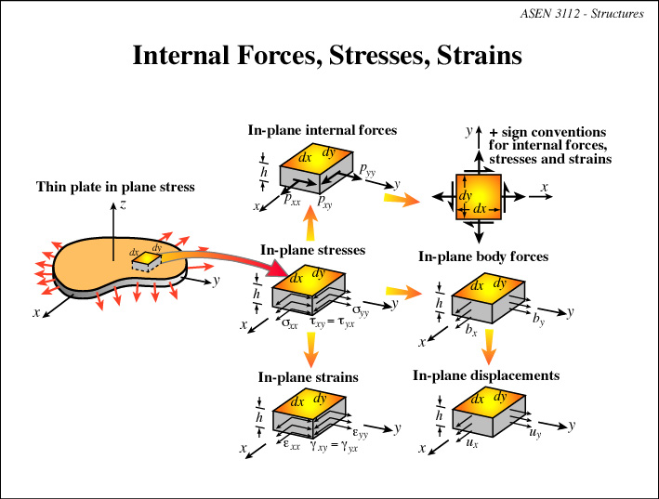

Slide 11
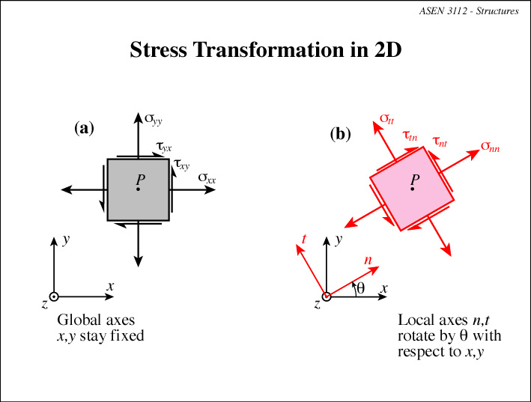

Slide 12
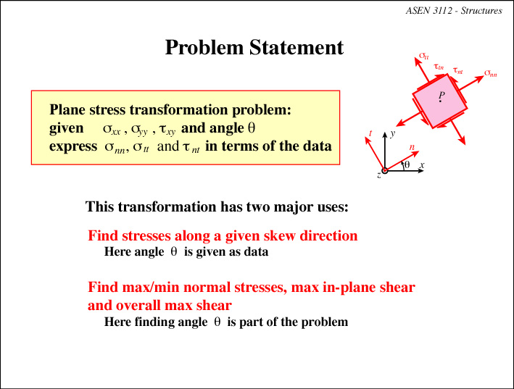

Slide 13
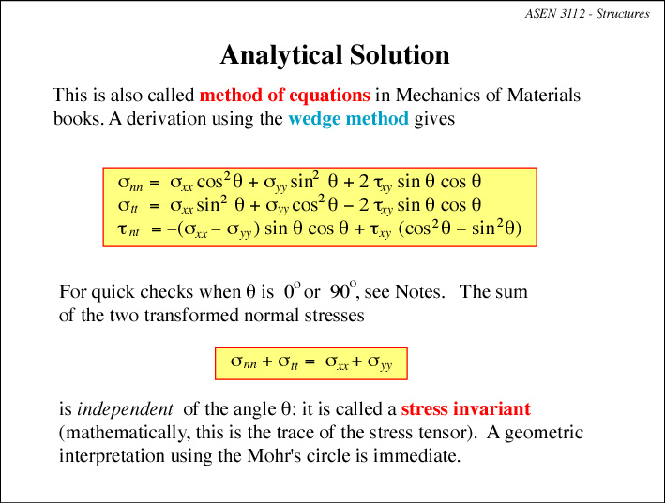

Slide 14
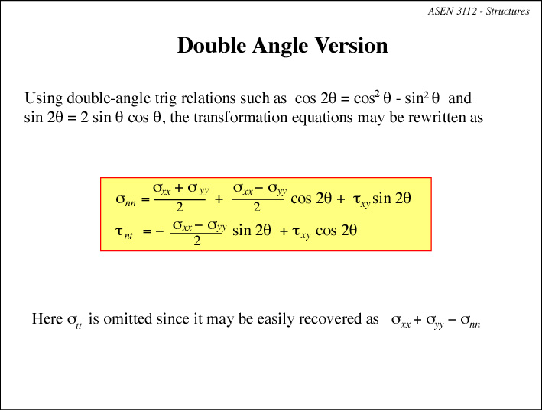

Slide 15
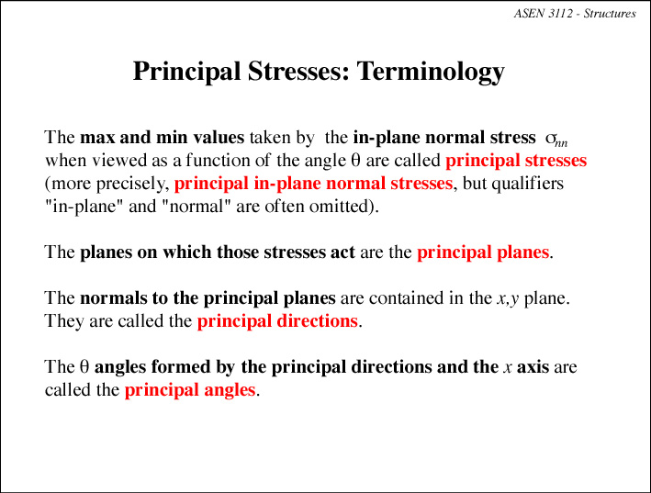

Slide 16
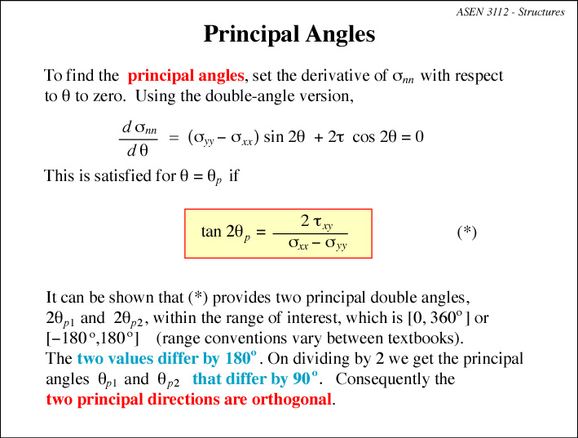

Slide 17
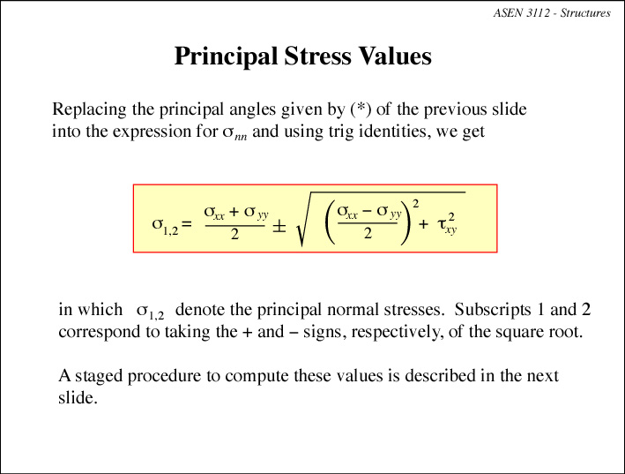

Slide 18
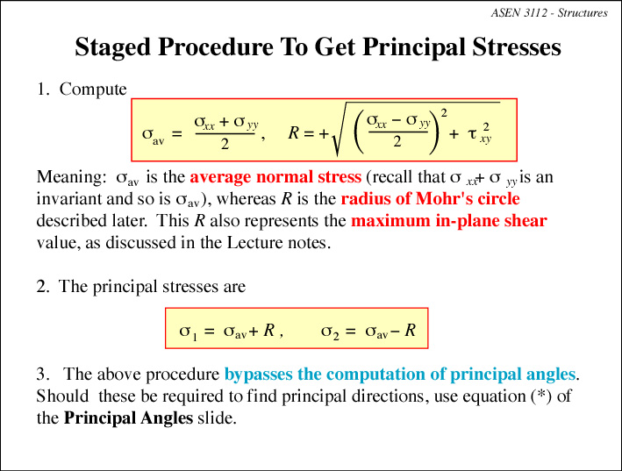

Slide 19
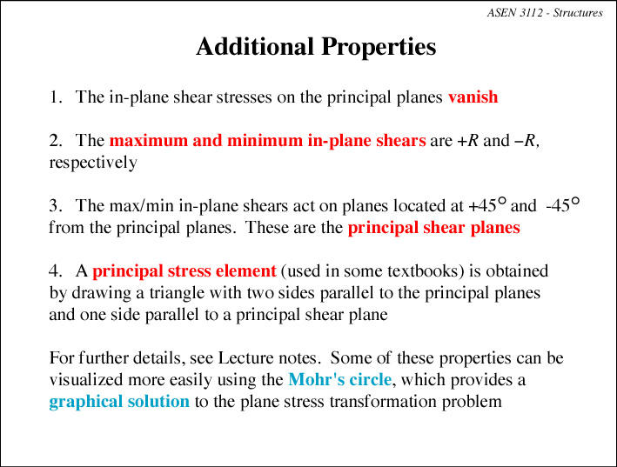

Slide 20
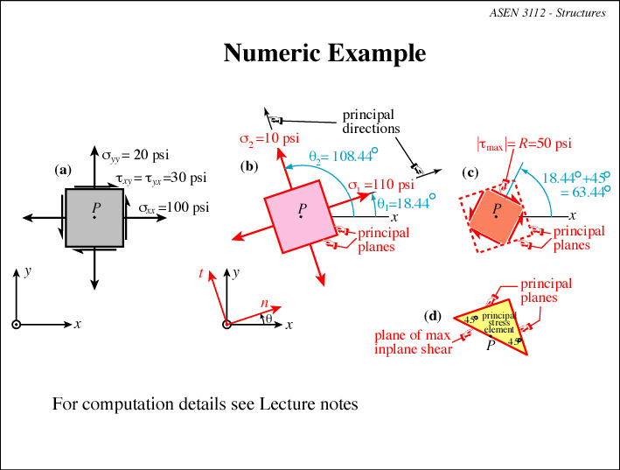

Slide 21
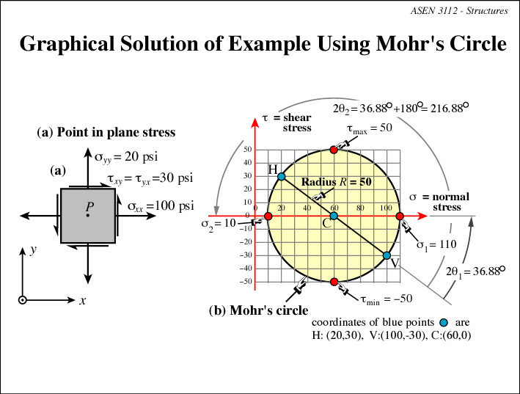

Slide 22
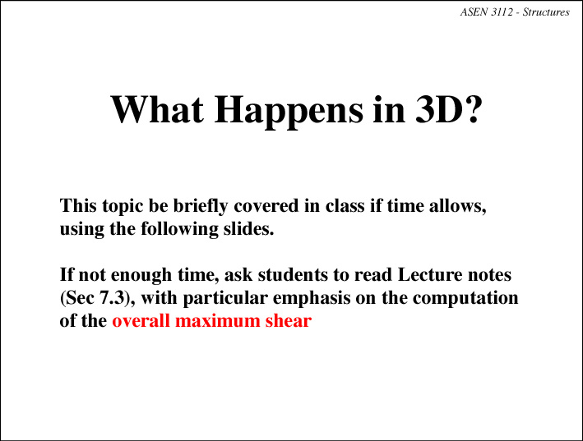

Slide 23
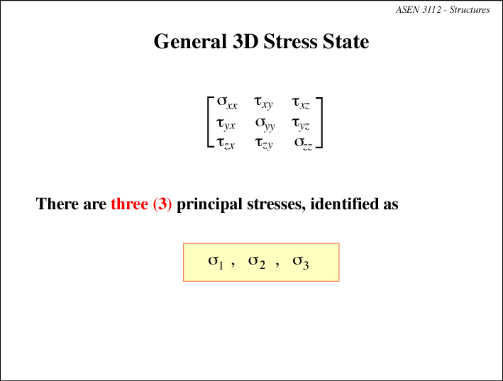

Slide 24
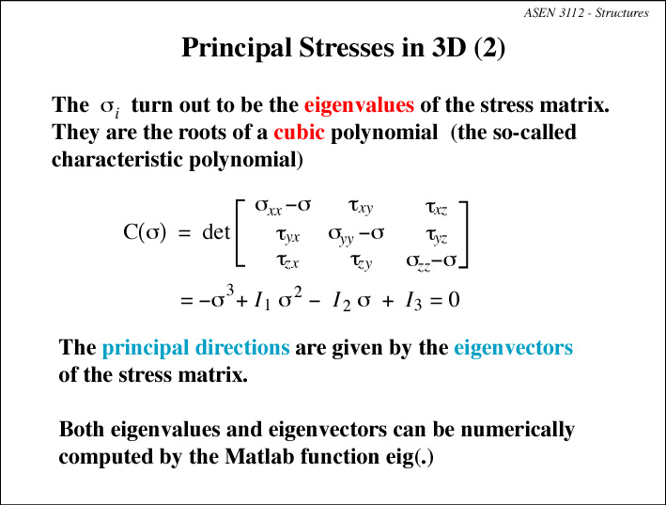

Slide 25
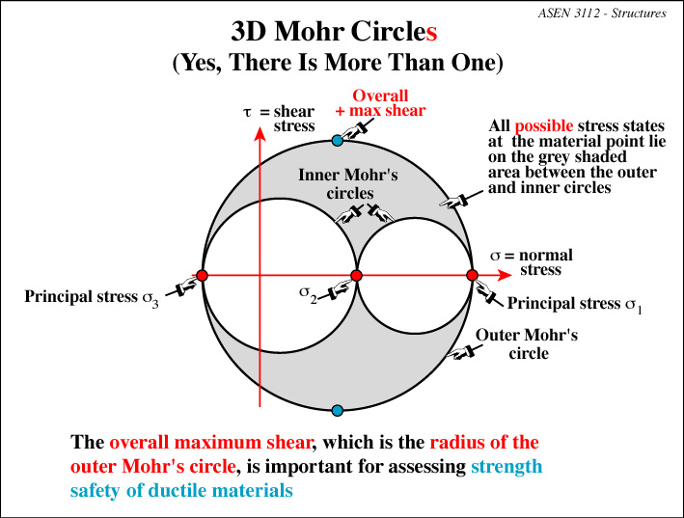

Slide 26
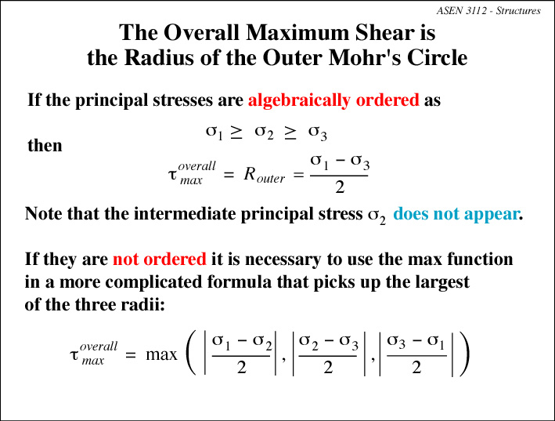

Slide 27
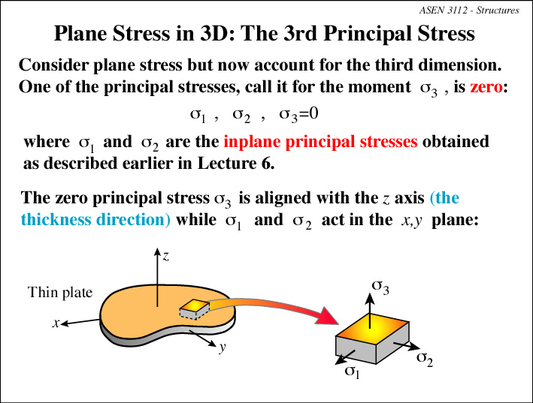

Slide 28
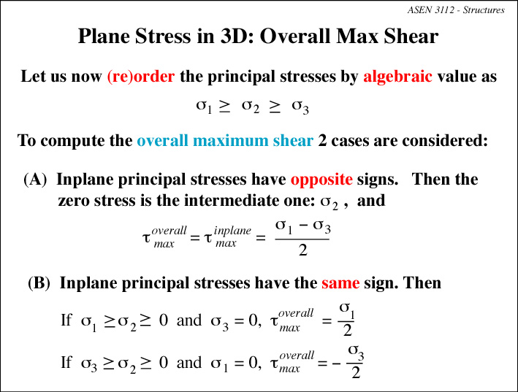

Slide 29
