Slide 1
Welcome to Flat Dreams
X
What?
Why?
Enter
Flat
Dreams
By Yaqeen
V 1.0
How Much?
Features
Credits
What are Flat Dreams
It's a fully customizable, free to use, royalty-free Open Document Presentation Template...
Why
Flat Dreams
Because of it's
2D Flat UI.
Flat UI
is the
Future
of UI...
Free
As In Beer :)
Use it, Edit it, Mod it, Trash it, Update it.
Flat Dreams
are for free
For you
Flat
Design
Designed in
Libre
Office
Moddable
Vector
Graphics
Shapes
Who
Designed
This?
Time to
Meet
It's
Maker
Behold
Yaqeen
*
»
?
:)
»
*
>
Read more
Learn more
Wanna know more
www.whitehatgroup.in

Slide 2
What are Flat Dreams
X
What?
Why?
How Much?
Features
Credits
What
are Flat Dreams?
Flat Dreams is a fully customizable, fully-featured, free-to-use, royalty-free Open-Document Presentation template.
Yes! I am talking about this template in front of your eyes right now.
It was my flat-dream. Now it's yours.
You can use it wherever you want in which-ever ways you want. You can customize it, edit it, re-distribute it anyway you want. If the creator's name would be associated with your future customizations of this template, it is much appreciated. Though it's not compulsory. But it's for non-commercial use. You may not sell this ODP under any circumstances without first seeking the author's written permission. I designed it free-of-charge. And I intend to keep it that way. It's made for humans by a fellow-human without a price-tag.
<
>
www.whitehatgroup.in

Slide 3
Why Flat Dreams
X
What?
Why?
How Much?
Features
Credits
WhyFlat Dreams?
Because of it's 2D Flat UI. Those days of embossed/engraved-type UI designs are passe'. The future is flat. Flat UI is the Future of UI.
Flat designs are everywhere, be it a website-layout, a mobile-app or a desktop UI interface.
So, why should presentation slides be any different?
When it comes to UI/UX, Dream flat-designs :)
<
>
www.whitehatgroup.in

Slide 4
How Much?
X
What?
Why?
How Much?
Features
Credits
Free As In Beer?
Use it, Edit it, Mod it, Trash it, Update it. Your call.
Why should everything on earth have a price-tag attached to it? It kills Art in a true sense-of-the-term. It kills the spirit of sharing. Because those who cannot afford that price-tag will never get to see your art-form. Be it digital or otherwise.
The feeling of creating a painting and sharing it with the rest of the world is simply price-less. Something that master-card cannot buy.
Flat Dreams are for free
For People Like You
<
>
www.whitehatgroup.in

Slide 5
Features
X
What?
Why?
How Much?
Features
Credits
FlatDesign
Designed entirely with Libre Office on Ubuntu 14.4 LTS
Modifiable Vector Graphics Shapes
Clickable navigation(hyperlink-based)
Install the accompanying fonts first for things to look beautiful
Runs smoothly on Libre-Office 4.2.6.3 or higher on both X-windows as well as Windows platforms
Included ready-to-edit sample designer graph/chart
Every square-pixel of this design is editable
SAMPLE GRAPH/CHART
<
>
www.whitehatgroup.in

Slide 6
Features Contd.
X
What?
Why?
How Much?
Features
Credits
< Back
FlatDesign
Double-Click on these diagrams to edit/change the data and layout/design.
<
>
www.whitehatgroup.in

Slide 7
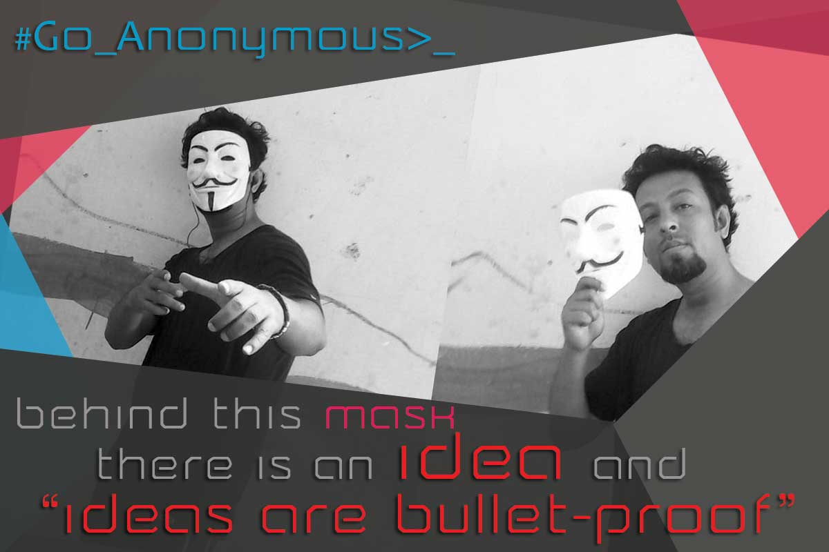
Credits
X
What?
Why?
How Much?
Features
Credits
tHANKS
keep
Dreaming
By Yaqeen
V 1.0
Who is Yaqeen ?
Who cares!
Right?
I know that the first thing you are going to do is change/edit/delete this slide and put your name on it. And you are most welcome to do it. Because it really doesn't matter. Consider me dead. That you downloaded this presentation template from the archive of a dead-man. That's gonna make you feel a lot better. Trust me :)
Still wanna know me?
»
<
>
www.whitehatgroup.in

