Slide 1
XML modelling of Judgment with Akoma Ntoso
10th International "Law via the Internet" Conference, Durban, South Africa
26 - 27 November 2009
prof. Monica Palmirani
CIRSFID Interdepartmental Centre of ICT Law
prof. Fabio Vitali
Department of Computer Science
University of Bologna

Slide 2
Index
Akoma Ntoso for judgments
The Document model
The Metadata model
The Judicial Legal Knowledge modelling
Conclusions: benefits of the standard

Slide 3
AKOMA NTOSO
It is an open legal XML standard for parliamentary, legislative and judiciary documents
Promoted by the UNITED NATIONS Department for Economics and Social Affairs (UN/DESA) in 2004
from the Kenya Unit
It means “Linked Hearts” – a symbol used by the Akan people of West Africa to represent understanding and agreement – but it is now promoted also in Latin America, Asia and European regions

Slide 4
AKOMA NTOSO
Architecture for Knowledge-Oriented Management of African Normative Texts using Open Standards and Ontologies:
  Describing structures for legal documents in XML
  Referencing documents across countries using a common naming convention - URIs
  Adding systematic metadata to documents using ontologically sound approaches
  Aiming at
    Being extendible for the custom needs of any country of the world
    Preserving the legal digital resources over the time
    Guaranteeing legal principles
    Favouring trust (authoritative versions, legal copies, etc.)

Slide 5
AKOMA NTOSO for judgment (1/2)
Common standard for any:
  type of court: African International courts or supra-order curt (ACHPR, ACJ, etc.), supreme court, high court, constitutional court, federal court, etc.
  level of judgment: first order, appeal, etc.
  nature of case: civil, penal, administrative
  judiciary system tradition: common and civil law
Document model:
  the document is the center of the representation
  descriptive approach rather than prescriptive
    “Guide to Uniform Production of Judgments” Honourable Justice, Olsson, L, T. 1999, Supreme Court of South Australia
    “Canadian Guide to the Uniform Preparation of Judgments”, Pellietier, Poulin, Felsky, 2002, Canadian Judicial Council and the Judges
    “Style Guide for the Writing of Judgments”, Constitutional Court of South Africa, January 2007

Slide 6
AKOMA NTOSO for judgment (2/2)
Metadata model:
  each actor in the workflow-chain can annotate with specific metadata the document (at least, name, role, data)
  semantic classification of the document and fragment of text is possible
Unique naming convention:
  URI for citations between different sources: other precedents, jurisprudence, legislation, regulations, foreign case-laws, doctrine, books, articles, etc.
  URI for multimedia objects: video, audio, etc.
  URI for annexes to the case-law: other documents of the trial
  URI are also used to express the Minimal Neutral Citation

Slide 7
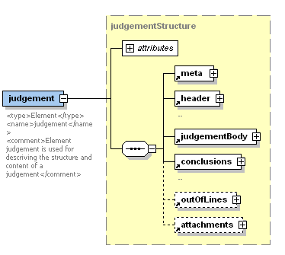
Judgments structure in Akoma Ntoso

Slide 8
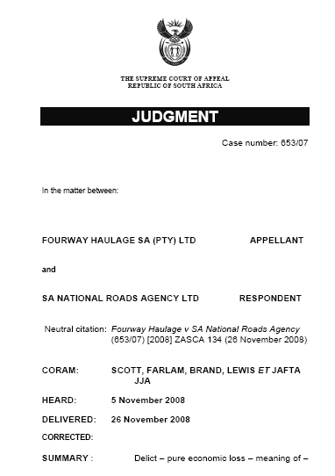
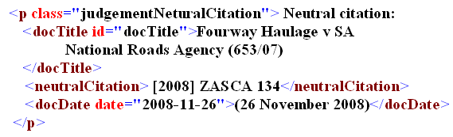
Header
Type of court
Name and place of court
Number case
Parties
Neutral citation
Names of Judges (Coram)
Dates: delivery, hearing, publication, registration, etc.
Summary/Abstract

Slide 9
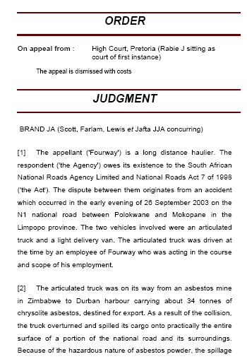
Body
Structure Type:
Hierarchy
List
Block
Multimedia object (video, audio)

Slide 10
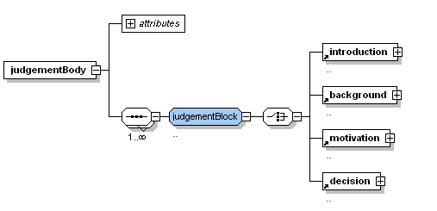
Body of judgments
Introduction: the summary of the case
Background: the description of the facts
Motivation: the argumentation of the judges
Decision: the decisions of the judges and the final order

Slide 11
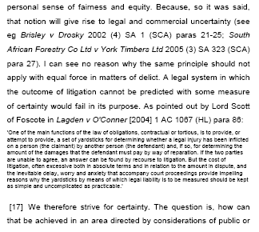
Citations
Include:
Citations
Quoted text
Notes

Slide 12
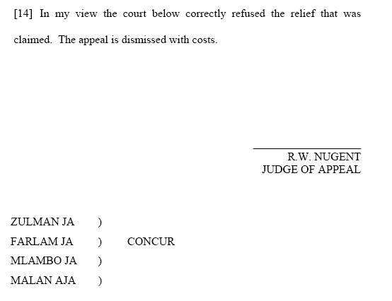
Decision
& Conclusion
Decision
  Qualification
  of the decision
  (penality, etc.)
Conclusions
  Signatures
  Date
  Place
  Qualification
  of the voting
  (minority report)

Slide 13
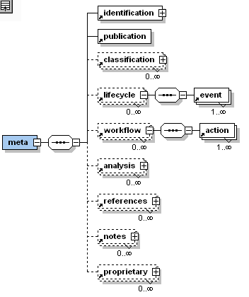
Metadata

Slide 14

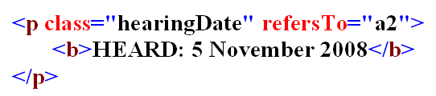
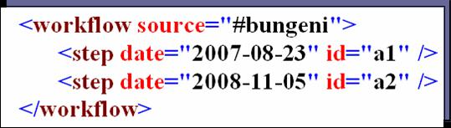
Metadata (1/2)
Descriptive metadata: date of delivery, date of publication, number of registry, name of chancellor, nature of the case, etc.
Classification metadata: matter of the case (values out of domain-specific thesauri)
Lifecycle metadata: the history of the document
Workflow metadata: the administrative steps and actions of the trial (first order, appeal, etc.)
structure
metadata
Notes:
The criteria for reportability are well recognised[1] and applied. They include:
(i) a case which introduces a new principle or new rule of law;
(ii) a case which materially modifies an existing principle of law or settles a doubtful question of law;
(iii) a case which applies an existing principle in a novel area;
(iv) a case in which the language of legislation is definitively interpreted;
(v) a case in which clauses, phrases or words in common use in documents (eg, wills, contracts, insurance policies, charter parties) are construed;
(vi) a case in which the rules of practice of the court are interpreted and their application extended, modified or applied to obscure or unsettled points;
(vii) all cases which for any reason are peculiarly instructive.

Slide 15
Metadata (2/2)
Citations: it is possible, through the references, to obtain all the documents cited by this case-law and all the documents that cite this case-law
Semantic annotation of the case-law:
  relevancy for the law report (reportable criteria: e.g if the case introduces a new rule of law)
  citation role in the current judgment with respect to the precedents
  semantic annotation of fragment of text (ratio decidendi)
Ontology: People, Organization, Role, Actions, etc.
Notes:
The criteria for reportability are well recognised[1] and applied. They include:
(i) a case which introduces a new principle or new rule of law;
(ii) a case which materially modifies an existing principle of law or settles a doubtful question of law;
(iii) a case which applies an existing principle in a novel area;
(iv) a case in which the language of legislation is definitively interpreted;
(v) a case in which clauses, phrases or words in common use in documents (eg, wills, contracts, insurance policies, charter parties) are construed;
(vi) a case in which the rules of practice of the court are interpreted and their application extended, modified or applied to obscure or unsettled points;
(vii) all cases which for any reason are peculiarly instructive.

Slide 16
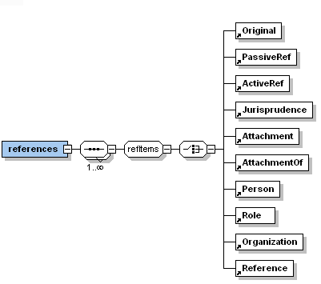
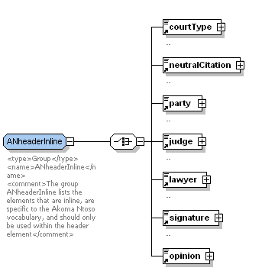
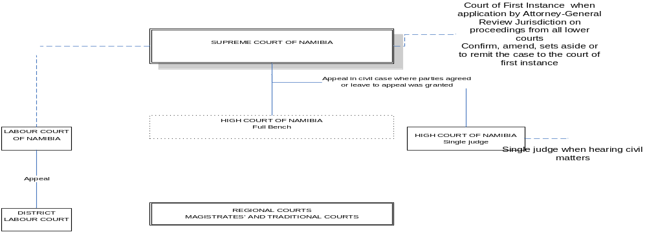
Connection
Meta & Ontology
metadata
structure
ontology

Slide 17
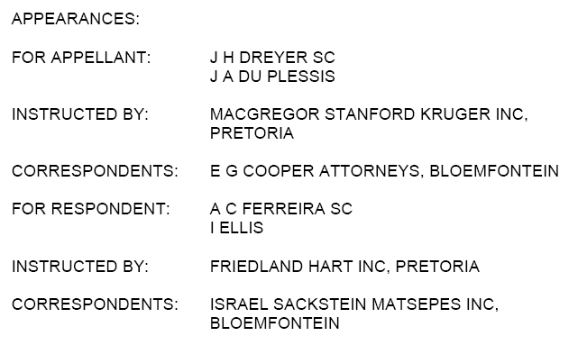
Semantic annotation: three relationships
3
2
1
<lawyer id="lawyer-3" refersTo="#Plessis"
for="#appellant" as="#advocate" empoweredBy=“#Kruger" >
J. A. DU PLESSIS
</lawyer>
2
3
1

Slide 18
Citations classification
Typology
  Legislation, Subsidiary legislation, Regulation
  National and foreign case-law
  Jurisprudence, doctrine
  Book, article, other sources
Role analysis
  for argumentation type (dissenting, applying, exception, supporting, overruling, analogy, etc.)
  for history (connected case, dismissed, confirmed)
Static or Dynamic
  Contrary to legislation, where the citation are mostly dynamic
  In the case-law the citation are mostly static
  “tempus regit actum”
Notes:
y

Slide 19
Citations analisys
Analysis of different classification existing in the main legal databaes
  LexisNexis
  Westlaw
  Kluwer
in Jurisrpudence
and in several court best practices
  Canada
  USA
  South Africa
  Kenya
  Australia

Slide 20
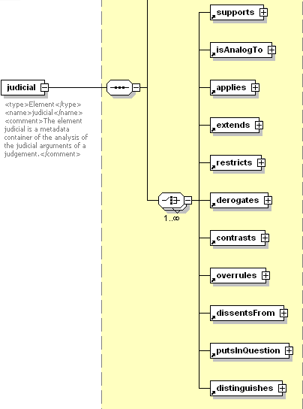

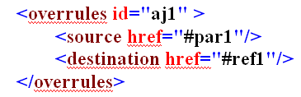

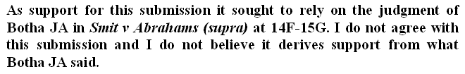
Classification of the references

Slide 21
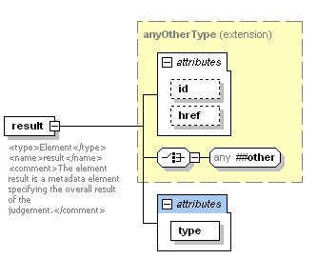

Classification of the case-law
deny
dismiss
uphold
revert
replaceOrder
remit
decide
approve

Slide 22
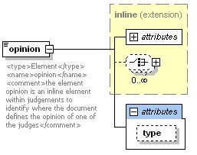
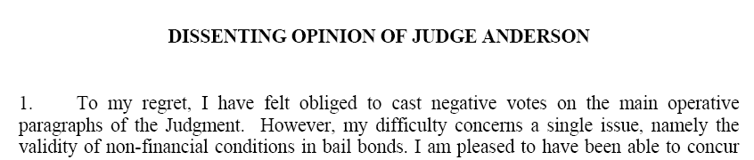
Classification of the voting
Agreeing
Dissenting
Approving
Rejecting
Null

Slide 23
Text semantic annotation
Each part of the text can be annotated for different purposes:
  Examining and comparing the arguments of the judges: logic consistency check
  Legal concept annotation: retrieval and comparison
Example of semantic annotation:
  In the Background: modeling the case for the comparison with other real cases
  In the Motivation: the part of the text relevant to the support the decision and new rule of law introduced (ratio decidendi)
  In the Decision: the statement on the parties

Slide 24
Conclusions: benefit of the standard (1/3)
For the citizens, enterprises, legal experts
Semantic retrieval: to extract and manipulate the knowledge in the case-law
Comparison: to compare different case-laws also coming from different countries
Traceability: to allow citizens and enterprises tracing the judicial proceeding and having awareness of the schedule, the expectation and the final results

Slide 25
Conclusions: benefit of the standard (2/3)
For the Judge and the Court System
Drafting and Consolidation: to support the judge with tools (editors) that help to write the judgments and to consolidate decisions coming from different judges
Decision support system: to help young judges to learn from the precedents and to maintain a quality standard
Dialogue: to help judges to learn from each other
Workflow support: to help the judge in the trial steps
Preservation: by making the XML document independent of the application and tool used to generate it

Slide 26
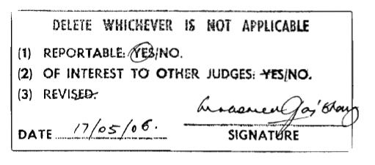
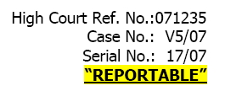
Conclusions: benefit of the standard (3/3)
For the publishers:
Publishing: to help the publishing process, to improve the commercial activity of the publisher, to allow for different manifestations of the same content (Gazette, paper, law report, etc.)
Law report definition: to improve the law report definition. E.g. selection of which case-laws are relevant in view of their insertion in the national law report

Slide 27
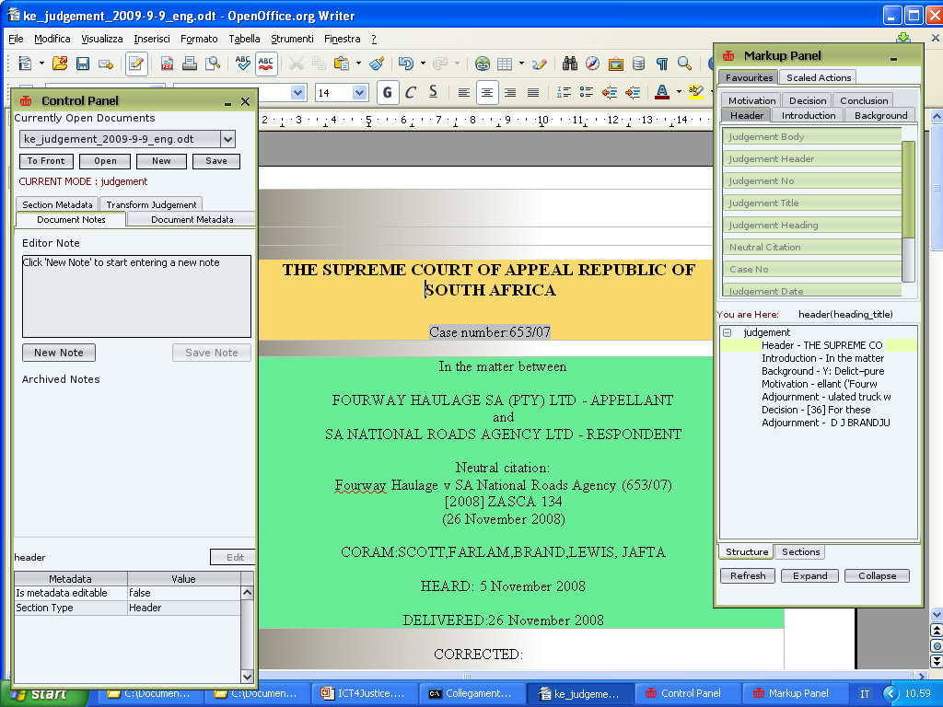
BungeniEditor- open source
Open Office markup editor

Slide 28
References
www.akomantoso.org
BungeniEditor on googlecode forum
thank you
for your attention
Monica Palmirani – monica.palmirani@unibo.it
Fabio Vitali – fabio@cs.unibo.it

