Slide 1
An introduction to the document types in Akoma Ntoso
Fabio Vitali
University of Bologna

Slide 2
Summary
A non technical introduction to some of the most relevant aspects of Akoma Ntoso
  The purpose of Akoma Ntoso
  Design issues of Akoma Ntoso
  Document types supported
  Structures shared across document types
  Special features of Akoma Ntoso
  The naming convention
  Schemas and subschemas

Slide 3
The purpose of Akoma Ntoso
To associate specific descriptive labels (called markup) to legal documents and their content.
Labels need to be associated to the whole document, to its main parts, to lesser structures (e.g., paragraphs), to individual words.
Markup traditionally is divided in
  Structural markup: to identify the parts of the documents and how they repeat, associate and contain others)
  Semantic markup: to associate by way of labels interpretations to pieces of text (e.g.: title, date, emanating body, etc.)
  Presentation markup: to associate specific visualization (e.g. typographical choices) to individual pieces of markup.
Furthermore, big importance is given to metadata, defined as every piece of information we want to associate to a document that does NOT belong to its content.

Slide 4
Design issues in Akoma Ntoso
Short and long term concerns
Attribution of contributions (authors vs. editors)
Descriptiveness and prescriptiveness
Different uses, contexts, legal systems

Slide 5
Short and long-term concerns
Short term concern
  Being able to be used in many different ways
    Multi-channel presentation, document workflow, document lifecycle, automatic point-in-time consolidation, semantic searches and classifications, etc.
Long term concern
  Being able to use the documents in 5, 10, 50 years’ time
    It means not relying on any software architecture, nor on the existence of specific resources, documents and manuals but the documents themselves
    which in turn means self-containment, self-description, rich set of metadata, expressive markup, etc.

Slide 6
Attribution of contributions
Akoma Ntoso supports the very nature of legal documents, whose nature, integrity and validity must be ascertained with no possible doubt.
Thus anything that affects its integrity needs to be not rejected, but carefully marked as such.
The main tool we have is the correct attribution of contributions.
Document have authors, that draft the content. For legislation, it is legislator, for judgments it is the judge, etc.
Documents may have editors, that enrich the document with annotations and additional information. Editors also create the markup of a document.
In Akoma Ntoso, the role of authors and editors is clearly identified, and their contribution (respectively, content and metadata) is NEVER mixed up.

Slide 7
Descriptiveness and prescriptiveness
A markup language resembles a language in that it has
  a vocabulary (the list of labels you can associate to the parts of the document)
  A grammar (the rules that let you combine the vocabulary and define correctness and incorrectness)
A grammar gives power to its author. Power that can but should never be imposed excessively.
  A prescriptive grammar rejects atypical constructs, and poses itself in a power position wrt thems
  A descriptive grammar tries to accommodate the widest collection of senseful constructs, and poses itself as their servant.
Depending on the objective, Akoma Ntoso can be made
  Prescriptive (e.g., in a drafting situation where you can and want to control the process of drafting)
  Descriptive (e.g., in the salvaging of past collection of unchangeable documents)

Slide 8
Different uses, contexts, legal systems
Most XML applications to legal systems have basically one purpose in mind: presentation.
In Akoma Ntoso we consider also
  Multi-channel presentation
  Hypertextual navigation (with static and dynamic links)
  Sophisticated search
  Automatic consolidation of amendments
In different legal systems
  Both civil law and common law countries

Slide 9
Document types in
Akoma Ntoso

Slide 10
Document types
Legislative documents
  Bills
  Acts
Debates
Amendments
Judgements
Collective documents
  Official gazettes
  Amendment lists
Generic documents

Slide 11
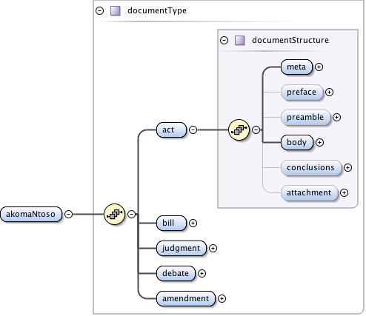
General structure of Akoma Ntoso documents

Slide 12
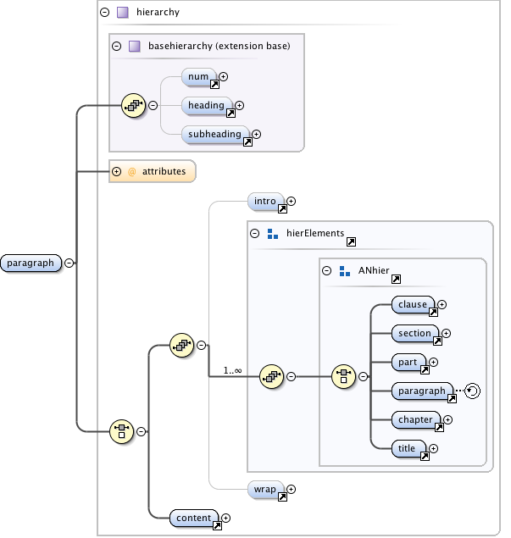
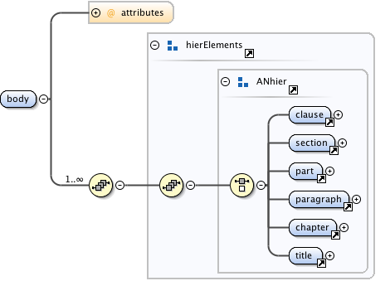
The structure of legislative documents

Slide 13
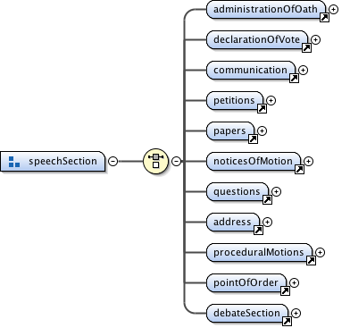
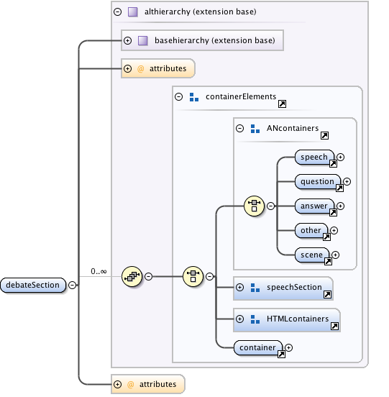
The structure of debate documents

Slide 14
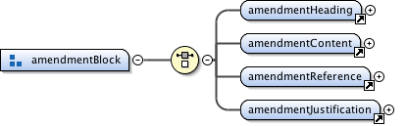
The structure of amendment documents

Slide 15
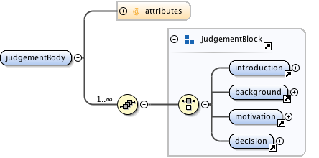
The structure of judgement documents

Slide 16
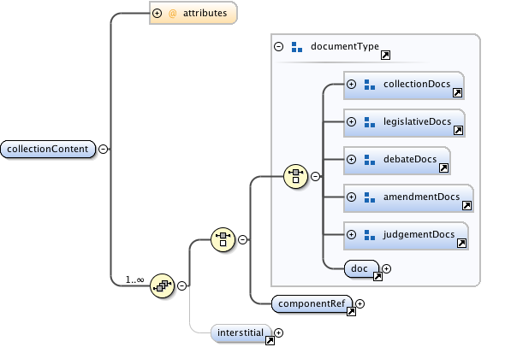
Collective documents

Slide 17
Further shared elements and concepts
Blocks and inlines
References
Semantic elements
Authorial vs. editorial footnotes
Metadata

Slide 18
Blocks and inlines
Once the structure is described with all its parts and meanings, blocks and inlines are used to actually contain the text of the document
Blocks are vertically separated containers of text (e.g., Word paragraphs).
Inline are containers of text that do not break the line (e.g., styles within paragraphs)
Akoma Ntoso has a rich collection of both.

Slide 19
References
Explicit references to other legal document or their subparts.
A static reference points to a specific version
A dynamic reference points to a version that depends on the context within which the document is being sought.

Slide 20
Semantic elements
Dates, individuals, concepts, events, documents need to be identified unambiguously to allow for sophisticated searches to work
E.g. the person making a speech, the document being modified by the amending act, the validity date of an act.

Slide 21
Authorial vs. editorial footnotes
In some document types the content is in the main flow, all all notes are explanatory comments placed by editors. These are editor-generated text and therefore metadata.
Sometimes the original content has text in a separate flow (sidenotes, footnotes, etc.) that is nonetheless authorial and authoritative.
These MUST be distinguishable

Slide 22
Metadata
A large collection of information items that are not drafted by the author, but by drafting offices, editors, publishers, scholars, etc.
  Metadata for identification
  Metadata for classification
  Metadata for workflow and lifecycle support
  Metadata for legal analysis
  Metadata for entity classification

Slide 23
Special features
Modifications
  Managing the (semi-)automatic generation of consolidated version of the document off the original version and the sequence of modifying documents
Lifecycle and workflow
  Recording every step of the workflow which the document underwent, and giving specific relevance to those steps that generated new versions of the document (lifecycle events) and the generated document themselves

Slide 24
The Akoma Ntoso naming convention
Possibly the most important feature of Akoma Ntoso is the mechanism to associate a identifiable name to each document, version of document, fragment of version of document regardless of type, country, age, etc.
Through the naming convention it is possible to
  Create the hypertextual navigation between documents, both static and dynamic
  Navigate through the maze of versions and variants of a document (across time, languages, uses, etc.)
  Consolidate versions for point-in-time access to docs
  Create a separation layers between the conceptual structure of the legal system and the physical storage on computers.
A tool need to be used to separate conceptual names from physical names
http://akn.web.cs.unibo.it/

Slide 25
Modular schemas
The full schema of Akoma Ntoso contains 229 elements and 79 attributes.
While they are reasonably easy to maintain because they belong to five fundamental families called patterns, they can become rapidly confusing for the author or drafter of legal documents.
Thus the full Akoma Ntoso has been modularized and it is possible to generate subschemas that are fully compatible with the complete schema, yet contain only those elements that are really useful for each individual situation.
A tool may help generating the right subschema.
http://akn.web.cs.unibo.it/aknssg/

Slide 26
Conclusions
Akoma Ntoso tries to provide for all kinds of legal documents.
Basic structures and needs are already taken care of (hopefully)
But experience has shown that individual countries do things differently all the time
For this reason it is important to contribute with one’s own experience and problem to the improvement of the whole standard

