Slide 1
Legal Source in the information society: opportunities and challenges
Monica Palmirani
CIRSFID – University of Bologna, Law Faculty

Slide 2
Outline
XML in Parliament
Legal XML
Akoma Ntoso

Slide 3
Outline
XML in Parliament
Legal XML
Akoma Ntoso

Slide 4
XML
XML (Extensible Markup Language) is a markup language open standard promoted by the W3C and largely adopted in worldwide for representing data and document
  searchable and readable by the machine
  (versus PDF, tiff)
  independent of the technology (versus Word format)
  separate the information presentation from the representation (versus the HTML)
  hierarchic, rigorous, extendible therefore more precise and flexible
  long term investment for archival

Slide 5

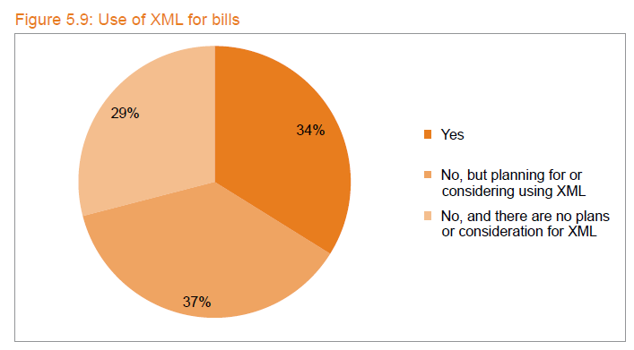
Use of XML in the Parliament
Form the World e-Parliament Report 2010
– 134 parliaments surveyed
34% declared to use XML in Parliament for bills and 37% declared to have the intention to use it in future

Slide 6
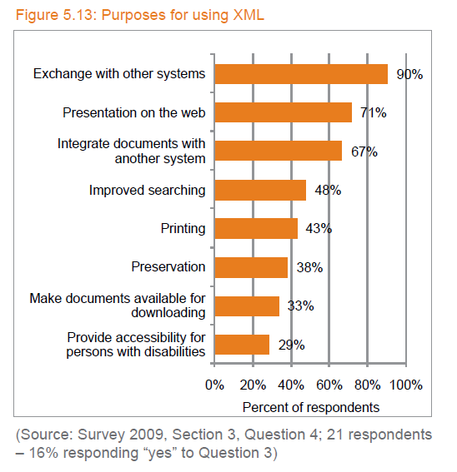
Why use XML in Parliament

Slide 7
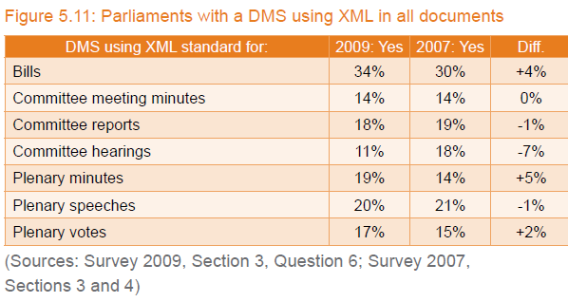
Typology of documents involved
Not all XML standards are oriented to legal documents
Legal XML is oriented to represent legal and parliamentary documents and knowledge

Slide 8
Outline
XML in Parliament
Legal XML
Akoma Ntoso

Slide 9
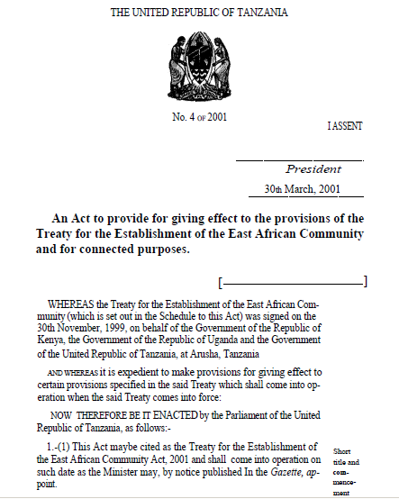
How to use Legal XML
<authority>
</authority>
Precise representation of the structure
<docNum>
</docNum>
Accuracy of the semantic mark-up
<docDate>
</docDate>
<title>
</title>
<preamble>
Identification of the legal information
It is an intellectual task
</preamble>
<section>
<authorialNote>
</section>

Slide 10
Legal XML in the world
EnAct - Tasmania, Australia, New Zealand e Canada
FORMEX data model - EUR-LEX
MetaLex and SDU BWB - Netherland
LexDania - Denmark
eLaw - Austria
CHLexML - Swiss
Crown XML Schema for Legislation - United Kingdom
NormeinRete – Italy
Chile XML
AKOMA NTOSO - United Nations for Pan-African Parliaments
House of Representatives

Slide 11


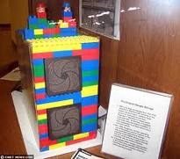
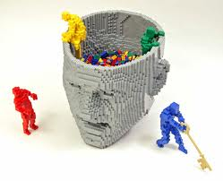
XML it is not enough… not all the XML standards are equally expressive
First
Google Server
Too simple
Too technical
Too complex

Slide 12
Legal XML characteristics
Document oriented – document is the focus
Self-contained – document is autonomous
Descriptive – document is well described, even in odd structures
Prescriptive – document is checked for quality
Separation of concerns - content, metadata, presentation are separated
Ontology-oriented – the ontological level is external to the document
Technology Neutral – independent of technology
Persistent over time – long term preservation for archival
Workflow-oriented – document is part of a legislative process

Slide 13
Outline
Why XML in Parliament
Characteristics of Legal XML
Akoma Ntoso

Slide 14
AKOMA NTOSO
An open XML standard for any legal document used in Parliamentary processes and judiciary systems
Started in 2004-2005 within the project “Strengthening Parliaments’ Information Systems in Africa”, promoted by the UNITED NATIONS Department for Economics and Social Affairs (UNDESA)
Akoma Ntoso means “Linked Hearts” and it is a symbol used by the Akan people of West Africa to represent understanding and agreement

Slide 15
AN supports quality
Support for best practices within processes
  A unique standard fosters the diffusion of best practices and the reengineering of the legislative processes
Support for the Quality of Law
  An XML standard fosters compliance to legal drafting guidelines
Support for interoperability
  The harmonisation of legal document formats allows interoperability between Parliaments, data interchange, common tools, shared templates, distributed web sites, larger marketplace for expertise, tools and education.
Support for open source tools development
  As an open standard it encourages the open source software community

Slide 16
AN supportes for parliamentary activities
Support for the generation of new documents
  Drafting activities, record keeping, translation into all national languages, etc.
Support for workflow and lifecycle of documents
  Management of documents across lifecycle, storage, security, timely involvement of relevant individuals and offices
Support for citizens’ access to legal global information
  Multi-channel publication (on paper and on the web), search, classification, identification
Further activities
  Consolidation, comparison, language synchronization, etc.

Slide 17
Akoma Ntoso design characteristics
A) Document oriented –
not data oriented
B) Separation of levels –
content, metadata, presentation
C) Pattern-oriented–
models and templates
D) Workflow-oriented – to describe the steps of the legislative process
Self-contained
Descriptive
Independent
persistence
Prescriptive
Ontology-oriented

Slide 18
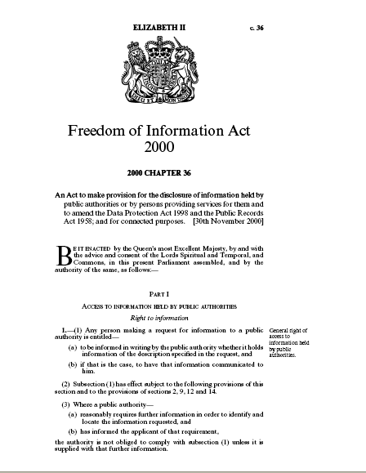

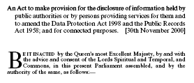

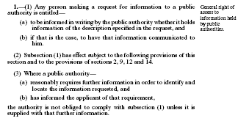
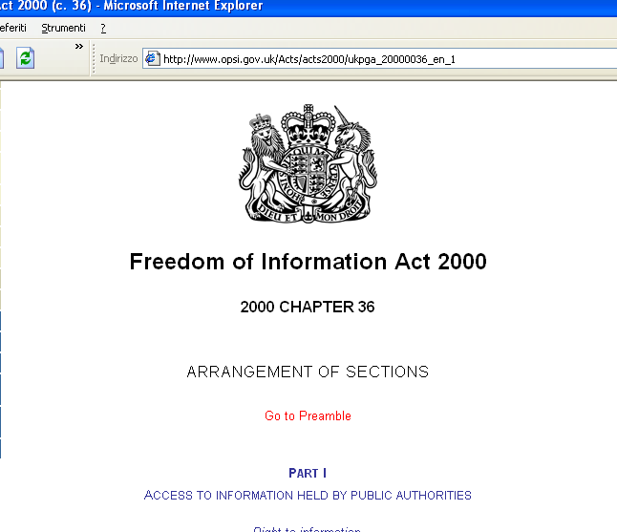
A) Data oriented
Database
supporting XML
as data format
Application
layer

Slide 19
Document oriented
Repository
<title>
</title>
<date>
</date>
transparency
<preamble>
Descriptive
legal
validity
Independent
persistence
</preamble>
<article>
</article>

Slide 20
B) Separation of document levels
Content
  What was written in the document by its creator
Structure
  How the content is organized
Metadata
  Any consideration or comment or additional information that can be expressed on the content and on the document by someone else
Ontology
  A representation of the conceptual model that shapes all metadata associated to a document

Slide 21
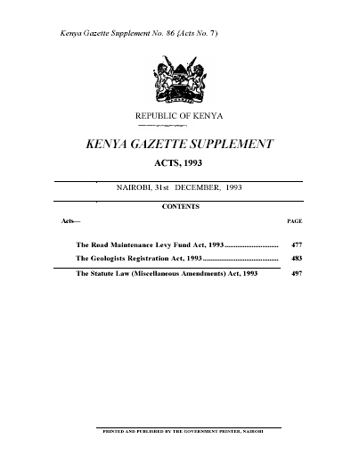
An Example
Metadata –
number and source
of publication
Presentation-oriented
text
Metadata- date of publication
Presentation-oriented
text
Presentation-oriented
text

Slide 22
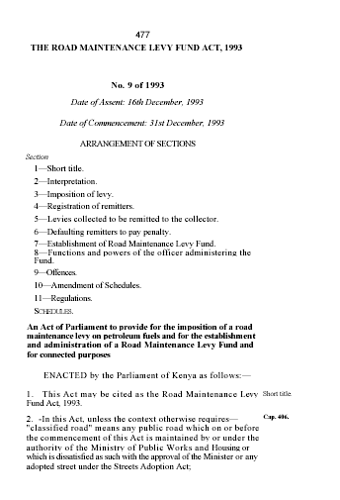
Presentation-oriented
text
Metadata- date of publication
Content

Slide 23


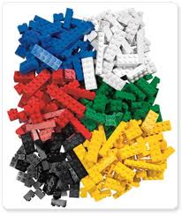



C) Pattern oriented
Models of Patterns
TAG set
Classes of TAG

Slide 24
D) Workflow-oriented
Pre-assembly
Recording
Assembly
Post-assembly
Committees
Stakeholders
Legislative
Offices
Official
Publishing
External Institutions
Documentalist
Metadata
Document Drafting
Translation
Simulation
Consolidation of documents
Consolidation of amendments
Ordering of amendments
Debates record
Official Printing
Final Drafting
Formal Check
Editorial Metadata
Post-Publishing
Consolidation
Publication Metadata
Annotation
Jurisprudence

Slide 25
Consolidation management
Direct:
(Consolidation of the Acts in the High Court of Cassation in Italy)
  the modifier leads the process and produce a new version of the modified
Inverse:
(Amendments on bills project in EU Parliament)
  the consolidation act is annotated for producing the connection with the modifier(s)
Dif: (Official Gazette of Canada)
  start from two versions of the same document deduct the modifications
M
V1
M
V1
M
Vn
Vn+1

Slide 26

Scenario of direct consolidation
CIRSFID
Original.
Bill
Consolidated
Bill
Amendment
Bill

Slide 27
Scenario of inverse consolidation
AM4EP
Original
Bill
Original+
Modif.
Bill
Amendment
Bill
Modifications

Slide 28
Scenario delta
Italian Senate
Side-by-side comparison
Bill
Version1
Bill
Version2
Diff
Modifications
List

Slide 29
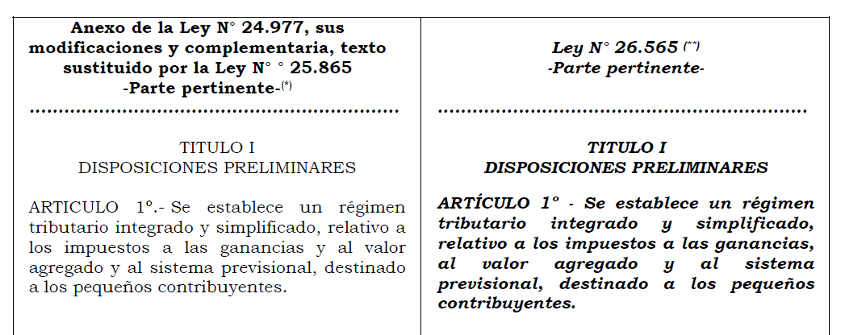
Pilot cases:
Italian Senate: act consolidation
AM4EP: amendment management
TAF: comparison between two versions

Slide 30
Conclusions
Not all the XML standards are fitted for legal document modelling
Descriptiveness of the legal document is fundamental
Legal document mark-up needs an accurate legal identification of the textual parts
Localization of Akoma Ntoso is fundamental for the success of the standard and of their applications

Slide 31
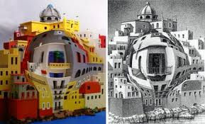
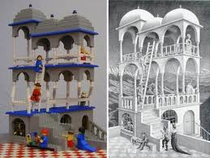
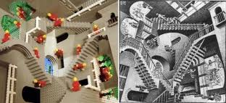
Enjoy …
www.akomantoso.org

Slide 32
Debates
Monica Palmirani
CIRSFID – University of Bologna, Law Faculty

Slide 33
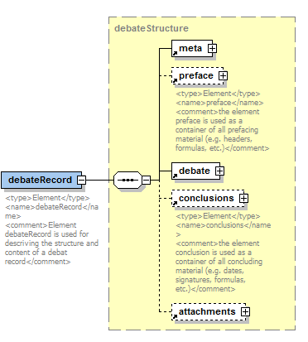
Debates

Slide 34
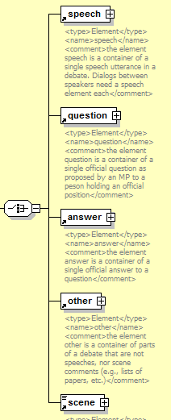
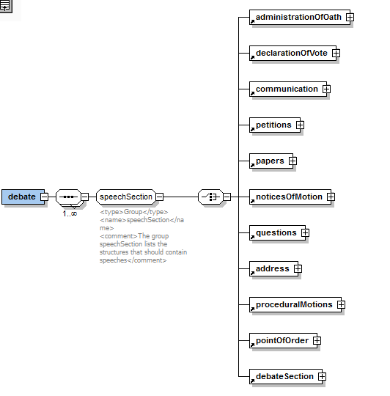
Debates

Slide 35
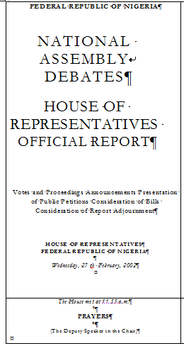
Debates
preface
debates
prayerSection

Slide 36
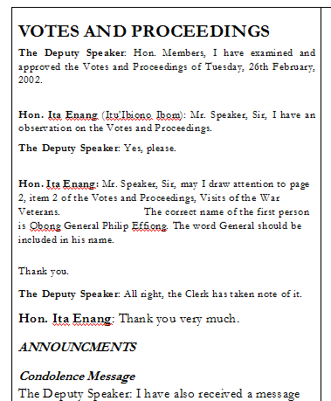
Debates
debateSection
speech
from
<speech id="sub1-spe01" by=“#speaker">
<from>The Deputy Speaker</from>
<p>Hon. Members, I have examined and approved the VOtes and proceeding of Tuesday, 26° Ferburary 2002.</p>
</speech>
<speech id="sub1-spe01" by=“#enang">
<from>Hon. Ita Enang (Itu'Ibiono Ibom): </from>
<p>Hon. Speaker, Sir, I have an observation on the Votes and Proceedings. </p>
</speech>
prayersSection

Slide 37
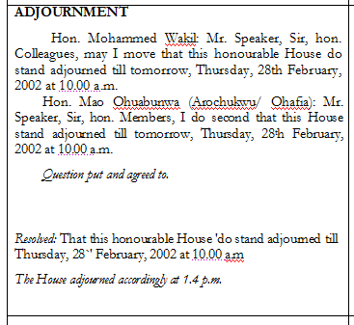
Adjournment section
adjournment
date
recordedTime
<recordedTime time="14:07:00" type="startEvent"/>

Slide 38
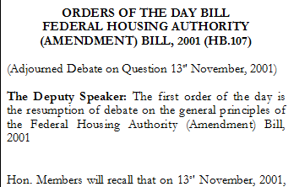
ordersOfBill

Slide 39
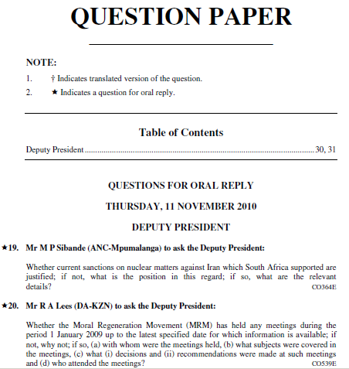
Question Paper
preface
questions
from
heading
code
question
num
South Africa

Slide 40
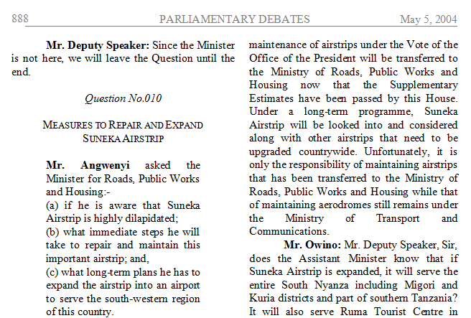
num
Kenya

Slide 41
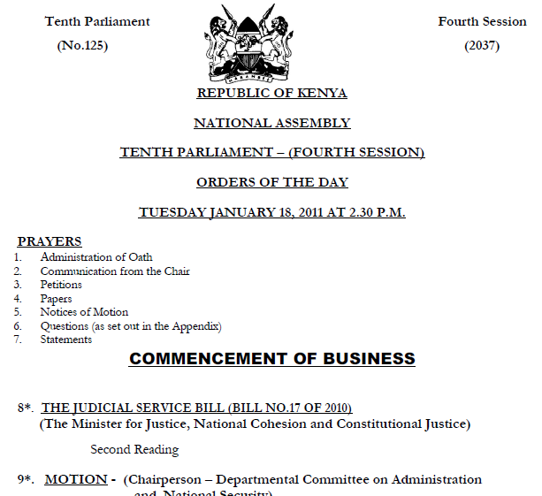
legislature information

Slide 42
New candidates
preyerSection
orderOfBill
adjurnment

Slide 43
Bill, Amendments Bill and Amendments
Monica Palmirani
CIRSFID – University of Bologna, Law Faculty

Slide 44
Bill
Monica Palmirani
CIRSFID – University of Bologna, Law Faculty

Slide 45
Bill structure
Third method
a document
Collection
First method
Two separate
documents
Second method
One document
with an Annex
Memorandum
Report
Bill
Bill
Commission approval
Memorandum
Bill
Bill approved
annex
act

Slide 46
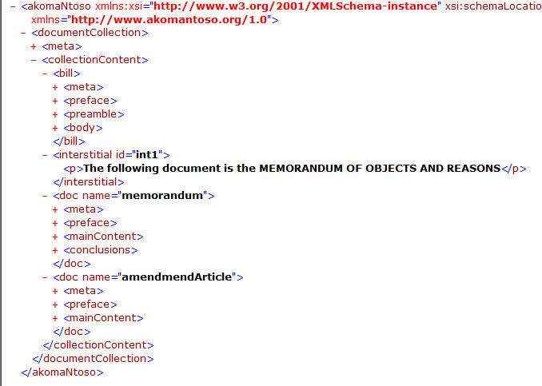
documentCollection
bill
memorandum
annex

Slide 47
Components
document
Collection
Forth method: components
Link to the Report
Link to the Bill
Link to approval document
Link to annex
Report
Bill
Approval document
Annex

Slide 48
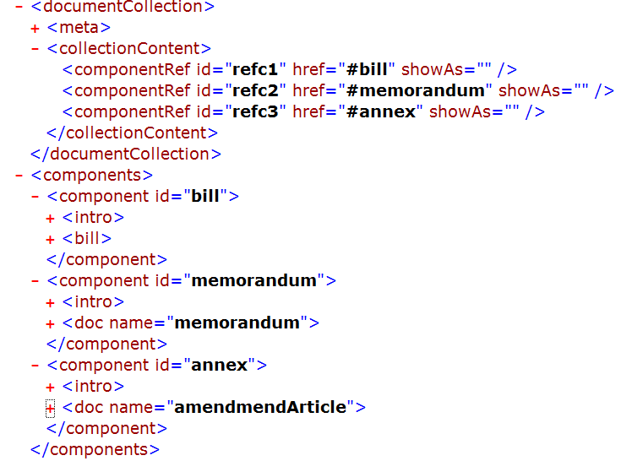

Slide 49
Bill and annexes
First method: separate files
Second method: included structures
bill
bill
annex
Annex.xml
map
Video
Audio
Movie
table
Annex.pdf
Anned.tiff

Slide 50
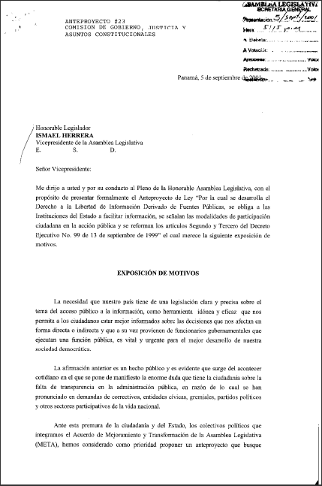
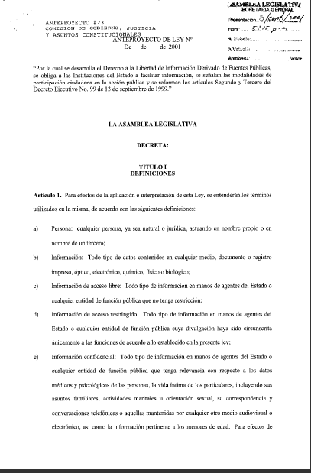
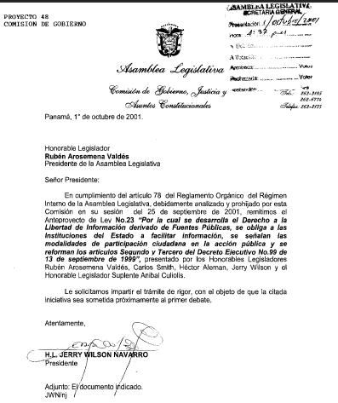
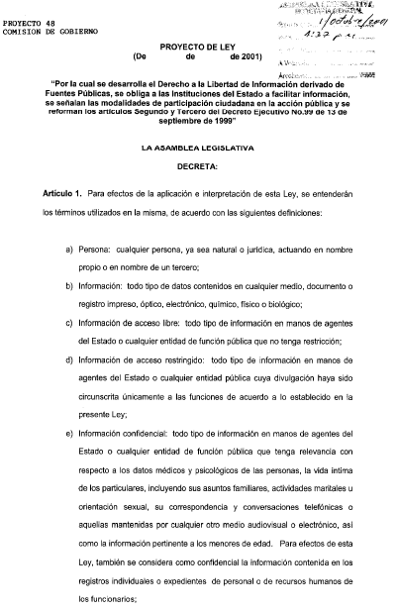
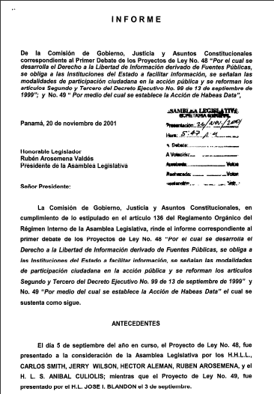
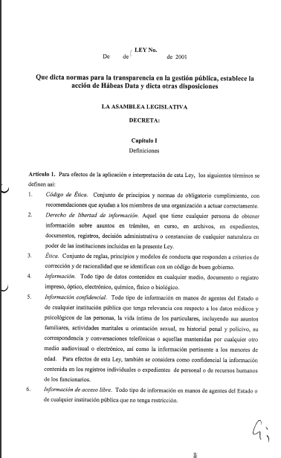
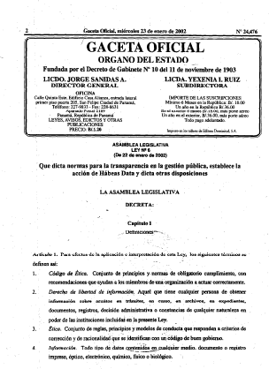
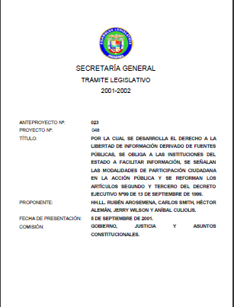
File of the Bill
Report or Memorandum
Bill
Commission approval
Bill approved by commission
First reading
Second reading
Third reading
Promulgation
Act
Panama

Slide 51
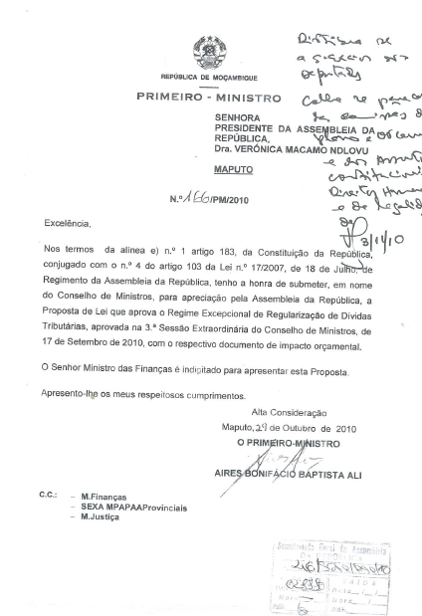
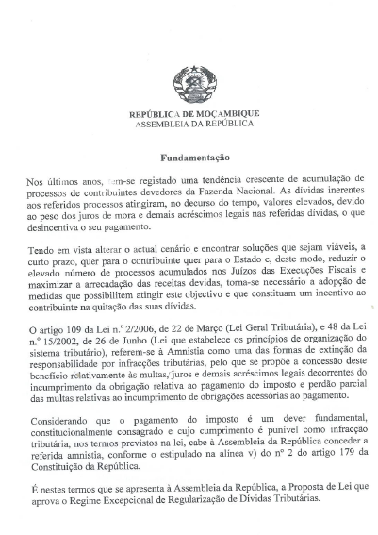
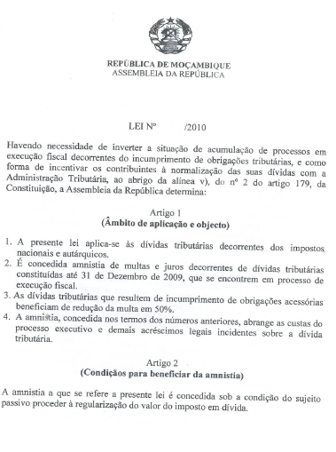
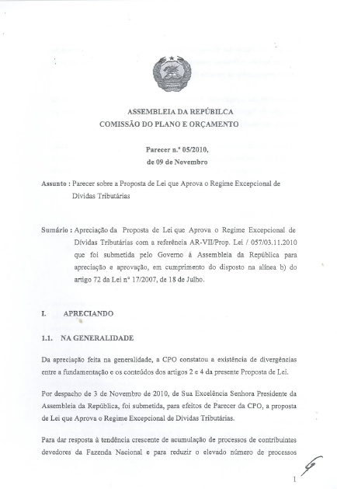
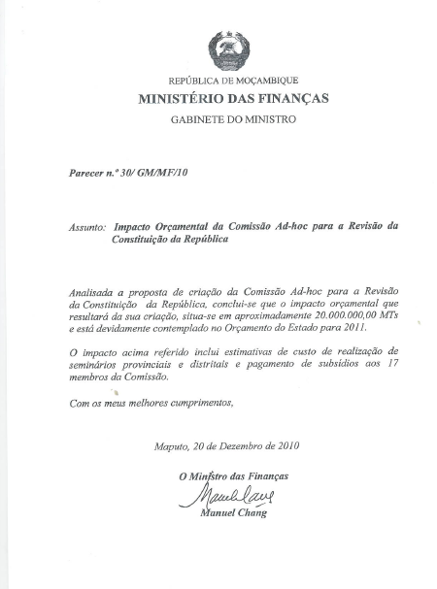
Mozambique

Slide 52
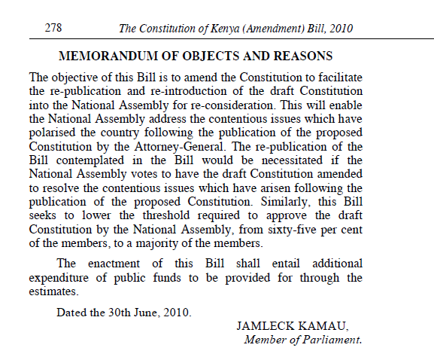
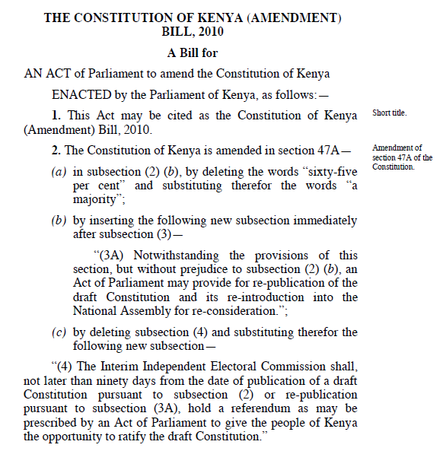
Kenya

Slide 53
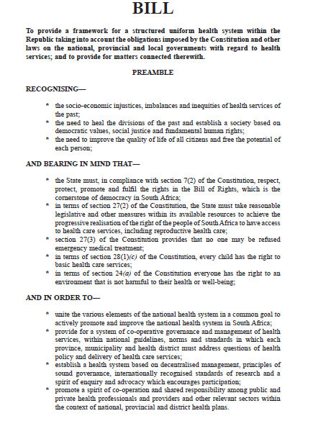
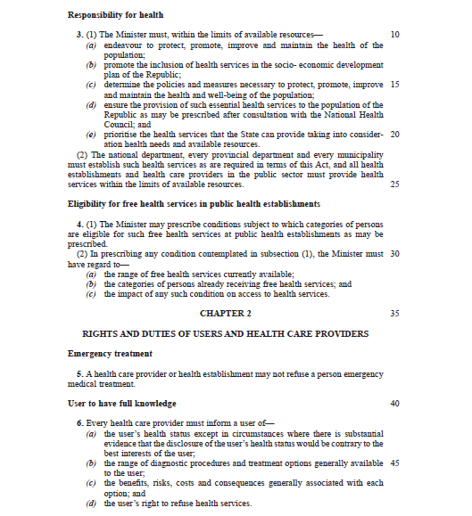
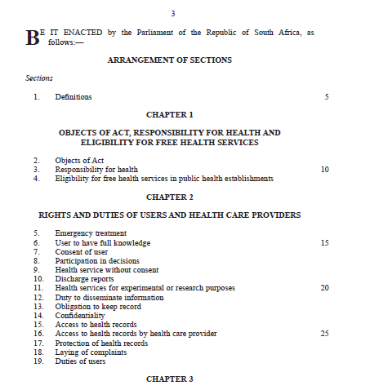
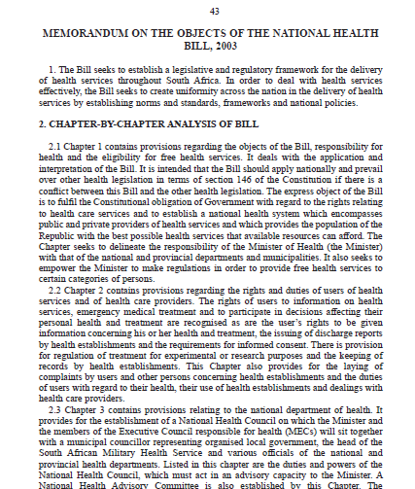
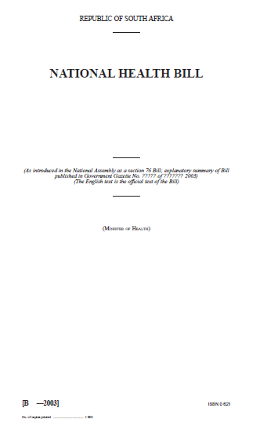
South Africa
preface
memorandum
body
index
preamble
cover

Slide 54
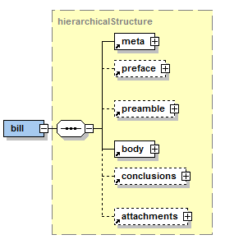
Bill
  Preface
    COVER element
  Preamble
  Body
  Conclusions
  Annexes

Slide 55

Cover information
  <docProponent>
<docCommittee>
<docIntroducer>
<docStage>
<docStatus>
Legilature
Session
Year of Legislation
Cameroon

Slide 56

presentation
docType
docNum
preface
longtitle
proponent
enterinforce
preamble
sideNote
Number of the line
body
Nigeria

Slide 57
Body (1/2)
[point]
[indent]

Slide 58
Body (2/2)

Slide 59
List
Introduction
  a)
  b)
  c)
  d)
Conclusion

Slide 60

List

Slide 61
Amendment Bill
Monica Palmirani
CIRSFID – University of Bologna, Law Faculty

Slide 62


Amendment Bill
ins
del

Slide 63
Amendments and Amendment List
Monica Palmirani
CIRSFID – University of Bologna, Law Faculty

Slide 64

Amendment

Slide 65

Amendments
EP
preface
affectedDocument
amendmentBody
old
new
amendmentHeading
amendmentContent
amendmentReference
lang
amendmentJustification

Slide 66

Amendments
Cameroon
preface
affectedDocument
amendmentBody
amendmentHeading
old
lang
amendmentContent
new
Cameroon

Slide 67

Amendments inside Report
preface
amendmentBody
amendmentHeading
amendmentContent
old
Kenya
new

Slide 68

Oral
Amendments in Debates
old
lang
new
Mozambique

Slide 69


European Parliament amendment list

Slide 70
Minutes & other parliamentary documents
Monica Palmirani
CIRSFID – University of Bologna, Law Faculty

