Slide 1
HALF ADDER AND FULL ADDER
USING LOGISIM
DDCA Mini Presentation
SUBJECT
LEVEL
PRESENTED BY
Digital Design & Computer Architecture
B.Tech 1st Year • Fresher
Name: Yashaswini Srija Akshita Guna
Group No: 05 __________
KL University
DDCA • Digital Design & Computer Architecture

Slide 2
2. Introduction
2
• Digital computers represent data using binary values 0 and 1.
• Binary addition is needed in many digital systems.
• An adder is a combinational logic circuit used for binary addition.
• Half adder adds two input bits, while full adder also accepts a carry input.
• Logisim helps us build and test these circuits visually.
KEY IDEA
Adder = binary addition using logic gates
TOOLS
XOR • AND • OR gates
SOFTWARE
Logisim circuit simulator
DDCA • Digital Design & Computer Architecture

Slide 3
3. What is Logisim?
3
• Logisim is a digital logic circuit simulator.
• It allows us to place logic gates and connect them with wires.
• Inputs can be changed between 0 and 1 to test the circuit.
• Outputs can be observed immediately.
• It is useful for learning and verifying digital logic concepts.
INPUT
Switches / input pins
LOGIC
XOR, AND and OR gates
OUTPUT
LEDs / output pins
DDCA • Digital Design & Computer Architecture

Slide 4
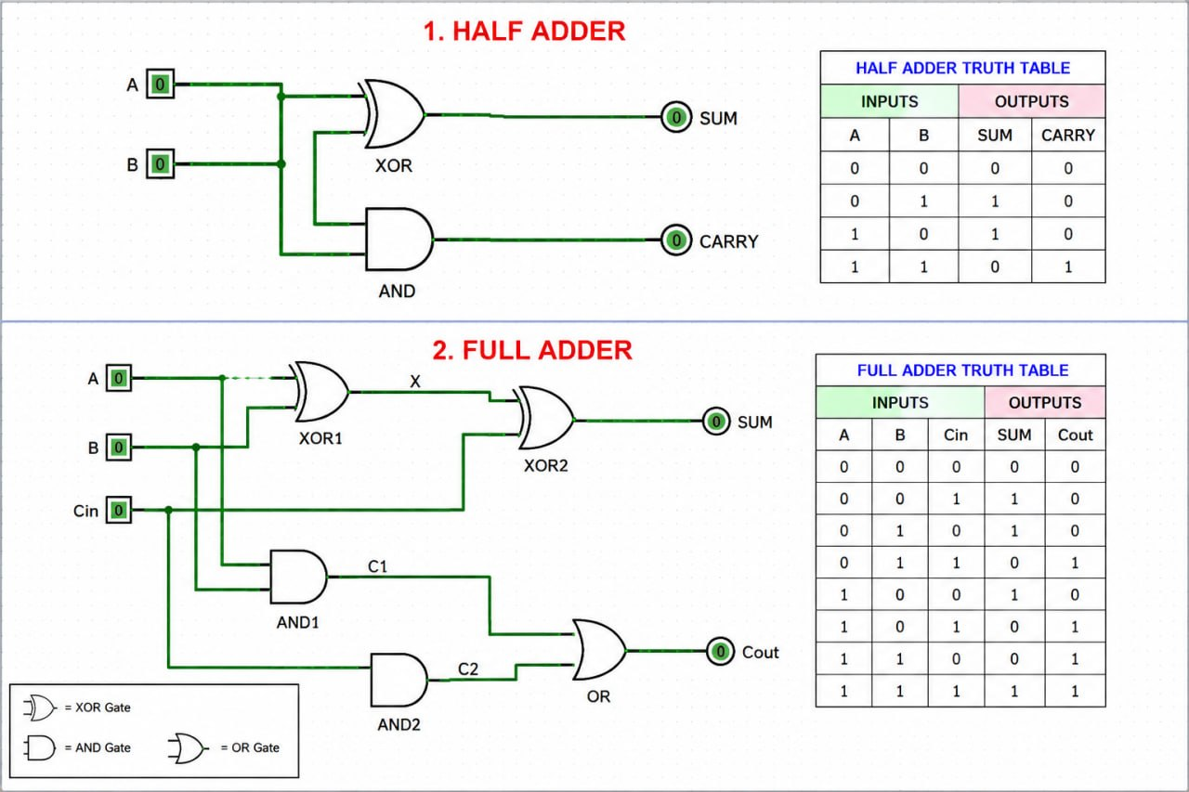
4. Half Adder
4
• A half adder adds two 1-bit inputs: A and B.
• It produces two outputs: Sum and Carry.
• XOR gate produces the Sum.
• AND gate produces the Carry.
SUM = A ⊕ B
CARRY = A · B
Logisim circuit + truth table
DDCA • Digital Design & Computer Architecture

Slide 5
5. Half Adder Truth Table
5
A | B | SUM | CARRY
0 | 0 | 0 | 0
0 | 1 | 1 | 0
1 | 0 | 1 | 0
1 | 1 | 0 | 1
OBSERVATION
Sum is 1 when inputs are different.
CARRY
Carry is 1 only when A = 1 and B = 1.
RESULT
Simple 2-input binary addition.
DDCA • Digital Design & Computer Architecture

Slide 6
6. Full Adder
6
• A full adder adds three 1-bit inputs: A, B and Cin.
• It produces Sum and Cout.
• It can be constructed using two half adders and an OR gate.
• Cin is important when adding multi-bit binary numbers.
SUM = A ⊕ B ⊕ Cin
Cout = AB + Cin(A ⊕ B)
Full adder implemented in Logisim
DDCA • Digital Design & Computer Architecture

Slide 7
7. Full Adder Truth Table
7
A | B | Cin | SUM | Cout
0 | 0 | 0 | 0 | 0
0 | 0 | 1 | 1 | 0
0 | 1 | 0 | 1 | 0
0 | 1 | 1 | 0 | 1
1 | 0 | 0 | 1 | 0
1 | 0 | 1 | 0 | 1
1 | 1 | 0 | 0 | 1
1 | 1 | 1 | 1 | 1
SUM
Odd number of 1s → Sum = 1
COUT
At least two 1s → Carry = 1
CHECK
Test every input combination in Logisim.
DDCA • Digital Design & Computer Architecture

Slide 8
8. Building the Circuit in Logisim
8
1
Place inputs
A, B and Cin
QUICK TEST
2
Add gates
XOR, AND and OR
For a full adder:
A=1, B=1, Cin=1
Expected:
SUM = 1
COUT = 1
3
Connect wires
Follow the required logic
4
Add outputs
SUM and COUT
5
Test
Change inputs 0 ↔ 1
DDCA • Digital Design & Computer Architecture

Slide 9
9. Half Adder vs Full Adder
9
Feature | Half Adder | Full Adder
Inputs | 2 (A, B) | 3 (A, B, Cin)
Outputs | Sum, Carry | Sum, Cout
Carry input | No | Yes
Main use | Basic 1-bit addition | Multi-bit addition
Typical gates | XOR + AND | XOR + AND + OR
Remember: Full adder = half-adder functionality + carry-in handling.
DDCA • Digital Design & Computer Architecture

Slide 10
10. Conclusion
10
• Half adder performs addition of two binary bits.
• Full adder performs addition of two bits along with carry-in.
• XOR is mainly responsible for the Sum output.
• AND and OR gates are used to generate Carry/Cout.
• Logisim makes circuit design, testing and verification easy.
LEARNED
Binary addition + logic gates
VERIFIED
Truth tables using Logisim
THANK YOU
Questions?
DDCA • Digital Design & Computer Architecture

