Slide 1
Digital Error Detection System Using Parity
Built with logic gates and simulated in Logisim
1
0
1
1
1
4 data bits + 1 even-parity bit
Presented by Team [Team Name] | B.Tech 1st Year | Digital Logic Design

Slide 2
Meet the Team
1
2
3
4
GUNA
SRIJA
YASHASWINI
AKSHITA
Roll No: 2620030324
Roll No: 2620030323
Roll No: 2620030276
Roll No: 2620030329
Circuit design
Logisim simulation
Testing and results
Presentation and report
Guided by: [Dayarnab] | [KLH]

Slide 3
What Is a Parity Bit?
Noise can flip a 0 to a 1 while data is sent or stored. A parity bit is one extra bit that makes the number of 1s even or odd, so a single flip can be spotted.
Even Parity
Odd Parity
Total 1s (data + parity) must be even
Total 1s (data + parity) must be odd
1
0
1
1
1
1
0
1
1
0
Data 1011 has three 1s, so P = 1 makes four
Data 1011 has three 1s already, so P = 0

Slide 4
Logic Gates We Use
XOR gate (A ⊕ B)
XNOR gate
Output is 1 only when the inputs differ.
XOR followed by NOT. Gives the odd-parity bit.
A | B | Y = A ⊕ B
0 | 0 | 0
0 | 1 | 1
1 | 0 | 1
1 | 1 | 0
NOT gate
Inverts a bit. Turns an even-parity bit into an odd-parity bit.
Chain XORs and the result is 1 when the count of 1s is odd. That is the parity.

Slide 5
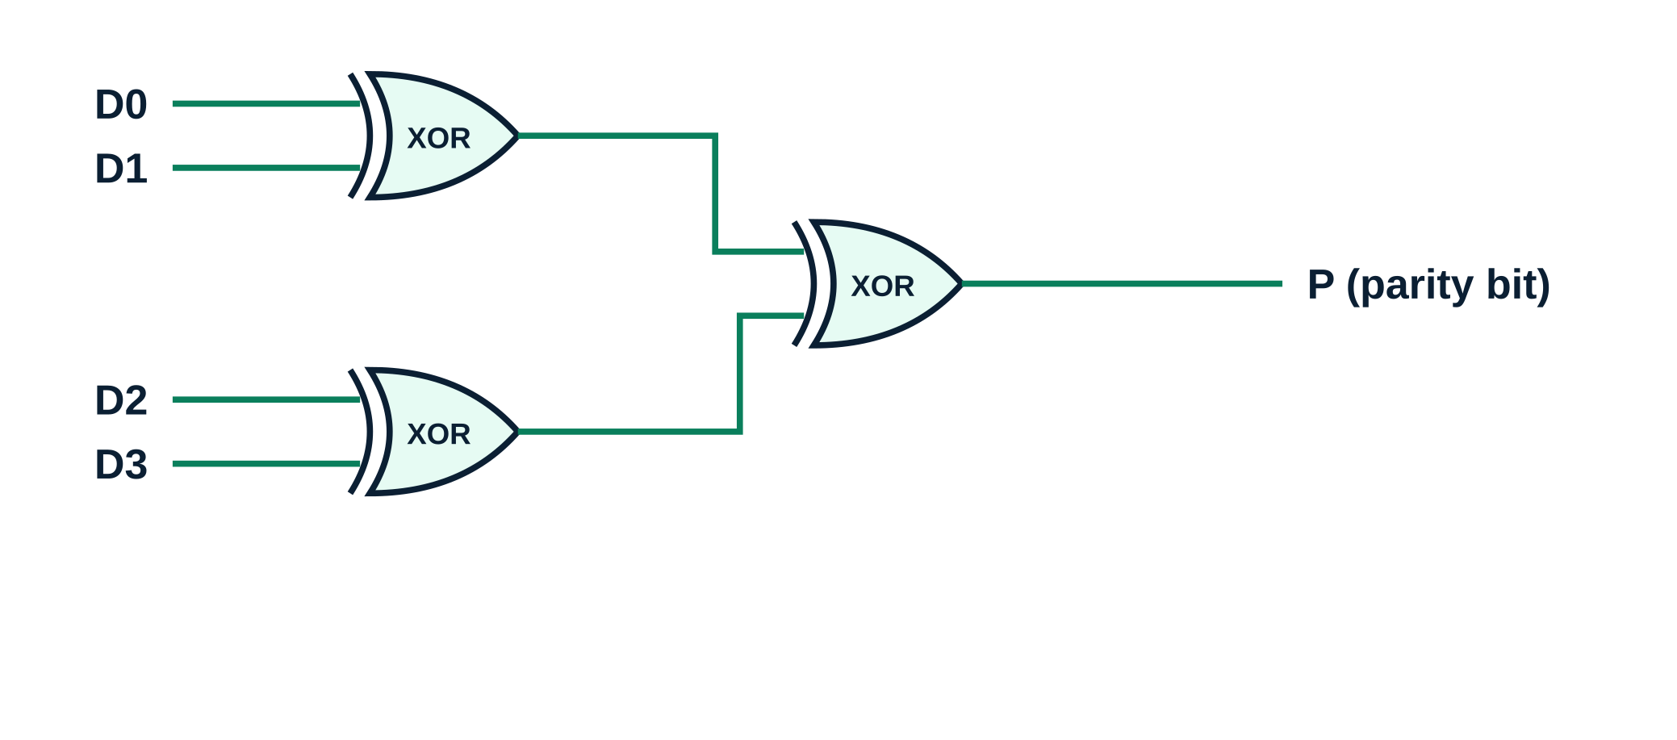
Parity Generator Circuit
Inputs: 4 data bits D0 to D3
Gates: 3 two-input XOR
Output P makes the total number of 1s even
For odd parity, add a NOT gate on P
P = D3 ⊕ D2 ⊕ D1 ⊕ D0

Slide 6
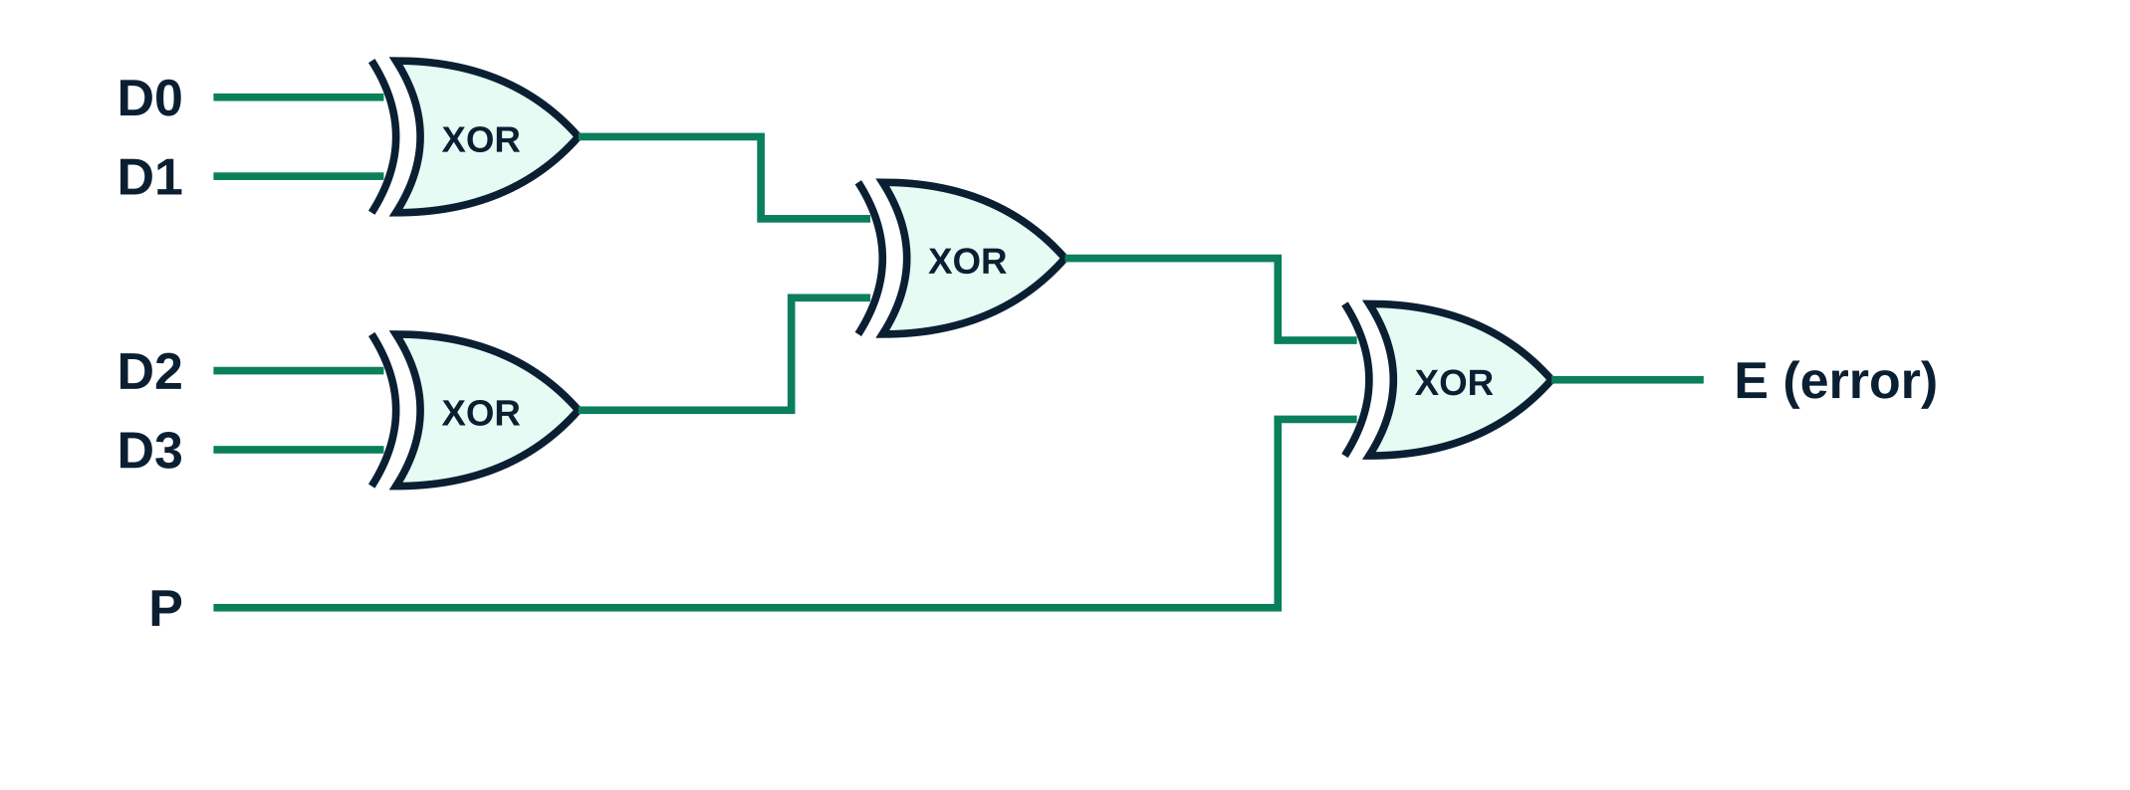
Parity Checker Circuit
Inputs: received data bits plus the parity bit
Gates: 4 two-input XOR
E = 0: no error detected
E = 1: error detected, ask for resend
E = D3 ⊕ D2 ⊕ D1 ⊕ D0 ⊕ P

Slide 7
Building It in Logisim
1
Create a new circuit and name it parity_generator
Components used
Input pins
Output pin or LED
XOR gate
NOT gate (odd parity)
Wiring and Poke tools
2
Add four Input pins (D0 to D3) and one Output pin (P)
3
Place three XOR gates from the Gates folder
4
Wire the gates as a tree, as in the circuit diagram
Tip: a 4-input XOR in Logisim outputs the parity directly.
5
Use the Poke tool to toggle inputs and check P

Slide 8
Simulation: Test Cases
Case | Data D3–D0 | Even P | Received | Output E | Result
No error | 1011 | 1 | 10111 | 0 | Accepted
Data bit D1 flipped | 1011 | 1 | 10011 | 1 | Error detected
Parity bit flipped | 1011 | 1 | 10110 | 1 | Error detected
Two bits flipped (D1, D0) | 1011 | 1 | 10001 | 0 | Missed
Parity catches any odd number of flipped bits, but misses an even number.

Slide 9
Limits, Uses and Next Steps
Limitations
Where it is used
Learn next
Detects only an odd number of flipped bits
Cannot tell which bit is wrong
Cannot correct errors
Serial links such as UART
Memory and bus checking
Storage systems like RAID use parity ideas
Hamming code: detects and corrects
Checksums and CRC
2-D block parity
Thank you. Any questions?

