Slide 1
PERSONAL FITNESS
TRACKER
F
PRESENTED BY
Name - Yashaswini Roll No - 2620030276

Slide 2
Abstract
A console-based tracker that turns daily workouts into measurable progress
Java-based fitness tracker where users log workouts, set calorie goals and monitor progress
01
Automates calorie calculation, workout history, goal tracking and progress summaries
02
Built with the six course modules: foundations, control flow, methods, OOP, file I/O and collections
03
Replaces scribbled notes and guesswork with an accurate, organised and motivating record
04

Slide 3
Understanding Problem Statement
Why an automated fitness tracker is needed
Manual notebook logs are easy to lose, inconsistent and hard to analyse
01
Guessing calories and progress leads to lost motivation and unrealistic goals
02
Need: validate inputs, calculate calories, handle invalid entries and keep records
03
Goal: a reliable console application for users, workouts, goals and progress
04

Slide 4
Module 1: Computational Thinking & Java Foundations
Algorithm design, data types, Scanner input and the main() skeleton
Decompose: users, workouts, goals, progress
Algorithm: set goal → log → calculate → report
Data types: int, double, boolean, String
Scanner for input, printf for output
Why & What
01
MODULE 1 OF 6
WHAT is used
• Data types: int (minutes), double (calories, goal), boolean (goal reached flag), String (workout type)
• Scanner for keyboard input, System.out.printf for formatted output
• Algorithm: set goal → log workouts → calculate calories → show progress
• main() entry point with a loop that keeps the program running
WHY it is used
• Decomposing the problem first keeps the design simple: users, workouts, goals, progress
• Correct data types avoid rounding and logic errors (calories need double, minutes need int)
• Scanner/printf give a clear, aligned console interface without any GUI

Slide 5
Module 2: Control Flow
switch, if / else and loops drive the menu and validation
switch drives the main menu
if / else validates every entry
while loop keeps the app running
for loop prints every workout
Why & What
02
MODULE 2 OF 6
WHAT is used
• switch statement to route each menu choice and pick the calorie rate per workout
• if / else to validate minutes, goal values and empty logs
• while loop to keep showing the menu until Exit
• for loop to print every workout in the history
WHY it is used
• switch is cleaner and faster to read than many if-else chains for a fixed menu
• if / else stops invalid entries before they change fitness data
• Loops let users do many actions in one run and avoid repeating code

Slide 6
Module 3: Methods, Recursion & Arrays
Methods, recursion and arrays split the work into reusable pieces
Methods split the work into small pieces
Recursion: readMinutes() retries bad input
Overloading: calories(type, min) and calories(type, min, kg)
Array: WORKOUTS for exercise types
Why & What
03
MODULE 3 OF 6
WHAT is used
• Methods: addWorkout(), setGoal(), showLog(), showProgress() each do one job
• Recursion: readMinutes() calls itself until a valid positive number is entered
• Overloading: calories(type, min) and calories(type, min, weightKg)
• Array: WORKOUTS = {Run, Walk, Cycle, Yoga}
WHY it is used
• Small methods are reusable, easier to test and easier to debug
• Recursion gives simple retry-on-bad-input without a messy loop
• Overloading lets one concept (calculate calories) work with different inputs
• A fixed array suits a short list of categories that never changes

Slide 7
Module 4: OOP & Exception Handling
Classes, inheritance, encapsulation and custom exceptions
Classes: User, Workout, Cardio, Strength, Goal
Inheritance with abstract burn()
Encapsulation: private name + getName()
Custom checked exceptions for fitness rules
Why & What
04
MODULE 4 OF 6
WHAT is used
• Classes: Workout (abstract), Cardio, Strength, User, Goal
• Inheritance and abstract burn() with polymorphism
• Encapsulation: private weight with getWeight()
• Custom checked exceptions: FitnessException, InvalidInputException, GoalNotSetException
WHY it is used
• Classes model real-world objects, so the code mirrors the workout routine
• Inheritance shares common workout code; polymorphism lets each workout burn calories differently
• Encapsulation protects data from accidental change
• Custom exceptions enforce fitness rules (positive minutes, valid goal) and give clear error messages

Slide 8
Module 5: Strings, Algorithms & File I/O
Regex validation, insertion sort and saving data to a file
Strings: regex validates usernames
Insertion sort ranks workouts by calories
File I/O: save and load fitness.txt
try-with-resources closes files safely
Why & What
05
MODULE 5 OF 6
WHAT is used
• String.matches() with regex [A-Za-z][A-Za-z0-9_]{2,15} to validate usernames
• Insertion sort to rank workouts by calories burned
• File I/O: PrintWriter / FileWriter to save, BufferedReader / FileReader to load fitness.txt
• try-with-resources to close files automatically
WHY it is used
• Regex rejects bad or unsafe names in a single line
• Sorting shows the most effective workouts first; insertion sort is simple for small lists
• File I/O keeps data after the program exits, so the workout history is not lost
• try-with-resources prevents resource leaks even when an error occurs

Slide 9
Module 6: Collections, Functional Programming & Streams
Maps, streams, lambdas and Optional compute the stats
LinkedHashMap and HashMap hold workouts and users
Streams find the totals and averages
Lambdas + Comparator for sorting
Optional handles days with no workouts
Why & What
06
MODULE 6 OF 6
WHAT is used
• LinkedHashMap for workouts (keeps date order) and HashMap for users (fast lookup by name)
• Streams + mapToDouble().sum() to total the calories burned
• Collectors.groupingBy, lambdas and merge() for statistics
• Optional to handle days that have no workouts
WHY it is used
• Maps give fast lookup by id or name instead of scanning lists
• Streams and lambdas make totals and statistics short and readable
• Optional avoids NullPointerException on empty days - shows "rest day" safely

Slide 10
Complete Program Code
The whole fitness tracker in one small, runnable Java file
FitnessTracker.java
import java.util.InputMismatchException;
import java.util.Scanner;
class User {
private final String name;
private final int age;
private final double weight;
private final double height;
public User(String name, int age, double weight, double height) {
this.name = name;
this.age = age;
this.weight = weight;
this.height = height;
}
public double calculateBMI() {
return weight / (height * height);
}
public boolean isAdult() {
return age >= 18;
}
public String getName() { return name; }
public int getAge() { return age; }
public double getWeight() { return weight; }
}
class Activity {
private final String workoutName;
private final int duration;
private final double calories;
public Activity(String workoutName, int duration, double calories) {
this.workoutName = workoutName;
this.duration = duration;
this.calories = calories;
}
public boolean isLongWorkout() {
return duration >= 30;
}
public double getRemainingCalories(double target) {
return Math.max(0, target - calories);
}
public void displayStatus() {
if (duration >= 30 && calories >= 200) {
System.out.println("Fitness Status: Excellent workout!");
} else if (duration >= 20 || calories >= 150) {
System.out.println("Fitness Status: Good workout!");
} else {
System.out.println("Fitness Status: Try to exercise more.");
}
}
public String getWorkoutName() { return workoutName; }
public int getDuration() { return duration; }
public double getCalories() { return calories; }
}
public class PersonalFitnessTracker1 {
static void displaySummary(User user, Activity activity) {
System.out.println("\n----- WORKOUT DETAILS -----");
System.out.println("Name: " + user.getName());
System.out.println("Age: " + user.getAge());
System.out.println("Weight: " + user.getWeight() + " kg");
System.out.println("Workout: " + activity.getWorkoutName());
System.out.println("Duration: " + activity.getDuration() + " minutes");
System.out.println("Calories Burned: " + activity.getCalories() + " kcal");
}
public static void main(String[] args) {
Scanner sc = new Scanner(System.in);
System.out.println("=================================");
System.out.println(" PERSONAL FITNESS & WORKOUT TRACKER");
System.out.println("=================================");
try {
System.out.print("Enter your name: ");
String name = sc.nextLine();
System.out.print("Enter your age: ");
int age = sc.nextInt();
System.out.print("Enter your weight in kg: ");
double weight = sc.nextDouble();
System.out.print("Enter your height in meters: ");
double height = sc.nextDouble();
System.out.print("Enter workout duration in minutes: ");
int duration = sc.nextInt();
System.out.print("Enter calories burned: ");
double calories = sc.nextDouble();
sc.nextLine();
System.out.print("Enter workout name: ");
String workout = sc.nextLine();
User user = new User(name, age, weight, height);
Activity activity = new Activity(workout, duration, calories);
displaySummary(user, activity);
double bmi = user.calculateBMI();
System.out.printf("BMI: %.2f%n", bmi);
if (bmi < 25) {
System.out.println("BMI Check: BMI is below 25.");
} else {
System.out.println("BMI Check: BMI is 25 or above.");
}
}
}
activity.displayStatus();
System.out.println("\n----- OPERATOR RESULTS -----");
System.out.println("Workout duration + 10 = " + (activity.getDuration() + 10));
System.out.println("Calories remaining from 500 = " + activity.getRemainingCalories(500));
System.out.println("Age 18 or above: " + user.isAdult());
System.out.println("Workout 30 minutes or more: " + activity.isLongWorkout());
System.out.println("\n----- WEEKLY WORKOUT ARRAY -----");
int[] weeklyMinutes = {30, 45, 20, 60, 35, 40, 50};
int totalMinutes = 0;
for (int i = 0; i < weeklyMinutes.length; i++) {
System.out.println("Day " + (i + 1) + ": " + weeklyMinutes[i] + " minutes");
totalMinutes += weeklyMinutes[i];
}
System.out.println("Total weekly workout minutes: " + totalMinutes);
if (totalMinutes >= 250) {
System.out.println("Milestone: You achieved more than 250 workout minutes!");
}
System.out.println("\n----- WORKOUT MENU -----");
System.out.println("1. Running\n2. Walking\n3. Cycling\n4. Swimming");
System.out.print("Choose workout type (1-4): ");
int choice = sc.nextInt();
switch (choice) {
case 1 -> System.out.println("Selected: Running");
case 2 -> System.out.println("Selected: Walking");
case 3 -> System.out.println("Selected: Cycling");
case 4 -> System.out.println("Selected: Swimming");
default -> System.out.println("Invalid workout choice.");
}
double[] caloriesHistory = {200.5, 250.0, 180.5, 400.0, 220.0};
System.out.println("\n----- HISTORICAL CALORIES HISTORY -----");
for (int j = 0; j < caloriesHistory.length; j++) {
String burnType = (caloriesHistory[j] >= 250) ? "High calorie burn" : "Normal calorie burn";
System.out.printf("Workout %d: %.1f kcal - %s%n", (j + 1), caloriesHistory[j], burnType);
}
} catch (InputMismatchException e) {
System.out.println("\n❌ Error: Invalid numeric input format typed into terminal.");
} finally {
sc.close();
}
System.out.println("\n=================================");
System.out.println(" Thank you for using the tracker!");
System.out.println("=================================");

Slide 11
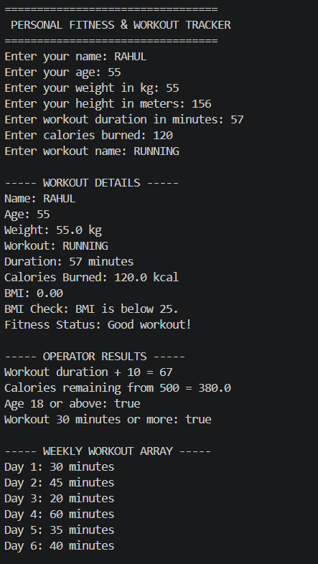
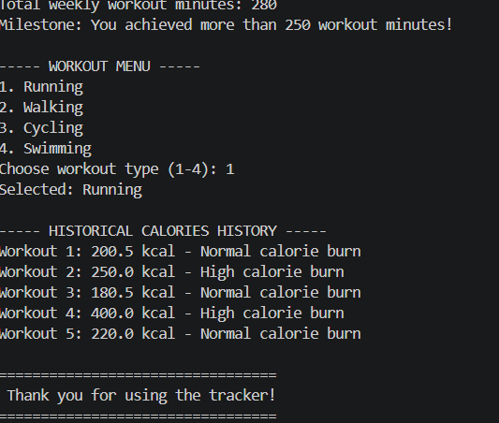
OUTPUT SCREENSHOT

Slide 12
Conclusion
What was achieved and where it can go next
Delivered a working personal fitness tracker in Java
01
Applied all six modules, from fundamentals to collections and streams
02
Future scope: mobile app or GUI, database storage, wearable sync, workout reminders
03

Slide 13
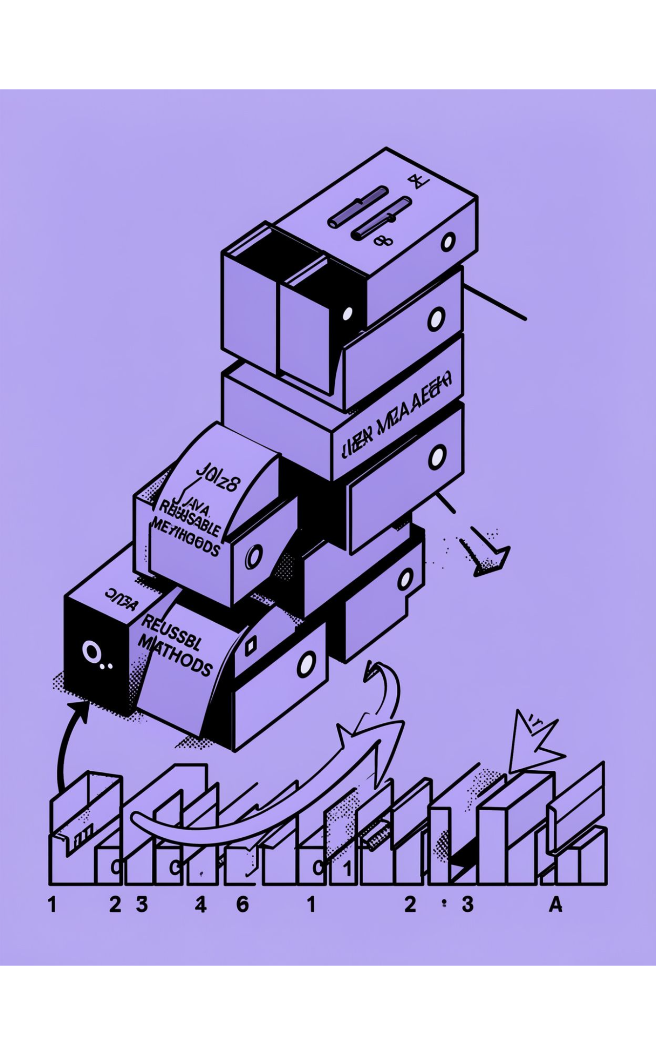
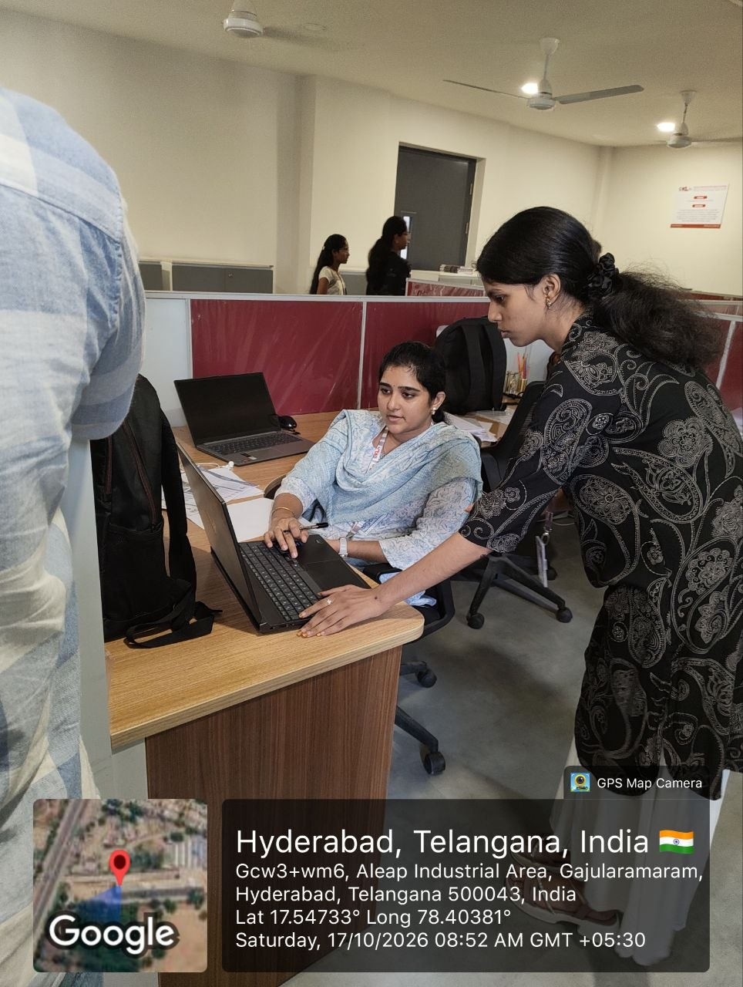
Geo Tag Photo and Git hub link
https://github.com/yekkaliyashaswini-ux/PSP-JAVA

