Slide 1
APPLYING COMPLEX ADAPTIVE SYSTEM APPROACH TO STRESS TESTING IN BANKING INDUSTRY
Enhancing Financial Resilience through CAS-Based Stress Testing
By Yawo Eklou

Slide 2
STRESS TESTING
WHAT?
Refers to a form of thorough testing, utilized to determine the stability of a given system, critical infrastructure or entity
WHERE?
Stress testing plays a crucial role in assessing the resilience and risk management capabilities of banks during times of financial crises.

Slide 3

ABSTRACT
In this project,
we aim to explore how the Complex Adaptive System (CAS) approach can enhance stress testing methodologies in the banking sector.
To accomplish this,
we have utilized NetLogo, a powerful agent-based modeling and simulation platform, to develop and analyze our stress testing model.
Throughout this presentation,
we will delve into the concepts of CAS, agent-based modeling, and stress testing to showcase the effectiveness of this approach in improving the stability and risk management practices within the banking industry.

Slide 4

OVERVIEW
CAS Agents in Stress Testing
Attributes and Interactions
Self-Organization and Adaptation
Emergence of Systemic Properties
NetLogo Simulation Demo

Slide 5
CAS AGENTS IN STRESS TESTING
Agents Types
Bank Accounts: Representing different types of accounts such as deposit accounts, loan accounts, and investment accounts.
Regulators: Entities responsible for overseeing and regulating the banking industry.
Central Bank: The central authority responsible for monetary policy and maintaining financial stability.

Slide 6
CAS ATTRIBUTES IN STRESS TESTING
Attributes for Deposit Account Agents in Stress Testing:
Balance
Default Risk
Liquidity
Withdrawal Rate
Interest Rate
Attributes for Loan Account Agents in Stress Testing:
Balance
Default Risk
Interest Rate
Repayment Schedule
Collateral Value
Attributes for Investment Account Agents in Stress Testing:
Balance
Market Value
Market Volatility
Market Liquidity
Market Risk

Slide 7
EMERGENCE OF SYSTEMIC PROPERTIES
Contagion: The spread of financial distress or default from one entity to another, leading to a cascading effect throughout the system.
Feedback Loops: The self-reinforcing cycles of positive or negative feedback that amplify or mitigate the impact of shocks within the system.
Systemic Risk: The risk that disruptions or failures in one part of the financial system can have widespread consequences and pose threats to its stability.
Resilience: The ability of the system to withstand shocks, adapt to changing conditions, and recover from adverse events.
Interconnection: The degree of interdependencies and linkages among different agents and their attributes, which can influence the transmission of risks and shocks.

Slide 8
NetLogo SIMULATION DEMO
Agents | Loan Accounts (5), | Deposit accounts(10) | Investment accounts (3)
Attributes | balance, default risk, | balance, default risk, Liquidity | balance, default risk, Market value loss

Slide 9
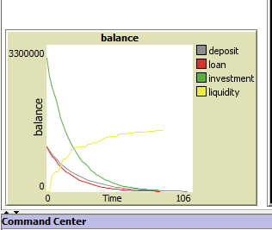
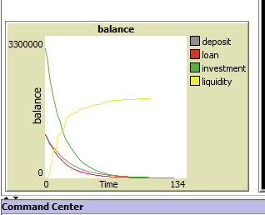
NetLogo SIMULATION DEMO
1- Low Stress Testing Output 2- High Stress Testing Output
Default, Withdrawal, and Market Decrease Rate set to 0.1 Default, Withdrawal, and Market Decrease Rate set to 0.5
fff

Slide 10
CONCLUSION
In summary,
applying a CAS approach to stress testing in banking enables a more comprehensive assessment of financial institution resilience, systemic risks, and contingency planning.
It offers valuable insights into emergent properties and enhances crisis management capabilities.

Slide 11
Question?

