Slide 1

Single Phase Sine wave Inverter
Simulation of
Group-5
1706073
1706079
1706080
1706090
Using Simulink

Slide 2
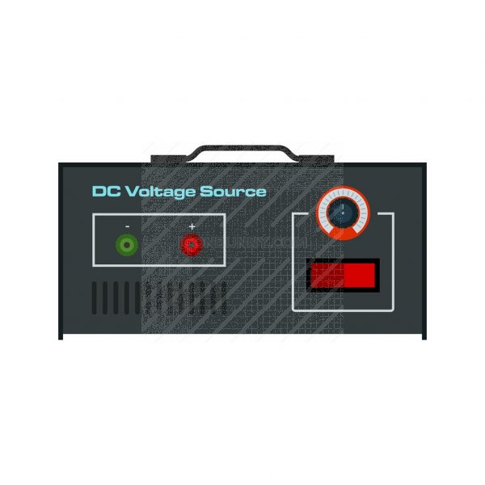
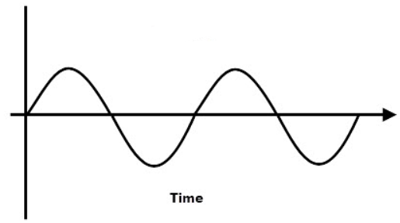
What an Inverter Does?
INVERTER
DC INPUT
AC OUTPUT

Slide 3
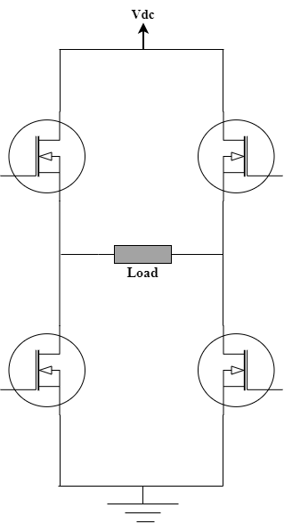
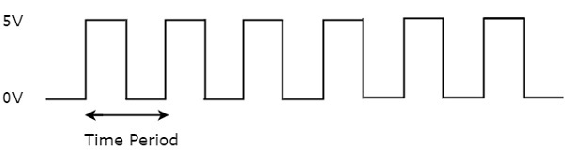





H-Bridge Topology
$$s_{1}$$
$$s_{3}$$
$$s_{4}$$
$$+ V_{o } −$$
$$s_{2}$$

Slide 4
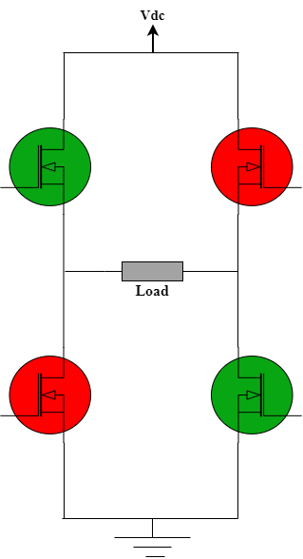
H-Bridge Topology
$$s_{1}$$
$$s_{3}$$
$$s_{4}$$
$$+ V_{o } −$$
$$s_{2}$$

Slide 5
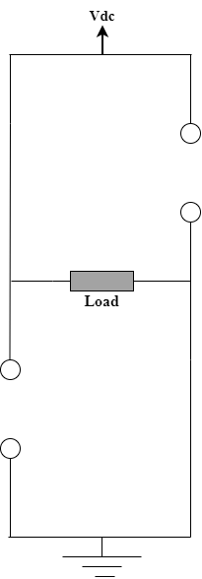





H-Bridge Topology
$$s_{1}$$
$$s_{3}$$
$$V_{o}=+{ V}_{dc}$$
$$+ V_{o } −$$
$$s_{4}$$
$$s_{2}$$

Slide 6
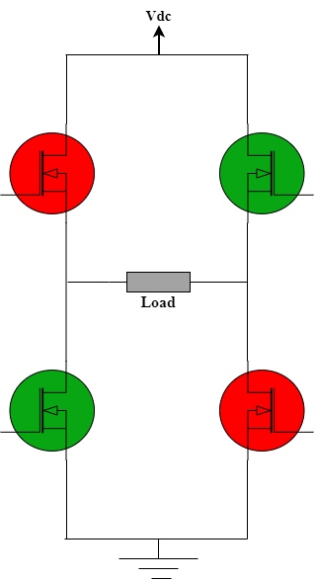
H-Bridge Topology
$$s_{1}$$
$$s_{3}$$
$$s_{4}$$
$$+ V_{o } −$$
$$s_{2}$$

Slide 7
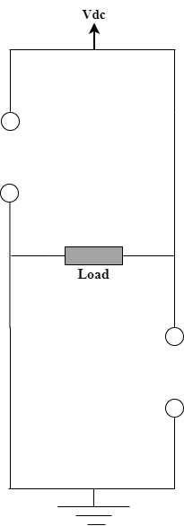





H-Bridge Topology
$$s_{1}$$
$$s_{3}$$
$$V_{o}=−{ V}_{dc}$$
$$+ V_{o } −$$
$$s_{4}$$
$$s_{2}$$

Slide 8
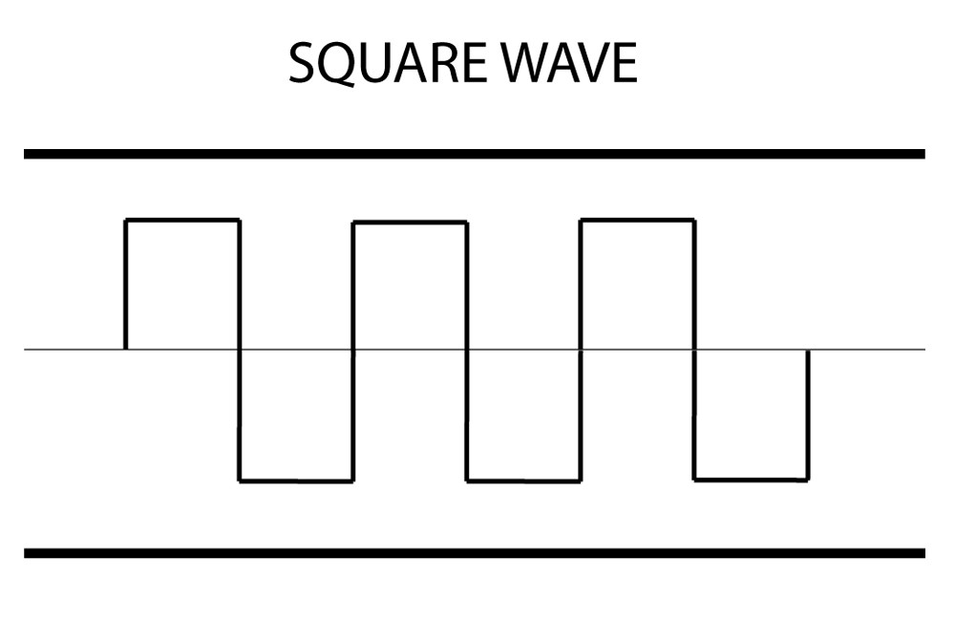




Output Signal
Gate Signal
$$V_{dc}$$
$$s_{1}s_{2}$$
$$s_{3}s_{4}$$
-$V_{dc}$

Slide 9
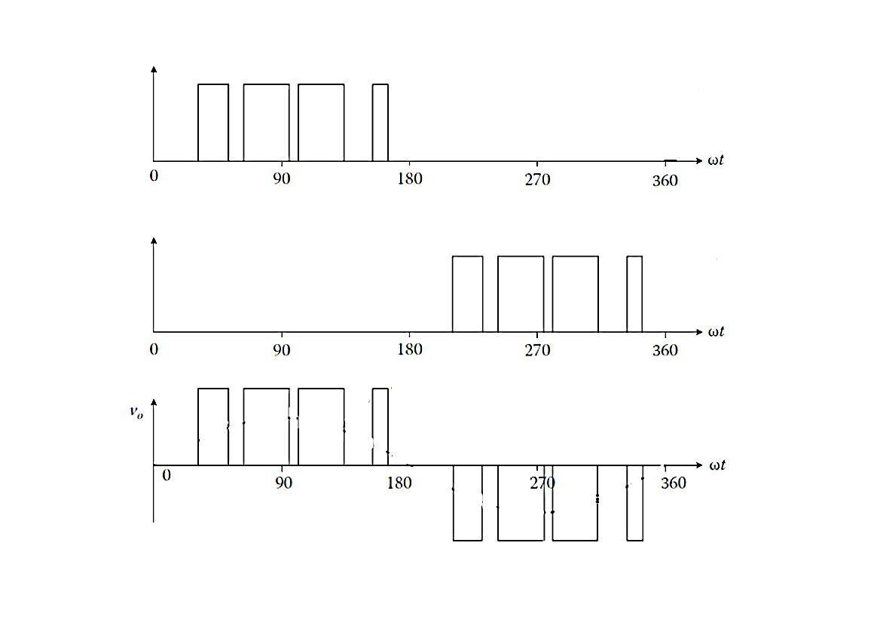


Applied Gate Signals
$$s_{1}s_{2}$$
$$s_{3}s_{4}$$

Slide 10
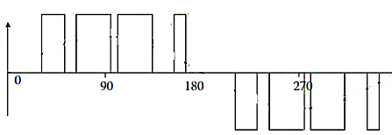
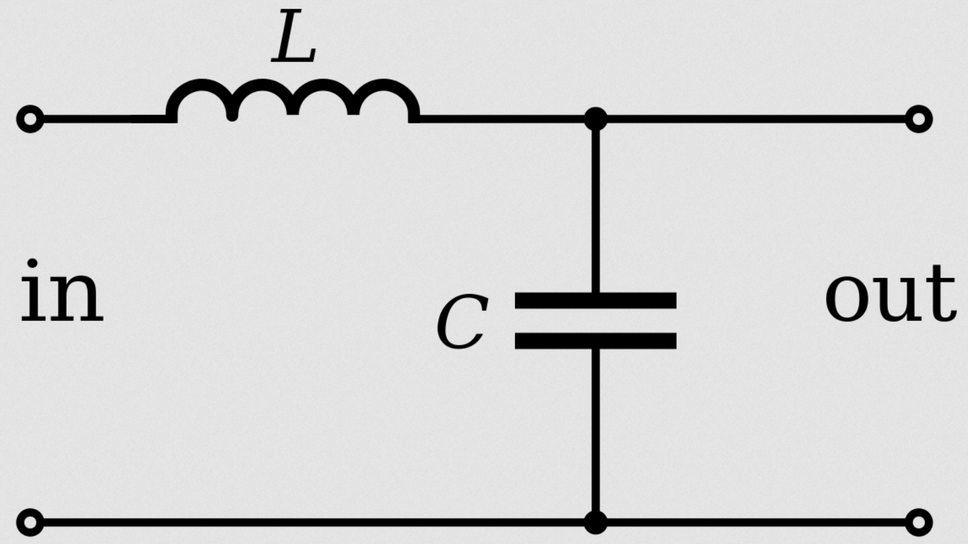
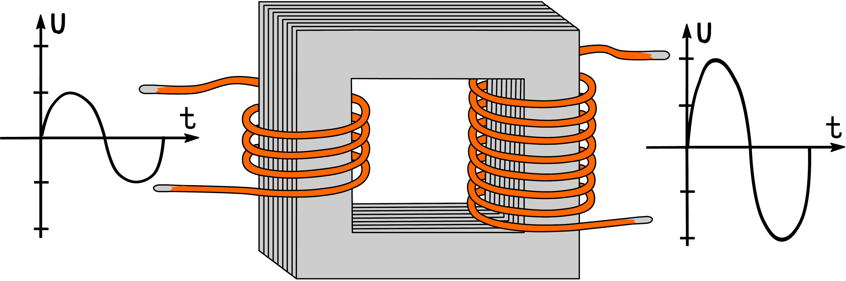
LC Filter
Step-Up Transformer

