Slide 1
AI Doctor Assistant
LLD Architecture
Validation(Authorization token)
Vector DB & LLM
Data Base Schemas

Slide 2
Backend
Users
Frontend
Register:
First name
last name
National code
Medical code
Password
Register Entry points
Register
First name
last name
National code
Medical code
Password
First name
last name
National code
Medical code
Password
Validate
National code
Medical code
Password
Authorization _token
API
Database
User info Centre:
First name
last name
National code
Medical code
Password
Centre
Patient id
Conversation id
Authorization
_token
Fast API
Doctor
Patient
Chat msg
Conversation
Msg history
Medical form
API Routers
Login:
National code
Password
Centre
Login Entry points
Login
API Endpoint
National code
Password
Centre
National code
Password
Centre
Report:
Patient id
Conversation id
Authorization
_token
summarizer
Report
Report
response
Patient id
Conversation id
Authorization
_token
Patient id
Conversation id
Authorization
_token
chat
LLM
Authorization
_token
Conversation id
prompt
Query
Analyze
Keyword &Embedding
chunk
Vector Database
Embedding cash
Data parsing
Company data
chat
Authorization
_token
Conversation id
Chat:
Authorization _token
Conversation id

Slide 3
Validation: Authorization token
Client
Server
Log in to Server with password
5) Check for expiration &signature validity
3)Validate JWT signature
2) Return JWT
JWT
validator
JWT
validator
4) Make request for validation
Validation
6a) If expired/invalid , return error
6b) If valid access resource
7) Return Validation

Slide 4
Validation: Authorization token
Login:
National code
Password
Centre
Create Authorization token
Report:
Patient id
Conversation id
Authorization
_token
Validate
National code
Medical code
Password
Authorization _token
Check Authorization token
Check Authorization token
Chat:
Authorization _token
Conversation id

Slide 5
Vector DB & LLM
Web
API
LLM
Task Executor
Prompt
answer
Document
parser
Re rank
OCR
Multi way recall
chunk
Vector Database
chunk
Qs
Document Layout
Analyze
File
Query
Analyze
Document
File
Task
Dispatch
Table Structure Recognition

Slide 6
Vector DB & LLM
Prompt
Prompt template
Prompt augmentation
Prompt request
LLM
Memory
buffer
Information search module
Tool augmentation module
response
Search and tools
Vector Database
Convert data to semantic vectors
Data parsing
Company data

Slide 7
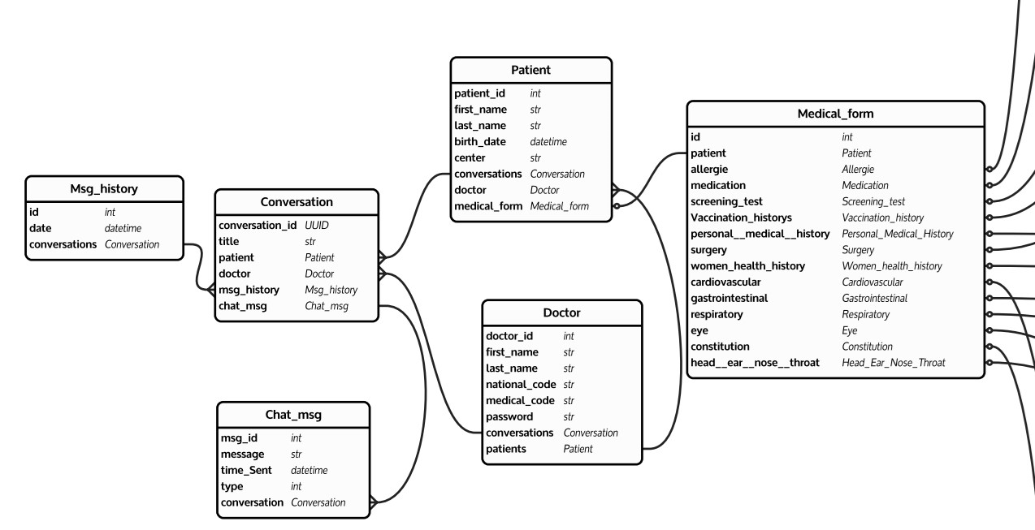
Data Base Schema

Slide 8
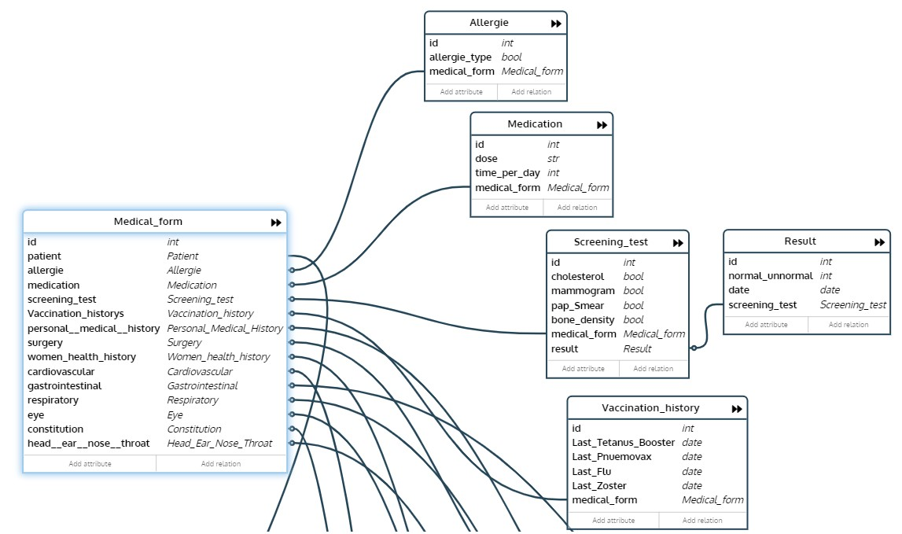
Data Base Schema

Slide 9
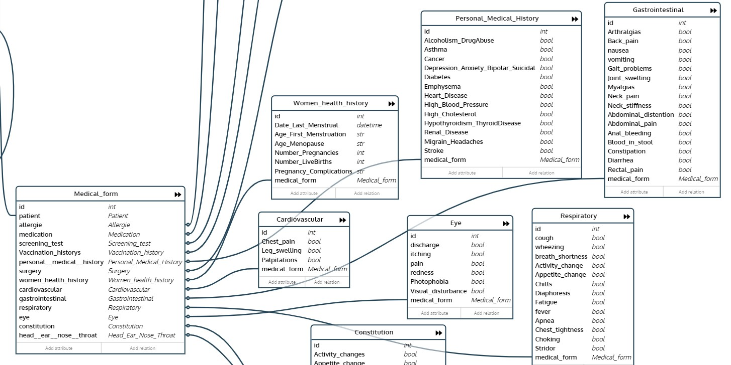
Data Base Schema

Slide 10
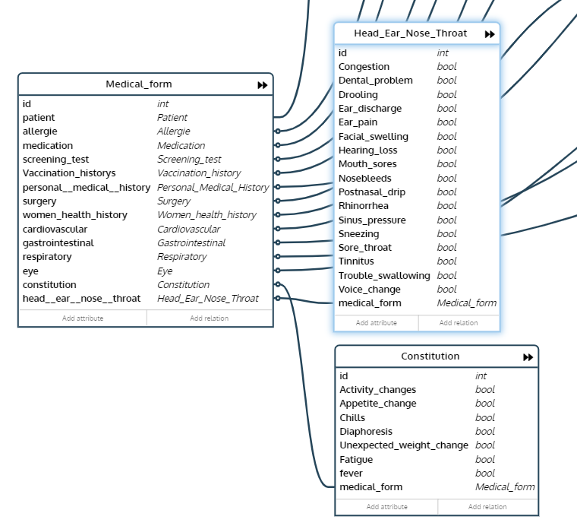
Data Base Schema

