Slide 1
Learning Natural Language Representations
Echo Liu
04/06/2019

Slide 2
Representation Learning in NLP
Multi-task learning (MTL)
Learn knowledge from previous tasks, apply on new tasks/learn jointly
Leverage supervised data from related tasks
Regularization alleviates overfitting
Language model pre-training
Learn universal representations from unlabeled data
ELMo, GPT, BERT (multi-layer bidirectional Transformer + masked word prediction & next sentence prediction)
Fine-tune (task-specific layers + task-specific training data)
Multi-Task Deep Neural Network (MT-DNN): combine!
GPT-2: language modeling

Slide 3
MT-DNN Overview
Idea
Leverage large amounts of cross-task data
Regularization leading to more general representations
10 NLU tasks: SNLI + SciTail + 8 GLUE tasks
Domain adaption with fewer in-domain labels
Improve GLUE benchmark (BERT) by 1.8% (absolute)
Notes:
General language understanding evaluation

Slide 4
MT-DNN Tasks
Single-sentence classification
CoLA: grammatically plausible/not
SST-2: sentiment of movie reviews positive/negative
Text similarity (semantic, regression)
STS-B
Pairwise text classification
RTE, MNLI: language inference (entailment, contradiction, neutral)
QQP, MRPC: semantically equivalent/not
Relevance Ranking (given a query & candidate answers, rank answers)
QNLI

Slide 5
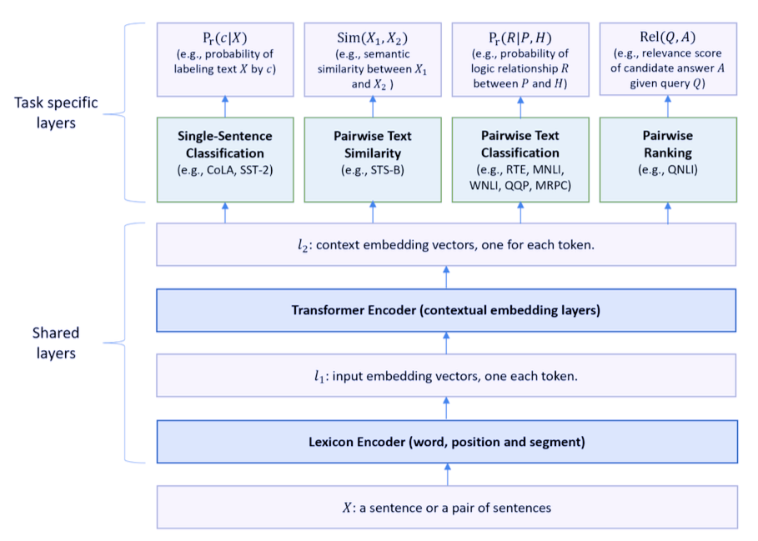
MT-DNN Model
BERT as shared text encoding layers
(sequence)
(self-attention)
(sequence)

Slide 6

Lexicon Encoder
Input: tokens $X=\{x_{1},⋯,x_{m}\}$
$x_{1}$ = [CLS]
Sentence pair: separate by [SEP]
Output: a sequence of embedding vectors ($l_{1}$)

Slide 7

Transformer Encoder
Input: representation vectors ($l_{1}$)
Multilayer bidirectional Transformer encoder
Output: a sequence of contextual embedding vectors ($d×m$, $l_{2}$)

Slide 8
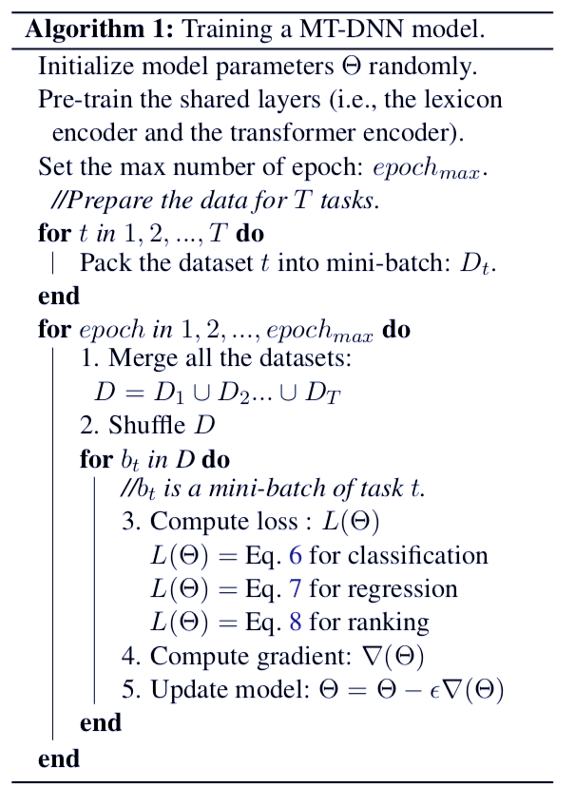
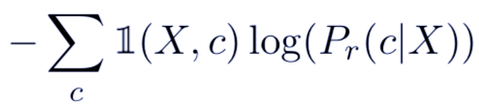

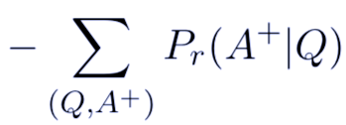
MT-DNN Training
Pre-training (same as BERT)
Masked language modeling
Next sentence prediction
Fine-tuning
MTL – multiple task-specific layers
Minibatch based SGD
Cross entropy:
MSE:
Negative log
likelihood:

Slide 9
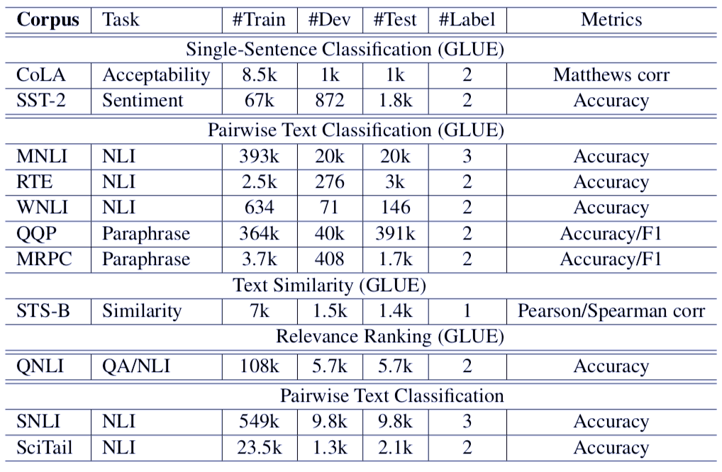
MT-DNN Experiments
Datasets

Slide 10
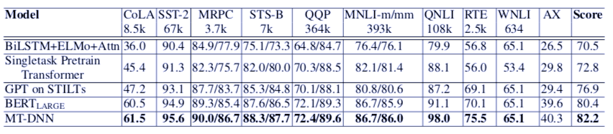
MT-DNN Experiments
GLUE: outperformance on 8 tasks, score 82.2%
Gain solely attributed to the use of MTL in fine-tuning.
Improvement substantial for tasks with less in-domain training data.
Flexible modeling framework.

Slide 11
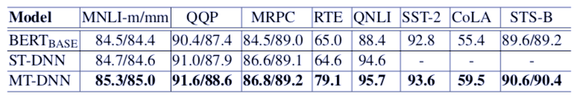
Model Design
ST-DNNs > BERT: SAN answer module better
ST-DNN (pairwise ranking loss) > BERT (cross entropy): problem formulation matters
Notes:
Stochastic answer network. SAN’s answer module uses multi-step reasoning. Rather than directly predicting the entailment given the input, it maintains a state and iteratively refines its predictions.

Slide 12
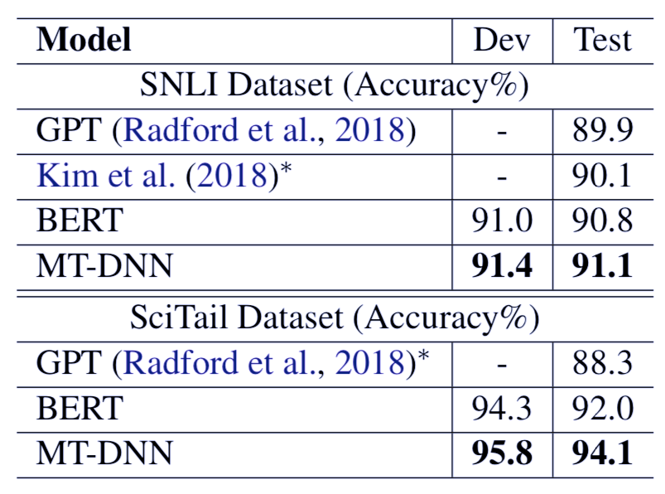
MT-DNN Experiments
SNLI: 91.1% (1%↑)
SCiTail: 94.1% (5.8%↑)

Slide 13
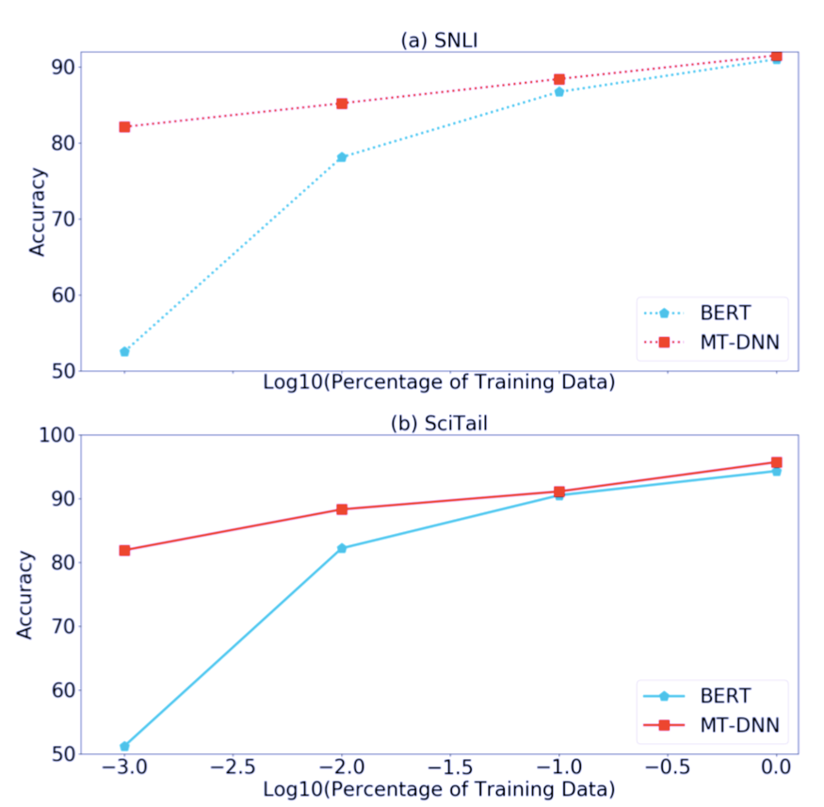
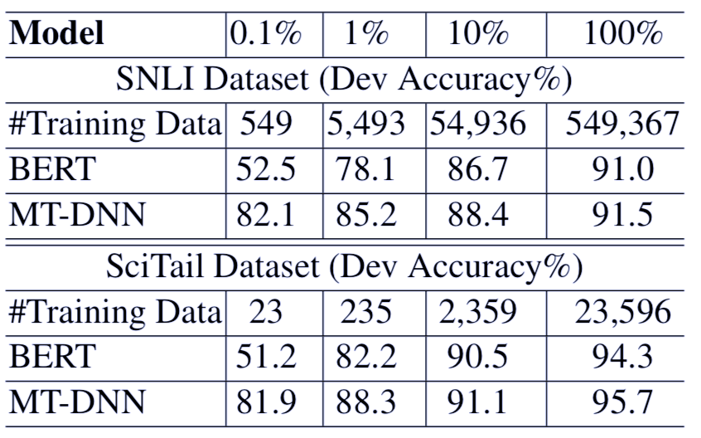
MT-DNN Experiments
Domain adaption

Slide 14
GPT-2 Overview
Idea
Language models can perform down-stream tasks in zero-shot setting
Learned on WebText
1.5B parameter Transformer (underfit)
55 F1 on CoQA without using training examples
State of the art results on 7 out of 8 datasets

Slide 15
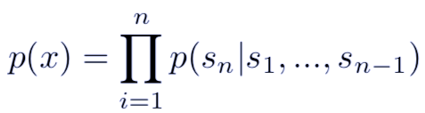
Language Models
Improvement in expressiveness of models, e.g. Transformer (Vaswani2017)
Language models able to learn some tasks without explicit supervision (McCann2018)
Sufficiently large language models can perform multitask learning, much slower than in supervised (Weston 2016)

Slide 16
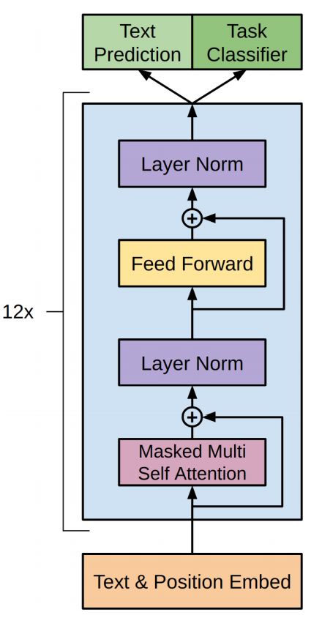
GPT-2 Model
GPT (Radford2018)
Layer normalization moved to input of each
sub-block
Layer normalization added after final self-attention block
Modified initialization

Slide 17
GPT-2 Training
Web scrapes (Common Crawl): large, diverse
Processed to WebText: only web pages curated/filtered by humans, 8 million documents, 40 GB of text
Byte Pair Encoding (BPE) for input representation: word level frequent symbol + character level infrequent symbol
Vocabulary size: 50,257
Context size: 1024 tokens
Batchsize: 512
Learning rate: tuned for best perplexity on 5% held-out sample

Slide 18
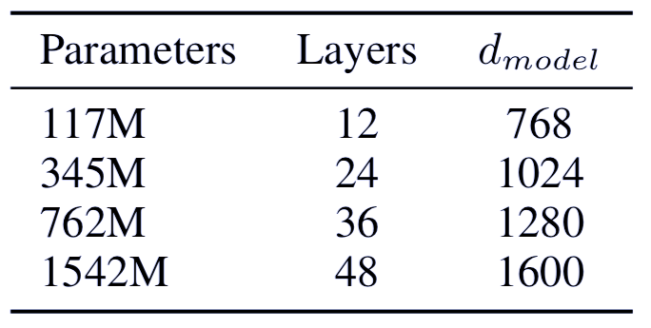
GPT-2 Training
All underfit WebText
~GPT
~Largest BERT
GPT-2

Slide 19
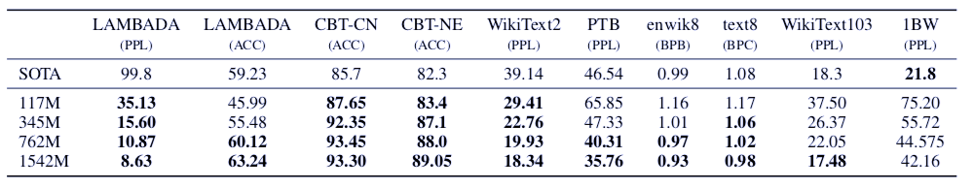
GPT-2 Testing
Language modeling
Transfer well across domains and datasets
Improve state of the art on 7 out of 8 datasets in a zero-shot setting
Notes:
Ppl: perplexity
Acc: accuracy
Bpb: bits per character performance

Slide 20
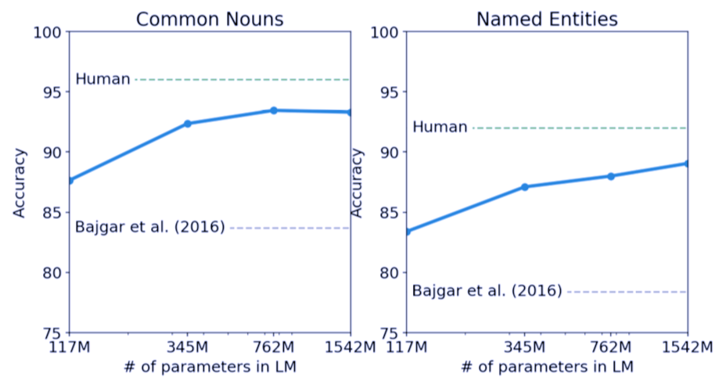
GPT-2 Testing
Performance on different categories of words
Performance improves as model size increases
GPT-2 achieves new state of the art (93.3%, 89.1%)

Slide 21
GPT-2 Testing
Model long-range dependencies: predict final word
GPT-2 improves state of the art from 99.8 to 8.6 perplexity, increases accuracy from 19% to 52.66%
Add a stop-word filter: increases accuracy to 63.24%

Slide 22
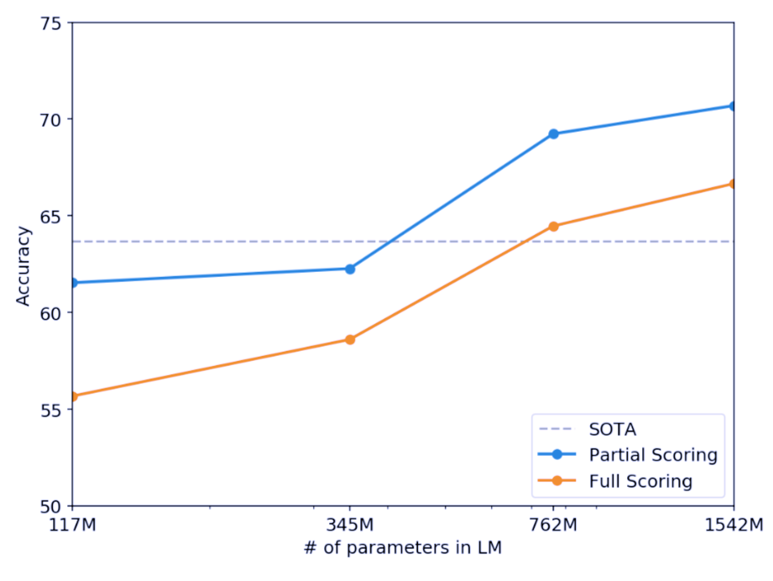
GPT-2 Testing
Commonsense reasoning: resolve ambiguities
GPT-2 improves state of the art accuracy by 7%, achieving 70.7%

Slide 23
GPT-2 Testing
Reading comprehension (CoQA)
GPT-2 achieves 55F1 on dev set, exceeds 3 out of 4 baselines without using manually collected samples (baselines used)

Slide 24
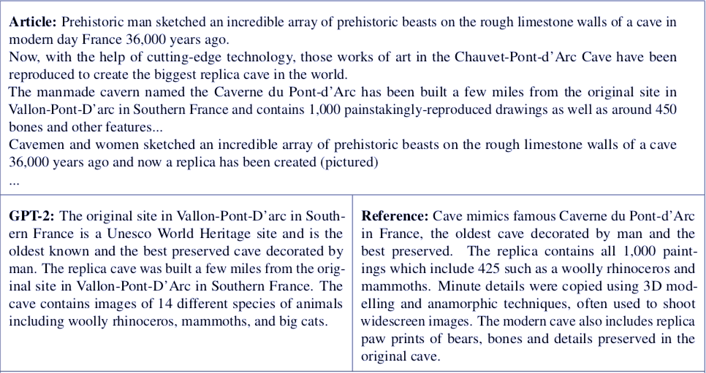
GPT-2 Testing
Summarization
Resembles summaries
Often focuses on recent content/confuses details
Only begin to approach performance of classical baselines
Barely outperform selecting 3 random sentences

Slide 25
GPT-2 Testing
Translation
WMT-14 English-French: 5 BLEU, slightly worse than a word-by-word substitution with a bilingual lexicon
WMT-14 French-English: 11.5 BLEU, outperform several unsupervised baselines, much worse than best (33.5 BLEU)

Slide 26
GPT-2 Testing
Question answering: generate answer to factoid-style questions
GPT-2 4.1% accuracy by exact match metric (smallest model never exceeds 1%)
Model capacity matters: GPT-2 answers 5.3 times more questions correctly
GPT-2 answers well calibrated: 63.1% accuracy on top 1% questions
GPT-2 worse than information-retrieval based systems
Notes:
questions for which a complete answer can be given in 50 bytes or less, which is roughly a few words

Slide 27
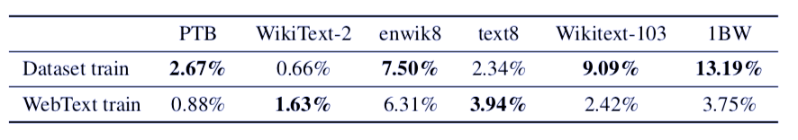
Generalization vs. Memorization
Test set 8 gram overlapping with training sets
Overlap provides small but consistent benefit to results
Need to understand and quantify highly similar text: better de-duplication techniques, important verification step in creation of training/test splits

Slide 28
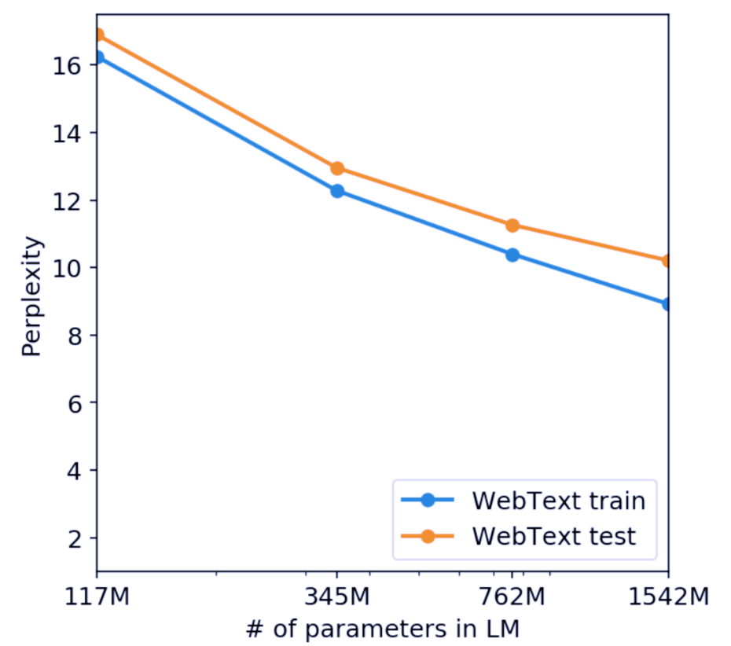
Generalization vs. Memorization
GPT-2 underfits WebText

Slide 29
Conclusion
MT-DNN combine multi-task learning & language model pre-training
MT-DNN has generalization capability in domain adaption
GPT-2 suggests unsupervised task learning is promising
Sufficiently large, diverse dataset for LM training
High-capacity models need little supervision
GPT-2 still far from usable in zero-shot setting application
Limit of fine-tuning not shown in GPT-2

