Slide 1
XYZ_20180122_456_2
pancreas

Slide 2
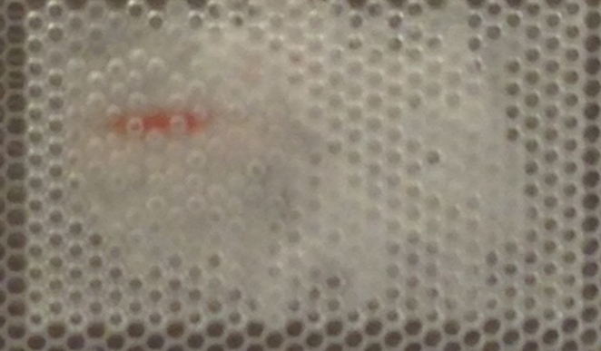
Transcript counts/cell

Slide 3
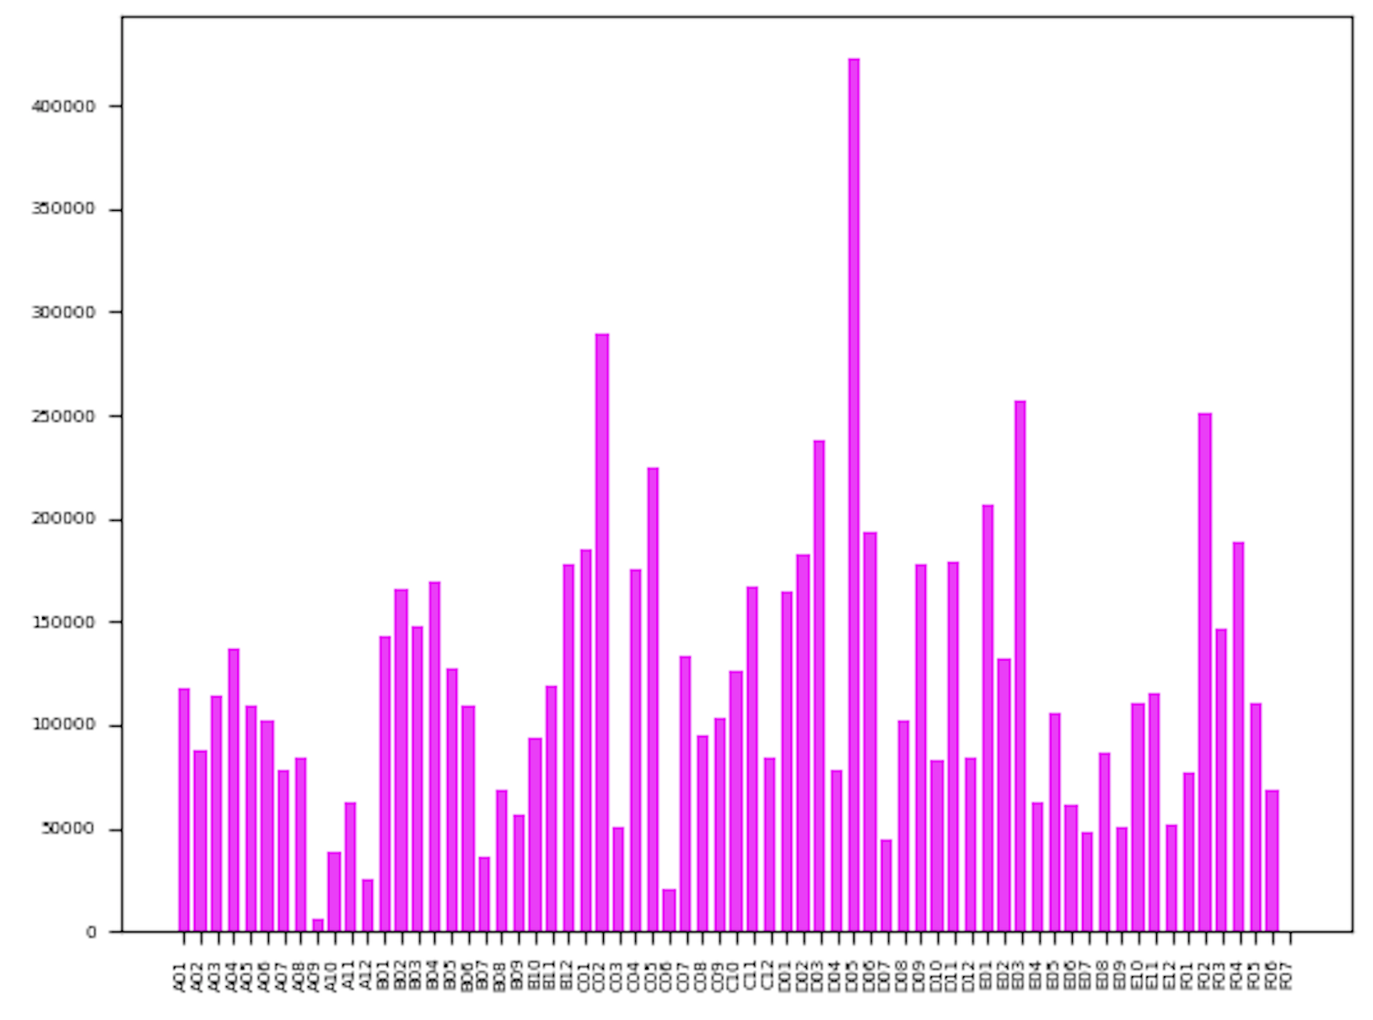
Average read depth: 121360
Read Depth
PCR Well

Slide 4
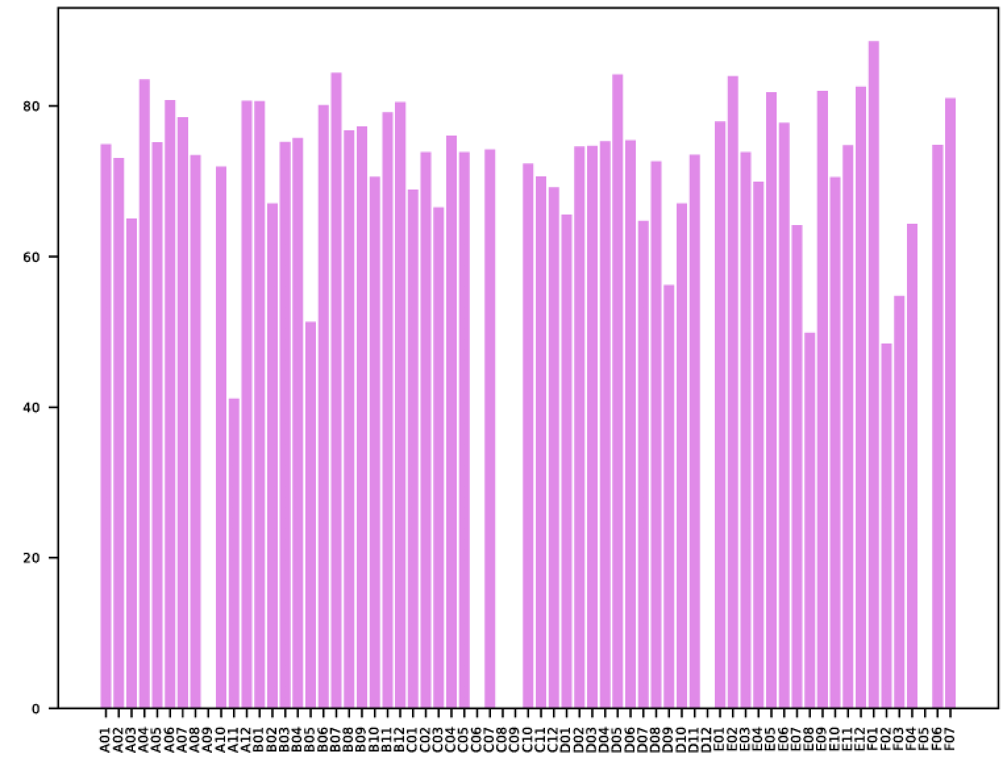
Average Mapping: 66.09%
Uniquely mapped reads (%)
PCR Well

Slide 5
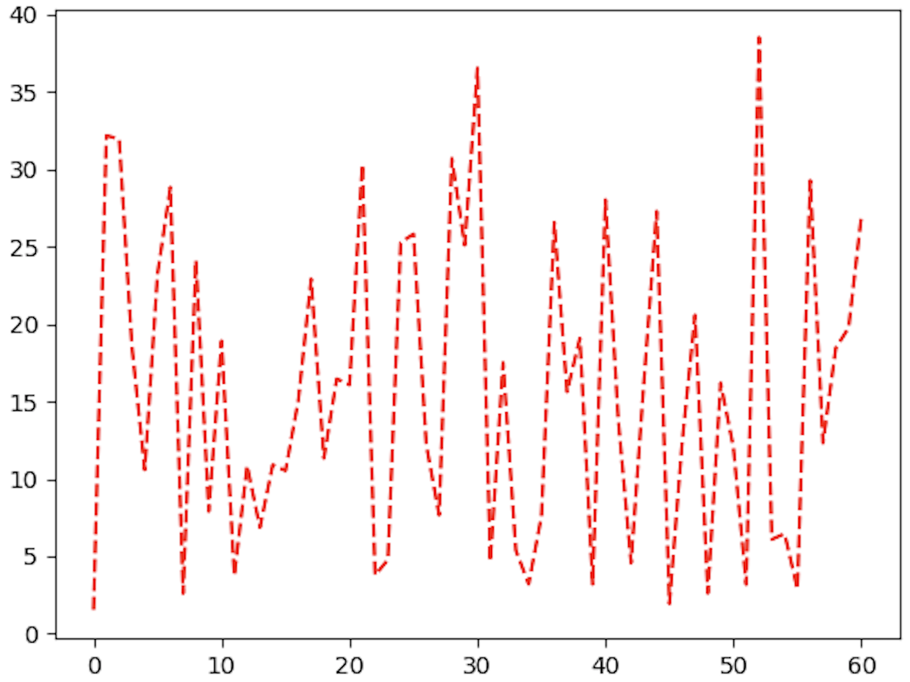
Percent duplication across PCR wells
Percent duplication
PCR Well

Slide 6
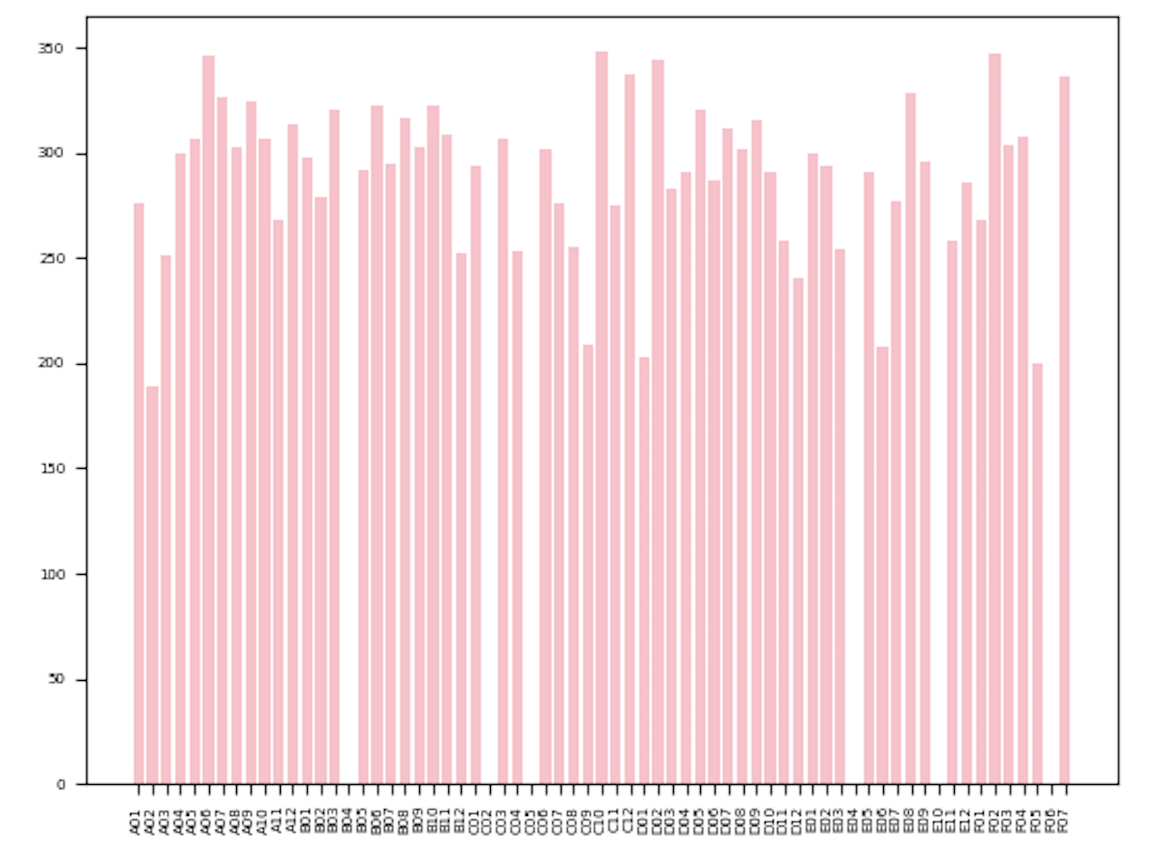
Number of cell barcodes: 17680
Number of cell barcodes
PCR Well

