Slide 1
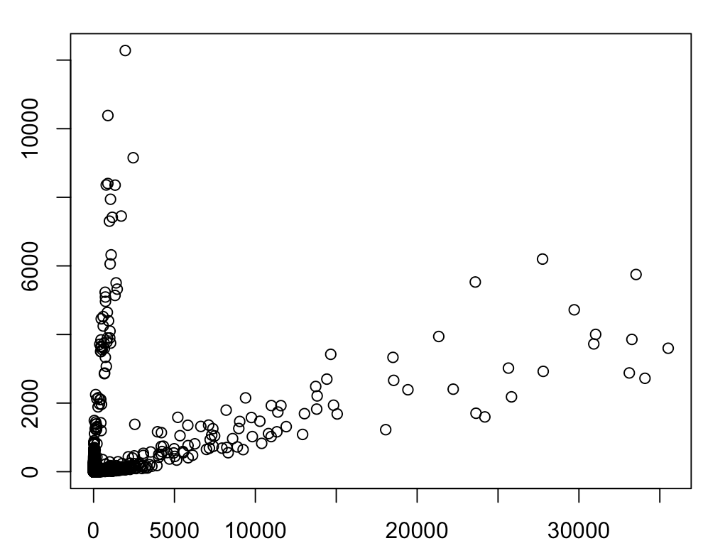
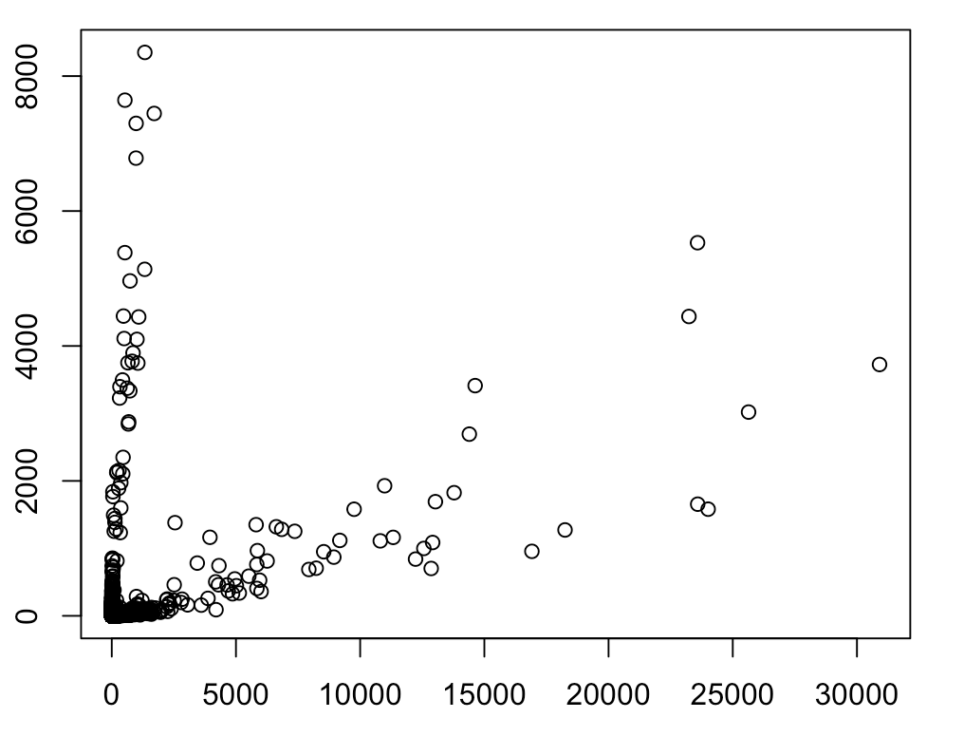
Mismatch = 2
Mouse reads
Human reads
Human-mouse tiling

Slide 2
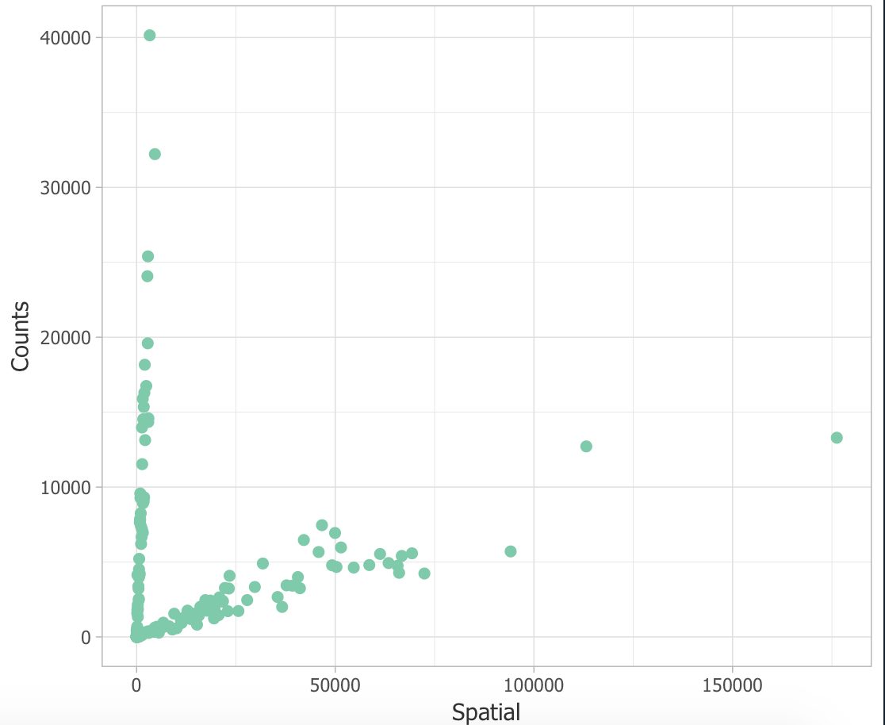
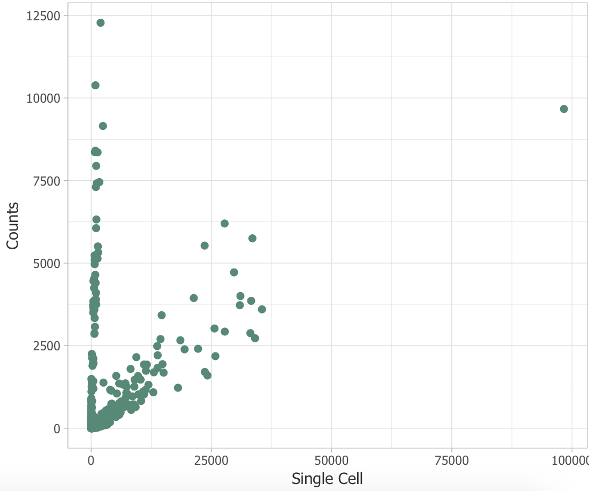
Spatial Read Count Distribution
Single Cell Read Count Distribution
Mouse Read Counts
Mouse Read Counts
Human Read Counts
Human Read Counts

Slide 3
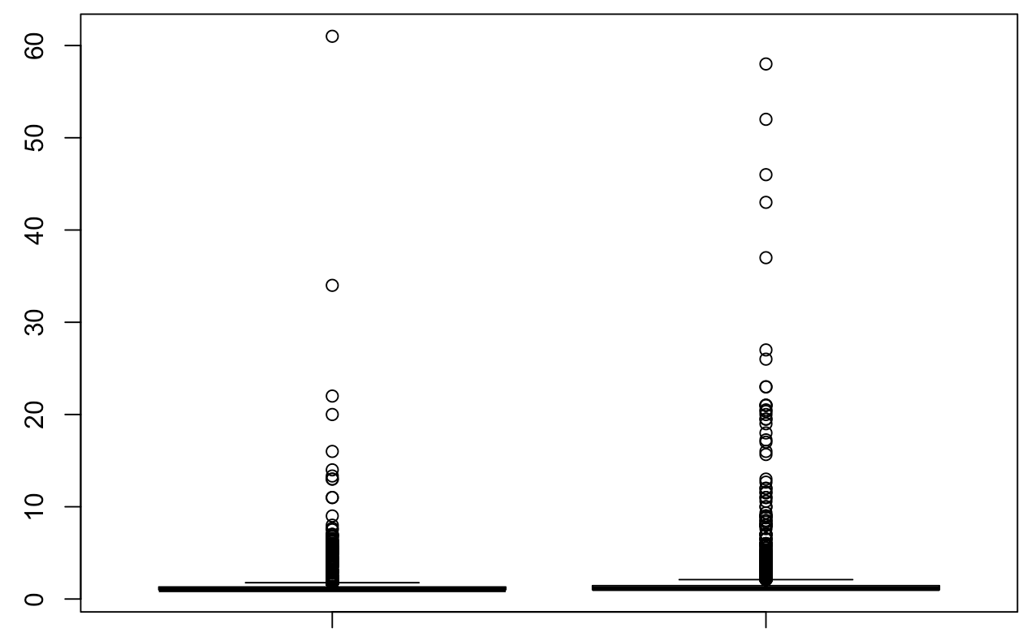
 | Number of UMIs | Number of cells
Mouse | 377,091 | 6,172
Human | 1,514,437 | 8,688
Number of UMIs/cell
Mouse
Human

Slide 4
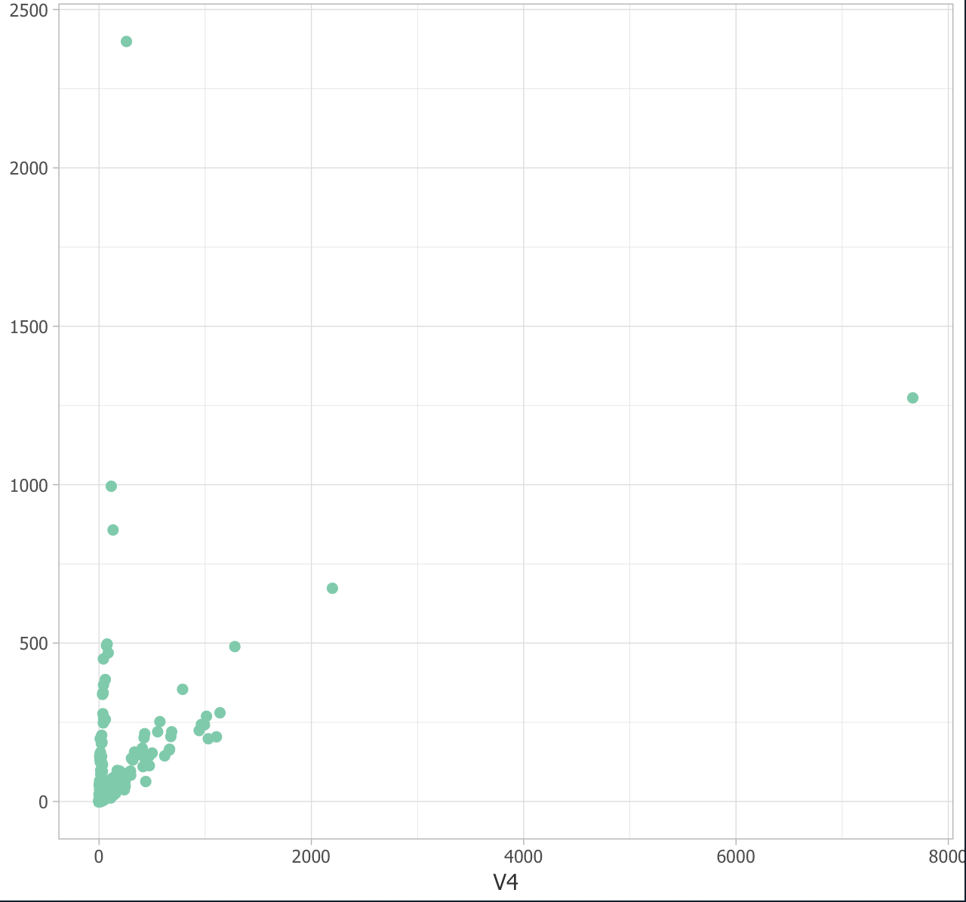
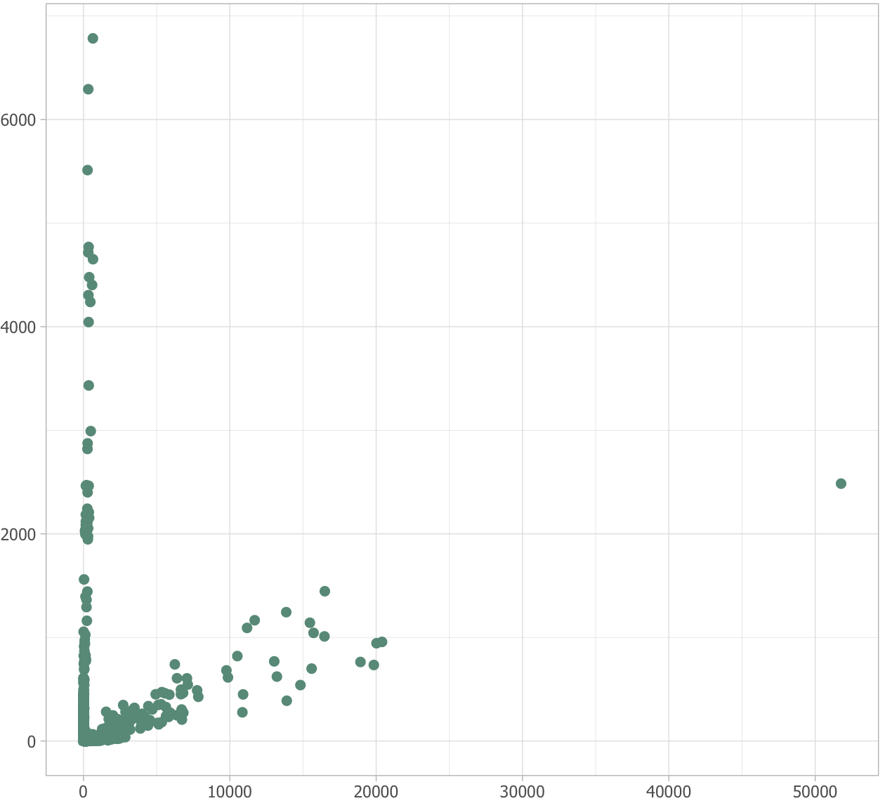
Spatial Read Count Distribution
Single Cell Read Count Distribution
Mouse Read Counts
Mouse Read Counts
Human Read Counts
Human Read Counts

Slide 5
