Slide 1
xyz_20180129_763_1 (pancreas)

Slide 2
Transcript counts/cell
xyz_20180129_763_1

Slide 3
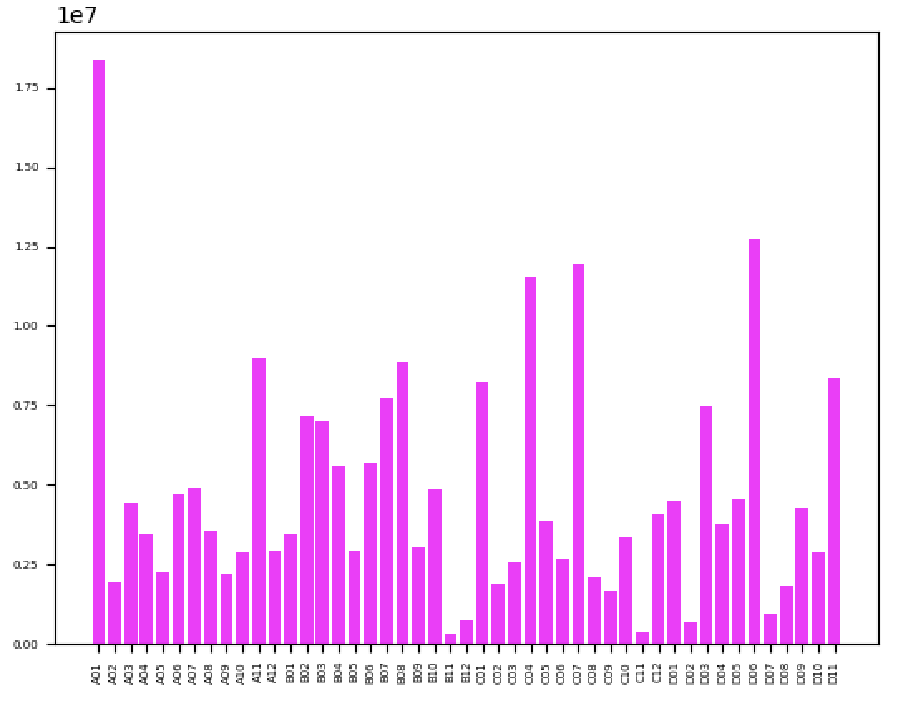
Average read depth: 4775875
Read Depth
PCR Well

Slide 4
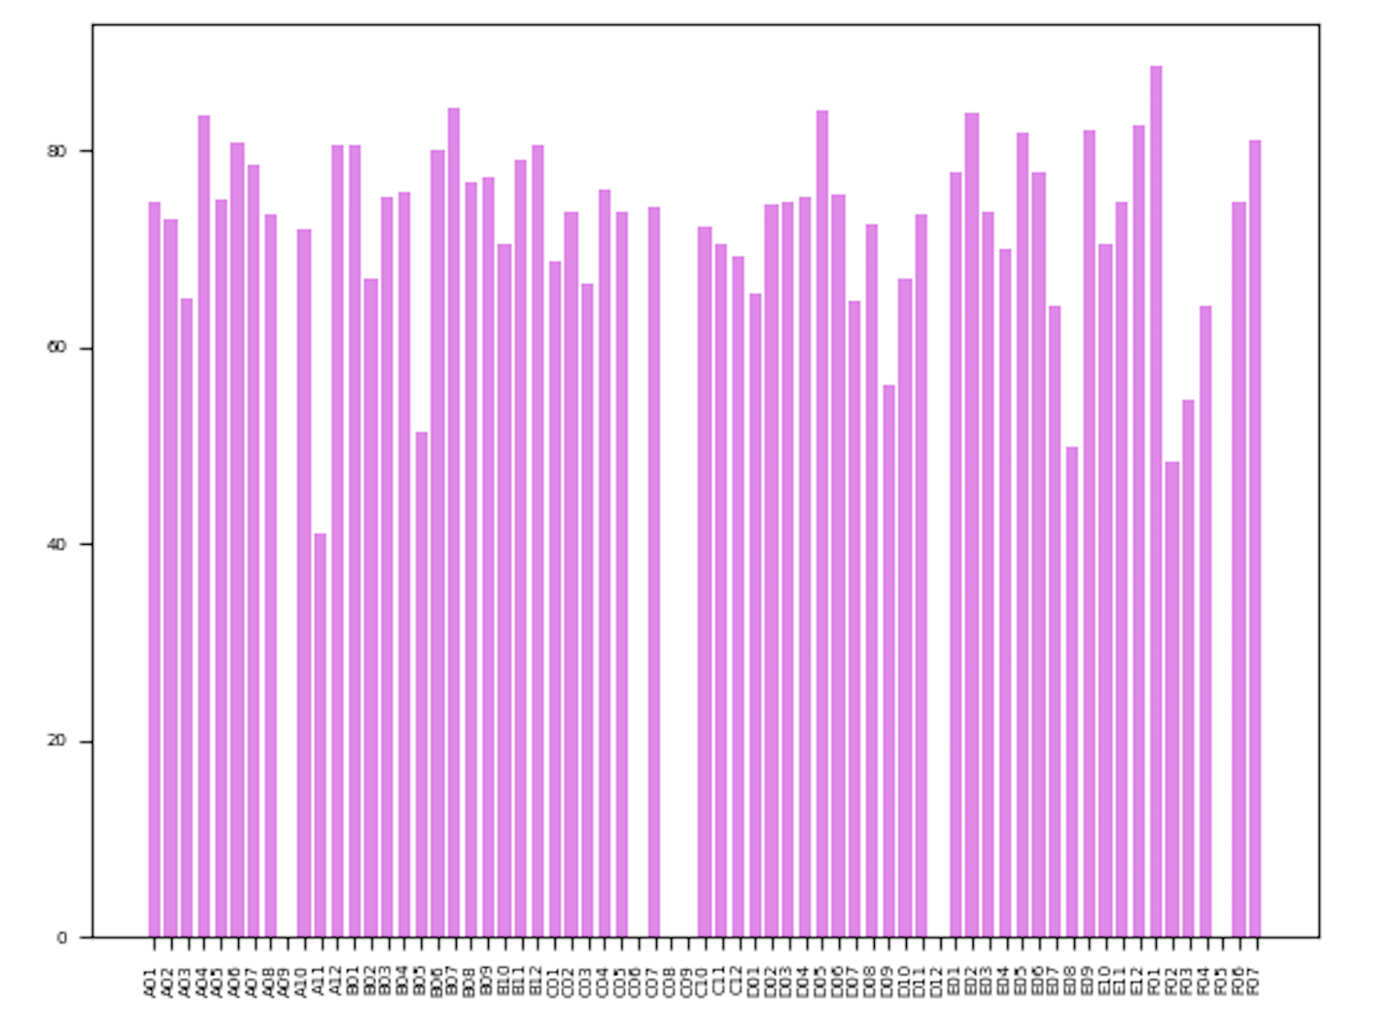
Average Mapping to mouse-human merged: 47.44%
Uniquely mapped reads (%)
PCR Well

Slide 5
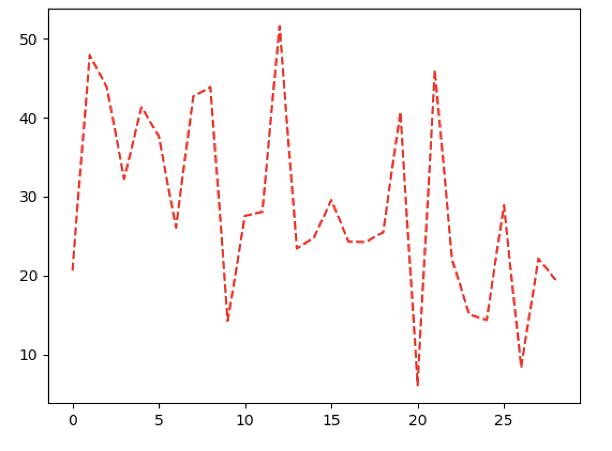
Percent duplication across PCR wells
Percent duplication
PCR Well

