Slide 1
XYZ_20180215_206_2
XYZ_20180215_206_3
(pancreas)

Slide 2
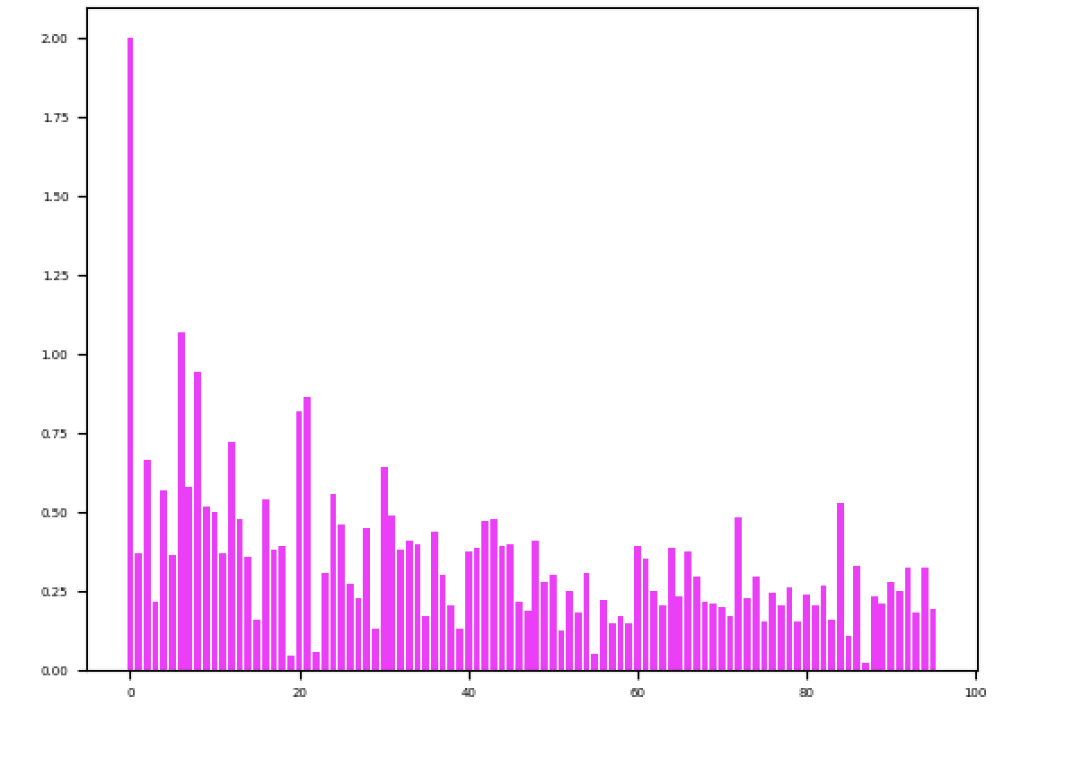
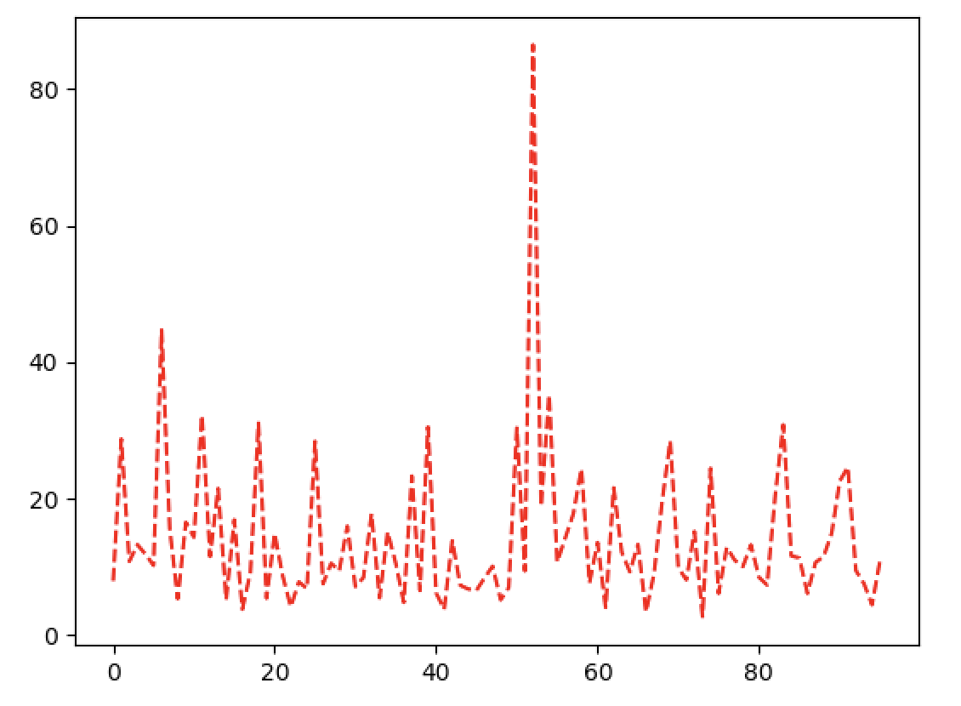
Num of reads
Dup rate
PCR well
PCR well
Average mapping: 39.57%
Average read num: 3509246.30
XYZ_20180215_206_2

Slide 3
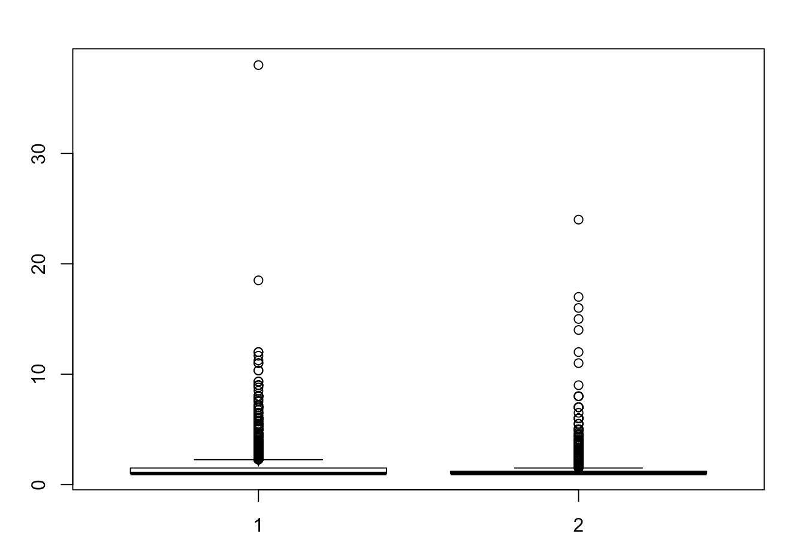
 | Number of UMIs | Number of cells
Pancreas 1 | 94, 011 | 17,761
Pancreas 2 | 20,795 | 7,215
UMI/cell
Pancreas 1
Pancreas 2

Slide 4
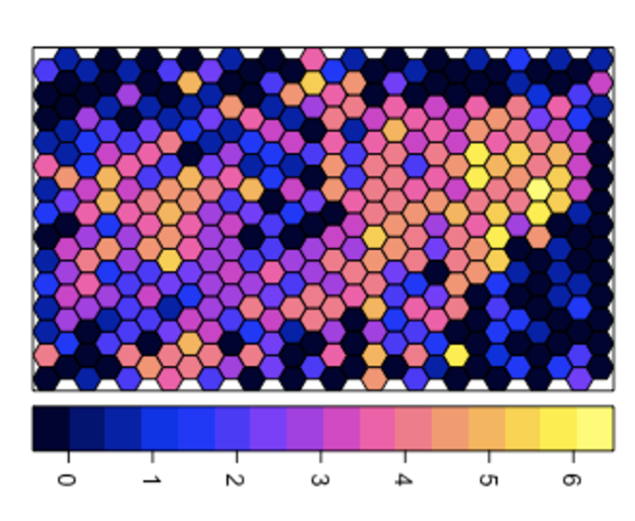
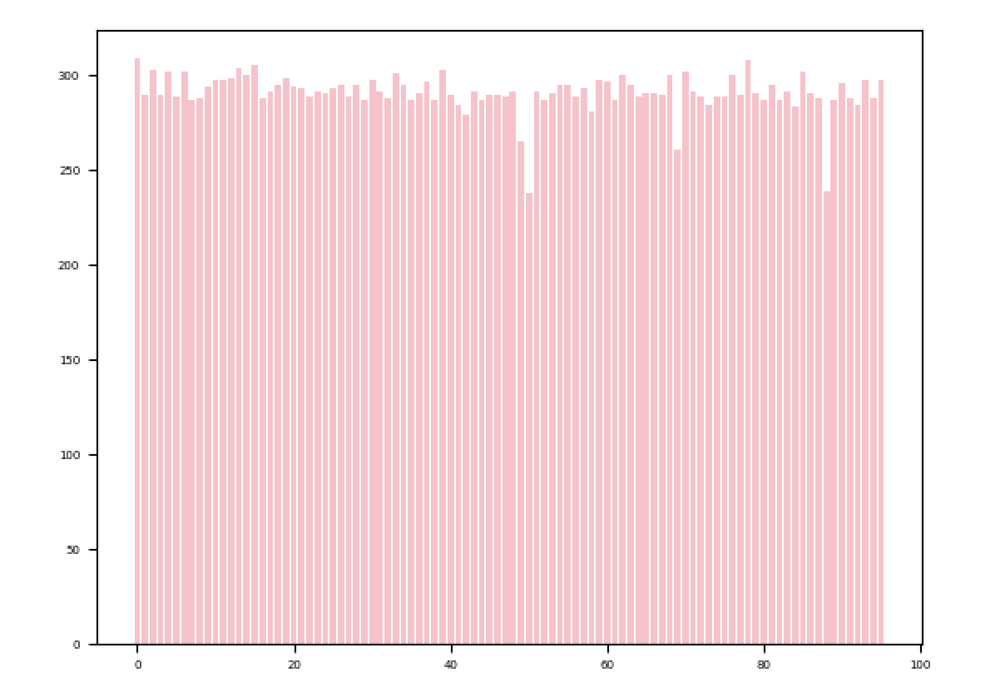
Number of UMIs
PCR well
XYZ_20180215_206_2

Slide 5
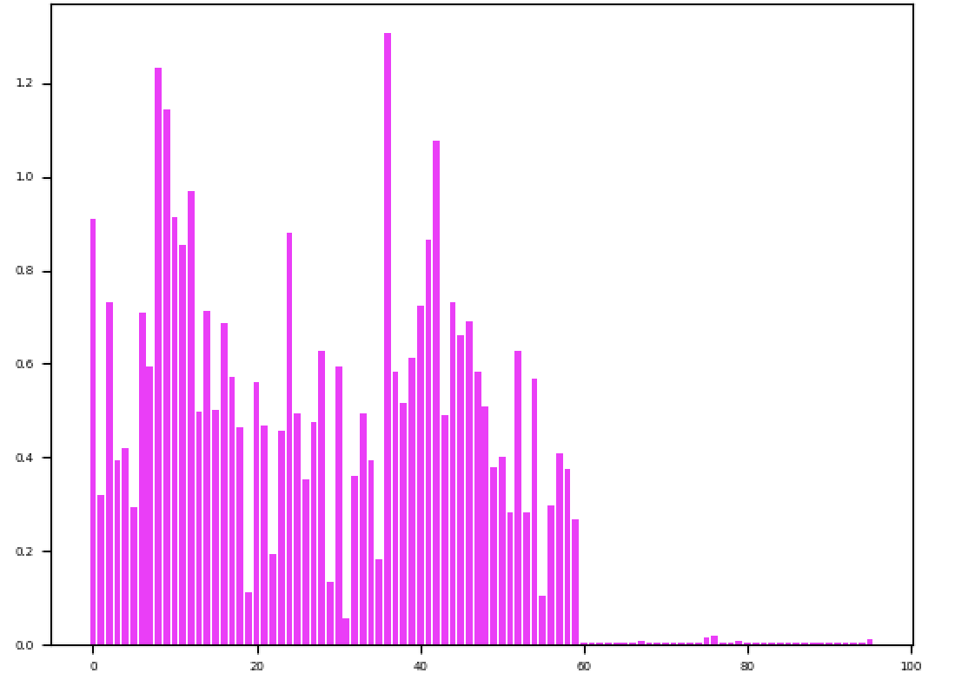
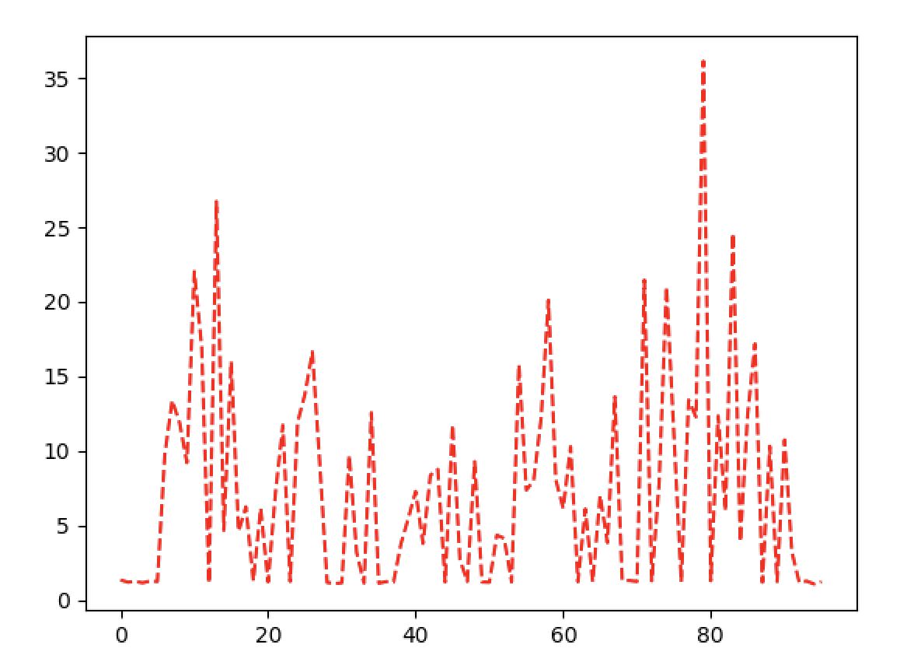
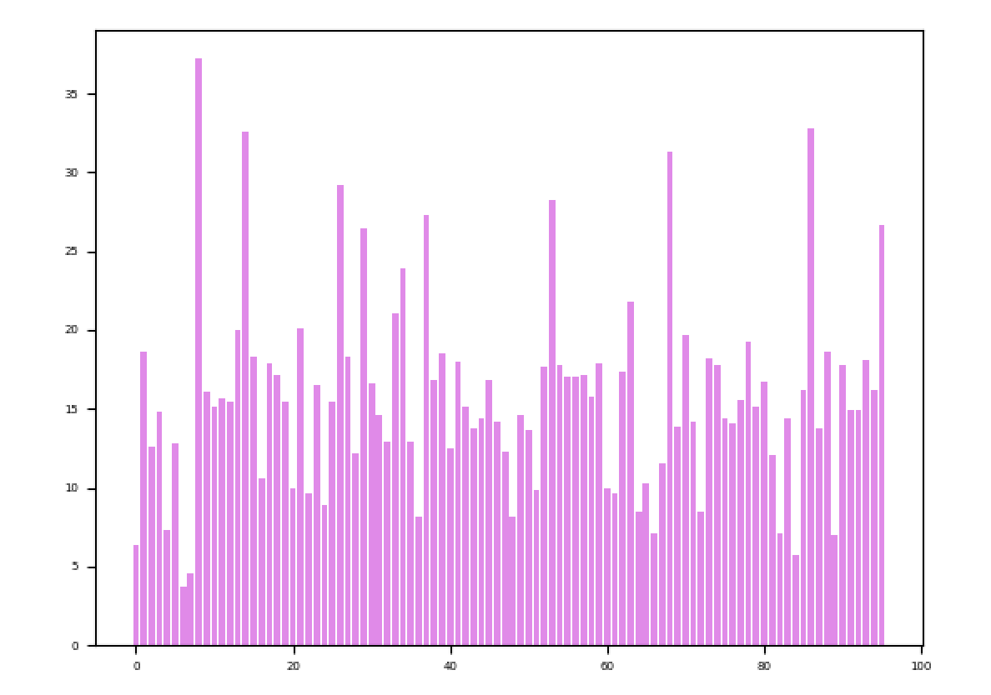
Dup %
Num of reads
PCR well
PCR well
Mapping %
Average mapping: 15.77
Average total reads: 3469756.65
XYZ_20180215_206_3
PCR well

Slide 6
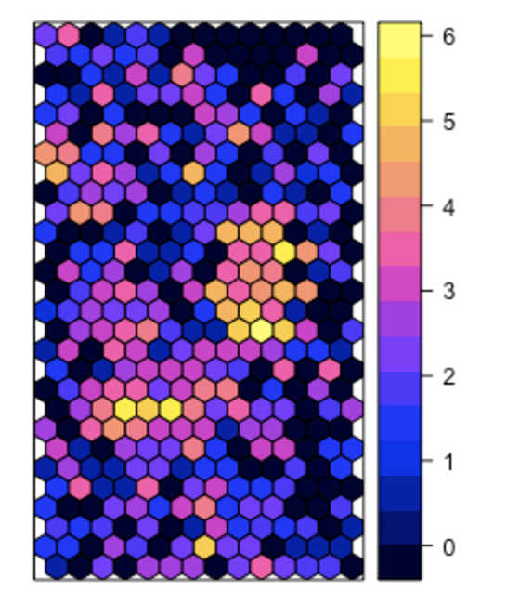
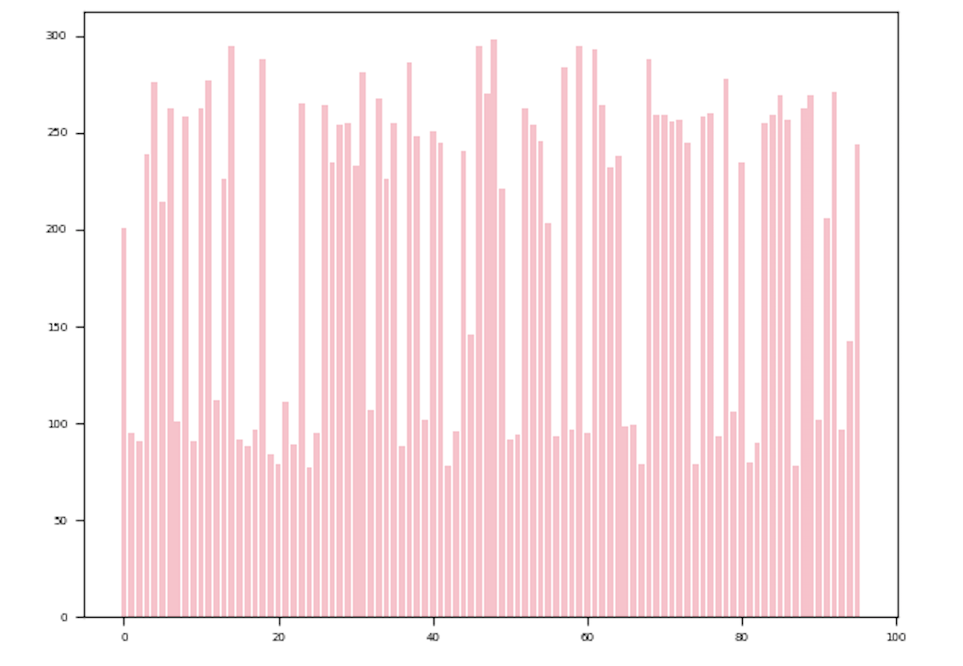
Number of UMIs
PCR well
XYZ_20180215_206_3

