Slide 1
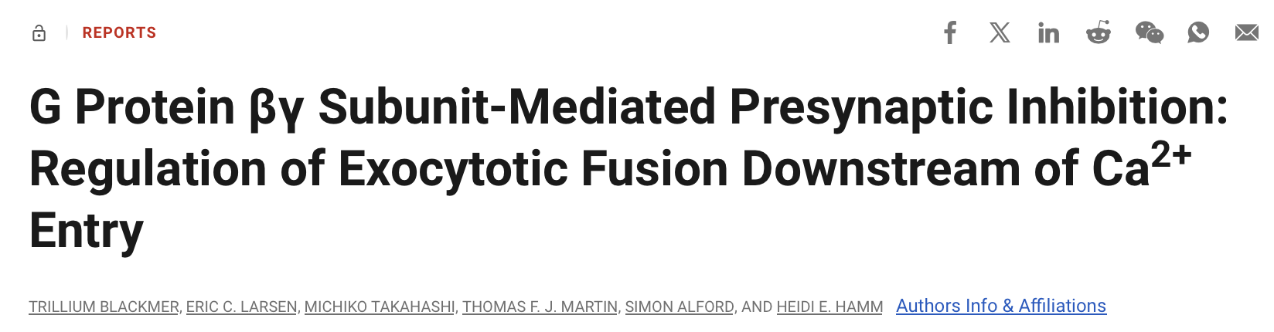
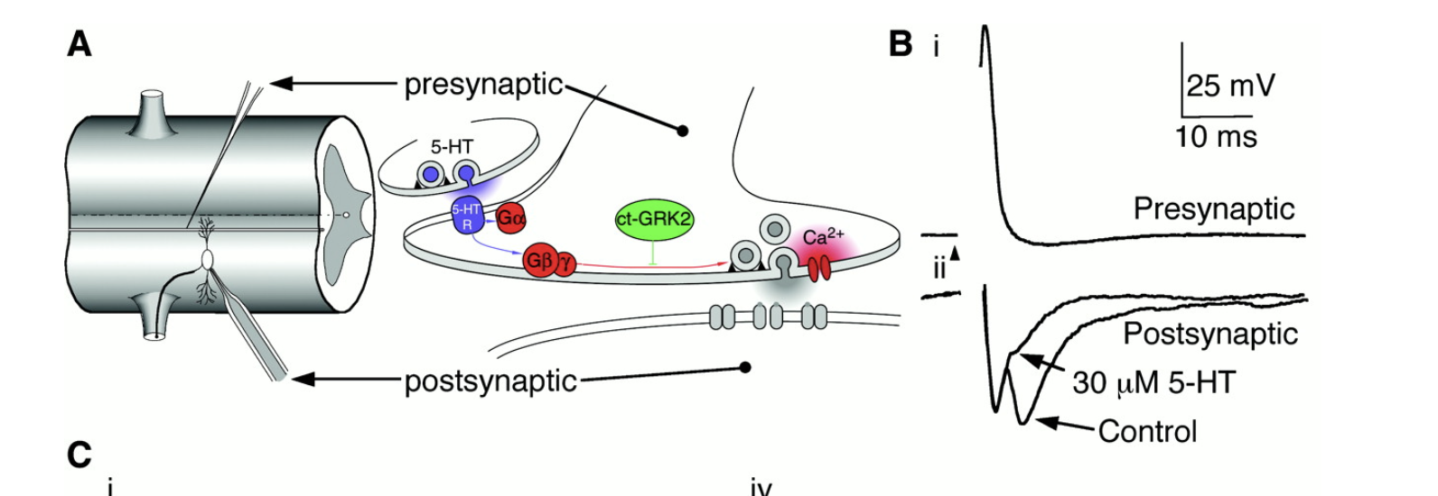
Notes:
The nervous system can modulate neurotransmitter release by neurotrans- mitter activation of heterotrimeric GTP–binding protein (G protein)–coupled receptors. We found that microinjection of G protein bg subunits (Gbg) mimics serotonin’s inhibitory effect on neurotransmission. Release of free Gbg was critical for this effect because a Gbg scavenger blocked serotonin’s effect. Gbg had no effect on fast, action potential– evoked intracellular Ca2 1 release that triggered neurotransmission. Inhibition of neurotransmitter release by seroto- nin was still seen after blockade of all classical Gbg effector pathways. Thus, Gbg blocked neurotransmitter release downstream of Ca21 entry and may directly target the exocytotic fusion machinery at the presynaptic terminal

