Slide 1

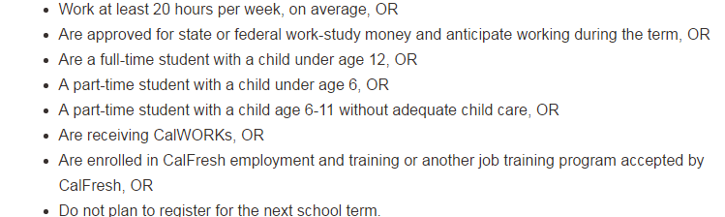
Am I Eligible? CalFresh Eligibility Checklist
Must be a US citizen or a legal permanent resident
Student Requirements:
Income Limits: Monthly gross income (before deductions) must be the same or below the amount listed in the chart below for the household size:
Family Size | 1 | 2 | 3 | 4 | 5 | 6 | 7 | 8 | 9 | 10
Income Limit | $2010 | $2708 | $3404 | $4100 | $4798 | $5494 | $6190 | $6888 | $7586 | $8284

Slide 2
Documents required to apply
Proof of residence (lease, copy of bills)
Work Study Certification Letter
***(you may be asked to submit your work study pay stubs depending on the case worker that is assigned to you)
Class schedule
Apply today! Enrolling in CalFresh takes 3 steps!
If you don’t apply, you won’t know if you qualify.

Slide 3
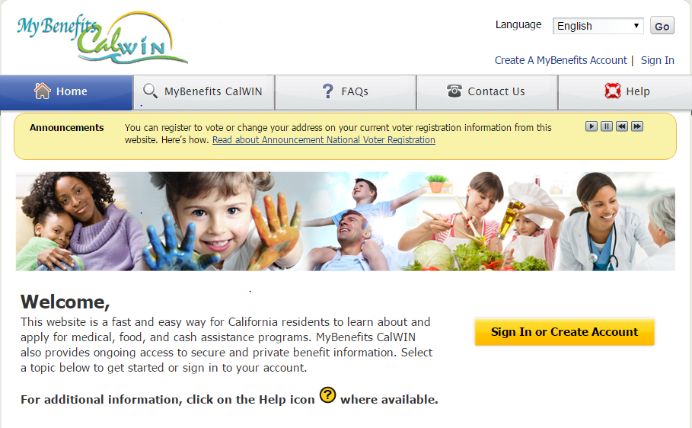
Step 1: Create an Account at mybenefitscalwin.org (5 mins)

Slide 4
Step 2: Upload documents (10 mins)
Income Verification: Financial Award Letter & either work study verification document OR recent pay stubs (if you’re employed)
Citizenship Verification (passport, birth certificate, or green card)
Student Verification (e.g. class schedule)
Be Sure to provide a good contact phone number & include the best time for a worker to call you to schedule an interview

Slide 5
Step 3: Phone Interview (10-20 mins)
Within 3 business days of applying online, you will receive a text message or a phone call to set up a phone OR in-person interview
Phone interview sample Q’s from a student who was approved
Verify name, address, & SSN
How much do you pay for rent & utilities? If utilities not included, how much do you pay for utilities?
Which bank firm do you use?
How much money do you have in your bank account? (If your checking/savings account(s) is $100 or less, you will receive benefits immediately)
Do you receive any financial help from parents or outside source?
Do you have any loans outside of school?
Are you a full-time or part-time student?
*NOTE You may want to consider NOT providing your bank account statements if your account reflects large deposits from school loans/grants disbursements)

Slide 6
Step 4: Approval or Denial Letter sent via mail (3-30 days):
How long will it take? The assigned worker have up to 30 days to either approve or deny your case (if you haven’t heard anything by 10-14 business days, give the HSA Medi-Cal office a call at 415-558-4700)
You may be eligible to get benefits within 3 calendar days, if you meet one of the criteria:
Your monthly gross income is less than $150 & your checking/savings account(s) is $100 or less
Your household’s housing costs are more than your monthly gross income & cash on hand or in checking/savings account(s)
If approved, you will receive UP TO $194/month. This amount varies depending on your income. If you’re in disagreement of your approved monthly benefits, contact your case worker.
If your application is approved, you will also receive a SAR 7 Eligibility Status Report Form via mail (this will need to be completed usually within 3-5 business days to keep benefits active)

Slide 7
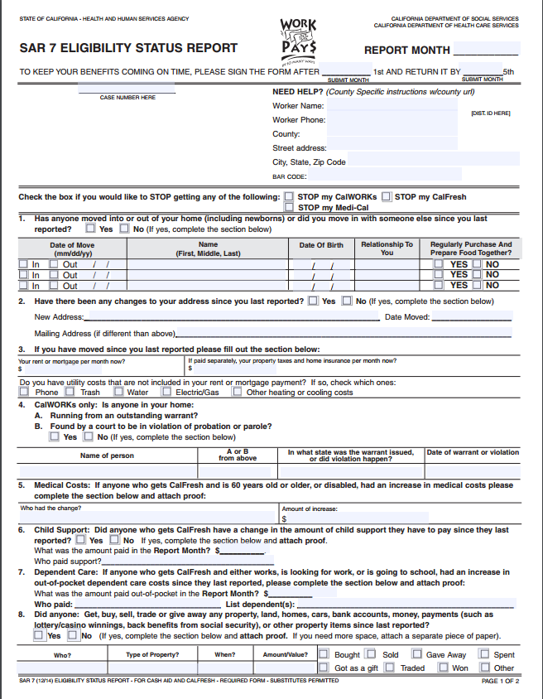
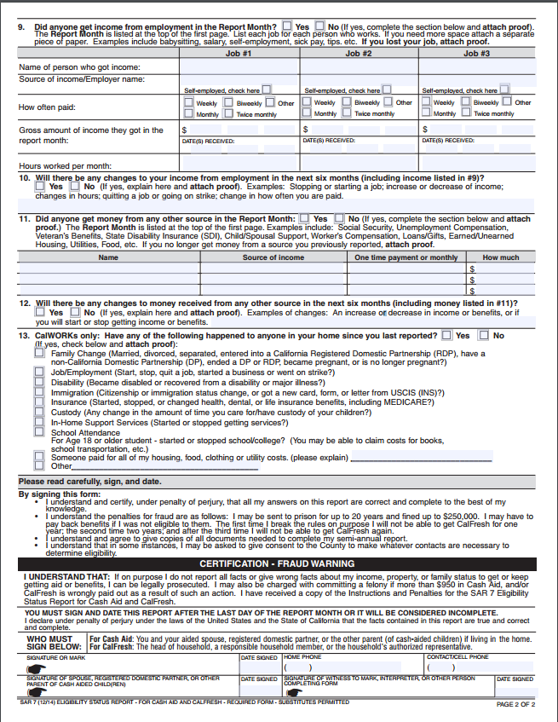
How to fill out your SAR 7 Eligibility Status Report http://www.cdss.ca.gov/cdssweb/entres/forms/English/SAR7A.pdf

Slide 8

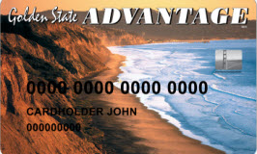

Where Can I Use My EBT Card?
Can be used to purchase food
at many San Francisco stores for FOOD ONLY!
To find stores in your area that accept CalFresh benefits visit:
https://www.ebt.ca.gov/caebtclient/cashlocationSearch.recip;jsessionid=F7563C65311FD79AB54E767AE732011A

Slide 9


Use Your CalFresh Benefits to Enjoy the Tastiest Local Fruits and Vegetables
DOUBLE YOUR CALFRESH/EBT DOLLARS W/ MARKET MATCH!
HOW MARKET MATCH WORKS:
Visit your PCFMA farmers' market Info Booth.
Buy EBT Scrip with your Golden State Advantage EBT card.
For every $1 dollar you purchase you will receive a free Market Match dollar worth $1 in fresh fruits and vegetables, up to
$10 in free scrip per farmers' market visit.
Shop for fresh fruits and vegetables, spending the tokens with farmers as you would spend cash.
To Locate a Participating Farmers’ Market in your area visit:
http://www.pcfma.org/visit/markets

Slide 10
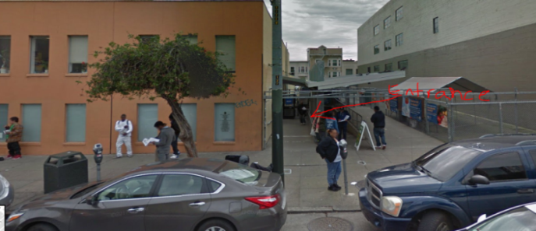
Office Locations/Contacts
Alameda County
P: 510-891-0700 (REALLY DIFFICULT to speak to someone over the phone at this office, phone lines are always busy)
Address: 2000 San Pablo Ave
San Francisco County:
P: 415-558-4700: Press 1 for English, 2 for Spanish; Press 1 for info on how to apply, 2 if you have existing case; Press 2 to speak to someone (can take up to 10 minutes to speak to a person)
Address: 1235 Mission Street 8a-5p weekdays.
(BEST to arrive prior to opening)
San Mateo County:
HAS Administrative Office – Belmont, Northern Region Office – Daly City, Northern Region Office– South City, Central Region Office – Belmont, Central Region VRS Services Connect – San Carlos, CA, Southern Region Office – Redwood City, & Southern Region Office – East Palo Alto, CA. (https://hsa.smcgov.org/hsa-locations)
Email: foods@sfgov.com (ONLY USE EMAIL TO SEND IN DOCUMENTS IF YOU HAVE A CASE NUMBER. INCLUDE your CASE NUMBER in subject of email)
*If applying in-person, process can take up to 2-3 hours.

