Slide 1
ISTQB® Foundation: Testing throughout the Software Development Lifecycle
UNDERSTANDING SDLC MODELS
Yelena Gouralnik
TEST AUTOMATION ENGINEER

Slide 2
ISTQB
International Software Testing Qualifications Board
Notes:
Their certification for testing is a standard in software industry

Slide 3
ISTQB – Foundation Level
Fundamentals of Testing
Testing throughout the SDLC
Static Testing
Testing Techniques
Test Management
Tool Support for Testing

Slide 4
ISTQB – Foundation Level
Fundamentals of Testing
Testing throughout the SDLC
Static Testing
Testing Techniques
Test Management
Tool Support for Testing
PS course
PS course
PS course
PS course
PS course
PS course

Slide 5



Who This Course Is For
Aspiring Tester
Junior Tester
Test Automation Engineer

Slide 6

Course Overview
SDLC models
Test levels Test types
Maintenance testing
Notes:
Intro:
This presentation is broken down into four major parts.
1. First, we'll define and explore different software development lifecycle models. It's important to know these models because they hugely influence the life and work of a tester.
2. Then we'll look at different test levels. You see, any nontrivial piece of software can be viewed as a stack or a network of subsystems or modules and there is a different way to test each layer, so it's really useful to know that.
3. Next, we'll define and explore different test types, such as functional and nonfunctional ones. If understanding test levels is like learning to see in 2D, then learning about the test types is like adding a dimension to your vision. You'll see the world of testing in 3D.
4. Last, but not least, we'll see what maintenance testing is all about, what it is triggered by, and the role of impact analysis on it.

Slide 7
Overview
Define SDLC
Broad SDLC categories
Notes:
So in this module we'll define the SDLC,
we'll talk about why it is important to have one,
we'll learn the two broad categories defined by ISTQB, and of course, the models themselves, such as Waterfall, the V‑Model, Scrum, and others.
As we explore them, we'll discuss their advantages and disadvantages, as well as their effect on testing. So let's get started.

Slide 8
SDLC
Why?
What?
Notes:
SDLC. Every modern software team uses one, but what is it, actually, and why do we need one at all?

Slide 9


SDLC
A systematic plan that defines a process and the what? who? when? and how? to deliver software in an
organized and efficient way
?!
??
Notes:
Let's start with a simple definition. SDLC is a systematic plan that defines a process and the what, who, when, and how to deliver software in an organized and efficient way. Systematic plan is key here. Whenever you have a complex undertaking involving many people and you want to achieve a common goal, you need to set up rules. You can't have a bunch of uncoordinated people do their own thing and hope it all turns out well in the end. It's going to be a mess.

Slide 10

SDLC
Offers a basis for project planning and control
Helps every team player know their role Ensures smooth progress
Increases development speed Keep costs low
Notes:
So to elaborate, a lifecycle model offers a basis for project planning and control, helps every team player know their role, what they are supposed to do and when.
This in turn ensures smooth progress and increases development speed. And if you have smooth progress, then you keep costs low. These are the benefits, at least in theory. Do all models provide equal benefits?

Slide 11

Not all lifecycle models are created equal
Notes:
You can probably guess that, no, not all lifecycle models are created equal. Some are better, some are worse, some are more appropriate to a specific context and project, some are less.

Slide 12
SDLC
A systematic plan that defines a process and the what? who? when? and how? to deliver software in an
organized and efficient way
Notes:
I've provided you with my own simple definition of the SDLC to give you a foundational understanding,

Slide 13
SDLC
A model that describes the types of activity performed at each stage in a software development project, and how the activities relate to one another logically and chronologically
Notes:
but now I'd like to give you the one given in the official ISTQB® material, and we'll be using that as a basis for the rest of the module.
SDLC is a model that describes the types of activity performed at each stage in a software development project and how the activities relate to one another logically and chronologically. Let's highlight the keywords.
Model. As I said, many different models exist, but any one of them must answer the main question, how, how to organize everyone to build software?
Activity. Who does what?
Stage. We should understand the different stages of any model, where you fit as a team member. And I would also like to highlight chronologically, when things get done.
This is probably the main differentiator between the models, as you'll see in just a moment

Slide 14
SDLC Models
Sequential
Waterfall, V-Model
Iterative
RUP, Scrum, Kanban, Spiral
Notes:
ISTQB groups the models into two broad categories, sequential and iterative. The classic sequential models are Waterfall and the V‑Model,
whereas examples of iterative models include Rational Unified Process, Scrum, Kanban, and Spiral.
They are not that fundamentally different.
They differ mostly on how things are done in the context of time.

Slide 15






SDLC Stages
Analysis
Design Development
Testing
Deployment Maintenance
Notes:
But regardless of what model you participate in, it will recognize the same basic building blocks, requirement analysis, design, development, also known as implementation or simply coding, testing, deployment or delivery, and, in most cases, maintenance.

Slide 16
Analysis
Design
Development
Testing
Deployment
Maintenance
Notes:
A sequential development model describes the software development process as a linear sequential flow of activities. This means that any phase should begin when the previous phase is complete, and thus the waterfall model is born.

Slide 17

Requirements
Analysis
Design
Development
Testing
Deployment
Maintenance
Notes:
Suppose you have to deliver a piece of software that has 10 big different features. With the waterfall model, business analysts do all of the analysis first, then developers and architects do all of the design to the last detail. Once that is done, they do all of the coding. They implement all 10 features.
This gets delivered to testers as version 1.0. The testers do the testing. They might find and report some bugs. Developers fix them and deliver the next version 1.1.

Slide 18




Requirements
Analysis
Design
Development
Simple
Testing
Deployment
Maintenance
Notes:
This can go back and forth until, say, version 1.5, then deliver to the customer, and then over time do minor maintenance and updates as the situation requires.
So even a strictly sequential model has some iterative actions, but it is kept to a minimum.
Sounds simple, right?
Well, simplicity is arguably the main advantage of this model. It's easy to understand in theory, In practice, however many things can go wrong, and the cost is really high.

Slide 19
Requirements
Analysis
Design
Development
Simple
Testing
Deployment
Maintenance
Notes:
A sequential development model describes the software development process as a linear sequential flow of activities. This means that any phase should begin when the previous phase is complete, and thus the waterfall model is born.

Slide 20
Requirements
Analysis
Design
Development
Simple
Testing
Deployment
Maintenance
Notes:
A sequential development model describes the software development process as a linear sequential flow of activities. This means that any phase should begin when the previous phase is complete, and thus the waterfall model is born.

Slide 21

Waterfall Disadvantages
Can be slow and inefficient
People wait for others to finish
Any phase can become a bottleneck (Very) late feedback
Additional pressure on testers
Notes:
Depending on how you manage it, the entire process can be slow and inefficient, where many people wait for others to finish.
If business analysts are taking too long to write up and deliver the requirements, then developers and testers sit around idle doing nothing.
While developers are writing code, testers are still sitting doing nothing. Yes, of course, testers can and should prepare tests in advance to keep themselves busy, but it usually doesn't take as long as actual development, so there's still a long period of idleness. There's another disadvantage. Any phase can become a bottleneck. If we come back to our previous example, then if developers are delaying because they are facing unexpected challenges, which is frequently the case, then testers have even more time to do nothing. Another extremely important factor is very late feedback, and I talked about it in the other ISTQB® course on testing fundamentals. There's always a chance that a mistake has been made very early in the process, let's say, an illogical or a contradictory requirement. That mistake then gets built into the software and it is discovered only several stages later in testing. This means a lot of rework, and that's not good. The sooner you discover an issue, the better. There is one more downside, which ISTQB® syllabus doesn't mention, but I would like to highlight, nevertheless, because it's part of real life and it's additional pressure on testers. Because here's what happens. Imagine a waterfall project that is supposed to last 4 months. Business analysts have 1 month to produce complete requirements, developers have 2 months to design and implement, and the last month is for testers to find and report bugs and developers to fix them. After that, we should deliver the software. Guess what? Things take longer than planned, and so you now have 1 week instead of 4. The amount of work is the same, but you have to somehow accomplish it four times faster. Testers might ask to extend the deadline because it's too much work in too little time, but the answer to that is usually a big no. And it's not uncommon then for testers being viewed as the bottleneck and the ones holding up the release. Of course, if you miss any bugs, that's also your fault. This is a bad scenario, but it's far from being the only one. Better models exist and followed, so let's see how your testing life looks like in the V‑model.

Slide 22


Slow?
Analysis
Design
Blocked
Development
Testing
Deployment
Maintenance

Slide 23

Busy
Analysis
Design
Development
Testing
Waiting
Delay…
Deployment
Maintenance

Slide 24

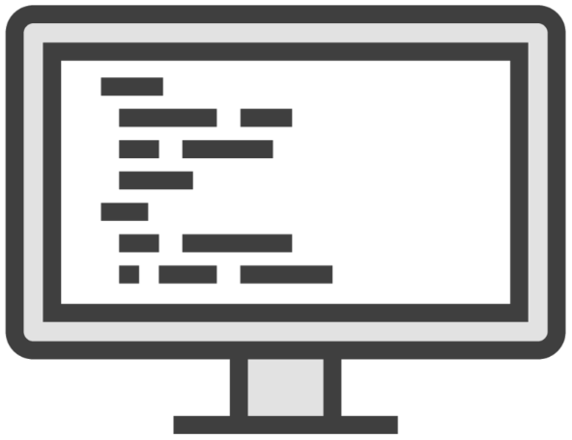




Software
Should do A, B and C
Develop

Slide 25
The sooner you discover an issue, the better.

Slide 26

What testers are left with
Analysis (1 month)
Development (2 months)
Testing (1 month)
+1 week delay
+2 weeks delay

Slide 27


Can we extend the deadline?
Ha ha! No!

Slide 28
Analysis
Design
Development
Testing
Deployment
Maintenance

Slide 29
static testing, a formal review
Acceptance Testing
Analysis
Test Basis A
System design
System Testing
Test Basis B
High-level design
Integration Testing
Low-level design
Unit Testing
Coding

Slide 30
Test Basis
Material that you use to derive tests from – formal requirements, technical specifications, code, etc.

Slide 31
Analyze all 10 features
Analysis
Design
Code all 10 features
Development
Test all 10 features
Testing
Deployment
Maintenance

Slide 32

Do the next ones
Analyze 1-2 features
Analysis
Design
Code 1-2 features
Busy with the first 2
Development
Test 1-2 features
Testing
Deployment
Maintenance

Slide 33
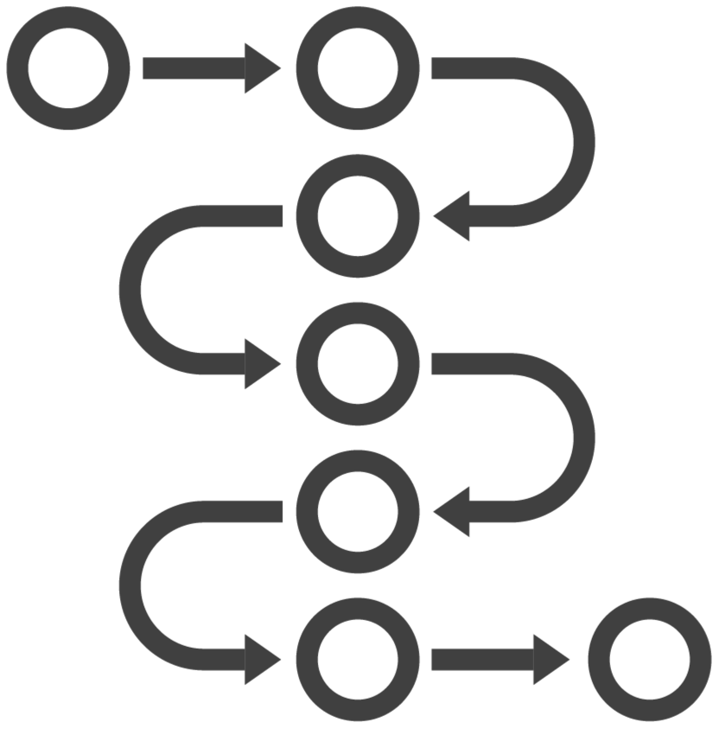
Iterative Approach
Break up the work:
By feature(s)
By time cycle (often fixed duration)

Slide 34
Weeks #1-2: two small features
Weeks #3-4: one bigger feature
What can we achieve in 2 weeks?

Slide 35
Sequential vs. Iterative
Sequential
One major activity at a time
Iterative
Everything within a fixed time frame Deliver something usable fast

Slide 36
Iterative Models
Rational Unified Process
Agile: an umbrella term
Scrum
Kanban
Spiral

Slide 37
Iterative Models
Rational Unified Process
Relatively long iterations (months)
Deliver groups of interrelated features
Scrum
Short iterations (weeks)
Deliver fewer things per iteration
Assigned roles and task owners

Slide 38
Iterative Models
Kanban
Fluid roles
Tasks shared by everyone
Timelines evolve
Spiral
Experimental
Most flexible, may integrate other models

Slide 39



Which SDLC is the best?
Which tool is the best?
Which programming language is the best?

Slide 40
It depends.

Slide 41
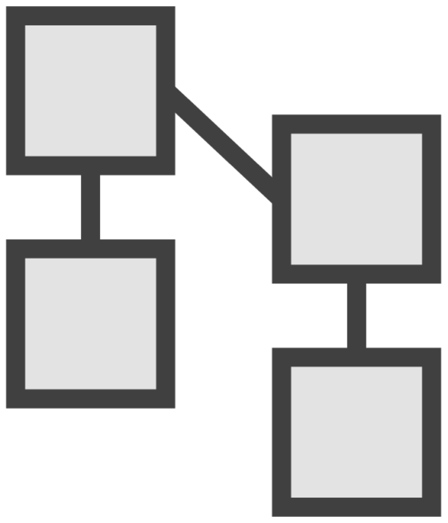
Models are a simplification of reality
A model is like a rough blueprint
Iterative models are NOT always better than sequential
Context matters
A robust sequential model may be good enough

Slide 42


Frontend: Scrum
Backend: V-Model

Slide 43
Mixing models is possible in practice.

Slide 44
SDLC: Software Development Lifecycle
Two broad categories:
Summary
Sequential: Waterfall, V-Model
Iterative: timeboxed periods to deliver subsets of functionality
Iterative examples: RUP, Scrum, Kanban, Spiral

Slide 45
Discovering Test Levels

