Slide 1
Discovering Test Levels
Yelena Gouralnik
TEST AUTOMATION ENGINEER
Notes:
In this section, we will be discovering the various test levels.

Slide 2

Notes:
Most modern nontrivial software is not a single monolith black box behind a screen where all the code is written in one huge file. Software can often be broken down into multiple layers and then those layers into smaller modules.
And those modules, in turn, consist of files with code that actually runs and executable whatever it is supposed to do.

Slide 3



8
Notes:
And today, building software and especially entire enterprise architectures is often similar to assembling a jigsaw puzzle. Developers create small jigsaw pieces.

Slide 4


Notes:
Then they gradually assemble them together until it all works.

Slide 5
Test Levels
Notes:
And this is the basic idea behind test levels. You can test big and small.
The development team together with testers can test the smaller units or components independently, then how they interact together, first two units, then three units, then all units as a whole.

Slide 6

Four test levels:
Overview
Component
Integration
System
Acceptance
Official ISTQB and widely used alternative definitions
Notes:
The ISTQB® Foundation syllabus lists four levels, component, integration, system, and acceptance levels.
Each of these levels has specific objectives and approaches, as well as types of typical defects found at every level, and we'll discuss these as we go along.
We will explore these specific levels and how they are defined by ISTQB® .
But be aware that I will also give you several widely used alternative definitions of those levels that are practiced in the real world.

Slide 7
Test levels explanation in under 90 seconds.
Notes:
Let me try and explain all of the test levels in under 90 seconds in a very simple way and then provide you with a sample system.
I will then ask you to keep that in mind as we go through the rest of the module, talking about details.

Slide 8

Component Testing
Notes:
Software is built from multiple components and at multiple layers.
You identify the smallest possible unit, and you test that unit in isolation, trying to find and fix defects in that component alone.
You do that for each component separately.

Slide 9

Integration Testing
Notes:
Then comes integration testing. You start connecting these components together. Units might work fine on their own, but they might fail when connected.
Ideally, you should do this incrementally. Connect two units, test, then integrate a third, test, then the rest one by one.

Slide 10


System Testing
Acceptance Testing
Who? For what purpose?
Notes:
System testing starts when everything or almost everything is in place, and you try to exercise the software from start to finish, and you do that using from the outside, which often involves an interface.
Finally comes acceptance testing. The software is given to the end user, the customer, or their representative, and they should work with the software so that they can say, yes, this works as I wanted. I accept.

Slide 11

Common Objectives
Reducing risk
Verifying functional and non-functional behaviors
Build confidence in the system Find defects
Prevent defects from escaping to higher levels
Notes:
All of these levels have common and specific objectives.
The common ones include reducing risk;
verifying functional and nonfunctional behaviors,
and we'll talk about test types in the next module;
build confidence in the system; find defects, obviously;
but also for components and integration levels, we want to prevent them from escaping to higher levels because finding and fixing a bug in lower levels is faster and easier.

Slide 12
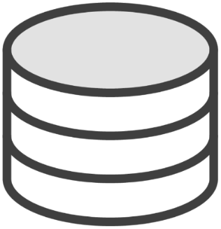
Current Account
Savings Account
Mortgage Calculator
Insurance Calculator
Unit?
Common Calculator
Notes:
Let me just introduce you to a fictional banking system.
This system provides a user interface through which you can do all sorts of things, check your current balance, check your savings account, transfer money into the savings account, play around with a mortgage calculator if you want to apply for one, as well as life and travel insurance calculators, all backed up by a common calculator module, providing basic math functions like adding and multiplying.
And finally, there's a pretty good chance that all of your personal data is stored in a database. That's good enough for a fictional system, and we'll use it as we explore the test levels.

Slide 13
Component Test Level
Component testing (also known as unit or module testing) focuses on components that are separately testable
Notes:
Component testing, also known as unit or module testing, focuses on components that are separately testable. Notice that, according to this definition, all three terms are synonymous.
This is how ISTQB defines it, and this is what you should remember for the exam, but I'd say that there's a 99% chance that this is not how people understand it in the real world.

Slide 14


What is a “unit” exactly?
How small?
Small. Can be tested independently.
Notes:
The main source of confusion here is the difficulty of exactly defining the word unit. It is something very small that can be tested independently and in isolation, but how small can you go?

Slide 15

Calculator
Tests
func add(a, b) {
return a + b;
}
assertTrue(add(1, 2) == 3);
Unit?
assertTrue(add(5, 5) == 10);
Notes:
Suppose you have a single code function that adds up two numbers, and it gives you the sum. Is this a unit? If you ask a developer, the answer will definitely be yes. And this can be tested.

Slide 16
Calculator
func | add(a, b);
func | subtract(a, | b);
func | multiply(a, | b);
Unit?
func divide(a, b);
Notes:
You can write multiple automated unit tests that verify it works correctly. But this function will be located in a source file, together with other small, logically‑related functions.
We can have a file called Calculator, and it will have functions, add, subtract, multiply, divide. So we could also say that this one file is a unit. It's a bigger unit, but it's a unit nonetheless.

Slide 17
Current Account
Savings Account
Mortgage Calculator
Insurance Calculator
Unit?
Common Calculator
Notes:
Finally, we could have a small component called Mortgage Calculator, and we know that internally it consists of multiple files. So can we call this a single logical unit?
So double‑check how you and your team define terms unit and module. Developers will tend to define it as a piece of code or a single source file at most, whereas testers, who don't see such low‑level details, might refer to a single logical business functionality.

Slide 18

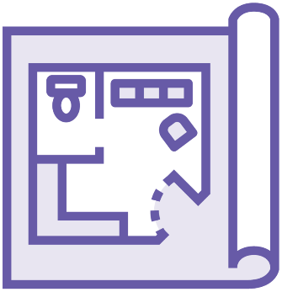

Test Basis
Developers:
Static testing
Automated unit tests
Test Basis
Testers:
1) Formal requirements
Notes:
Consequently, the test basis and the approach will vary too. For developers, the test basis will be code itself, tech design, and perhaps a data model.
reading code and trying to find mistakes in code, or writing unit tests that exercise the separate functions and ensuring that they produce correct output.
However, the terms are fluid, and if you are a tester and you have been tasked with component testing without looking at the code then your test basis will be the component spec, an outline telling you how exactly the calculation is supposed to happen.
The main objective of unit testing is to find defects in that single component. Sounds obvious, but many still ignore the value such testing can bring.

Slide 19

Here!
Notes:
Imagine looking for a needle in a haystack. The needle is a software bug. It might take ages to find, but doing unit‑level testing is like providing your team with a method that tells you, hey, I don't know where exactly the defect is, but I'm pretty sure it's in this small region over here, so concentrate your effort on this area.

Slide 20
Integration Testing
Notes:
Next comes the integration testing. The concept is simple. We tested units separately, now we start connecting them and making sure nothing blows up.
Testing two units is integration testing.
Testing three or four units together is also integration testing. It just means a bigger integration test, but still an integration test.
.

Slide 21
Current Account
Savings Account
Integration
Mortg.
Calculator
Insurance Calculator
Integration
Common Calculator
Notes:
If you have a typical three‑layer system, UI, also called the front end, the back end, where most of the logic lives, and the database.
If you execute a test that uses all three of these layers, we could call that an integration test, too. So remember that working with two or more boxes across two or more layers automatically means you're doing some kind of integration testing.
The way I presented the idea is more of a tester's perspective. If you ask a developer, however, they will probably have a different or an additional definition of integration testing.

Slide 22


Current Account
Savings Account
Insurance Calculator
Dev Integration Test
Common Calculator
Notes:
Since they work with code at the lowest levels, writing automated tests that verify communication between two or three source files will be considered an integration test by them. If a test needs to fetch a single file in the file system, even that will qualify the test as an integration one.

Slide 23

Dev Testing
Book: Unit Testing Principles, Practices, and Patterns
If you have programming skills
Definitions different from ISTQB
Not necessary for ISTQB exam Integration testing: two or more “units”
Notes:
The developer's perspective on unit and integration testing is explored quite well in Unit Testing Principles, Practices, and Patterns book, and I recommend it for two reasons. If you have some programming basics, you will understand the developer's perspective on testing levels. And second, you will realize that ISTQB test level definitions are not universal in the industry.

Slide 24
Integration Testing Categories
Component Integration
System Integration
Notes:
The ISTQB syllabus recognizes two specific subcategories of integration testing, component integration and system integration.

Slide 25
Your System X
Other System Z
Current Account
Savings Account
Insurance Calculator
Gate way
Common Calculator
Notes:
Component integration is what we already discussed. You have a system, you have many components, you test that they integrate with each other without issues.
That's within a single system wherever you draw the border of that system.
On the other hand, system integration testing focuses on interactions between systems. Our fictional bank doesn't exist in isolation. It needs to communicate and exchange data with other banks, with credit card companies, and dozens of other vendors.
Each of them has their own system with a public interface, the endpoints through which these systems communicate.

Slide 26

Integration Testing
Test objects:
Subsystems
Databases
Infrastructure components
Microservices
Test basis:
Technical spec
Design documents
Sequence diagrams
Public interface definitions
Notes:
Given this rather broad definition of integration testing, it's not a surprise that both the test object and the test basis can be just about anything.
Entire subsystems, databases, infrastructure components, interfaces, and microservices are all examples of test objects. And you can use any documentation related to these objects as a test basis for your test scenarios, technical spec, design documents, sequence diagrams, and public interface definitions.

Slide 27



System
Test Automation Engineers
Developers
Testers
Notes:
When it comes to the test approach, it's a real mix. Frequently, both developers and testers participate in integration testing, and it will vary quite a lot depending on where you work, and it depends on many factors.
For example, a strong technical background is required to carry out such testing in some projects, and it just so happens that the testers don't have it.
So the developers mostly do the integration testing.
We have enough test automation engineers that are capable to carry out all sorts of independent technical integration testing, and we support manual testers who focus on system and acceptance testing.

Slide 28
System Test Level
Full integration testing of all modules
Notes:
In a way, system testing is a bit like full integration testing of all modules. You would expect all pieces to be put together, and instead of testing various combinations of subsections of the same system, you take a step back and focus on the behavior of the system as a whole.

Slide 29
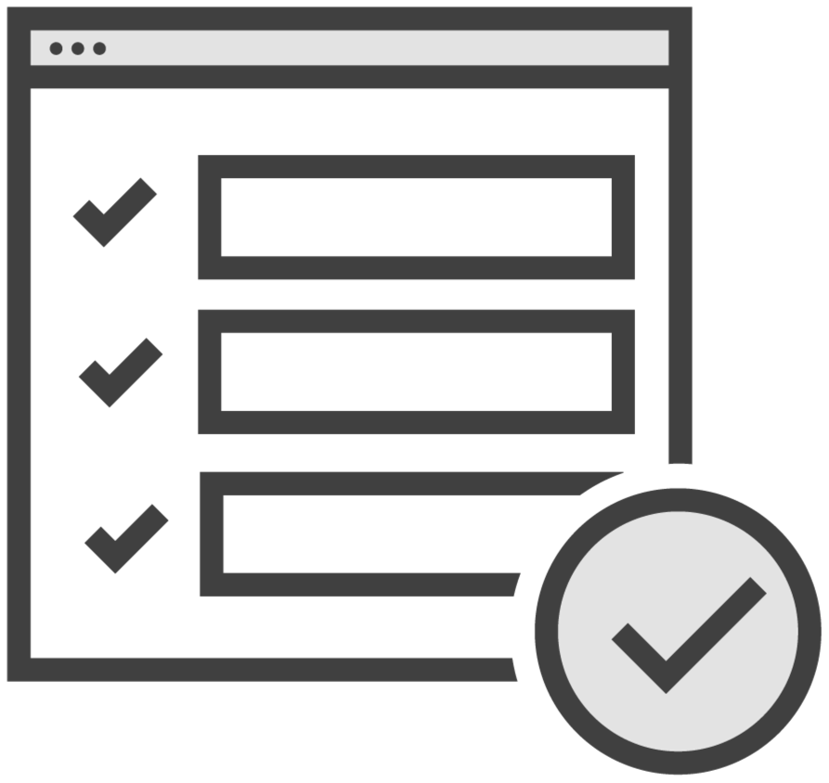
System Testing
Your starting point is typically not within the system, but rather outside
Considers system paths and flows
End-to-end (e2e)
Front-to-back (f2b)
External behavior vs. inner structure
Notes:
Two things to consider when you do system testing. Your starting point is typically not within the system, as is the case with integration testing, but rather outside.

Slide 30
Your System X
Notes:
Whatever public interfaces the system has, imagine like the outside doors or windows of a house, and you interact with the system only through these interfaces or endpoints, as if you didn't know about the internal mechanics.

Slide 31

Car Integration Testing
Notes:
If you were testing a car, then integration testing would be like looking at the car internals and make sure that the engine fits and works well with the rest of the car.

Slide 32

Car System Testing
Notes:
Whereas system level testing is more similar to just taking it for a test drive without knowing or caring anything about what happens inside. The public interface to you, in this case, is the steering wheel, the seat, the pedals, and the gearbox. As long as you can drive around without problems, then the system works fine.

Slide 33
System Testing
Your starting point is typically not within the system, but rather outside
Considers system paths and flows
End-to-end (e2e)
Front-to-back (f2b)
External behavior vs. inner structure
Notes:
The second thing to consider are the system's paths and flows.

Slide 34
Flow 1
Current Account
Savings Account
Flow 2
Flow 3
Mortgage Calculator
Insurance Calculator
Common Calculator
Notes:
If you are making a payment to a different account, that is one flow. If you are getting a mortgage, that's another flow. If you are buying some package deal that involves several financial products with a special discount, that's a third flow, which is a combination of the first two.

Slide 35
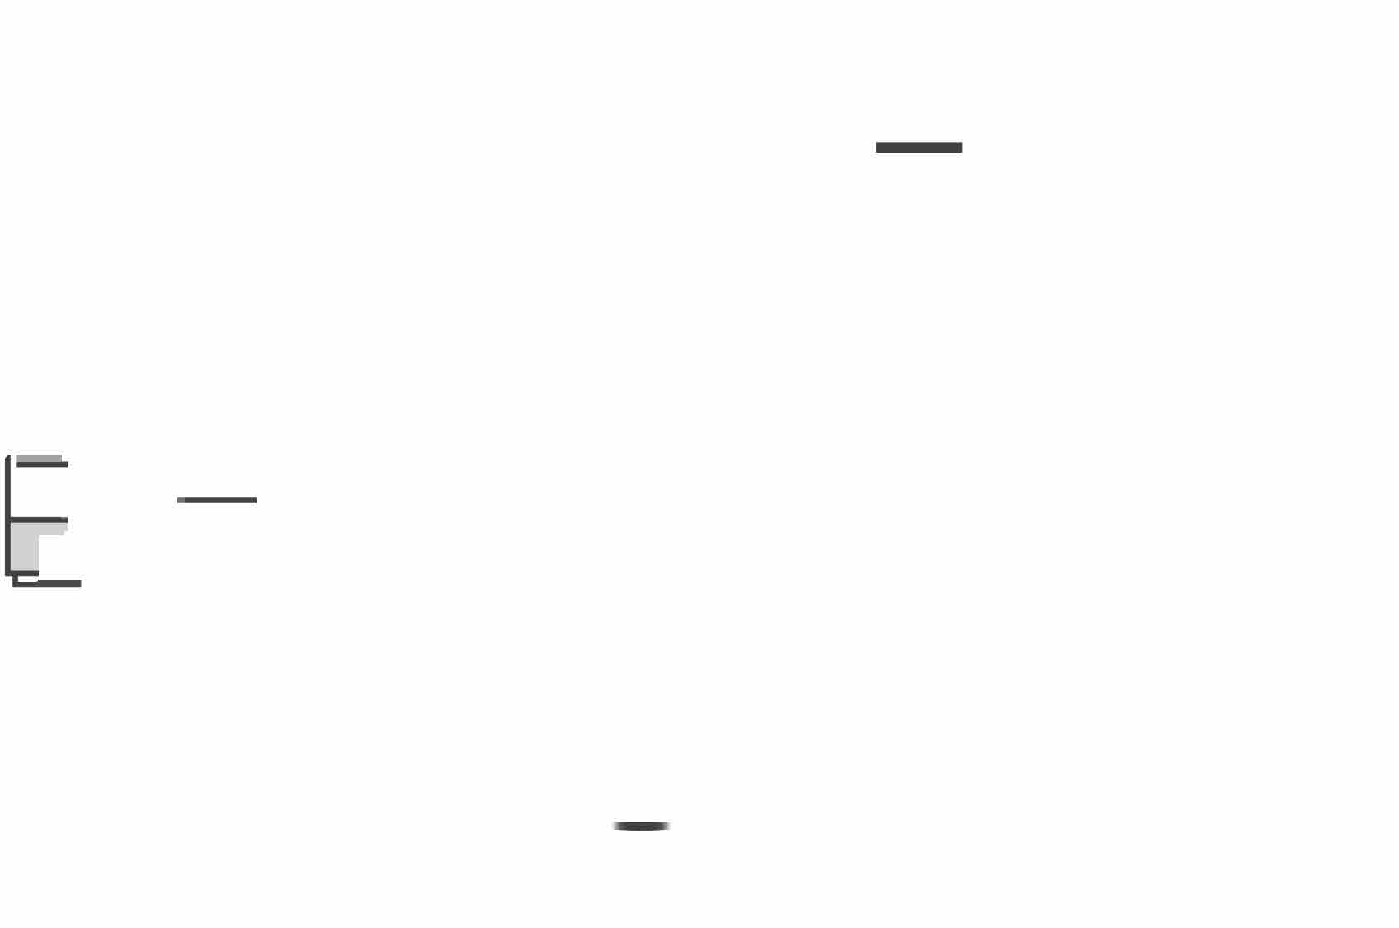
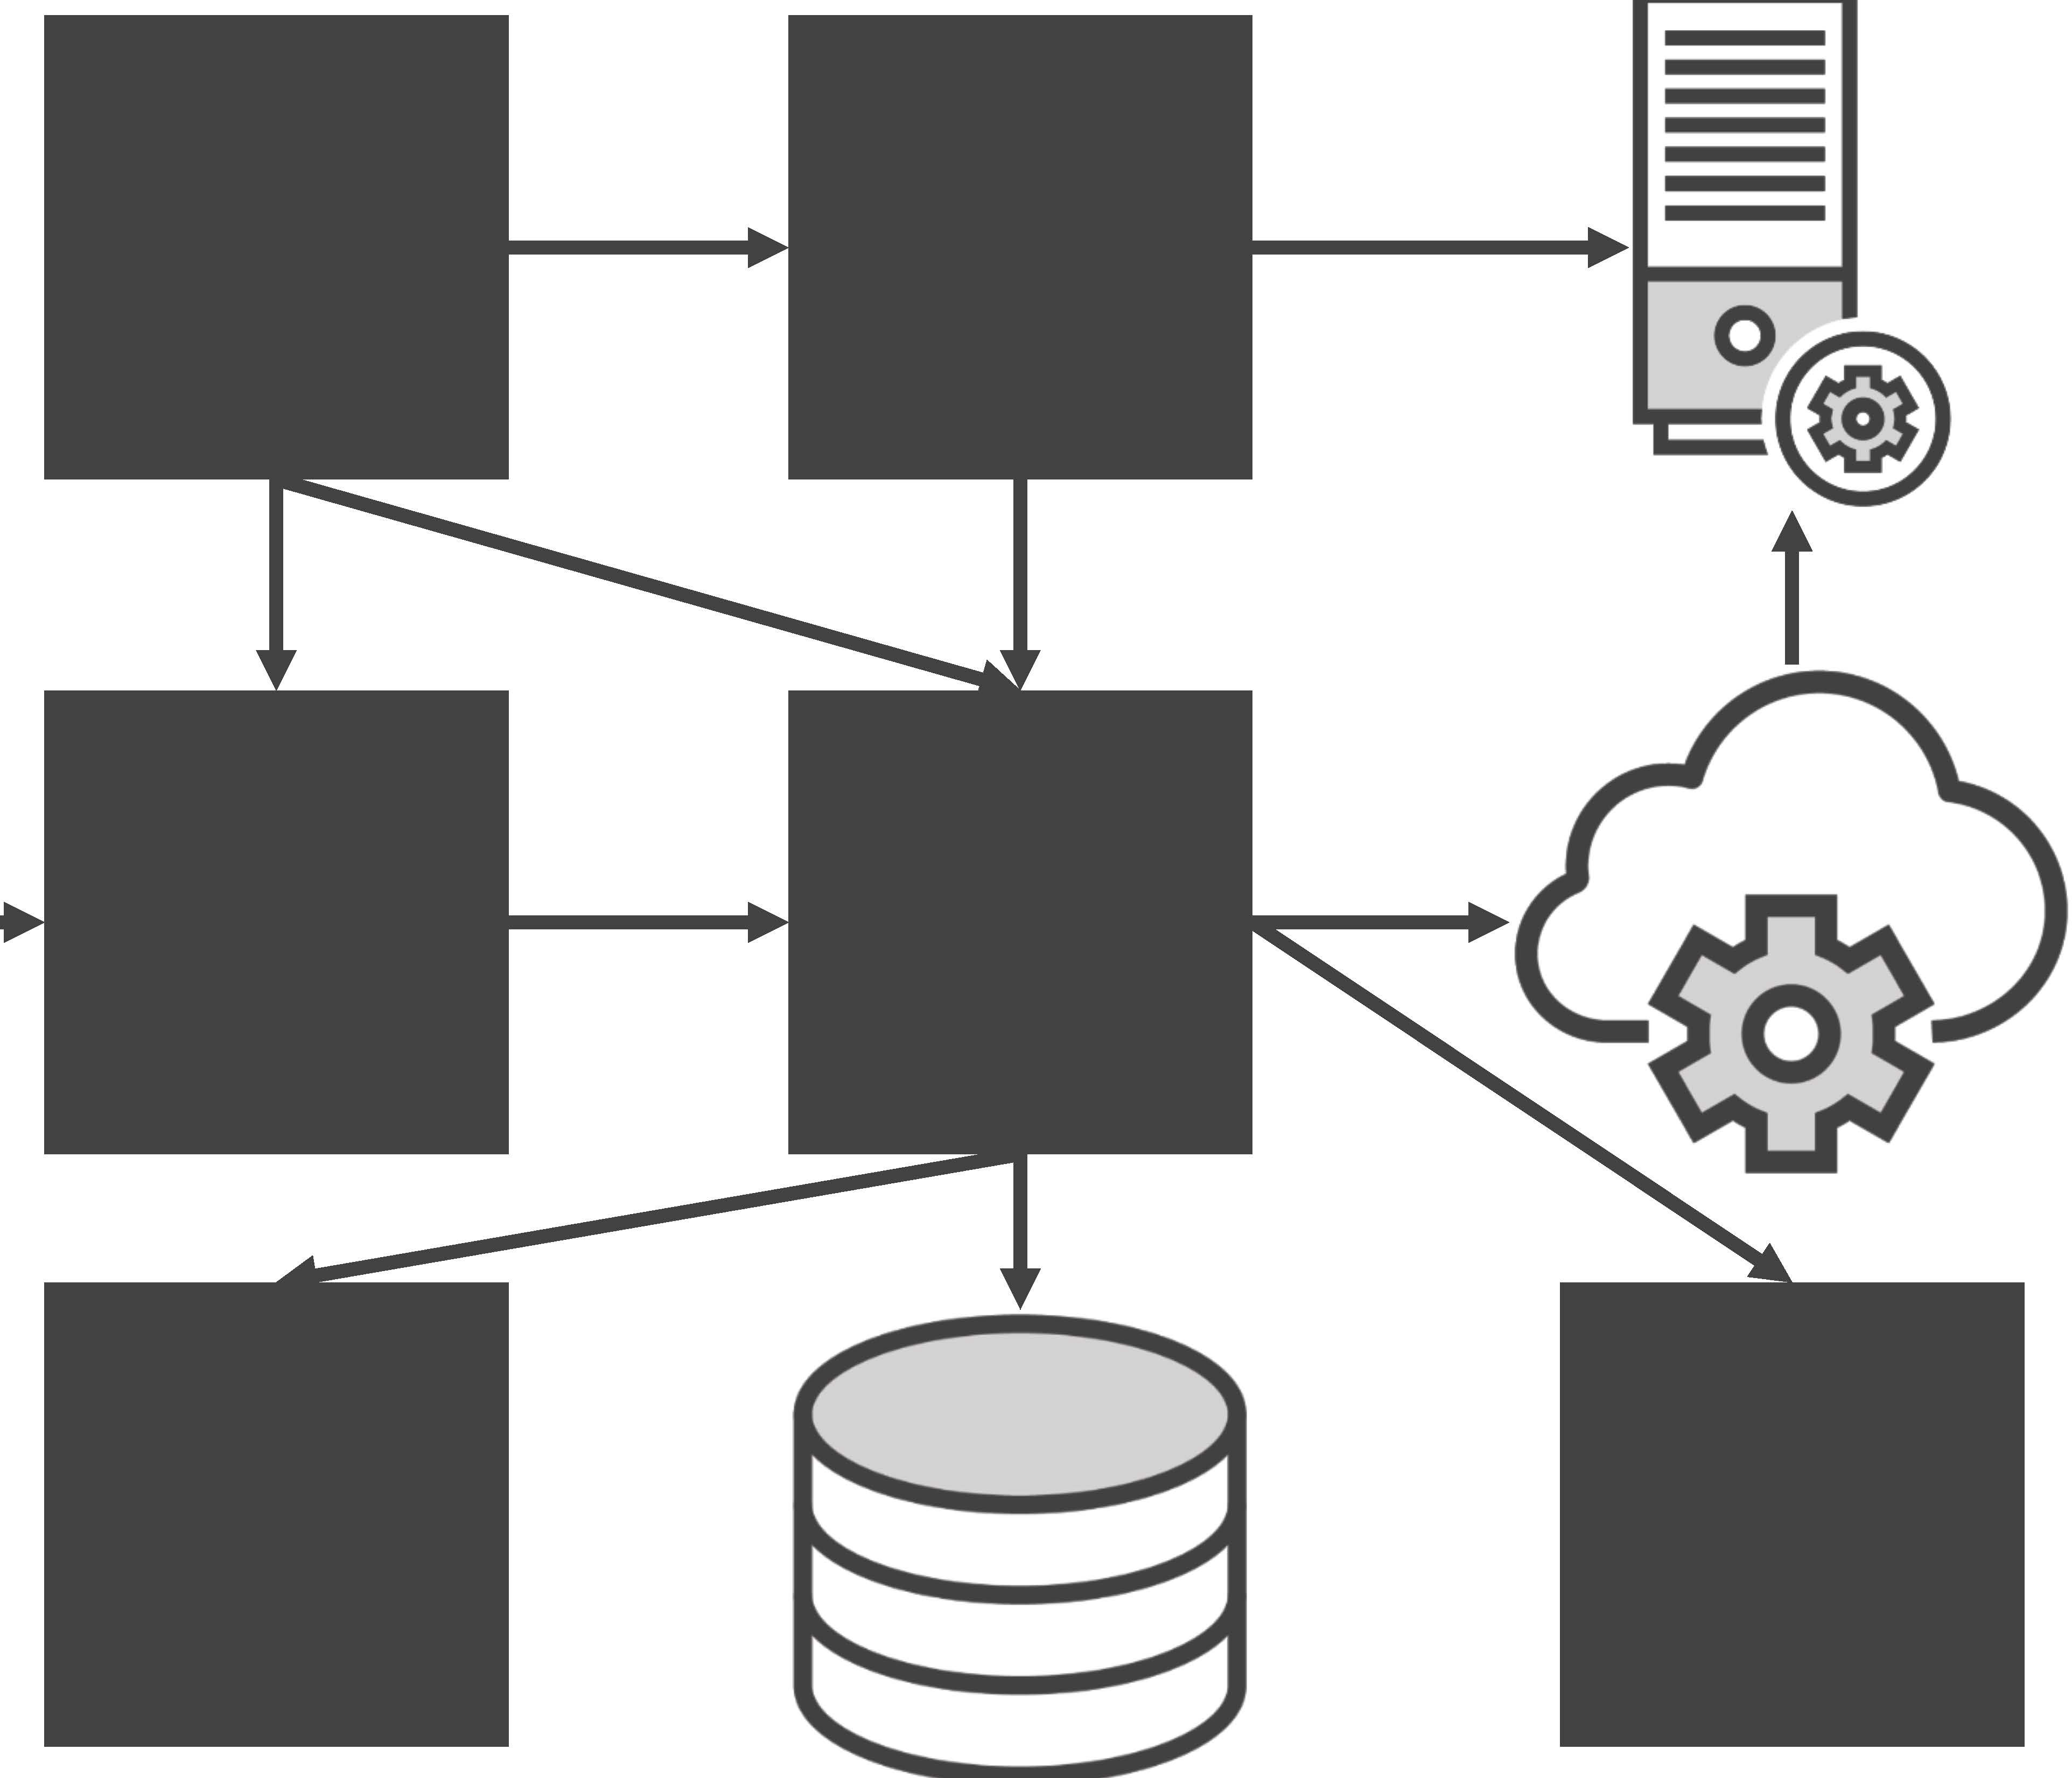

-
Notes:
As you might imagine, a complex system has hundreds or even thousands of such paths and flows, and it takes quite a bit of experience and knowledge to figure out how you can cover as much as sensibly possible in the little time you have.

Slide 36
System Testing
Acceptance Testing
Who? For what purpose?
Notes:
Acceptance testing is very similar to system testing.
Just like system testing, its objective is to validate that the delivered software is complete and it works.
But not just that, there is an additional focus on who does the testing and for what purpose.

Slide 37
System Testing
Acceptance Testing
Who? For what purpose?
Notes:
System testing starts when everything or almost everything is in place, and you try to exercise the software from start to finish, and you do that using from the outside, which often involves an interface.
Finally comes acceptance testing. The software is given to the end user, the customer, or their representative, and they should work with the software so that they can say, yes, this works as I wanted. I accept.

Slide 38
Does the car work OK?
Yes, but I ordered a minivan, not a sportscar.
It is not what I wanted, I don’t accept!
Notes:
Going back to the car example, we could say, does the car work? Yes, it's great, but I ordered a minivan for my family, not a sports car.
As you can see, acceptance testing is a means for customers to approve what has been delivered.
In other words, if the system does not solve the problems it was built to solve, we have not been successful. This level is often a part of closing a deal between the customer and the supplier, and as such

Slide 39

Clear and complete requirements
Notes:
this is why it's so important to have clear and complete requirements.

Slide 40


$$
Software X
Works OK
Notes:
This is what may happen in the real world. Company A pays Company B a fixed sum of a million dollars to deliver software X within a year. Company B delivers. Company A asks a couple of users to click around the system and report if it's okay. They say it's okay. The handover is complete, and just days later all sorts of problems are discovered when hundreds of people start using it.

Slide 41
Fix it!
You signed off.
It will cost you extra.
Notes:
Company A comes back to Company B and says, what the heck? Fix this immediately. And Company B has the full right to say, sorry, you signed off the handover, it's too late now. We can fix all the discovered issues, but it will cost you extra.

Slide 42
Fix it before we sign off!
Software X
Notes:
This scenario could have been avoided if Company A hired independent testers to execute thorough acceptance testing, find most of the severe defects, throw the software back to Company B, and say, hey, we're not signing this off until you fix all of these issues, and we're not paying a dollar more.

Slide 43
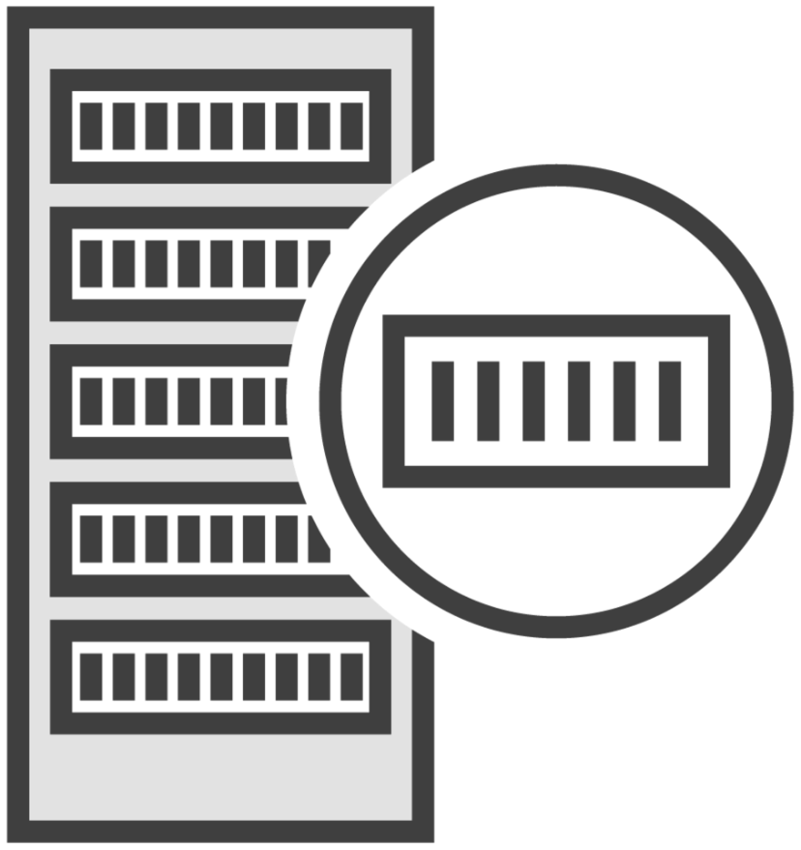
Acceptance Testing
UAT: User Acceptance Testing
OAT: Operational Acceptance Testing
Backup and restore
Installing, uninstalling, upgrading
Disaster recovery
Data load and migration
Performance and load testing
Notes:
What we discussed is commonly known as UAT, user acceptance testing. The focus is on users being able to use the software for their needs.
There is also OAT, operational acceptance testing, which focuses on rather boring, but necessary operations such as backup and restore, installing and uninstalling and upgrading, disaster recovery, data load and migration, as well as performance and load testing with real amounts of data and the real number of users.
We typically don't think of these things until we have to do them, and when we do problems come out of nowhere.
And so again, test management should be forward thinking and include such acceptance testing into their test plan.

Slide 44
Acceptance Testing
Categories: Alpha and Beta testing
Beta testing: for Commercial Off-the-shelf (COTS) software
Both carried out by independent testers or potential customers
Notes:
Acceptance testing can be broken down into different logical categories, specifically alpha and beta testing.
You've probably heard about a beta version of some application. This is directly related.
ISTQB® says that this is typically done for commercial of‑the‑shelf software, but I believe this is not necessarily the case. This can be done for just about any kind of software. In both cases, the testing is carried out by independent testers or potential or existing customers, not the testers on the development team.

Slide 45
Acceptance Testing
Alpha testing happens at the developer’s site
Beta testing happens at the site of the customer
Notes:
The main difference is that alpha testing happens at the developing organization site, while beta testing happens on the site of the customer. Or it can be an application deployed to the devices of a small group of selected users.

Slide 46
The point of Beta testing is to use the infrastructure, both hardware and software, of the end users.
Notes:
The main point in beta testing is to use the infrastructure, both hardware and software, of the end users.

Slide 47
It works on my machine!
Dev environment
App
Customer environment
Notes:
You may have heard of the cliché saying, it works on my machine. This happens when things are tested on the developers' infrastructure, it works, things get delivered to the customer, they try to run it on their infrastructure, which is very likely not identical to the one developers had, and it fails.
It's just impossible to predict everything, because the cause for failure might even be a small browser plugin used by the company users and that happens to interfere with your web application.
Beta testing takes out the guesswork. Just try to run the system on the customer's infrastructure and see what happens.

Slide 48
Comparing Test Types

