Slide 1
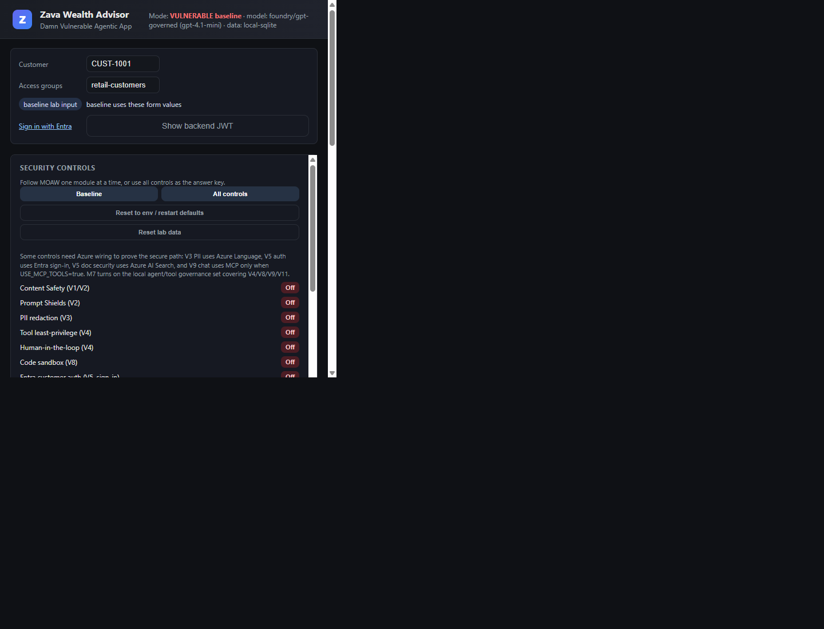
Hardening a Damn Vulnerable Agentic AI App
Zava Wealth Advisor lab walkthrough
Break V1-V11, then add Azure security layers: Foundry guardrails, PII redaction, secure tools/MCP, Entra + Search ACLs, APIM gateway, governance, evaluations, Purview, red teaming.
No fluff: exploit -> control -> proof
Hosted app currently forced to Foundry

Slide 2
WHY THIS LAB EXISTS
Lab Objective
What learners do
What they learn
What success means
Run a real multi-agent finance app, exploit each missing control, then turn on the Azure layer and verify the exploit is dead.
Where each control belongs: model, API, identity, retrieval, tool boundary, runtime, data governance, or test gate.
A before/after proof for V1-V11, not a checkbox list. Every mitigation is tied to code, Azure config, and a user-visible result.
Break
Fix
Inspect
Verify
Zava Wealth Advisor security lab

Slide 3
WHAT IS BEING SECURED
The App: Zava Wealth Advisor
Multi-agent finance assistant
Sensitive data by design
Security boundary map
Orchestrator routes to Knowledge/RAG, Accounts, Transactions, and Reporting agents. It handles account balances, credit scores, statements, transfers, and reports.
Names, customer IDs, account numbers, balances, credit scores, addresses, SSNs, private documents, and state-changing financial actions.
Model safety protects prompts and completions. Identity determines customer scope. Search ACLs trim documents. Tool policies gate actions. Gateway/runtime controls protect endpoints. Governance/evals prove drift is caught.
Zava Wealth Advisor security lab

Slide 4
PART 1
Vulnerable Baseline
Baseline route
Browser -> FastAPI app -> local model/local data. No platform guardrails, no trusted identity, no document trimming, no gateway.
Learner action
Facilitator point
Click exploit chips for V1-V11 and read event traces under the answers.
Do not skip Part 1. The controls only matter after learners see the failure.
Baseline model now explicit
The hosted shared app is forced to Foundry for cohort stability. Local ACA/Phi remains available as an explicit model-route choice for vulnerable-model demos.
Zava Wealth Advisor security lab

Slide 5
DECODER RING
V1-V11 Vulnerability Map
V1
Ungoverned model
V2
No guardrails
V3
PII leakage
V4
Overpermissioned tools
V5
Broken customer auth
V6
Data poisoning
V7
Insecure runtime
V8
Unsafe code execution
V9
Insecure MCP
V10
No AI gateway
V11
A2A poisoning
Use this slide as the transition map
Modules are grouped by Azure security layer, not by vulnerability number. Module 4 intentionally closes V4, V8, V9, and V11 together because they share the tool/action boundary.
Zava Wealth Advisor security lab

Slide 6
RESPONSIBLE AI, PROMPT SHIELDS, GROUNDEDNESS
M1-M2 · Foundry Guardrails
Exploit
Azure pitch
Proof
Harmful prompts, jailbreaks, poisoned RAG documents.
Foundry/OpenAI guardrails apply content filtering to prompts and completions; Prompt Shields detect user prompt attacks and document attacks; groundedness detects responses not supported by source material.
Jailbreak and poisoned-doc prompts block before unsafe model use.
run exploit
enable layer
rerun exploit
capture proof
Learn: Content Safety overview; Prompt Shields quickstart; Foundry guardrails docs
Zava Wealth Advisor security lab

Slide 7
AZURE AI LANGUAGE
M3 · PII Protection
Exploit
Azure pitch
Proof
Prompt or tool output contains SSN/card/account data and leaks into responses or logs.
Azure AI Language PII detection identifies sensitive entities so the app can transform data before model calls, responses, and logs. This is a data pipeline control, not just a model block.
The same answer is returned with sensitive values redacted and audit-safe events.
run exploit
enable layer
rerun exploit
capture proof
Learn: Azure AI Language PII detection overview
Zava Wealth Advisor security lab

Slide 8
LEAST PRIVILEGE AND ACTION SAFETY
M4 · Tools, MCP, HITL, Code
Exploit
Azure pitch
Proof
IDOR, SQLi, transfer without approval, unsafe report code, untrusted MCP tool, forged handoff.
Foundry agents expose scoped hosted tools; PostgreSQL/RLS and MCP allow-lists narrow what an agent can do; human approval gates state changes; Code Interpreter provides a sandboxed execution boundary.
Read-only scope, approval-required transfer, sandbox blocks imports, MCP state-changing probe is denied.
run exploit
enable layer
rerun exploit
capture proof
Learn: Foundry agents/tools; Azure Database for PostgreSQL; Code Interpreter; MCP tool scoping
Zava Wealth Advisor security lab

Slide 9
ENTRA OBO AND AI SEARCH DOCUMENT SECURITY
M5 · Identity + Search ACLs
Exploit
Azure pitch
Proof
Editable customer ID/groups return another customer or restricted docs.
OBO propagates the signed-in user to downstream APIs. AI Search trims retrieval with a filterable `group_ids` field and `search.in()` over caller groups, so the RAG layer cannot see unauthorized documents.
Learner sees retail/public docs only; manager sees manager/private-client docs.
run exploit
enable layer
rerun exploit
capture proof
Learn: Microsoft identity platform OBO; Azure AI Search security filters
Zava Wealth Advisor security lab

Slide 10
APIM, OBSERVABILITY, DEFENDER
M6 · Gateway + Secure Runtime
Exploit
Azure pitch
Proof
No throttling, exposed model/tool endpoints, verbose runtime errors, weak audit trail.
APIM centralizes model/tool access with token limit policy, auth, logging, and key isolation. Monitor and Defender add operational evidence and threat detection around the workload.
Burst requests hit token budget; safe errors replace stack/detail leakage; logs show governed calls.
run exploit
enable layer
rerun exploit
capture proof
Learn: APIM Azure OpenAI token limit policy; Azure Monitor; Defender for Cloud
Zava Wealth Advisor security lab

Slide 11
AGT, GROUNDEDNESS, EVALS, PURVIEW, RED TEAM
M7-M11 · Governance + Assurance
Exploit
Azure pitch
Proof
Controls drift, poisoned data persists, no regression gate, tenant data policies missing, attacks untested.
Governance inventories agents/tools, evaluations measure quality and safety, Purview DSPM/DLP extends data controls across the tenant, and red teaming turns attacks into repeatable coverage.
Policy check/eval/red-team reports become the gate before a lab fix is called done.
run exploit
enable layer
rerun exploit
capture proof
Learn: Purview AI protection; Azure AI Foundry evaluations; red teaming transparency
Zava Wealth Advisor security lab

Slide 12
EFFICIENT PRESENTER FLOW
Walkthrough Agenda
0-5 min
Objective + app boundary
Use slides 1-3. Make the finance/PII risk concrete.
5-20 min
Baseline tour
Show V1-V11 map and run 3 fast exploits: jailbreak, PII, IDOR.
20-55 min
Core Azure layers
Foundry guardrails, PII, tool/MCP/HITL, Entra/Search, APIM/runtime.
55-70 min
Assurance
Governance, evaluations, Purview, red-team as the regression story.
70+ min
Hands-on lab
Switch to MOAW and have learners run exploit -> fix -> verify.
Zava Wealth Advisor security lab

Slide 13
CLOSING
Boundary Placement
Security for agentic apps is boundary placement.
Platform first
App layer where needed
Proof beats posture
Use Foundry, Entra, Search ACLs, APIM, Purview, Monitor, and Defender where they can enforce controls outside app code.
Redact PII, inspect tool/MCP output, validate inter-agent handoffs, and gate state-changing actions.
Every module ends with before/after evidence: blocked prompt, trimmed docs, denied tool, rate limit, eval or red-team result.
MOAW: docs/workshop.md
Hosted: ca-app-zava8zn5p.yellowrock-178fa456.swedencentral.azurecontainerapps.io

Slide 14
FOR SPEAKER BACKUP
Microsoft Learn Sources
1
Azure AI Content Safety: content filters, Prompt Shields, groundedness, protected material
2
Azure AI Language: PII detection and redaction pipeline
3
Azure AI Search: document-level security pattern with group_ids and search.in()
4
Microsoft identity platform: OAuth 2.0 On-Behalf-Of flow
5
Azure API Management: Azure OpenAI token limit and gateway policies
6
Microsoft Purview: protect and govern data for generative AI apps
7
Azure AI Foundry evaluations and red-team safety evaluation guidance
Keep detailed docs in MOAW; keep the PPT as the talk track.

