Slide 1


Shattering the Monolith of “Private School Effect”
Using ML to analyze between-country differences in education across SE Africa
Isaac Riley Julio Alvarez

Slide 2

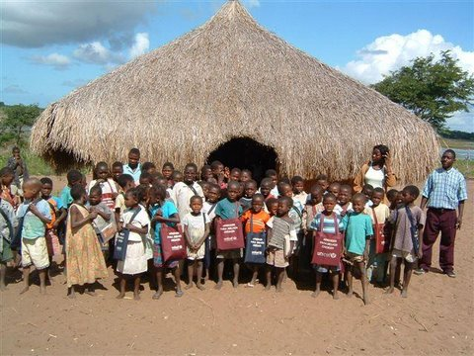
Overview
Motivation
About SACMEQ*
Data preparation
Cross-prediction (SVR)
Variables importance (Lasso)
Graphic representation of clusters (T-SNE)
* The Southern and Eastern Africa Consortium for Monitoring Educational Quality

Slide 3

Planners and Searchers
Battle of ideas in development:
William Easterley vs Jeffrey Sachs
Easterley’s key idea in White Man’s Burden:
Planners think large-scale and work top-down.
Searchers think local and work bottom-up with
a sense of conditions “on the ground.”
Searchers = good
Searchers > Planners

Slide 4
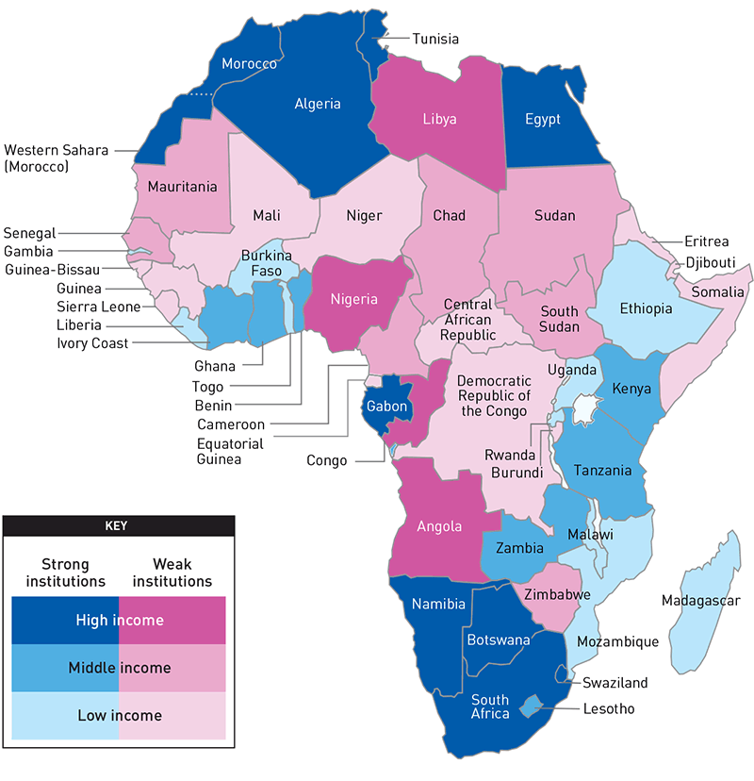
Motivation: “The” Private School Effect:
Research hubs: Kenya, Nigeria, Tanzania, South Africa
Research deserts: Angola, Mozambique, Equatorial Guinea
When is external validity of within-country
studies a safe assumption?
⮕ Observed vs unobserved factors
(and observable vs unobservable)

Slide 5

About the project
Test Scores for Math and Reading in over 20 countries gives us insight on how to improve student performance
“Southern and Eastern Africa Consortium for Monitoring Educational Quality”
Largely funded by the Netherlands Development Cooperation
Result of a collaboration between the Ministries of Education of six SE African nations
Headquartered at the University of Botswana

Slide 6
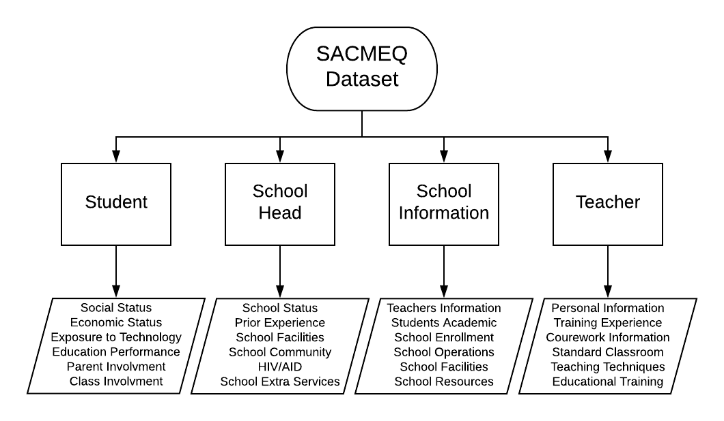
About the Dataset
Over 2,300 variables in 4 major sections: Pupil, School Head, School Information, and Teacher variables.

Slide 7
Data Preparation
Drop large set of HIV-related variables (secondary purpose of SACMEQ)
Convert variables from string to numerical (hardest part)
Drop irrelevant factors
Identify factor categories (pupil-level, school-level, teacher-level)
Feature Engineering:
Consolidating similar categories: town/city, rural/isolated (to create new factors)
Sum variables that belong to a set to create more meaningful factors: family possessions, school resources
Create mean factors by school
Data restriction: based on both availability of variables and for practicality, we restrict our investigation to 6 reasonably representative countries

Slide 8
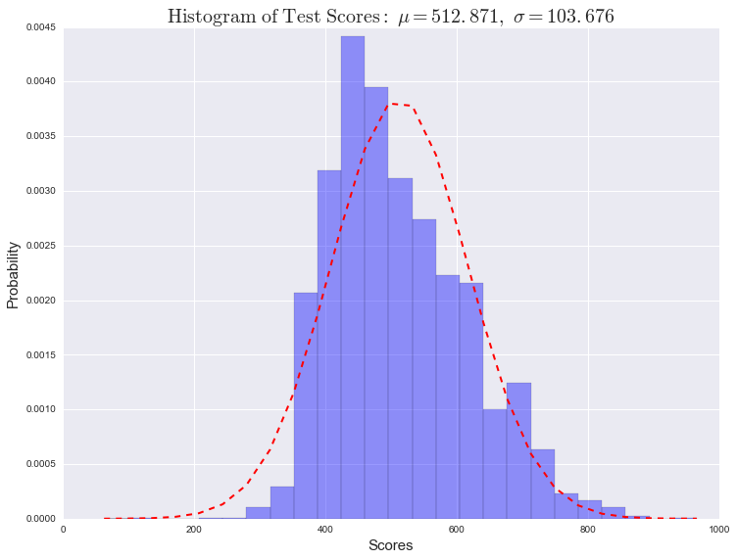
Outcomes of Interest
Private school attendance
Mathematics exam score
Reading exam score

Slide 9
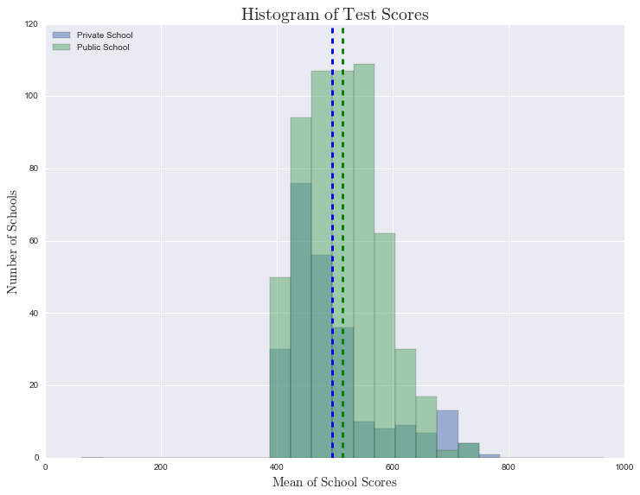
Public Vs. Private Scores

Slide 10
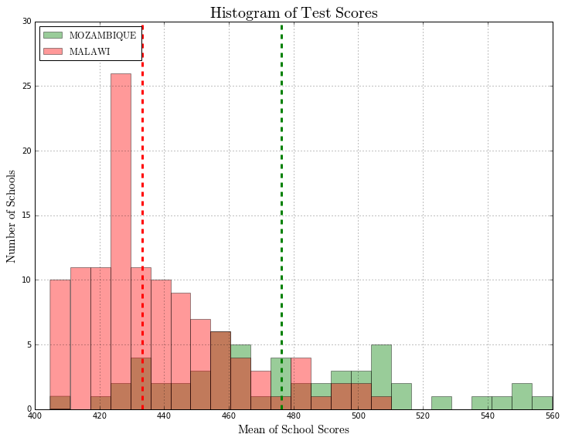
Country Comparison

Slide 11
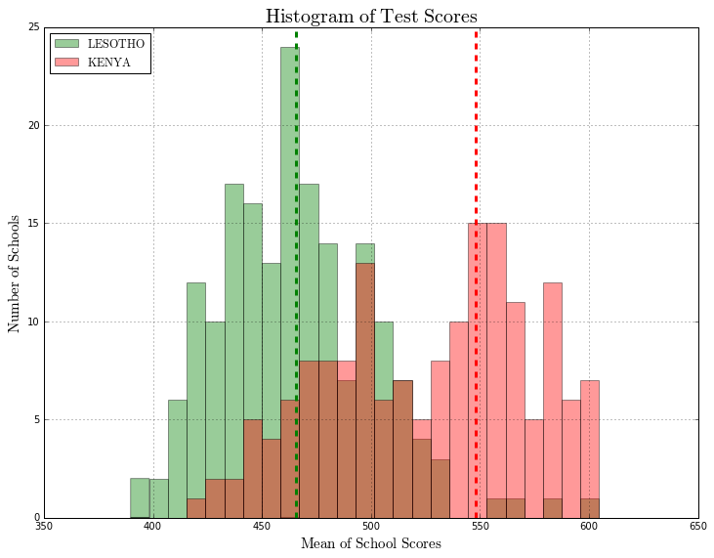
Country Comparison

Slide 12
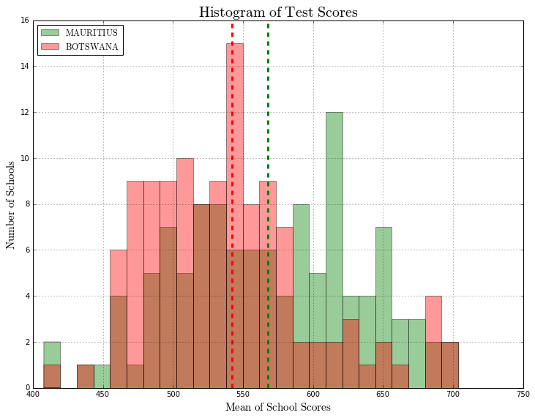
Country Comparison

Slide 13
Cross-Prediction across Countries
Central assumptions of our method:
1) Pairs of countries with similar observed factors will perform better than less similar pairs in cross-prediction
2) The same is true of unobserved factors

Slide 14
ML advantage over linear regression:
Scope for more variables (collinearity less problematic)
Easier feature selection
Improved classification/prediction capabilities

Slide 15
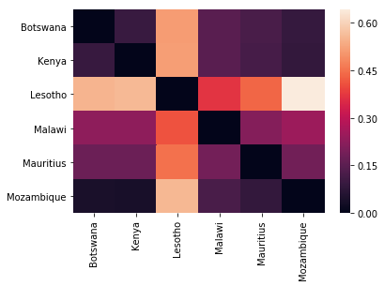
School Type Cross-predictions Visualized
MSE Heatmap (SVR)
Training Dataset
Test Dataset

Slide 16
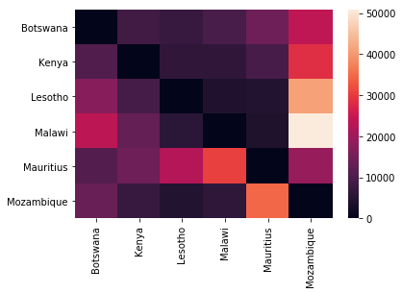
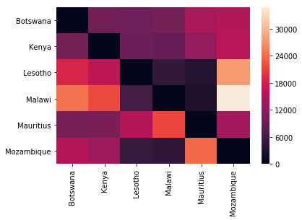
Test Score Cross-predictions Visualized
MSE Heatmap (SVR)
MSE Heatmap (SVR)
Training Dataset
Training Dataset
Test Dataset
Test Dataset

Slide 17
Why SVR (or SVM)?
Generalization: “Support Vector Regression (SVR) attempts to minimize the generalization error bound so as to achieve generalized performance.”
Nonlinearity: “The idea of SVR is based on the computation of a linear regression function in a high dimensional feature space where the input data are mapped via a nonlinear function.”
High-noise data: “SVR is suited to time series and financial (noisy and risky) prediction” (like all educational data ever)
Simplicity of execution
⮕ Great for our purposes!
References: Basak et al. (2007), Wellington (2004)

Slide 18
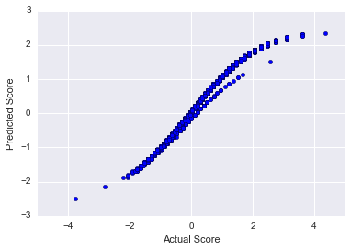
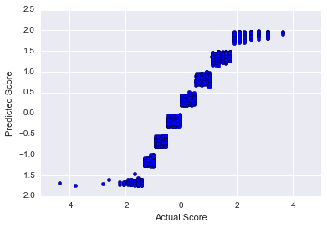
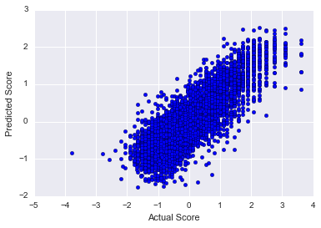
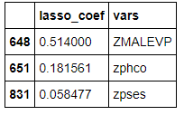


LASSO “Evolution”

Slide 19
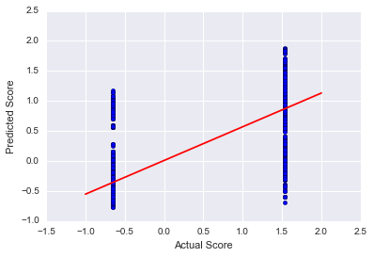
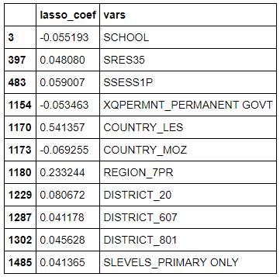
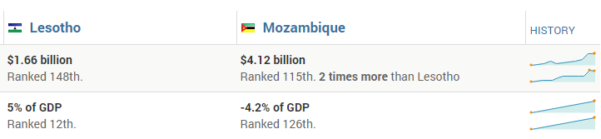
LASSO on School Type

Slide 20
Feature Selection Results (Lasso and ElasticNetCV)
Our composite SES proxy (sum of family possessions) is by far the best exogenous predictor of both score and attendance at a private school.
Other important factors for score: parental education, both parents alive, school type (for score), female, age, urban, number of siblings, number of grade repeats, frequency with which English is spoken at home, help received with homework.
School type is much harder to predict, with no non-endogenous or non-geographical predictors selected by the lasso approach.
No surprises here.

Slide 21
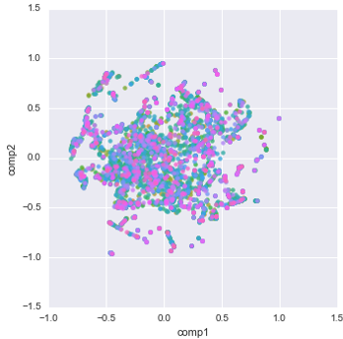


Visualization of Full Dataset (t-SNE)
nPC = 50, perplexity = 50

Slide 22
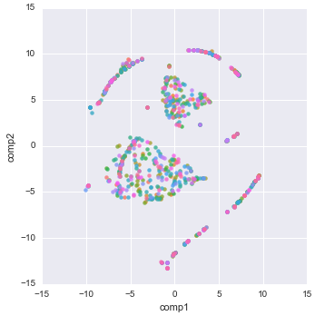
Dataset Collapsed at School Level (t-SNE)
nPC = 50, perplexity = 50

Slide 23
Takeaways from t-SNE: Some clustering in the data, just not clearly on school type or test score.

Slide 24
Conclusions
In a nutshell: Assume responsibly!
Don’t generalize without a compelling case for external validity.
Research as close to “home” as possible.
Be sensitive to unobserved differences between samples.

Slide 25


